Slide 1

Machine Learning for Practical Real-Time Test Campaign Design
Purdue: Zachary McDaniel, Trey Francis, Francis Centlivre, Gregory Blaisdell, Jonathan Poggie, Joseph S. Jewell
Sandia: Timothy Walsh, Kyle Williams, Steven J. Beresh

Slide 2
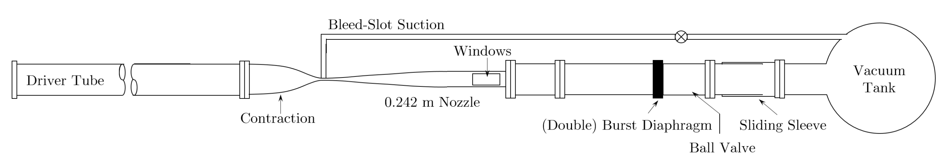
Boeing/AFOSR Mach 6 Quiet Tunnel
Hypersonic wind tunnel at Purdue University capable of producing quiet Mach 6 flow.
Quiet flow has freestream noise fluctuation levels that are similar to those found in flight.
Tests take about 50 minutes to complete. About 40 tests can be completed in a week.
Wind tunnel models and air pressure are changed from test-to-test to see their effects.

Slide 3
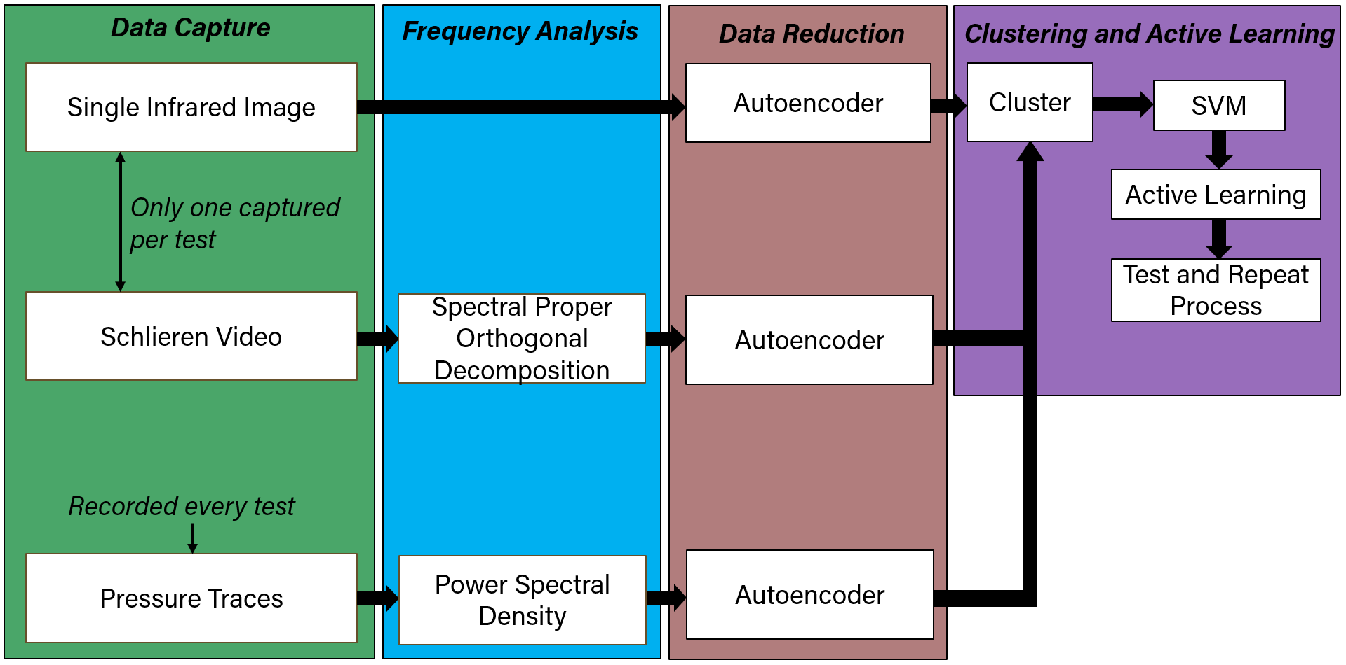
Active Learning Strategy Overview
There is a limited number of experiments that can be completed. Experiments that provide the most information should be prioritized.
Results from one test can suggest what to test next (Active Learning).
Tunnel experiments collect infrared temperature data, schlieren data, and pressure transducer data.
  Summarizing the information into an array of numbers permits active learning to be completed.
Summarized data is fed into a clustering algorithm, whose results are then sent to a Support Vector Machine (SVM) which predicts what next test configuration will provide the most information.
Architecture must quick, simple and work with a small amount of data.
Workflow of collecting data, reducing it, and deciding what to test next.

Slide 4
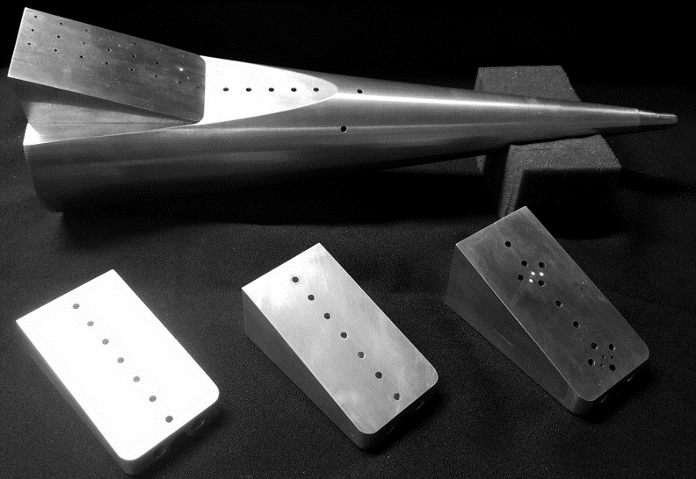
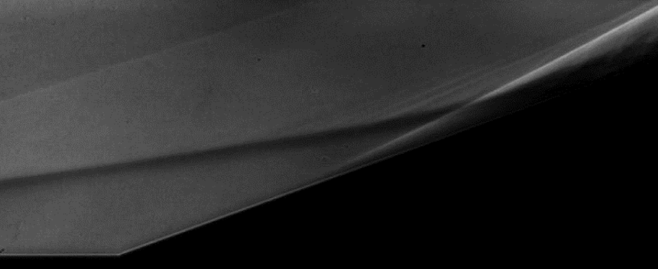
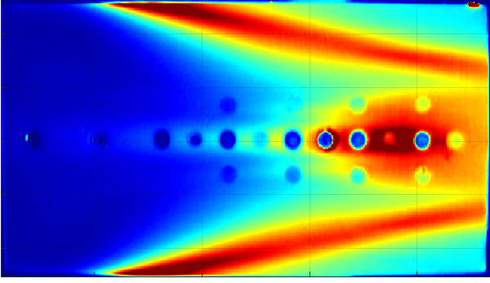
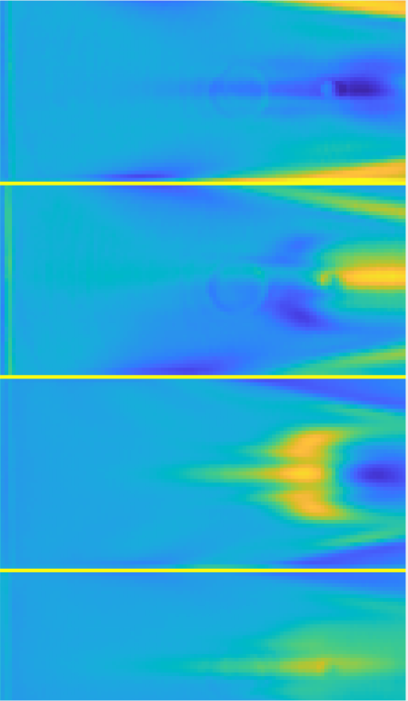
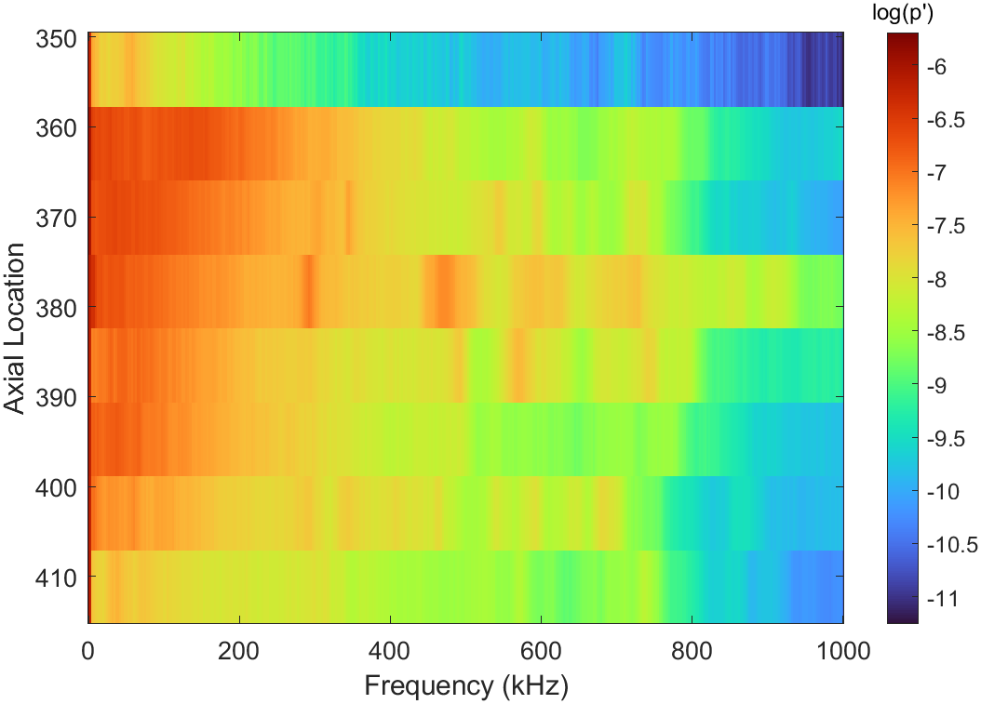
Summarizing Data for Input into the SVM
IR
Schlieren Raw Data
Infrared Raw Data
Pressure transducer, schlieren video, and infrared images are reduced down to a few components.
An array of numbers represent the strength of these components in an experiment.
The SVM uses the numbers to suggest what next test would provide the most insight.
S
SPOD + Autoencoder
Autoencoder
Pressure Sensor PSDs
4 Autoencoder Features
(Viewing Pink Region on Ramp)
7 Autoencoder Features (4 Shown)

Slide 5
Summary of Machine Learning Parameters
Support Vector Machine
  Box constraint (similar to regularization) of 1.
  Radial basis function kernel.
Autoencoder for Infrared Data
  7 latent space variables.
  L2 weight regularization: 0.0001.
  Sparsity regularization and proportion: 3 and 0.08.
K-means for clustering
  Number of clusters is manually inputted.
  Algorithm ran several hundred times to find clusters that maximize Calinski-Harabasz index.

Slide 6
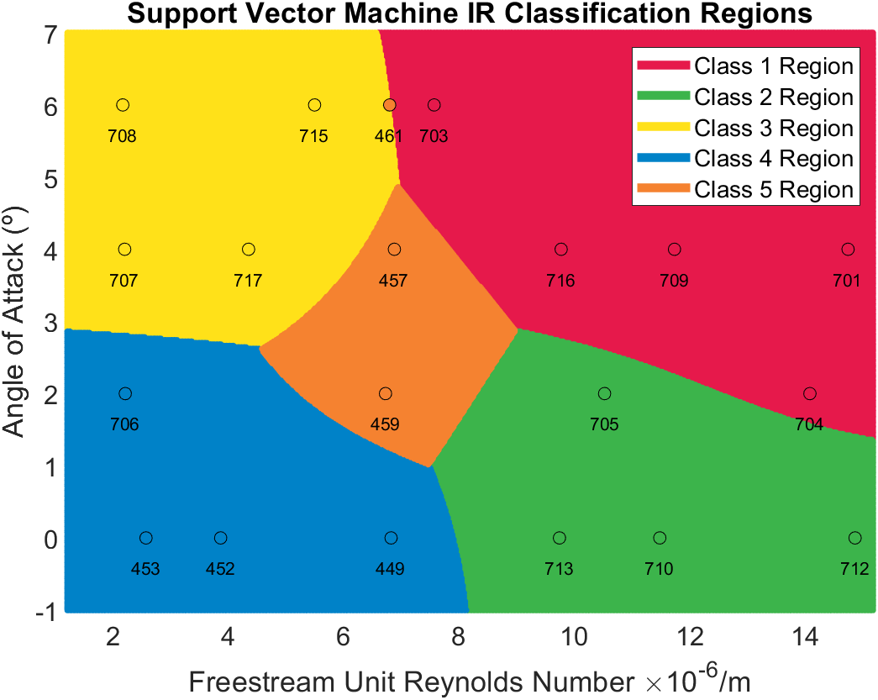
Support Vector Machine Active Learning

Slide 7
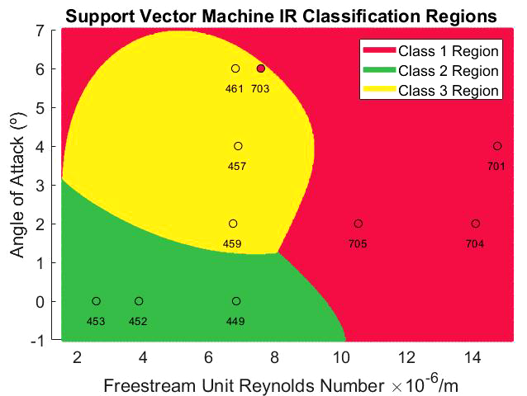
SVM Region Development
SVM regions should settle after a large number of runs.
The clustering algorithm to determine regions is susceptible to flipping between competing cluster identifications.
  This could interrupt testing, since it can significantly shift the margin.
Two solutions:
  Best cluster is chosen by its inter/intra cluster distance, but also how similar it is to previous clusters.
  If two different sets of clusters have similar quality scores, add another cluster.

Slide 8
Autoencoder to Account for Shifts in IR Features
Several autoencoder weights just account for shifts of features in images.
  May be limiting clustering accuracy.
An architecture that can account for translation of features would better capture dynamics, and may help predict candidate configurations .
Original Image
AoA, Pressure Smoothness Cost Function
CNN?
Set of IR Shapes
Translations, Scale, Intensity
Set of Modified IR Shapes
Sum Shapes Together
Recreated Image

Slide 9
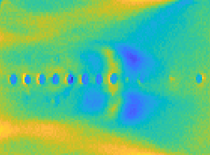




Predicting IR Results with Autoencoder
Generating IR predictions with the latent space is relatively straightforward. But there must be a way to acquire the latent space from AoA or Re (pressure).
Incorporating a cost function for continuity of IR features with Re and AoA might make it possible to predict encodings by test configuration.
Degree of Translation, Scale, or Intensity
$$L$$
$$h$$
$$b_{1}$$
$$b_{2}$$
Increasing Pressure or Angle of Attack

Slide 10
Summary and Future Work
Summary
  Data from wind tunnel results is reduced by a set of autoencoders.
  The latent space of autoencoders is paired with a clustering algorithm to assign each test to a category.
  A support vector machine uses the clusters to calculate regions where different flow physics preside.
  Issues with cluster assignment changing, shifting SVM regions.
Future Work
  Incorporate flow parameters into autoencoders.
  Define stopping metric for active learning.
  Gather a complete test matrix at a different facility and design the active learning architecture afterward.
  Compare usefulness of active learning with random sampling, pre-planned test matrix, and tests suggestions made by the experimenter.

Slide 11
Thank You

