Slide 1

Probabilistic Approaches to Transfer Learning
6th annual Sandia Machine Learning and Deep Learning Workshop
7/22/2022
Wyatt Bridgman (SNL)
Collaborators:
Moe Khalil (PI), Fulton Wang, Justin Jacobs, Ahmad Rushdi, Reese Jones,
Jackie Chen, Martin Rieth, Yuki Shimizu & Bruno Soriano (SNL),
Tarek Echekki (NCSU), Chris Pettit (USNA), Minh Do & Molly Dasso (UIUC)
SAND2022-9310 C
Notes:
Thank you to everyone for attending
This talk will provide an overview of ongoing efforts, lead by an CIS LDRD, to develop new transfer learning approaches based on probabilistic characterization of model parameters and thereby allowing us to explicitly characterize and propagate uncertainties through both machine leaning and physics-based models.
This project is led by Moe Khalil and involves a number of collaborators working on various aspects of the LDRD.
It’s relatively new effort so some of the results that I’ll be presenting are somewhat preliminary ones.

Slide 2
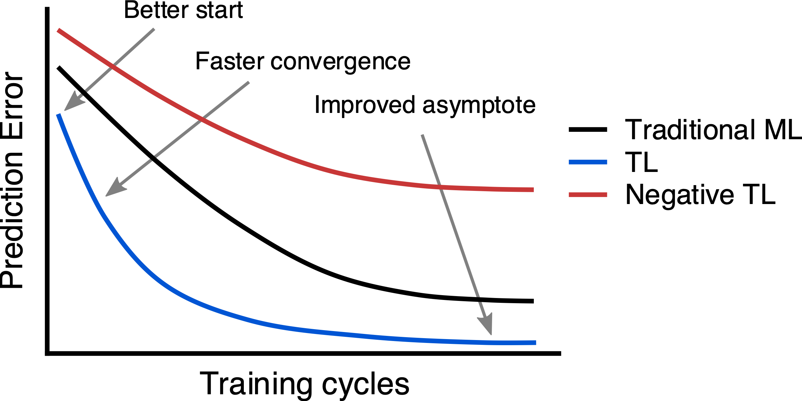
Alleviating Ill-Posedness in Training of ML Models with Sparse Data
Challenge: Many Sandia mission domains are defined by a lack of reliable data, effectively precluding the use of many modern deep learning/machine learning techniques for predictive modeling:
  Excessive expense of computer simulations
  Prohibitive experimental data acquisition cost
  Limited access to classified ad/or sensitive data
Goal: Enhance the trust in machine learning (ML) model predictions within noisy and sparse data settings
Proposed Solution: Novel probabilistic transfer learning framework.
Transfer learning (TL): knowledge gained through
similar training tasks is used to possibly improve
the training process on a target domain having
limited/noisy data:
  Improved initialization
  Increased rate of convergence
  Greater achievable performance
Proposed framework will aim to alleviate potential
negative transfer: TL resulting in decreased
Performance
Notes:
Let me start with the problem that we’re tackling
Machine learning models have thus far mainly been applied to tasks that have sufficient volumes of data. For many Sandia mission domains, ML models of great capacity are often needed to capture the complex underlying physics. However, the required volume of data is often not available for many reasons, including the excessive expense of high-fidelity computer simulations, inability to carry out certain experiments, or limited accessibility to classified or sensitive data.
The goal of this effort is to develop a new transfer learning framework that strives to enhance the trust in machine learning model predictions in such noisy and sparse data environments.
Transfer learning is the process whereby knowledge gained through similar training tasks or domains is used to improve the training process on a target domain and task.
There are three common measures by which transfer might improve learning, as shown in this figure. First is the initial performance achievable in the target task using only the transferred knowledge, before any further learning is done. Second is the amount of time it takes to fully learn the target task given the transferred knowledge, in comparison to the amount of time to learn it from scratch. And third is the final performance level achievable in the target task compared to the final level without transfer.
We would also tackle an often-cited challenge in developing transfer learning methods which is to avoid negative transfer, defined as a decreased achievable performance. This could happen when source and target domains are unrelated, for example when dealing with different physical regimes of operation, or data of varying levels of fidelity

Slide 3
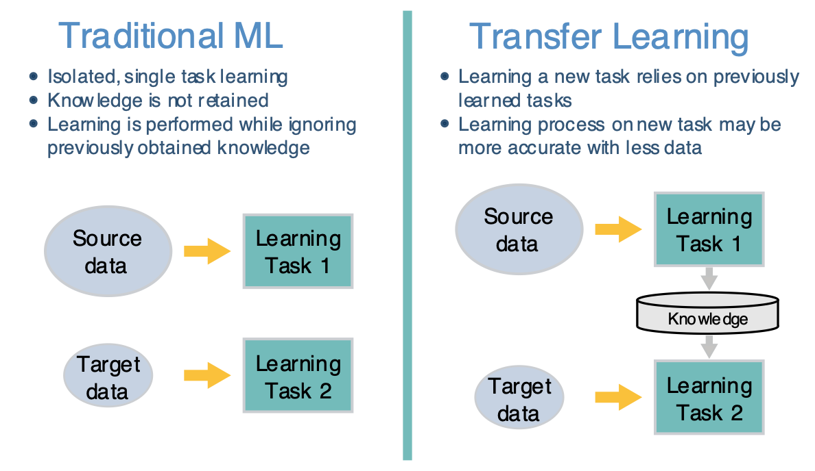
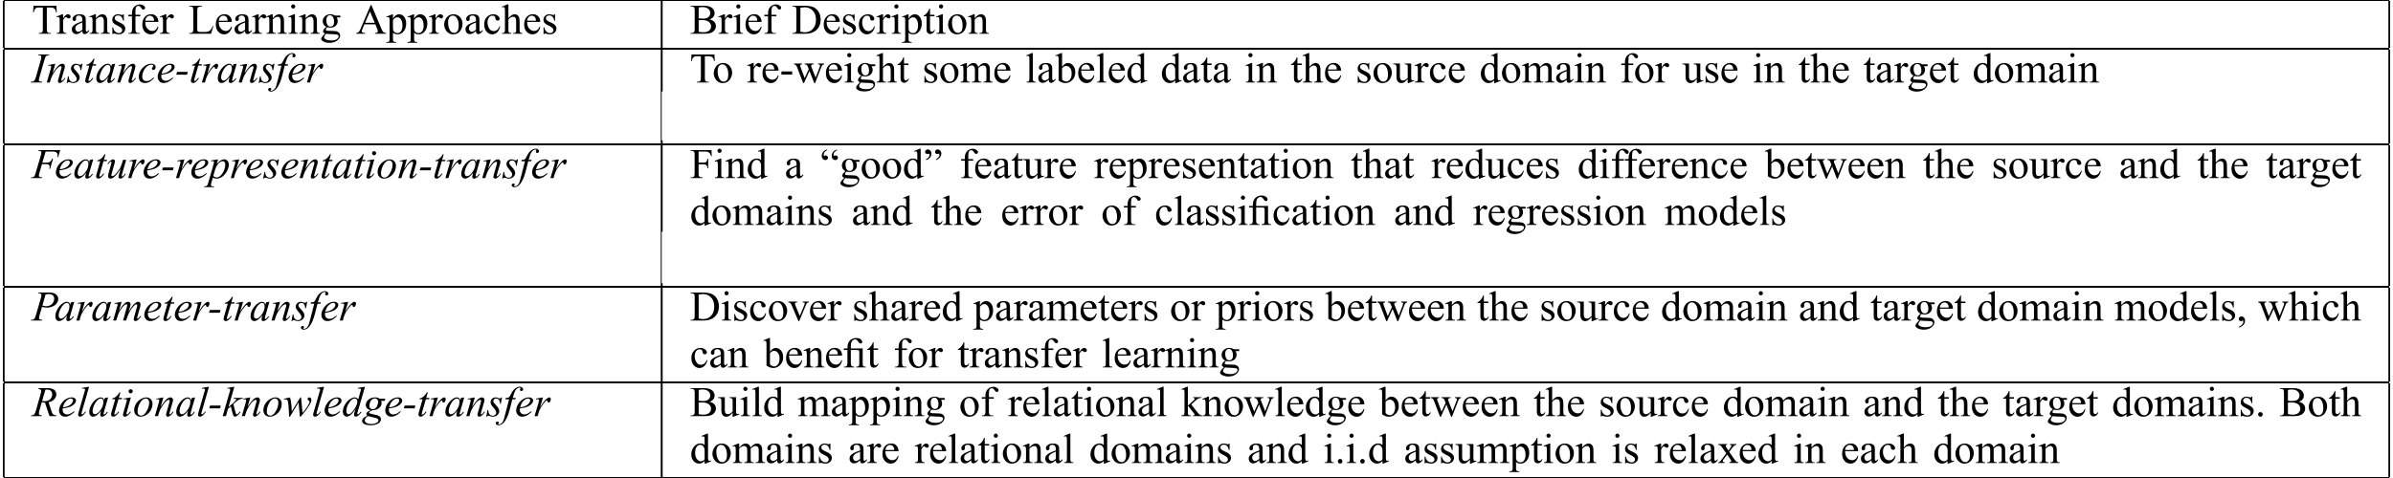
Shortcomings of existing TL methodologies
State-of-the-art algorithms in TL
  tend to be ML model-specific [George et al., 2018]
  do not consider all (if any) types of uncertainties (data, parametric,
  model-form/fidelity) [Colbaugh et al., 2017, Raina et al., 2006]
  use simplified (i.e. Gaussian) probability representations of data
  [Karbalayghareh et al., 2018].
Most importantly, existing methods do not address key questions
relating to
  when it is worth applying TL (as opposed to traditional ML)
  which ML model to use in TL (out of a set of plausible ones)
  how much knowledge is to be transferred in order to safeguard against negative learning
Notes:
In terms of gaps in the state of the art, TL algorithms and frameworks tend to be model-specific. For example being tailored for deep neural networks.
Few consider any type of uncertainty. And out of those, they strictly focus on data uncertainty and not parameter or model-form uncertainty.
In terms of capturing uncertainties, they rely on a simplified, Gaussian representation of uncertainties, which we know generally does not hold for various types of data and nonlinear models
But I think the main challenges that are holding back the applicability of transfer learning relate to the following questions which are not addressed with formal approaches. Those relate to when it is worth applying TL, which ML model best serves the purposes of TL, and how much knowledge should one transfer if any, to safeguard against negative learning
Most of the research has been focused on the question of what to transfer. This table summarizes some of the highly-cited approaches for transfer learning based on what is transferred
Instance transfer relates to utilizing available data from similar source domains and weighing them to control how they influence the target learning task
In terms of deep learning networks, feature representation transfer relates to utilizing learned convolutional layers from other domains and tasks that carry out feature extraction and relearning only the top most layers which better relate to the specific task at hand.
Other approaches focus on transferring parameter values, or relationships between source and target domains

Slide 4
Technical Approach
Proposed TL framework aims to address the shortcomings in existing methodologies.
It determines when to apply TL, which model to use, and how much knowledge to transfer.
It relies on probability/measure theories to characterize and propagate uncertainties, thereby enhancing the trustworthiness of ML models in making predictions based on noisy and sparse training data.
Notes:
The framework will address the aforementioned shortcomings by assessing when it is worth applying TL, which ML model to use in TL, and how much knowledge is to be transferred, achieved through extensions of various techniques and concepts in the fields of Bayesian inverse modeling and UQ.
Here I summarize our proposed approach versus the traditional approach to machine learning, all in a probabilistic setting.
On the left, you can see that traditional learning is isolated and occurs purely based on specific tasks and datasets. Training takes place separately for individual tasks and knowledge is not shared across similar training tasks. Within a probabilistic setting, we end up with separate posterior PDFs for the model parameters based on the calibration tasks.
The probabilistic approach is attractive since it allows us to consider all forms of uncertainties in calibrating such models. The main issue that we’re focusing on is that target training tasks suffer under sparse and noisy data settings, thereby diminishing the predictive power of such models
Our approach, shown schematically on the right, would allow for the transfer of probabilistic knowledge gained from a source task, which might or might not be similar to the target task of interest. The knowledge captured in the form of posterior PDFs is fed into the target training task in the form of prior PDFs.
This is analogous to what goes on in sequential data assimilation, such as Kalman based filters and particle filters. The main difference is that in order to control how much of that knowledge is to be transferred, we propose the use of so-called tempering transformations controlled by hyper-parameters which I denote by beta. This is where the proposed approach deviates from existing data assimilation workflows.

Slide 5
Technical Approach
The proposed framework comprises of four inter-related tasks:
  Capturing the knowledge to be transferred in training on source data
    Provide flexibility in capturing PDFs
      Low-fidelity Gaussian approximations (obtained using, for example, variational inference)
      High-fidelity Gaussian mixture-models (GMM), able to characterize general non-Gaussian PDFs while enabling analytical scrutiny of the Bayesian framework.
    Result in a spectrum of performance gains in TL
  Propagating the knowledge to be transferred to target training tasks
    Achieved via extensions of sequential (Bayesian) data assimilation
    Rely on prior PDF tempering transformations (more on this later)
  Determining how much knowledge to transfer given a choice of tempering transformation
    Hierarchical or empirical Bayesian approaches for (joint) inference of tempering hyper-parameters
    Information-theoretic measures; similarity and distance metrics
  Selecting optimal ML model to use in TL
    Probabilistic TL framework facilitates the use of Bayesian techniques for optimal model selection
    Investigate feasibility of enhancing model complexity by leveraging Relevance Vector Machine learning techniques
Notes:
In terms of workflow, there are four key pieces.
The first task relates to capturing the knowledge to be transferred while training on source data. Knowledge gained in training on source data is captured in the form of probability density functions using Bayesian inversion.
The first task involves capturing knowledge from the source task using Bayesian inversion. As ML models often involve nonlinear mappings, we're also investigating the use of Gaussian mixture models as high-fidelity approximations to the resulting intractable posteriors.
ML models in general often involve non-linear mappings from model parameters or weights to model predictions, which in sparse and noisy data settings render the likelihood pdfs or objective functions multi-modal. We will therefore investigate the feasibility of utilizing Gaussian mixture-models, able to capture multi-modality while enabling analytical scrutiny of the Bayesian framework.
The second piece relates to propagating the knowledge to be transferred.
This will be accomplished using new extensions of sequential data assimilation techniques in which prior PDFs undergo tempering transformations as I’ll describe later
The third is to determine how much knowledge to transfer given a choice of tempering transformation. This essentially amounts to selecting the optimal tempering hyper-parameters using hierarchical or empirical Bayesian modeling strategies. Our proposed framework would incorporate competing objective functions, based on information-theoretic measures or PDF distance metrics
The fourth task is to determine which ML model to use in TL. In practice, many competing ML models are envisioned to model the available sparse and noisy data for the target learning task. Out of a set of candidate models, there exists a unique model that best balances the data-fit and predictive capability among all models considered. We will determine the optimal model for transfer learning using Bayesian model selection

Slide 6
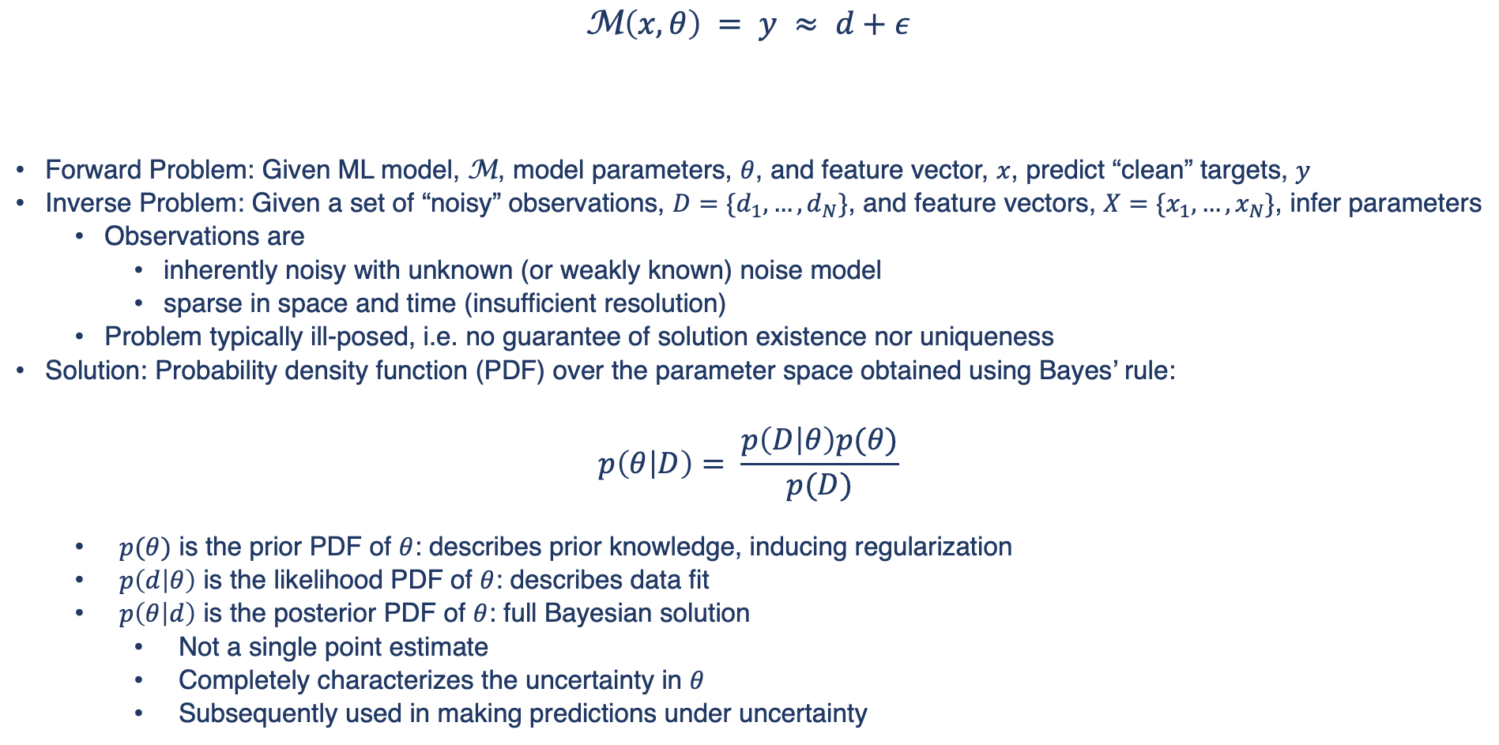
Training of ML Models – Bayesian Approach
$$\text{M}\left(x, θ\right) = y ≈ d+ε$$
Forward Problem: Given ML model, $\text{M}$, model parameters, $θ$, and feature vector, $x$, predict “clean” targets, $y$
Inverse Problem: Given a set of “noisy” observations, $D=\{d_{1},…,d_{N}\}$, and feature vectors, $X=\{x_{1},…,x_{N}\}$, infer parameters
  Observations are
    inherently noisy with unknown (or weakly known) noise model
    sparse in space and time (insufficient resolution)
  Problem typically ill-posed, i.e. no guarantee of solution existence nor uniqueness
Solution: Probability density function (PDF) over the parameter space obtained using Bayes’ rule:
$$p\left(θ | D\right)= \frac{p\left(D | θ\right)p(θ)}{p(D)}$$
  $p(θ)$ is the prior PDF of $θ$: describes prior knowledge, inducing regularization
  $p\left(d | θ\right)$ is the likelihood PDF of $θ$: describes data fit
  $p\left(θ | d\right)$ is the posterior PDF of $θ$: full Bayesian solution
    Not a single point estimate
    Completely characterizes the uncertainty in $θ$
    Subsequently used in making predictions under uncertainty
ML model
noise
features
observation
parameters
target
likelihood
prior
posterior
evidence
Notes:
- In order to describe the proposed framework, I’m going to give this one slide summary on inverse problems and the Bayesian approach to solving them.
In the context of utilizing machine learning models for scientific and engineering purposes, a physical system or component is described or approximated by a forward ML model that provides a response given a set of parameters theta. This is the so-called forward problem.
- The process of tuning such model involves solving the inverse problem of estimating the parameters from sparse and noisy observations.
Inverse problems may be ill-posed, having no unique solution for the parameter vector theta, or a solution that is highly sensitive to the noise in the data.
- In the Bayesian framework, the unknown quantities are treated as random variables. Bayes equation provides the posterior probability density function for the unknown vector theta as a product of the likelihood function describing the probability of obtaining the available data given the parameters and the prior pdf which describes any believe in the vector x prior to the analysis of data.
- The solution to the inverse problem is a full probability density over the parameter vector which can be used to make probabilistic predictions.

Slide 7
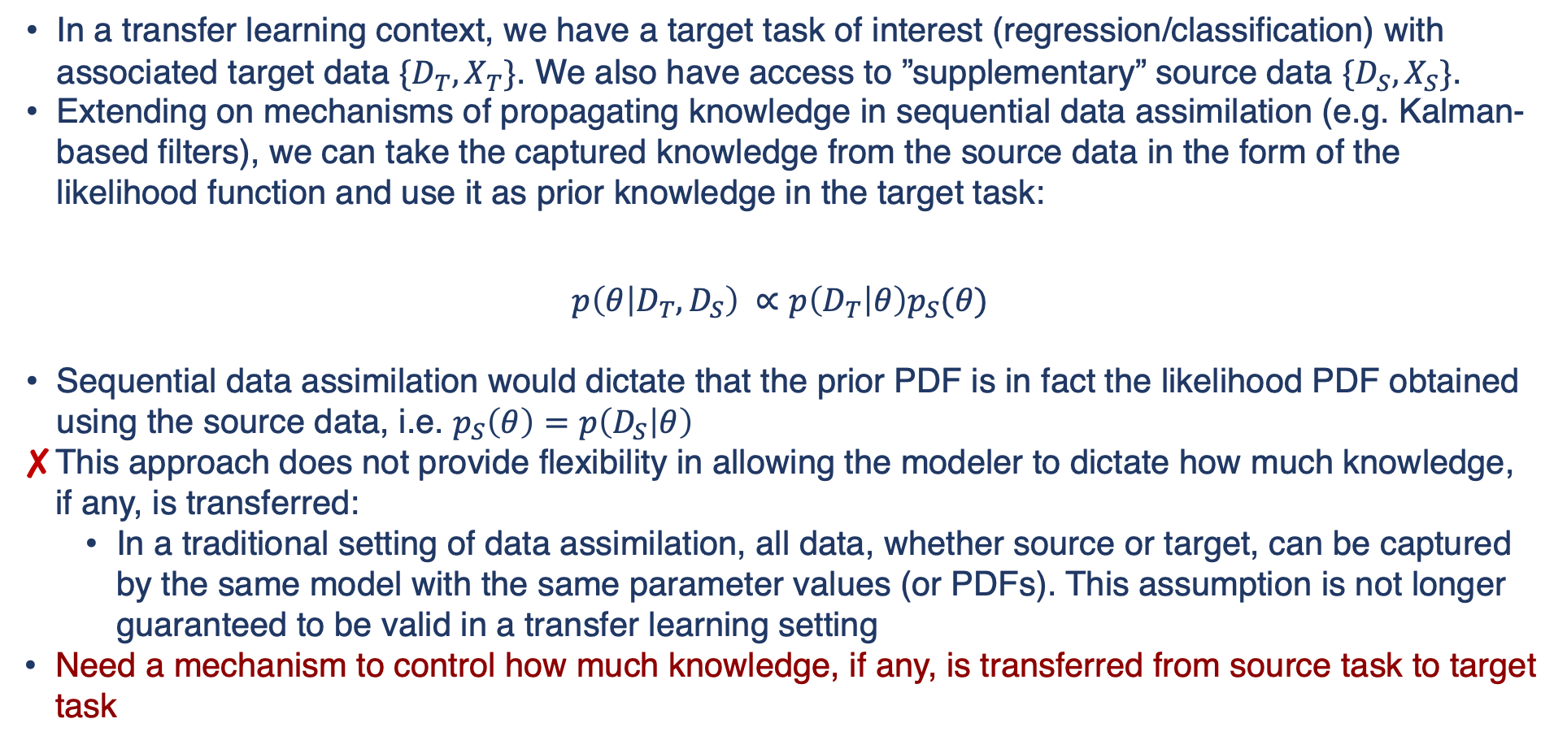
Transferal of “Learning” in a Probabilistic Setting
In a transfer learning context, we have a target task of interest (regression/classification) with associated target data ${\{D}_{T}, X_{T}\}$. We also have access to ”supplementary” source data ${\{D}_{S}, X_{S}\}$.
Extending on mechanisms of propagating knowledge in sequential data assimilation (e.g. Kalman-based filters), we can take the captured knowledge from the source data in the form of the likelihood function and use it as prior knowledge in the target task:
$$p\left(θ | D_{T}, D_{S}\right) ∝p\left(D_{T} | θ\right)p_{S}(θ)$$
Sequential data assimilation would dictate that the prior PDF is in fact the likelihood PDF obtained using the source data, i.e. $p_{S}\left(θ\right)=p\left(D_{S} | θ\right)$
This approach does not provide flexibility in allowing the modeler to dictate how much knowledge, if any, is transferred:
  In a traditional setting of data assimilation, all data, whether source or target, can be captured by the same model with the same parameter values (or PDFs). This assumption is not longer guaranteed to be valid in a transfer learning setting
Need a mechanism to control how much knowledge, if any, is transferred from source task to target task
likelihood of target data
posterior
prior from source data
Notes:
So working in a Bayesian setting, we will attempt to incorporate knowledge through training of a model using source data into a target training task. As as is done in sequential data assimilation, as in for example Kalman-based filters, the knowledge that’s captured in the parameter PDF from source data will be used as a prior PDF.
This tends to regularize the solution obtained as the posterior PDF for the target task. The likelihood contains the knowledge gained from assimilating the target task data.
The main issue here is that this approach does not allow for flexibility in controlling how much knowledge is transferred from source domain to target domain.
So we need to find a way to introduce that flexibility.

Slide 8
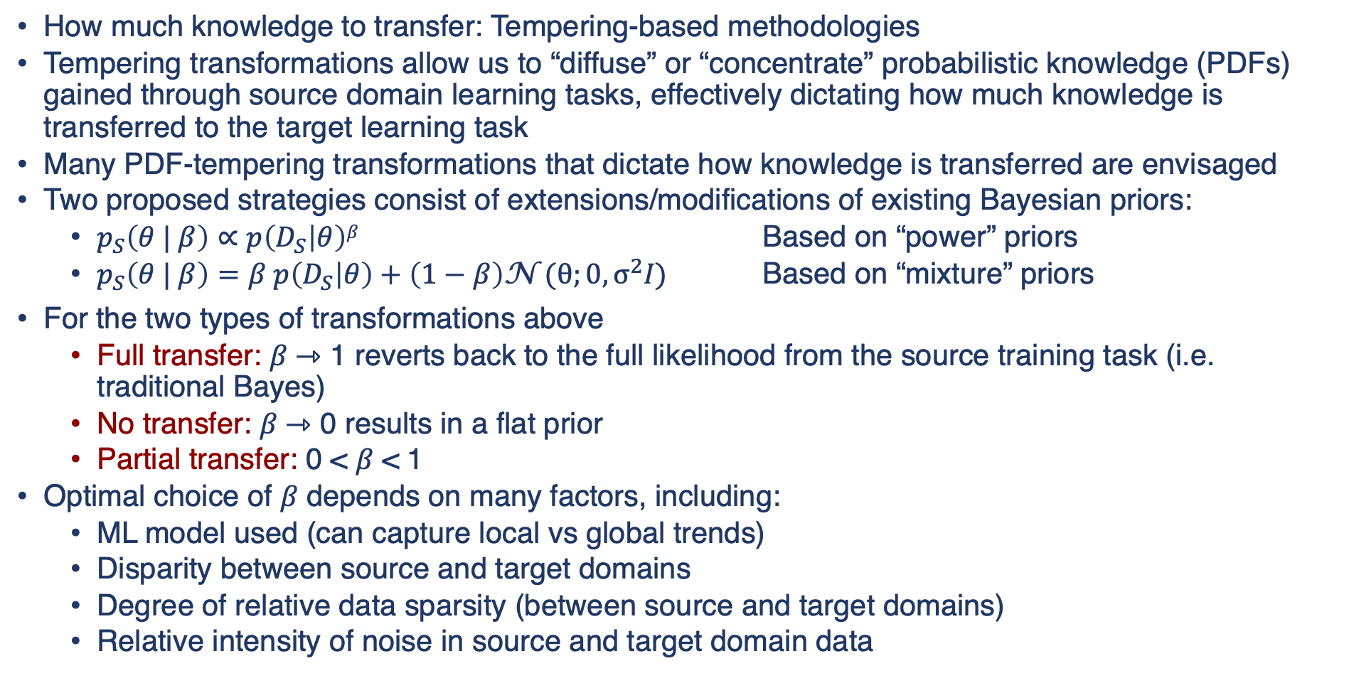
Tempering-based Diffusion of Knowledge
How much knowledge to transfer: Tempering-based methodologies
Tempering transformations allow us to “diffuse” or “concentrate” probabilistic knowledge (PDFs) gained through source domain learning tasks, effectively dictating how much knowledge is transferred to the target learning task
Many PDF-tempering transformations that dictate how knowledge is transferred are envisaged
Two proposed strategies consist of extensions/modifications of existing Bayesian priors:
  $p_{S}\left(θ | β\right)∝p\left(D_{S} | θ\right)β$ Based on “power” priors
  $p_{S}\left(θ | β\right)=β p\left(D_{S} | θ\right)+\left(1−β\right)\text{N} \text{(}θ;0,σ^{2}I\text{)}$ Based on “mixture” priors
For the two types of transformations above
  Full transfer: 𝛽 ⇾ 1 reverts back to the full likelihood from the source training task (i.e. traditional Bayes)
  No transfer: 𝛽 ⇾ 0 results in a flat prior
  Partial transfer: 0 < 𝛽 < 1
Optimal choice of 𝛽 depends on many factors, including:
  ML model used (can capture local vs global trends)
  Disparity between source and target domains
  Degree of relative data sparsity (between source and target domains)
  Relative intensity of noise in source and target domain data
Notes:
Our solution is to use so-called tempering transformations. They allow us to propagate knowledge gained in a source task in the shape of prior PDFs with controls over how much that knowledge affects subsequent target learning tasks.
There are many transformations that are envisaged to potentially solve that task, but let me explain briefly two ideas that we have. One is based on so-called power priors while the other one on mixture priors, where sigma is chosen to be a relatively large value. The first is predominantly used to control information flow in Bayesian networks, while the later is used to introduce some skepticism associated with a given prior.
Both approaches would take the available prior PDF from previous training tasks, possibly ones carried out on abundant, low-fidelity data, and modify them to result in a spectrum of priors. On one end the prior PDF is left unmodified and full knowledge is transferred and on the other extreme no knowledge is transferred since the resulting PDF is a flat uninformative one. The hyper-parameters beta control how much knowledge is transferred, with optimal values really being case dependent based on models used, quality of data and how closely related are the two tasks
Optimal values for beta would be obtained using hierarchical Bayes, as is carried out for slack and slab priors and other sparsity inducing algorithms.

Slide 9
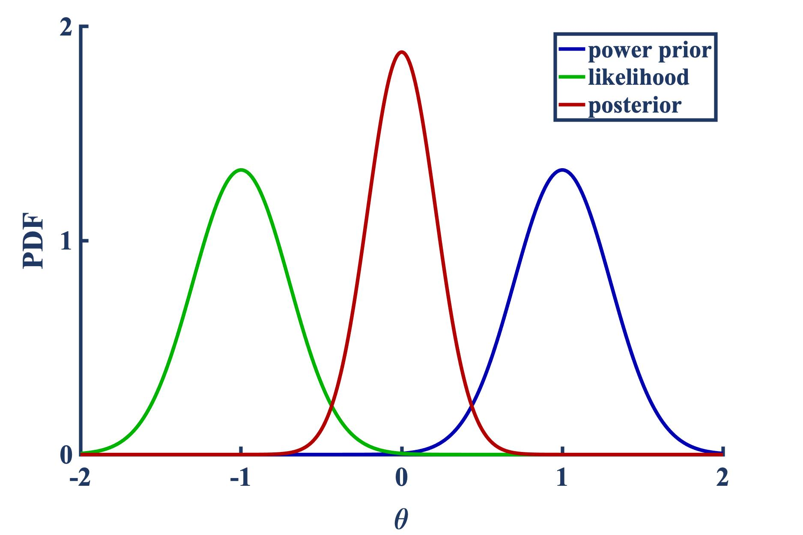
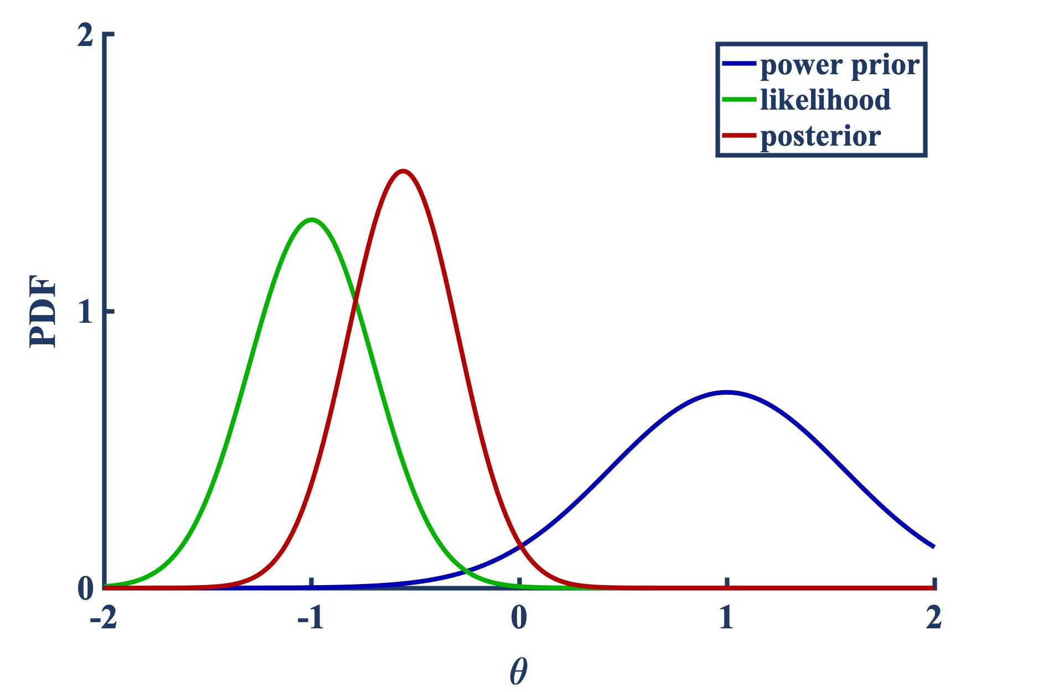
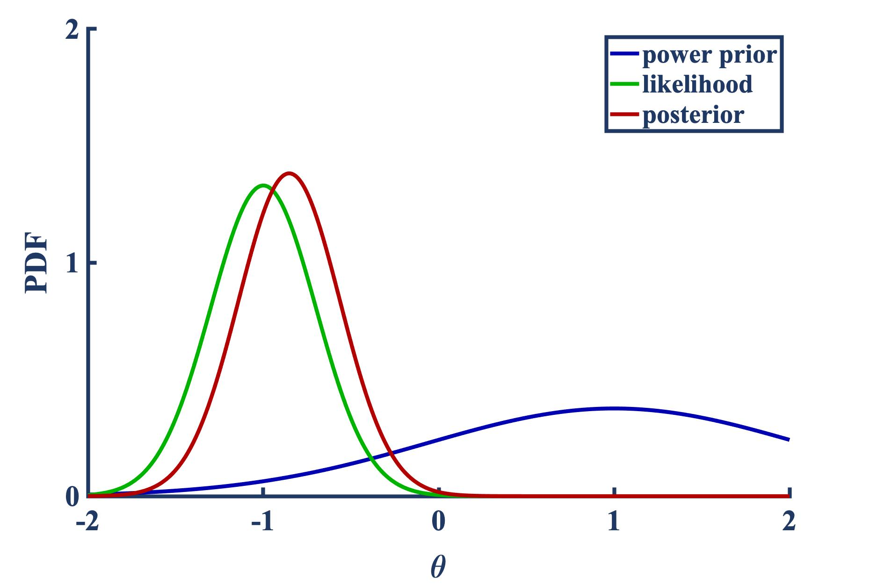
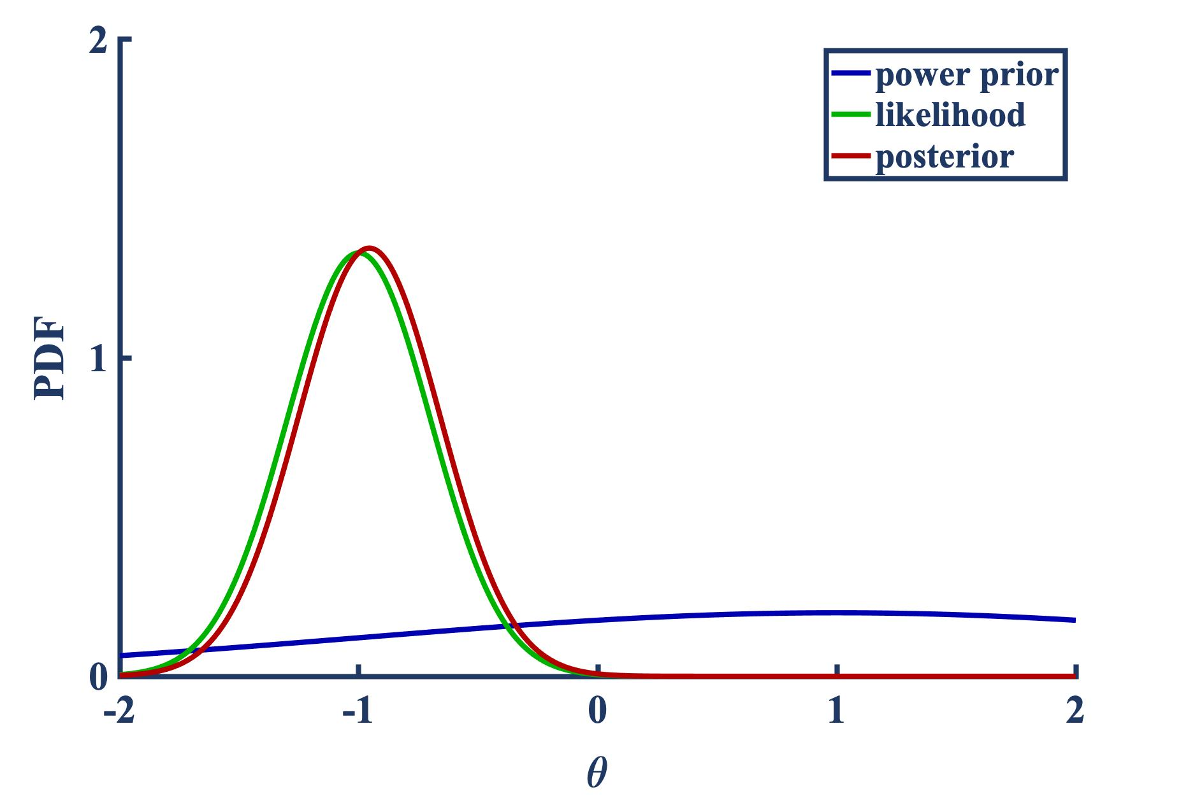
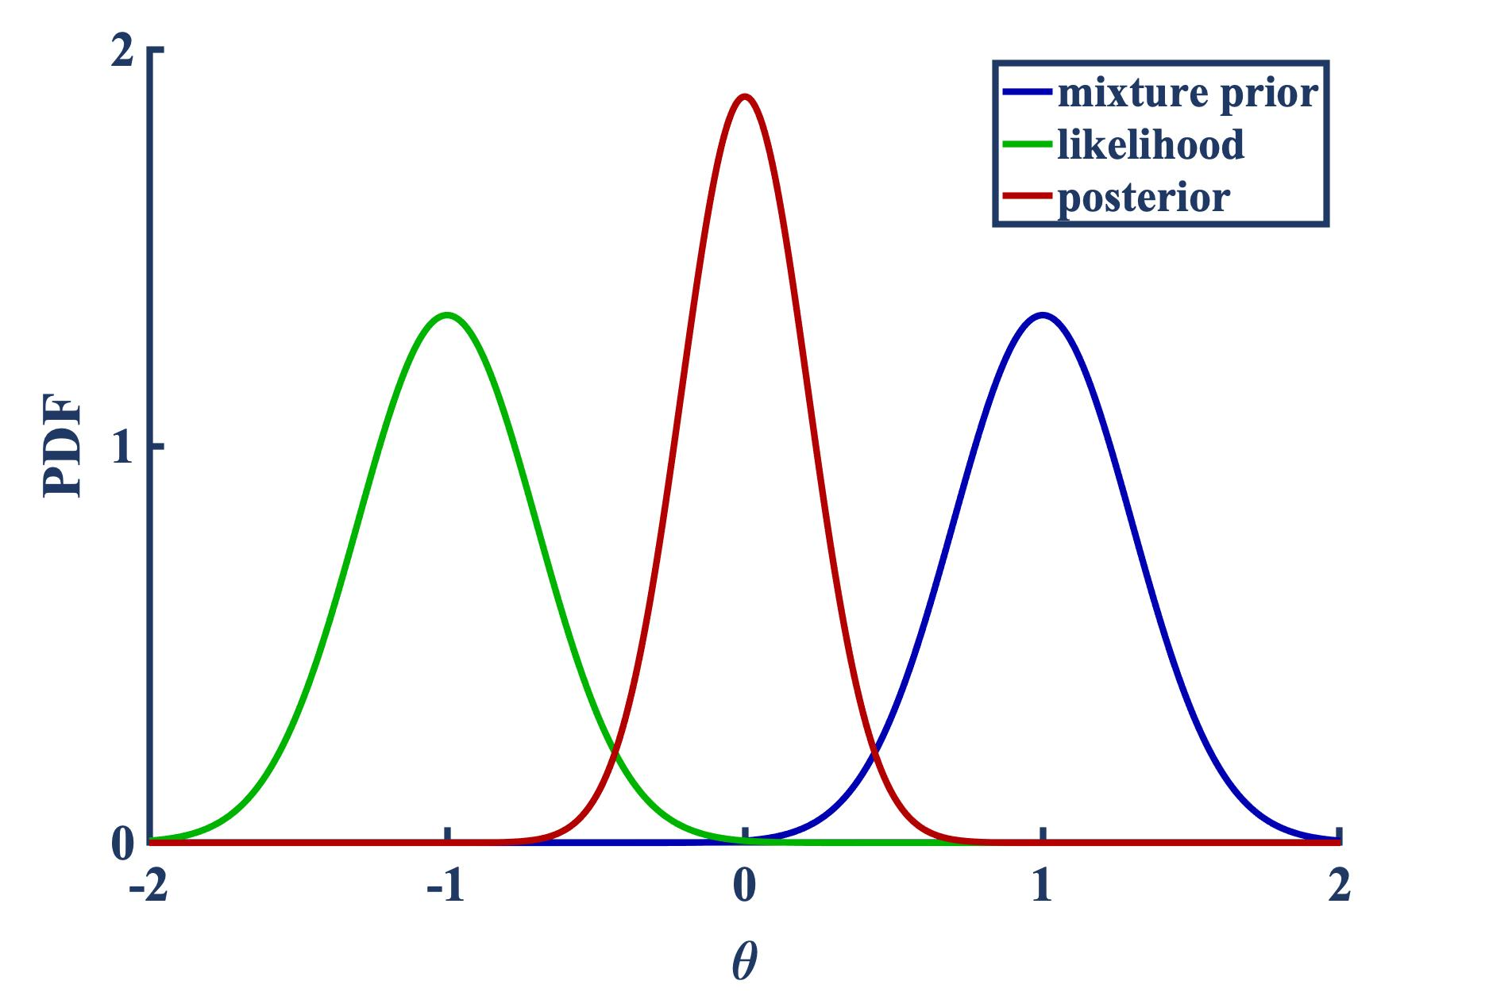
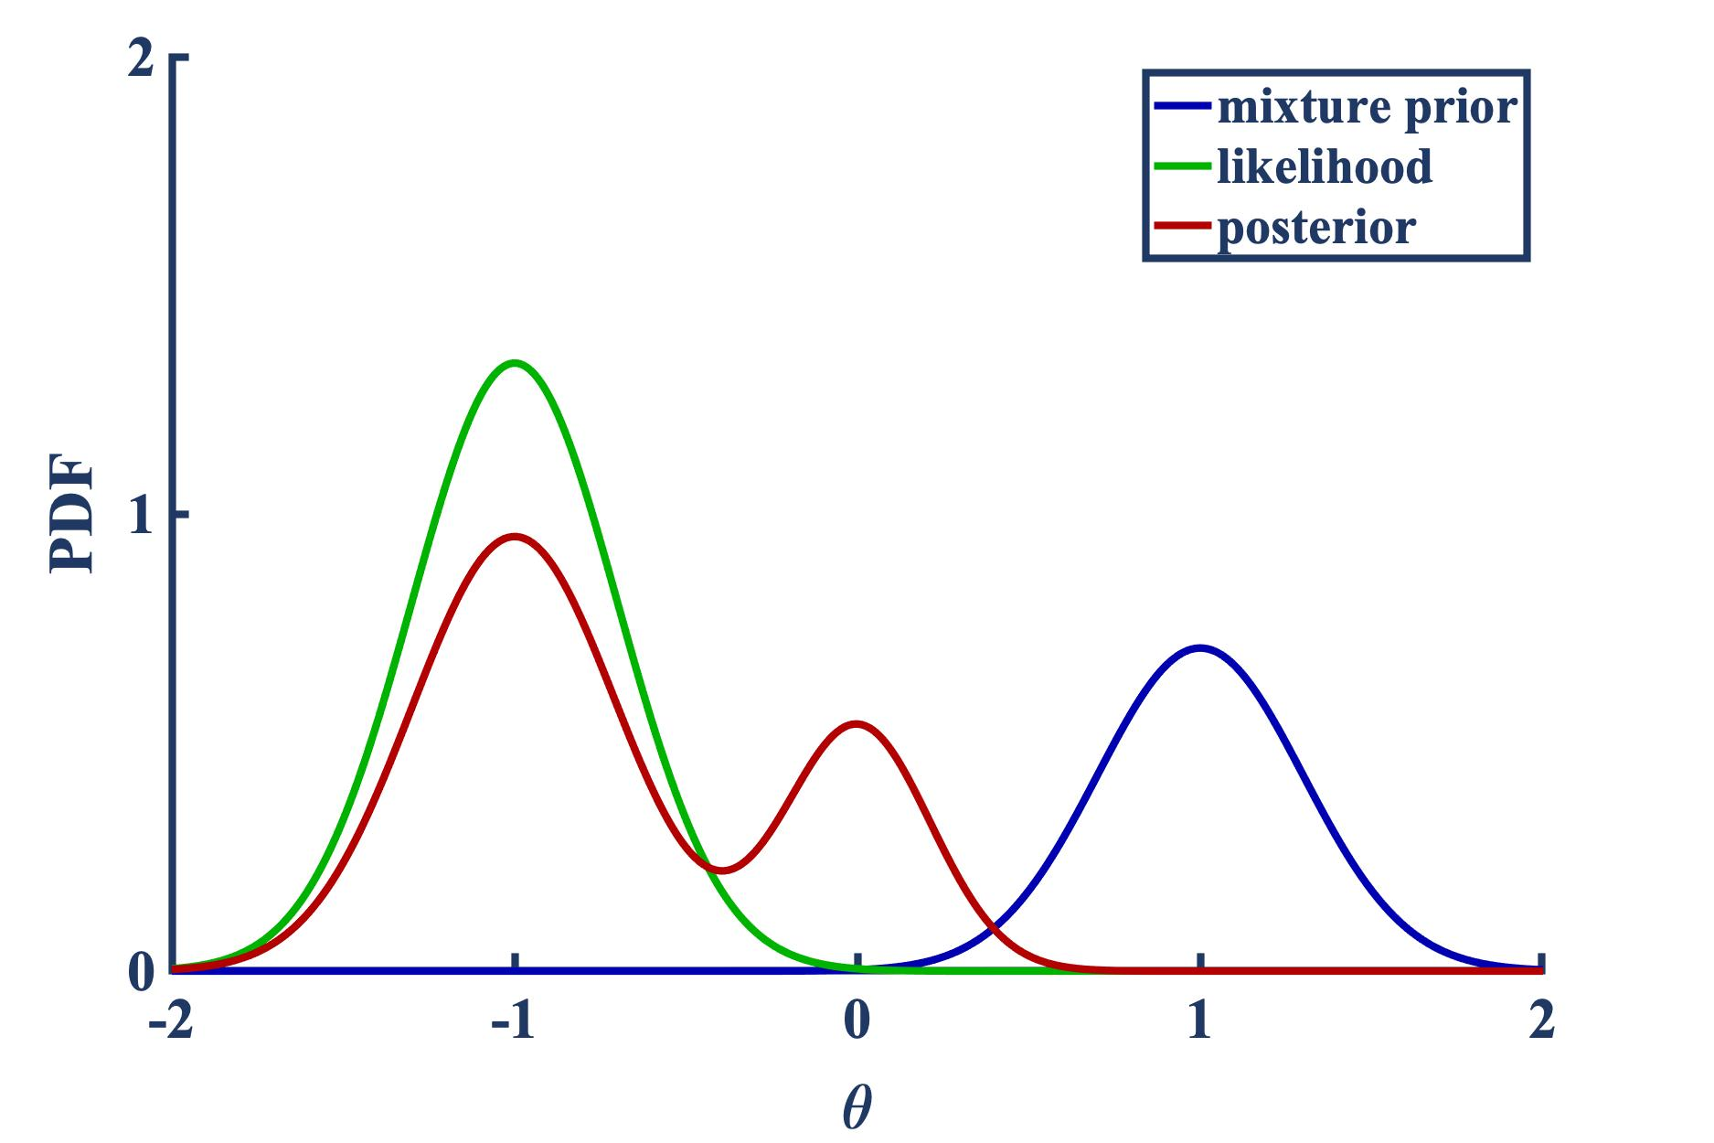
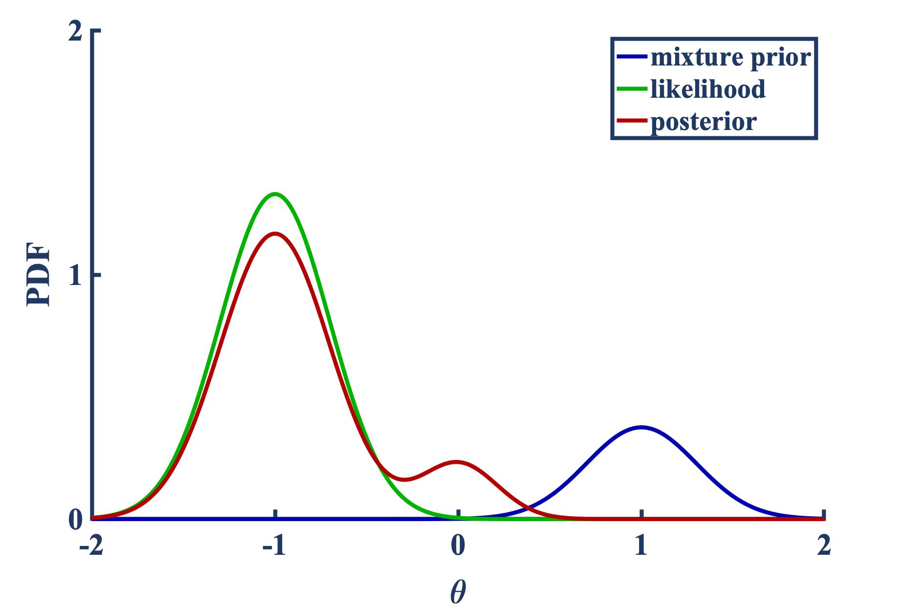
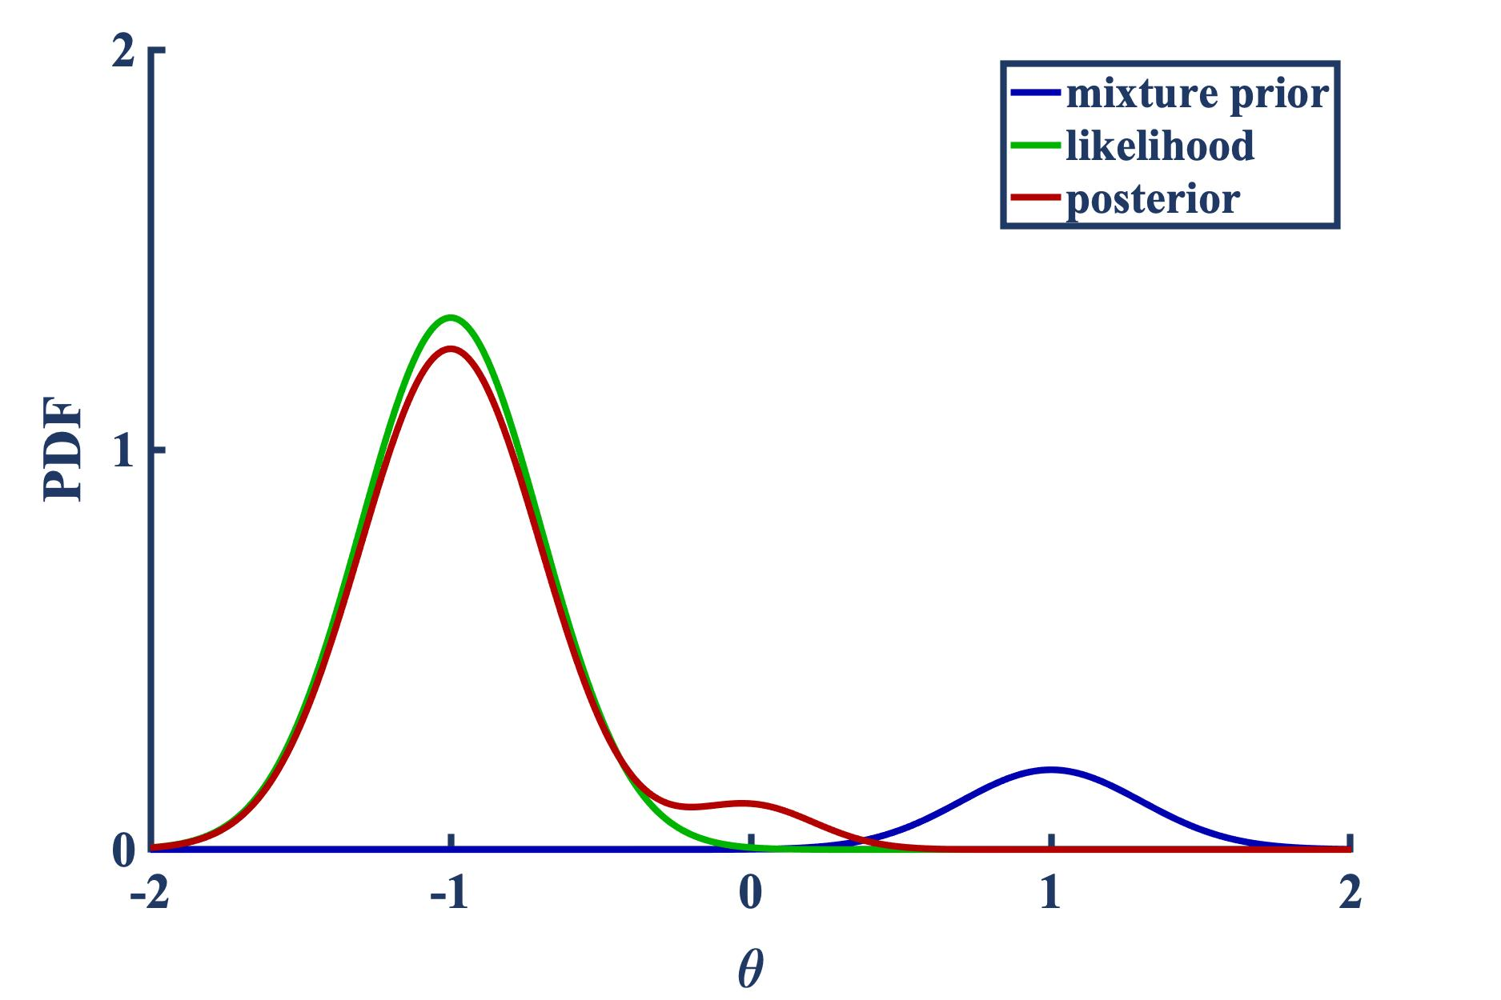





Tempering-based Diffusion of Knowledge
The following is an example of the extension of power-based and mixture-based prior tempering transformation to “diffuse” knowledge in the prior PDF
The prior and likelihood PDFs are chosen to be Gaussian
Note: one can show that for a Gaussian PDF, raising it to a power $β$ is equivalent to scaling the associated covariance matrix by the same $β$ (mean vector unaffected)
Power prior: Gaussian posterior
$$p\left(θ | D,β\right) ∝p\left(D | θ\right)p(θ)β$$
Mixture prior: Gaussian-mixture posterior
$p\left(θ | D,β\right) ∝p\left(D | θ\right)[β p\left(θ\right)+(1−β)$ $\text{N} \text{(}θ;0,1×\text{10}\text{4}\text{)}$]
$$β=1$$
$$β=0.5$$
$$β=0.3$$
$$β=0.15$$
Notes:
Let’s see how some of the proposed transformations work by diffusing knowledge gained in similar tasks.
On the top left figure, I’m showing a pdf shown in blue which I’m calling the prior PDF. This is obtained through a previous training task on similar data, which is called source data in a transfer learning setting. The idea is to introduce flexibility in how much this prior PDF controls the posterior. Essentially we control how much knowledge is transferred through this prior.
Two proposed approaches are described mathematically, one is to raise the prior to a power beta, and the other is to diffuse this prior with an additional uninformative gaussian component.
You see as we go from left to right, the prior pdf starts loosing precision as this hyper-parameter beta goes form a value of 1 to zero and the likelihood and posterior begin to coincide.
In a transfer learning setting, the target data provides the likelihood PDF shown in green. We combine this parametrized prior in blue along with the likelihood to arrive at the posterior in red.
You see that as beta decreases from one, the prior PDF which contains knowledge gained from training on similar data, becomes less and less influential.
This hyper-parameter beta gives us essentially control on how much knowledge is transferred, if at all.

Slide 10
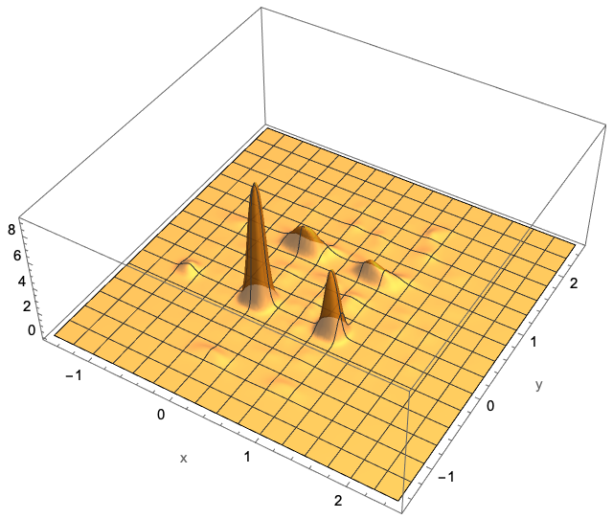
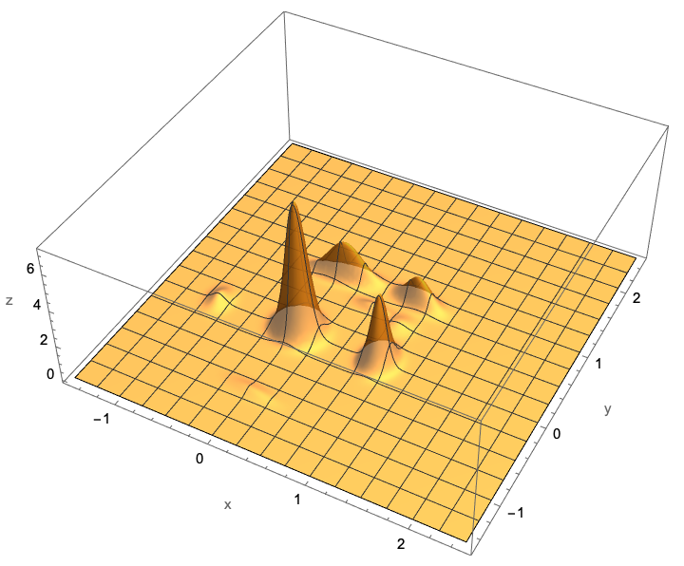
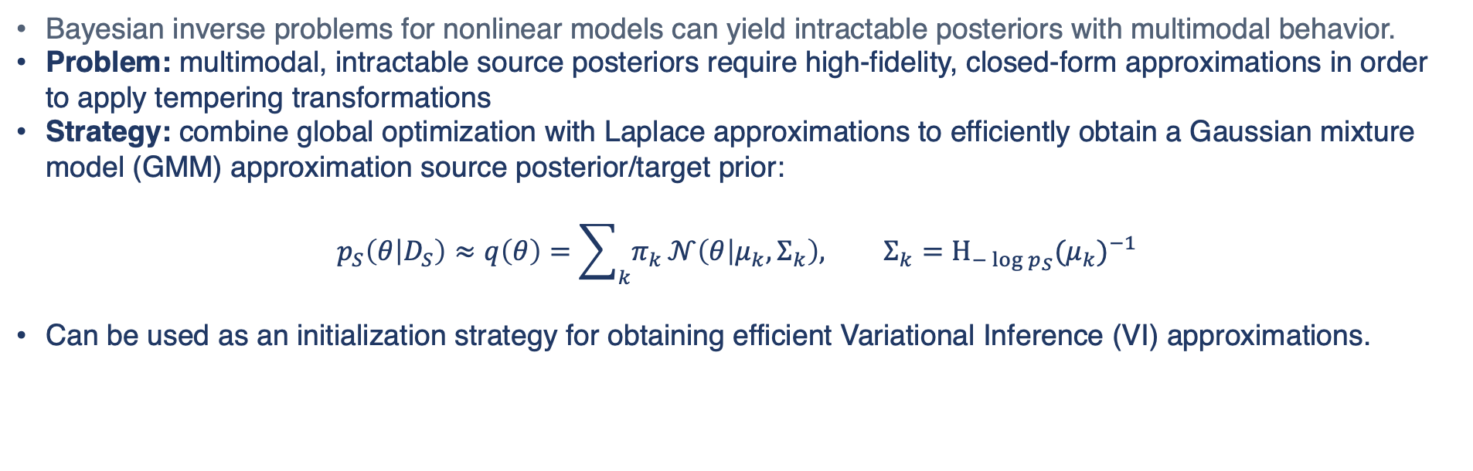
Tempering intractable posteriors - high fidelity PDF approximations
Bayesian inverse problems for nonlinear models can yield intractable posteriors with multimodal behavior.
Problem: multimodal, intractable source posteriors require high-fidelity, closed-form approximations in order to apply tempering transformations
Strategy: combine global optimization with Laplace approximations to efficiently obtain a Gaussian mixture model (GMM) approximation source posterior/target prior:
$$p_{S}\left(θ | D_{S}\right)≈q\left(θ\right)=\sum_{k}{π_{k}}𝒩\left(θ | μ_{k},Σ_{k}\right), Σ_{k}=Η_{−\log{p_{S}}}{(μ_{k})}^{−1}$$
Can be used as an initialization strategy for obtaining efficient Variational Inference (VI) approximations.
Multimodal, intractable posterior
High-fidelity GMM approximation
Scalability of VI initialized by GMM approx.
Notes:
A natural question you might ask is how can we temper the intractable posteriors that typically result from nonlinear problems? Addressing this issue forms one of the current research efforts of the LDRD so I’ll give a brief description of our approach.
In order to apply tempering transformations, we need closed-form approximations that are also high-fidelity as the source posterior distribution can be multimodal and sub-dominant modes may still transfer knowledge to the target task.
The strategy we’re currently investigating is to combine global optimization with local Laplace approximations to efficiently obtain a Gaussian mixture model approximation of the intractable source posterior. In the bottom left set of figures, we see such an intractable posterior as well as its high-fidelity GMM approximation.
This approach can be used as a standalone approximation or as an initialization scheme for obtaining a more refined approximations using Variational Inference. Variational inference with GMMs becomes expensive due to the rapid growth in model parameters as the dimension increases and also suffers from getting stuck in poor local minima. Hence, good initialization can help to efficiently obtain an accurate posterior approximation.

Slide 11






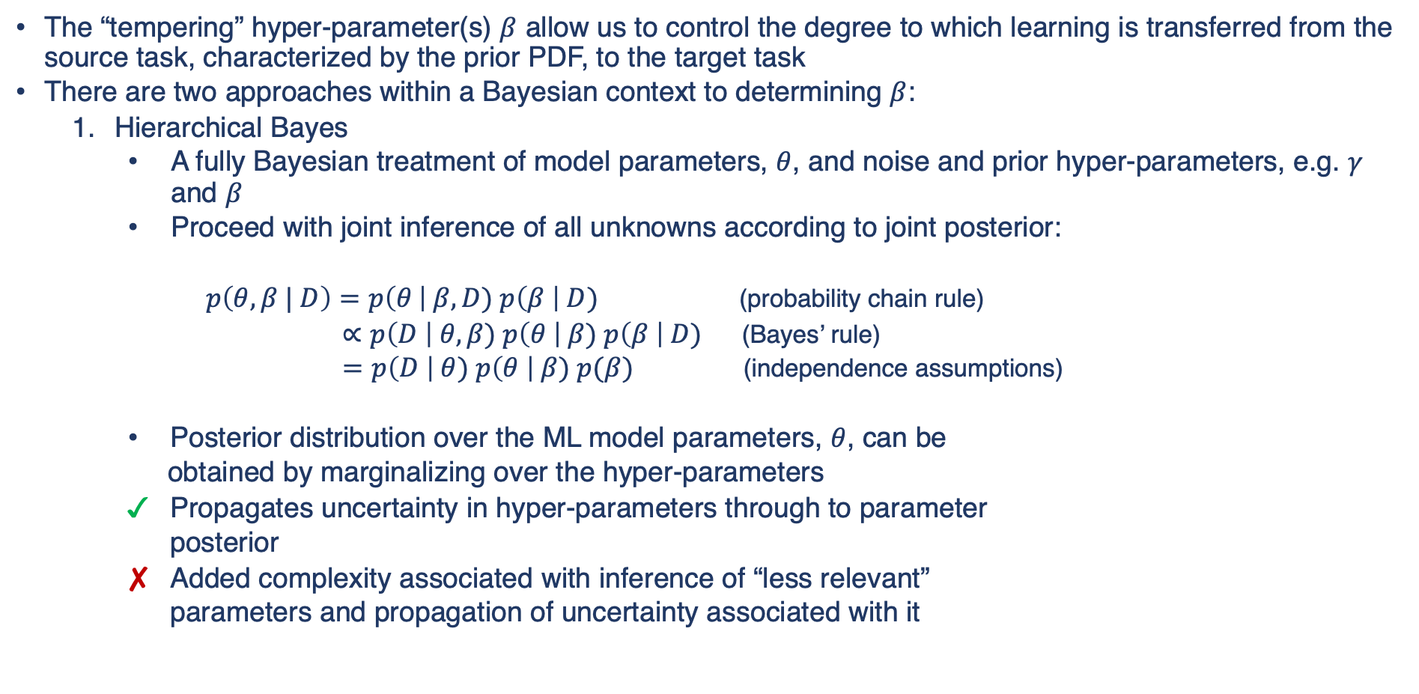


Degree of Knowledge/Learning to Transfer - Hierarchical Bayes
The “tempering” hyper-parameter(s) $β$ allow us to control the degree to which learning is transferred from the source task, characterized by the prior PDF, to the target task
There are two approaches within a Bayesian context to determining $β$:
  Hierarchical Bayes
    A fully Bayesian treatment of model parameters, $θ$, and noise and prior hyper-parameters, e.g. $γ$ and $β$
    Proceed with joint inference of all unknowns according to joint posterior:
    $p\left(θ,β | D\right)=p\left(θ \right| β, D) p\left(β \right| D)$ (probability chain rule)
    $∝p\left(D \right| θ, β) p\left(θ \right| β) p\left(β \right| D)$ (Bayes’ rule)
    $=p\left(D \right| θ) p\left(θ \right| β) p(β)$ (independence assumptions)
    Posterior distribution over the ML model parameters, $θ$, can be
    obtained by marginalizing over the hyper-parameters
    Propagates uncertainty in hyper-parameters through to parameter
    posterior
    Added complexity associated with inference of “less relevant”
    parameters and propagation of uncertainty associated with it
$$γ$$
$$β$$
$$ε \sim \text{N} (0,γ)$$
$$θ \sim p_{S}\left(θ | β\right)$$
$$ε$$
$$θ$$
$$\text{M}\left(x, θ\right) = d+ε$$
$$d$$
Notes:
Now that we’ve discussed the idea of tempering to control knowledge transfer, how can we obtain the right amount of transfer? In other words, what’s the right value of beta?
In a Bayesian setting, there are two approaches. First, we can work with the joint parameter and hyper-parameter pdf and infer them jointly.
This is in a sense a fully Bayesian approach. This is what’s called hierarchical Bayes and it’s common to see it when one is dealing with noise model hyper-parameters as shown on the right, which influence the likelihood function. We are introducing hyper-parameters that affect the prior PDF which is a key difference.
However, this adds extra degrees of freedom which increase the complexity in both the training task as well as predictive ones.

Slide 12
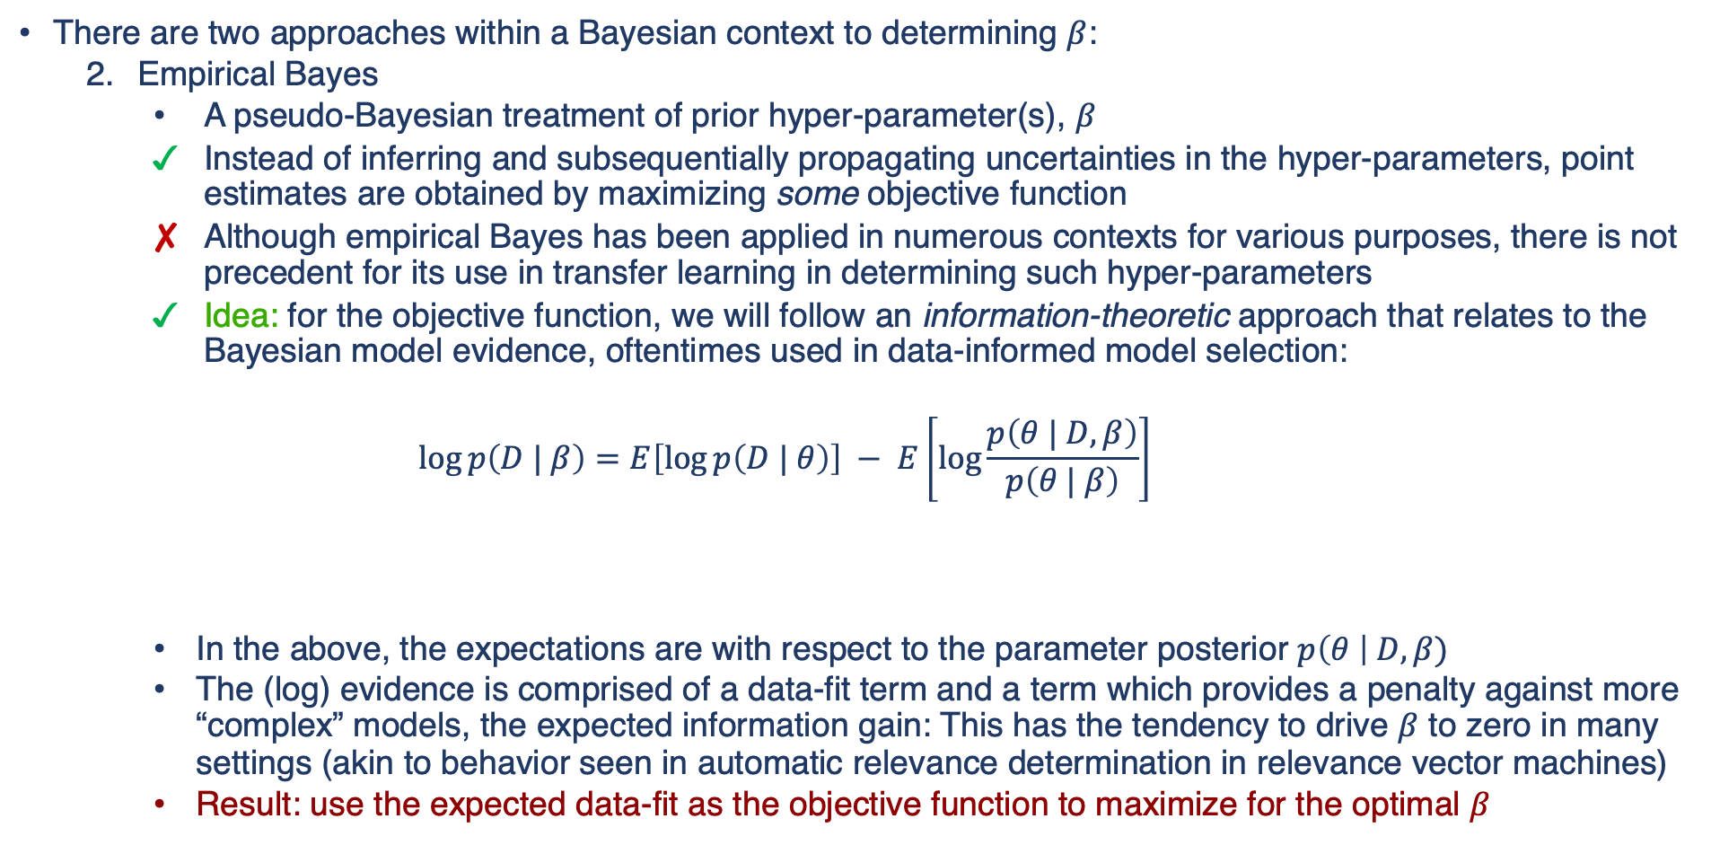
Degree of Knowledge/Learning to Transfer - Empirical Bayes
There are two approaches within a Bayesian context to determining $β$:
  Empirical Bayes
    A pseudo-Bayesian treatment of prior hyper-parameter(s), $β$
    Instead of inferring and subsequentially propagating uncertainties in the hyper-parameters, point estimates are obtained by maximizing some objective function
    Although empirical Bayes has been applied in numerous contexts for various purposes, there is not precedent for its use in transfer learning in determining such hyper-parameters
    Idea: for the objective function, we will follow an information-theoretic approach that relates to the Bayesian model evidence, oftentimes used in data-informed model selection:
    $$\log{p\left(D | β\right)}=E\left[\log{p\left(D | θ\right)}\right] − E\left[\log{\frac{p\left(θ | D,β\right)}{p\left(θ | β\right)}}\right]$$
    In the above, the expectations are with respect to the parameter posterior $p\left(θ \right| D,β)$
    The (log) evidence is comprised of a data-fit term and a term which provides a penalty against more “complex” models, the expected information gain: This has the tendency to drive $β$ to zero in many settings (akin to behavior seen in automatic relevance determination in relevance vector machines)
    Result: use the expected data-fit as the objective function to maximize for the optimal $β$
log-evidence
expected data-fit
expected information gain
Notes:
For now we are focused on the second approach, named empirical bayes in which a point estimate for the hyper-parameter is used. It is pseudo-Bayesian since we’re not incorporating the uncertainty in the hyper-parameter, just the parameters of interest.
The main limitation is that there are not standard approaches to obtain a value of beta, Without going into much details, we are now utilizing the first component of the log-evidence, which is called the expected data-fit. We are not including the effect of the second term since that penalizes model complexity and tends to drive the hyper-parameters to infinity.
So our strategy currently is an information-theoretic one, which is to maximize the expected data-fit to obtain point estimates for the tempering hyper-parameters
While this objective function makes intuitive sense, we have found in practice that it doesn't always yield sensible values for beta hence we're investigating the use of regularization to control poor behavior as well as alternate objective functions based on similarity metrics.

Slide 13
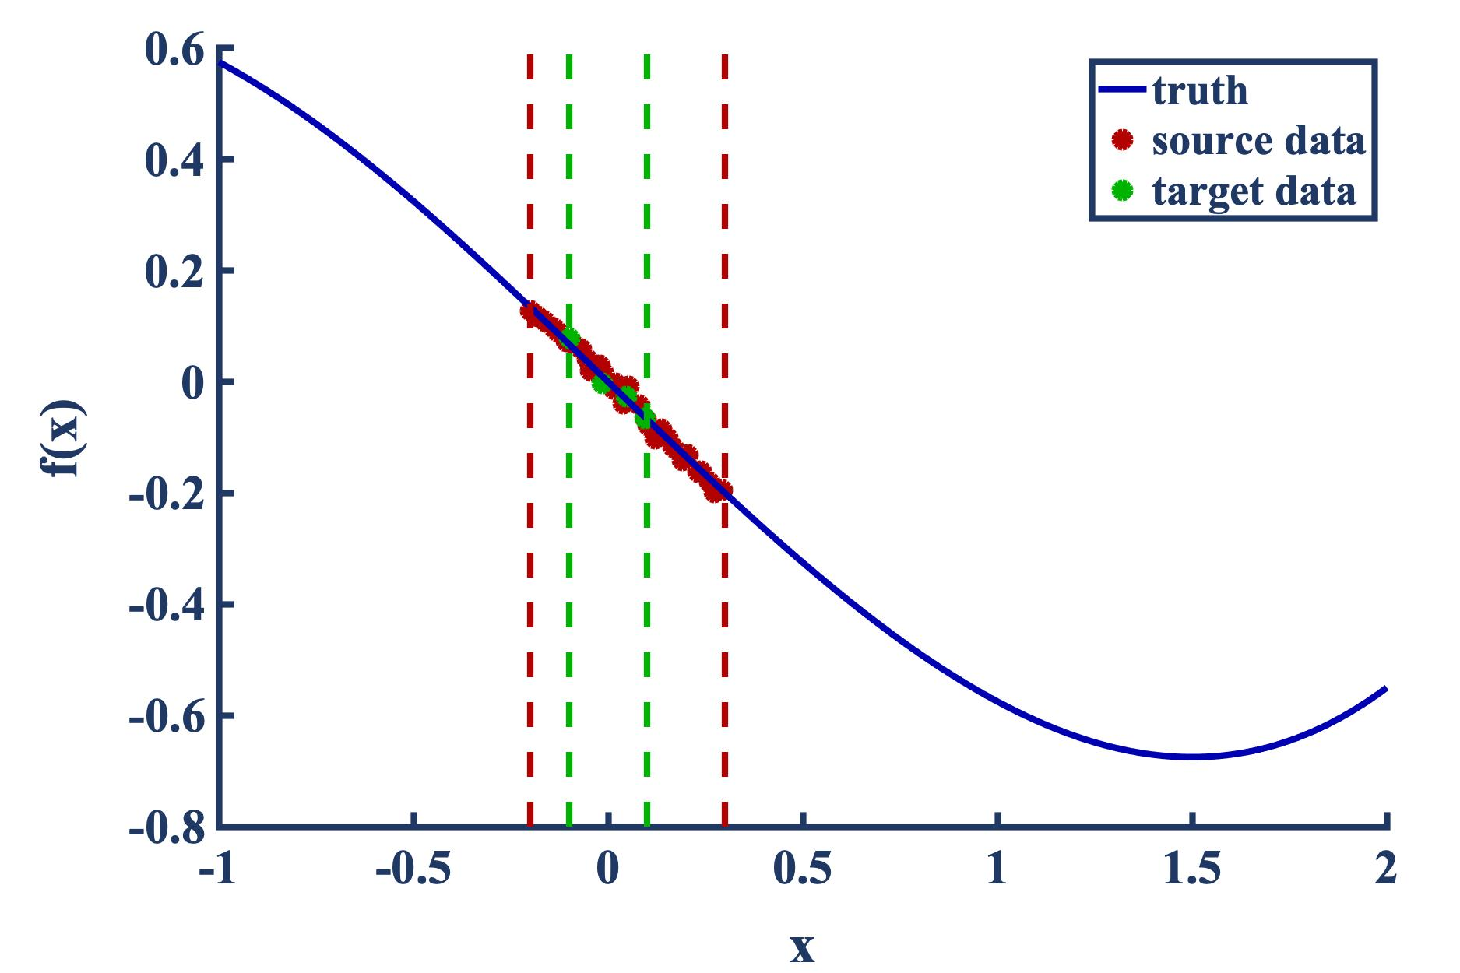
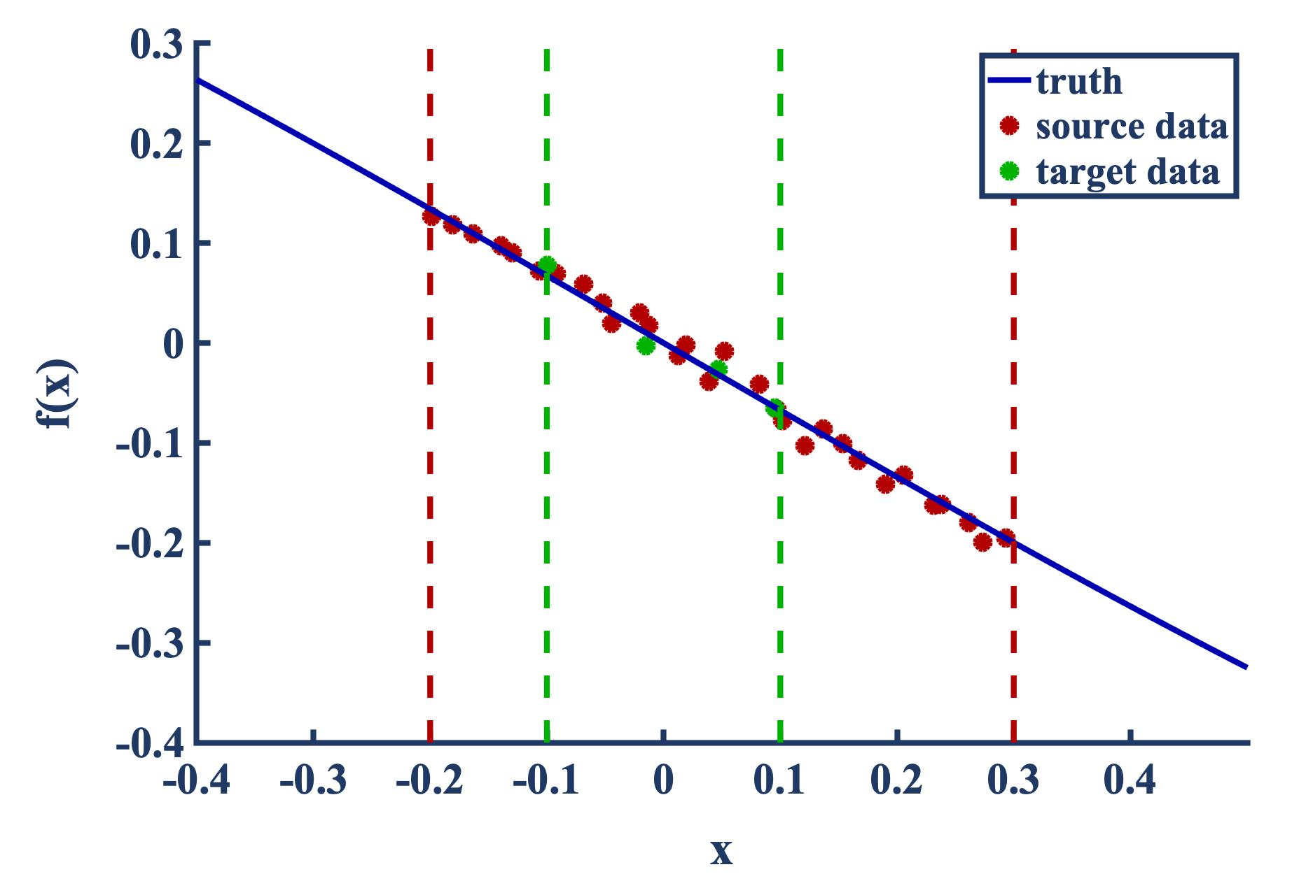
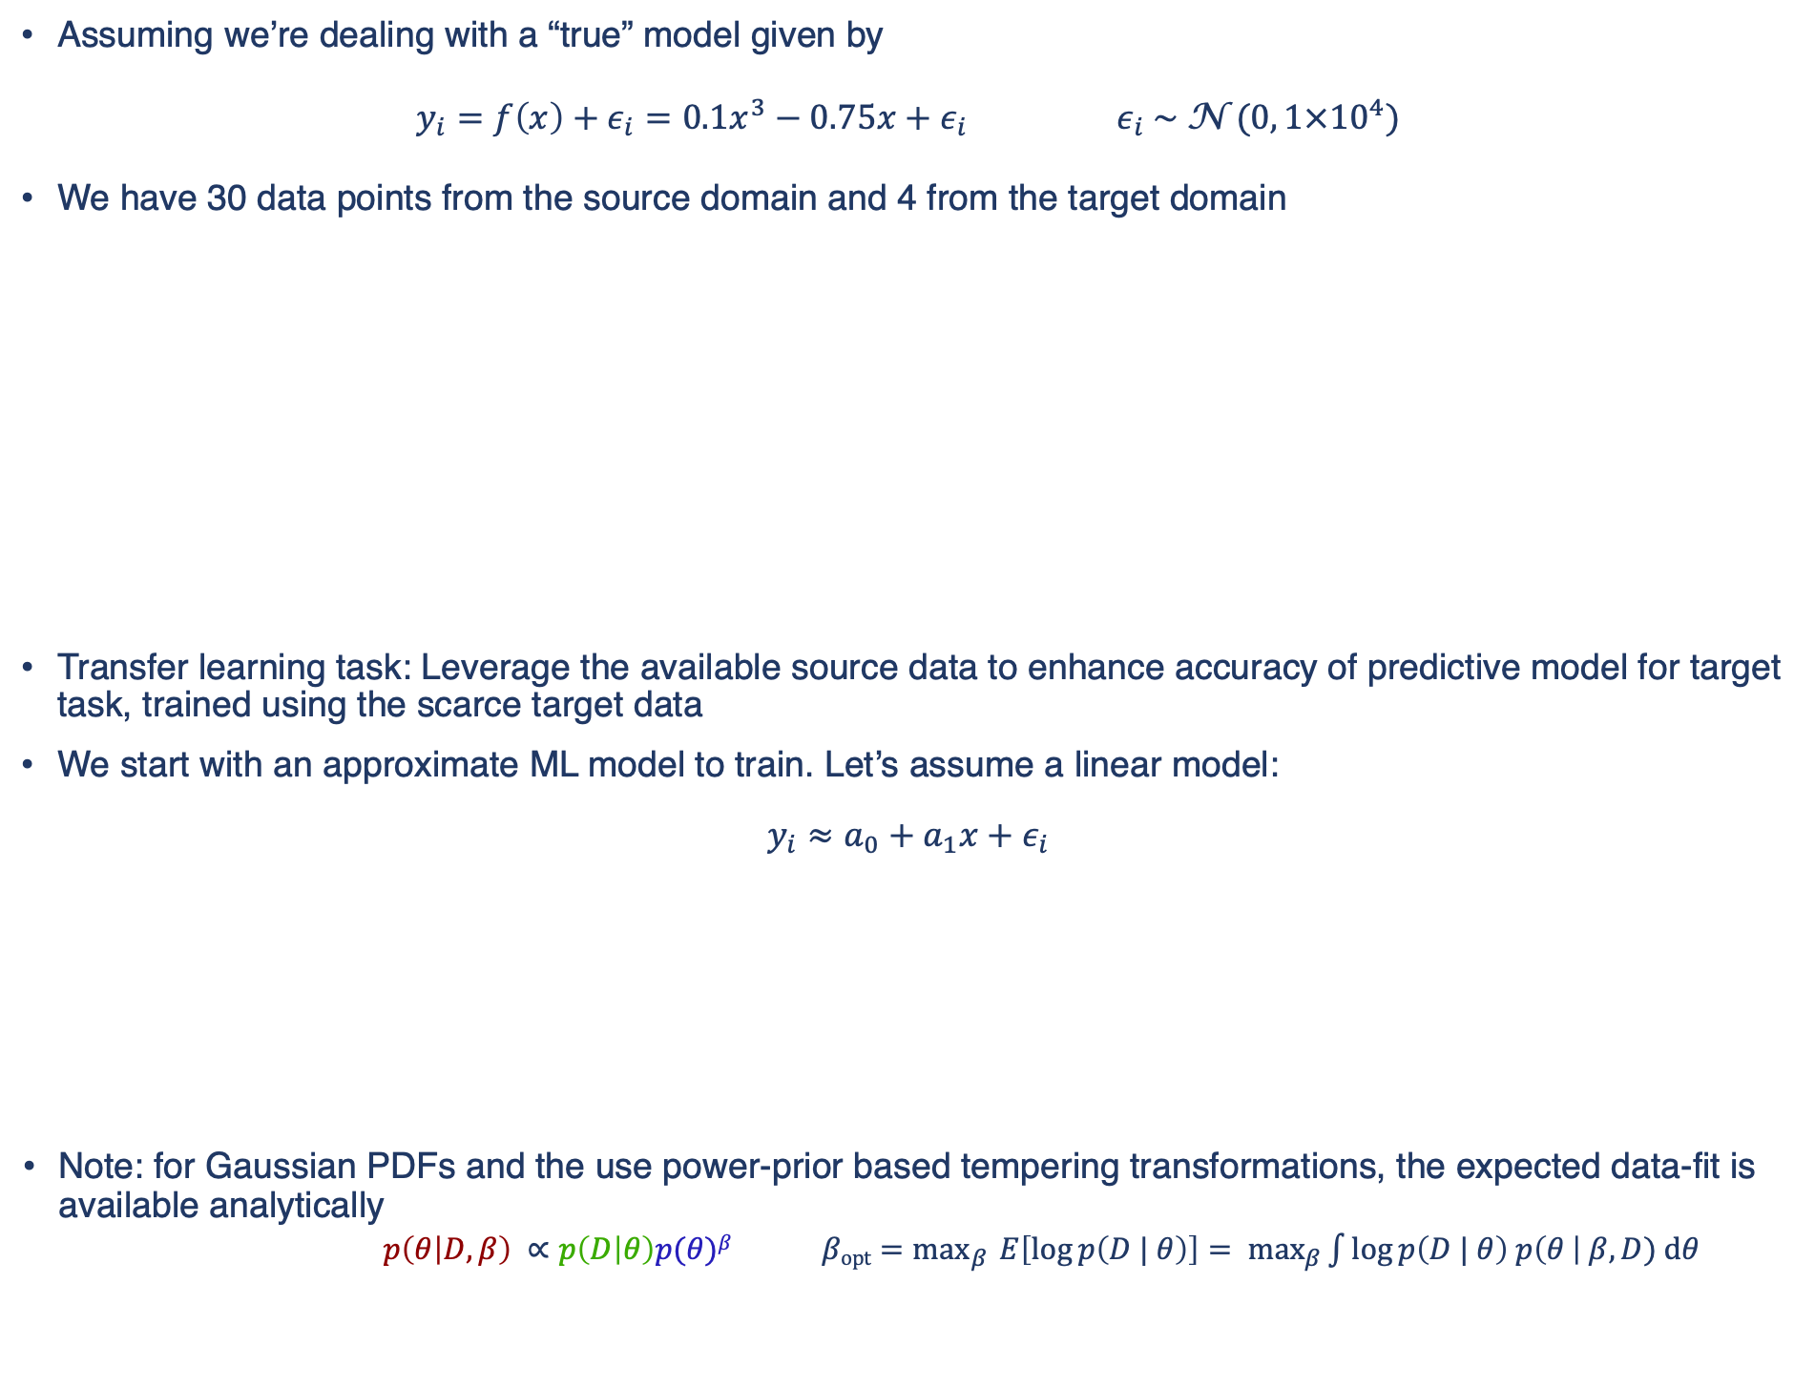
Probabilistic Transfer Learning at Work – Polynomial Surrogates
Assuming we’re dealing with a “true” model given by
$y_{i}=f\left(x\right)+ε_{i}=0.1x^{3}−0.75x+ε_{i}$ $ε_{i} \sim \text{N} \text{(}0, 1×{10}^{4}\text{)}$
We have 30 data points from the source domain and 4 from the target domain
Transfer learning task: Leverage the available source data to enhance accuracy of predictive model for target task, trained using the scarce target data
We start with an approximate ML model to train. Let’s assume a linear model:
$$y_{i}≈a_{0}+a_{1}x+ε_{i}$$
Note: for Gaussian PDFs and the use power-prior based tempering transformations, the expected data-fit is available analytically
$p\left(θ | D,β\right) ∝p\left(D | θ\right)p(θ)β$ $\underset{β }{β\text{opt}=max}{E\left[\log{p\left(D | θ\right)}\right]= \max_{β}{\int{\log{p\left(D | θ\right) p\left(θ \right| β, D) \text{d}θ} }} }$
Notes:
- Let's look at how this works in practice. We assume the following cubic model to be our true model given by this expression.
We assume we have 30 data points from a source domain, shown here using red circles.
We are interested in a target training task involving only 4 data points from the target domain shown using the green circles. I’m also showing here the extent of the two domains, the source using red dashed lines and the target using green dashed lines
We apply the presented transfser learning framework to train the following approximate linear model as a target traning task. The 4 data points from the target domain will in this setting provide us with the likelihood fiunction of the target task. The 30 data points from the source domain will provide the prior PDF from the source problem that we will transform as a power prior.
In this case, both the likelihood and the prior PDFs, and subsequently the posterior PDF, are all Gaussian, and are available analytically.

Slide 14
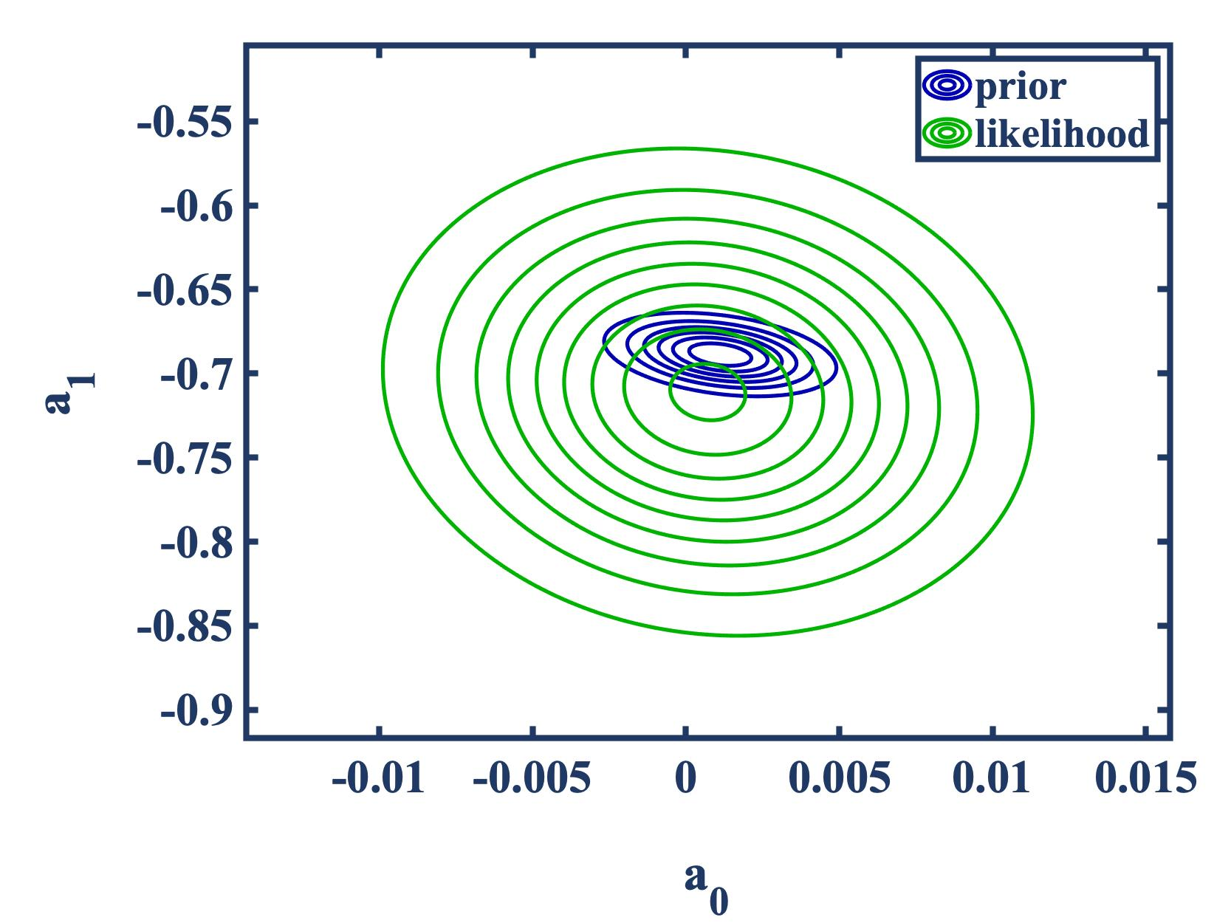
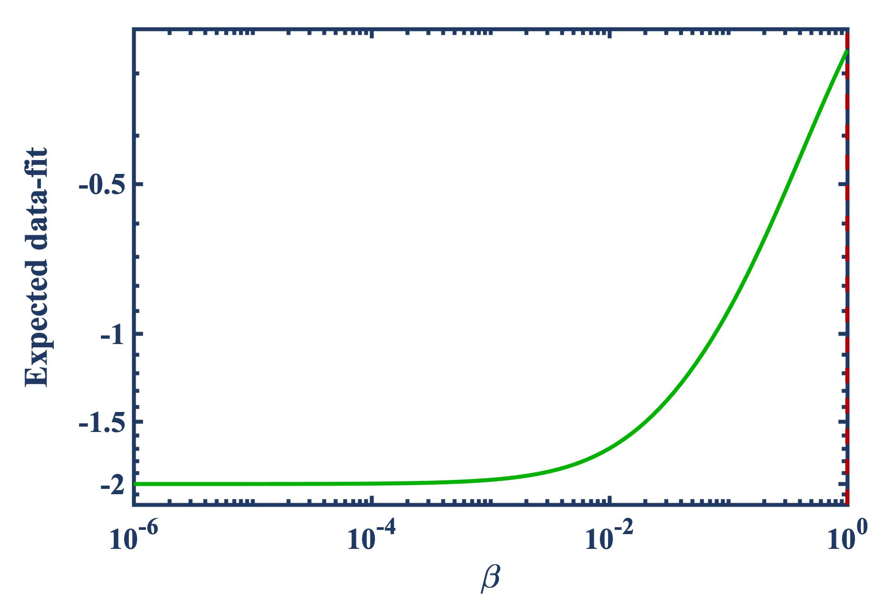
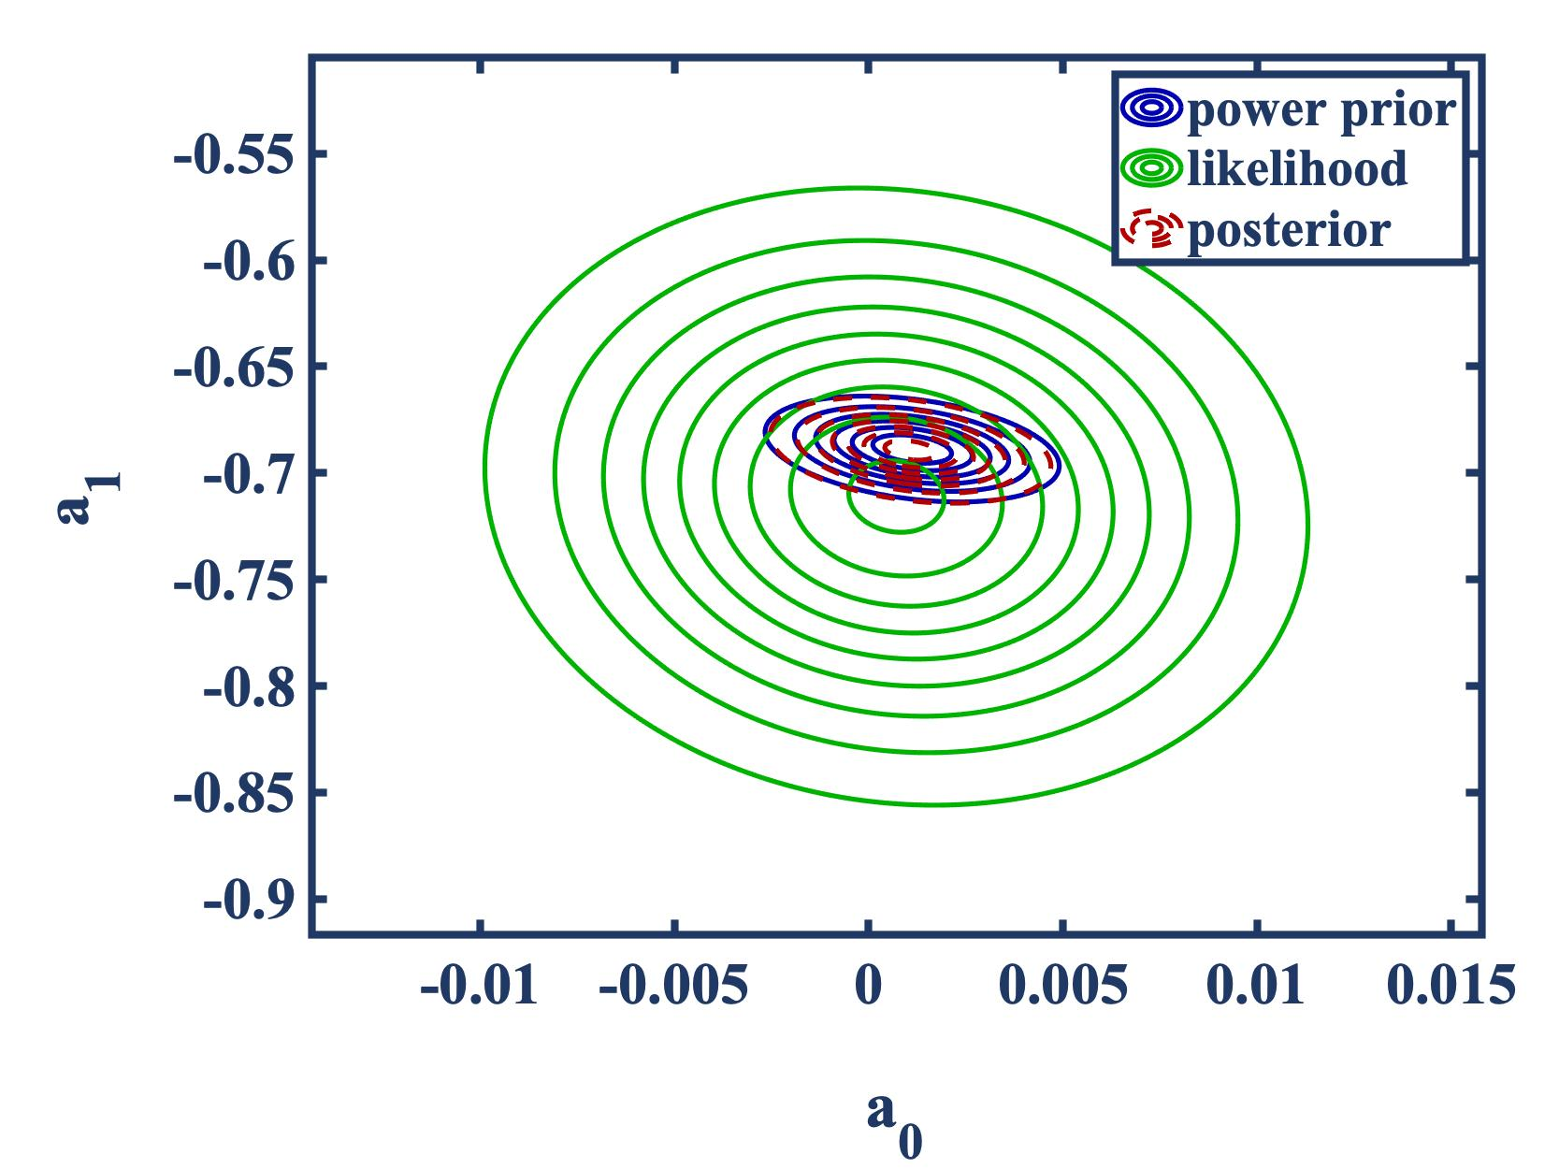
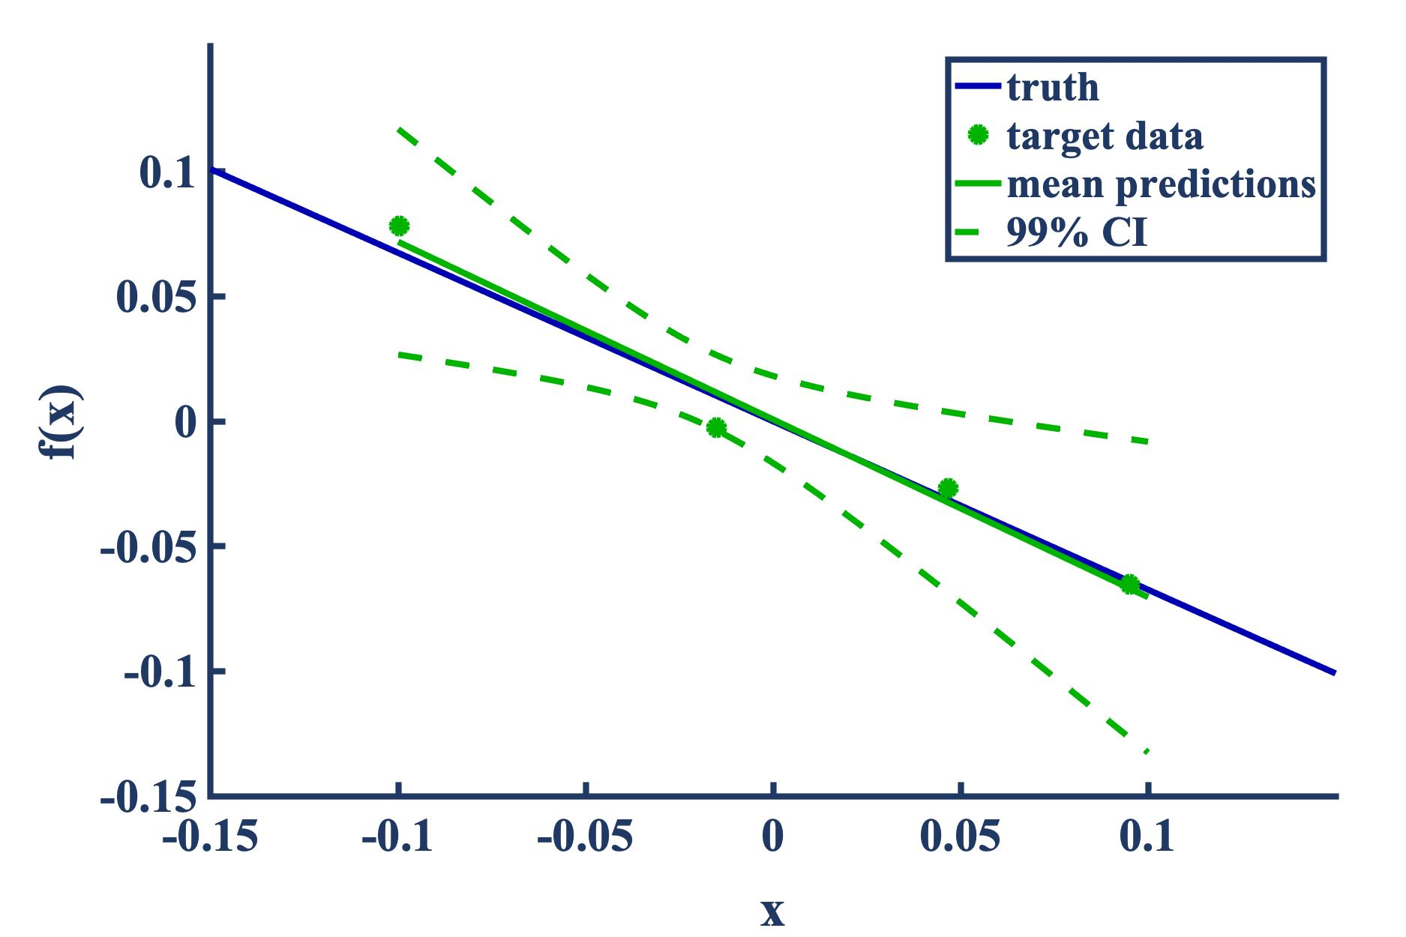
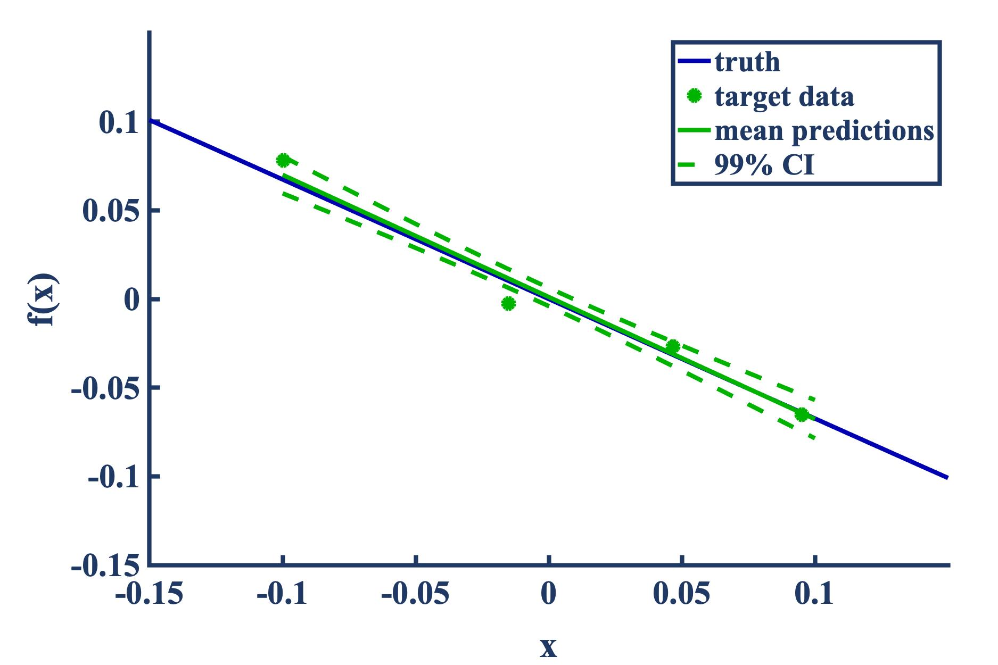

Probabilistic Transfer Learning at Work – Polynomial Surrogates
The source data, once assimilated, provide the prior PDF for subsequent use in the target training task
Similarly, the target data provide the likelihood PDF
We maximize the expected data-fit to arrive at an optimal power prior
The following are posterior predictive mean estimates and confidence intervals
Observation: overlapping source and target domains result in full transfer of learning
no transfer
full transfer
optimal transfer, $β\text{opt}=1$
Notes:
Applying the proposed framework, we start with the likelihood and prior PDFs shown in the upper left figure. Those are Gaussian and obtained by calibrating the same linear model using the source and target data, separately.
We maximize the datafit shown in the middle to arrive at an optimal beta of 1, which results in full transfer of knowledge gained from the source task. This is expected since the source and target domains are overlapping.
At the bottom I’m showing the posterior predictive for the target task, first without any transfer, then with full transfer, and in this case with the optimal amount of transfer which provides the same results as full transfer since beta is 1.
You see how the utility of source data and learning associated with it has effectively reduced the predictive uncertainty.

Slide 15
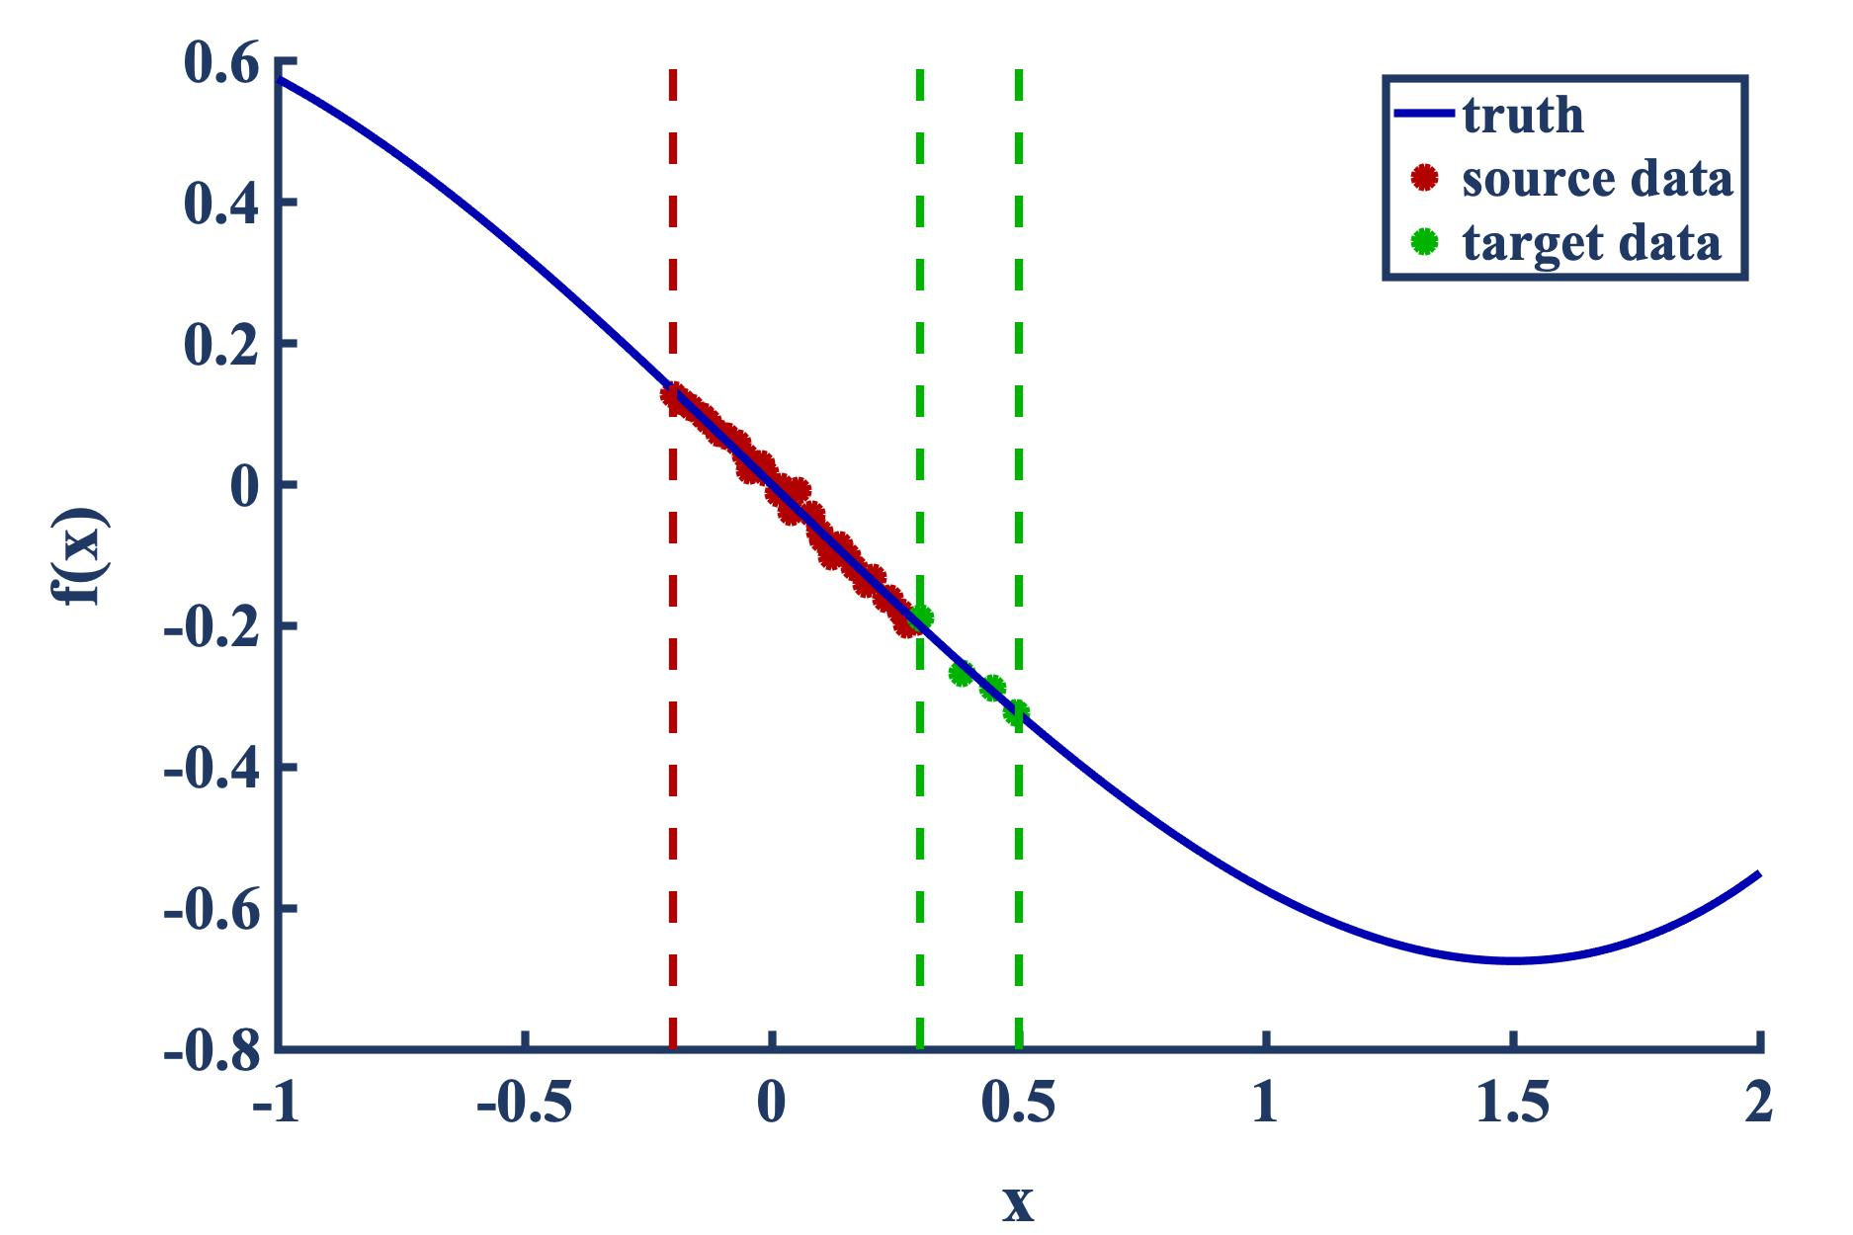
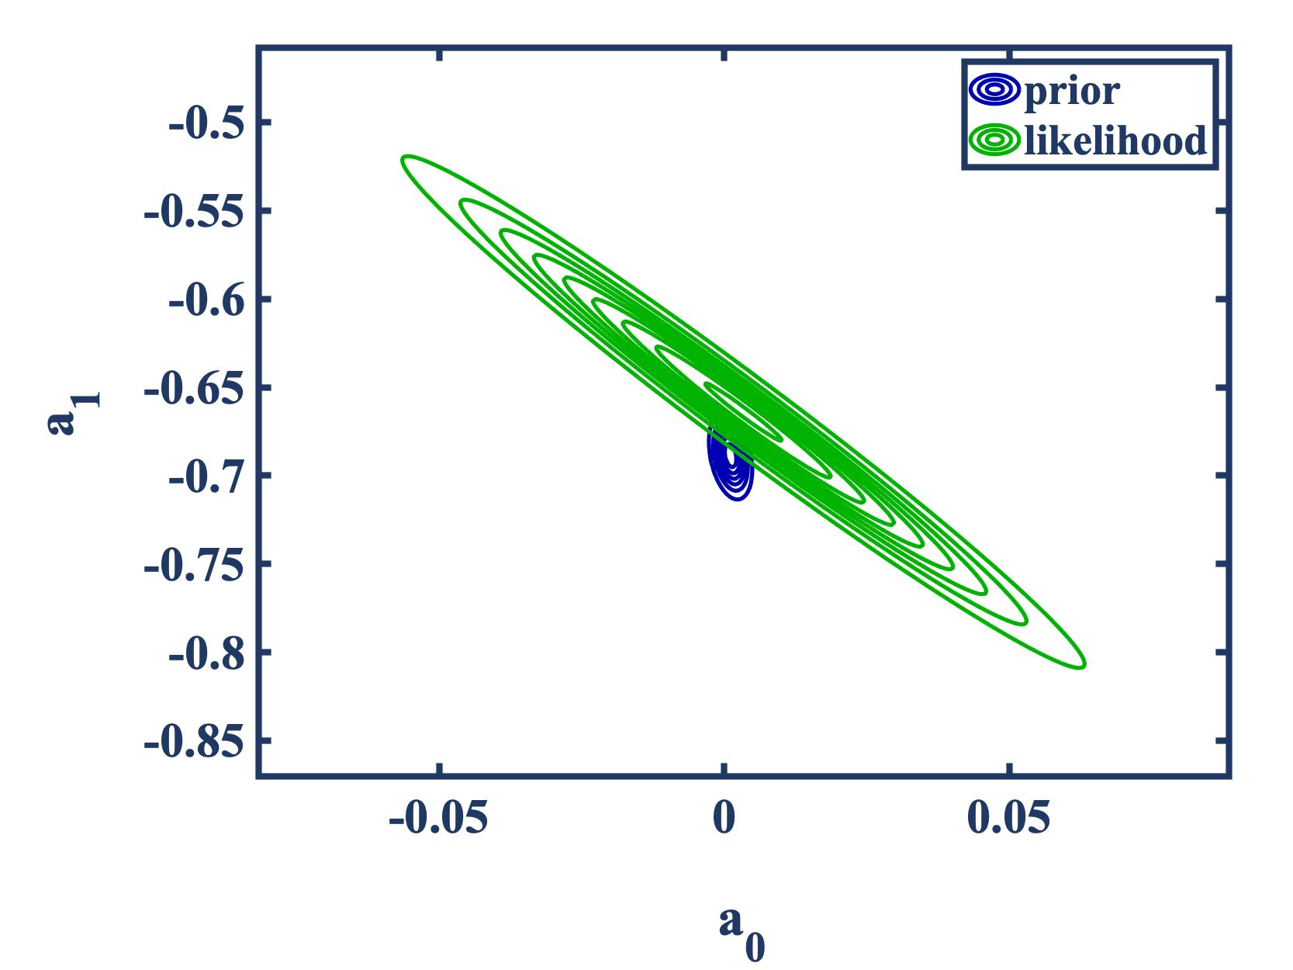
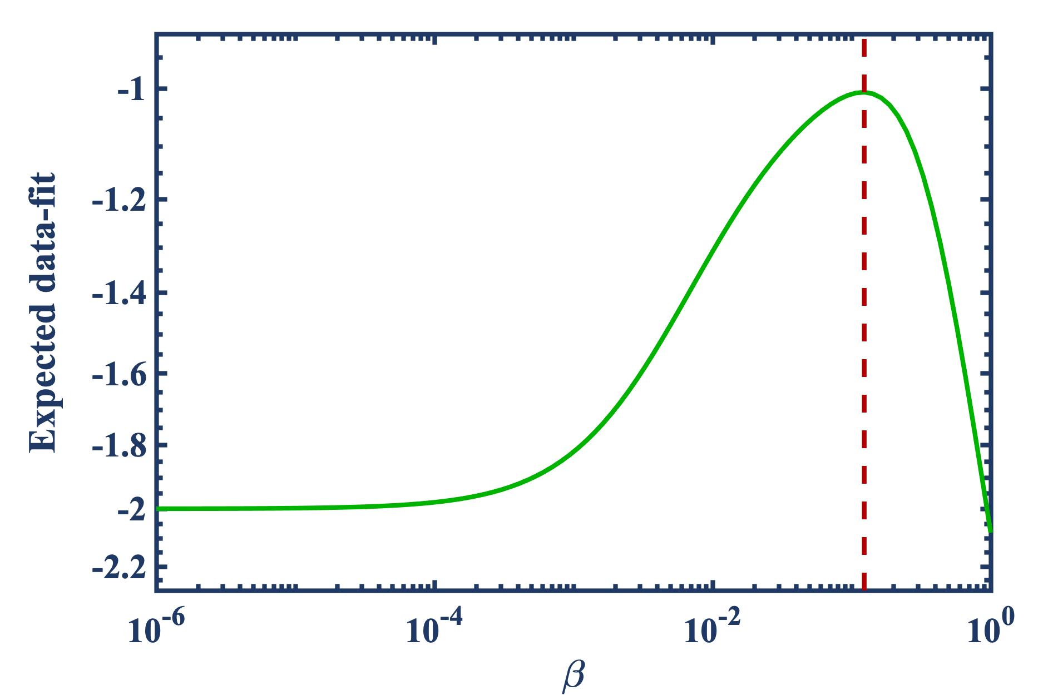
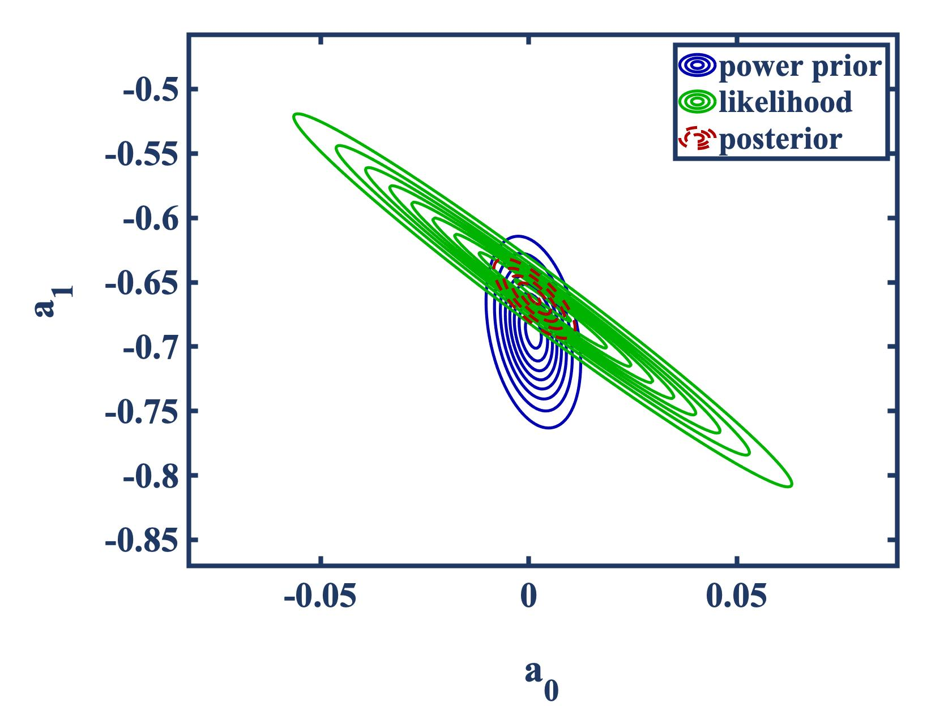
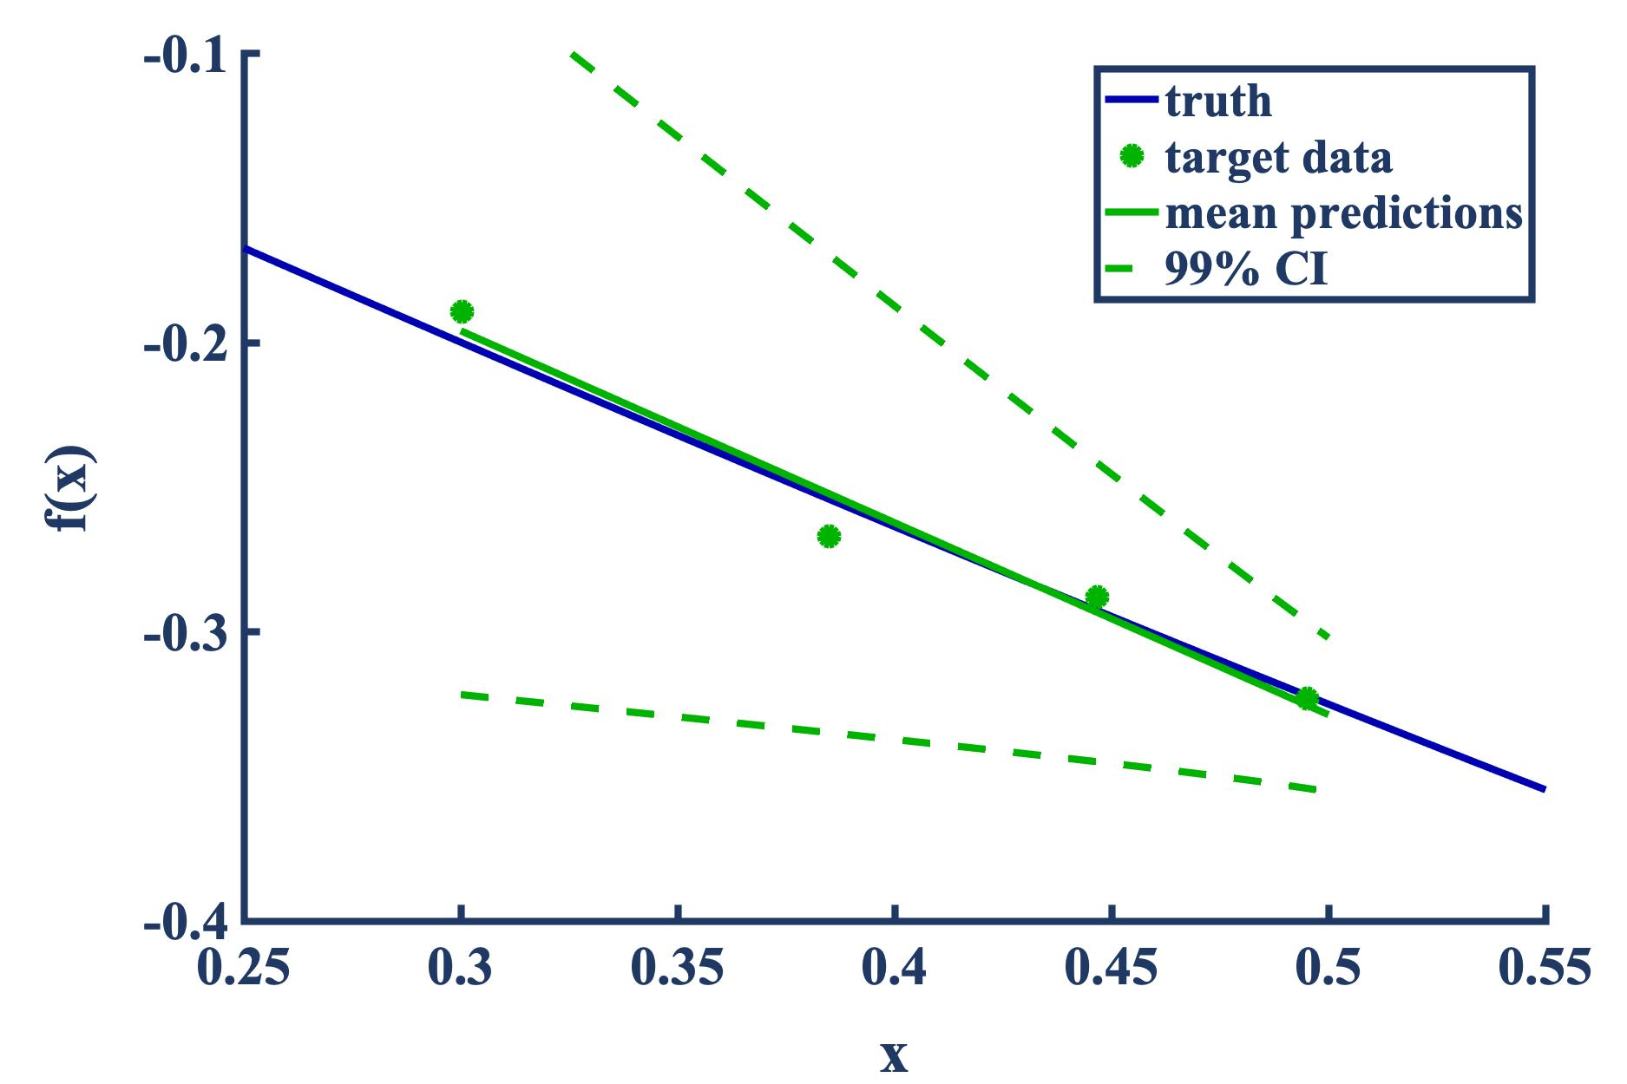
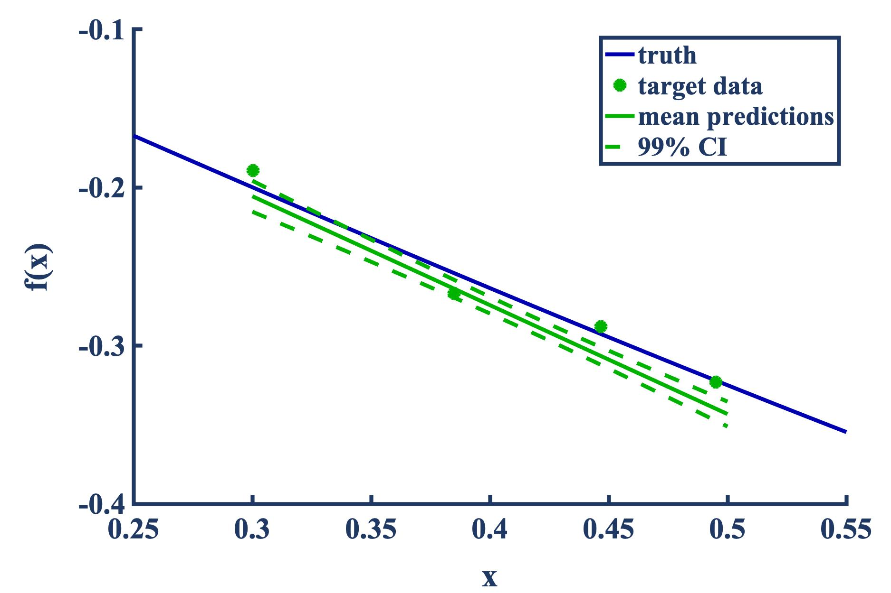
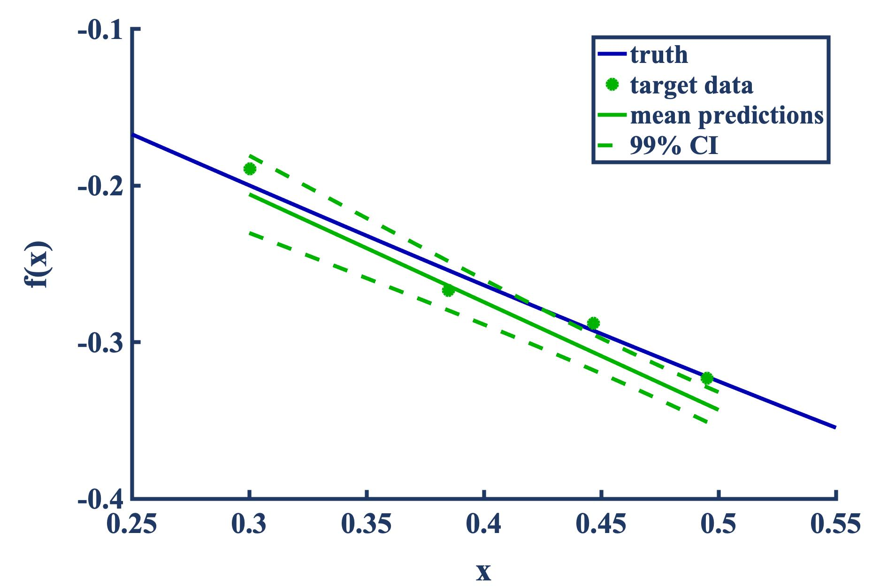

Probabilistic Transfer Learning at Work – Polynomial Surrogates
Let’s repeat the procedure with a target domain that’s adjacent to the source domain (extrapolation)
Again, we maximize the expected data-fit to arrive at an optimal power prior
The following are posterior predictive mean estimates and confidence intervals
Observation: Optimal transfer results in more accurate/precise predictions
no transfer
full transfer
optimal transfer, $β\text{opt}≈0.1$
Notes:
We repeat the process, but now with a slight shift in the target domain of interest to be non-overlapping with the source domain, but adjacent to it. You’d expect for the amount of transfer to be reduced a bit. That’s what we see when we examine the datafit in the top figure.
Nonetheless, the posterior predictive still exhibits greater precision than the case of no transfer. You also start to see the effect of negative transfer in the bottom middle figure, whereby full transfer results in biased estimates
So in this case we’re safeguarding against negative transfer through the utility of the expected data-fit.

Slide 16
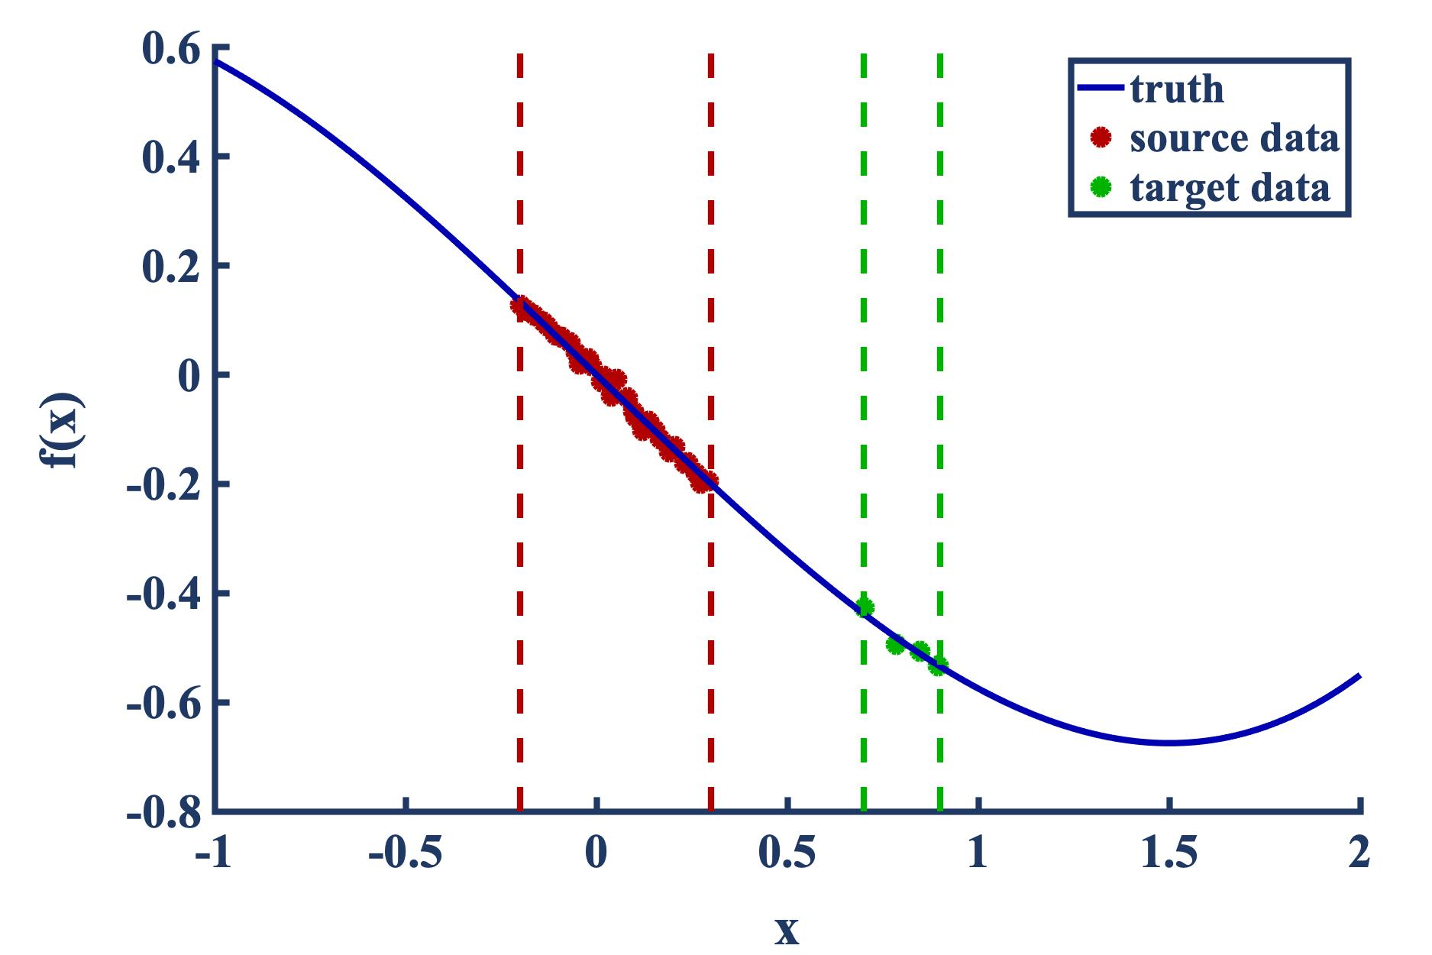
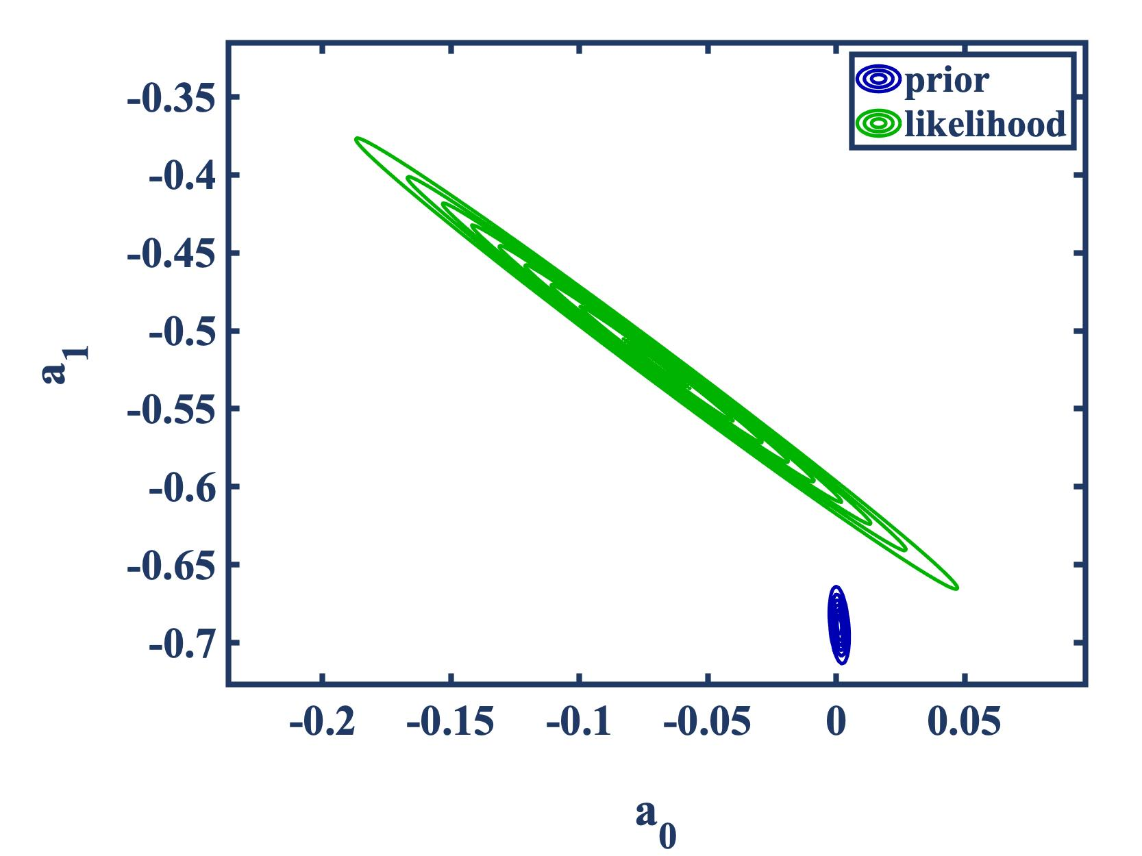
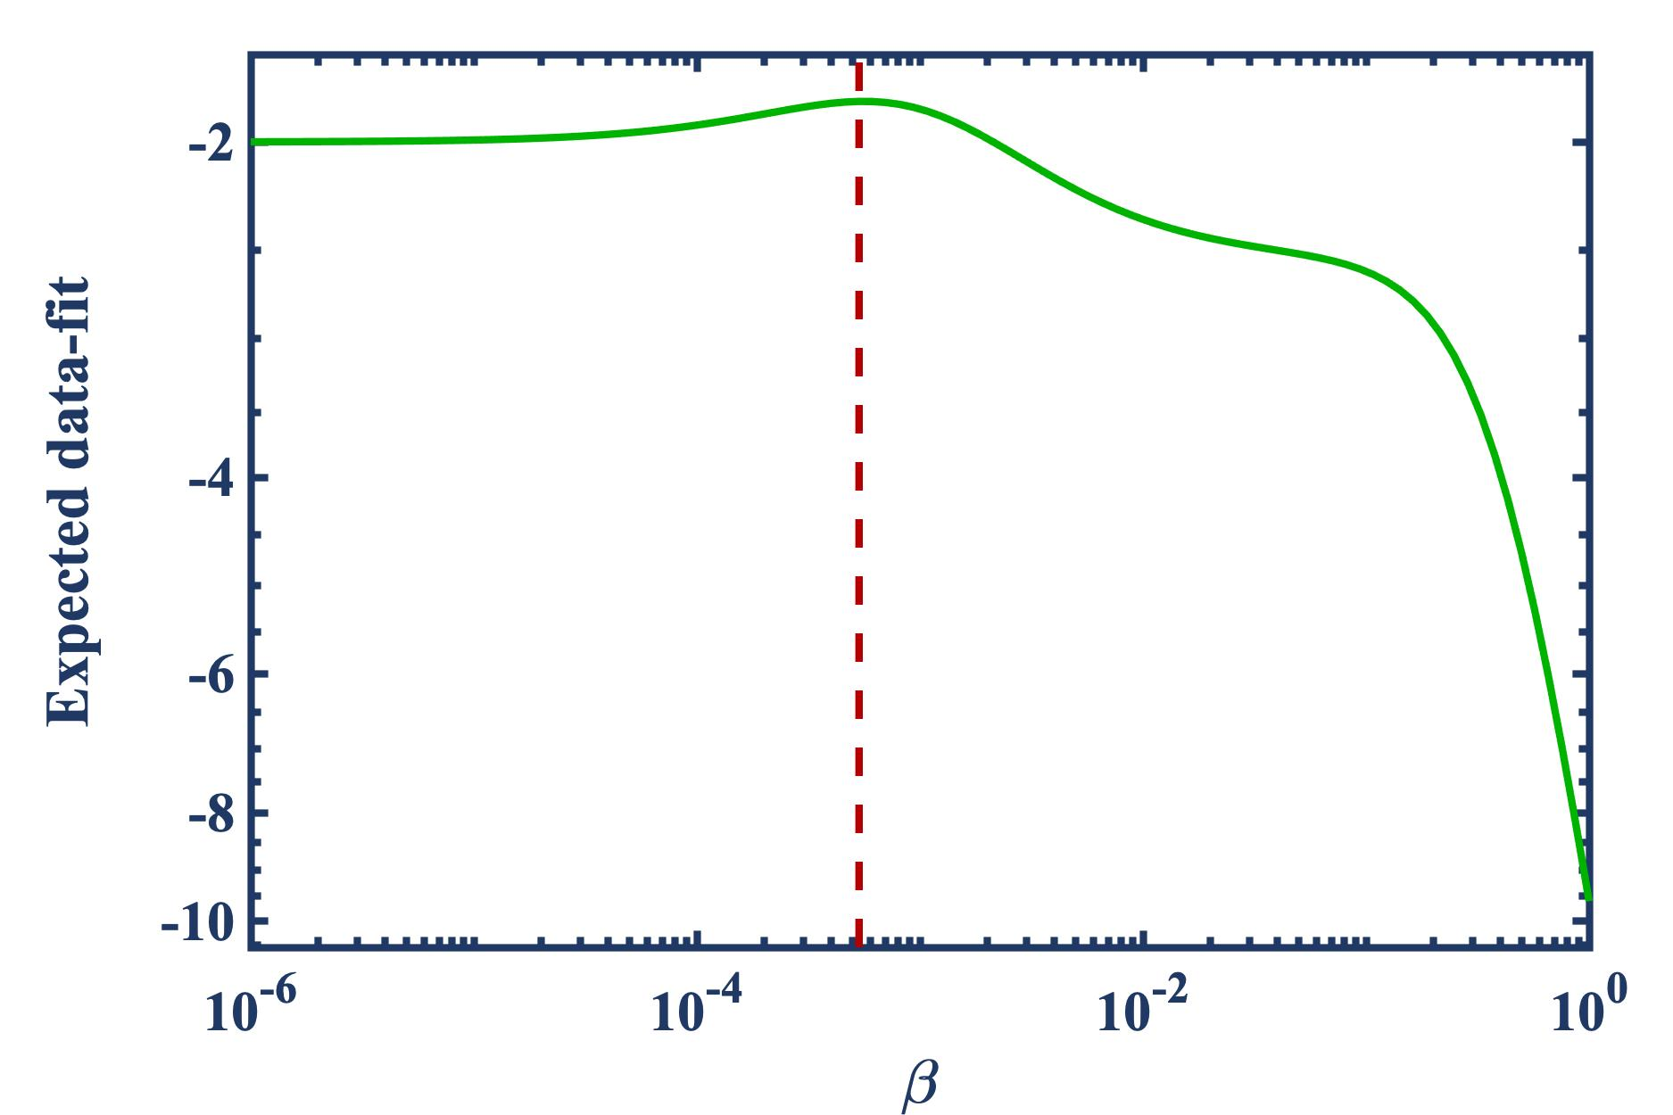
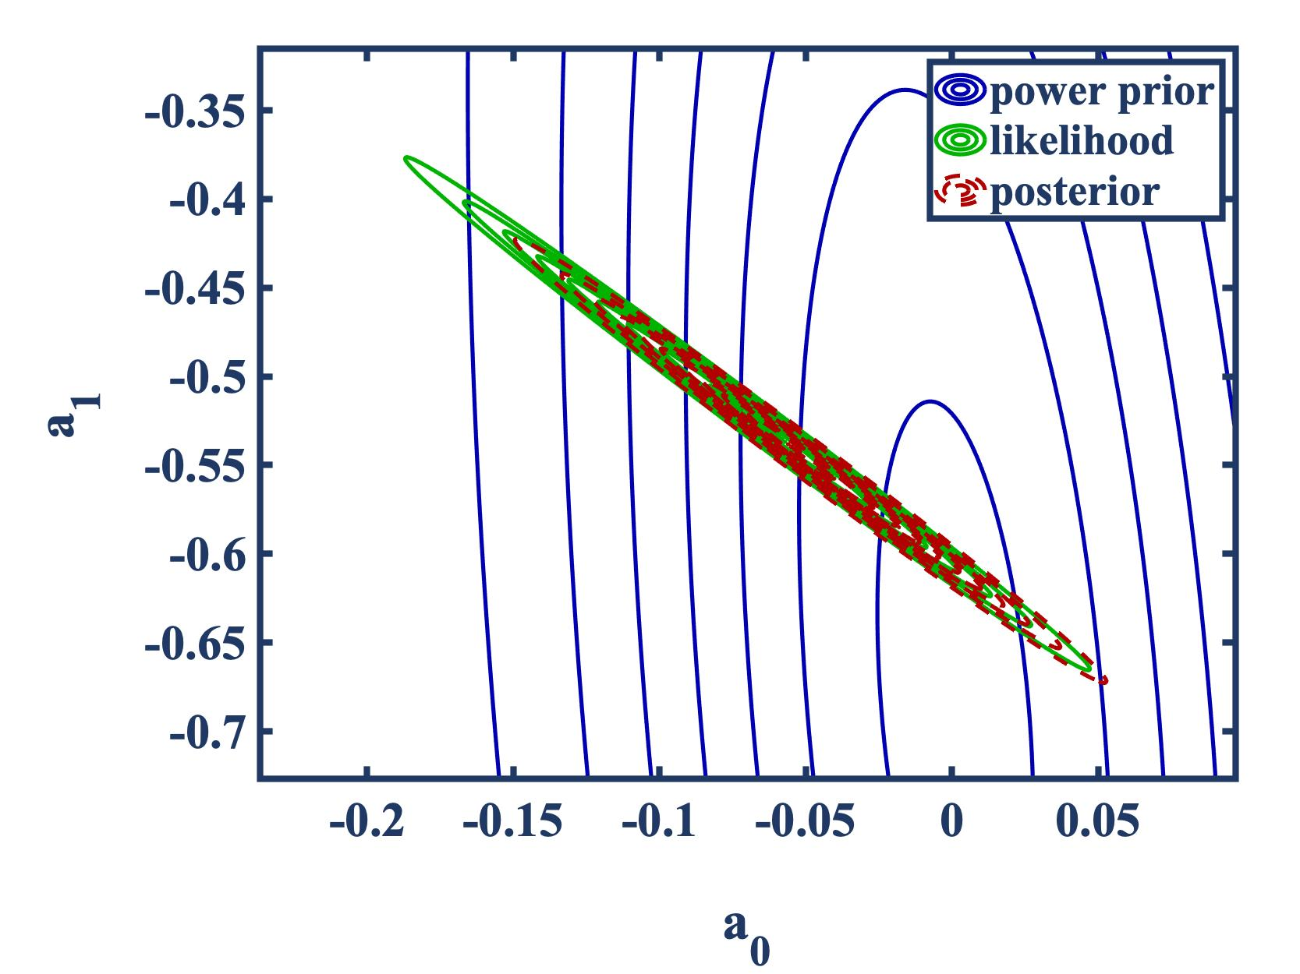
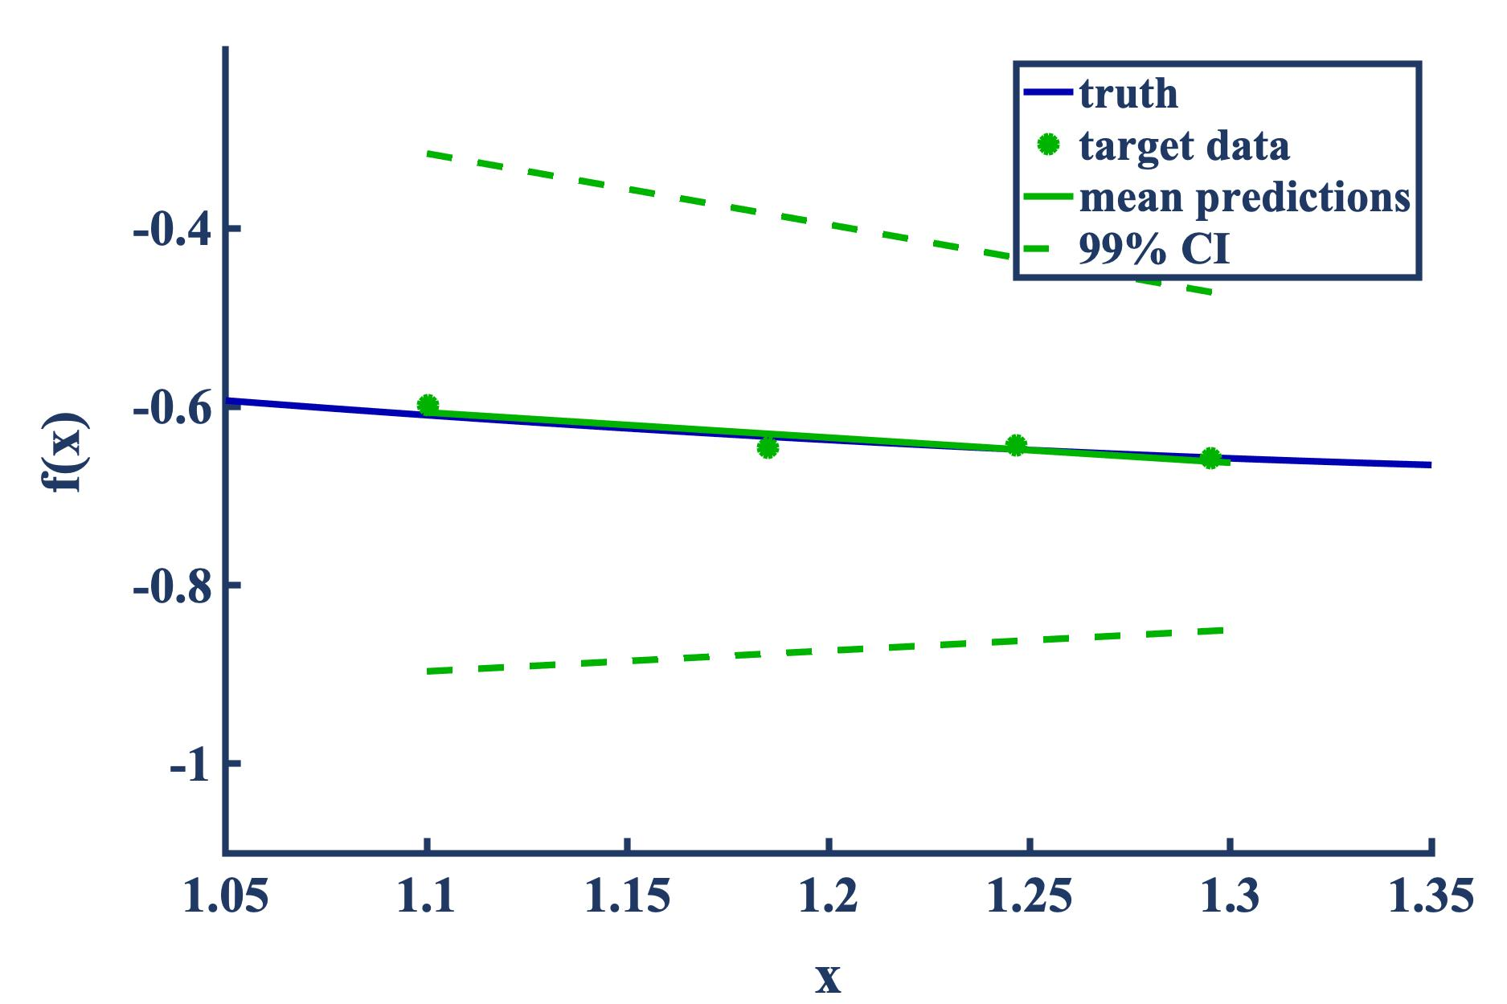
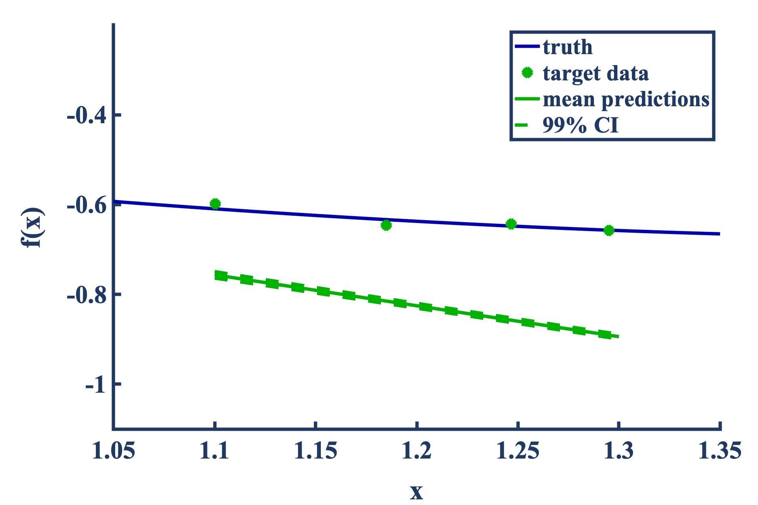
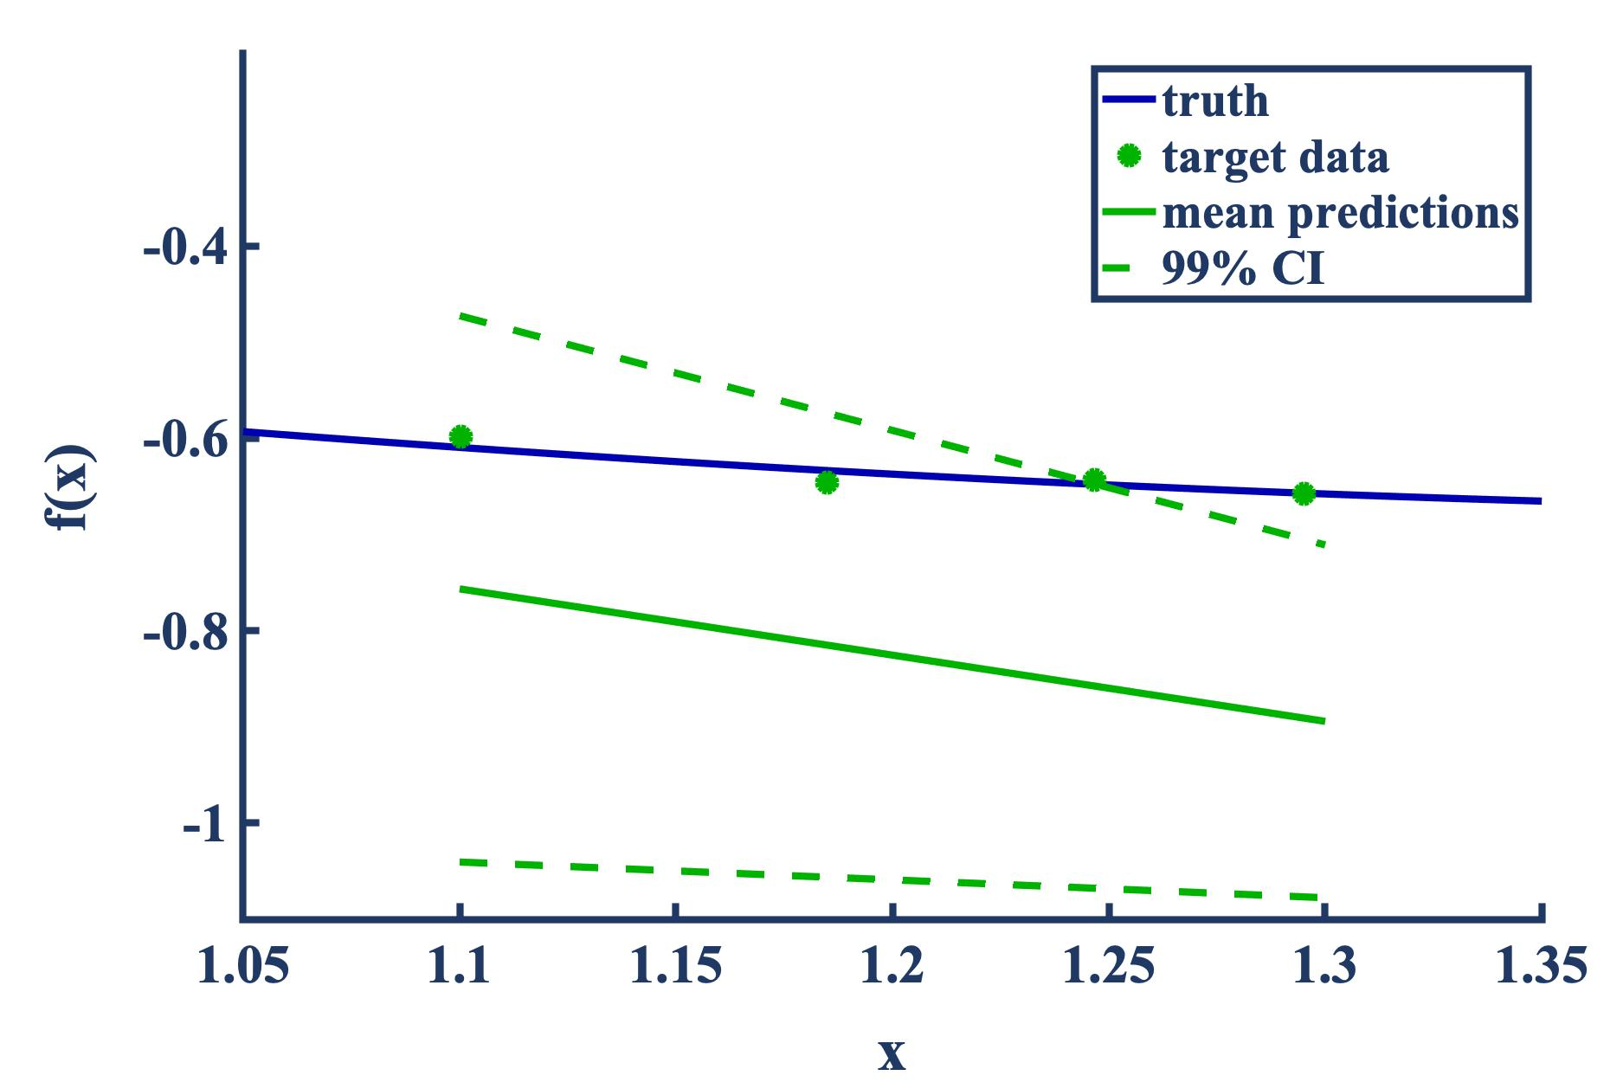

Probabilistic Transfer Learning at Work – Polynomial Surrogates DELETE
Lastly, we examine dissimilar target and source domains
Again, we maximize the expected data-fit to arrive at an optimal power prior
The following are posterior predictive mean estimates and confidence intervals
Observation: Negligible transfer takes place with dissimilar tasks
no transfer
full transfer
optimal transfer, $β\text{opt}≈0.0005$
Notes:
A last experiment is to further shift the target domain and in this setting, we see that we effectively end up with a case in which the optimal amount of learning to transfer is negligible, with a relatively small beta. You also see the detrimental effect of full transfer on the highly-biased posterior predictive, indicating negative transfer.

Slide 17
Summary
Goals for probabilistic transfer learning
  Model performance: improve model performance by leveraging data from similar domains
  UQ: propagating parametric, model-form, and data uncertainties towards predictions
  Model selection: allowing for optimal ML model selection within the TL paradigm
  Scalability: exhibiting moderate/strong computational scalability with increasing data volume and model complexity
  Optimal transfer: safeguarding against negative learning.
Key technical steps:
  Capture the knowledge to be transferred in training on source data
    Probability density functions on the calibrated ML model parameters/hyperparameters using Bayesian inversion
    Efficient, high-fidelity approximations of parameter PDFs using Gaussian Mixture Models
  Propagate the knowledge to be transferred to target training tasks
    Novel mechanisms for knowledge transfer that extends the traditional Bayesian approach via the application of prior PDF tempering transformations
  Determine how much knowledge to transfer given a choice of tempering transformation
    Explore hierarchical or empirical Bayes approaches, based on information-theoretic measures and distance metrics
Thank you!
Notes:
In summary we are interested in developing a novel probabilistic framework for transfer learning.
This aims to reduce the test errors of ML models by leveraging data from similar domains.
As we saw in a previous slide, transferring knowledge from such related domains can decrease the predictive uncertainty, and thereby increase the trust in model predictions.
We are proceeding with applying this framework to DoD-relevant applications involving turbulent combustion modeling as well as DoD-one in atmospheric acoustics.
That concludes my presentation, thank you to everyone for listening and I'd be happy to take any questions.

