Slide 1
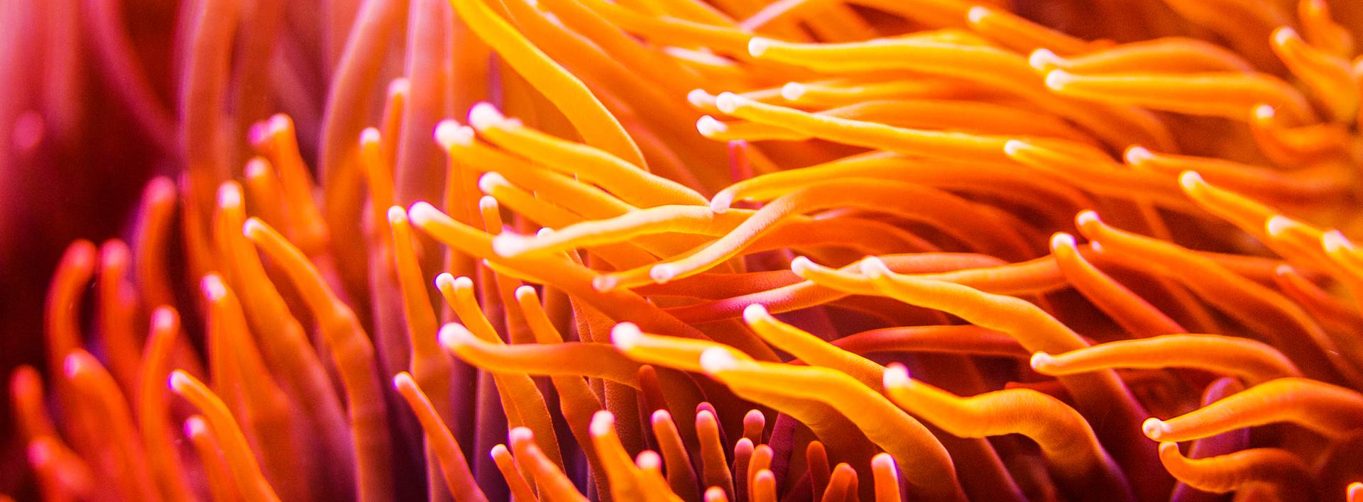
You Should Give a Tutorial
Sarah Ackerman
Sr. Software/Machine Learning Engineer
2024 Sandia MLDL Workshop
Sandia National Laboratories is a multimission laboratory managed and operated by National Technology & Engineering Solutions of Sandia, LLC, a wholly owned subsidiary of Honeywell International Inc., for the U.S. Department of Energy’s National Nuclear Security Administration under contract DE-NA0003525.
SAND2024-11279C

Slide 2
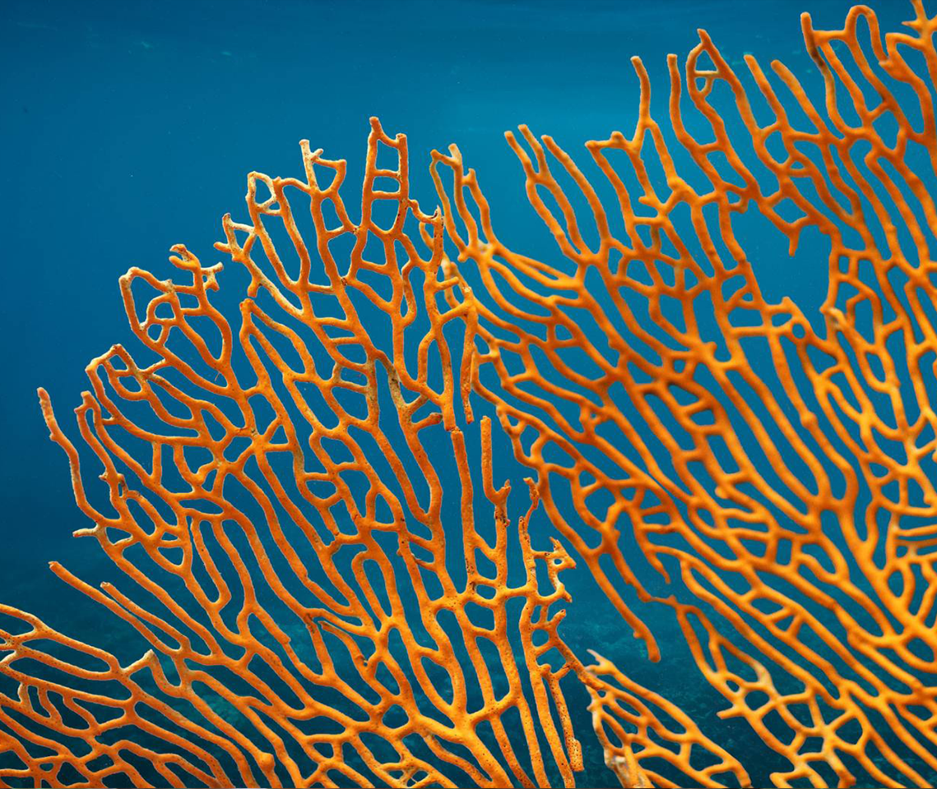
OUTLINE
1. You Know Everything
2. You Are Confident and Comfortable
3. They Will Pay You

Slide 3
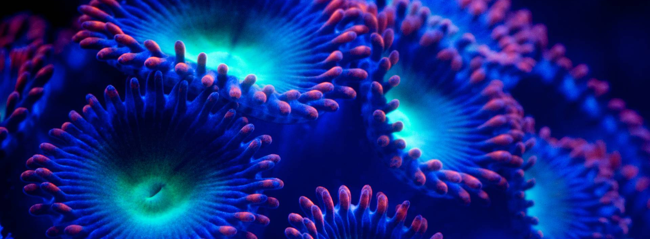
1. You Know Everything
. . . E V E R Y T H I N G . . .

Slide 4
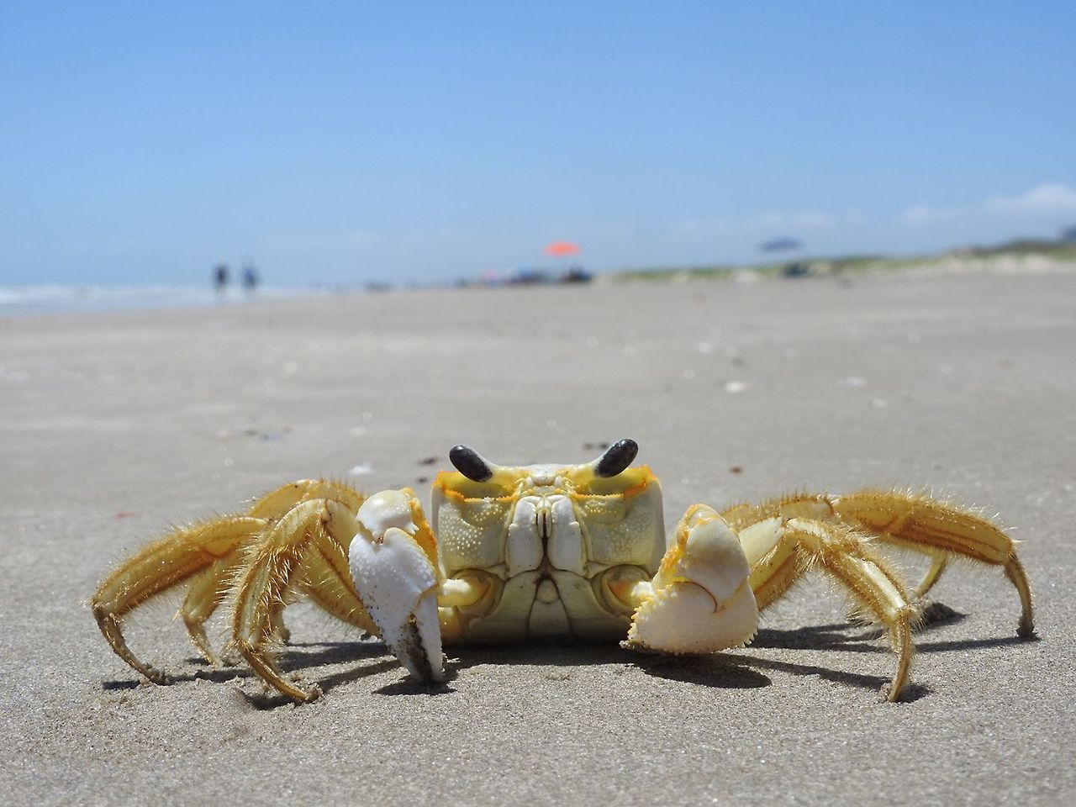
You Should Give a Tutorial If…
Pssssh… yeah right!
You know everything.
Judgmental crab by Ranger Okie Suarez | NPS

Slide 5
You Should Give a Tutorial If…
Oh reeealllyyyyy?
You know everything.
You know everything about something.
Judgmental crab by Ranger Okie Suarez | NPS

Slide 6
You Should Give a Tutorial If…
Well, I mean, sure…
You know everything.
You know everything about something.
You know something about something.
Judgmental crab by Ranger Okie Suarez | NPS

Slide 7
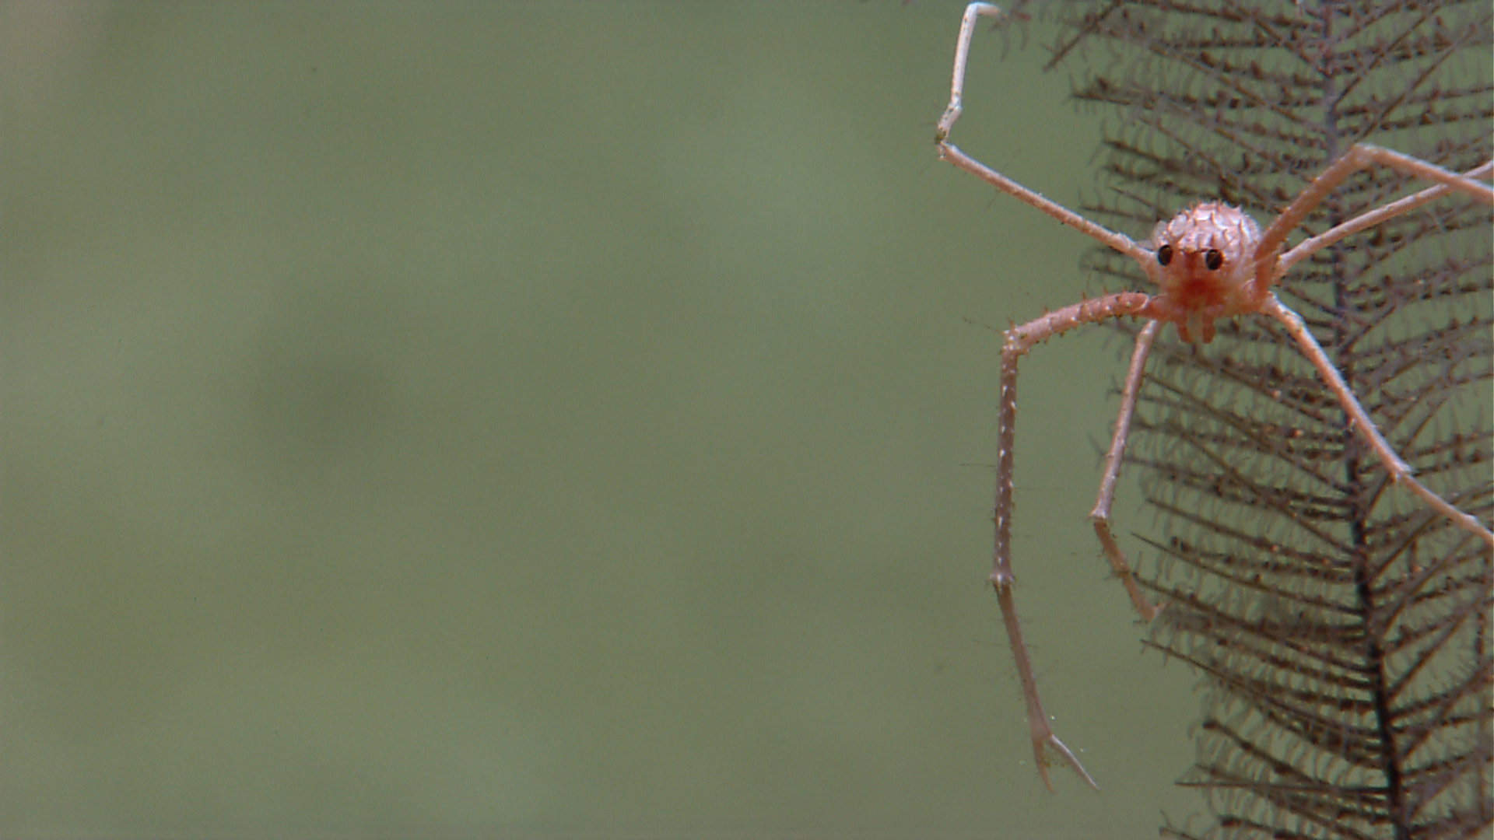
You Should Give a Tutorial If…
I’m listening…
You know everything.
You know everything about something.
You know something about something.
You want to know more about something.
NOAA Office of Ocean Exploration and Research, Exploration of the Gulf of Mexico 2014

Slide 8
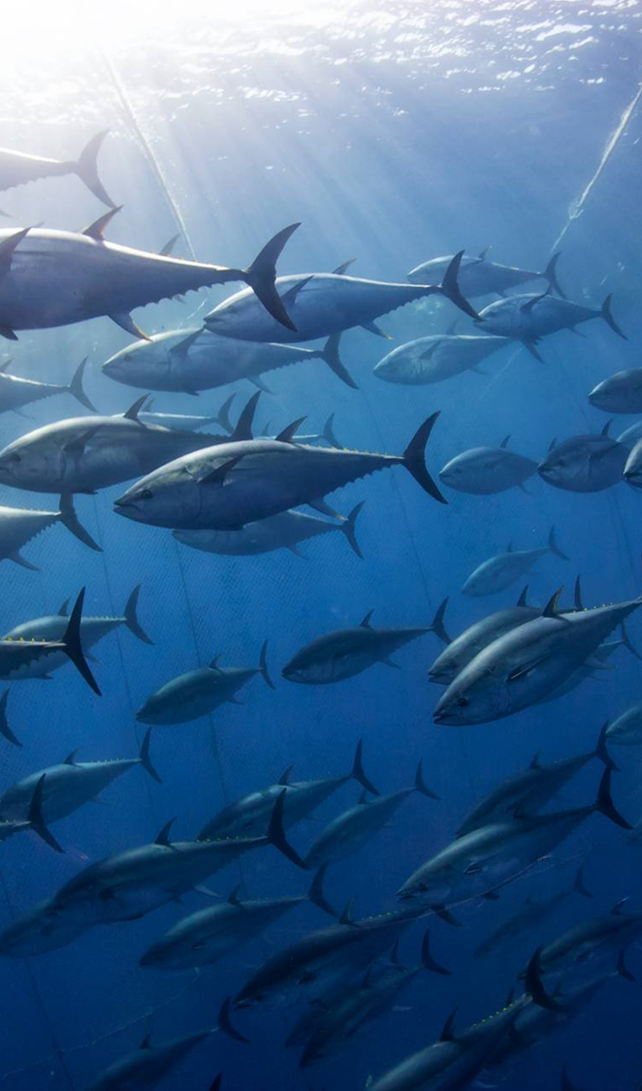
Growth Mindset
Making slides will help you:
  organize your thoughts
  find gaps in your knowledge
  speak about your topic

Slide 9
Growth Mindset
Your audience will be happy to tell you when you get something wrong.
  …or when they think you do
Be willing to admit your mistakes and revise your work:
  Folks will trust you more
  You could learn something

Slide 10
2. You are confident and comfortable
… and you have never ever mispronounced a word, ever.

Slide 11
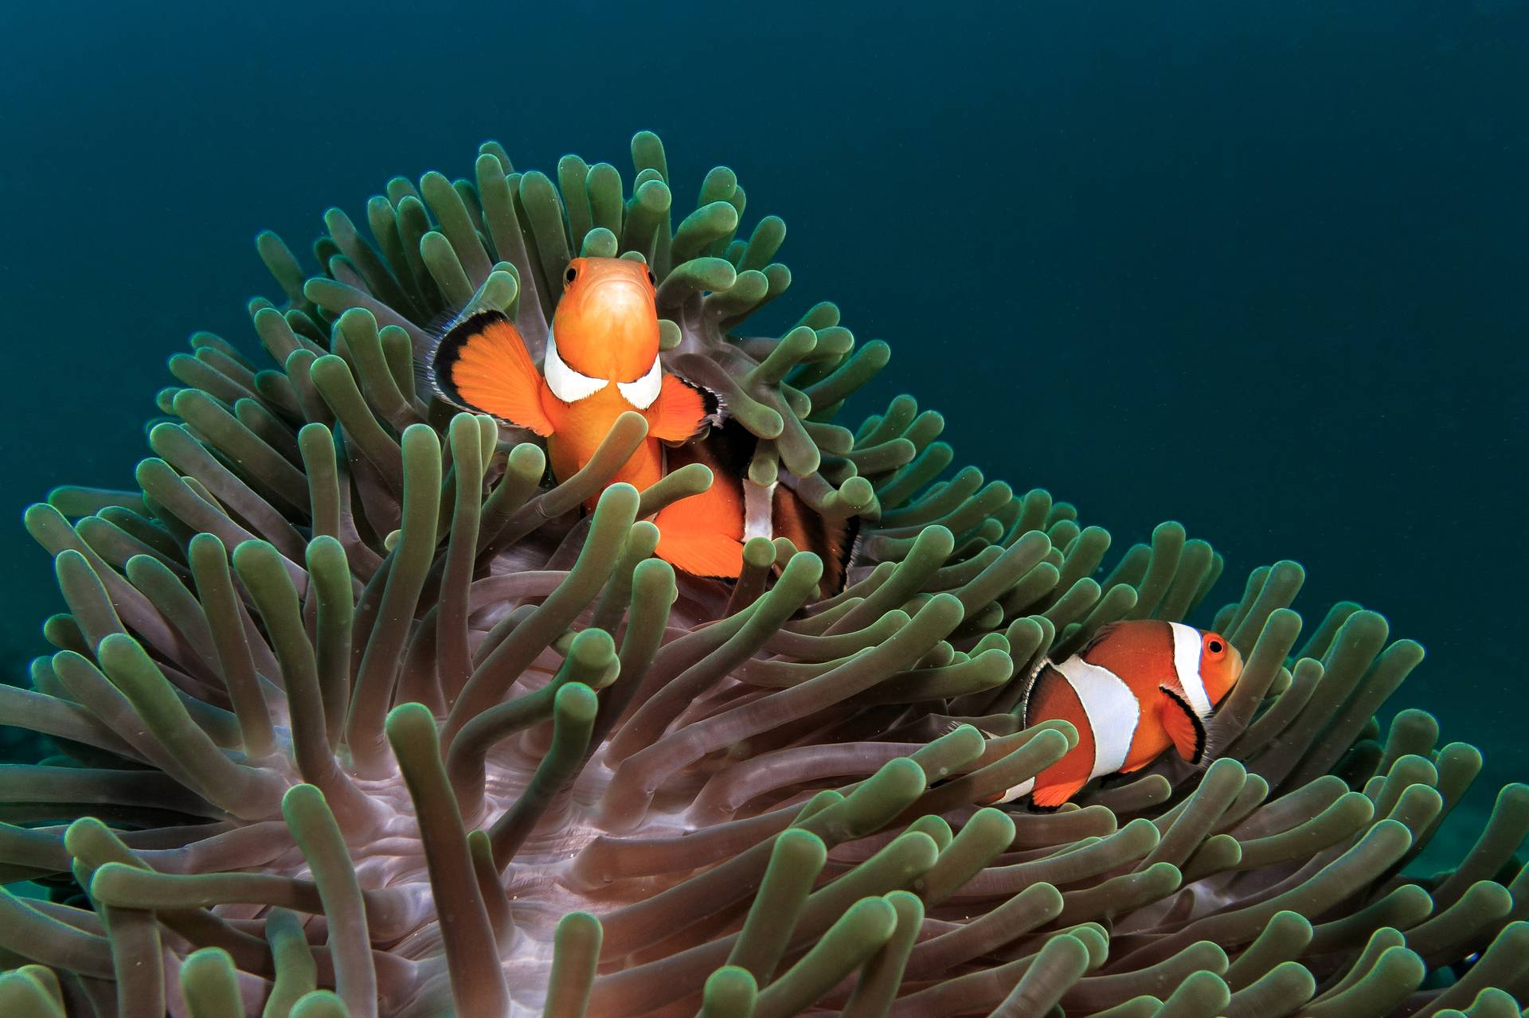
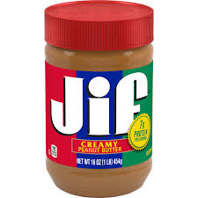
Hi, my name is—
Words I have mispronounced
what?
in Computer Science:
  /etc
  Erdos
  gif
from the sea:
  boatswain
  anemone
until writing this presentation:
  potable
  respite

Slide 12
Hi, my name is—
Words I have mispronounced
what?
in Computer Science:
  /etc
  Erdos
  gif
from the sea:
  boatswain
  anemone
until writing this presentation:
  potable
  respite

Slide 13
My name is—
You will get things wrong
who?
"Heavier-than-air flying machines are impossible." - Lord Kelvin, 1895.
"There is practically no chance communications space satellites will be used to provide better telephone, telegraph, television, or radio service inside the United States." - T. Craven, FCC Commissioner, 1961.

Slide 14
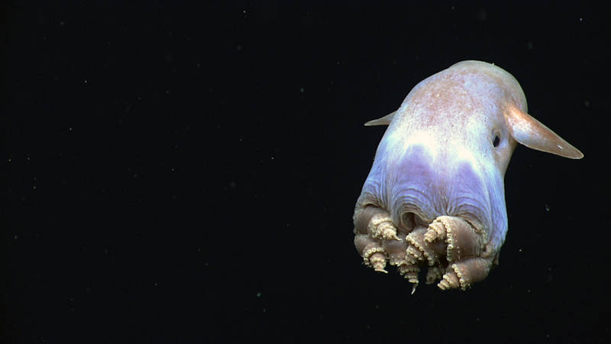

Slide 15
Stay humble
Clifford Stoll, Newsweek 1995:
Internet will die after ‘96
Digital news will die
Interactive libraries will die
Clifford Stoll, Newsweek 2010:
  “Now, whenever I think I
  know what’s happening, I
  temper my thoughts:
  Might be wrong, Cliff…”
NOAA Office of Ocean Exploration and Research, Exploration of the Gulf of Mexico 2014
https://thehustle.co/clifford-stoll-why-the-internet-will-fail

Slide 16
I am uncomfortable:
introducing myself
making mistakes
pronouncing something wrong
expressing a minority opinion
holding the door open for someone who is too far away
when someone else is holding the door open for me when I am too far away
NOAA Office of Ocean Exploration and Research, Exploration of the Gulf of Mexico 2014

Slide 17
WE ARE
^
I am uncomfortable:
introducing ourselves
making mistakes
pronouncing something wrong
expressing a minority opinion
holding the door open for someone who is too far away
when someone else is holding the door open for us when we are too far away
NOAA Office of Ocean Exploration and Research, Exploration of the Gulf of Mexico 2014

Slide 18

People like you more than you think
“Our studies suggest that after people have conversations, they are liked more than they know.”
Boothby, et al. “The Liking Gap in Conversations: Do People Like Us More Thank We Think?” Psychological Science, 2018.
NOAA Office of Ocean Exploration and Research, Exploration of the Gulf of Mexico 2014

Slide 19
3. They will pay you
Are “they” in the room with us right now?

Slide 20
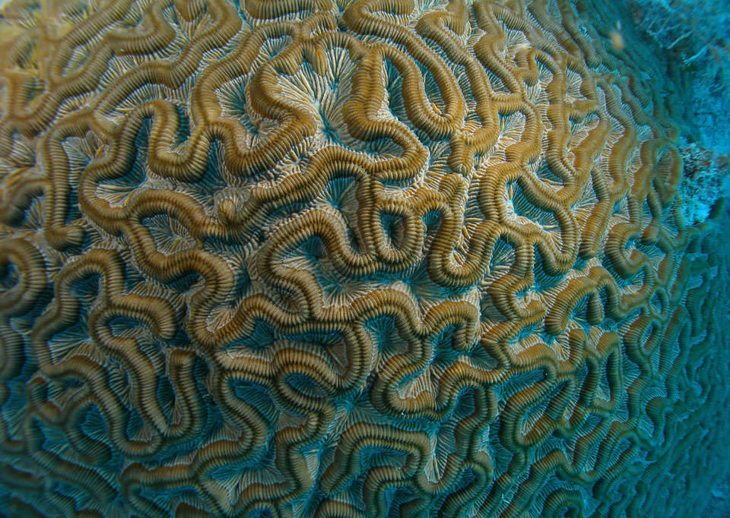
People will find you
Your name will be “out there”, and associated with your topic.
People will reach out to you with questions, suggestions, and ideas.
You will have a slide deck you can update and reuse.
Brain coral, NOAA

Slide 21
Ideas can lead to collaboration
$
$
I’ve forwarded about a dozen inquiries and ideas to others who were a better fit than me.
I’ve had several suggestions develop into funded projects:
  Tadpole (GenAI session)
  3 other projects
$
$
$
$
Brain coral, NOAA

Slide 22
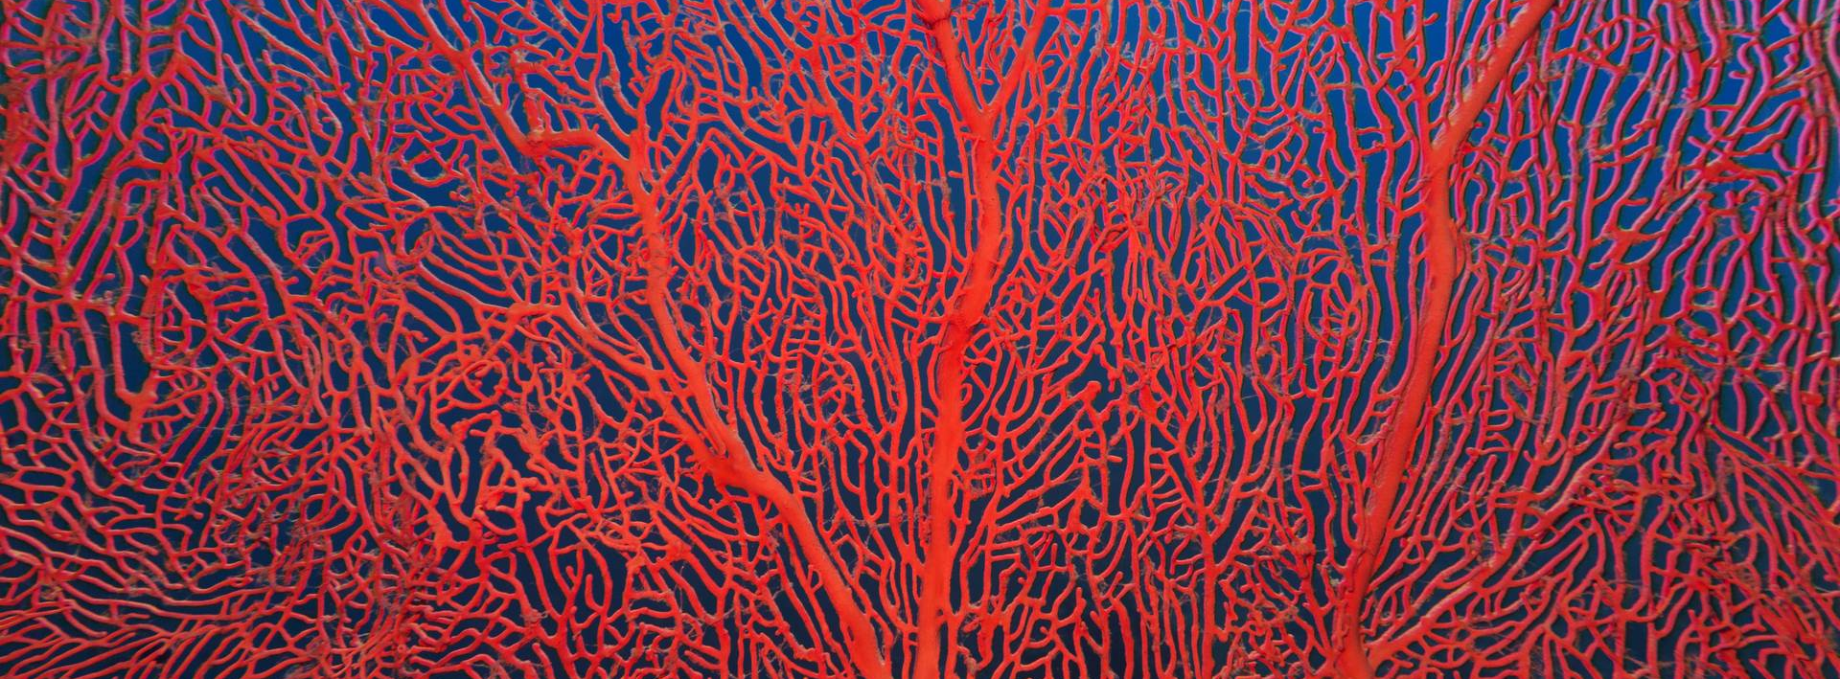
Conclusion

Slide 23
Yes, You should give a tutorial
Learn more about something
We like you, imperfections and all
Turn ideas into projects
$

Slide 24
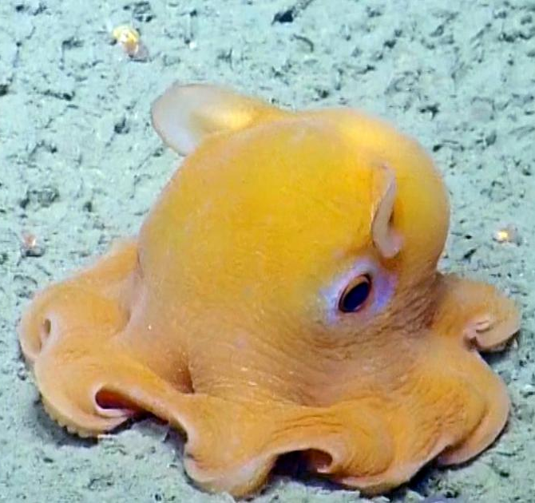
Go forth, & give tutorials
Nautilus Live, Ocean Exploration Trust, Inc.
THANK YOU
Sarah Ackerman
sackerm@sandia.gov

Slide 25
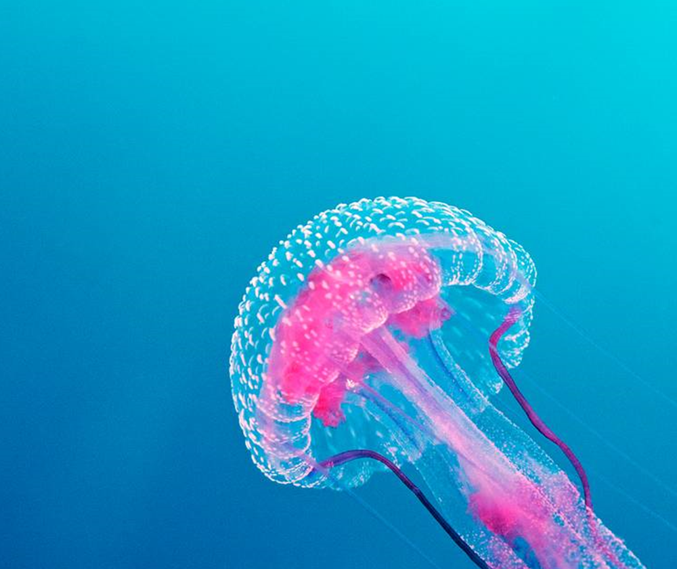
/etc
Sandia National Laboratories is a multi-mission laboratory managed and operated by National Technology & Engineering Solutions of Sandia, LLC (NTESS), a wholly owned subsidiary of Honeywell International Inc., for the U.S. Department of Energy’s National Nuclear Security Administration (DOE/NNSA) under contract DE-NA0003525. This written work is authored by an employee of NTESS. The employee, not NTESS, owns the right, title and interest in and to the written work and is responsible for its contents. Any subjective views or opinions that might be expressed in the written work do not necessarily represent the views of the U.S. Government. The publisher acknowledges that the U.S. Government retains a non-exclusive, paid-up, irrevocable, world-wide license to publish or reproduce the published form of this written work or allow others to do so, for U.S. Government purposes. The DOE will provide public access to results of federally sponsored research in accordance with the DOE Public Access Plan.

