Slide 1
Automated Algorithms for Screening Electronic Parts for Aging using Power Spectra Analysis (PSA) Data
Rosalie Multari, Ph.D., Stephanie DeJong, Abigail Carnali, Joel Christiansen, and Kelsey Carilli
Honorary co-author: The Late Paiboon Tangyunyong
September 2024
SAND2024-09493C

Slide 2

To be covered
Analysis objective
Power Spectral Analysis (PSA)
Multivariate analysis as a tool for building screening algorithms
Data used in the analysis
Algorithm results
  High Humidity Zener Diode PSA Algorithms
  MOSFET PSA Algorithms
  Zener Diode Conventional IV Algorithms
Conclusions & Next Steps

Slide 3
Analysis objective
Understanding the use age of semiconductor parts is of interest to manufacturers using semiconductor parts and to semi-conductor part manufacturers for quality control.
Power spectrum analysis (PSA) is a fast, non-destructive, sensitive method for examining semiconductor parts.
The objective of this analysis is to investigate the use of multivariate analysis on PSA data and conventional IV data collected to create algorithms that can be automated to screen semiconductor parts for aging.
The automated algorithms could then be used in manufacturing facilities to
  screen incoming parts for use aging in manufacturing facilities using semiconductor parts
  evaluate and predict the performance of semiconductor parts through reliability stressing in semiconductor manufacturing facilities for the purpose of quality control

Slide 4
Power Spectral Analysis (PSA)
PSA uses a unique off-normal biasing scheme to detect differences between electronic devices.
  the testing board is pulsed with a periodic-waveform voltage
  this waveform is modified when a test device is connected due to dynamic loading of the device
  this time-domain signal is then transformed via Fourier transform to a frequency signal that is characteristic of the device
  PSA is a comparative technique, so this frequency is normalized to a reference spectrum prior to analysis.
    accounts for changes in the signal related to changes in instrument set-up or other changes in measurement environment over time
PSA non-intrusive and fast
  typically taking only ~10 seconds to collect data on any given device.
Sample/Reference
Spectrum
Analyzer
Normalize Spectrum
AMPLITUDE RATIO
FREQUENCY
PSA Spectrum
FREQUENCY
No Device in the test fixture
Connected to a device
4
Notes:
PSA measures the dynamic frequency-domain responses of a microelectronics device when subjected to dynamic stimuli.

Slide 5
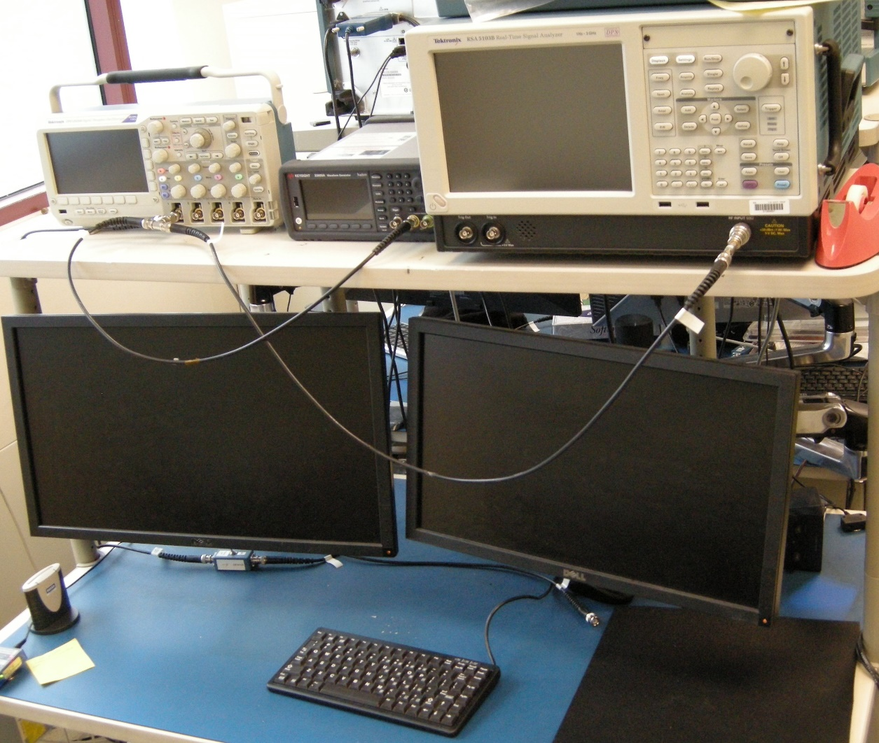
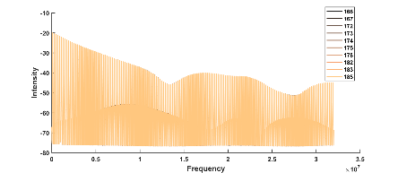
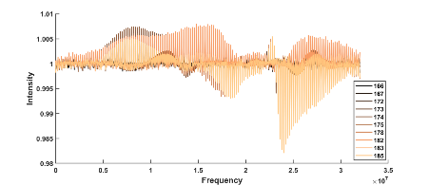
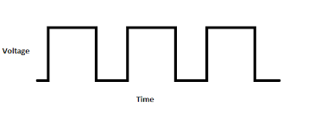
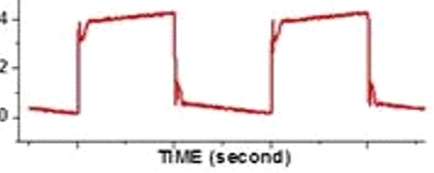
PSA Data Collection
Oscilloscope
Signal Generator
Spectrum Analyzer
9 weeks
PC with Collection Software
Power Spectrum
Normalized Power Spectrum
Spectrum
Analyzer
Signal
Generator
DUT
Square wave input

Slide 6
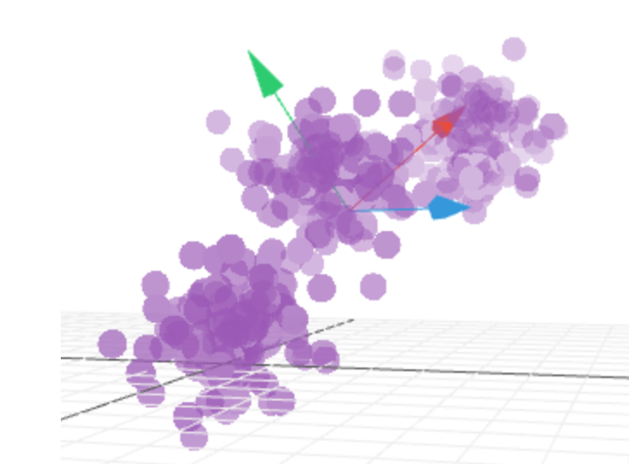
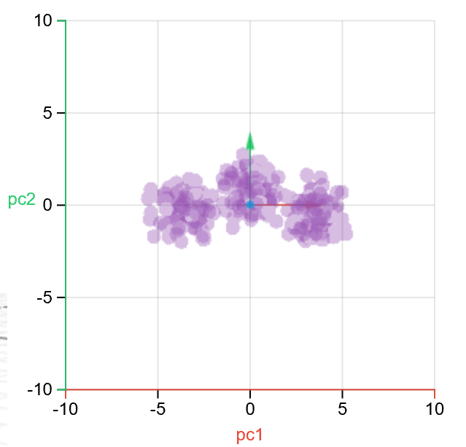
Multivariate Analysis
Modeling method that assumes a relationship exists between a set of measured variables (observations) and the properties of interest
  Observation = Structure + Noise
    Variables X (set of observations)
    Response Y = F(X) (set of possible responses)
Modeling extracts the structure in the data that correlates to the observed responses.
Successive transformations are used for the analysis in which the data is projected onto axes or “Principal Components” (PC’s) representing the direction of maximum variation of the data.
  PC’s are centered on the mean of the data, aligned to the direction of the maximum variation of the data, and orthogonal to each other
With each successive transformation to a new PC, more of the variance in the data is explained and a smaller portion of the variance remains unexplained.
Original Data
“Score” Space
Projection of original data onto PC1 & PC2

Slide 7
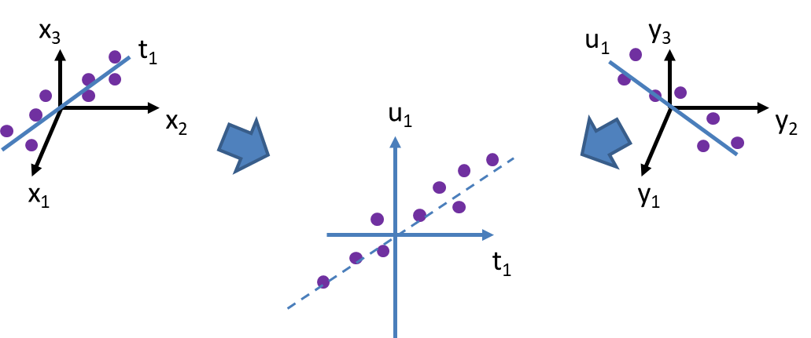
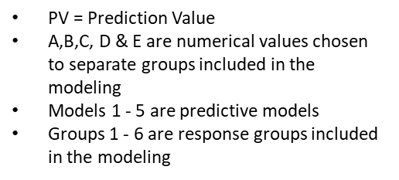
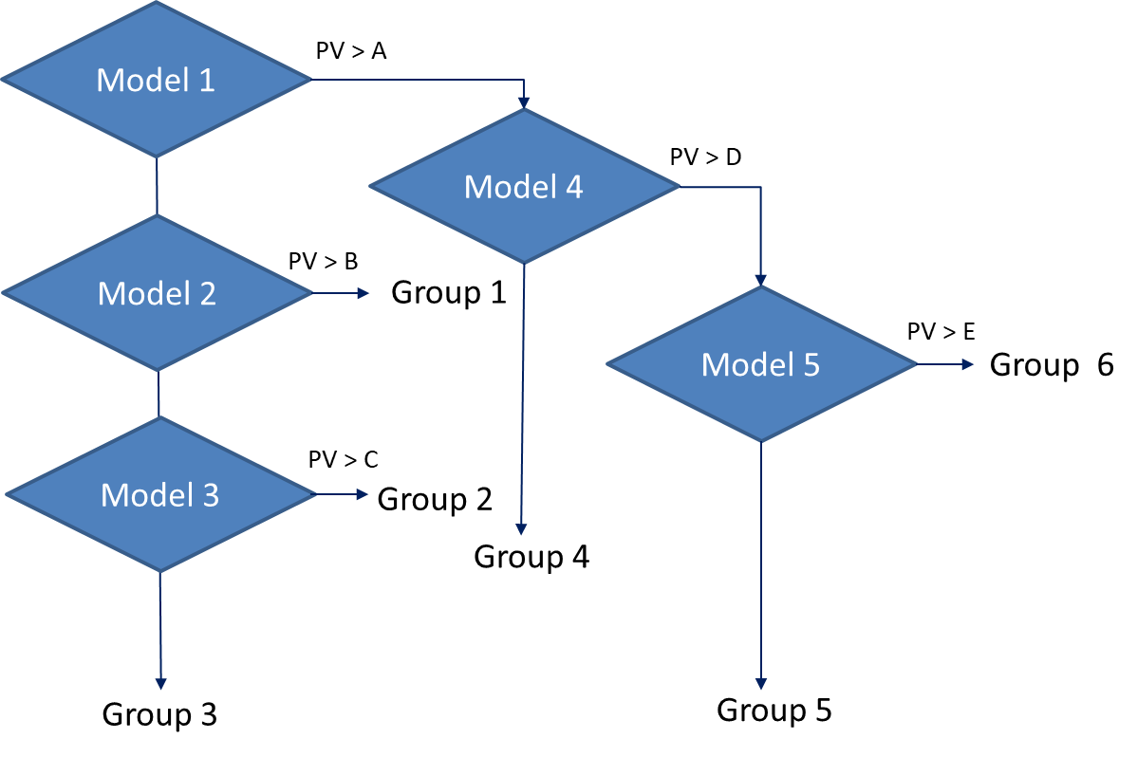
Partial Least Square Regression (PLSR)
Data is arranged in a 1Xn matrix for modeling.
PC’s are calculated by modeling both the X and Y matrices (variables and responses) simultaneously using known data.
  Uses PCA on the variables (X^{T}Y)
  Uses PCA on the responses (Y)
  Creates a transformation designed to maximize the covariance between X & Y
Each interactively calculated PC has a characteristic linear equation for the relationship of the response to the variables:
Y = b0 + b1x1 + b2x2 + b3x3 +….
  The loadings indicate the contribution of each variable to the PC calculation
Using an optimal number of PC’s, a “Prediction Value” (PV) is calculated by the PLS prediction model that indicates how well matched new input data is to one of the response groups in the modeling.
Multiple models can be combined to create a programmed flow to differentiate new data based on PV’s for input data.
Y data structure influences the decomposition of the structure in the data

Slide 8
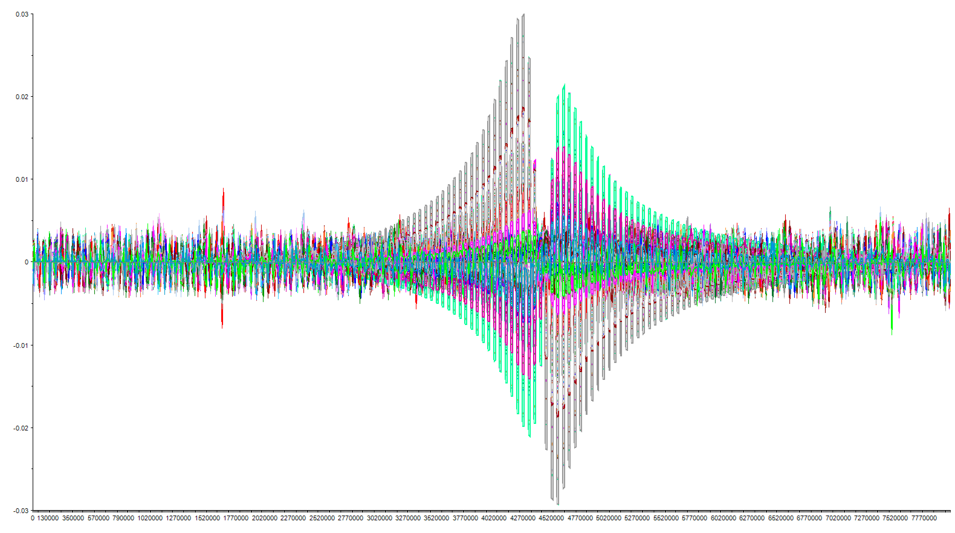
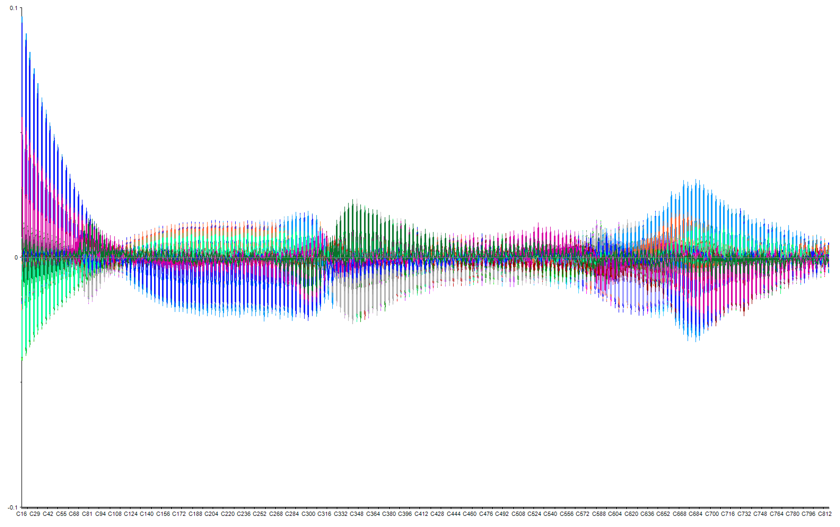
Analysis “Fingerprints”
Multivariate analysis can be done on any data set provided.
  1 X n data structure can be created to represent each unit/test being evaluated
  Columns in the vector must be the same for all measurements in the data set
    All columns must have the same information
    No missing data
Zener Diodes
MOSFET

Slide 9
Data used in the PSA analyses
Zener Diode
    3 different bias voltages: 0.8 V, 1 V, & 3V
    4 Stress cycles: 110 ºC, 85% Relative Humidity
    Controls: No aging stresses applied
MOSFETS
  2 different vendors
  2 different bias voltages
  6 stress conditions: none, conditioned, 24 hrs., 48 hrs., & 96 hrs.
  Controls: No aging stresses applied
Data was centered by mean of controls and divided into a modeling and test set prior to analysis.

Slide 10
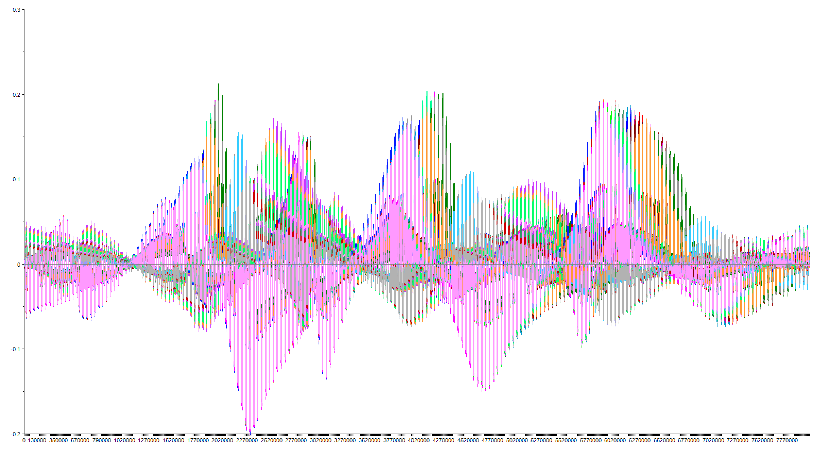
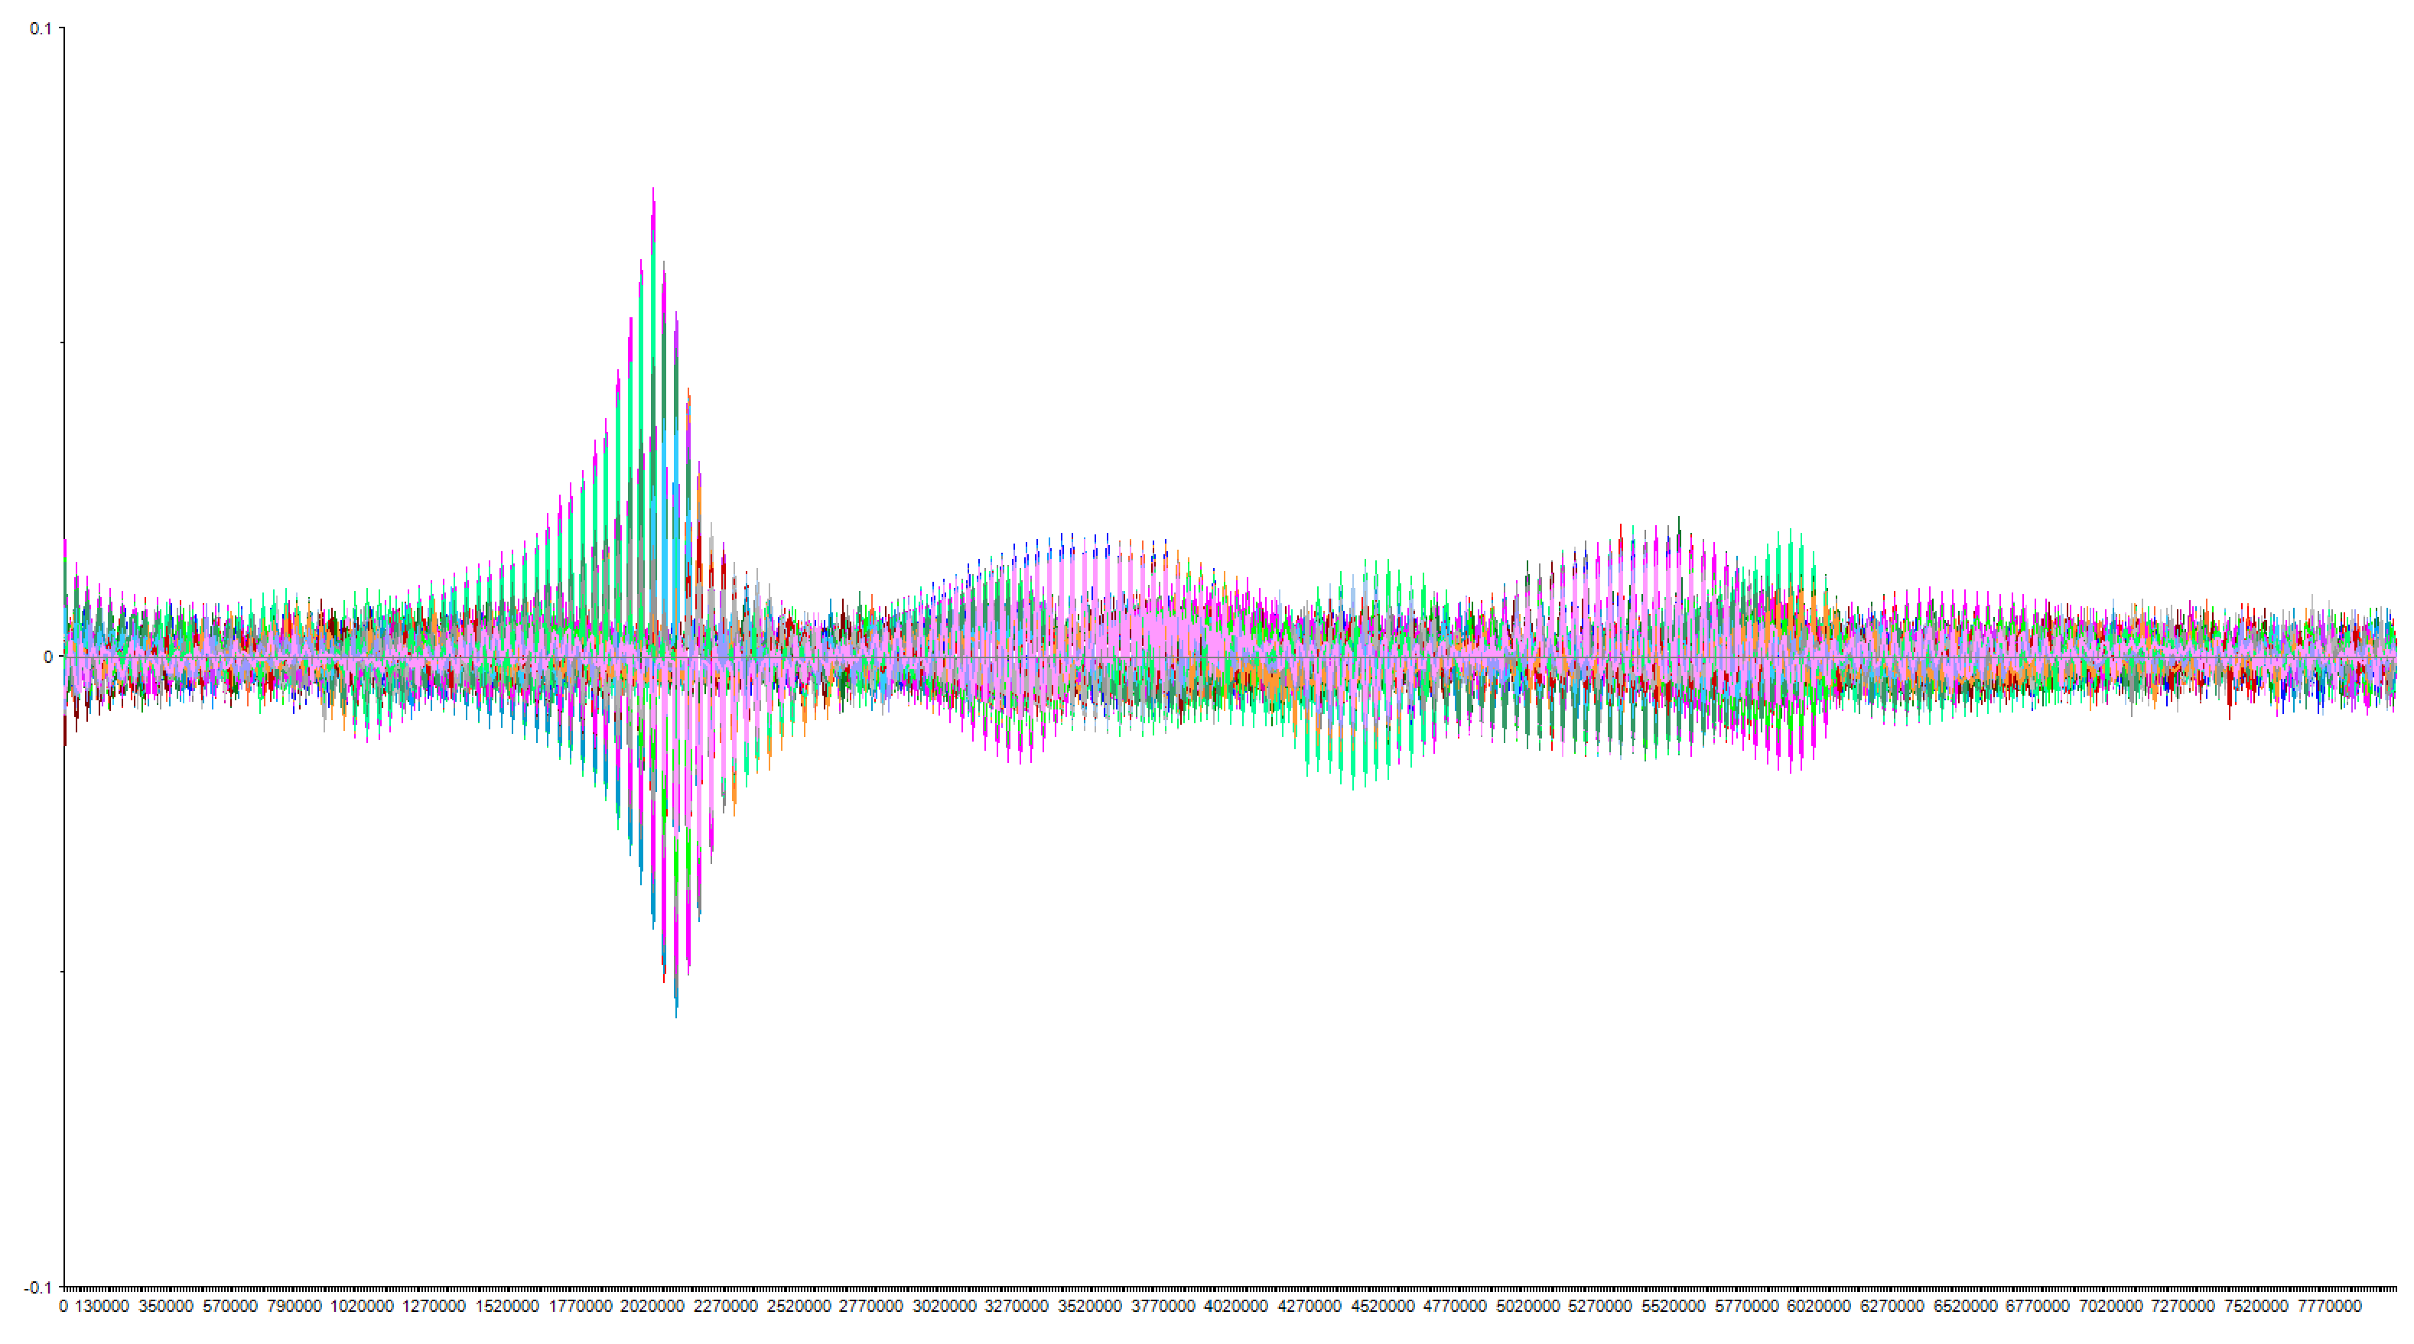
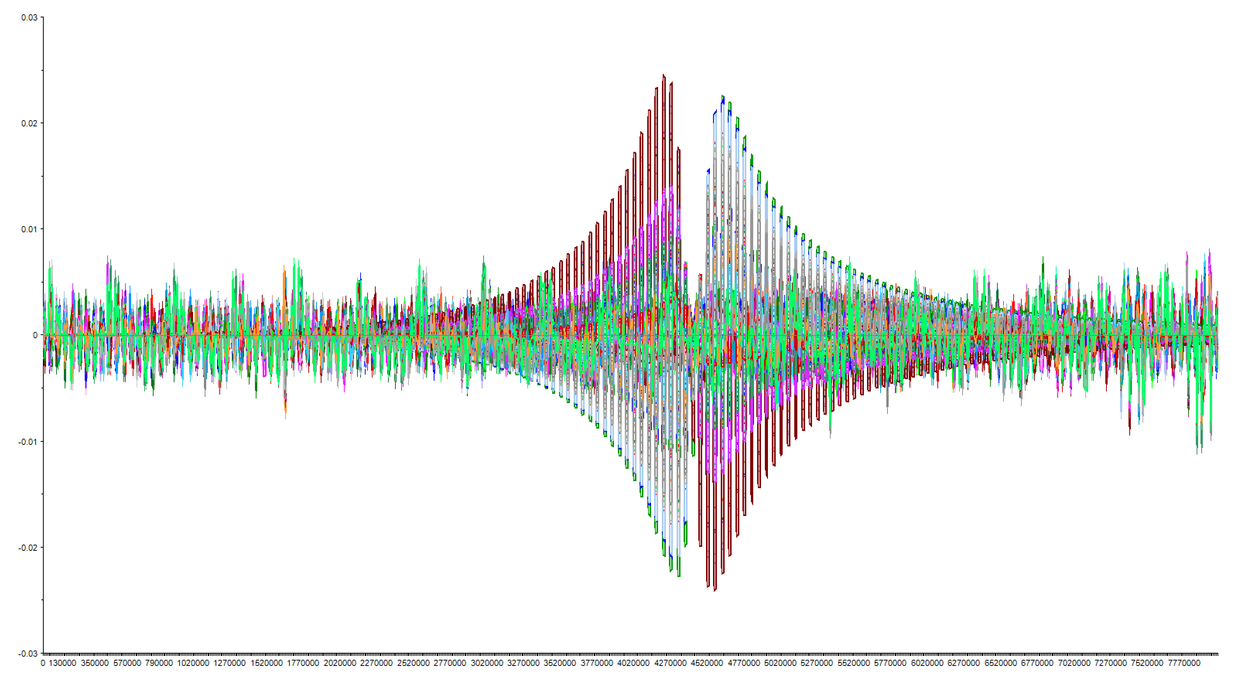
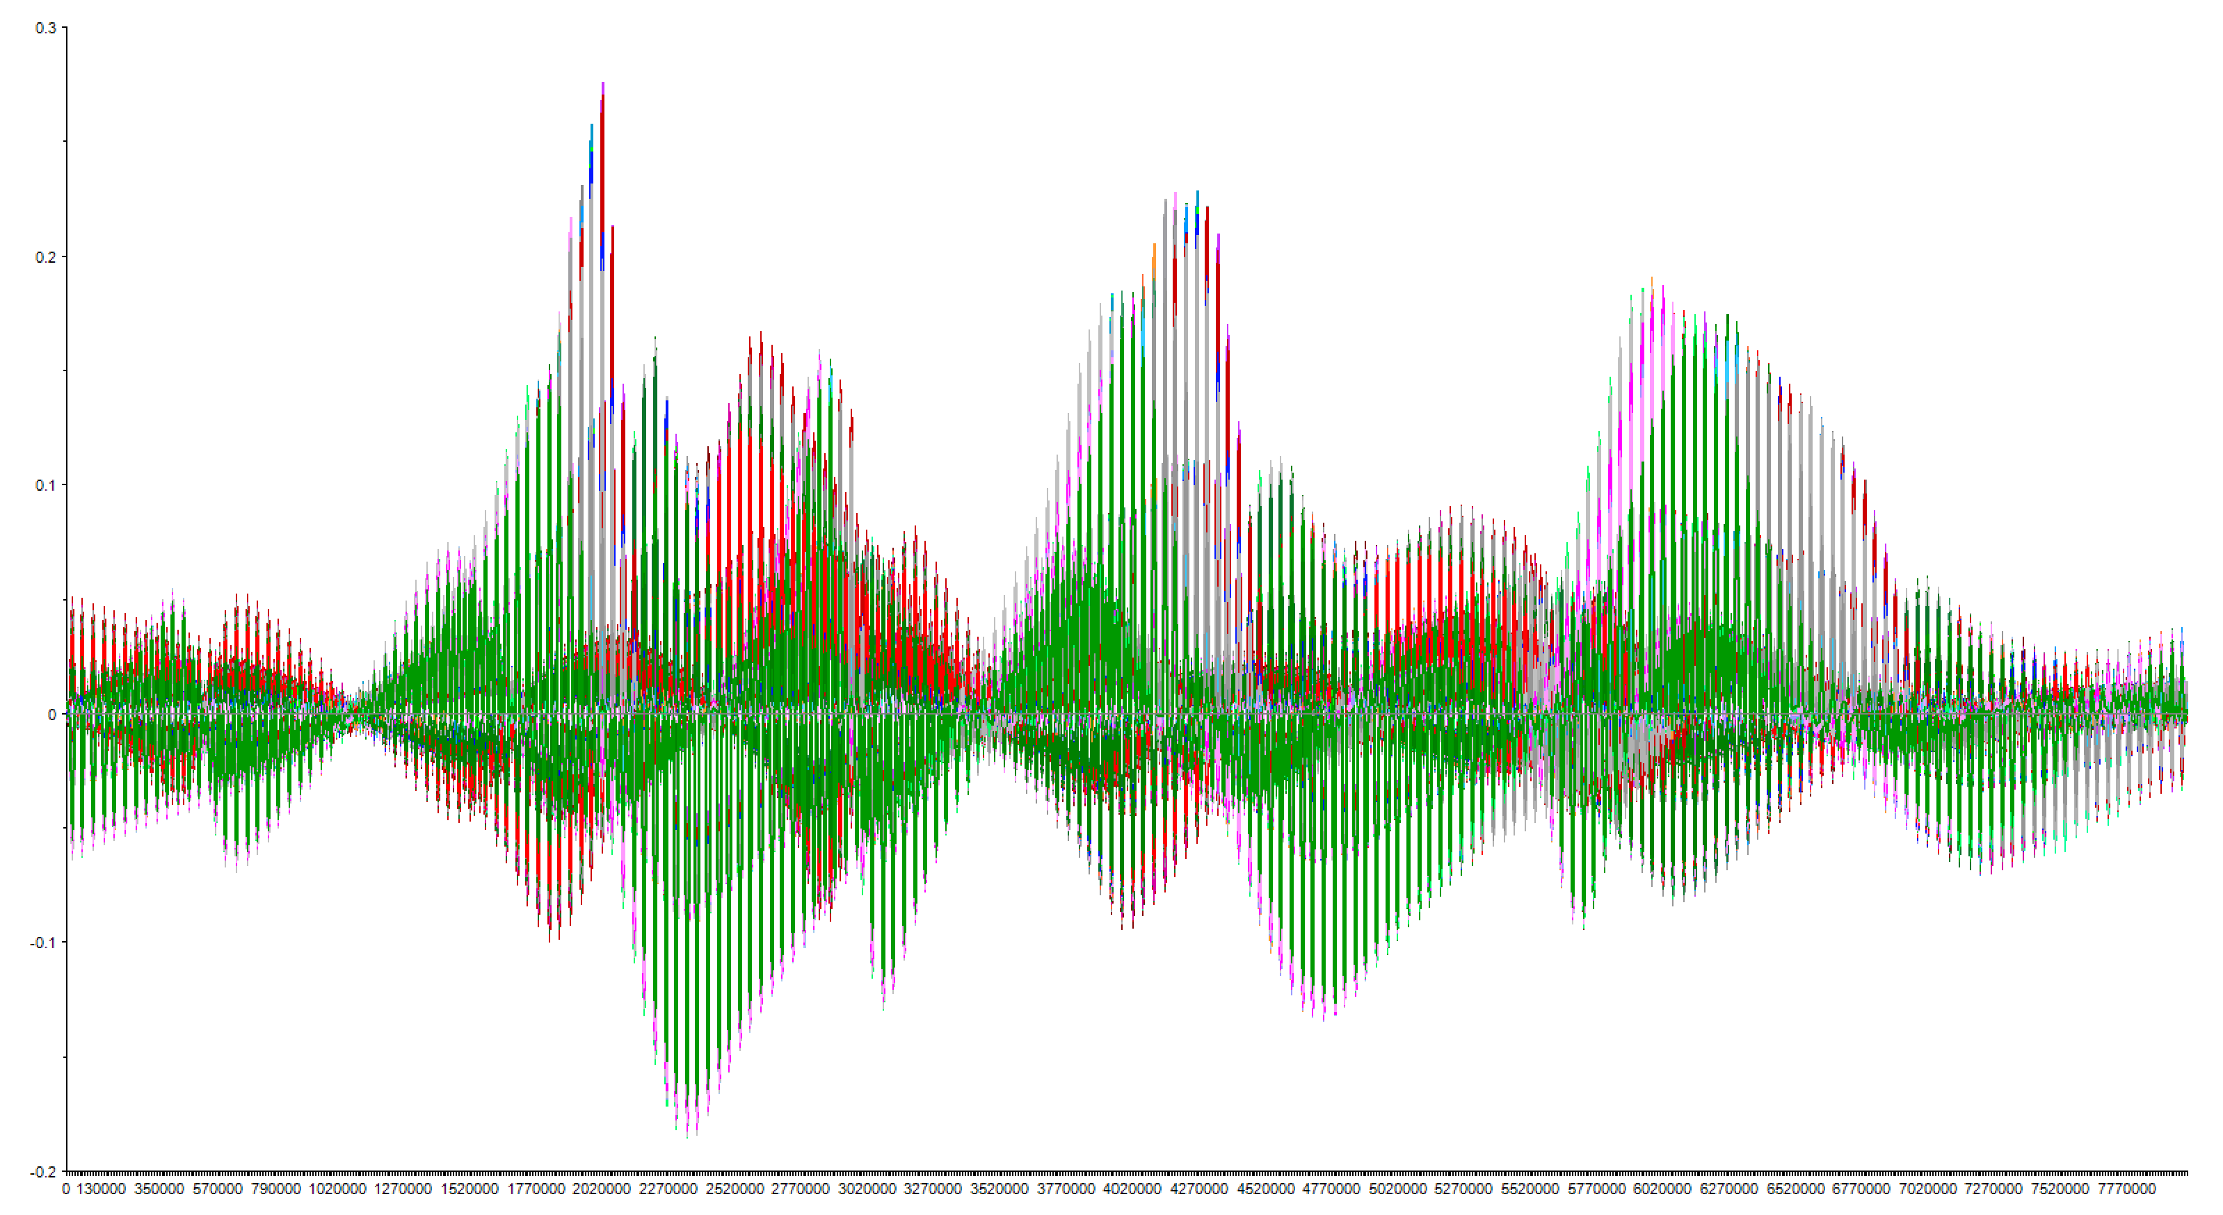
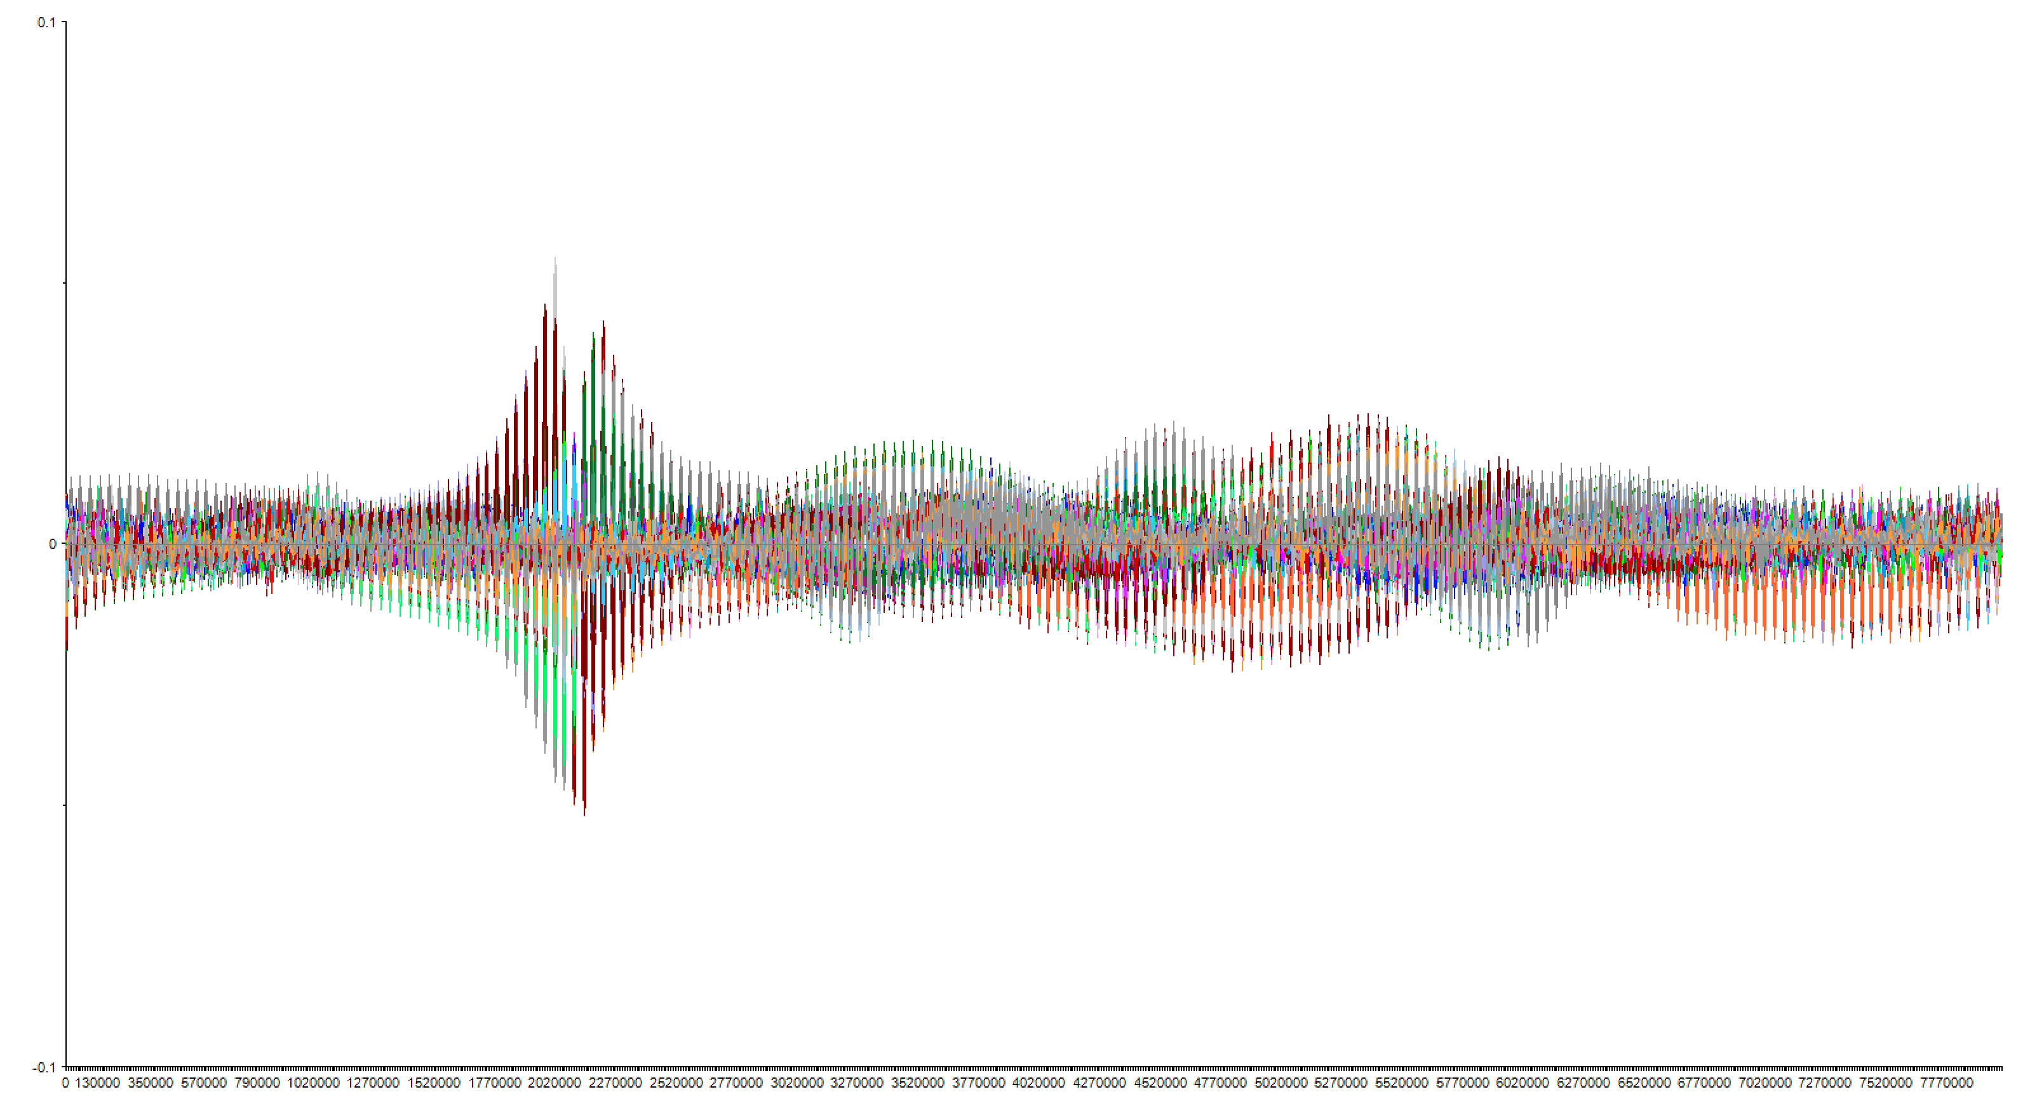
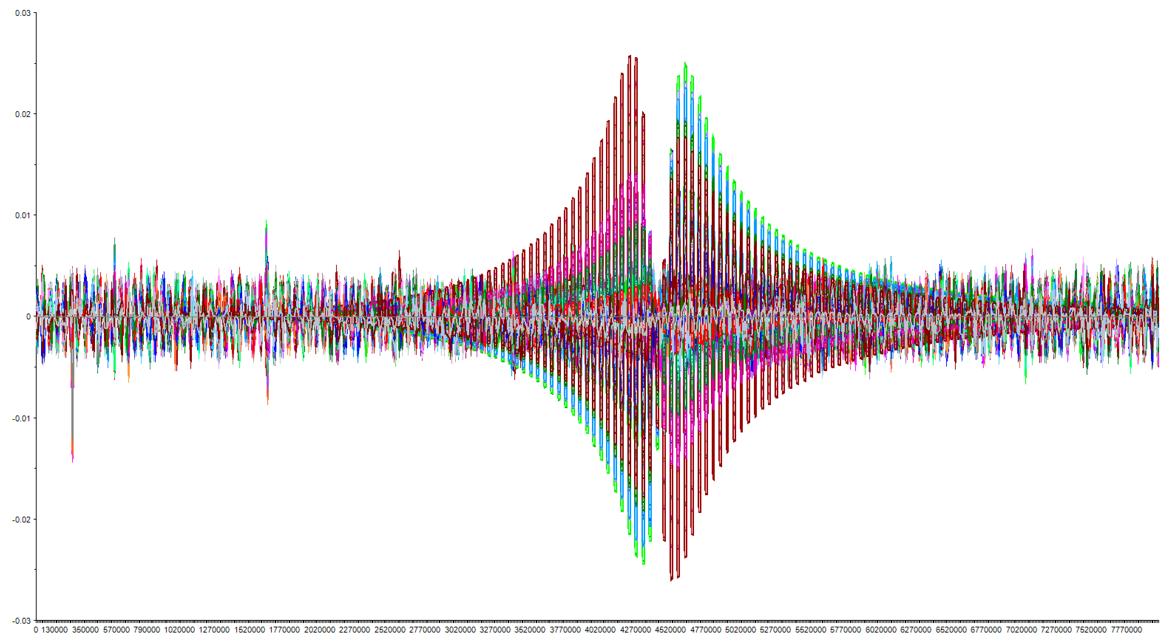
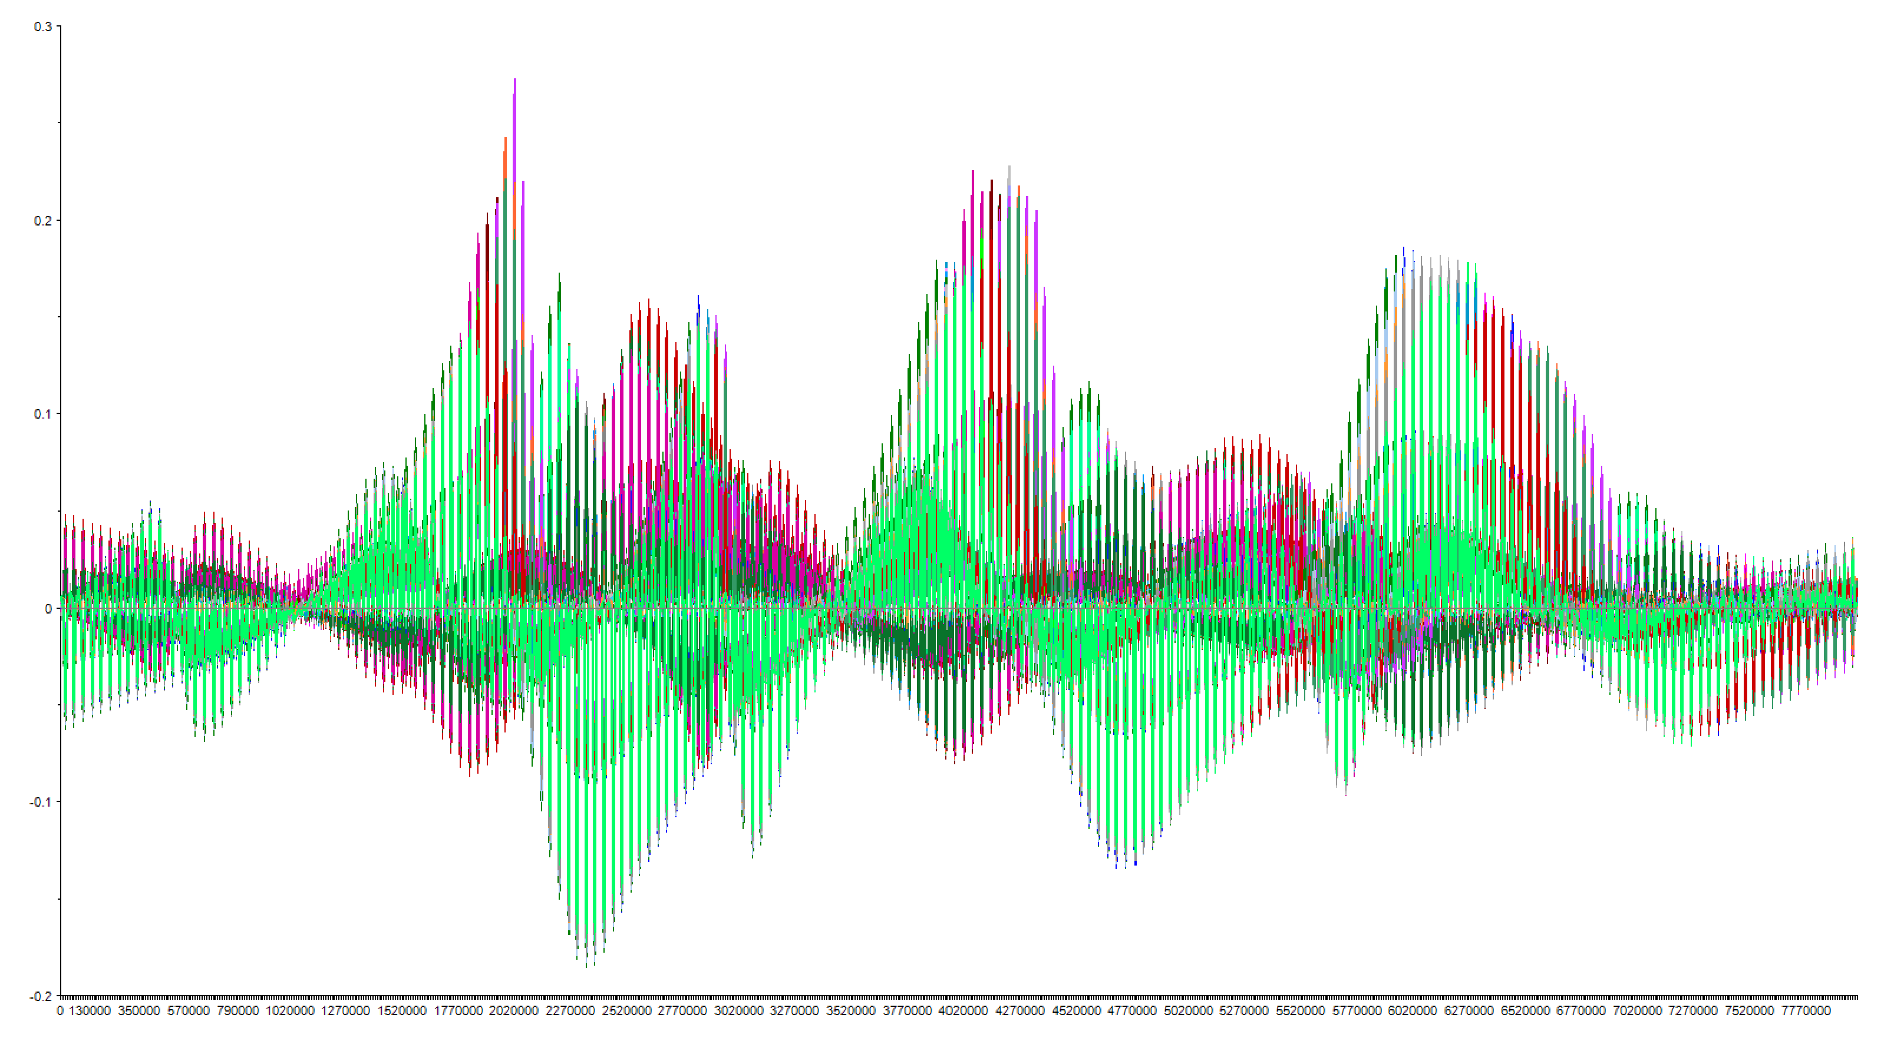
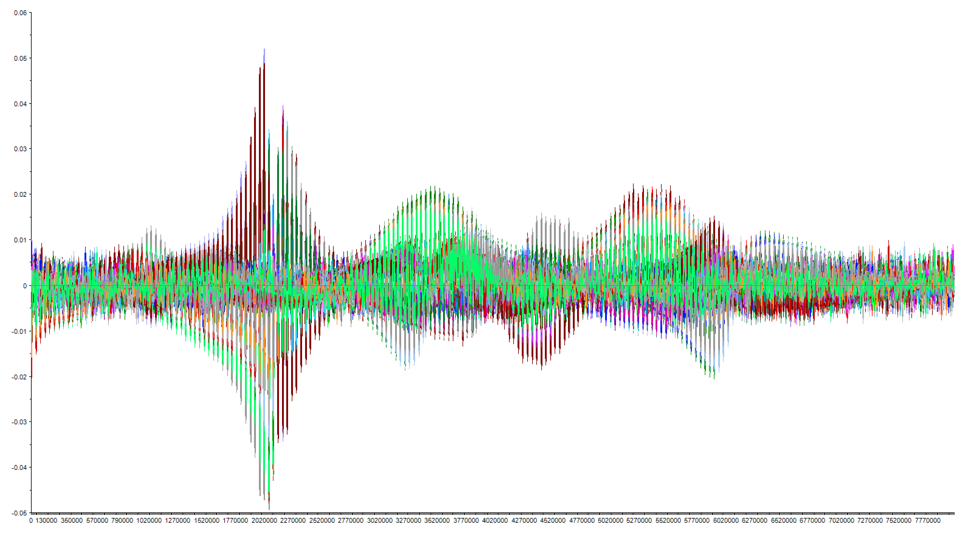
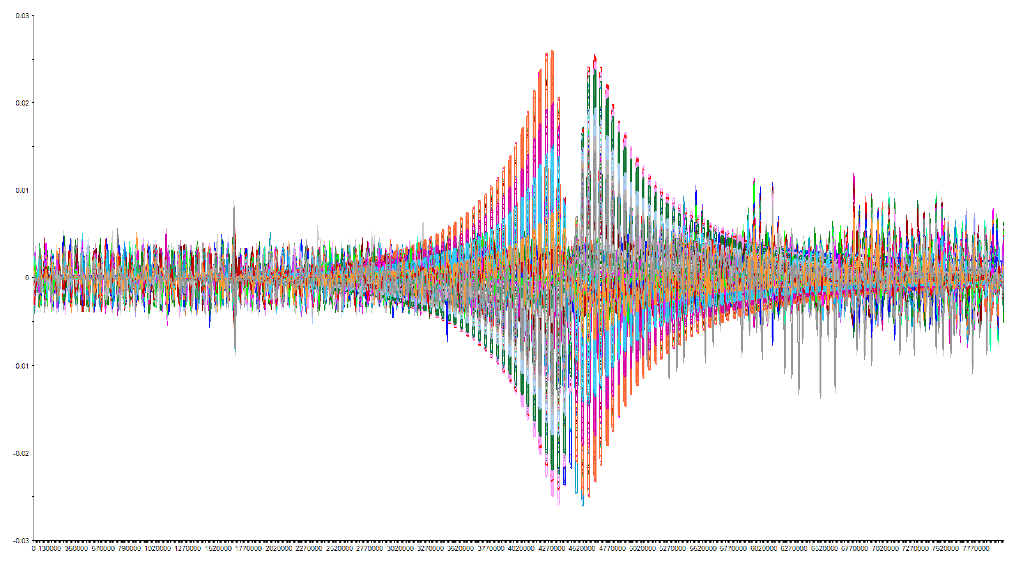
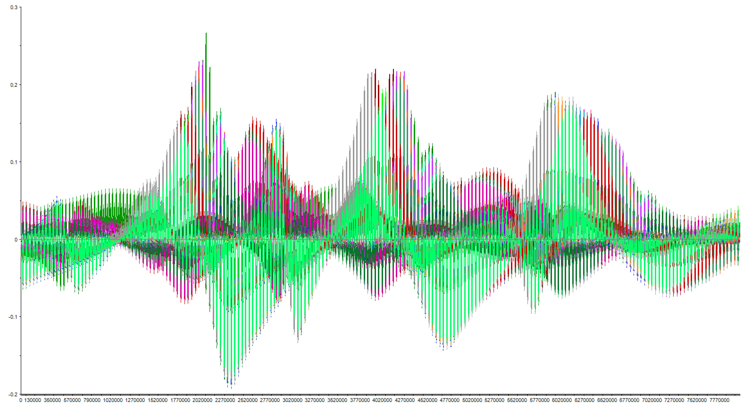
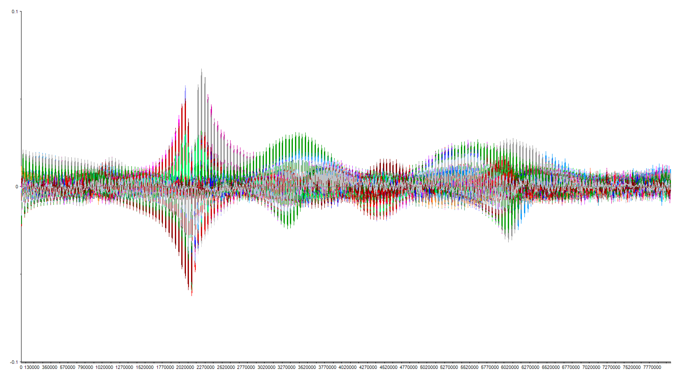
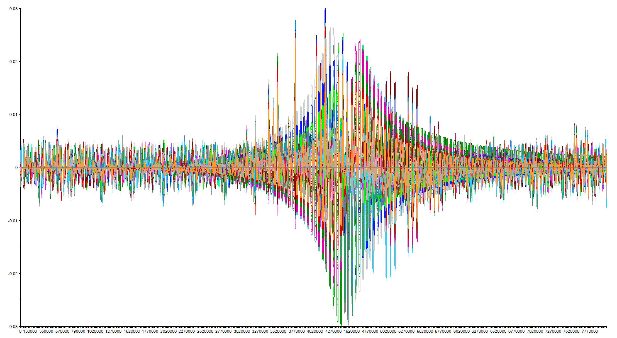
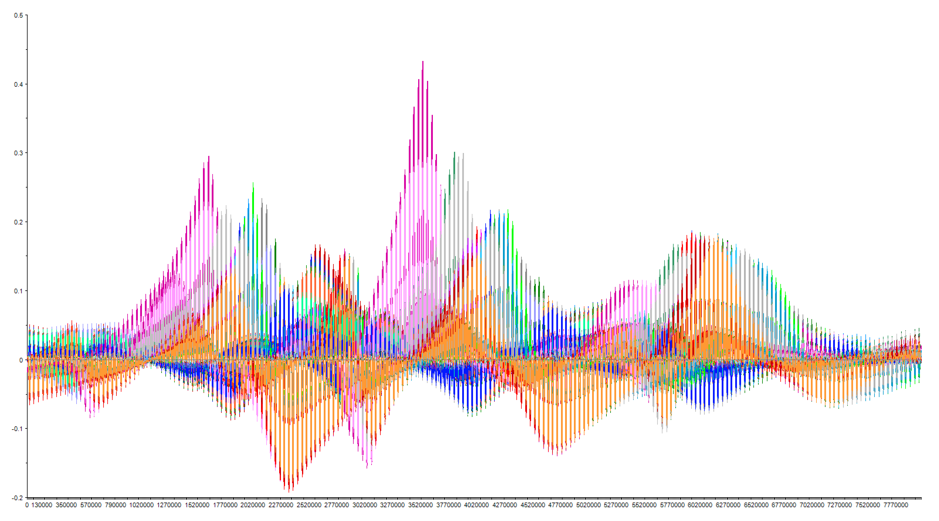
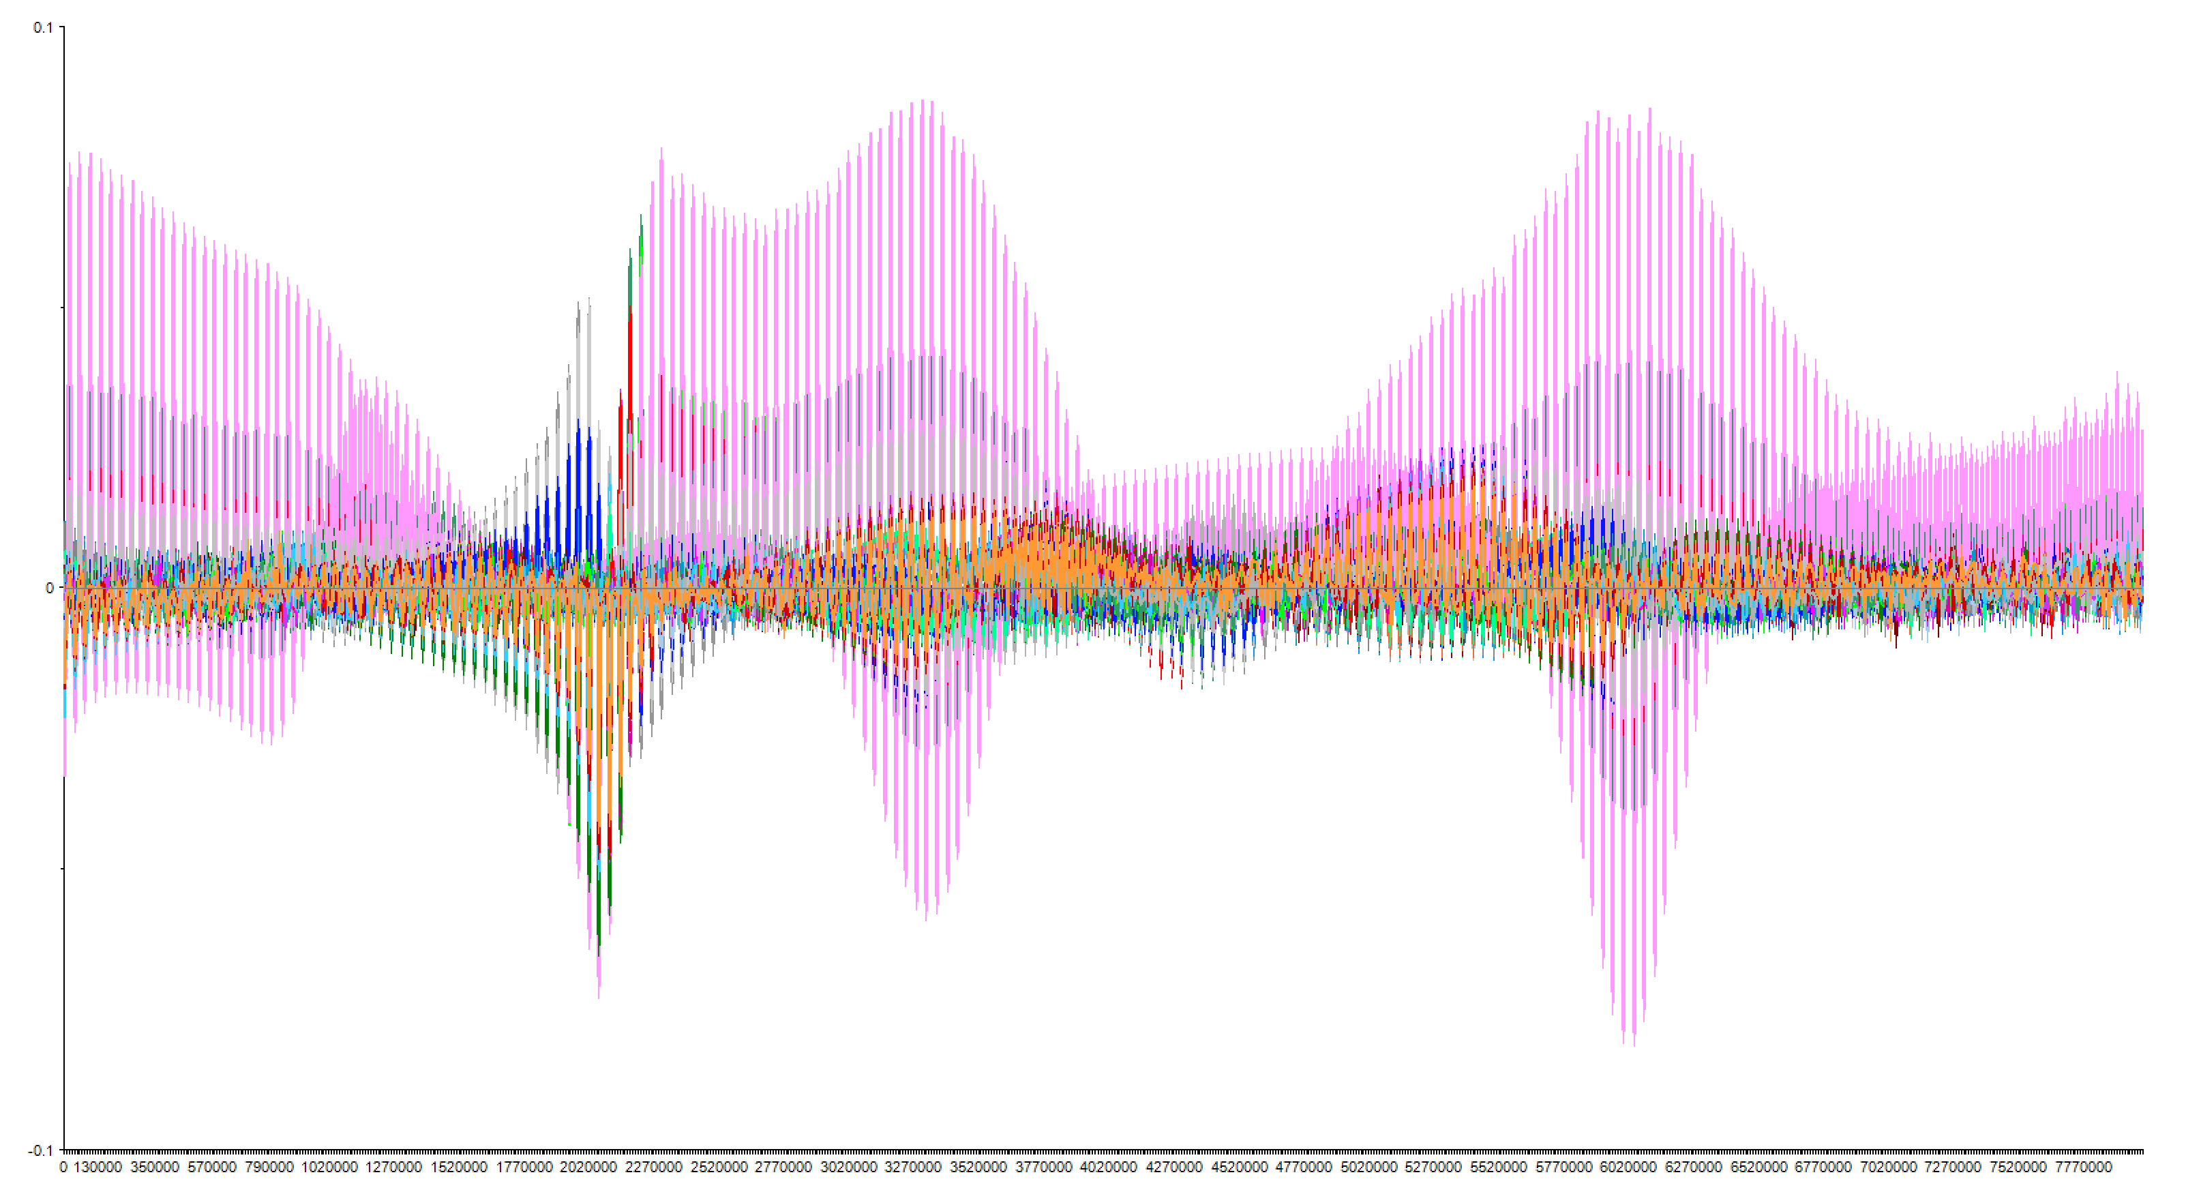
Zener Diode PSA Data
0.8 V Cycle 0
1 V Cycle 0
3 V Cycle 0
0.8 V Cycle 1
0.8 V Cycle 1
1 V Cycle 1
3 V Cycle 1
0.8 V Cycle 2
1 V Cycle 2
3 V Cycle 2
0.8 V Cycle 3
1 V Cycle 3
3 V Cycle 3
0.8 V Cycle 4
1 V Cycle 4
3 V Cycle 4

Slide 11
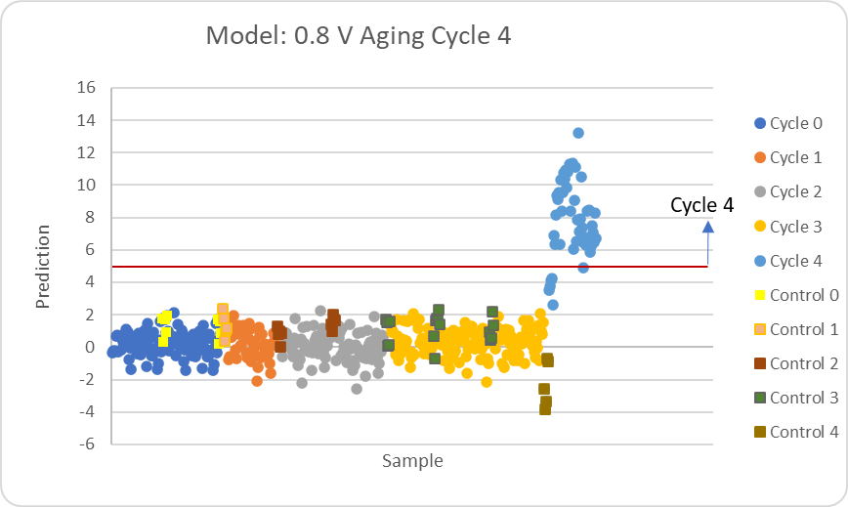
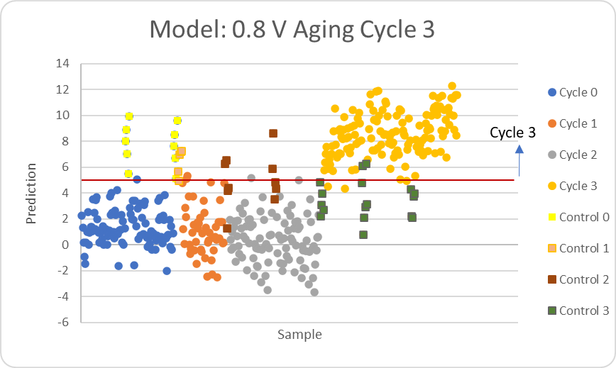
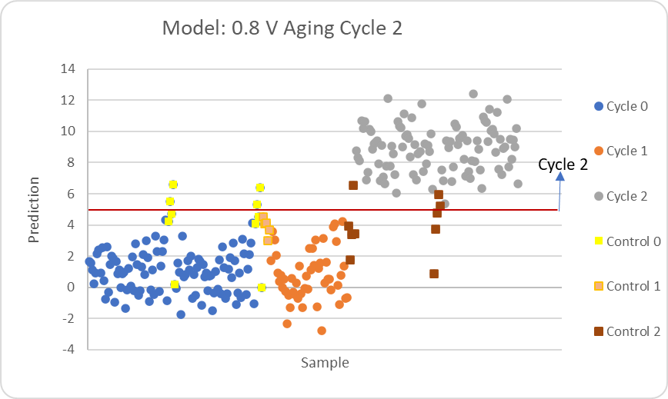
Zener Diode
0.8 V Algorithm
Cycle 4?
Modeled on 484 measurements
Tested on 483 measurements
> 5
Cycle 4
97.9% correct ID
< 5
Cycle 3?
> 5
Modeled on 431 measurements
Tested on 430 measurements
Cycle 3
< 5
94.9% correct ID
Cycle 2?
> 5
Cycle 2
Modeled on 272 measurements
Tested on 272 measurements
< 5
Cycle 1
97.4% correct ID

Slide 12
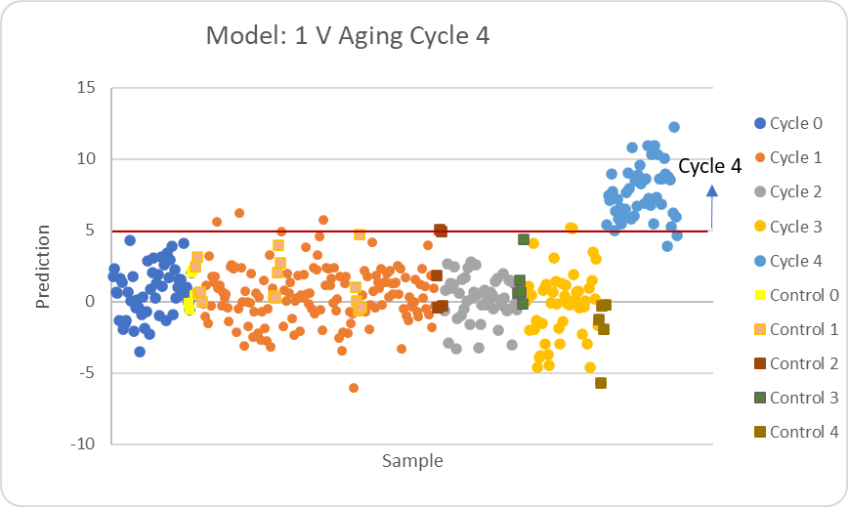
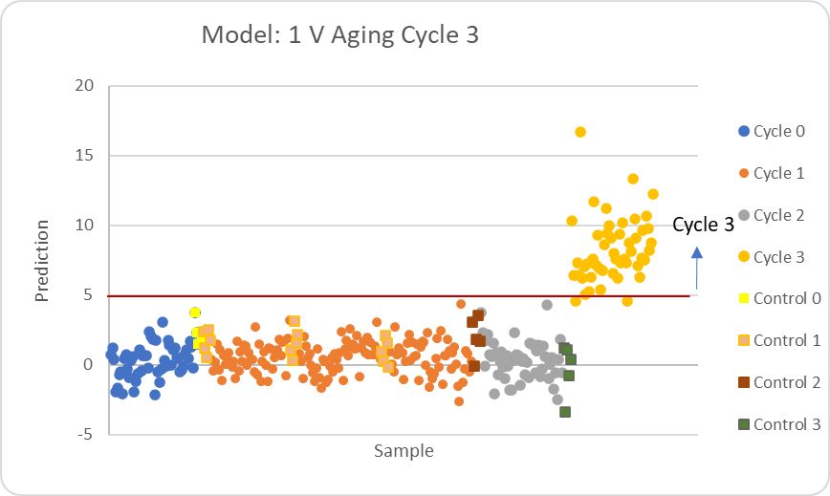
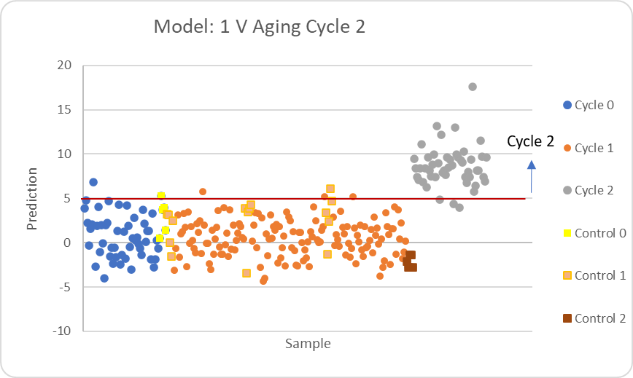
Zener Diode
1 V Algorithm
Cycle 4?
Modeled on 377 measurements
Tested on 376 measurements
> 5
Cycle 4
97.9% correct ID
< 5
Cycle 3?
> 5
Modeled on 324 measurements
Tested on 323 measurements
Cycle 3
< 5
99.4% correct ID
Cycle 2?
> 5
Cycle 2
Modeled on 270 measurements
Tested on 269 measurements
< 5
Cycle 1
97.0% correct ID

Slide 13
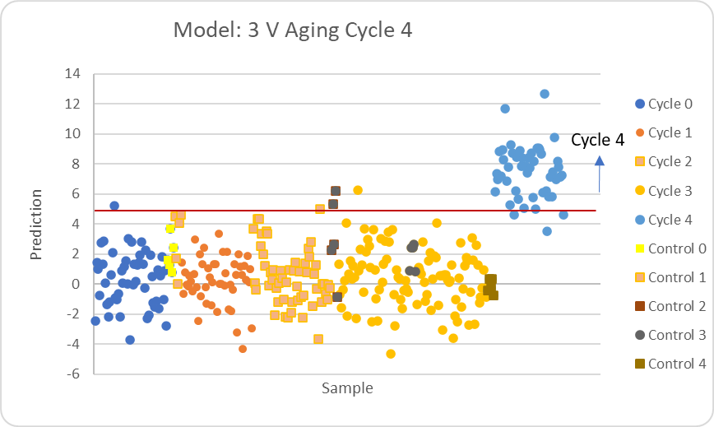
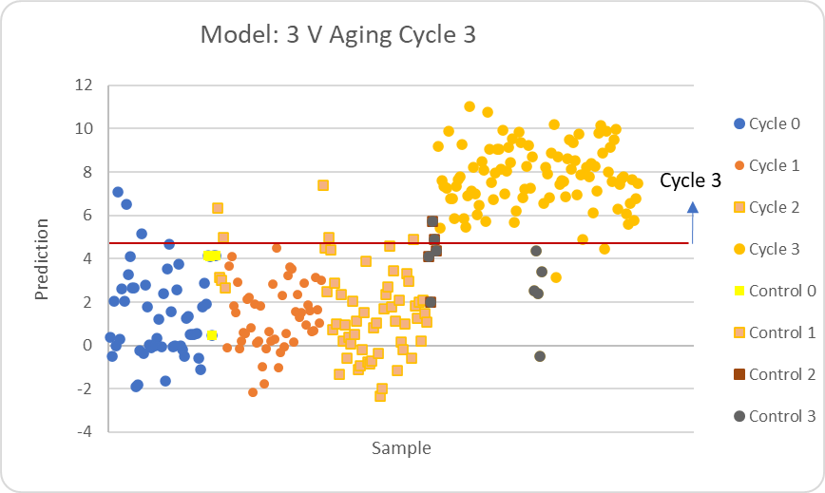
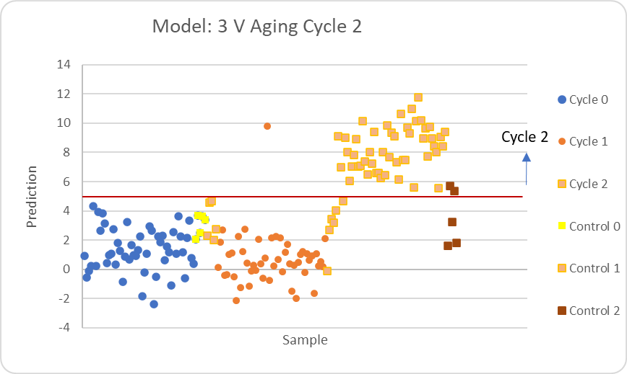
Zener Diode
3 V Algorithm
Cycle 4?
Modeled on 324 measurements
Tested on 324 measurements
> 5
Cycle 4
97.5% correct ID
< 5
Cycle 3?
> 5
Modeled on 271 measurements
Tested on 271 measurements
Cycle 3
< 5
96.3% correct ID
Cycle 2?
> 5
Cycle 2
Modeled on 163 measurements
Tested on 163 measurements
< 5
Cycle 1
95.1% correct ID

Slide 14
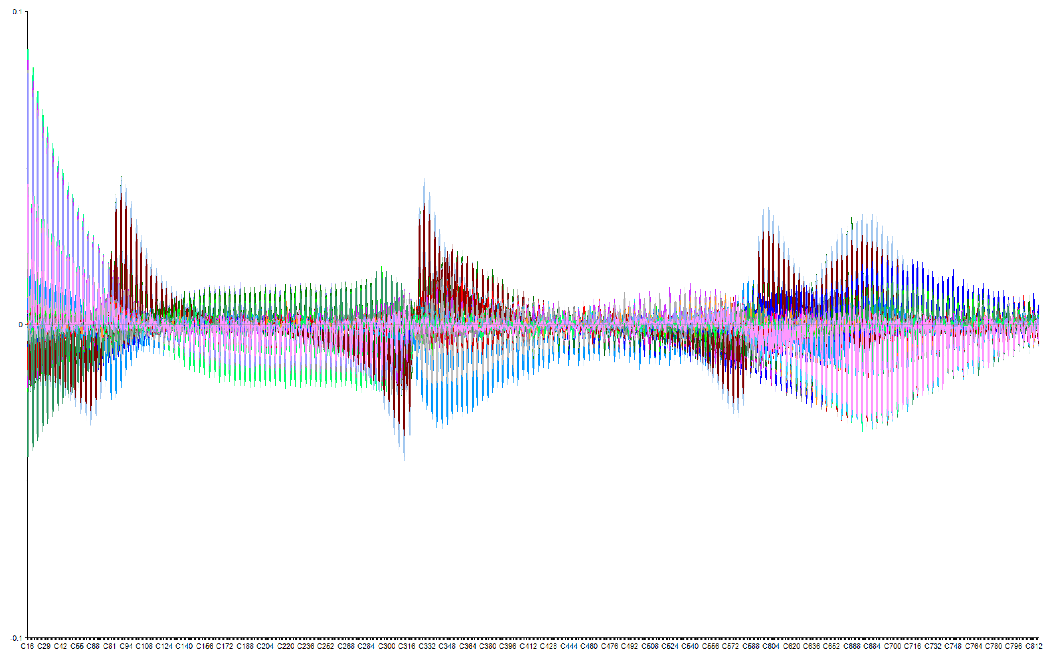
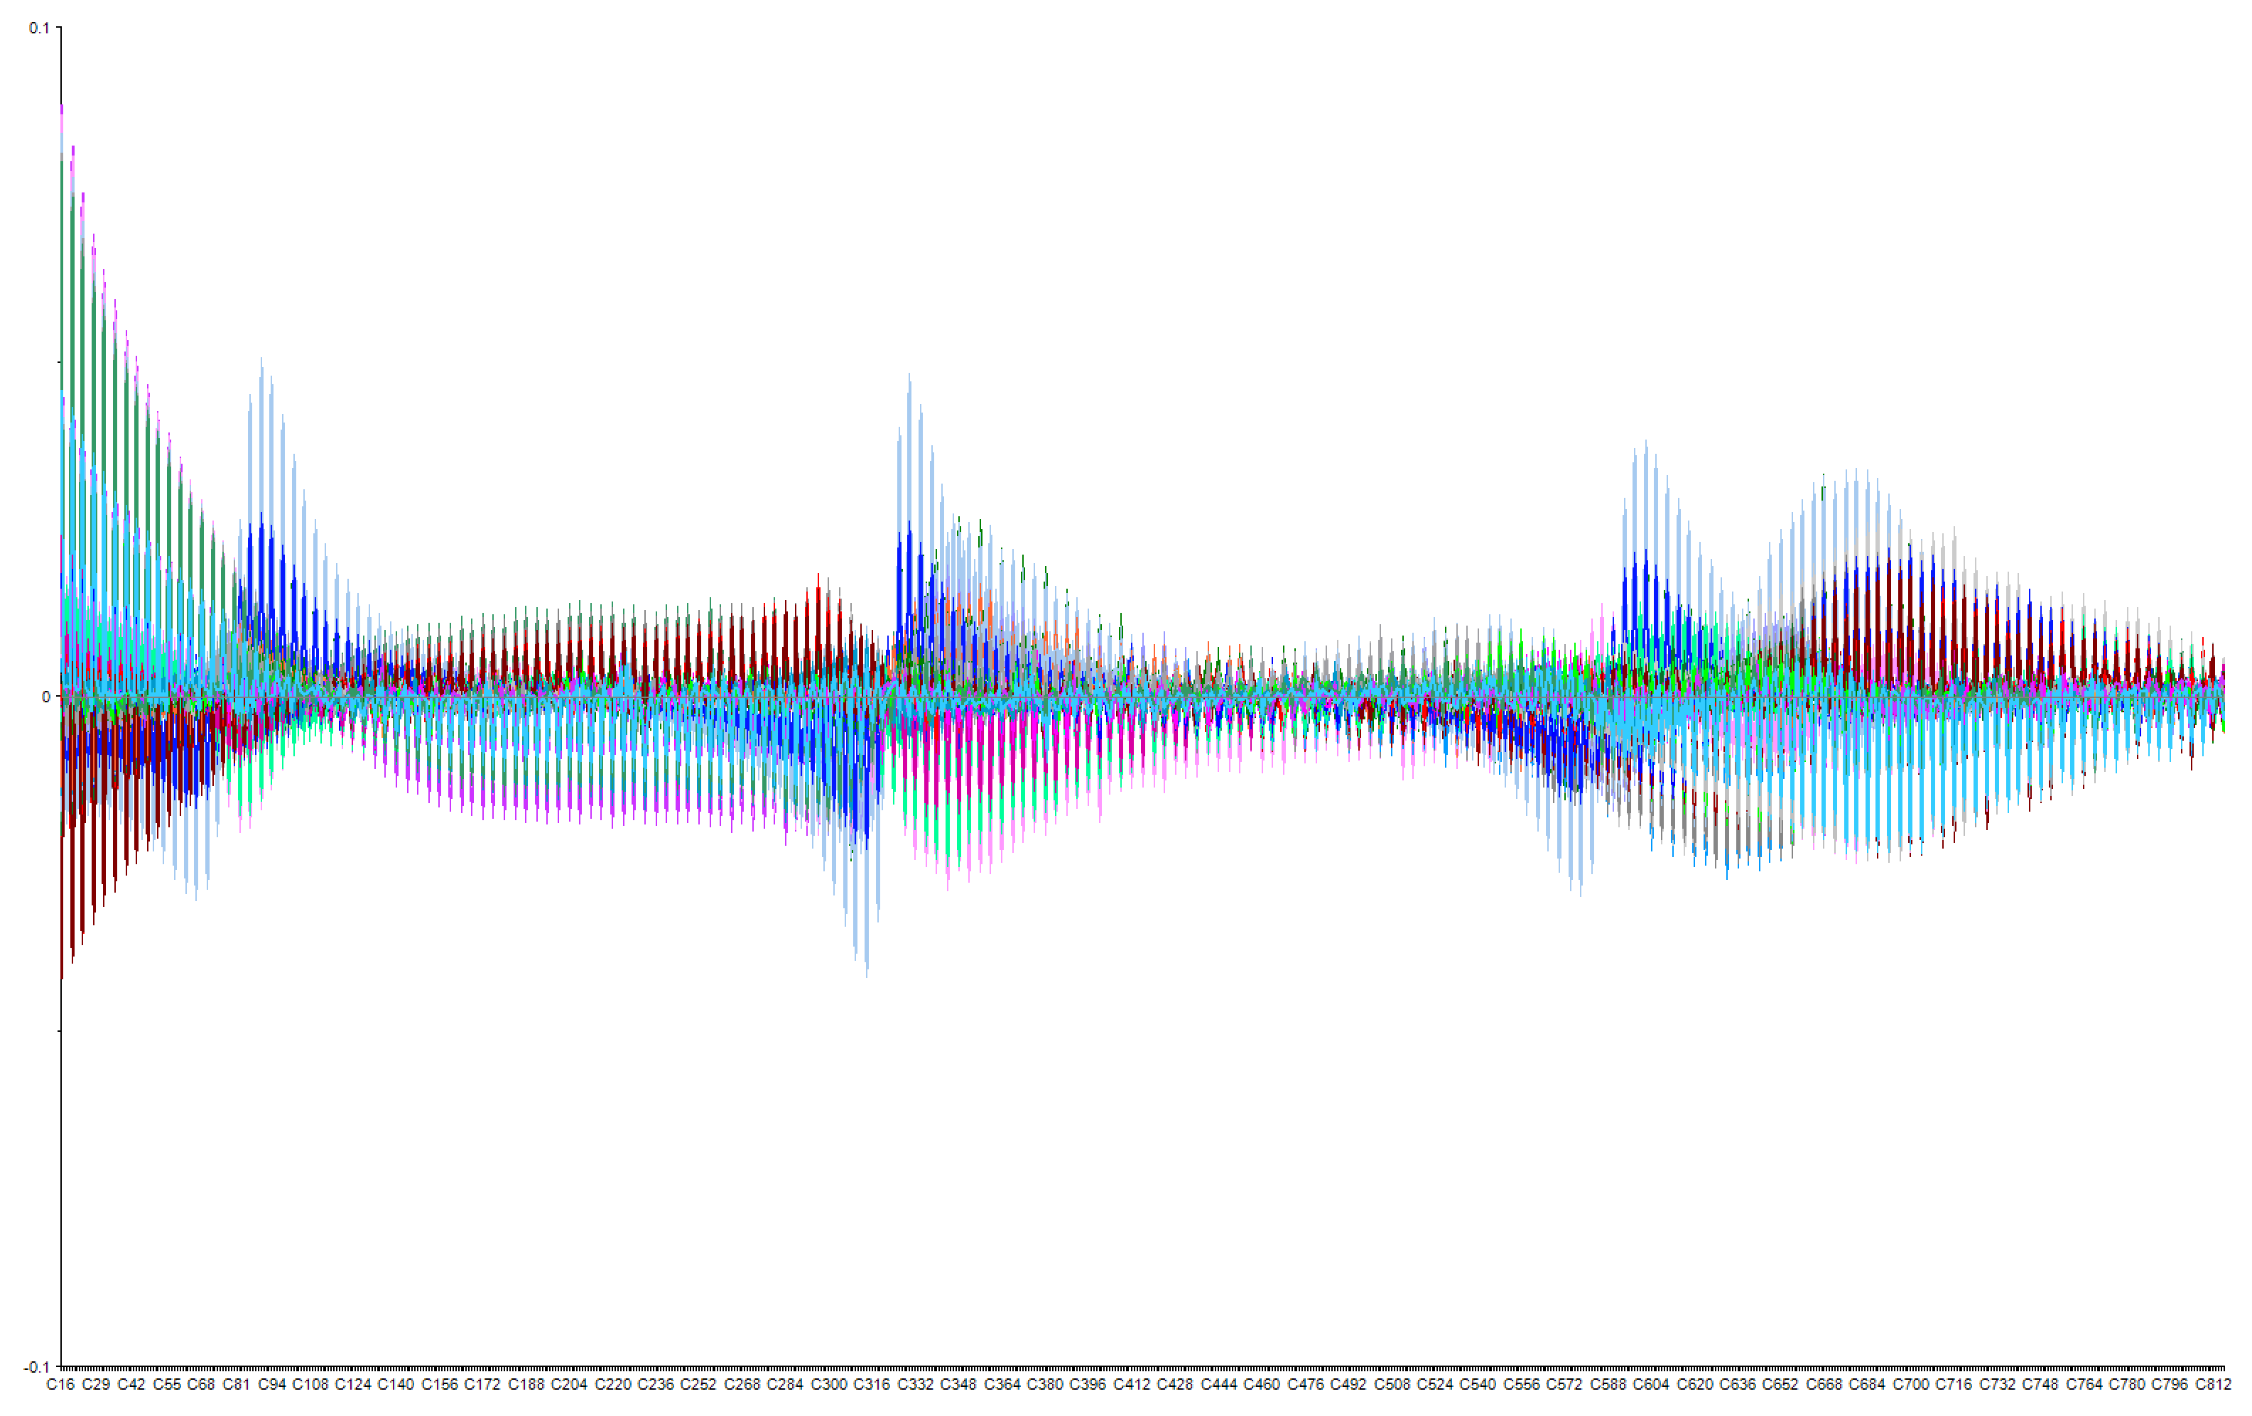
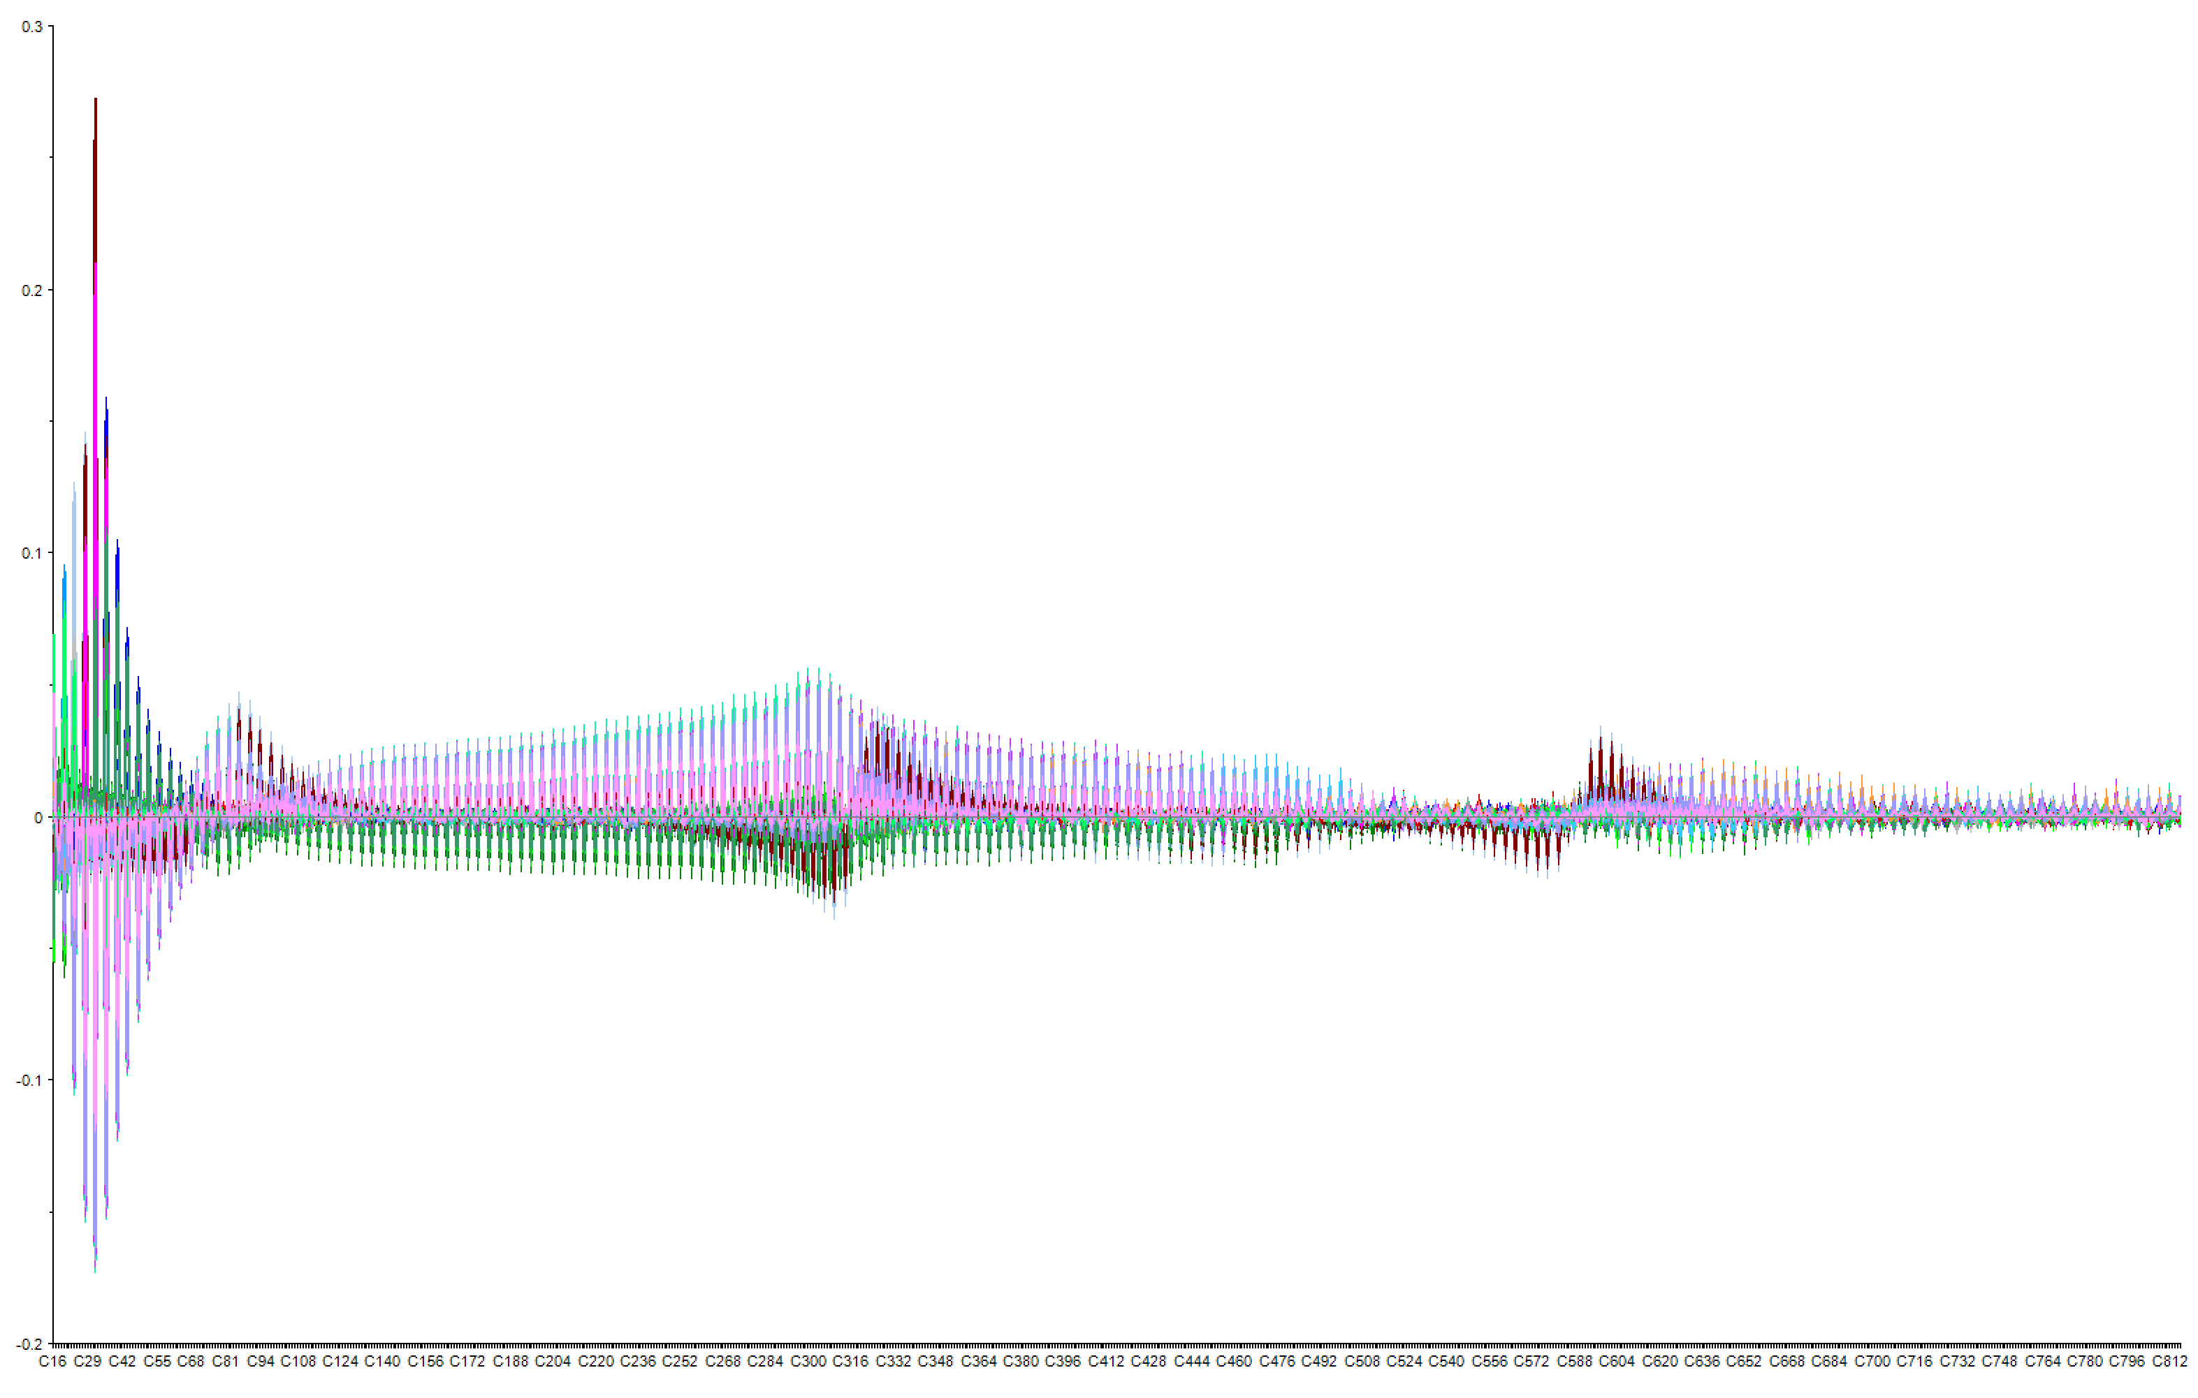
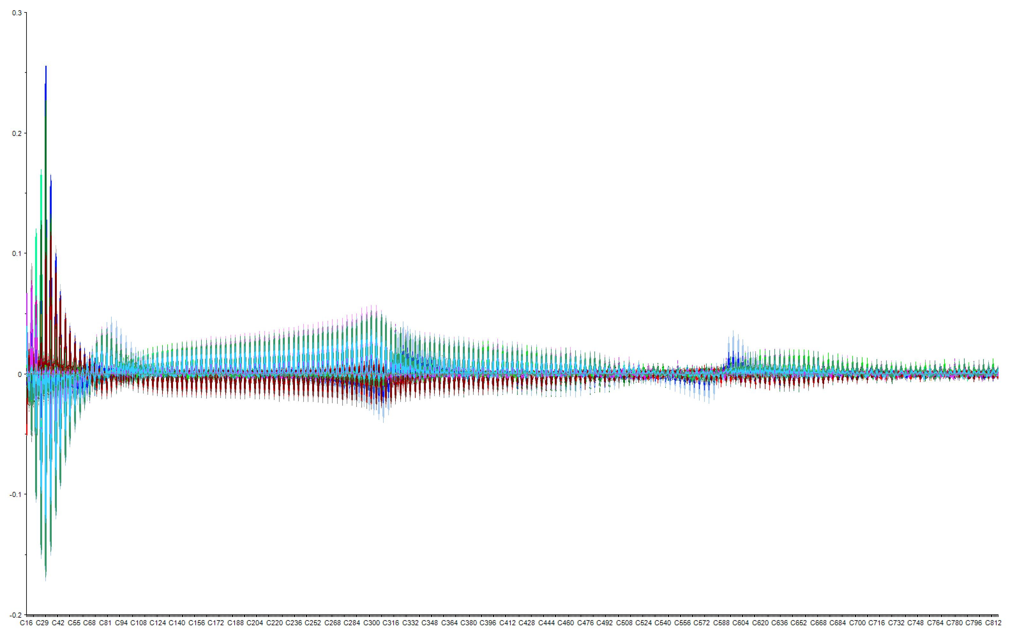
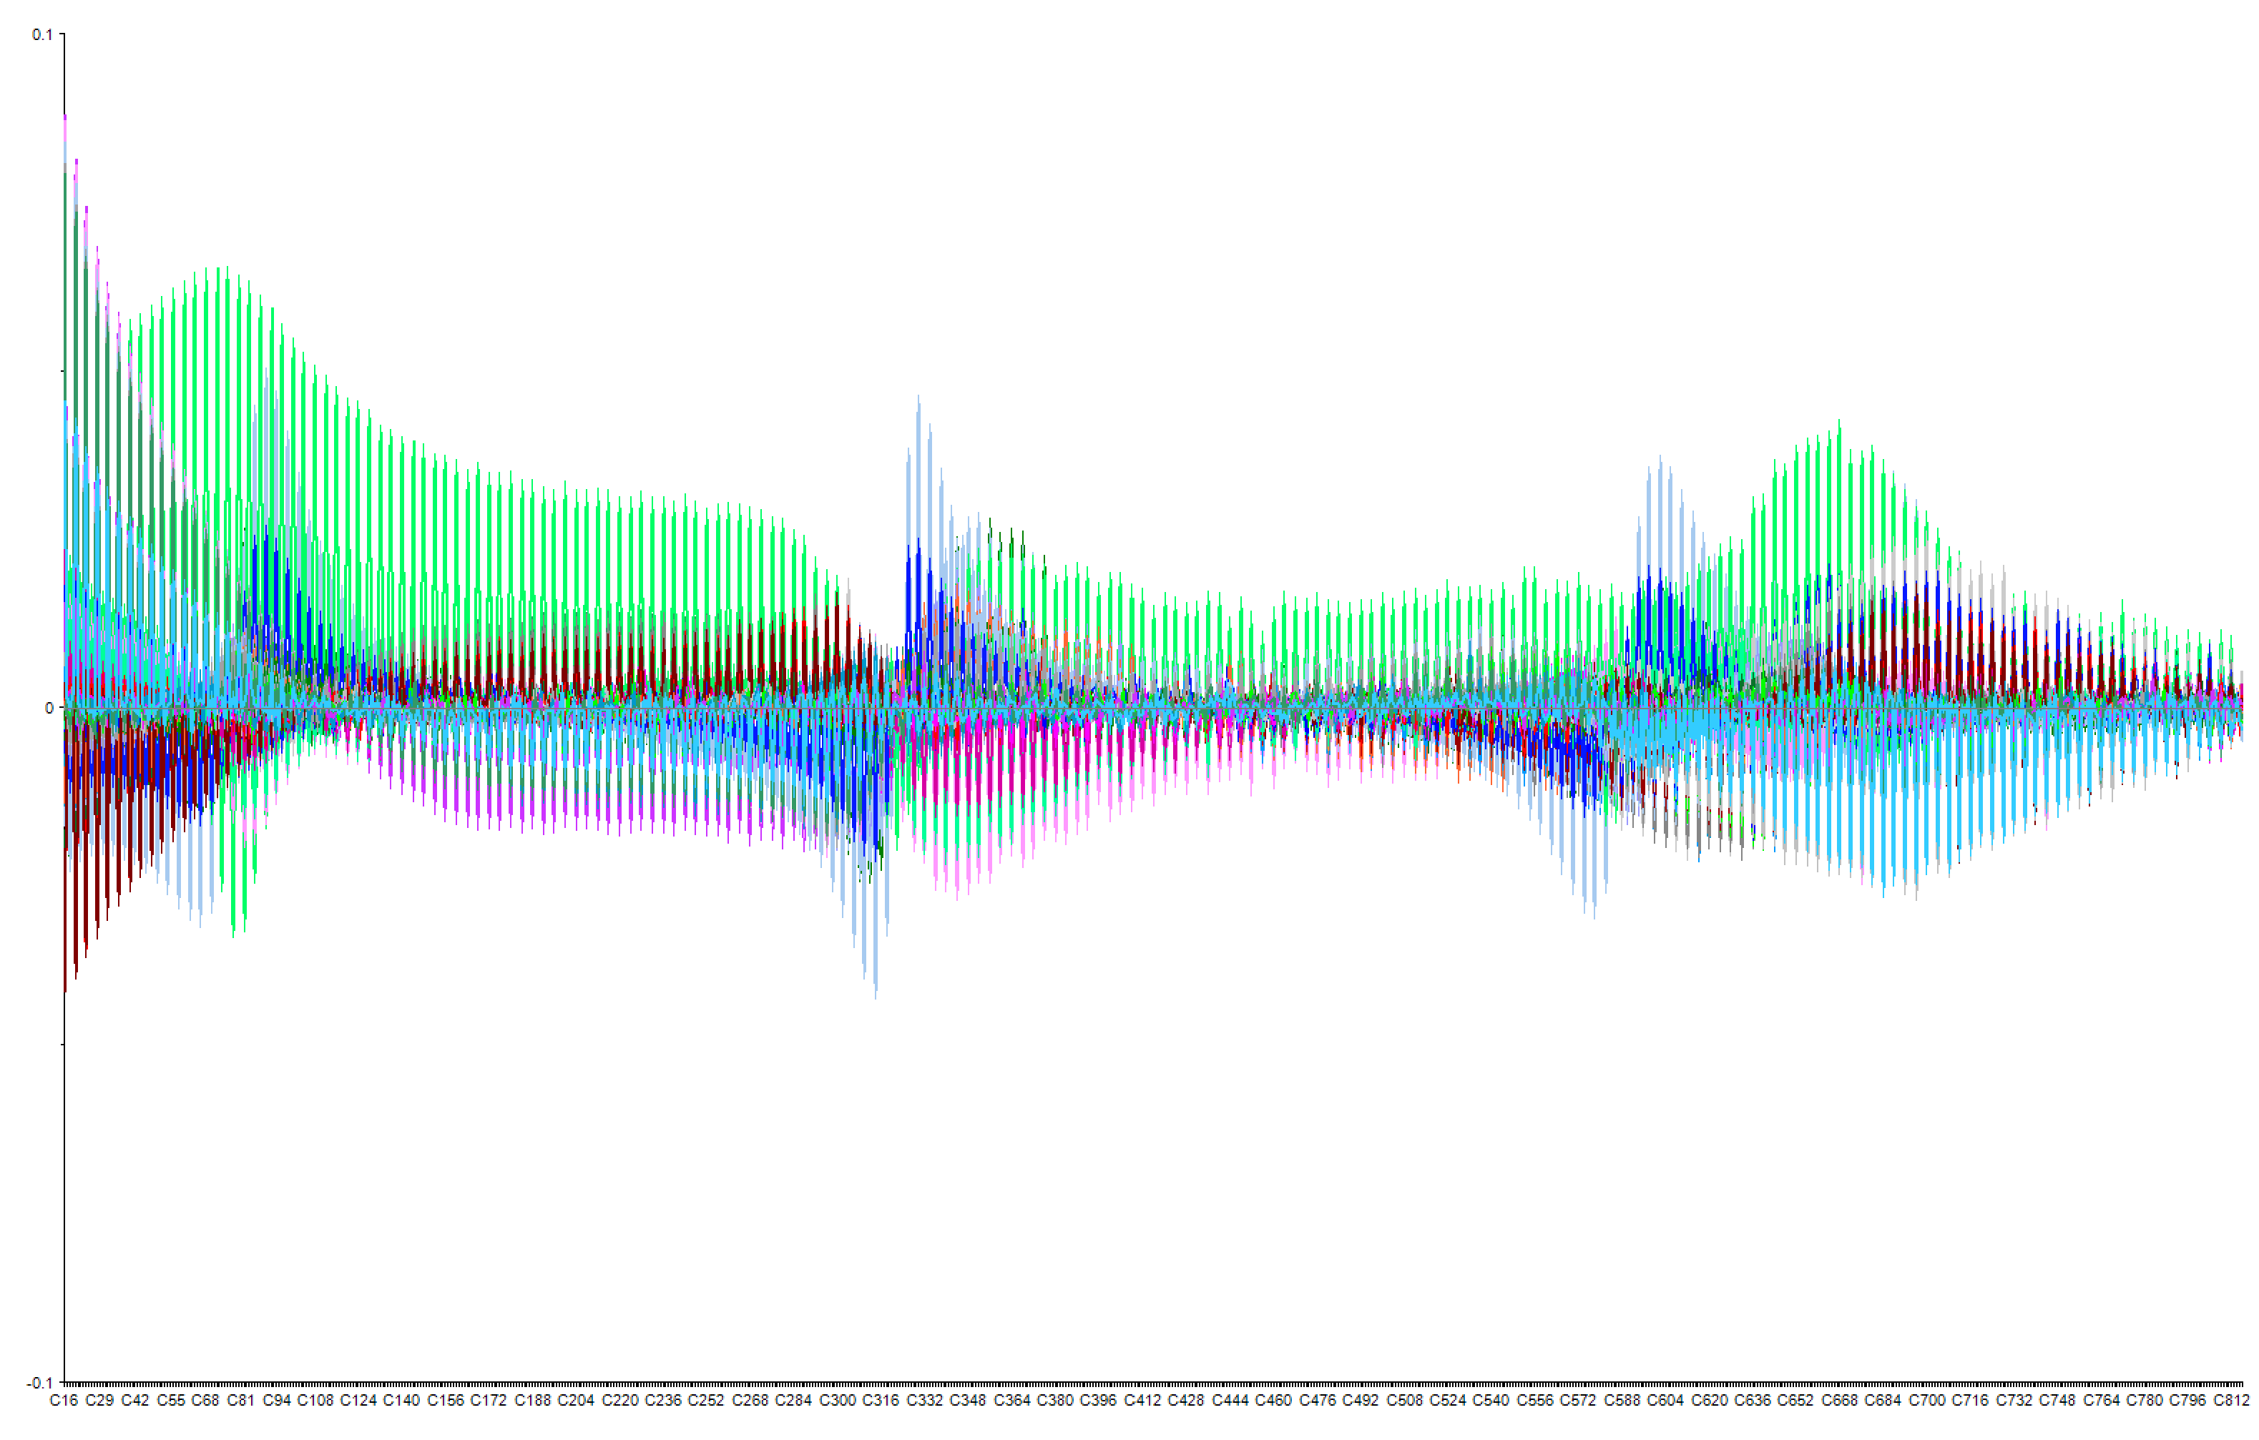
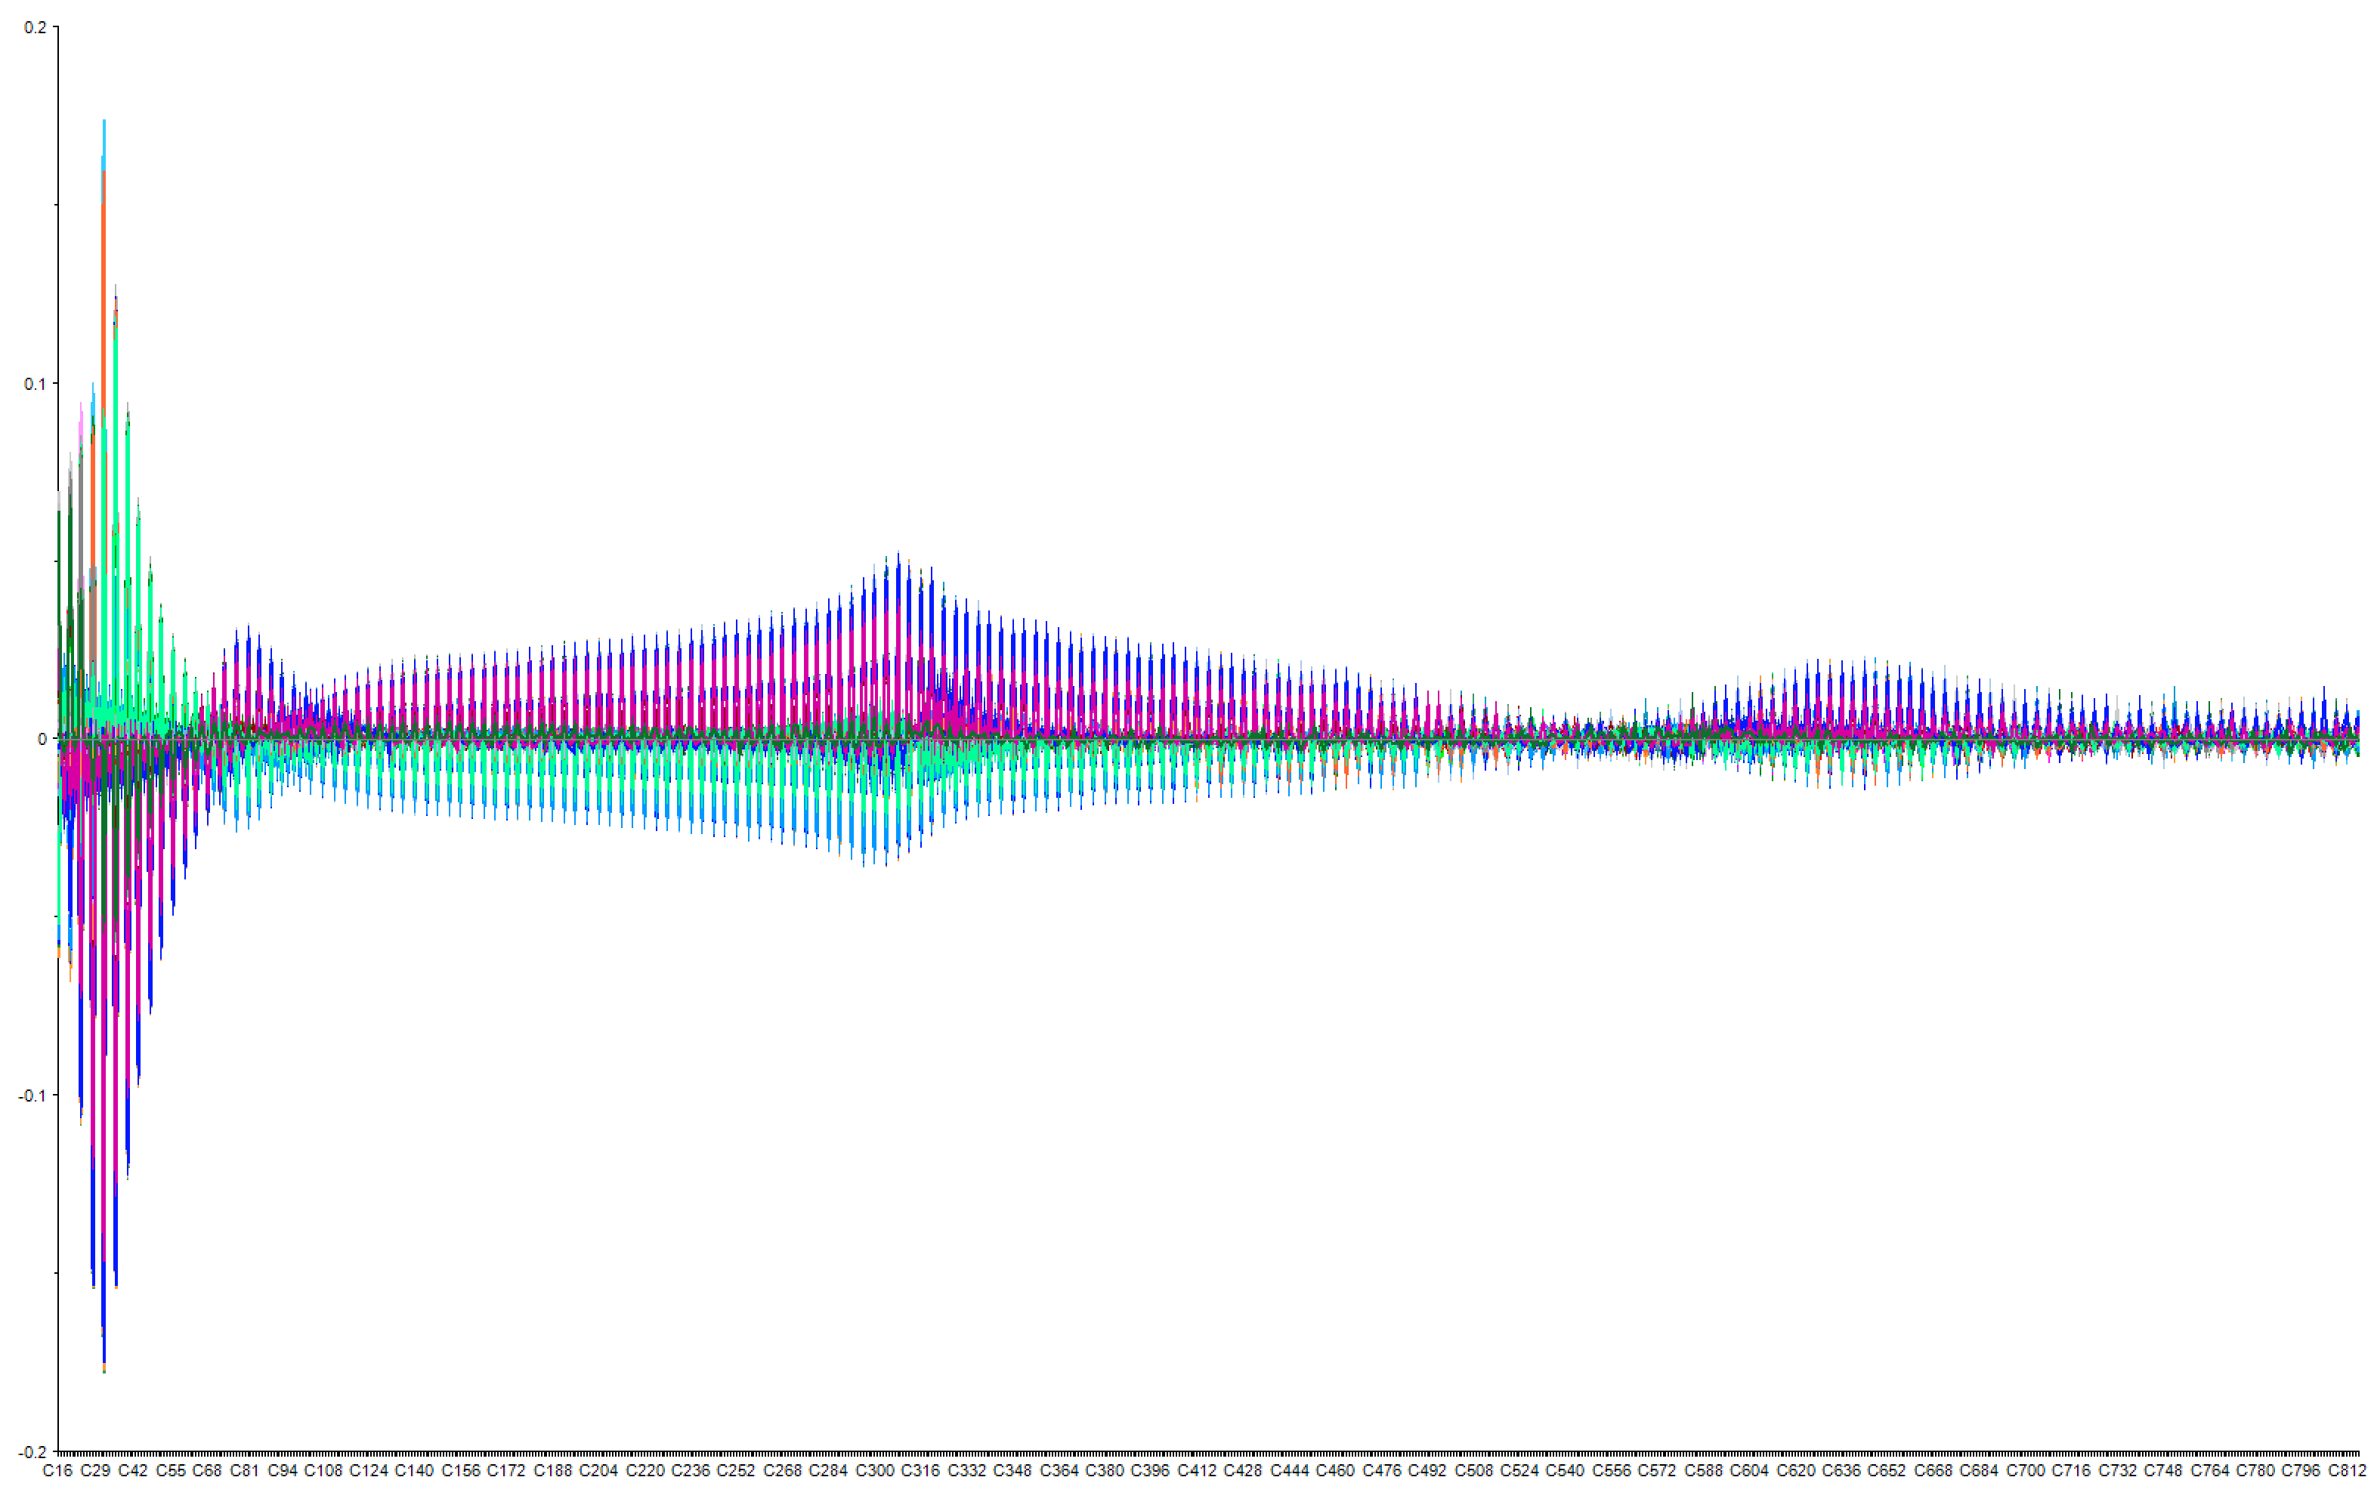
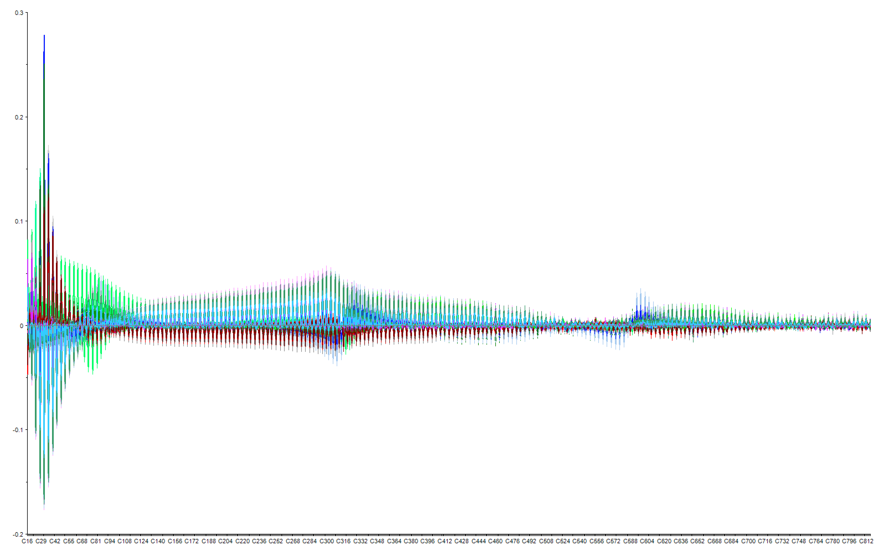
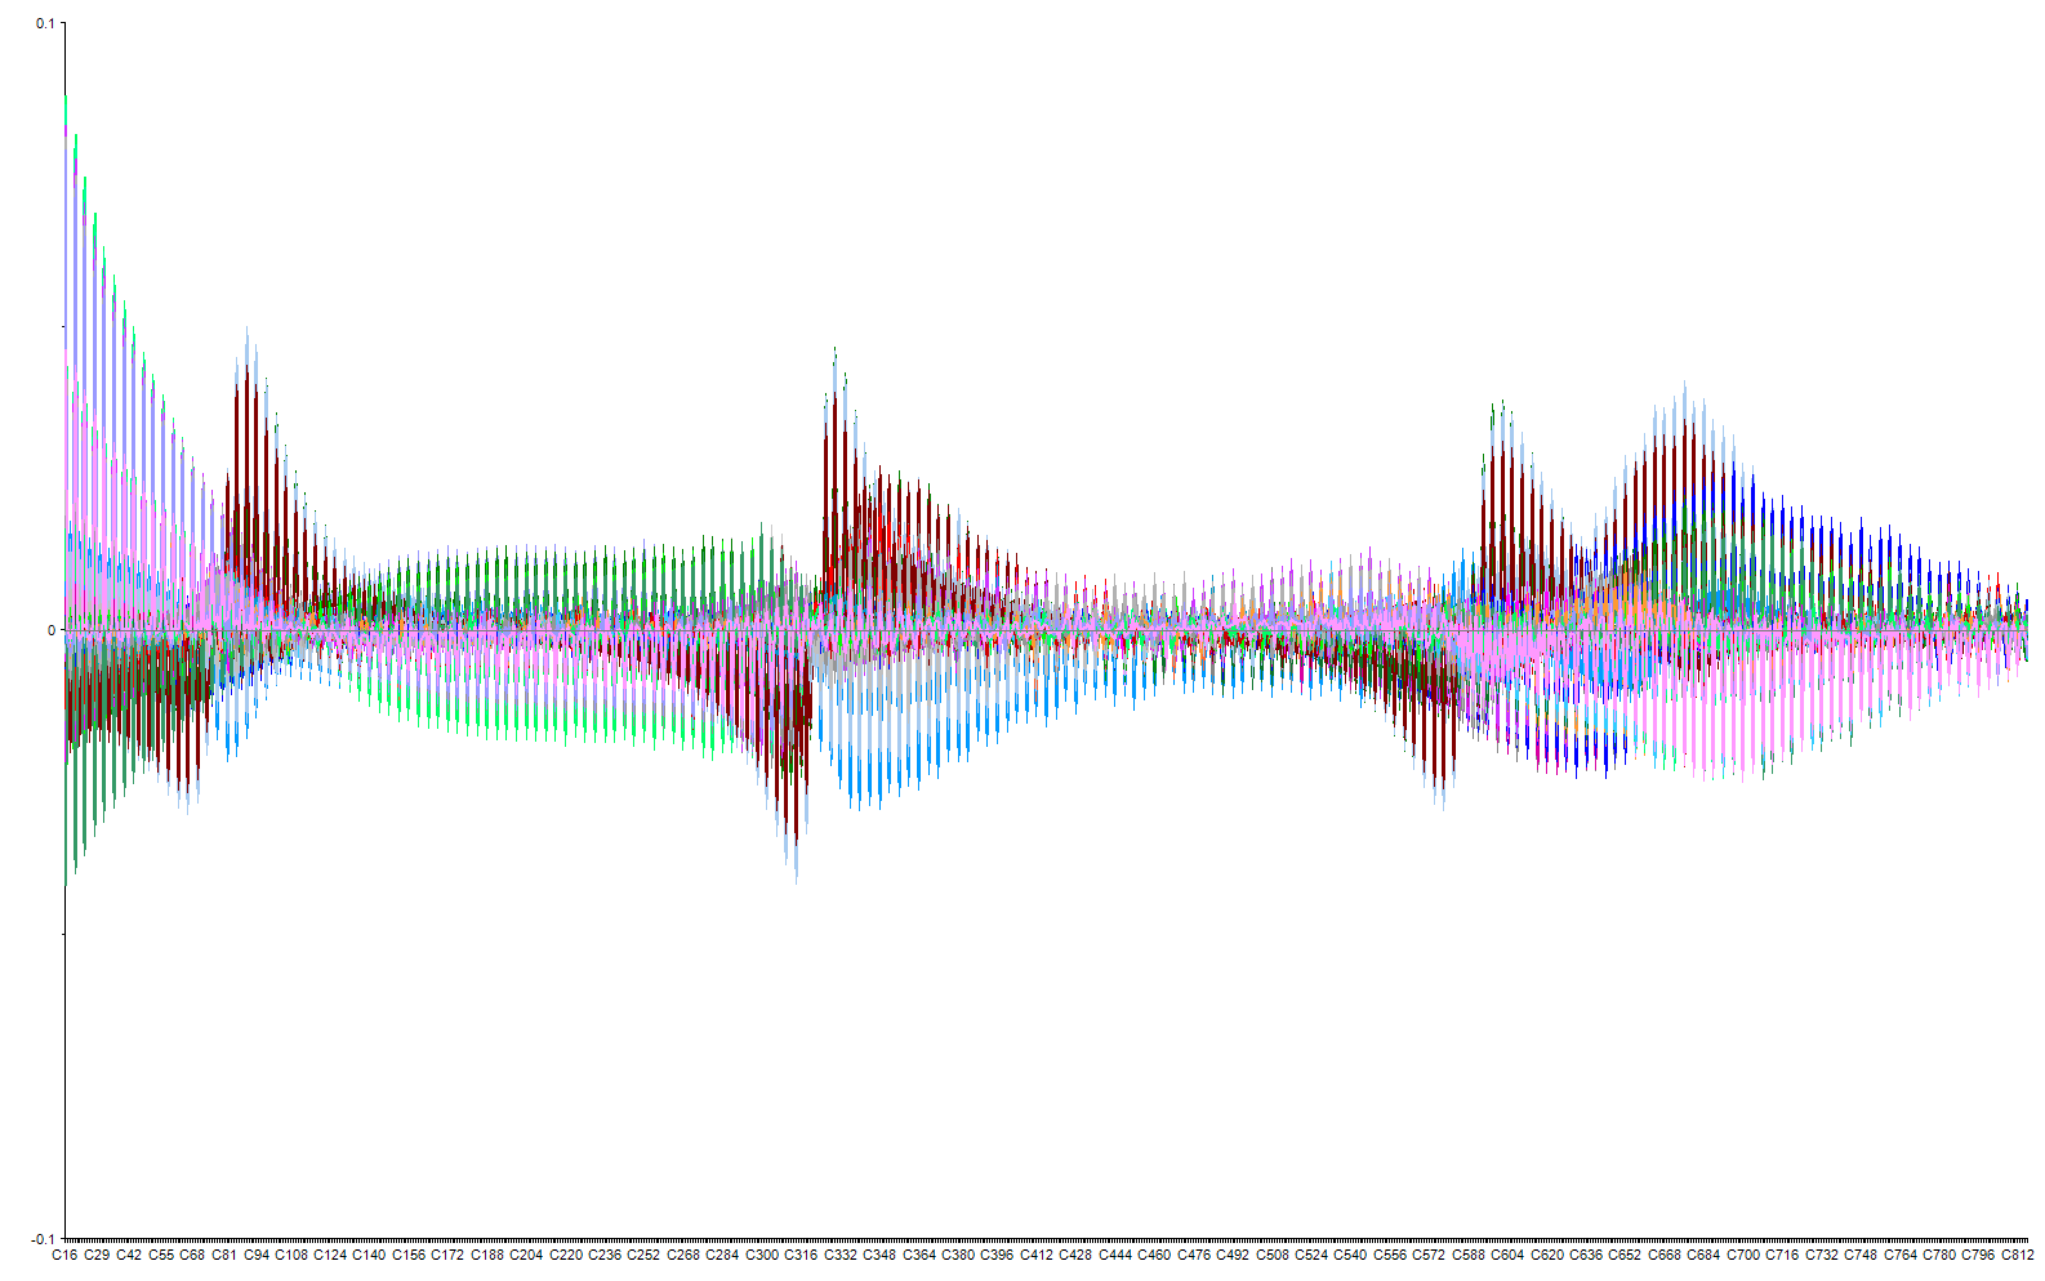
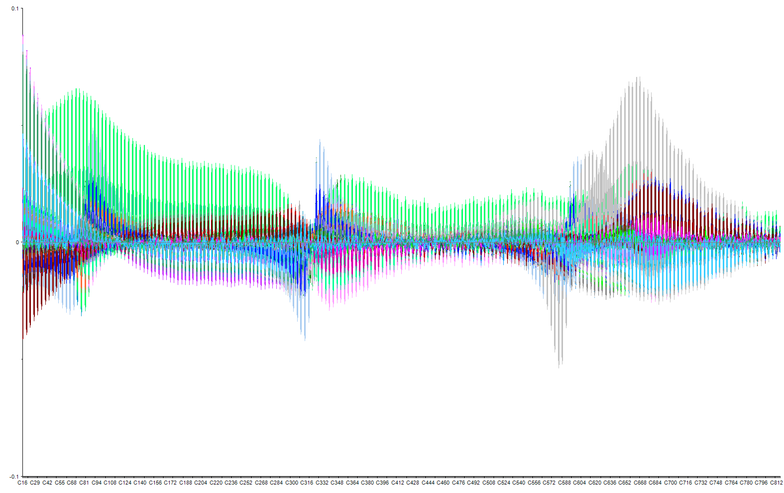
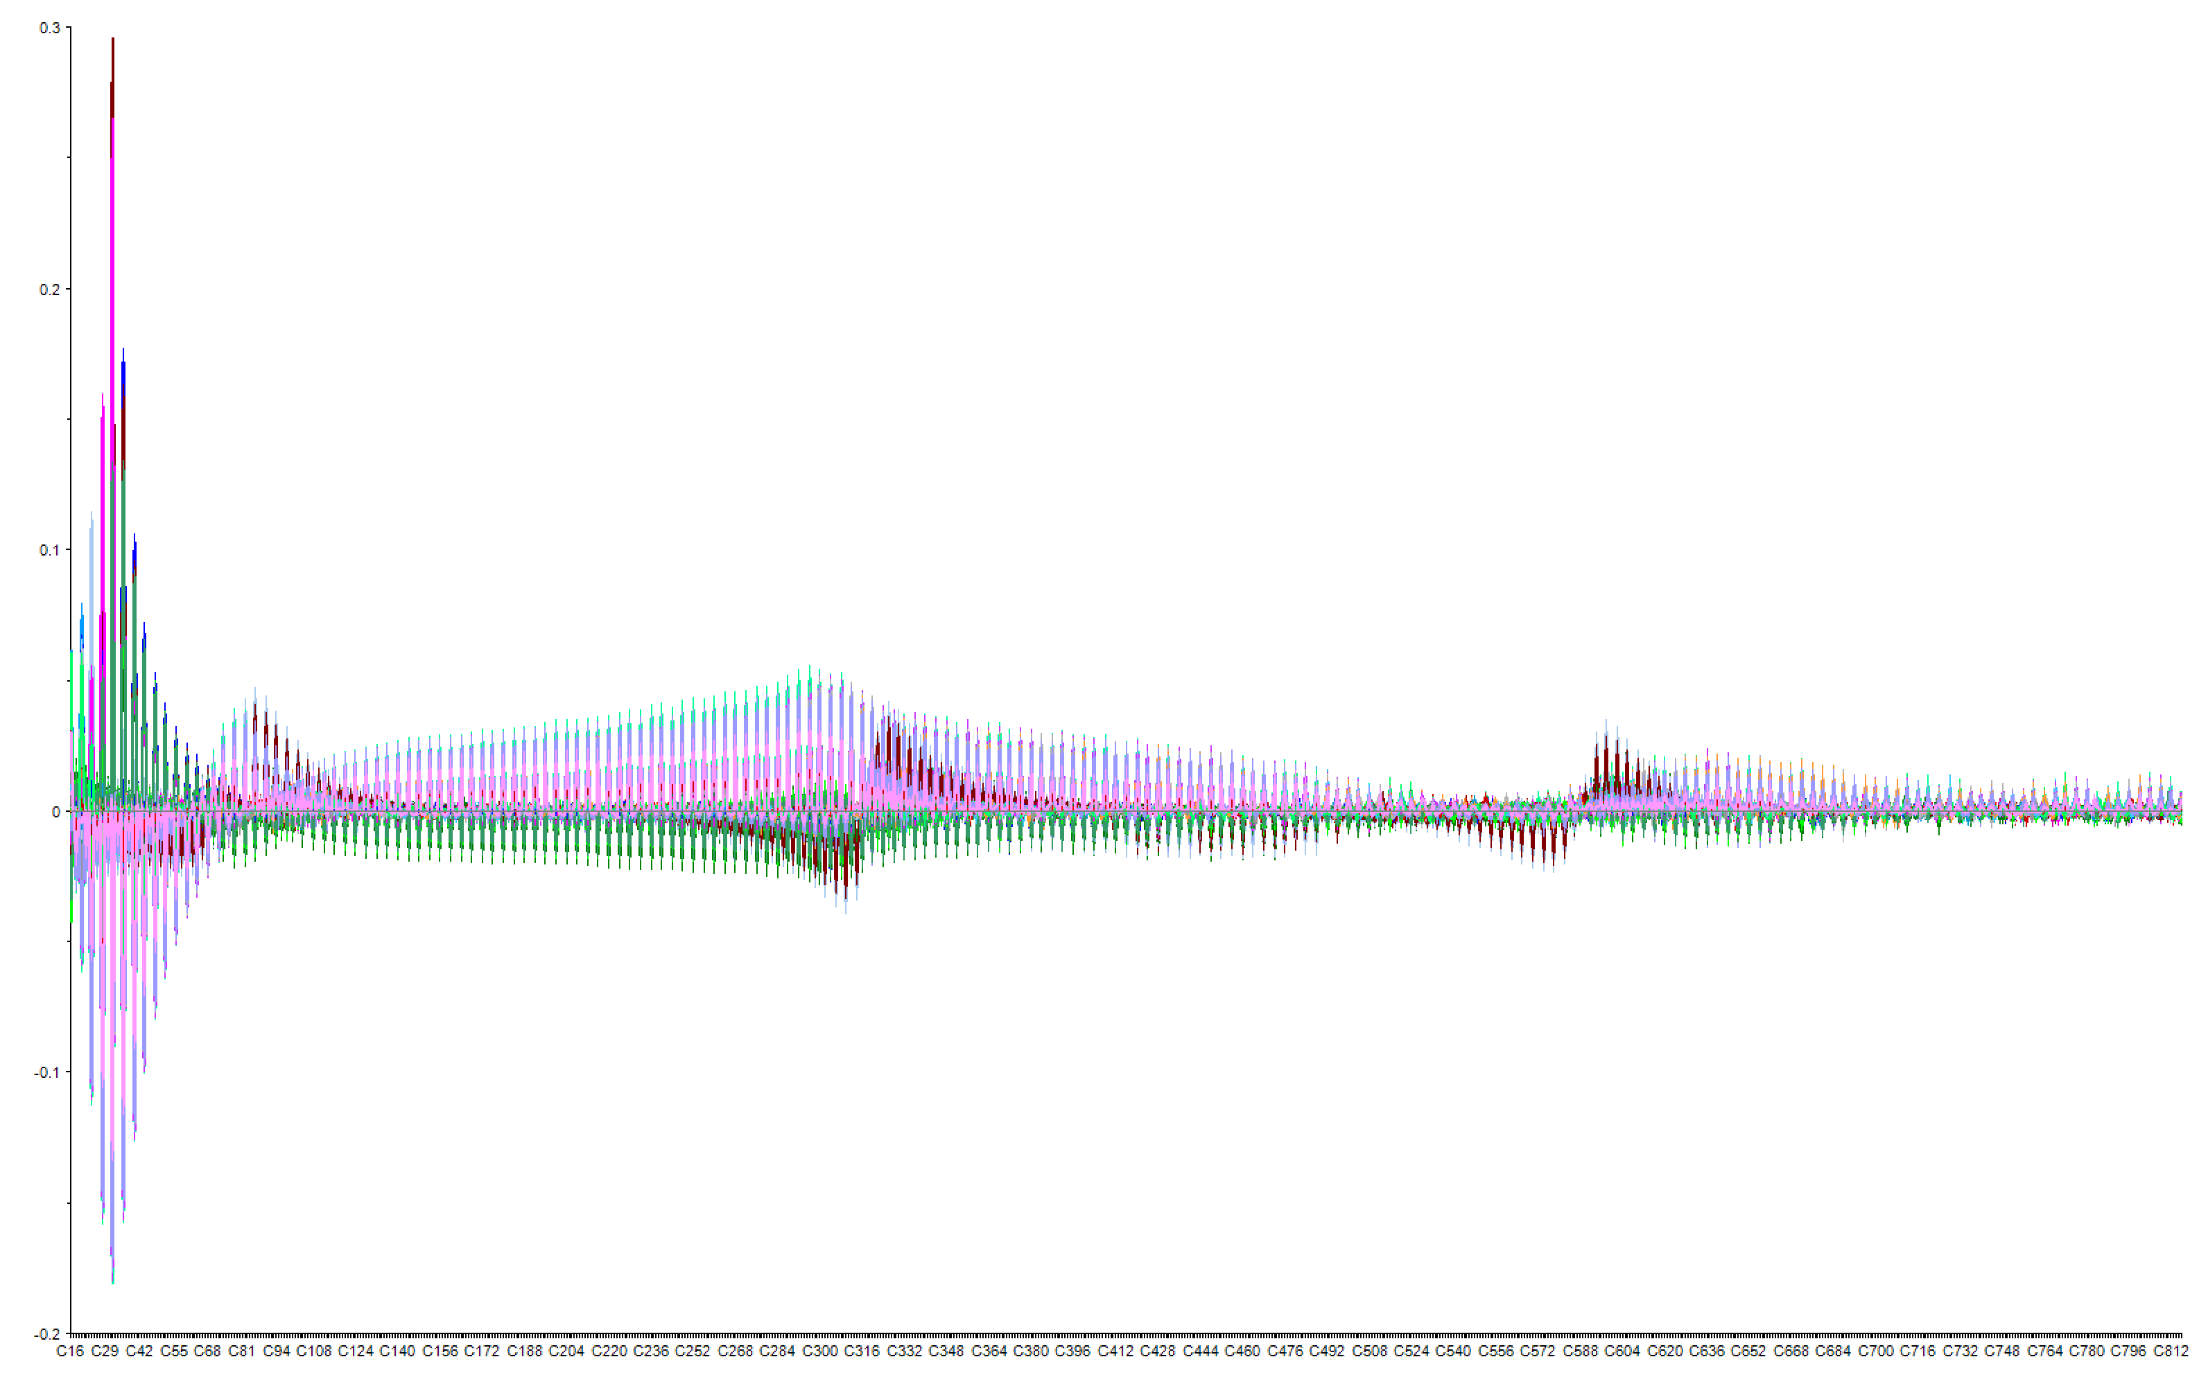
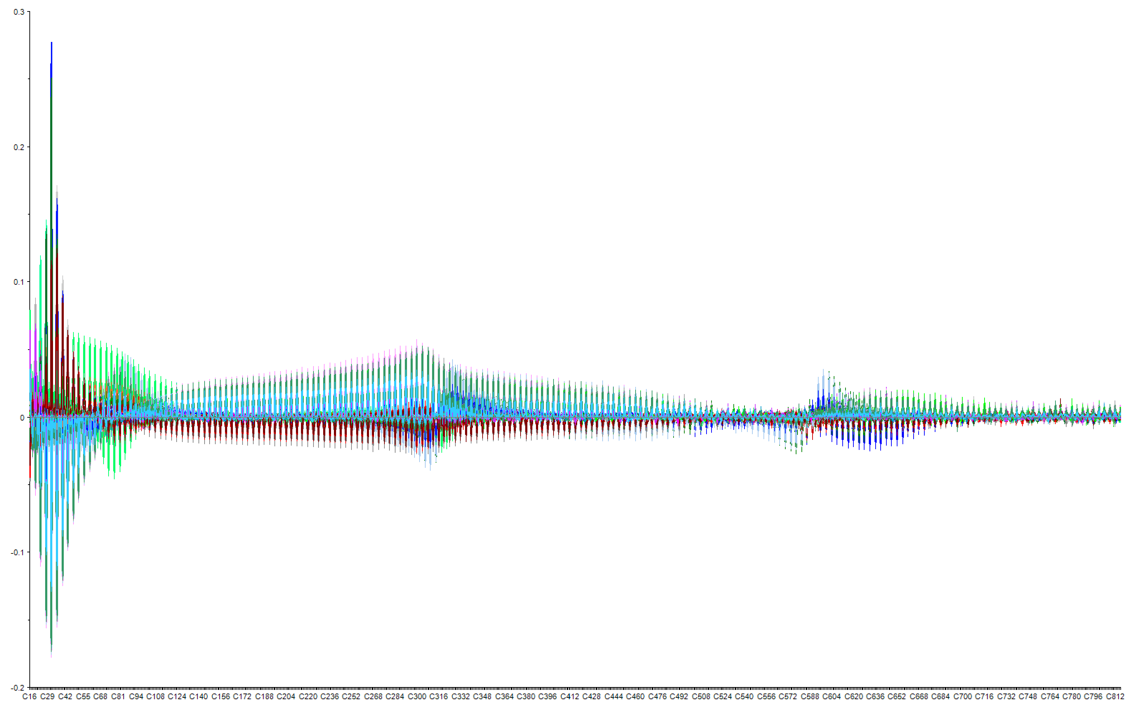
MOSFET PSA Data
Bias 1
Bias 2
Baseline
24 hours stress
Baseline
24 hours stress
Controls
48 hours stress
Controls
48 hours stress
Conditioned
96 hours stress
Conditioned
96 hours stress

Slide 15
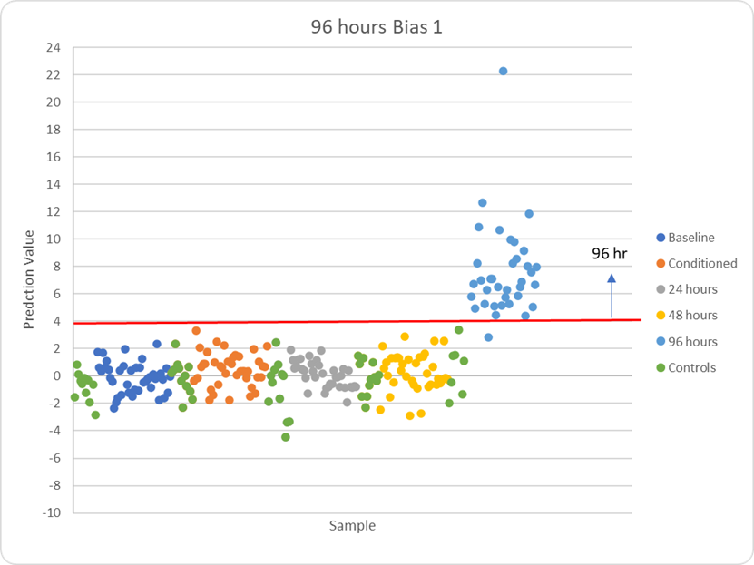
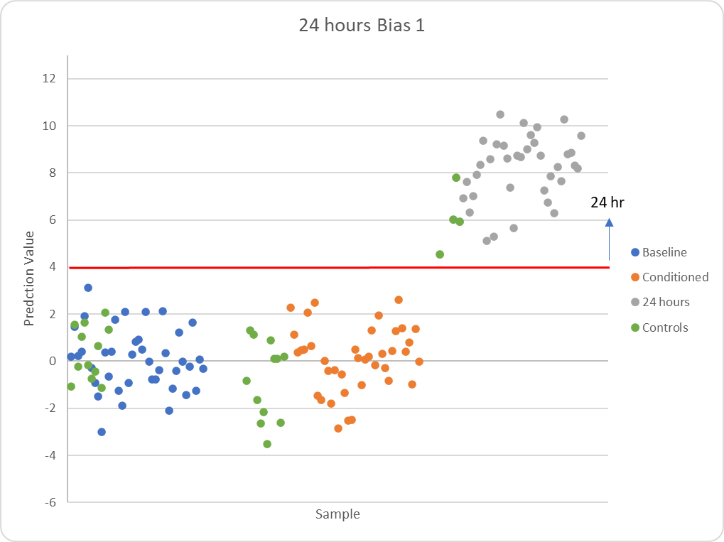
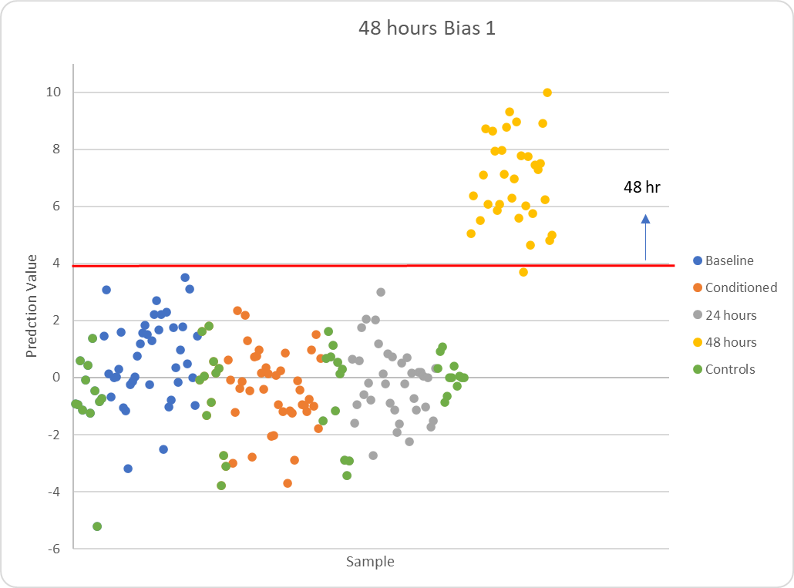
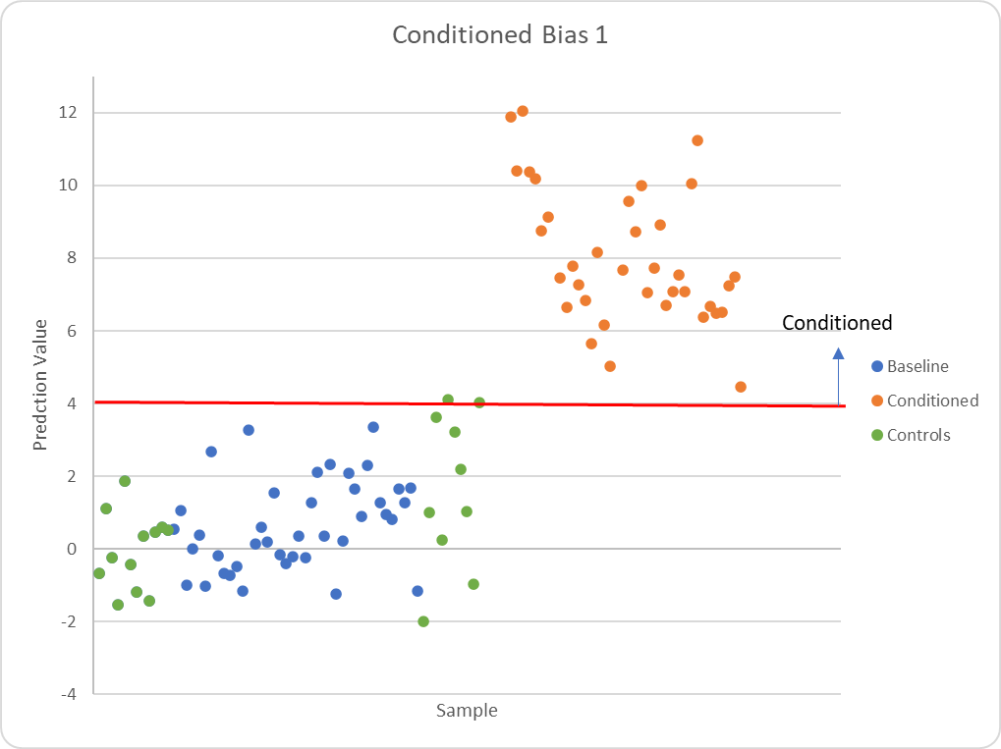
MOSFET
Bias 1 Algorithm
96 hours?
> 4
96 hours
96.8% Correct ID
99.6% correct ID
< 4
48 hours?
> 4
48 hours
99.4% correct ID
< 4
24 hours?
> 4
24 hours
97.0% correct ID
< 4
Conditioned?
> 4
Conditioned
98.0% correct ID
< 4
Baseline

Slide 16




MOSFET
Bias 2 Algorithm
96 hours?
96.4% Correct ID
> 4
96 hours
99.2% correct ID
< 4
48 hours?
> 4
48 hours
100% correct ID
< 4
24 hours?
> 4
24 hours
96.9% correct ID
< 4
Conditioned?
> 4
Conditioned
96.4% correct ID
< 4
Baseline

Slide 17


Zener Diode
Conventional IV Algorithm
For Algorithm:
Modeled on 111/79 measurements
Tested on 1476 measurements
Cycle 0 – no stressing
Cycles 1 & 2 stressing at 150 ºC, 65% Relative Humidity
Cycle 2?
> 5
Cycle 2
91.7% Correct ID (289/315)
8.3% mis-ID (26/315)
< 5
Cycle 1?
> 5
Cycle 1
96.5% Correct ID (307/318)
3.5% mis-ID (11/318)
< 5
Cycle 0
97.5% Correct ID (930/954)
2.5% mis-ID (24/954)

Slide 18
Conclusions & Next Steps
Multivariate analysis of PSA data and conventional IV data can be used to create algorithms that could be automated to screen semiconductor parts for aging.
The ability to screen semiconductor parts for aging is useful for:
  Manufacturers using electronic parts in the systems they are making
  Semiconductor manufacturers interested in the quality and reliability of the parts being made
  Anyone interested in assess the age related performance of a semiconductor device
The next steps in this research are to investigate another semiconductor components (GaN HEMT) and other kinds of data that can be included in the analysis fingerprint (ex. combine PSA and IV data into one fingerprint for analysis).

Slide 19
Funding
Sandia National Laboratories is a multimission laboratory managed and operated by National Technology & Engineering Solutions of Sandia, LLC, a wholly owned subsidiary of Honeywell International Inc., for the U.S. Department of Energy’s National Nuclear Security Administration under contract DE-NA0003525.

