Slide 1
A novel ensemble approach to uncertainty quantification in operator learning
Machine Learning & Deep Learning Workshop
September 2024
Ravi G. Patel (1441), Tian Yu Yen (1441), Joey Hart (1441), Indu Manickam (5524), Reese Jones (8363), Benj Wagman (8931)
SAND2024-09373C

Slide 2
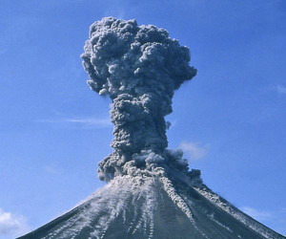
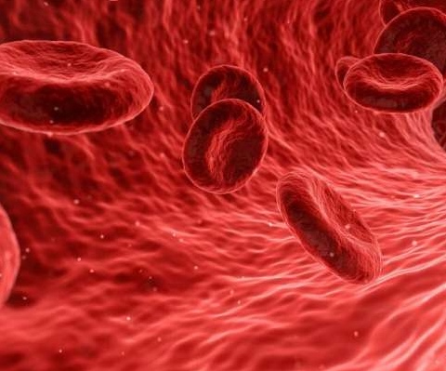
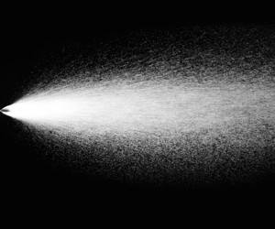

Finding models for multi-scale, multi-physics systems
Given experimental/high fidelity simulation data from a system
Find a mathematical model that describes the system
  Typically a PDE
Experiments/simulations generate noisy, biased, sparse data

Slide 3
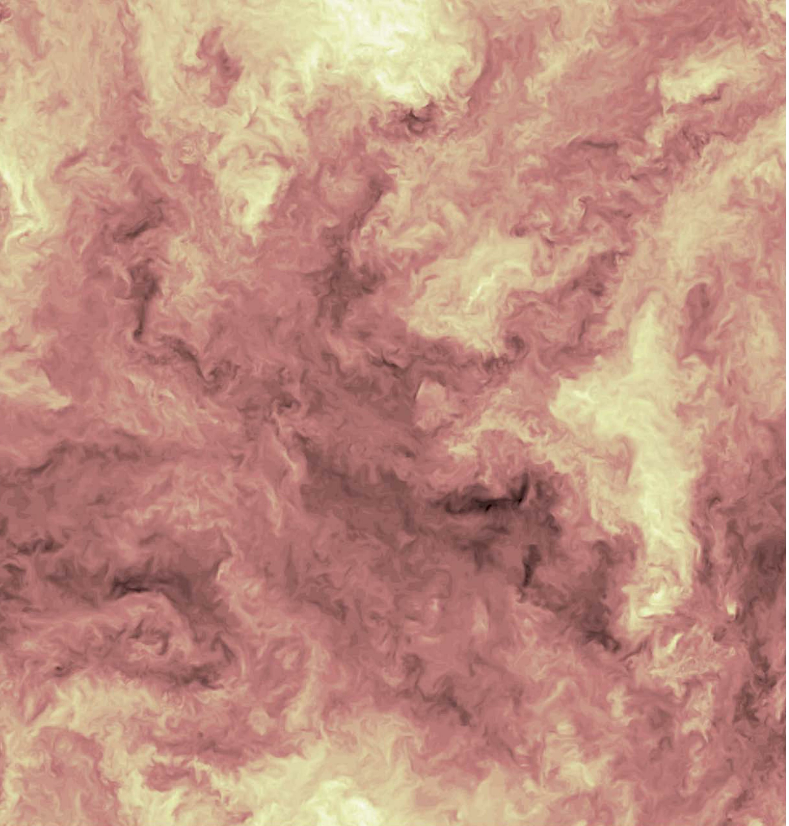
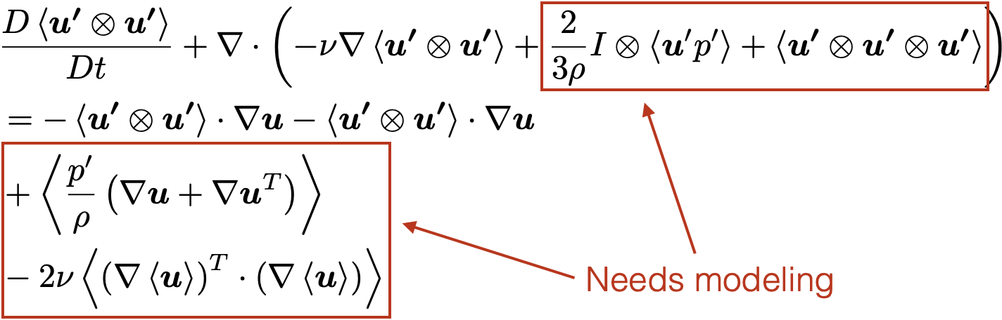
PDE modeling is hard
Multiphase, multiphysics problems
  Can’t easily model with intuition
  Data driven methods provide an alternative
Reynolds stress modeling for single phase turbulence
Forced isotropic turbulence
JHTDB, turbulence.pha.jhu.edu

Slide 4
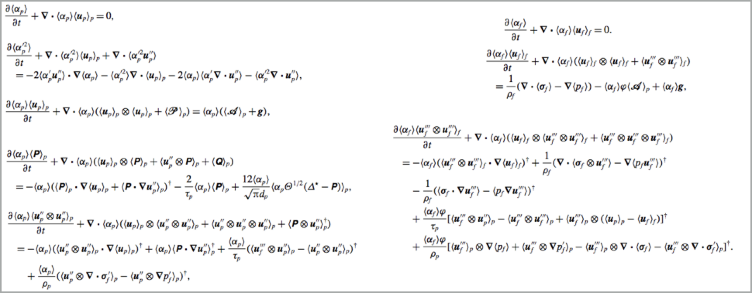
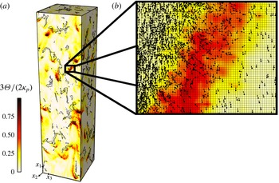
PDE modeling is hard
Multiphase, multiphysics problems
  Can’t easily model with intuition
  Data driven methods provide an alternative
Granular temperature field in cluster-induced turbulence¹
Reynolds averaged transport equations¹ for particle-laden turbulent flow
¹Capecelatro et al., J. Fluid Mech. (2015)

Slide 5
PDE modeling is hard
Multiphase, multiphysics problems
  Can’t easily model with intuition
  Data driven methods provide an alternative
Granular temperature field in cluster-induced turbulence¹
Closure models are all operators – functions that map fields to fields
Reynolds averaged transport equations¹ for particle-laden turbulent flow
¹Capecelatro et al., J. Fluid Mech. (2015)

Slide 6
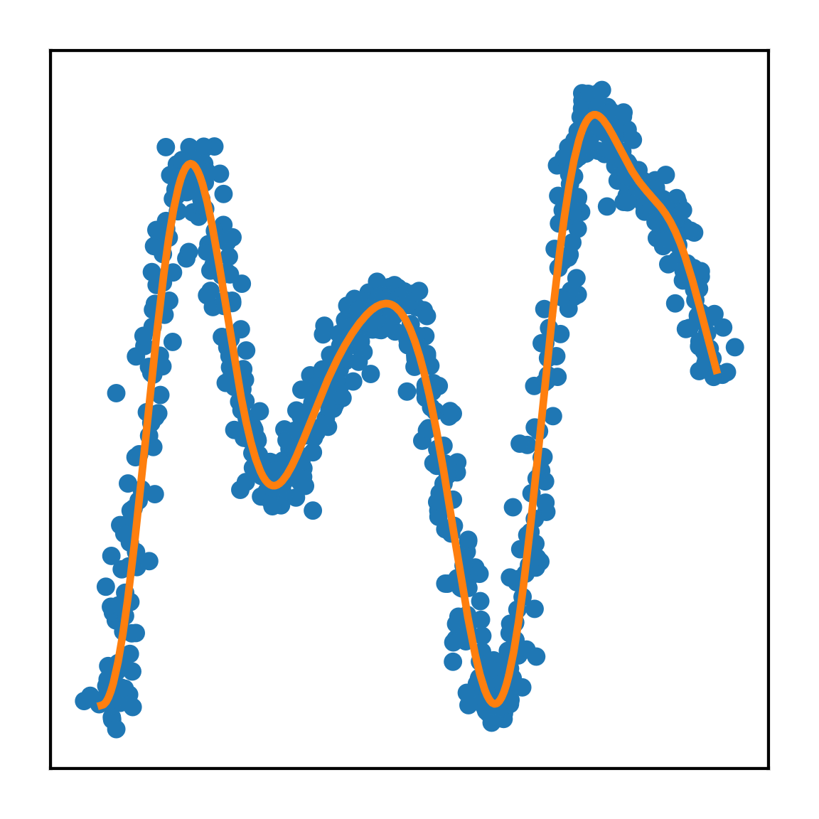
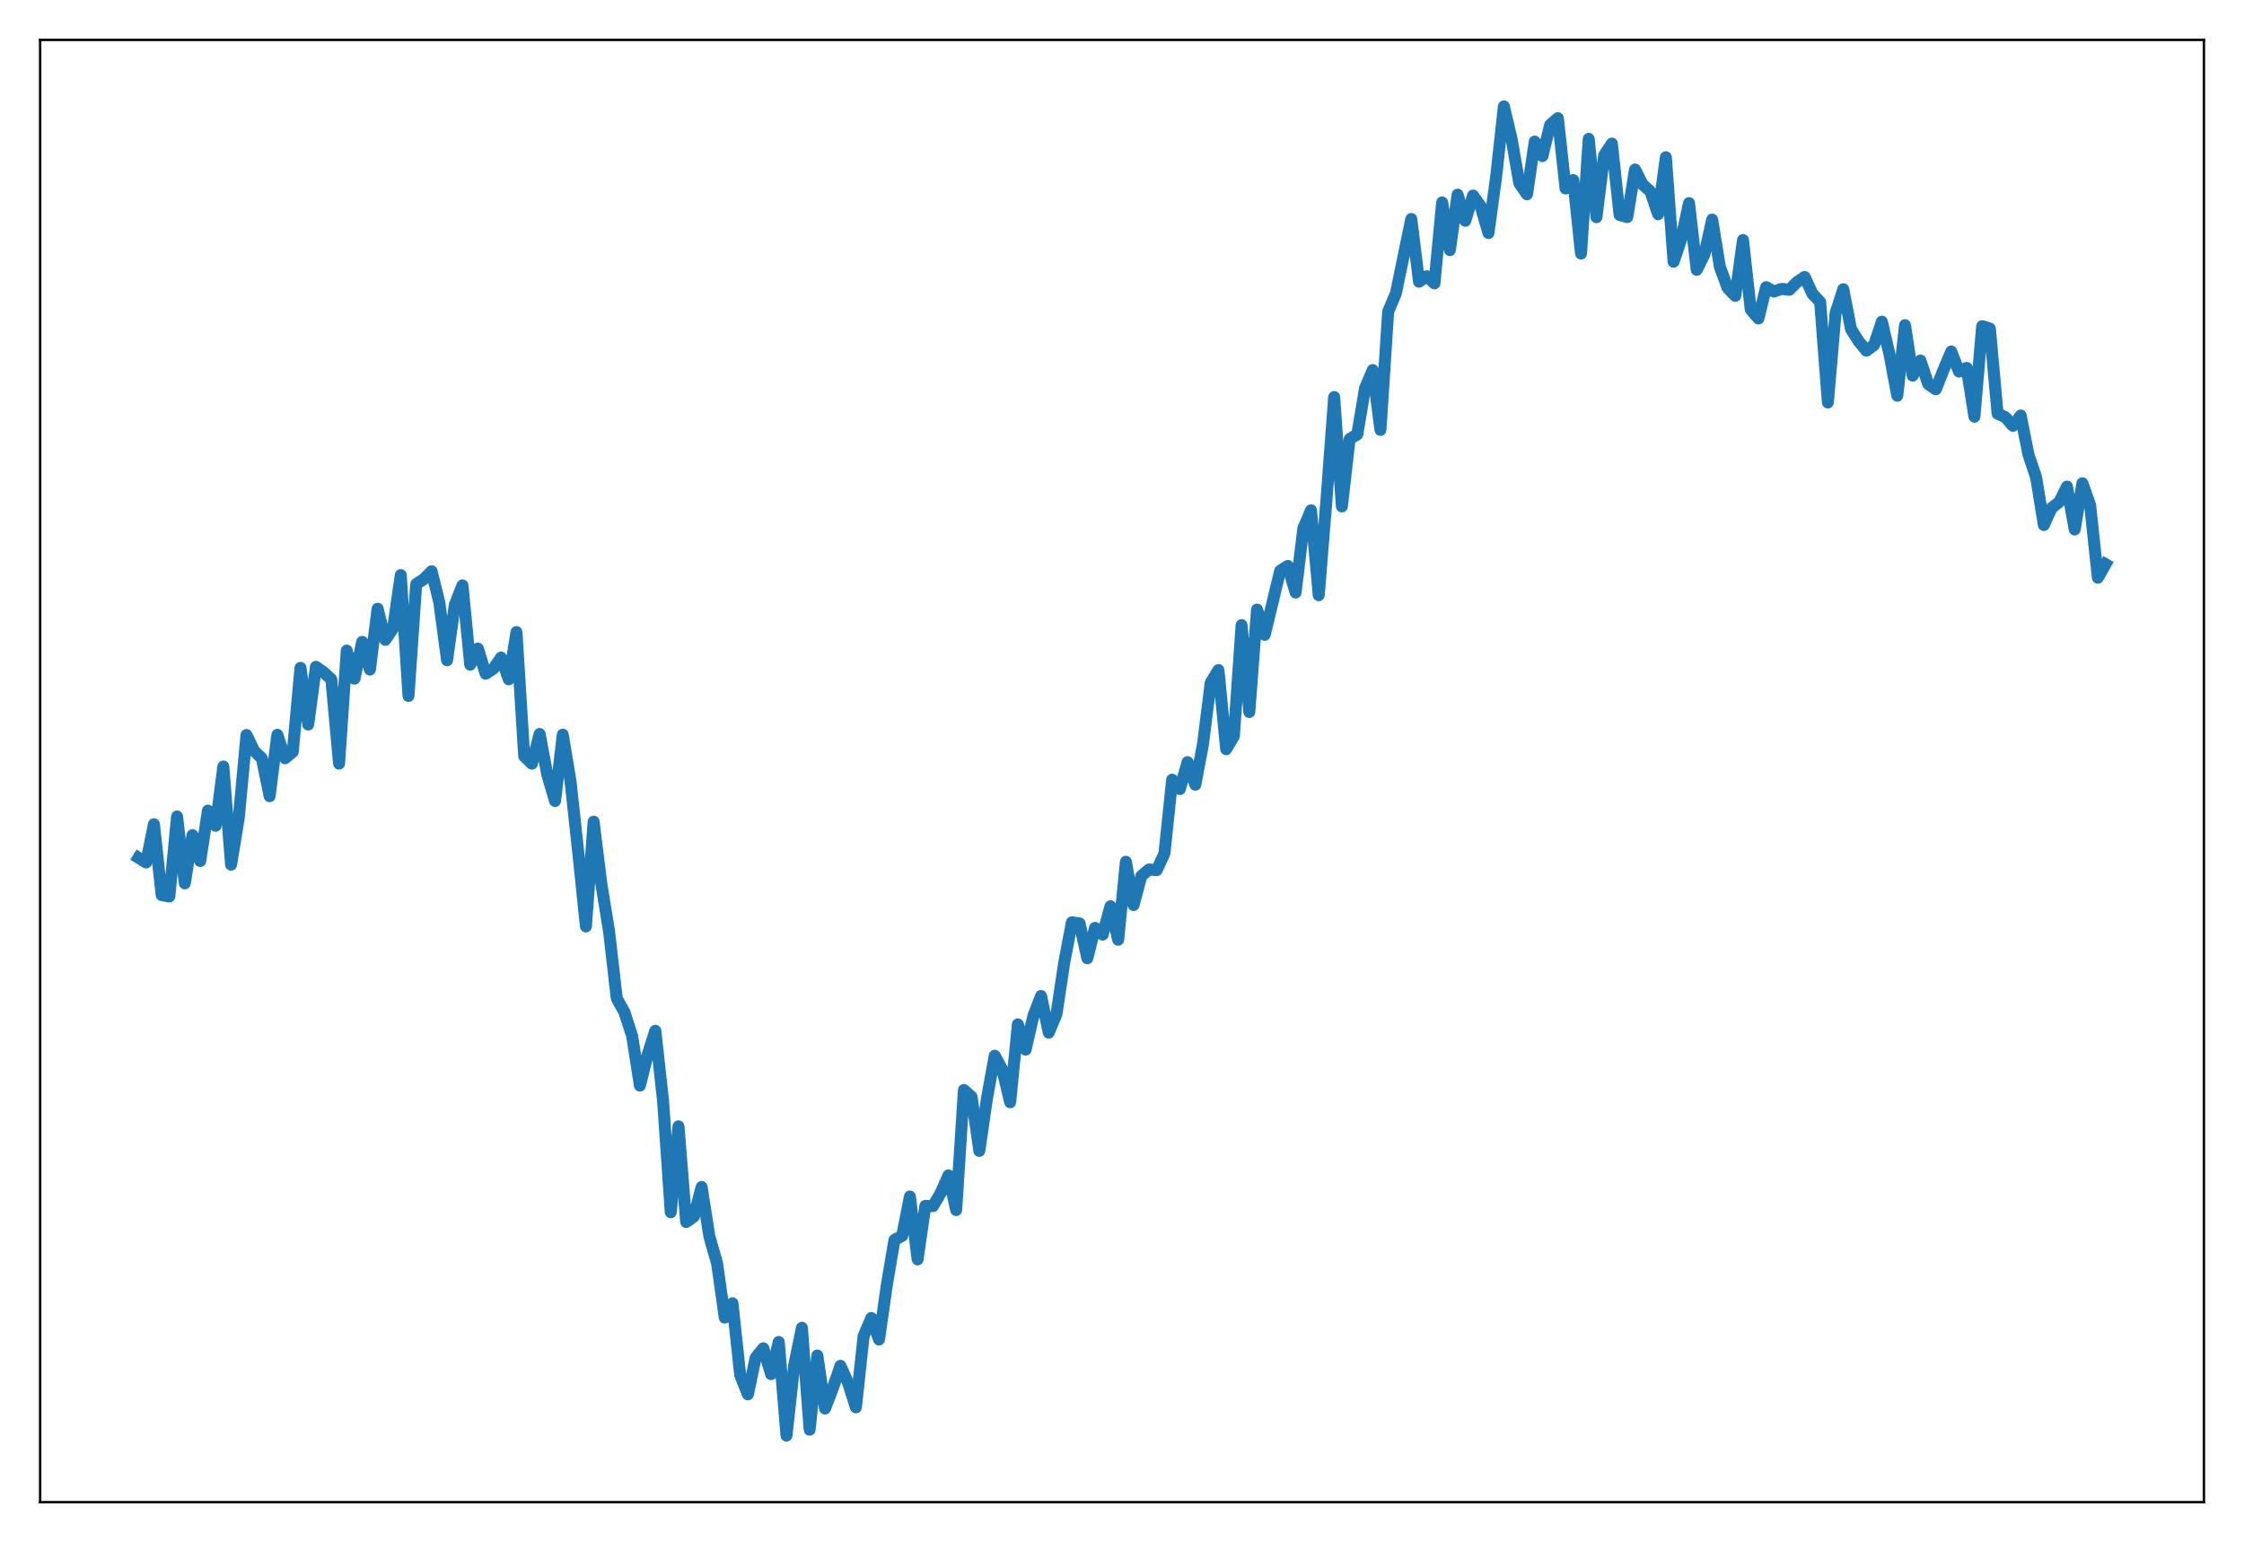
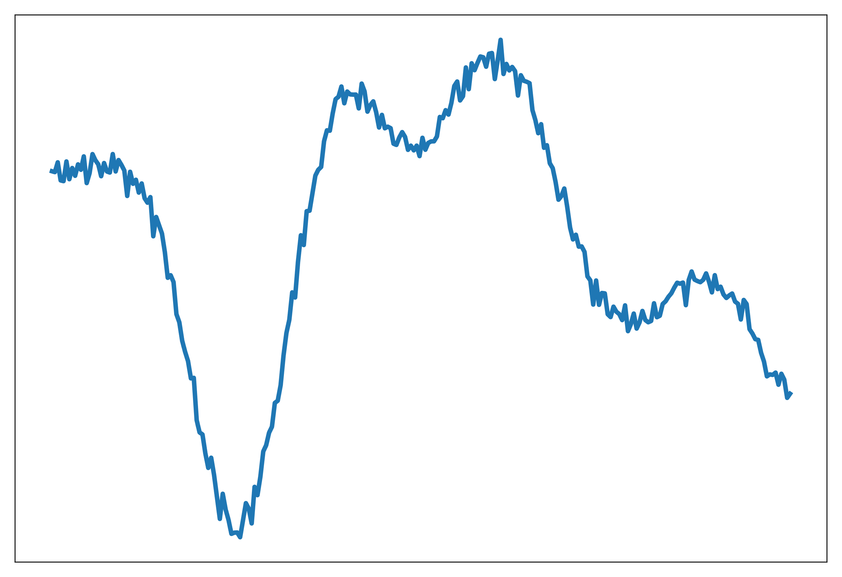
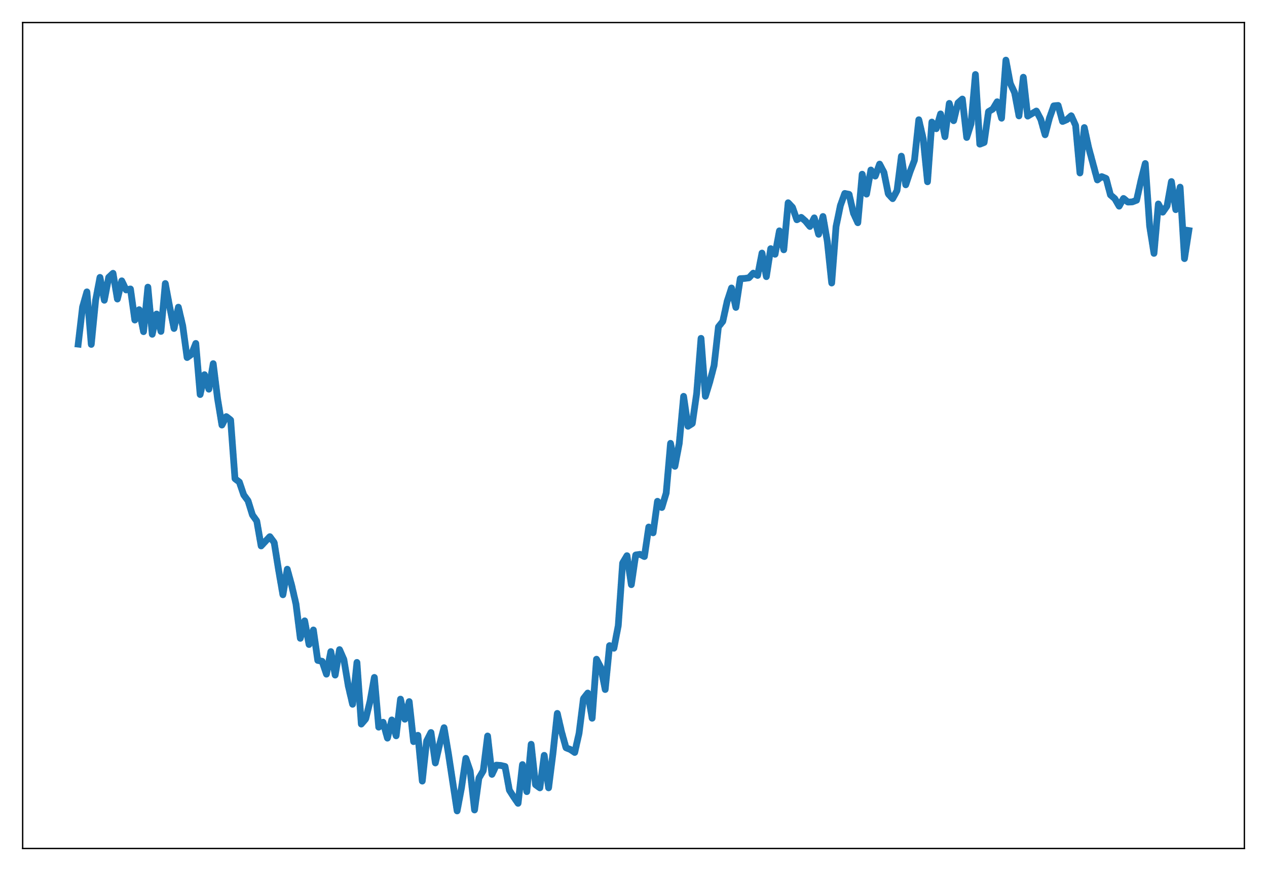
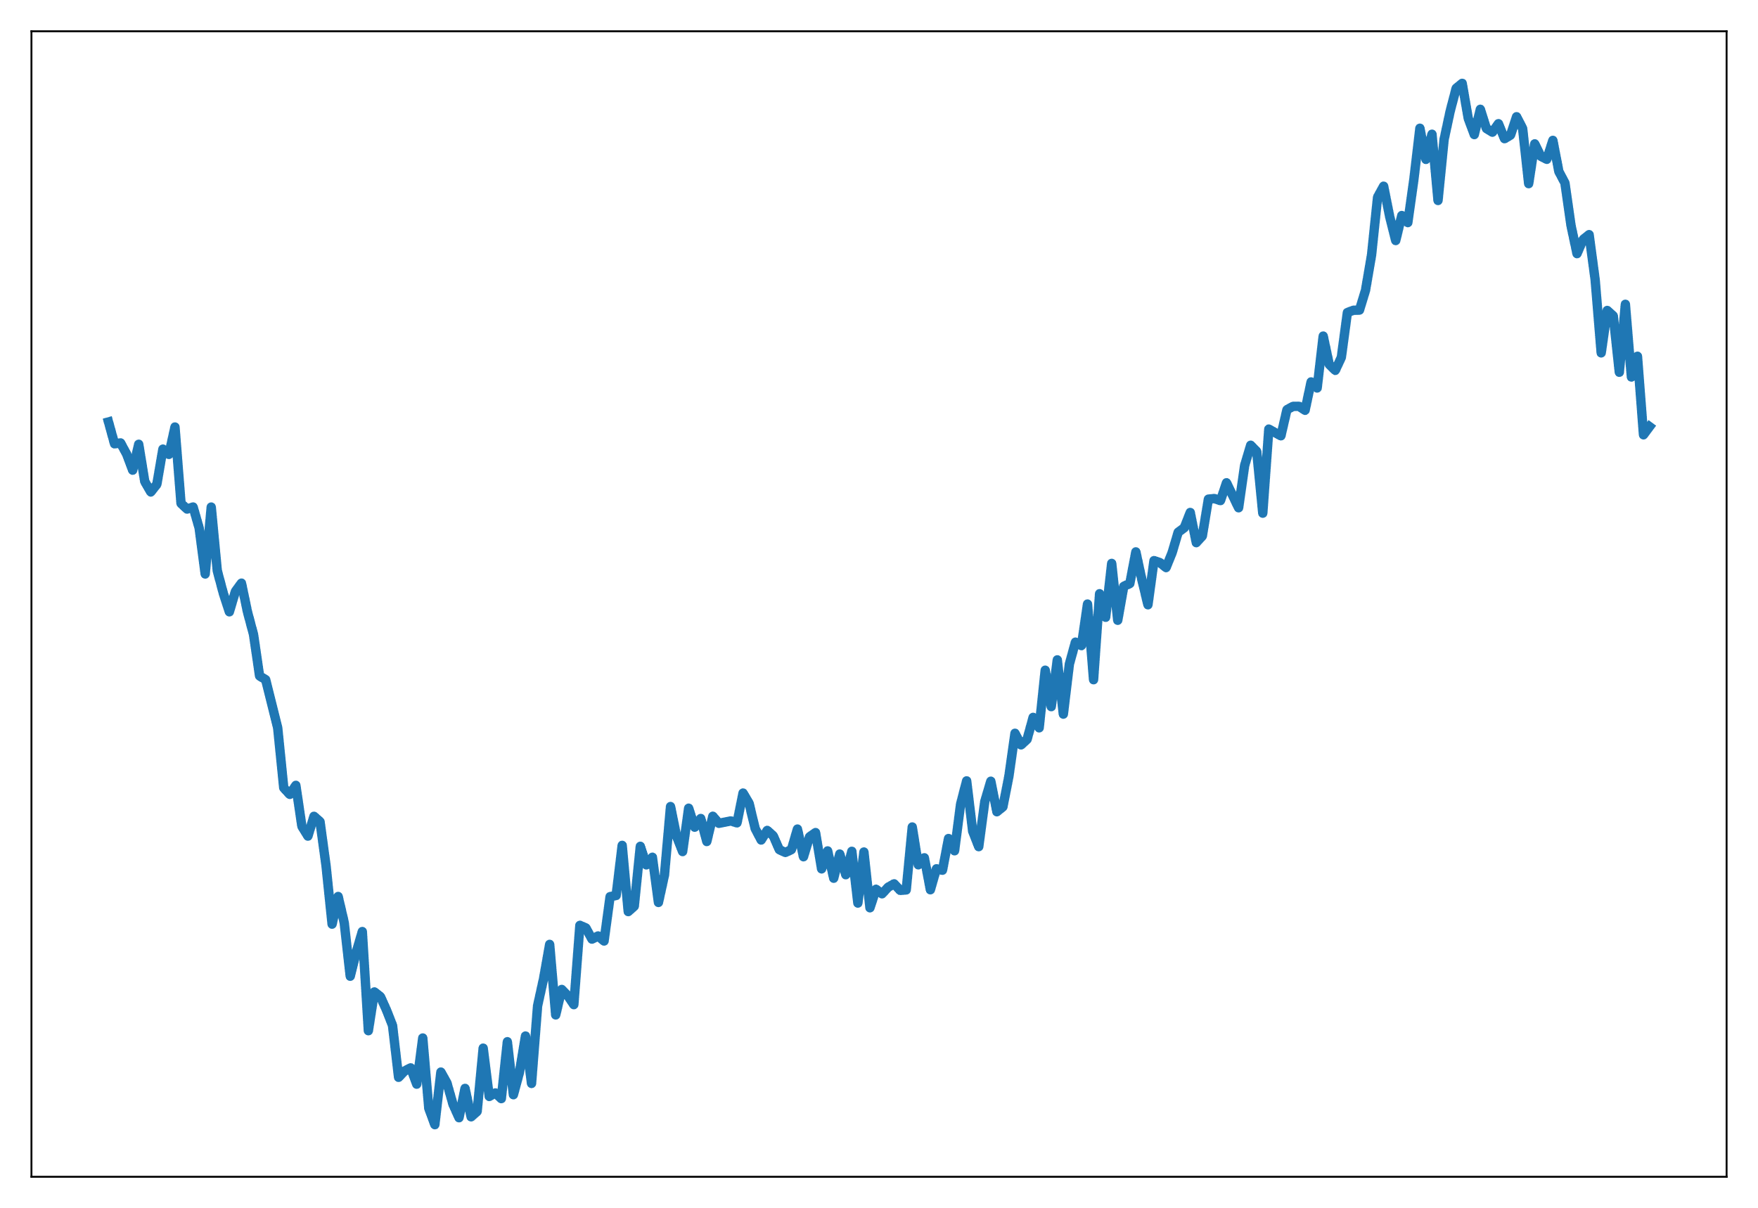
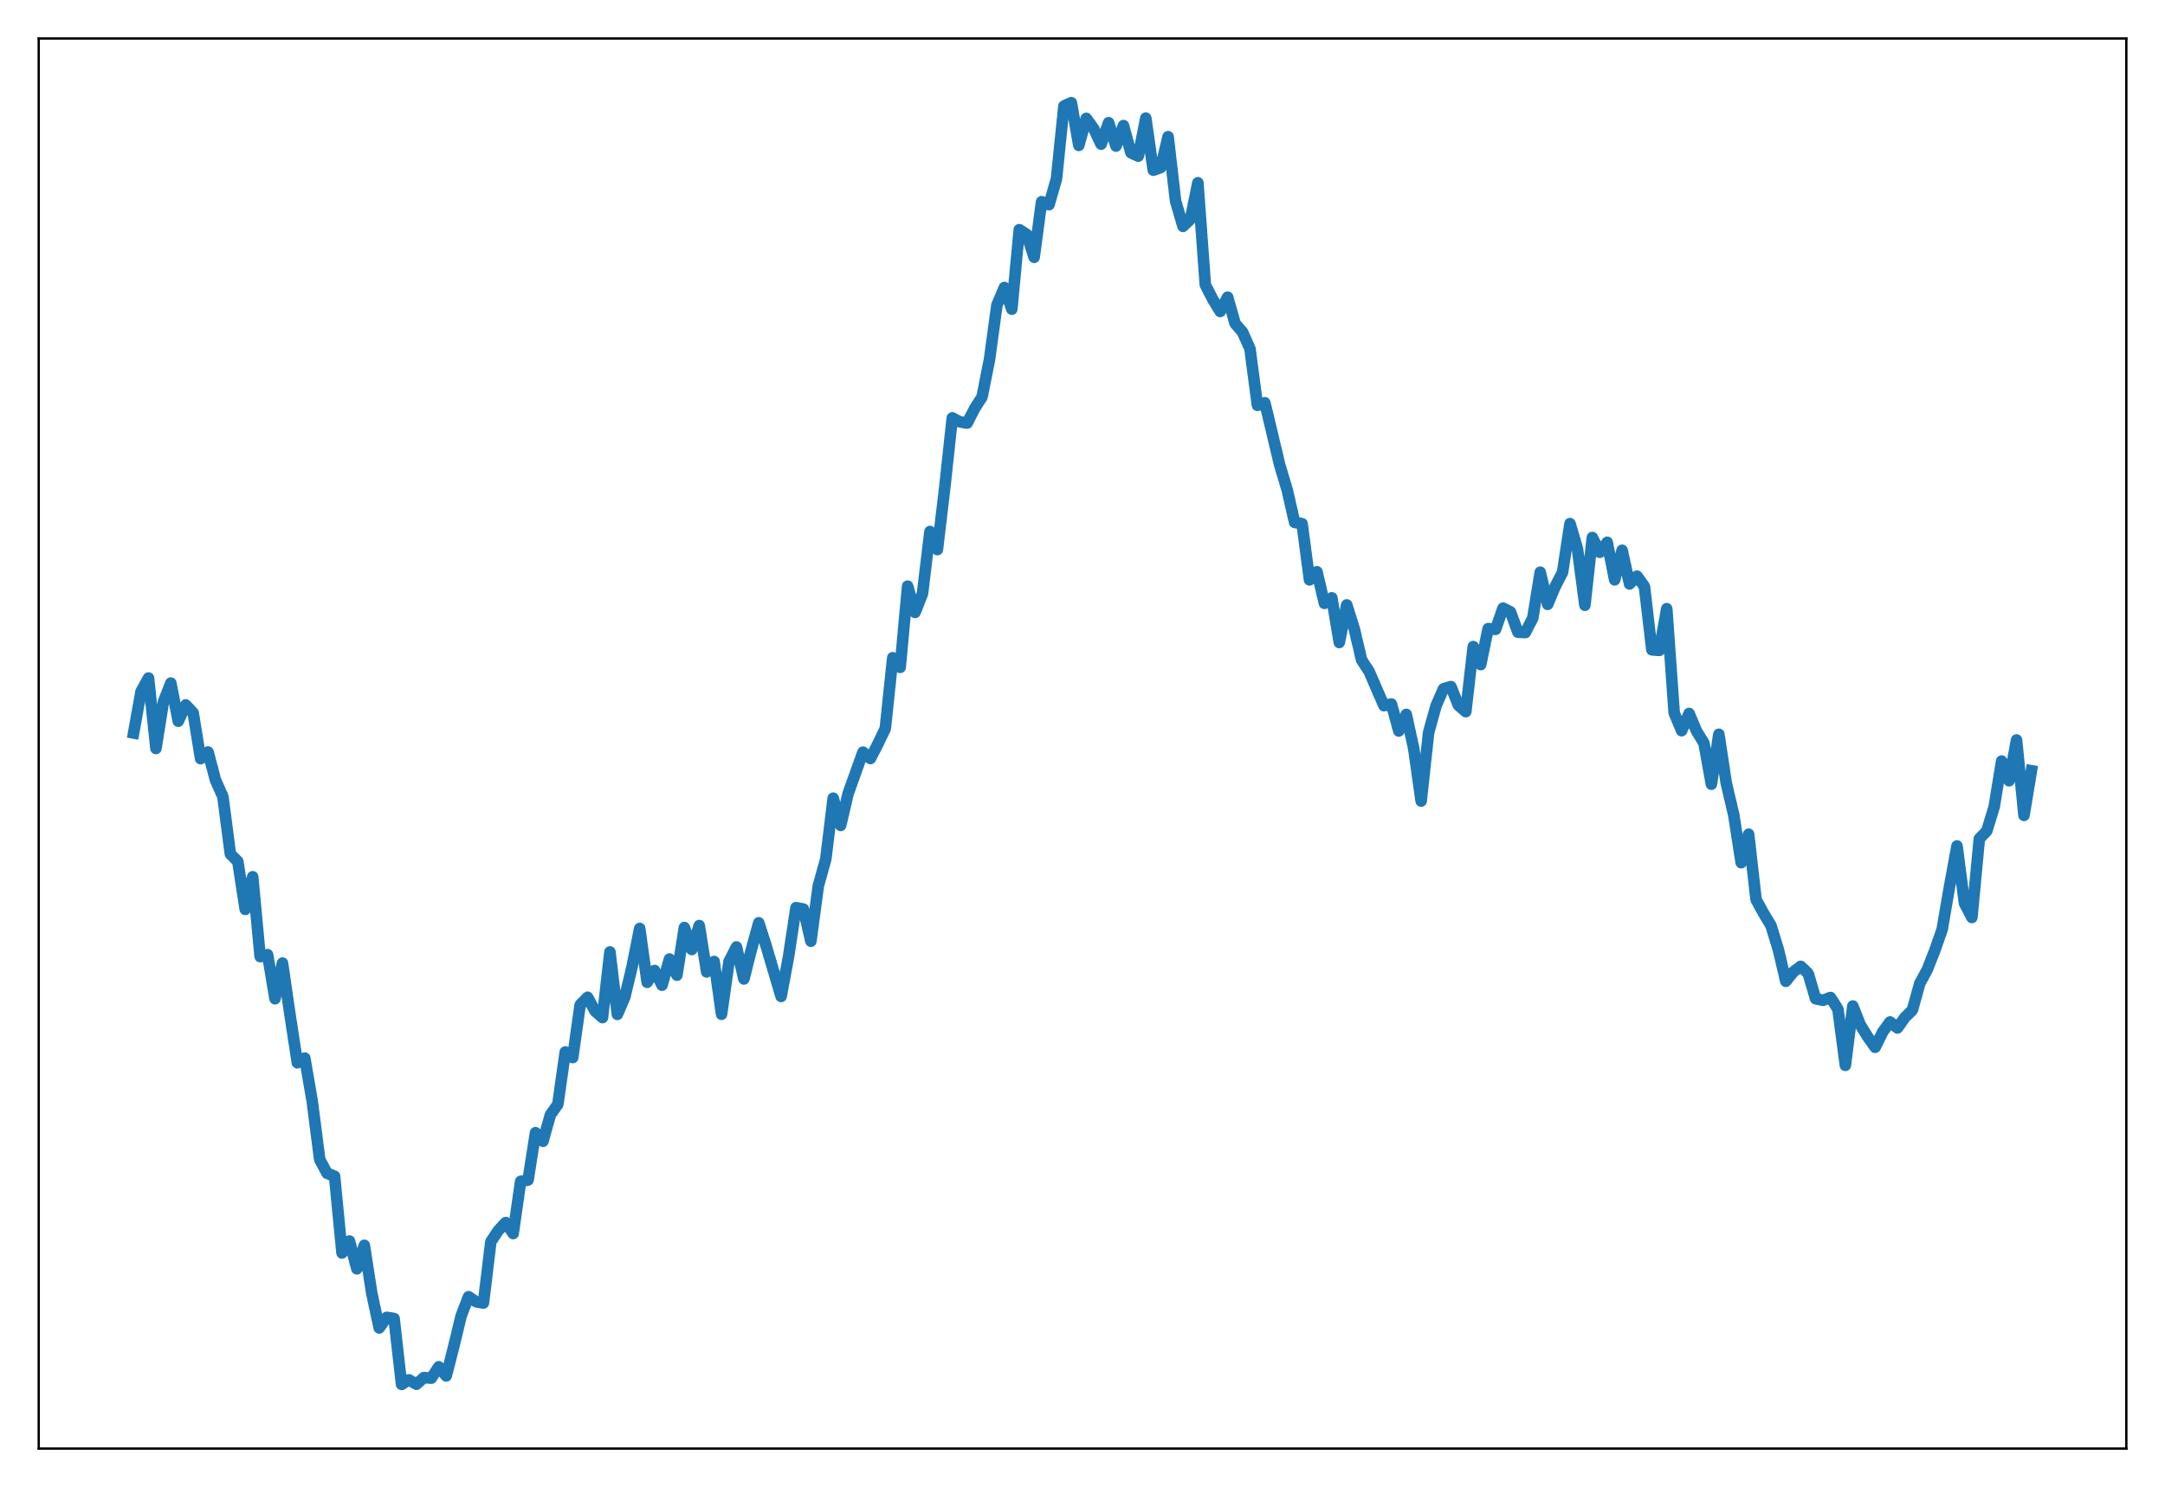
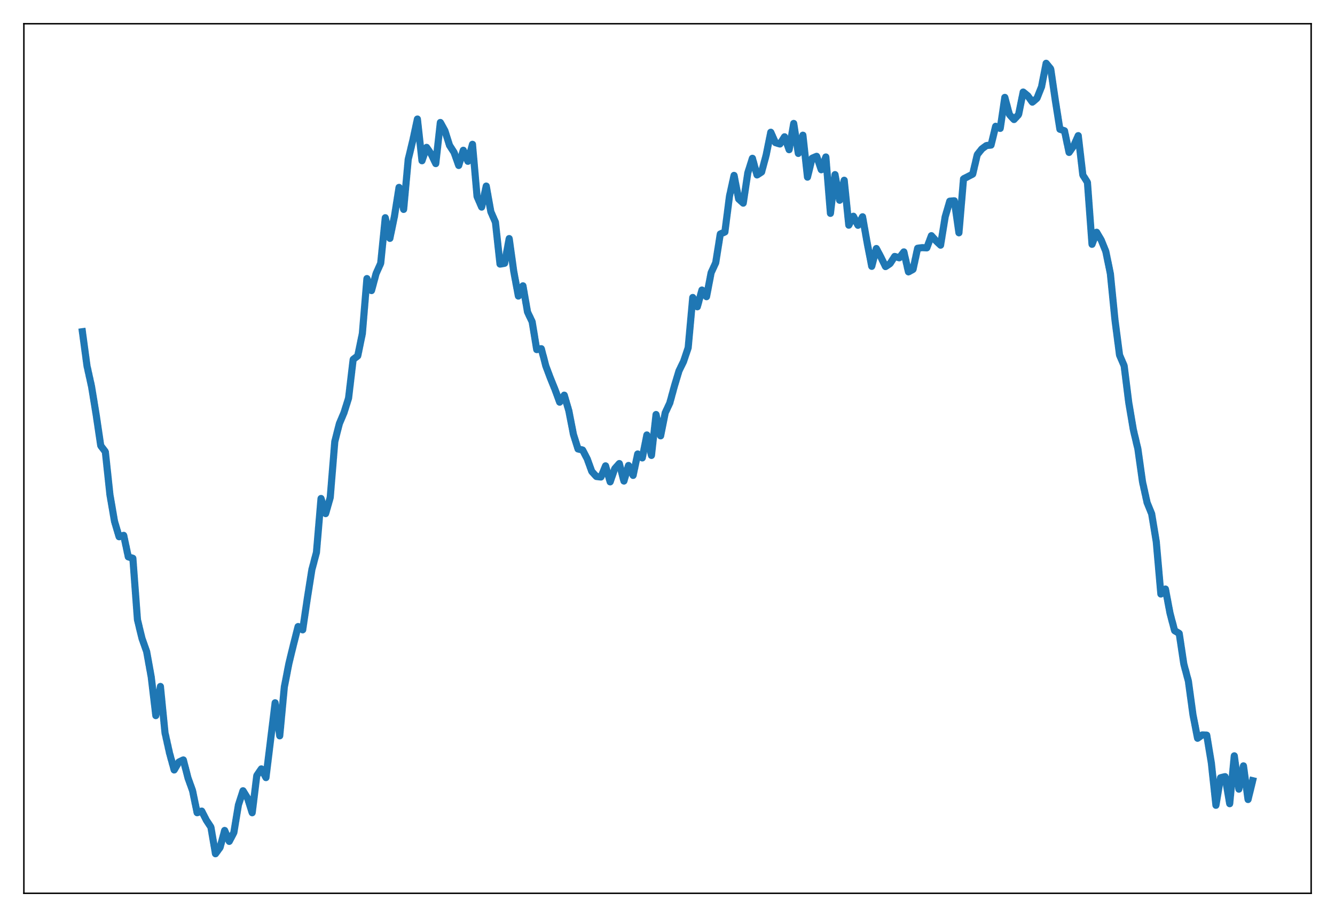
Operator learning – an ingredient for PDE modeling
Fitting functions
Fitting operators

Slide 7
Operator learning – an ingredient for PDE modeling
Fitting functions
Fitting operators
How do you parameterize the operator?

Slide 8
Operator learning parameterizations
Modal Operator Regression for physics (MOR-Physics)^{1,2}
Given pairs of functions, , find a mapping,
  Let’s assume they’re given as point-wise evaluations on a regular, periodic grid
We parameterize the unknown operator as,
Where and are neural networks.
is the Fourier transform
Optimization problem becomes,
    ¹R.G. Patel and Desjardins, arxiv: 1810.08552 (2018)
    ²R.G. Patel et al., CMAME (2021)

Slide 9
Operator learning parameterizations
Modal Operator Regression for physics (MOR-Physics)^{1,2}
Given pairs of functions, , find a mapping,
  Let’s assume they’re given as point-wise evaluations on a regular, periodic grid
We parameterize the unknown operator as,
Where and are neural networks.
is the Fourier transform
Optimization problem becomes,
First neural operator (2018)
Fourier Neural Operator (2020) uses a similar parameterization
Translation invariance
Can capture non-local behavior
Motivated by Fourier pseudo-spectral methods
Accelerated by the FFT
    ¹R.G. Patel and Desjardins, arxiv: 1810.08552 (2018)
    ²R.G. Patel et al., CMAME (2021)

Slide 10
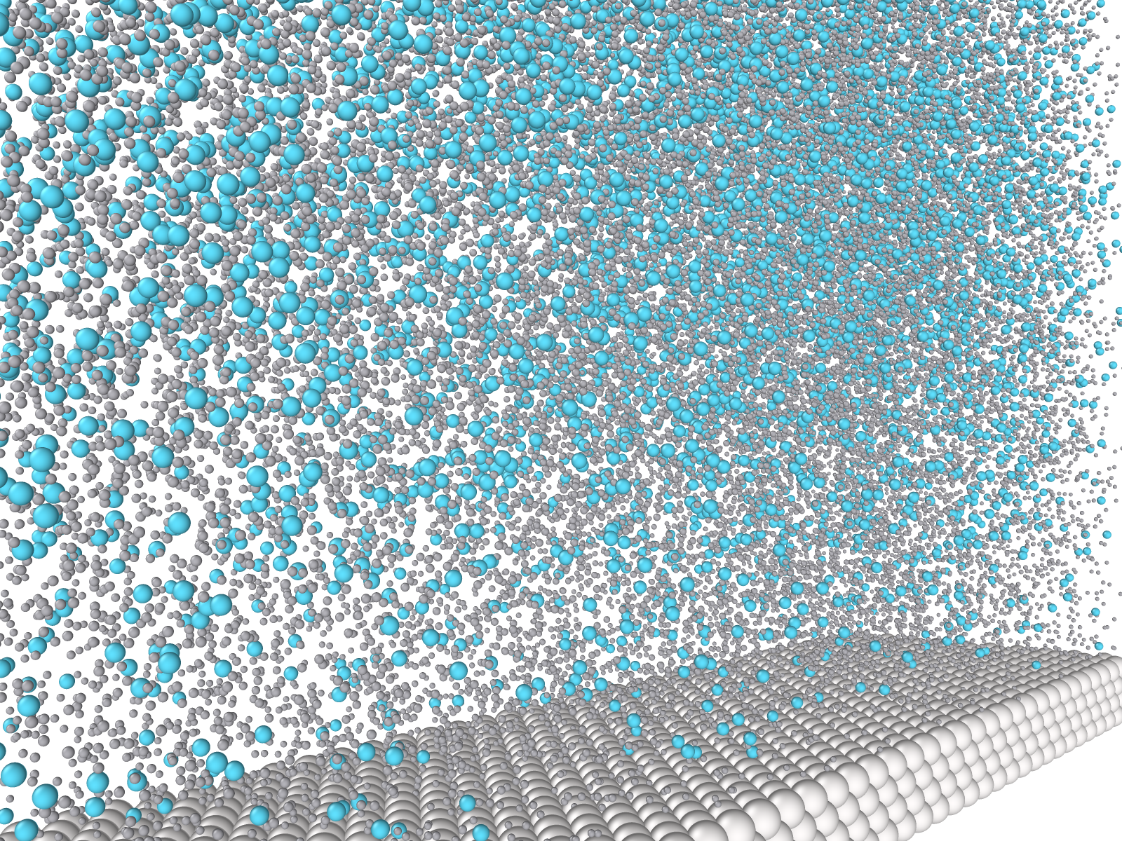
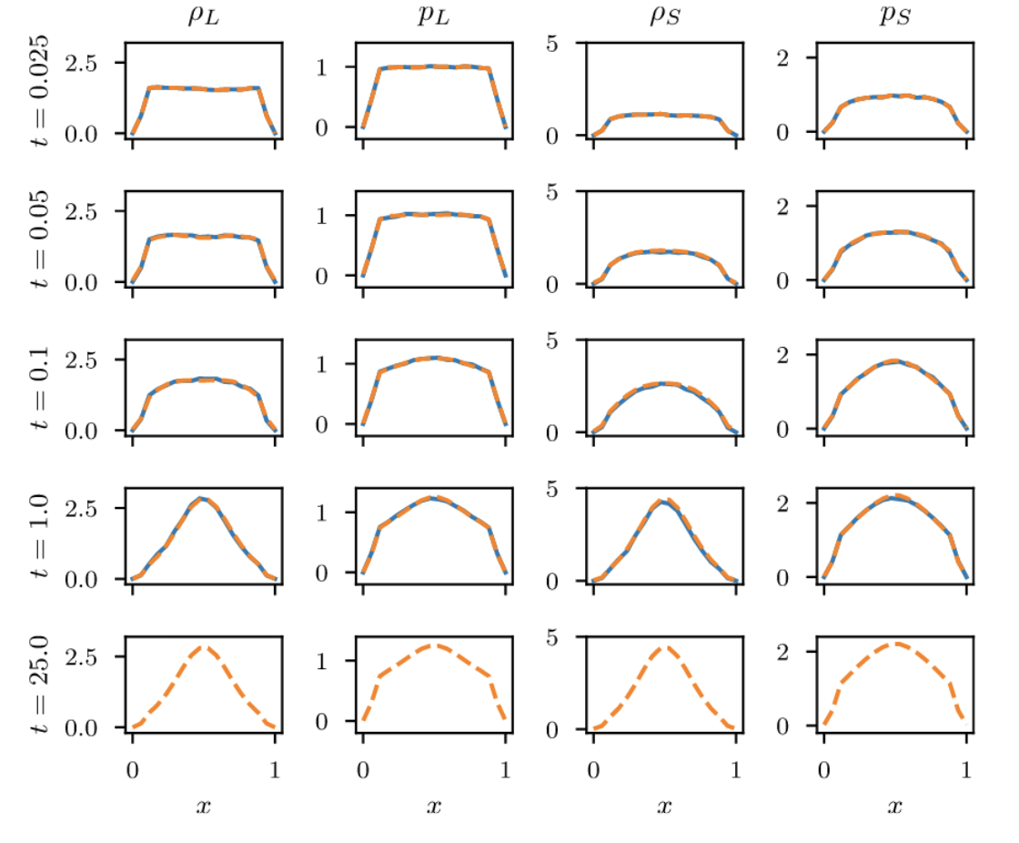
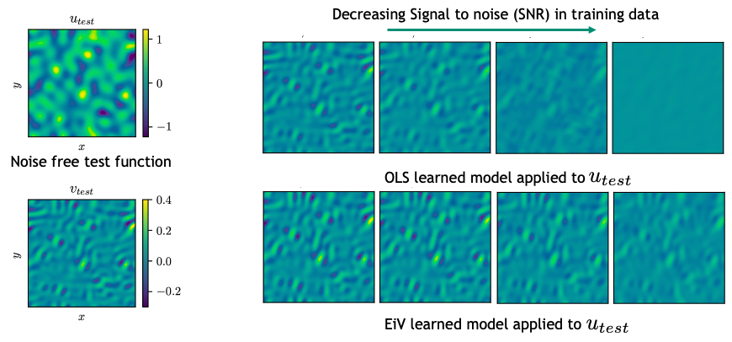
Operator learning parameterizations
MOR-Physics results and extensions^{1,2}
Added physics informed inductive biases into the parameterization¹
  Conservation, rotational equivariance, symmetry
Introduced error-in-variables modeling for operator learning to counteract attenuation bias²
MOR-physics learns dynamics of colloidal system from molecular dynamics simulations. Generalizes to unseen concentration and colloid diameter¹
    ¹R.G. Patel et al., CMAME (2021)
    ²R.G. Patel et al., MSML (2022)

Slide 11
Operator learning parameterizations
Other operator learning methods
GMLS-Nets
  N.A. Trask et al., NeurIPS (2019)
DeepONets
  L. Lu et al., Nature Machine Intelligence (2021)
Fourier Neural Operator
  Z. Li et al., ICLR (2021)

Slide 12
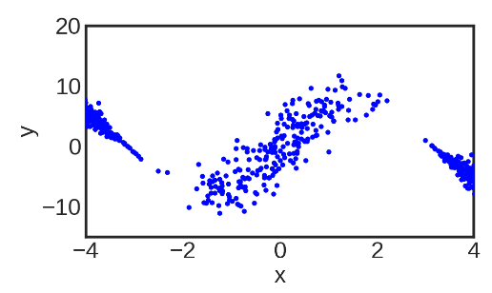
Synthetic Benchmark for scalar function inference
High aleatoric uncertainty
High epistemic uncertainty
Low uncertainty
Uncertainties for standard regression¹
¹Depeweg et al., PNAS (2018)

Slide 13
Synthetic Benchmark for scalar regression
High aleatoric uncertainty
How do we extend this to operator learning?
High epistemic uncertainty
Low uncertainty
Uncertainties for standard regression¹
¹Depeweg et al., PNAS (2018)

Slide 14
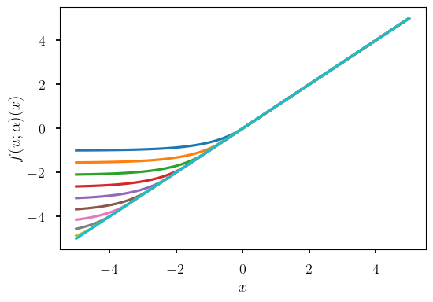
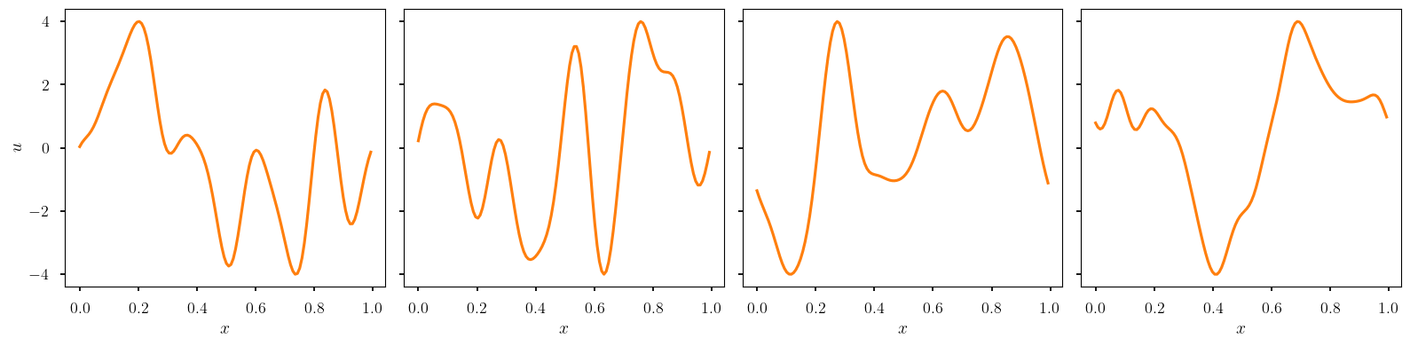
Synthetic Benchmark for operators
Aleatoric Uncertainty
Fit the operator,
Samples of input functions
Notes:
compose a derivative with a pointwise nonlinearity with varying nonlinearity
right - effect of different samples alpha on f

Slide 15
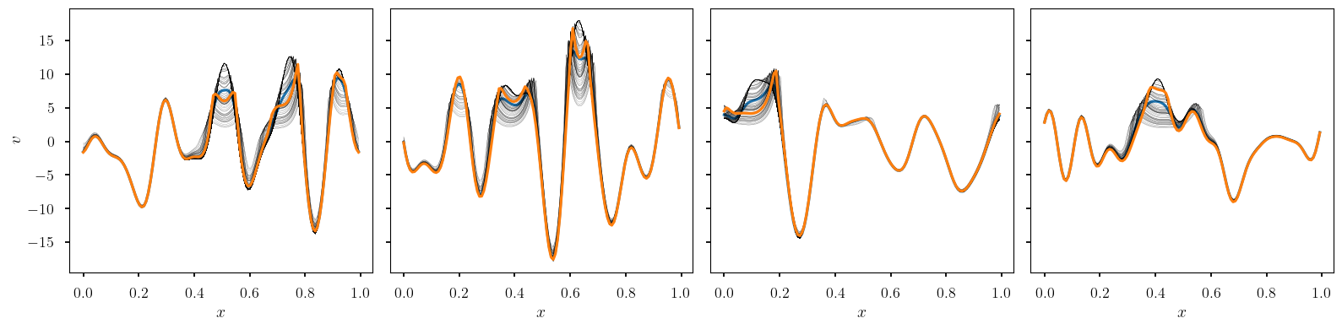
Synthetic Benchmark for operators
Aleatoric Uncertainty
Fit the operator,
Samples of output functions

Slide 16



Ensemble approach to quantifying aleatoric uncertainty
Given data from a stochastic operator, i.e., the pairs of functions,
Construct an ensemble of parameterized operators
Match the actions of the parameterized operators to the action in the data
Currently writing a manuscript on the method. Preprint will be released soon
16

Slide 17
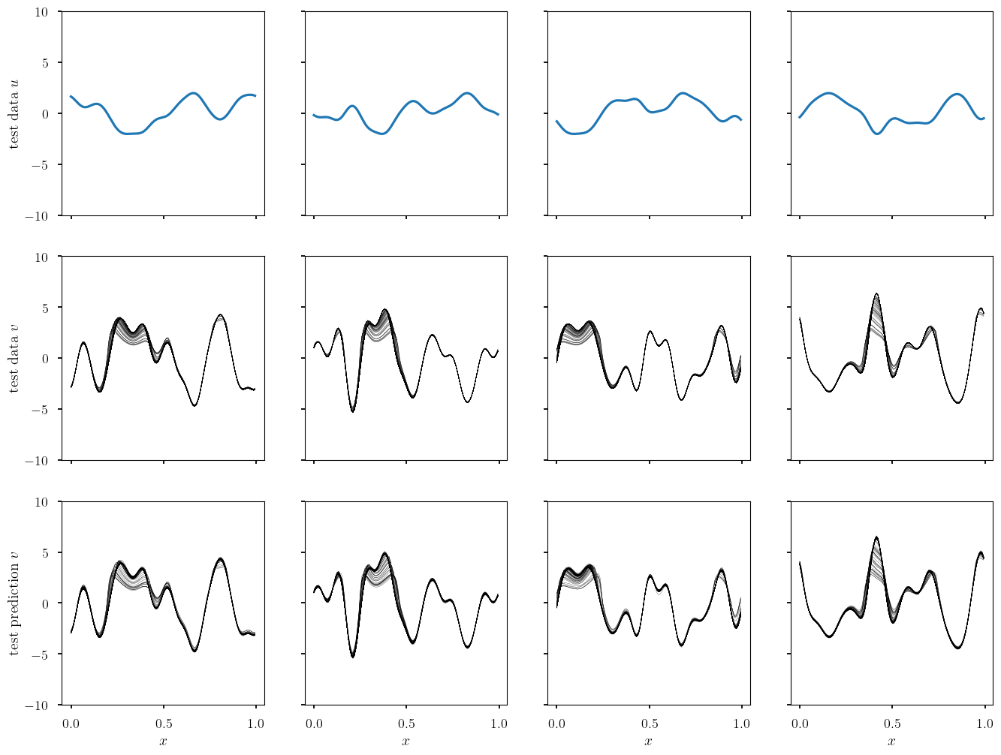
Synthetic benchmark for operators - results
Test input
functions
Test output
functions
Model Predictions

Slide 18
Synthetic benchmark for operators - results
Test input
functions
Test output
functions
Model Predictions

Slide 19
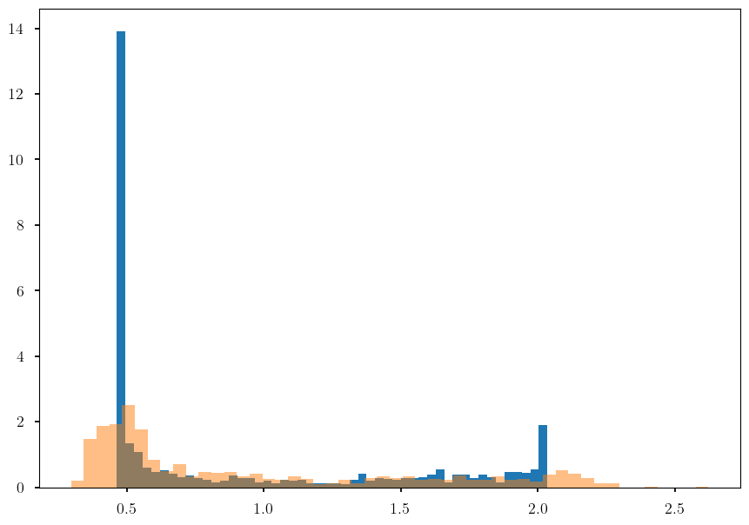
Synthetic benchmark for operators - results
Test input
functions
Test output
functions
 | Learned operators | True operators
mean | 0.9223 | 0.9351
std | 0.5771 | 0.5871
skewness | 0.8354 | 0.9094
kurtosis | -0.9675 | -0.6136
Model Predictions

Slide 20
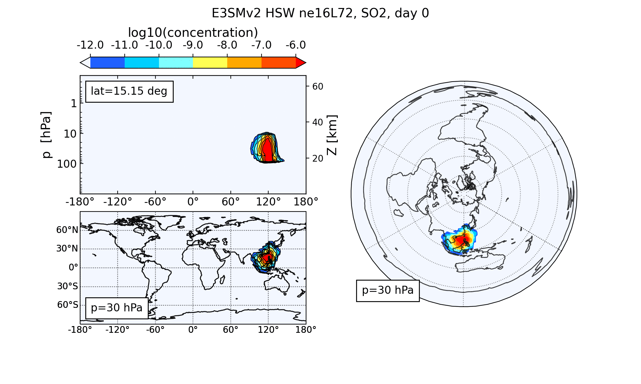
Conclusions
Developed a benchmark problem to examine aleatoric uncertainty in operator learning
Ensemble approach is a viable strategy to quantifying aleatoric uncertainty
Preprint describing method to be released soon
Future work
  Extend ensemble approach to epistemic uncertainty
  Apply methods to surrogate modeling problems
    Fracture mechanics
    Climate data

