Slide 1
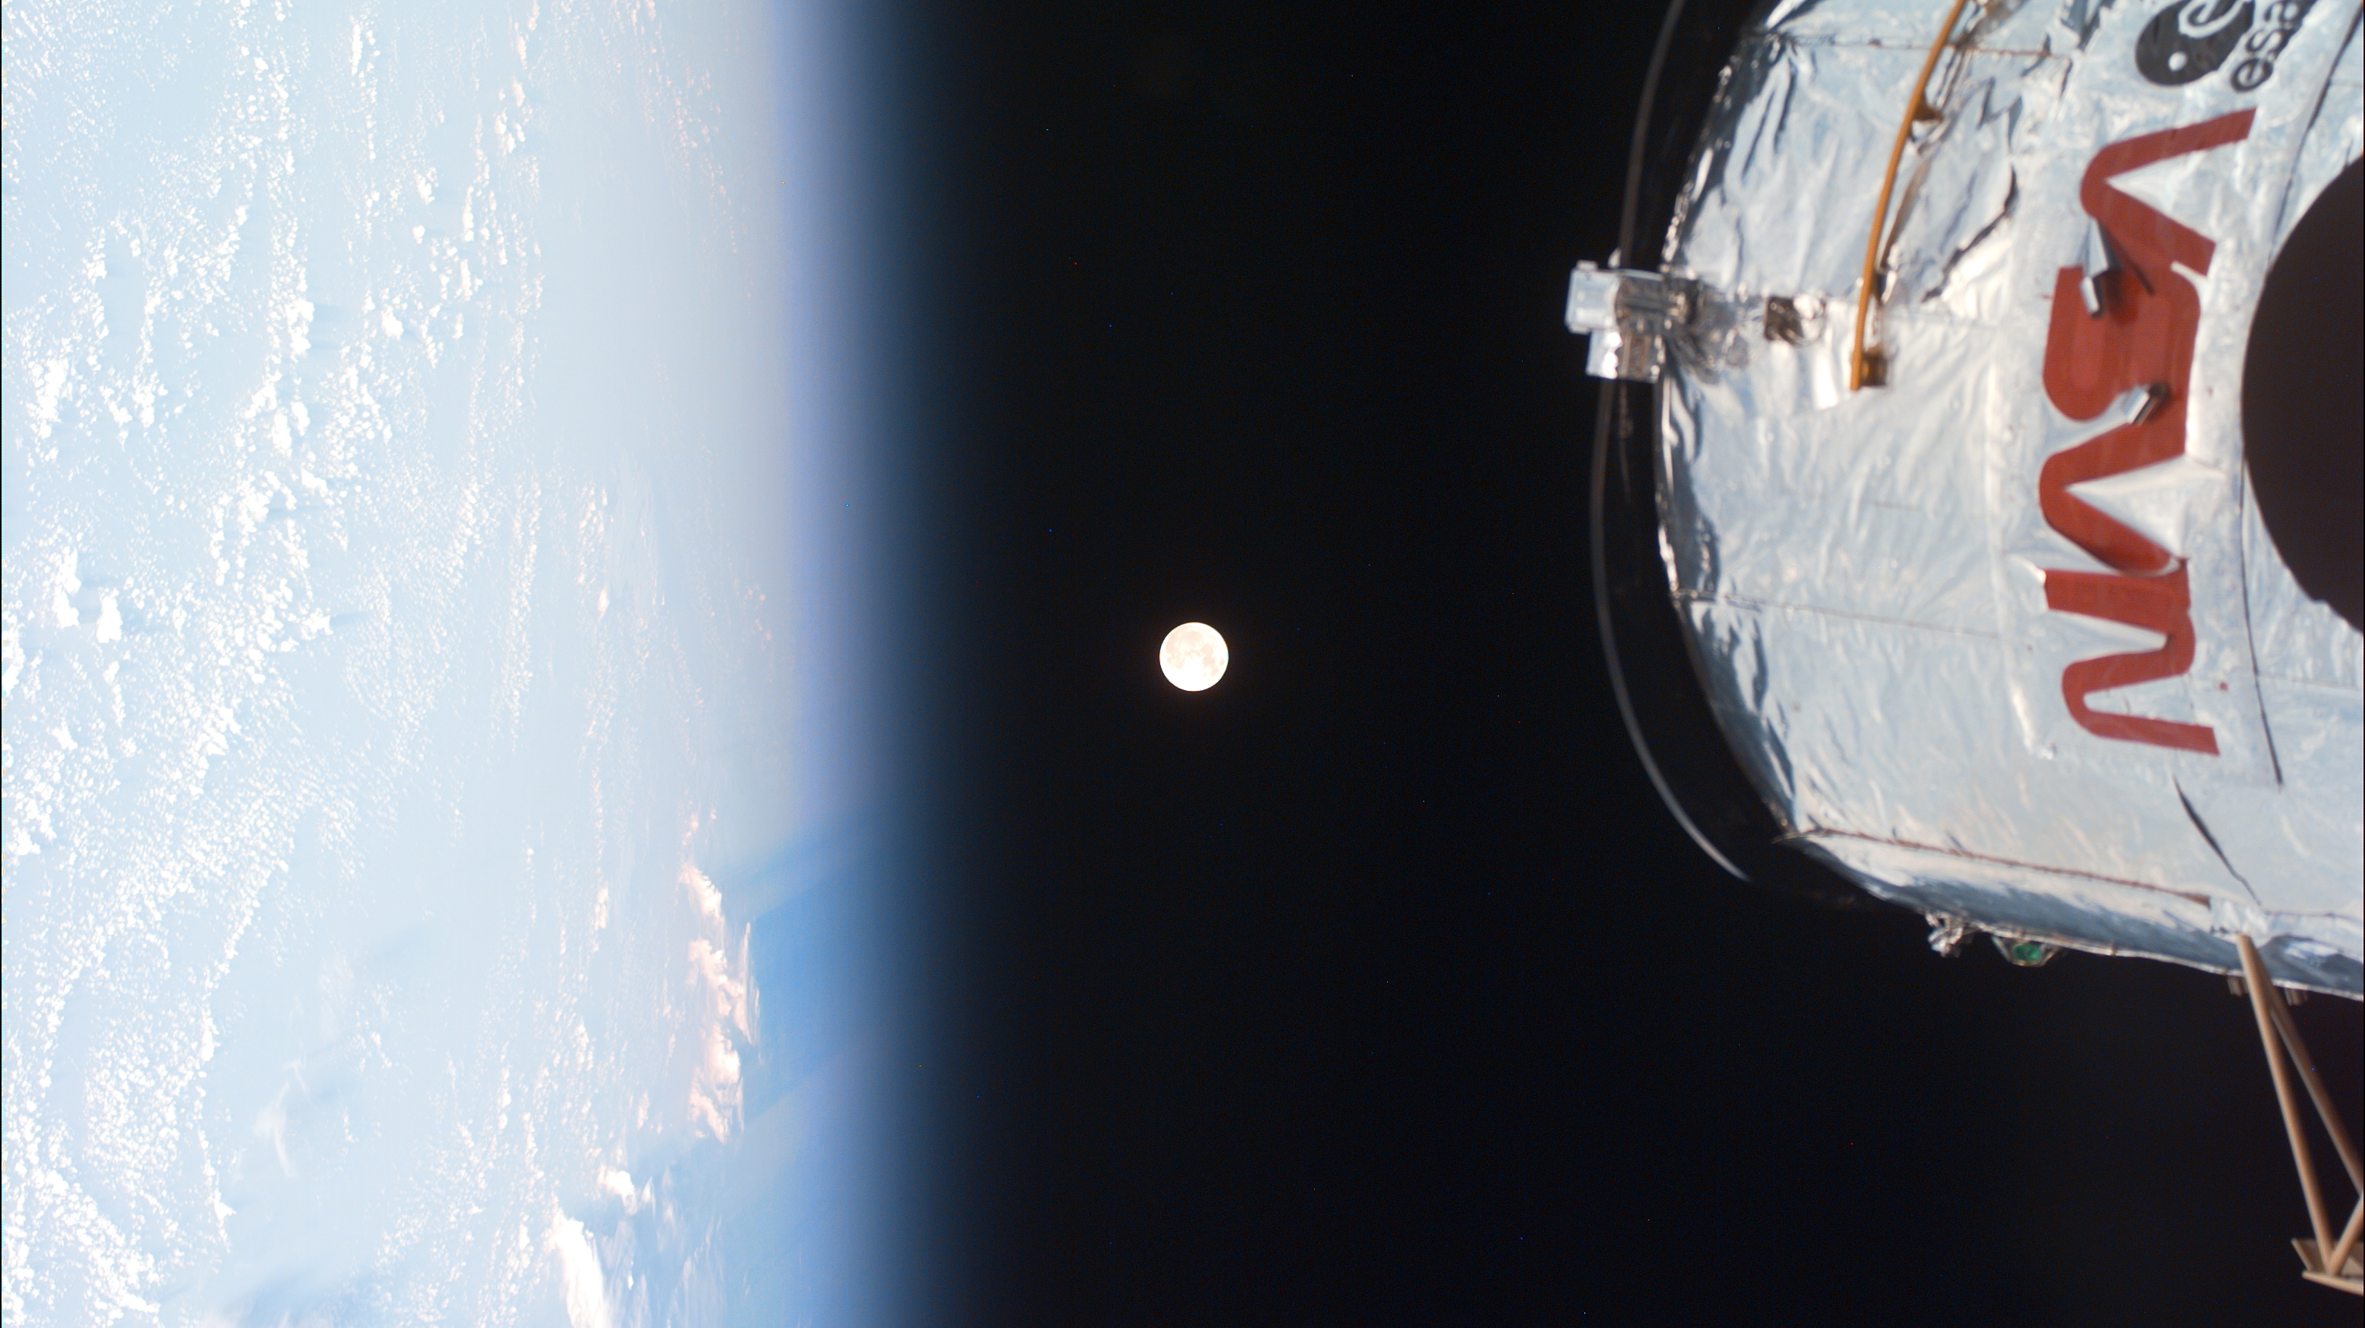
Image Credit: NASA
Characterization of Ion-Induced Damage: Application of CNNs
Pranav Rane (prane@haverford.edu)
Faculty Advisors: Phillip First, Zhigang Jiang
Mentor: Alisha Vira

Slide 2
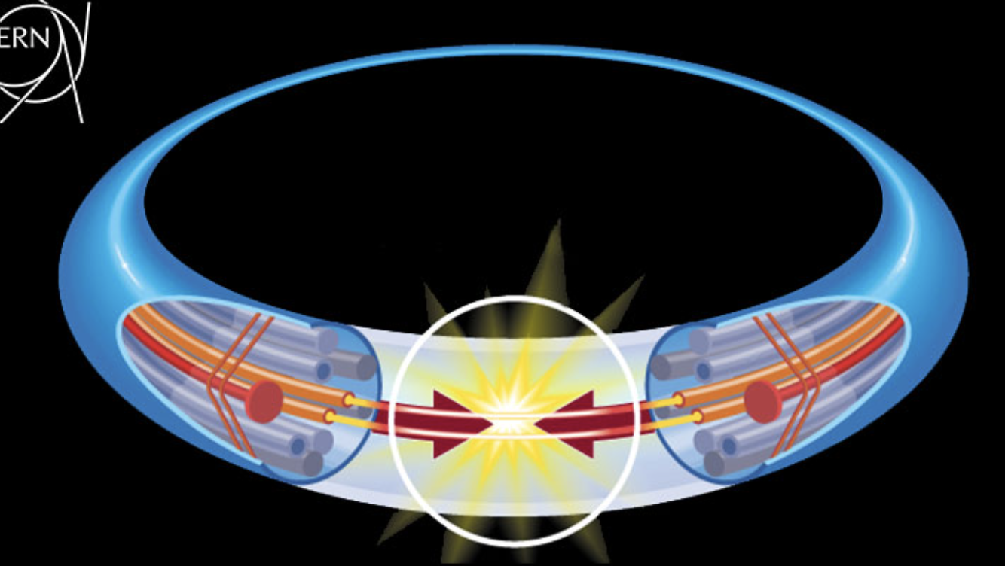
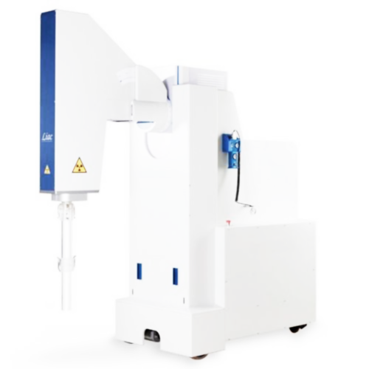
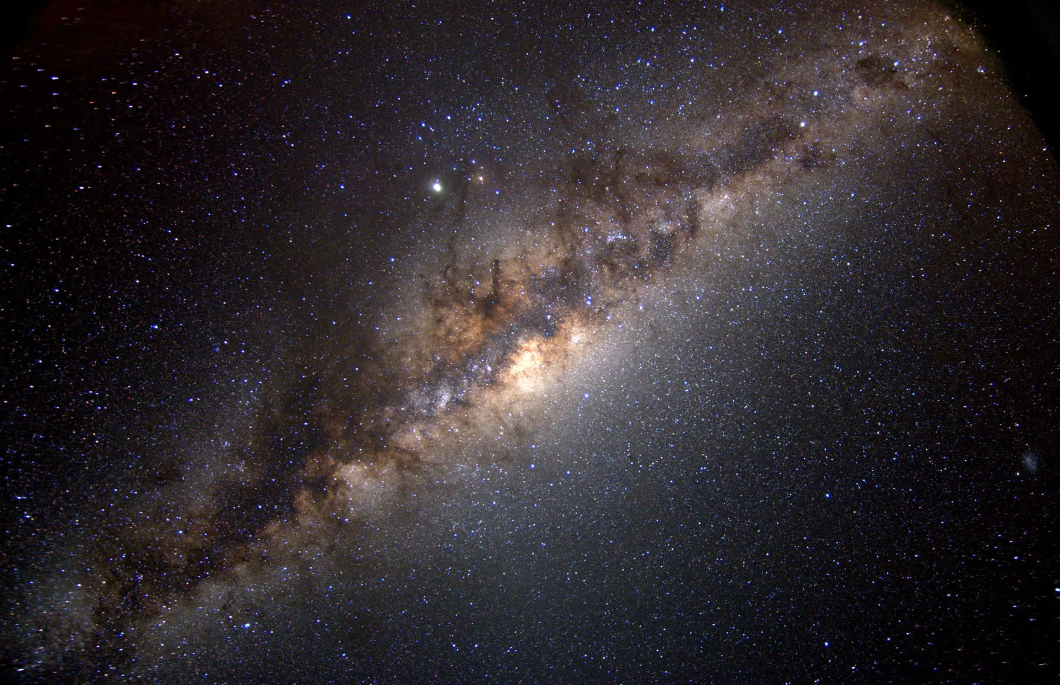
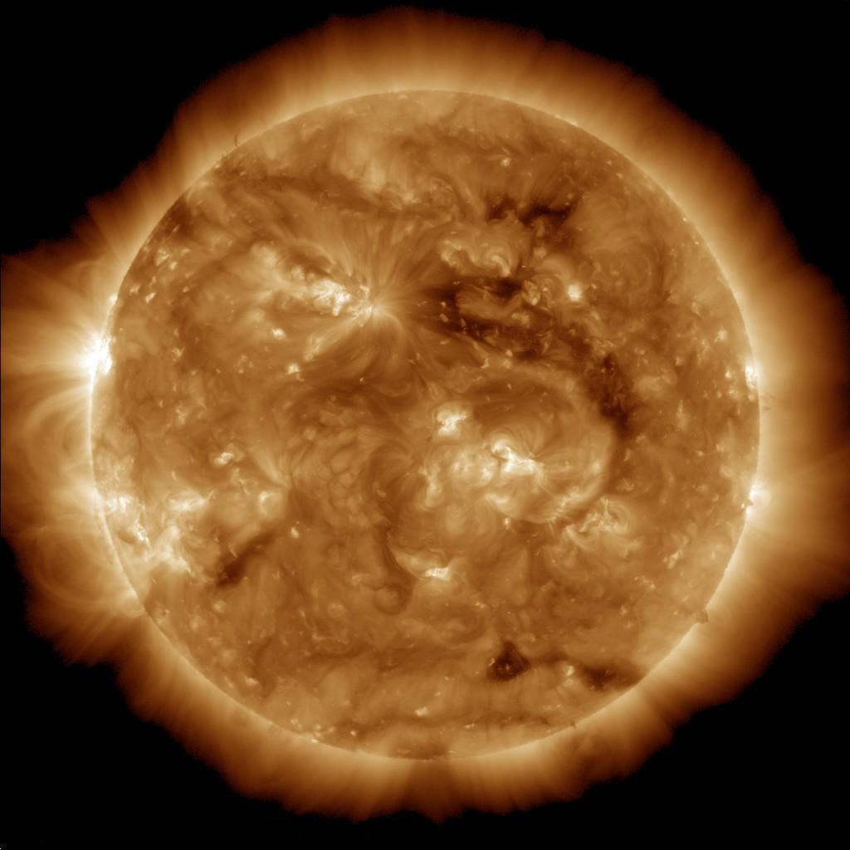
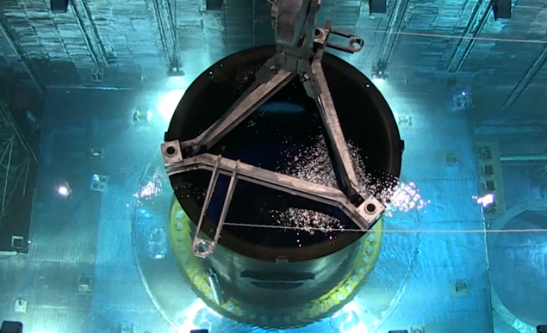
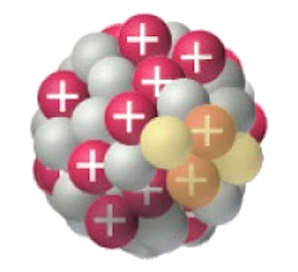
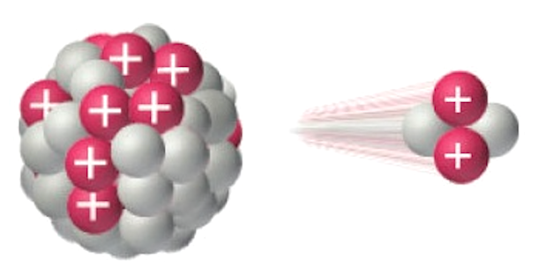
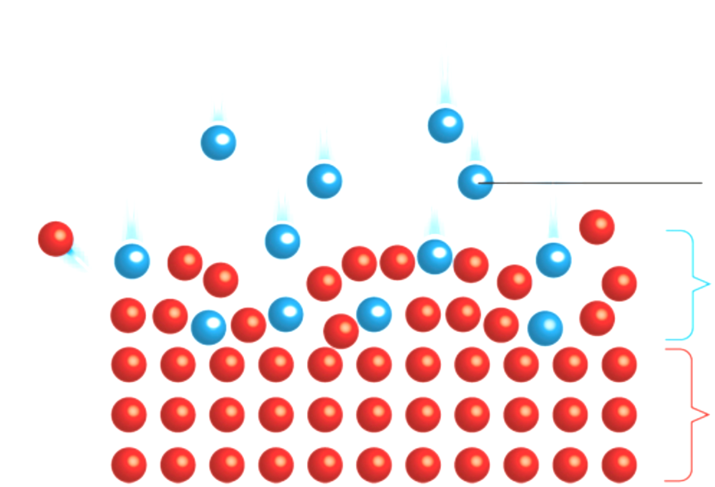
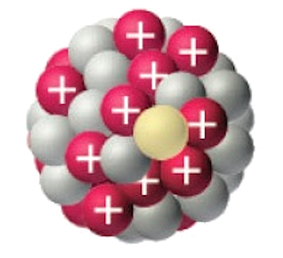
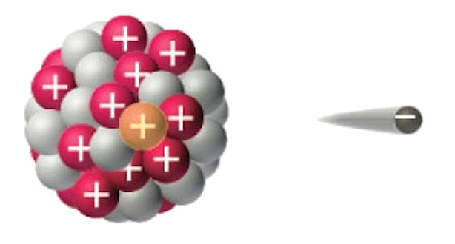
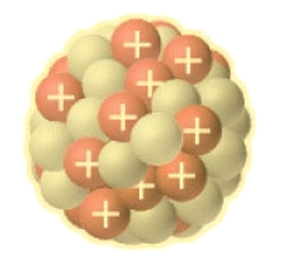
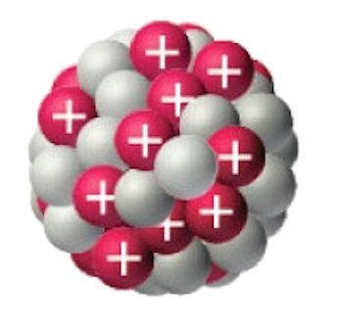
Radiation Sources
Nature
Human-made
EGCR
SCR
GCR
Intraoperative radiation therapy (IORT) can use high-energy electrons
Parent
Daughter
$α$-particle
Modified surface layer
$β$-particle
Nuclear fission can cause irradiation of high-energy neutrons.
Parent lattice
gamma ray

Slide 3
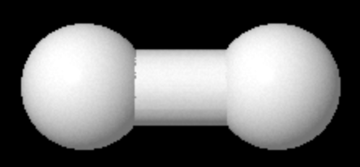
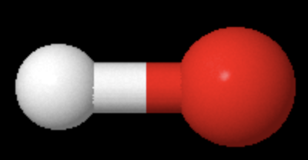
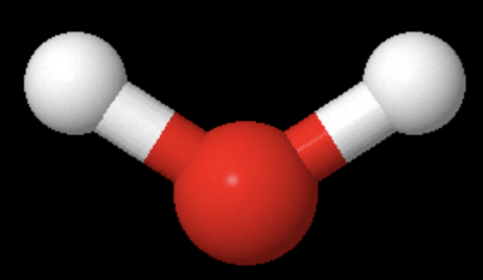
Solar wind: high-energy ions
H
H
H
O
Burke et al. (2022)
Burgess et al. (2023)
e⁻
H
H
+
O
NASA
NASA

Slide 4
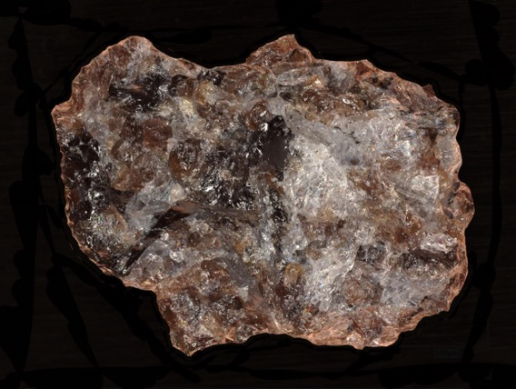
^{Atomic force microscopy (AFM)}
Objective: Irradiate Apollo 17 lunar sample with ions to recreate solar wind vesicle formation
SiO₂
²H⁺ ions
^{Fluence}
Lunar sample 75035.232
Question: What fluence (ions/cm²) creates subsurface vesicles?
deep cavities
surface blisters

Slide 5
Is the character of surface blisters correlated with the character of subsurface vesicles?
Character:
Blister Coverage (%)
sub-surface
surface
Need semantic segmentation…

Slide 6
Semantic segmentation (U-net)
Overview:
Convolutional neural network with U-net architecture
Classification of each pixel as ‘blister’ or ‘background’
Results: Binary Mask
Limitations:
Small training data size → incorrect classifications
Single metric: blister coverage (%)
incorrect classifications
Solutions:
Pretrained neural network
Instance segmentation
blister
background

Slide 7
Instance segmentation
semantic segmentation
instance segmentation
New metrics:
Average object area
Object number density (e.g. # of people per image)

Slide 8
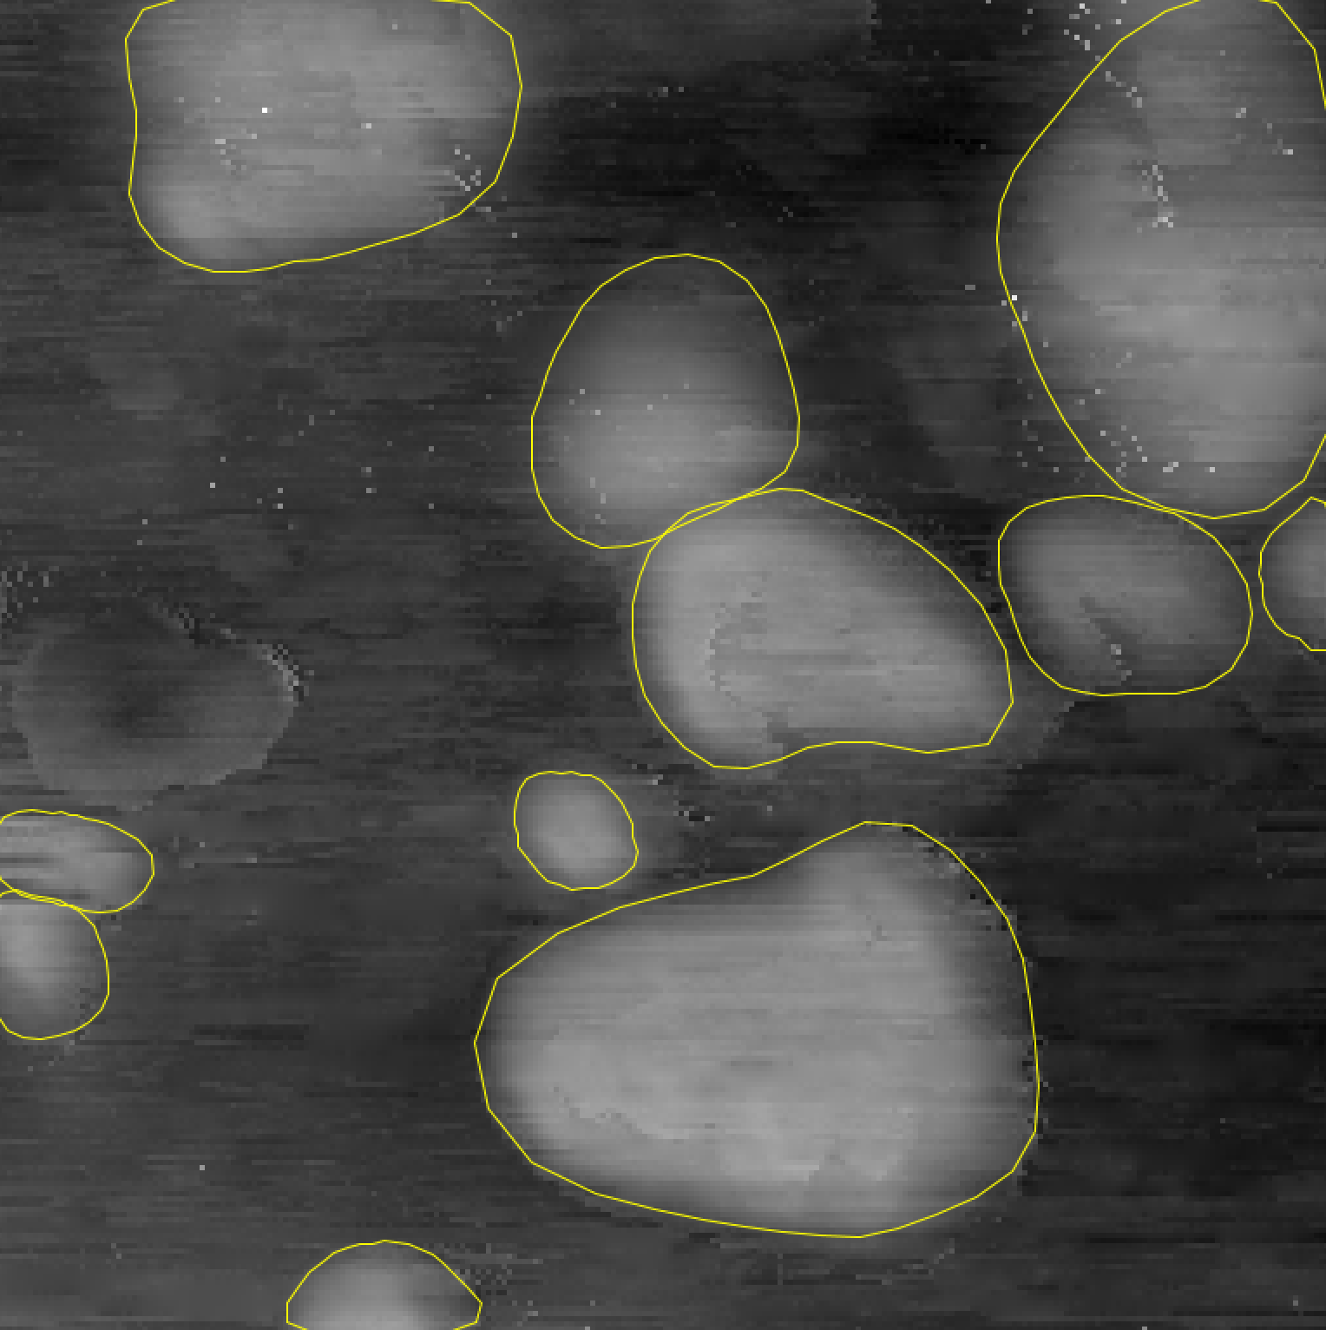
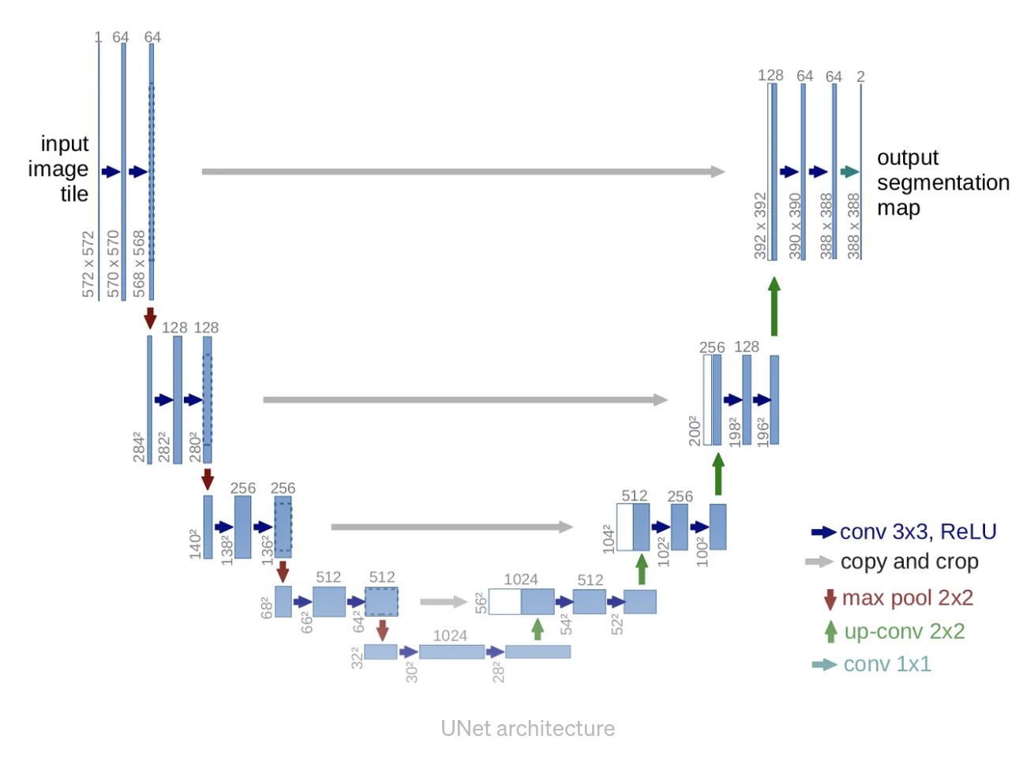
StarDist
$$r_{i,j}^{1}$$
$$r_{i,j}^{2}$$
$$r_{i,j}^{3}$$
$$r_{i,j}^{n}$$
Cell centroid map ($h × w × 1$)
branch 1
$$5.2$$
$$6.1$$
$$6.0$$
$$5.5$$
3x3x128 conv + ReLU
1x1x1 conv + sigmoid
Pixel (i,j)
Radial Components Map
branch 2
Radial components map ($h × w × n$)
1x1xn conv + none
Schmidt, Weigert et al. (2018)

Slide 9
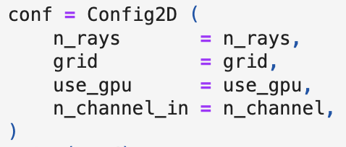
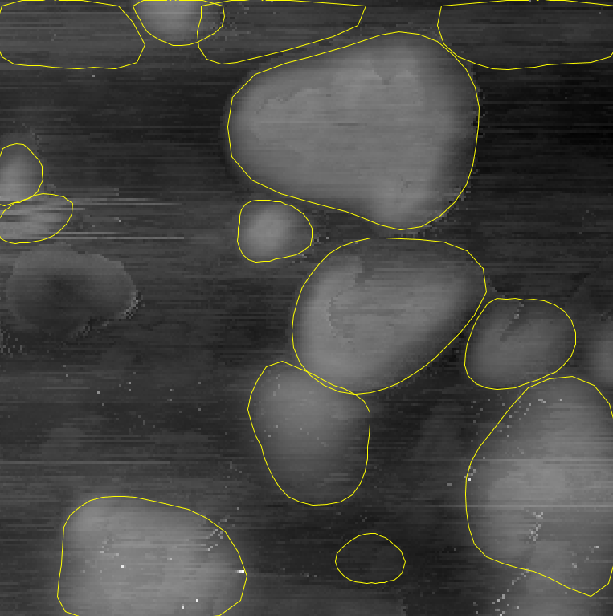
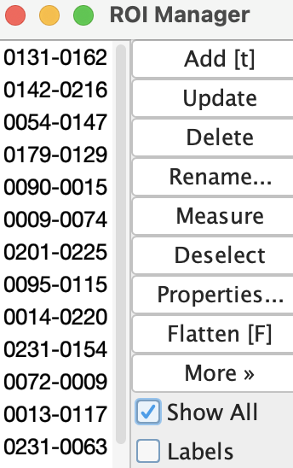
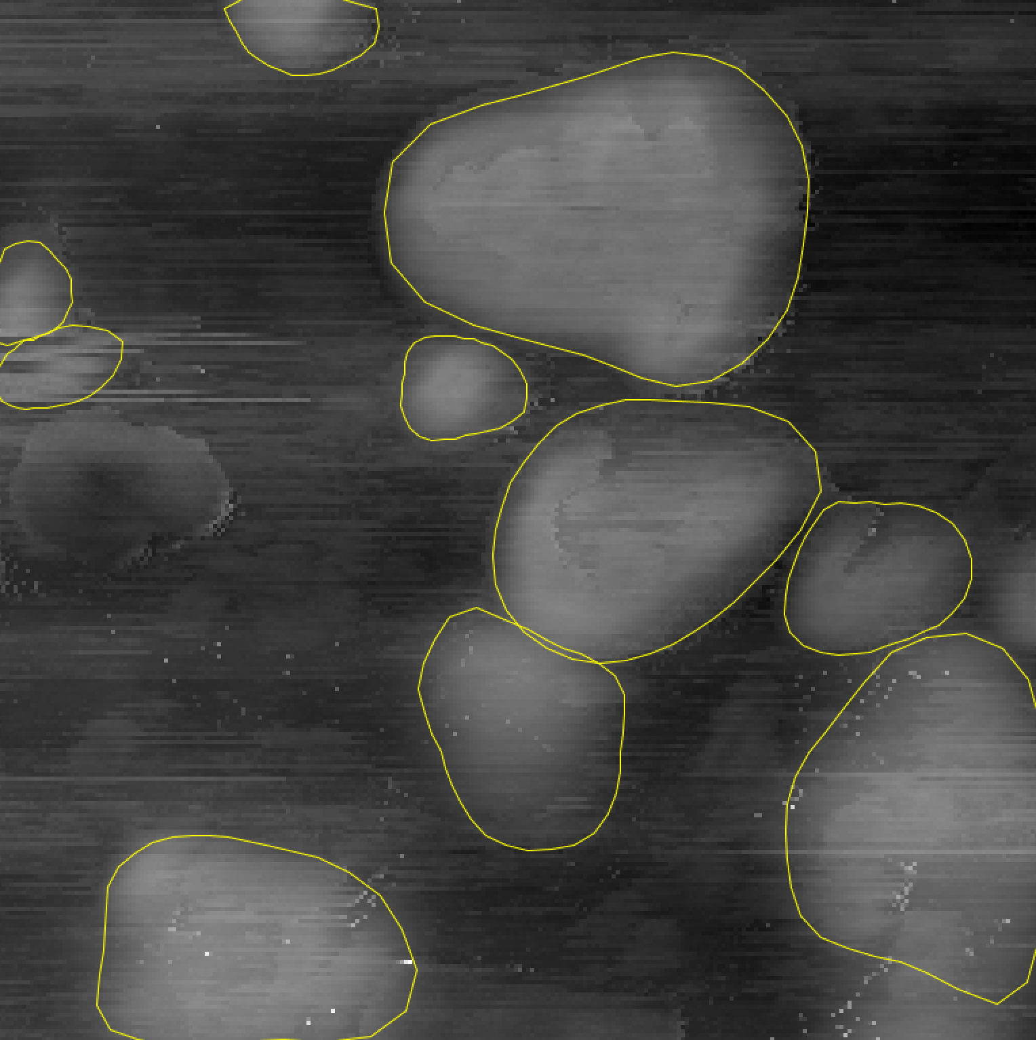
StarDist Implementation
Fiji/ImageJ
Python
model.export_TF()

Slide 10
Fluence/blister relation
Conclusion:
Spatially separated surface blisters form on SiO₂ when deuterium fluence < 10¹⁸ cm⁻²
When fluence > 10¹⁹ cm⁻² surface blisters erupt (overexposure)
10¹⁷

Slide 11
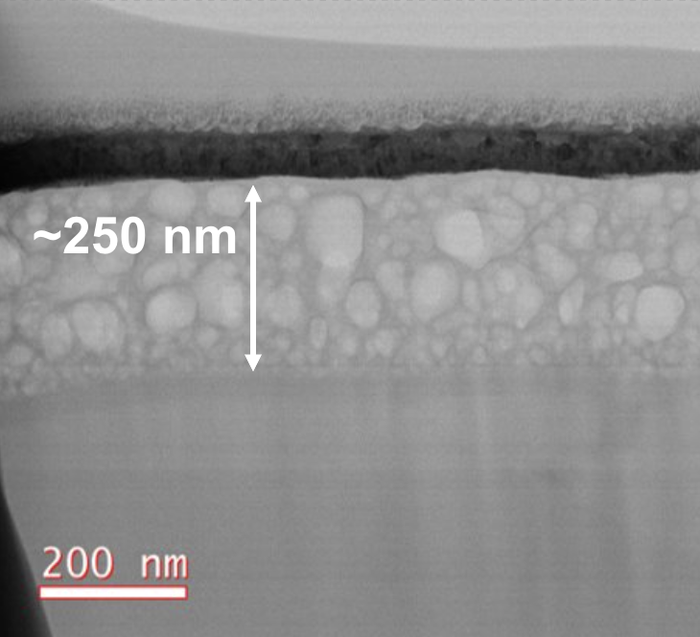
Future work
1
4
2
Explore correlations between fluence and other statistical metrics such as blister number density and average blister size
Use STEM and StarDist to characterize subsurface vesicles in anorthite to confirm correlation between surface blister character and subsurface vesicle character
Use calibrated fluence to irradiate Apollo 17 lunar sample to recreate solar wind vesicles and use nano-FTIR to identify water
Fluence
3
5
9
7
10
6
8
H
H
H
O
H
H
O
Lunar sample 75035.232

Slide 12
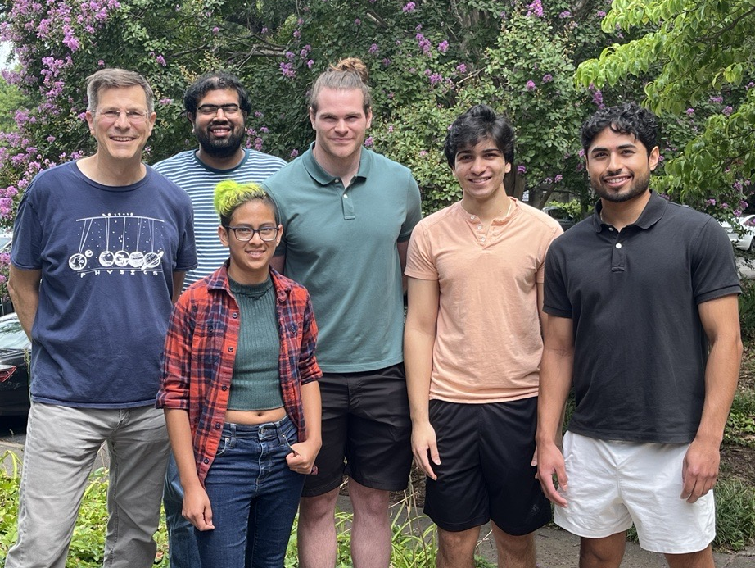
Acknowledgements
References
“17.3: Types of Radioactivity- Alpha, Beta, and Gamma Decay,” Chemistry LibreTexts. Accessed: Jul. 24, 2024. [Online]. Available: https://chem.libretexts.org/Bookshelves/Introductory_Chemistry/Introductory_Chemistry/17%3A_Radioactivity_and_Nuclear_Chemistry/17.03%3A_Types_of_Radioactivity-_Alpha_Beta_and_Gamma_Decay
U. Veronesi et al., “A preliminary report of intraoperative radiotherapy (IORT) in limited-stage breast cancers that are conservatively treated,” European Journal of Cancer, vol. 37, no. 17, pp. 2178–2183, 2001, doi: 10.1016/S0959-8049(01)00285-4.
U. Schmidt, M. Weigert, C. Broaddus, and G. Myers, “Cell Detection with Star-convex Polygons,” vol. 11071, 2018, pp. 265–273. doi: 10.1007/978-3-030-00934-2_30.
“CERN’s plans for a new particle accelerator dwarfs the existing LHC,” The Silicon Review. Accessed: Jul. 24, 2024. [Online]. Available: https://thesiliconreview.com/2019/01/lhc-successor-fcc-20-billion
K. D. Burgess, B. A. Cymes, and R. M. Stroud, “Hydrogen-bearing vesicles in space weathered lunar calcium-phosphates,” Commun Earth Environ, vol. 4, no. 1, p. 414, Nov. 2023, doi: 10.1038/s43247-023-01060-5.
C. Burke, R. L. Howard, and P. Kessler, “Internal Layout of a Lunar Surface Habitat,” 2022.
S. J. Zinkle and G. S. Was, “Materials challenges in nuclear energy,” Acta Materialia, vol. 61, no. 3, pp. 735–758, Feb. 2013, doi: 10.1016/j.actamat.2012.11.004.
“NUCLEAR 101: How Does a Nuclear Reactor Work?,” Energy.gov. Accessed: Jul. 24, 2024. [Online]. Available: https://www.energy.gov/ne/articles/nuclear-101-how-does-nuclear-reactor-work
K. Nordlund et al., “Primary radiation damage: A review of current understanding and models,” Journal of Nuclear Materials, vol. 512, pp. 450–479, Dec. 2018, doi: 10.1016/j.jnucmat.2018.10.027.
O. Ronneberger, P. Fischer, and T. Brox, “U-Net: Convolutional Networks for Biomedical Image Segmentation,” May 18, 2015, arXiv: arXiv:1505.04597. Accessed: Jul. 31, 2024. [Online]. Available: http://arxiv.org/abs/1505.04597
Georgia Tech Prof.
Contact: prane@haverford.edu

