Slide 1

MatFold: systematic insights into materials discovery models’ performance through standardized cross-validation protocols
Matthew Witman¹, Peter Schindler²
¹ Sandia National Laboratories California
² Northeastern University, Boston

Slide 2
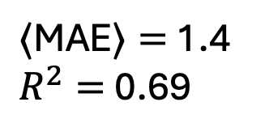
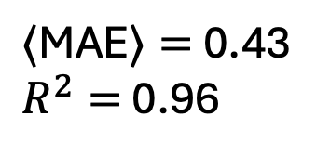
Motivation: Expected performance in materials science machine learning models depends drastically on how cross-validation (CV) experiments are designed
$⟨$MAE$⟩=$ 0.43
$R^{2}=$ 0.96
~3x increase
$⟨\text{MAE}⟩=$ 1.4
$R^{2}=$ 0.69
~30% drop
Automatically and systematically generate model-agnostic, materials-specific CV splits to:
  Assist the materials ML materials community with tools for more standardized CV experiments
  Systematically improve insights into model generalizability, uncertainty, and improvability
  Facilitate fairer comparison of competing models’ generalization capabilities (regardless of data size)

Slide 3
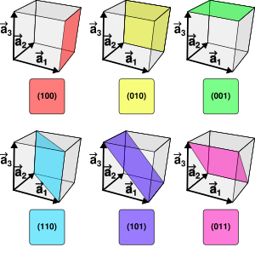
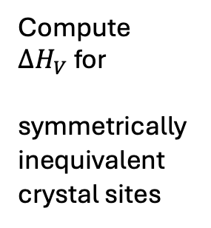
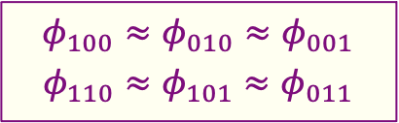

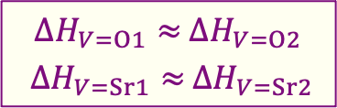

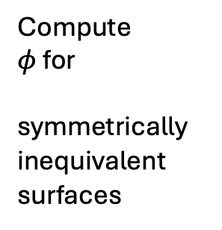
Motivation: Examples of materials datasets^{[1,2]} where data leakage readily occurs
(1) Vacancy formation energy, $ΔH_{V}$
(2) Surface work function, $φ$
Energy to remove an atom from the bulk crystal structure
…Definition…
Energy to remove an electron from the bulk to the vacuum above a surface
Compute $ΔH_{V}$ for
symmetrically inequivalent crystal sites
Compute $φ$ for
symmetrically inequivalent surfaces
https://en.wikipedia.org/wiki/Miller_index#/media/File:Miller_Indices_Felix_Kling.svg
$ΔH_{V=O1}≈$ $ΔH_{V=O2}$
$ΔH_{V=Sr1}≈$ $ΔH_{V=Sr2}$
… Symmetrically distinct examples may still be very similar within the same crystal structures…
$$φ_{100}≈φ_{010}≈φ_{001}$$
$$φ_{110}≈φ_{101}≈φ_{011}$$
^{[1]} Witman, Goyal, Ogitsu, McDaniel, Lany. Nature Computational Science, 2023
^{[2]} Schindler, et al. Advanced Functional Materials, 2024

Slide 4
Motivation: overview of “defect” graph neural networks for materials discovery
Pros:
Generalizable (no manual feature engineering)
Chemistry & structure agnostic
Improvable w/more data
Many orders of magnitude faster than DFT
Cons:
Highly data reliant
Not interpretable
^{[1]} Witman, Goyal, Ogitsu, McDaniel, Lany. Nature Computational Science, 2023

Slide 5
MatFold concept: propose standardized & automated CV analysis with, among other options, increasingly difficult chemical/structural splitting criteria
Creates increasing out-of-distribution test sets, regardless of modeling approach and dataset size

Slide 6
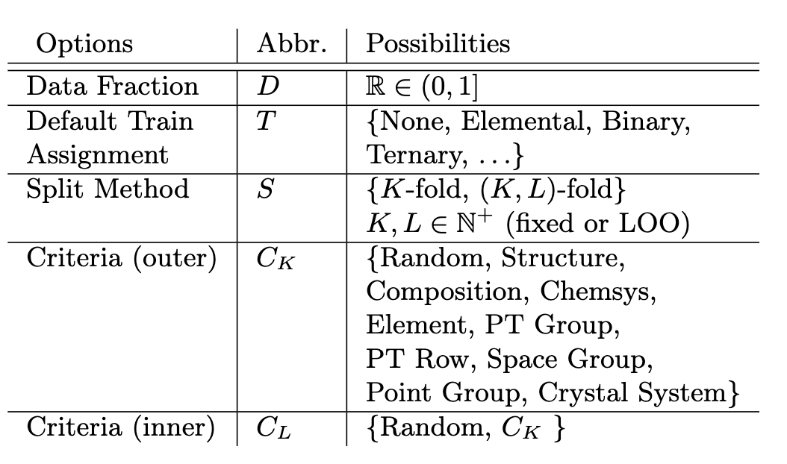
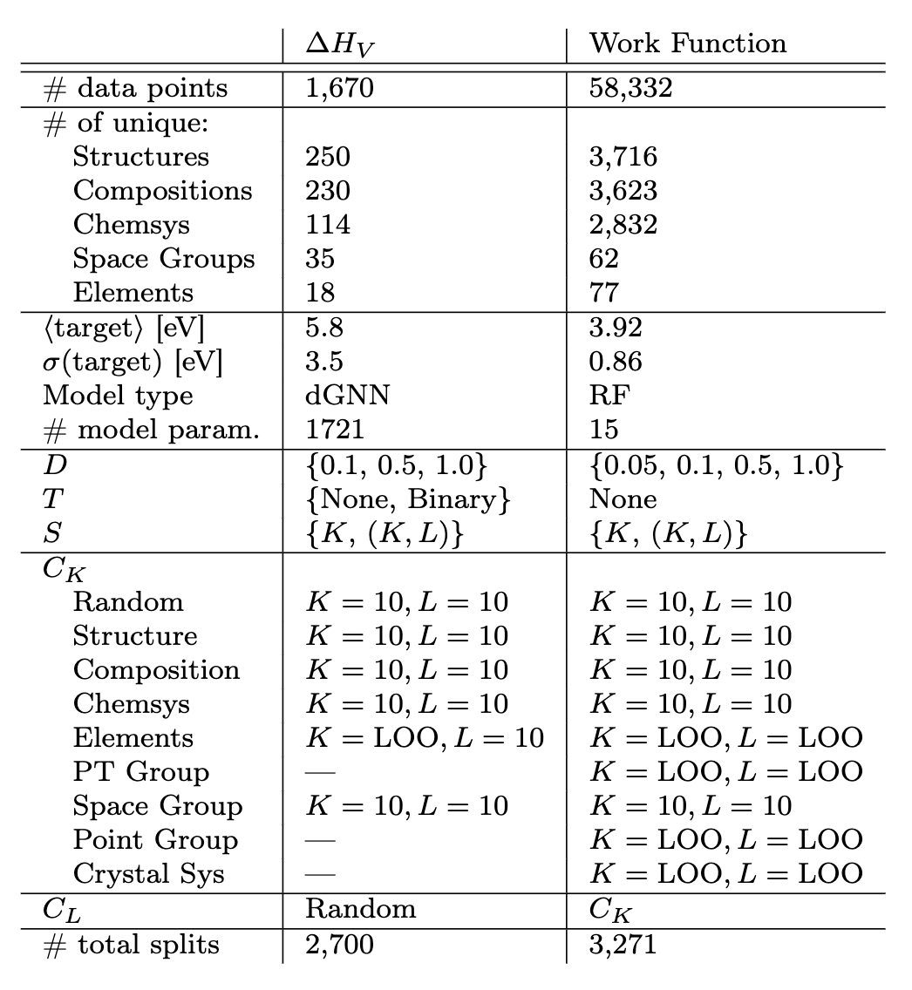
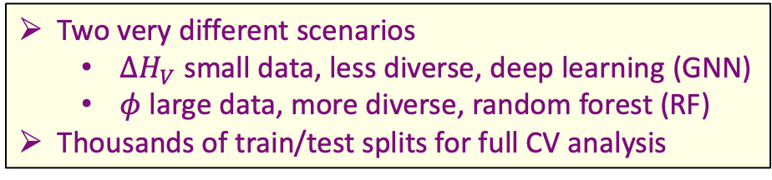
MatFold concept: give user fixed set of options for CV analysis that can be compared between any modeling approach and materials dataset
(1) Currently available CV options (more to be added)
(2) Data & CV summary for our exemplars
Two very different scenarios
  $ΔH_{V}$ small data, less diverse, deep learning (GNN)
  $φ$ large data, more diverse, random forest (RF)
Thousands of train/test splits for full CV analysis

Slide 7
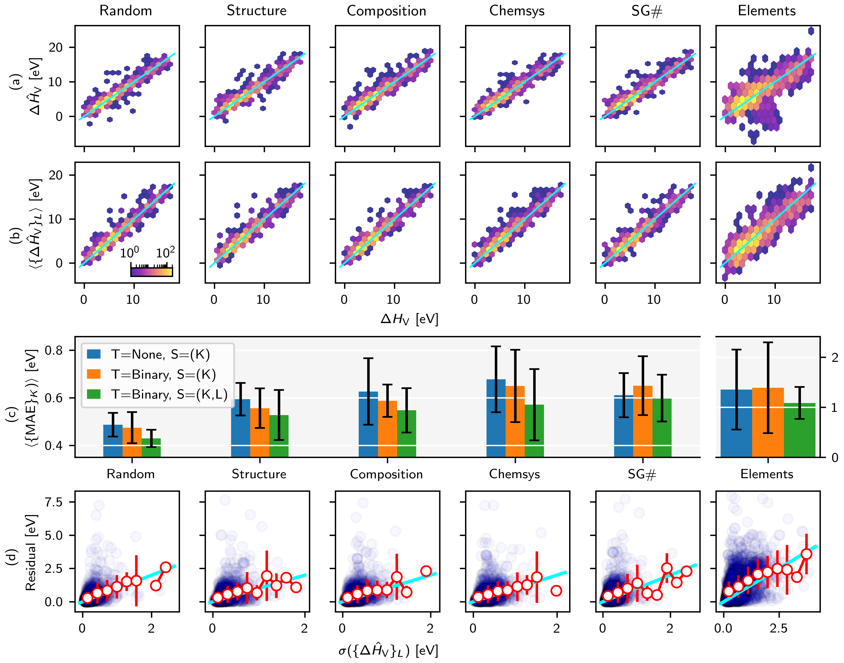
MatFold insights: $ΔH_{V}$ expected error depends significantly on split criteria
Increasingly OOD test splits
Overfitting mitigated by bootstrapped ensembles
Very large expected performance gap during inference (i.e., materials screening) if all OOD test splits are not evaluated
~2.5x increase
~30% increase

Slide 8
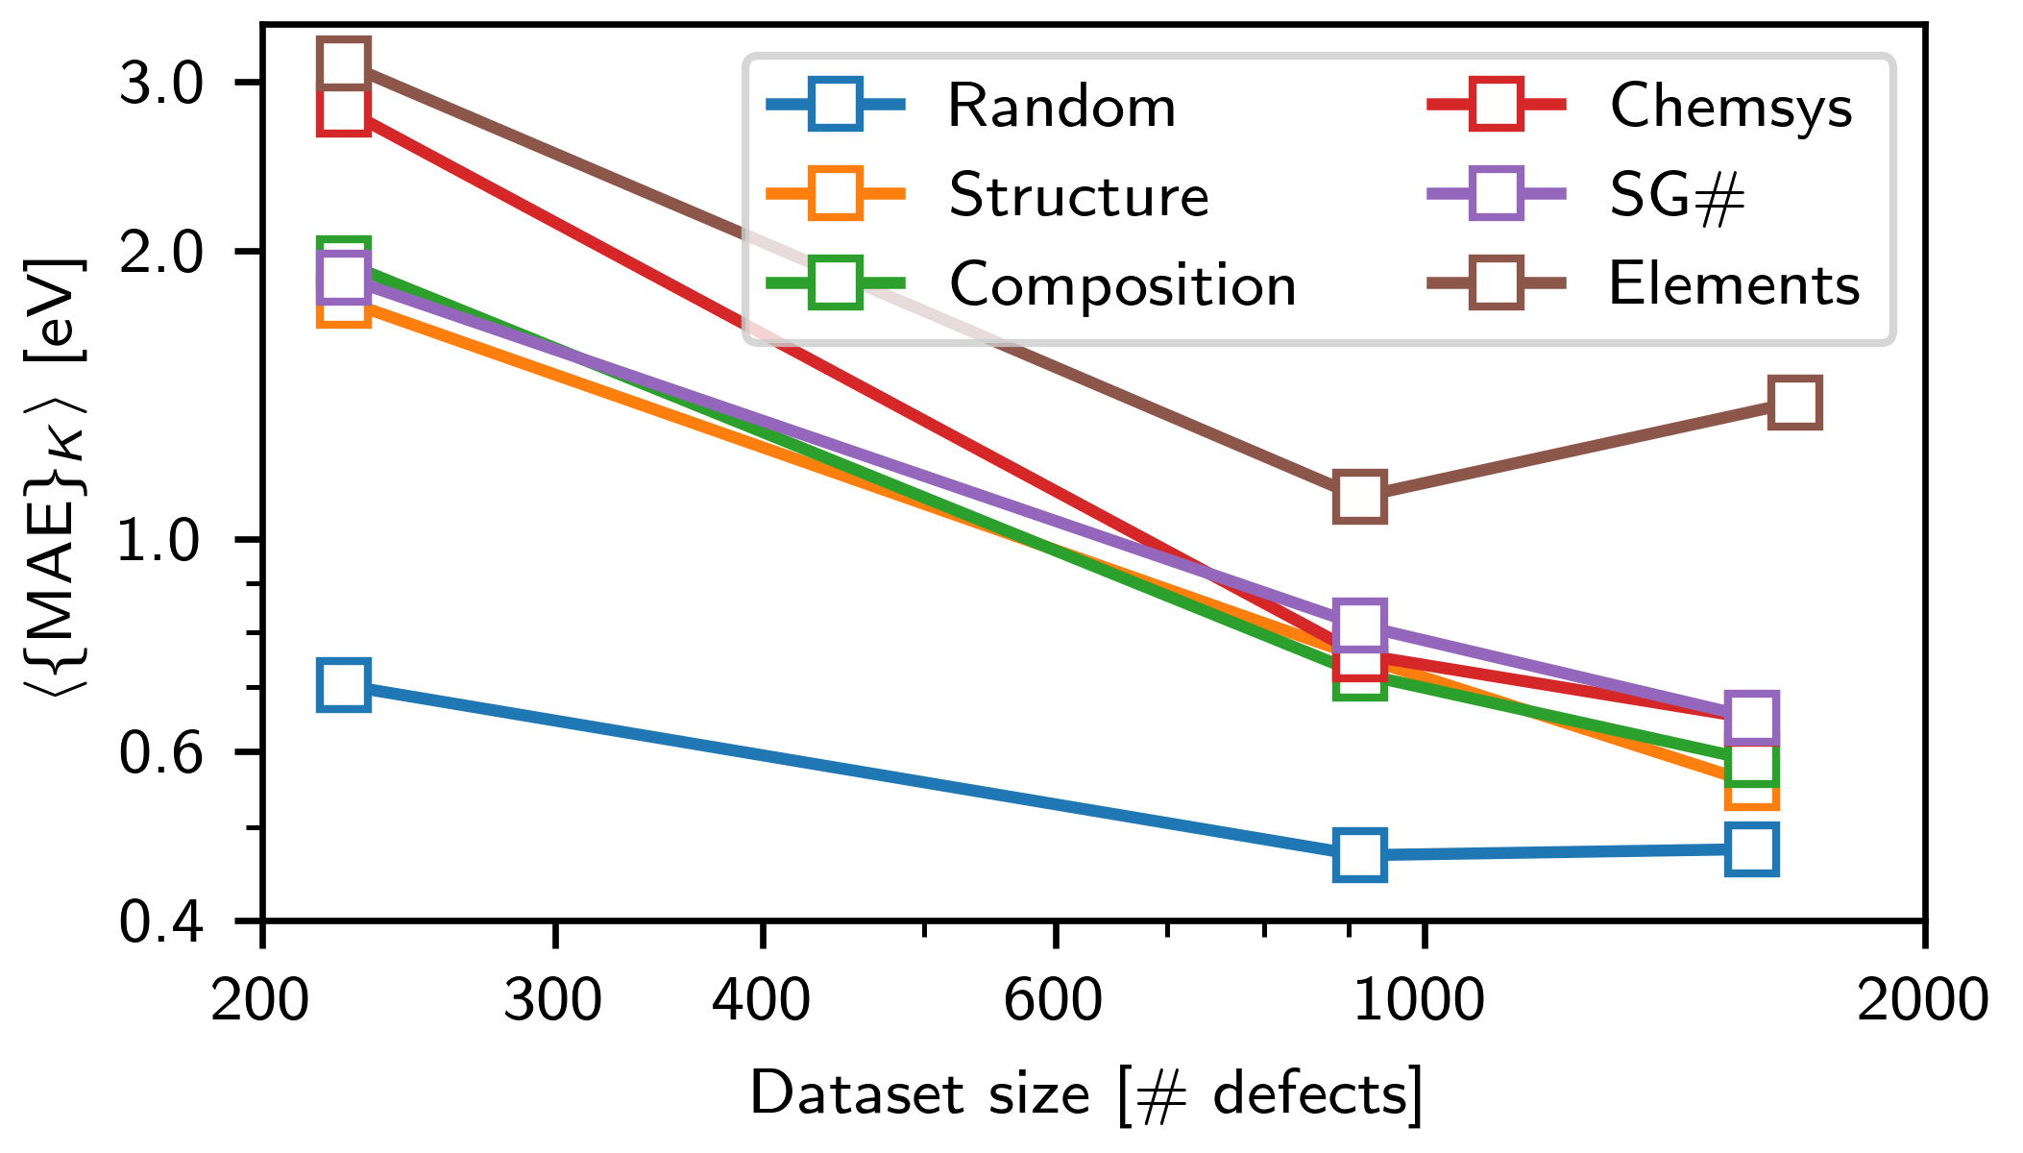

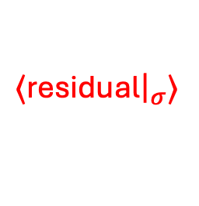
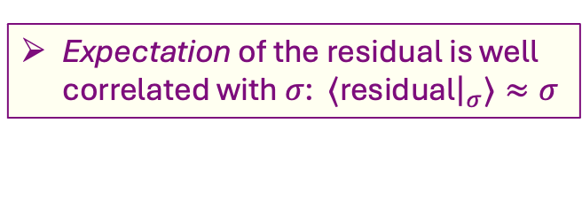
Mat Fold insights: (1) Validity of bootstrapped uncertainty metric and (2) expected value of continued data collection
(1) Absolute prediction error vs. standard deviation of inner fold model ensembles
(2) Evolution of expected MAE with increasing dataset size
~4x
Residual (individual abs. prediction error)
$⟨$residual${\left.​\right|}_{σ}⟩$
$$y=x$$
~1.4x
Expected error gap between splitting criteria shrinks w/more data
“Random” plateau portends an accuracy limit of the approach
“Elements” plateau portends a generalizability limit of the approach
Expectation of the residual is well correlated with $σ$: $⟨$residual${\left.​\right|}_{σ}⟩≈σ$

Slide 9
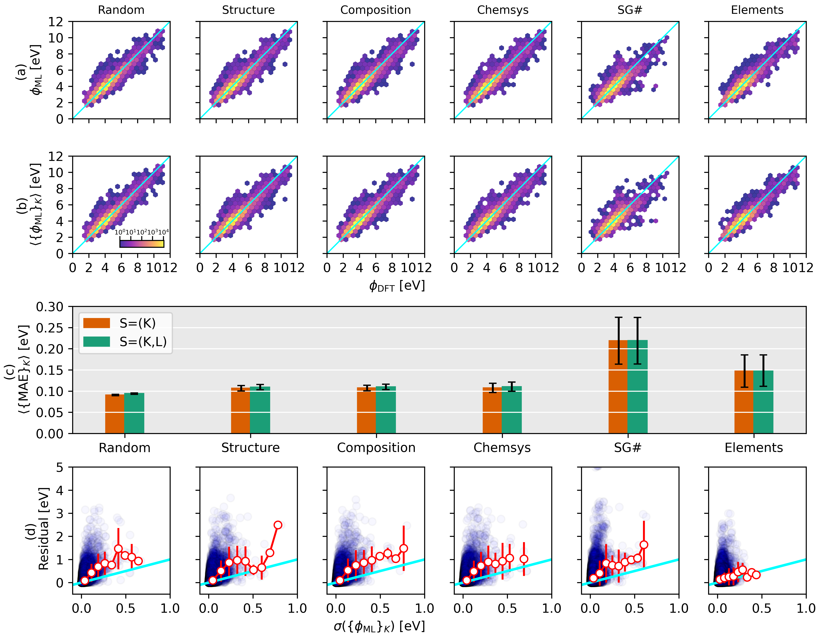
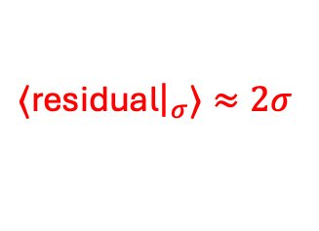
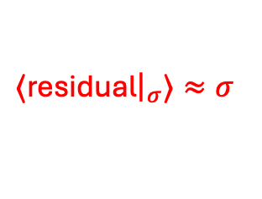

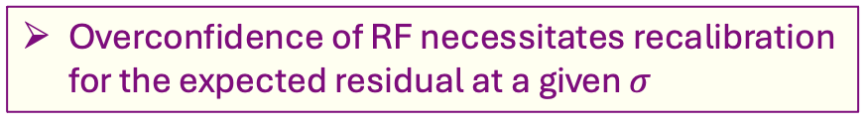


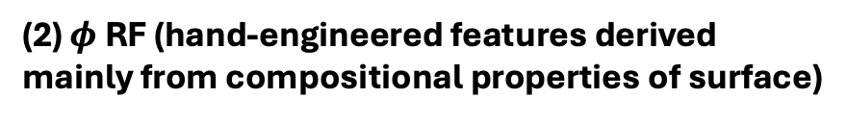

Mat Fold insights: Comparing strengths and weaknesses across modeling approaches and data domains
(1) $ΔH_{V}$ GNN (direct crystal structure input)
Vs.
(2) $φ$ RF (hand-engineered features derived mainly from compositional properties of surface)
OOD chemistry vs. structure generalization
Bootstrapped uncertainty comparison
$$ΔH_{V}$$
$ΔH_{V}$:
$⟨$residual${\left.​\right|}_{σ}⟩≈σ$
$φ$:
$⟨$residual${\left.​\right|}_{σ}⟩≈2σ$
Better at unseen structural types than chemistry
~2x
$$φ$$
Better at unseen chemistry than structural types
~1.5x
Overconfidence of RF necessitates recalibration for the expected residual at a given $σ$

Slide 10
Some Key Takeaways
Expected error of ML models in materials sciences varies dramatically based on CV split criteria, especially as they increasingly enforce distribution mismatch between train and test
MatFold provides an automated tool for standardized, model-agnostic, chemistry-specific CV analysis to compare models/approaches/data domains on equal footing
General insights into model generalizability, uncertainty, and improvability can be readily obtained without any additional work beyond added compute time

Slide 11
Thank you for your attention!
Questions/comments/collaborations?
mwitman@sandia.gov

