Slide 1
Adjusting for Spatial Correlation in Machine and Deep Learning
Matthew J. Heaton, Andrew Millane and Jake Rhodes

Slide 2
Spatial Correlation

Slide 3
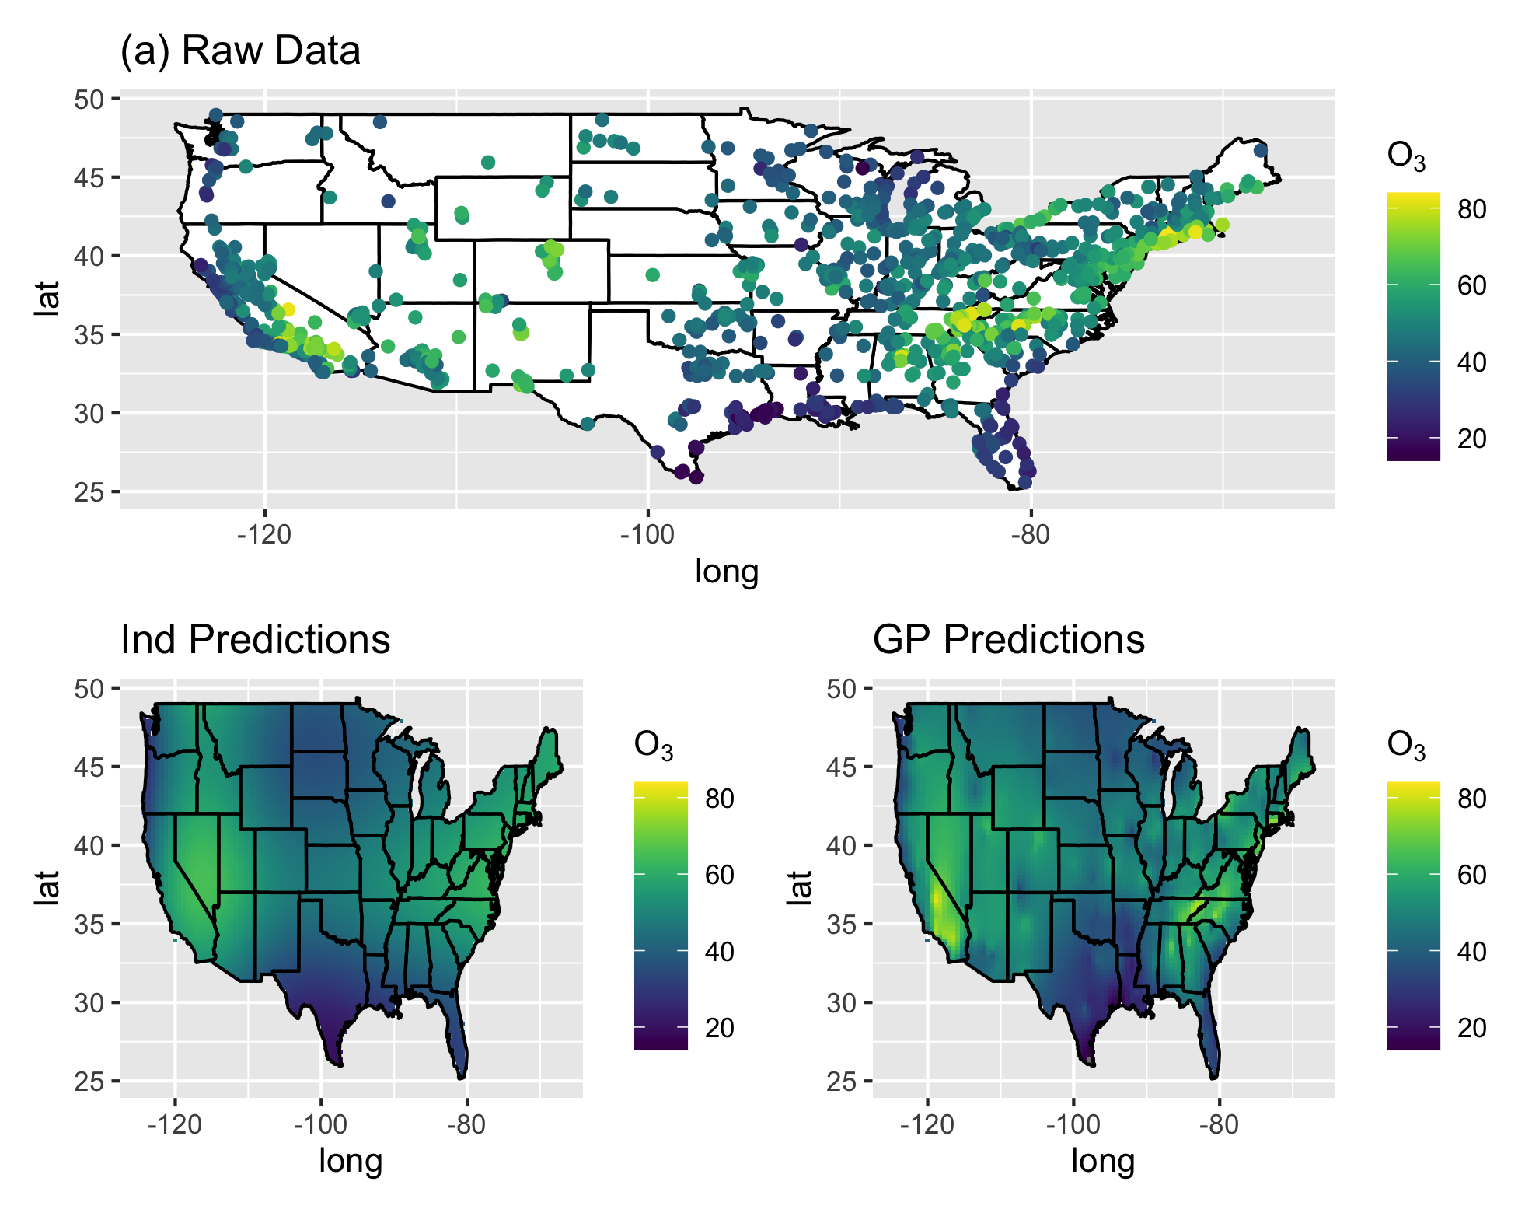
Why should we care about spatial correlation?
If you ignore correlation, you lose predictive power!

Slide 4
Machine Learning and Spatial Correlation
Most Machine Learning Algorithms are “trained” (i.e. fit) using squared error loss
but when you have correlation, you should use generalized squared error:

Slide 5
GLS and Machine Learning
Large covariance matrices are annoying to compute with
In ML, can’t use traditional bootstrap or minibatching

Slide 6
Research Goals:
Scalable approach to account for spatial correlation in ML or DL models
Must still be able to bootstrap (for, say, RF) or minibatch (for, say, neural nets)

Slide 7
Background:
Correlated Regression Model
Consider the correlated regression model:
Consider the Transformation:
then
where

Slide 8
Properties
Properties of the decorrelated data
No more spatial correlation (I can bootstrap or minibatch all I want)
Scalable - biggest matrices are KxK where K=number of spatial neighbors
Trained (fitted) using squared error loss
Use the linear basis to expand to non-linear functions (any ML model you want).

Slide 9
Spatial ML Algorithm
Choose Spatial and Machine Tuning Parameters
Transform to
Train a machine on
Predict from machine and back-transform predictions via inverse transform

Slide 10
The Devil is in the Details
The correlation matrix so we have to tune the correlation parameters in addition to any machine-specific tuning parameters.
Predictions are made by “re-correlating” or backtransforming the predictions:

Slide 11
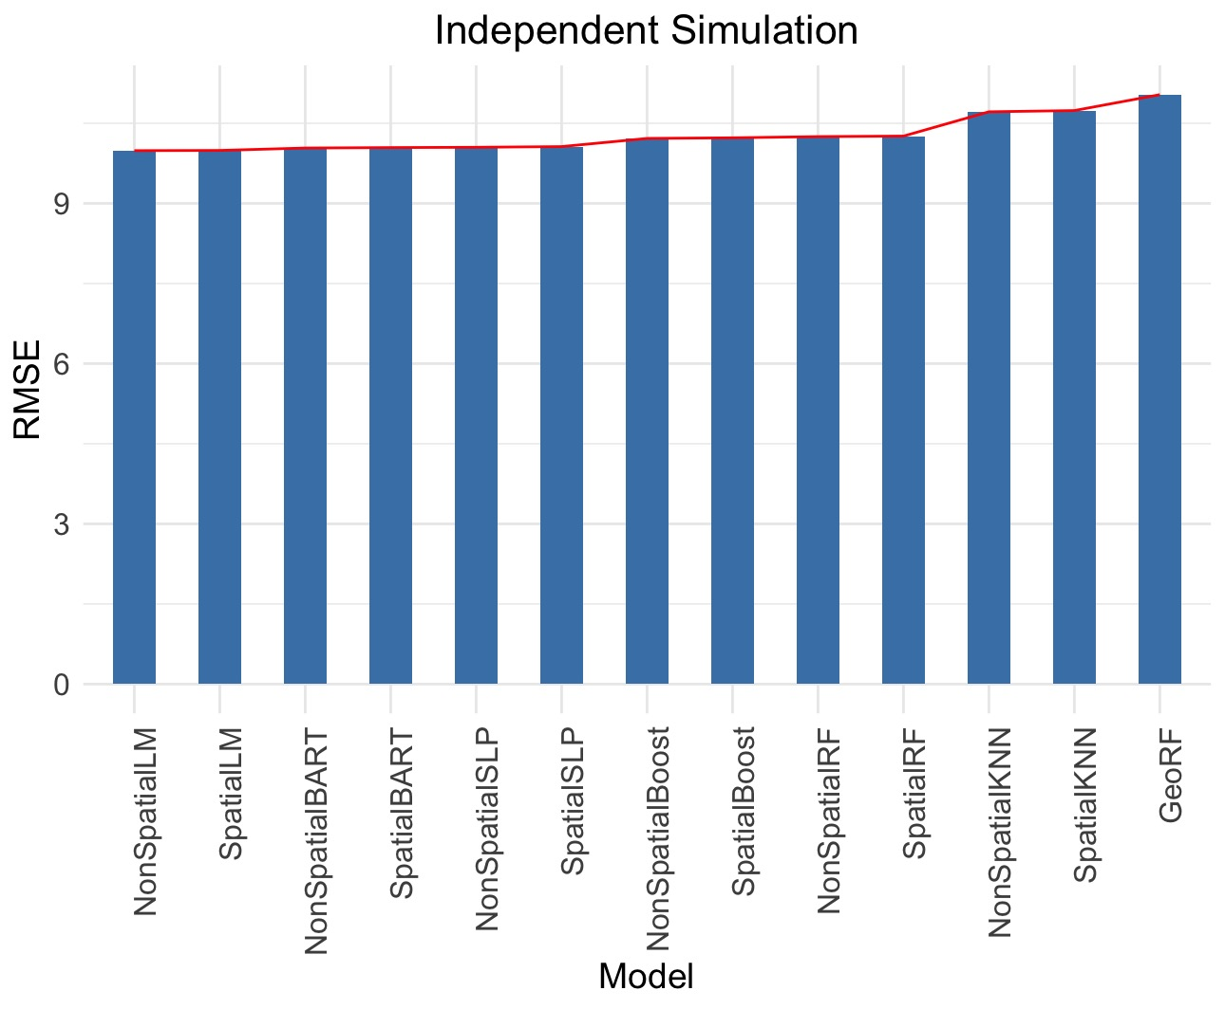
Simulation Study 1:
Linear and Nonspatial

Slide 12
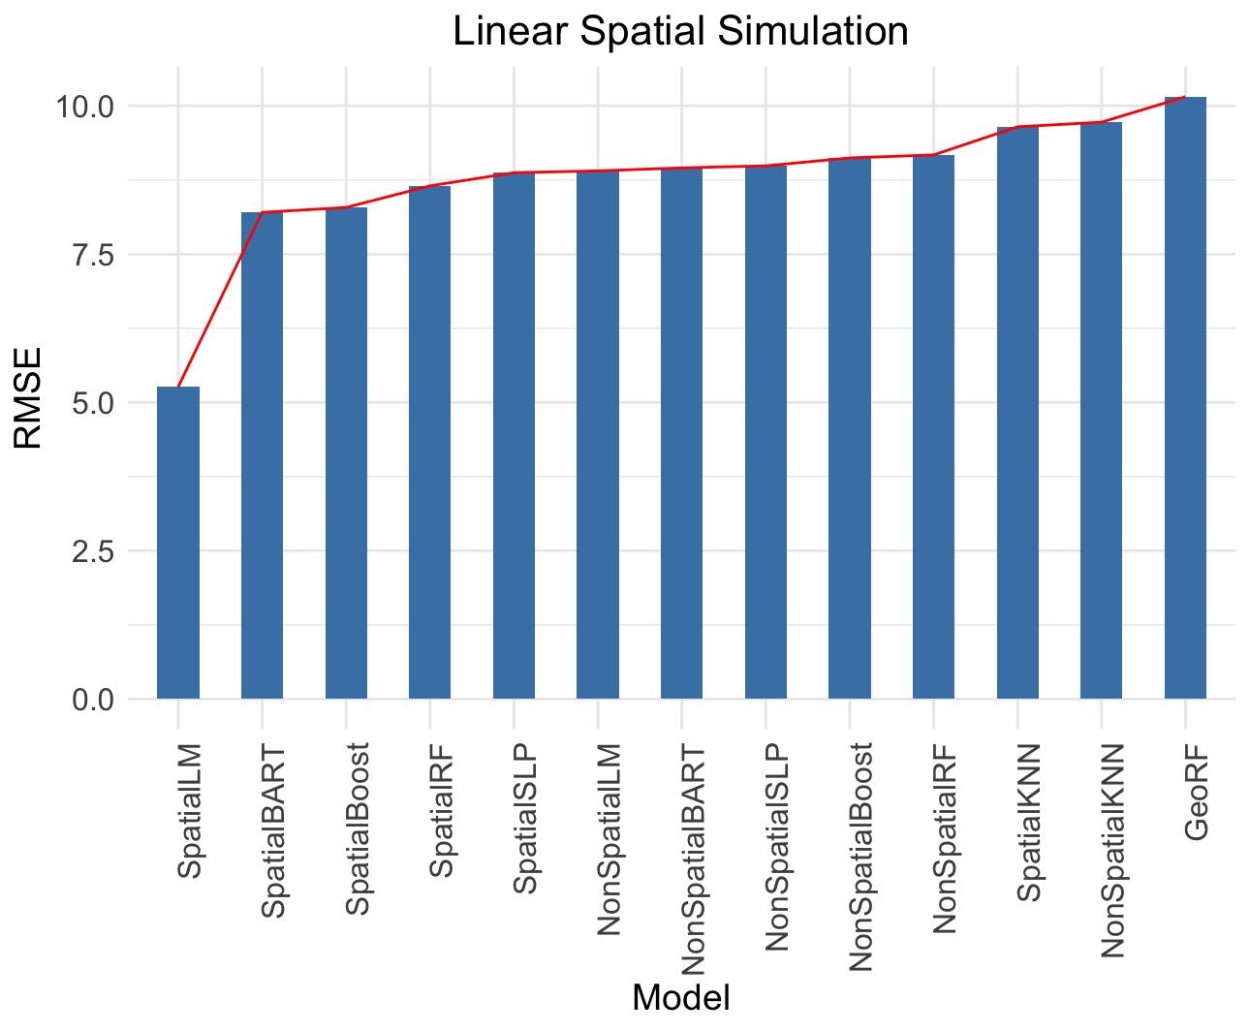
Simulation Study 2:
Linear and Spatial

Slide 13
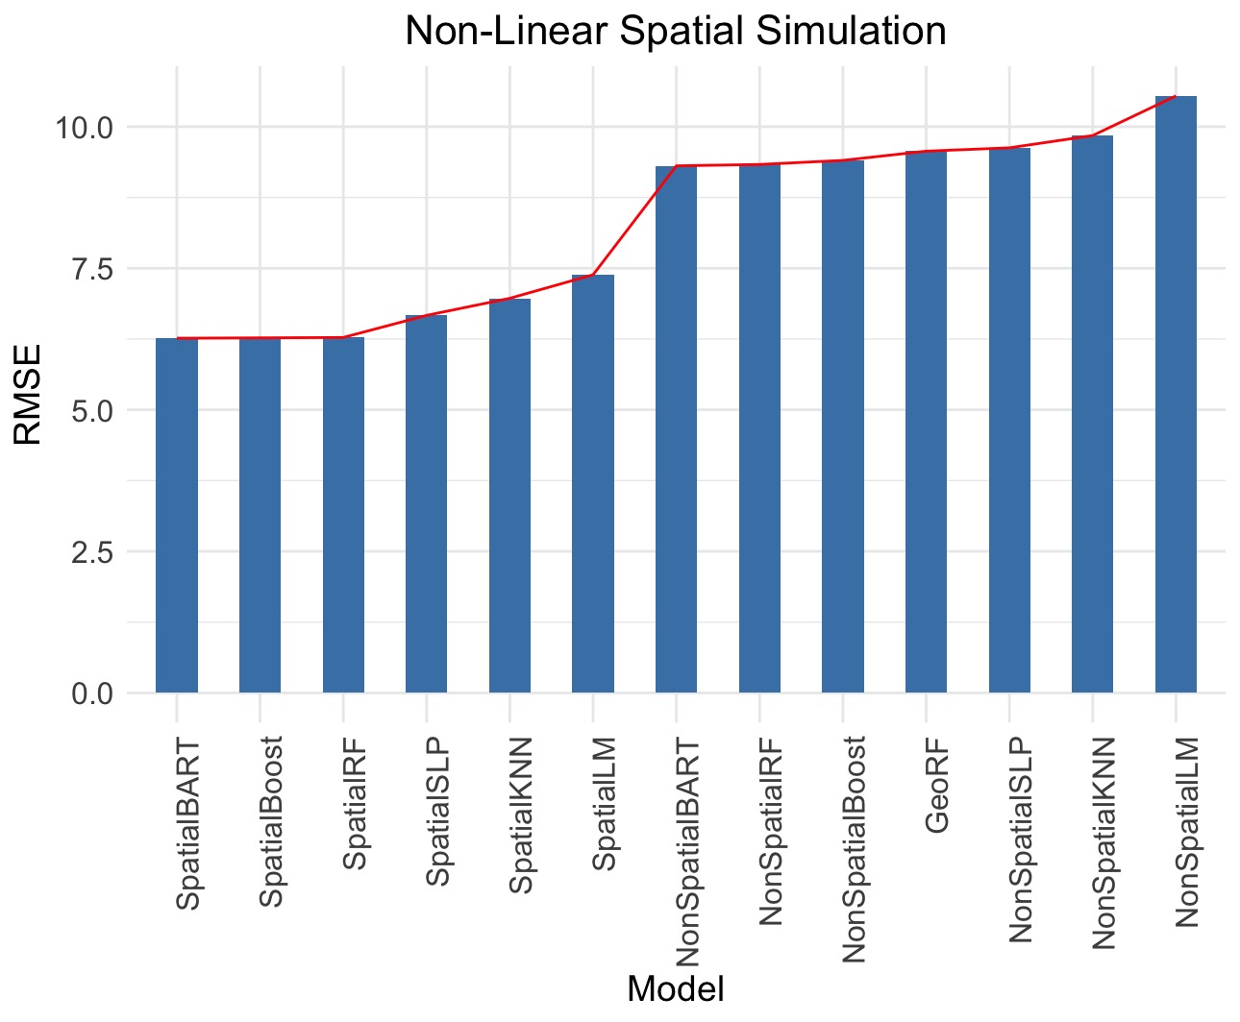
Simulation Study 3:
Nonlinear and Spatial

Slide 14
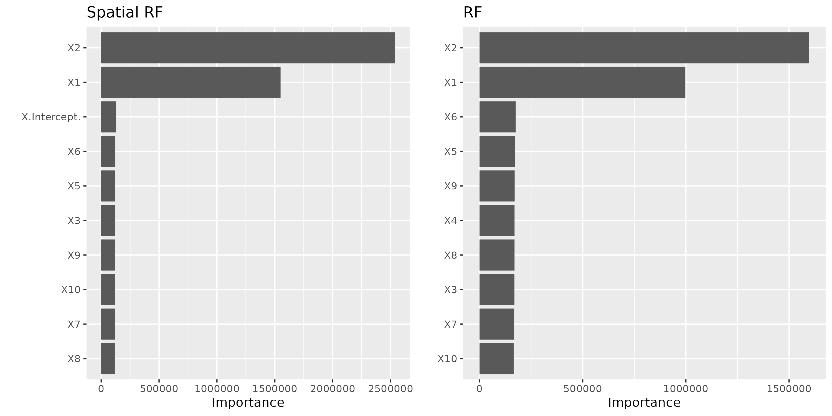
Variable Importance

Slide 15
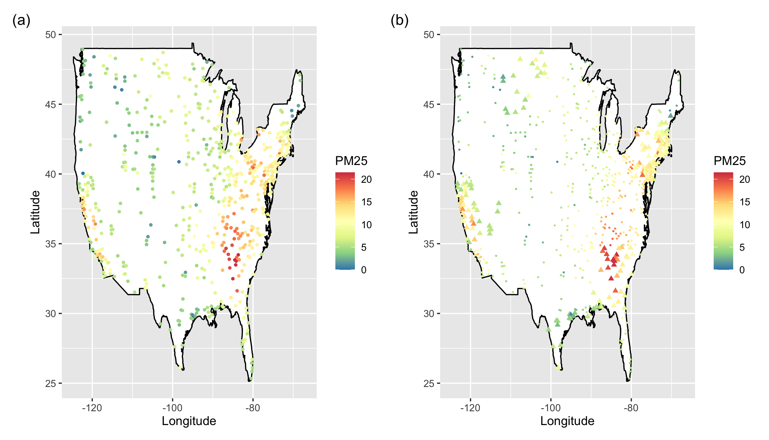
Application:
PM 2.5 Monitoring

Slide 16
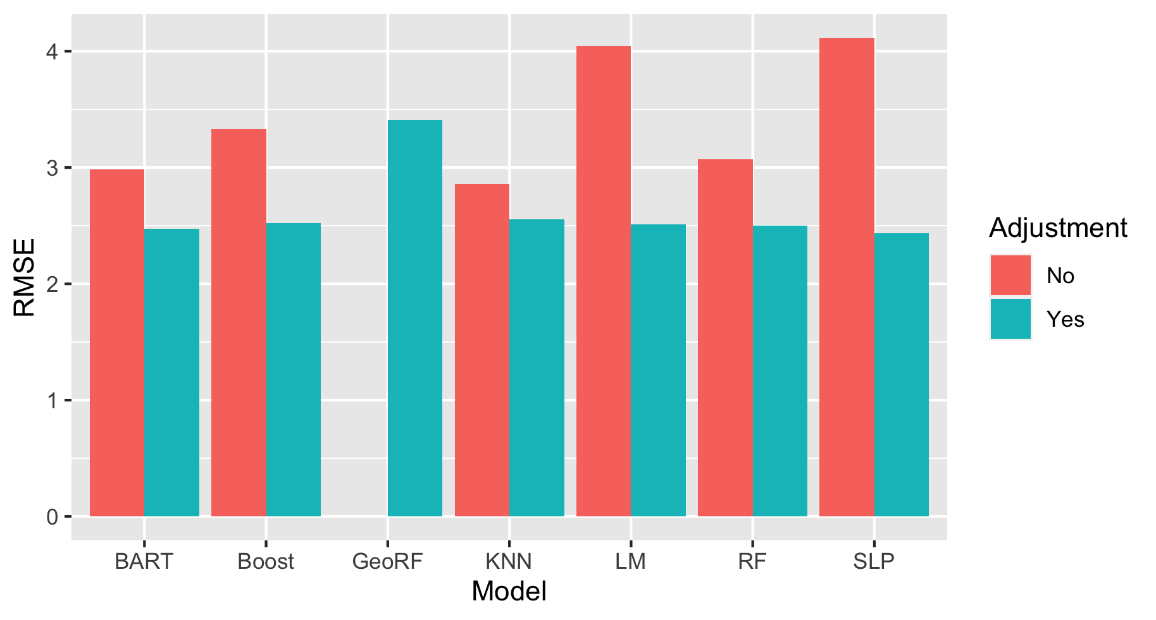
Application:
PM 2.5 Monitoring

Slide 17
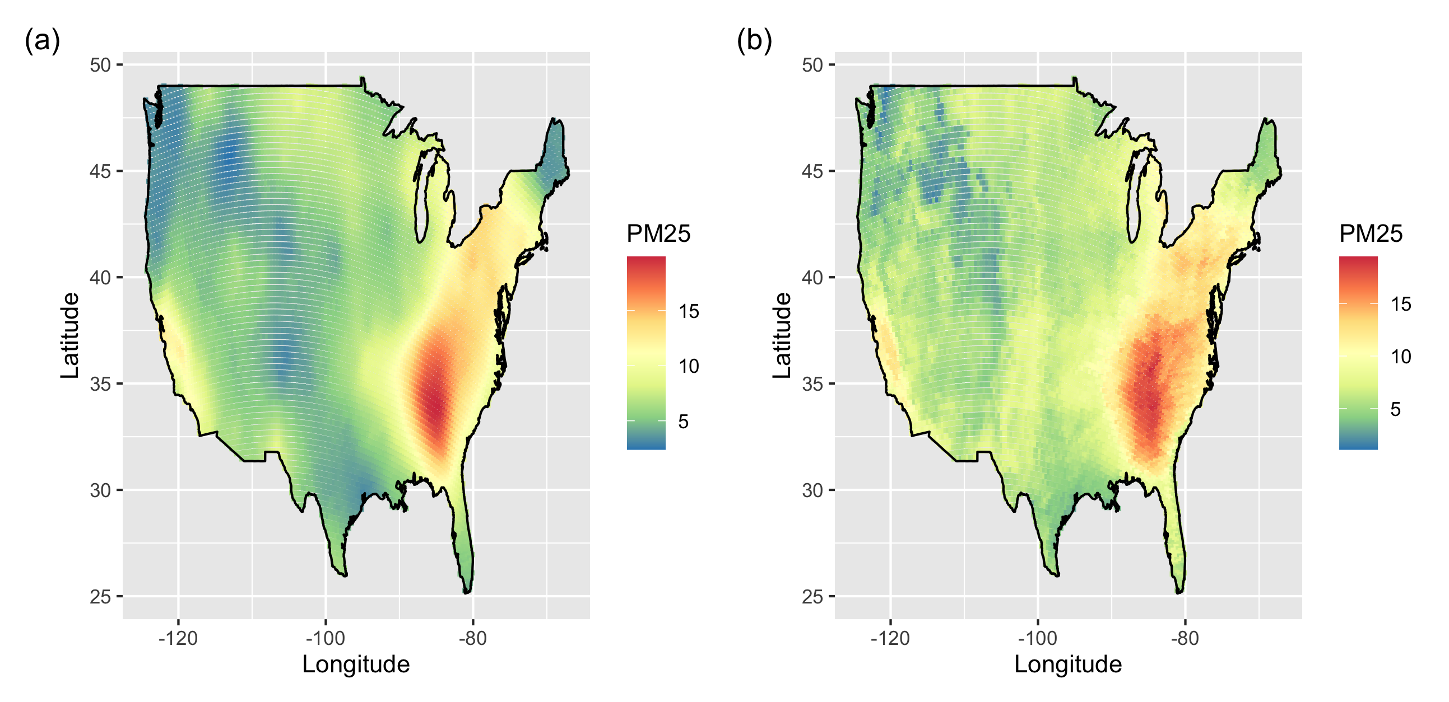
Application:
PM 2.5 Monitoring

Slide 18
Conclusions
We developed computationally scalable and portable method to account for spatial correlation in machine and deep learning.
Future Work:
  Uncertainty Quantification
  Non-Gaussian Response
  Multivariate Response
  Spatially-varying Relationships

