Slide 1
Applied machine learning for elucidating relationships between epigenomic regulatory rules and gene expression
between fungal species across phylogenetic distances
Presented by: Laura Weinstock, PhD
Sandia National Laboratories
Sandia ML/DL Workshop
SAND2024-10235PE

Slide 2
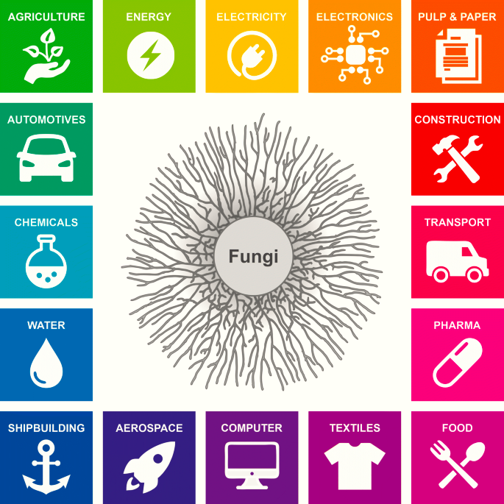
Background: Fungi in biomanufacturing
Improving biomanufacturing outcomes
​Engineered fungi are promising chassis for future sustainable biomanufacturing and bioproduction.
Yeast alone (Nicholas Money, 2018):
5% of USA’s GDP (>$900B)
3% of USA’s workforce (>5M)
Reliable regulation of the functionality in diverse fungi at scale remains a significant challenge to commercialization.
Meyer et al. (2020).
Notes:
Mention snl and doe cares about sustainable and secure bioman
Explain chassis, epigenetics

Slide 3
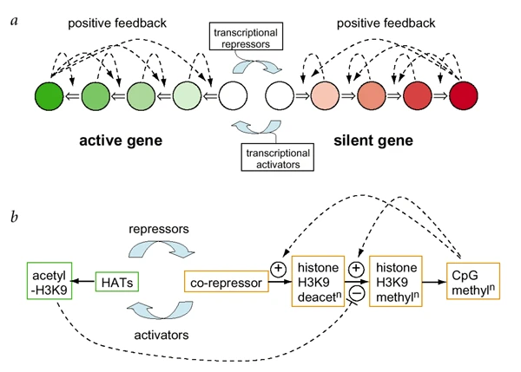
Background: regulating bioProduction
Biomanufacturing requires dynamic, fine-tuned multicellular control
Getting the exact desired properties of fungal chassis is challenging, and it is uneconomical to seek new chassis to overcome every limitation.
Precise modulation of chassis attributes will support efficient biomanufacturing
Epigenetic modifications play a crucial role in regulating gene expression and provide finer-resolution control of expression than genetic modifications
A systems problem needing a systems-level solution
Gene A
Gene B
Gene C
Gene D
Gene E
Gene F
In reality, you need more than on and off switches
Jaenisch & Bird. (2003). Nat Gen.

Slide 4
Defining the problem for model development
Can machine learning be used to determine relationships between epigenomics and gene expression in fungi?
Fungal biomanufacturing requires: the right genes, available metabolic flux, controlled regulatory cross-talk:
Must find the right ‘knobs and levers’ of broad gene regulation for process optimization
Use of predictive models to assess process controllability, supplement with targeted experimentation
1
EPIGENETIC MODIFICATION TO PREDICT RNA EXPRESSION Uses peri-gene (TSS +/- n bp) histone modifications and DNA methylation data to predict or regress against RNA expression.
APPROACH 1
PLSR
Neural Networks
DeepDiffChrome
2
DNA SEQUENCE TO PREDICT EPIGENETIC MODIFICATIONS Uses native DNA sequence to predict or regress against epigenetic modification binding.
Enformer
CisRegModels
3
UNSUPERVISED LEARNING OF EPIGENETIC MODIFICATIONS AND/OR DNA SEQUENCE Learn patterns in the epigenetic modification or DNA sequence data without expression information.
Random forest
k-means clustering
SCI-DNN
APPROACH 2
APPROACH 3
Notes:
Determining conserved and variable rules of gene regulation and across fungal species would be instrumental for optimizing biomanufacturing processes
Predictive modeling can also help reduce the number of experimental conditions needed to achieve optimally engineered fungi across species
Is it predictive?
What is predictive?
Make predictions and test

Slide 5
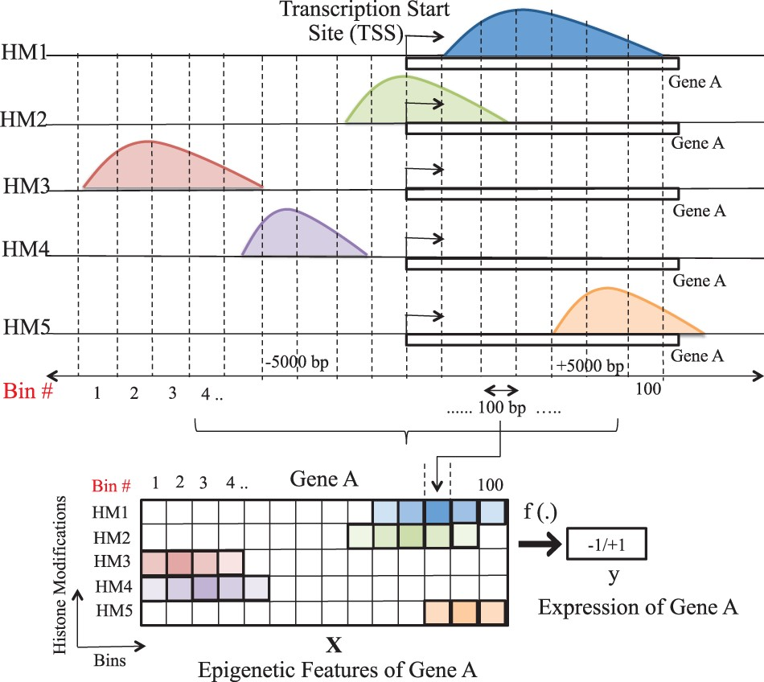
Previous efforts using machine learning to understand gene regulation
Convolution and attention are powerful tools to combine for extracting features from sequence and epigenetic signal information
DeepChrome: binary classification of gene expression using binned histone modification expression profiles
Enformer: sequence-to-sequence prediction using convolutional and transformer layers
Singh et al. (2016) Bioinformatics.
Avsec et al. (2021). Nat Methods.
Notes:
Recent efforts have sought to understand the relationship between gene sequence, epigenetic modifications, and gene expression within fungal species using machine learning and deep learning (ML/DL) methods but there remains limited understanding of how similar epigenetic modifications control gene expression across fungal species.

Slide 6
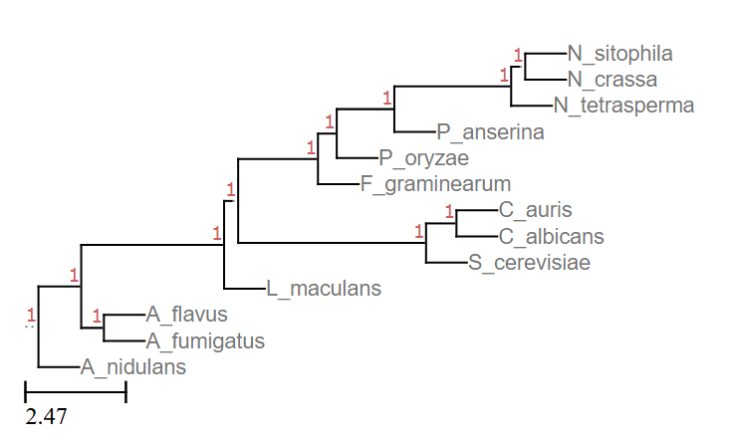
Model training and evaluation strategy
Species selected based on phylogenetic distance and overlapping epigenetic modification data availability
Training and testing data → epigenetic modification data
Predicted values → RNA expression
Species 1 Training
Model
Learning
Optimized Model
Species 1 Test/Evaluation
Intra-species Performance
Species 1 Validation
Evaluation
Species 2 Test/Evaluation
Cross-species Performance

Slide 7
Shallow model results: Cross-species evaluation
Candidate tree-based models do not maintain performance in cross-species prediction.
Eval Model
Leptosphaeria maculans
Neurospora crassa
Fusarium graminearum
Notes:
Data vis/ viz inspection

Slide 8
Deep learning model architecture
Custom model with Convolution with MaxPooling, Attention, and Fully Connected layers uses epigenetic signal profile to predict 2-class gene expression
Based on previous models for similar purposes in other species

Slide 9
Deep learning model results
Custom CNN with Attention model outperforms benchmark models on cross-species prediction performance.
Leptosphaeria maculans
Neurospora crassa
Fusarium graminearum
Model = Modified model from Lee et al.
Model = Modified model from Lee et al.

Slide 10
Interpreting model predictions: SHAP
Intra-species
Cross-species
Ncrassa → Fgram
Y=1

Slide 11
SHAP results (cont.)

Slide 12
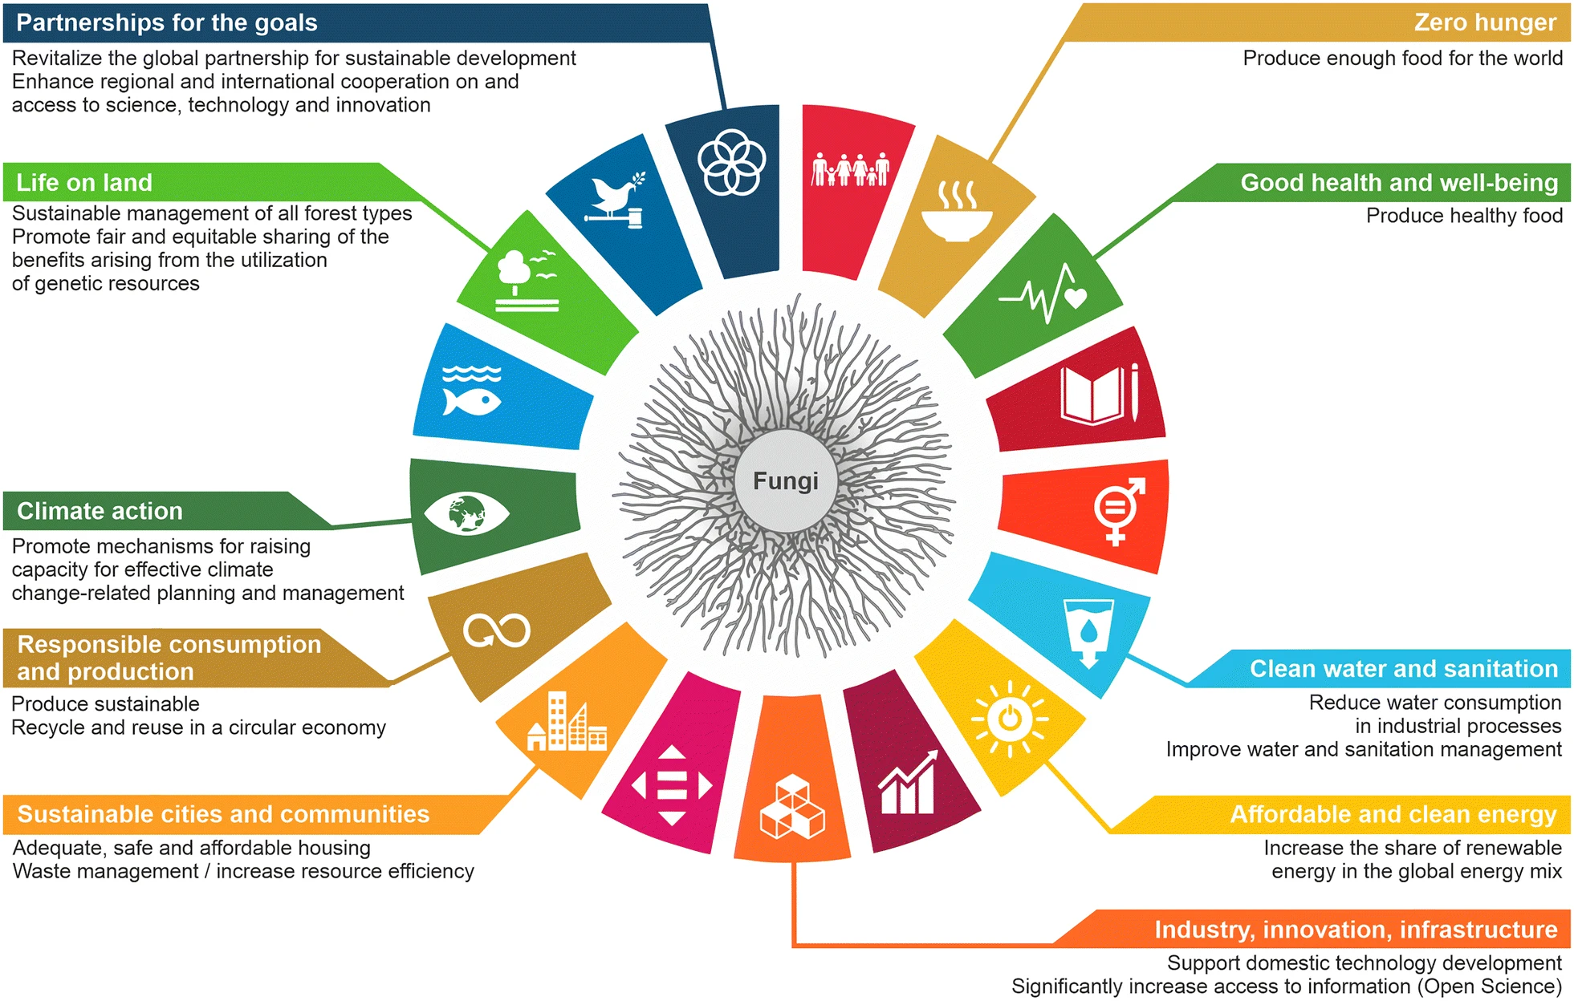
conclusions
Shallow models have limited ability to predict intra-species gene expression based on average epigenetic modification expression signals.
Custom CNN + Attention model predicts intra- and cross-species gene expression based on epigenetic modifications signal profiles.
We can use conservation of epigenetic mechanisms across related species to predict functional outcomes
Limitations in predictive capacity may be due to underlying biological constraints or limited data availability.
Highly modular gene expression enabled by predictive ML modeling of regulatory epigenetic modification rules is possible
Support sustainable and secure bioenergy and biomanufacturing goals, and understanding of fungal disease.
Supporting sustainable circular bioeconomy goals
Meyer et al. (2020).

Slide 13
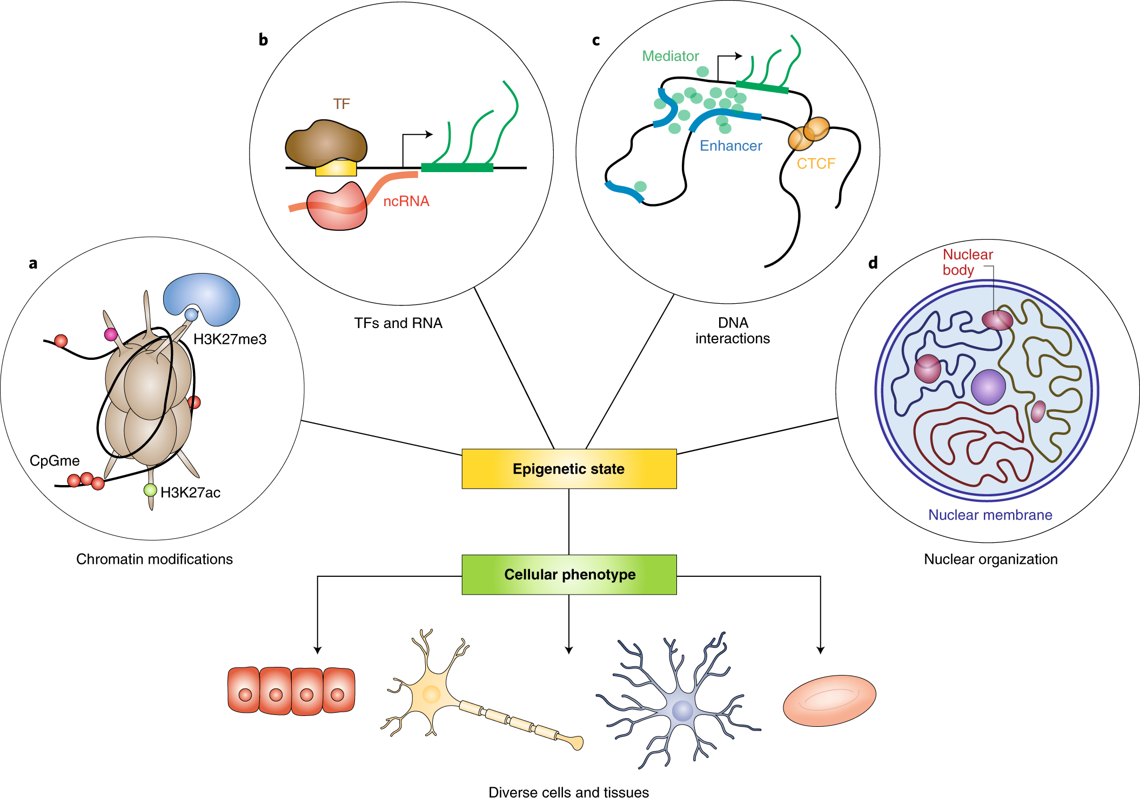
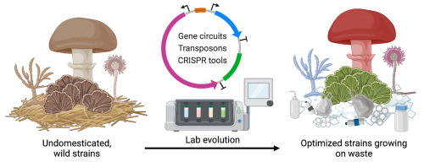
Future directions
Additional sequence, chromatin structure, and unsupervised prediction strategies
Identify modification features that drive prediction
Experimentally validate predicted modifications that regulate gene expression
Develop modular epigenome editing tool for testing across fungi
Nakamura et al. (2021). Nat Cell Bio.
1
EPIGENETIC MODIFICATION TO PREDICT RNA EXPRESSION Uses peri-gene (TSS +/- n bp) histone modifications and DNA methylation data to predict or regress against RNA expression.
APPROACH 1
PLSR
Neural Networks
DeepDiffChrome
2
DNA SEQUENCE TO PREDICT EPIGENETIC MODIFICATIONS Uses native DNA sequence to predict or regress against epigenetic modification binding.
Enformer
CisRegModels
3
UNSUPERVISED LEARNING OF EPIGENETIC MODIFICATIONS AND/OR DNA SEQUENCE Learn patterns in the epigenetic modification or DNA sequence data without expression information.
Random forest
k-means clustering
SCI-DNN
APPROACH 2
APPROACH 3
Jo et al. (2023). Materials Today Bio.

Slide 14
acknowledgments
PI: Raga Krishnakumar
Cameron Kundstadt
Jenna Schambach
Anna Fisher
Matthew Hirakawa
Elizabeth Koning
Ethan Lee
Wittney Mays
Warren Davis
Yooli Light
Joshua Podlevsky

Slide 15
backup

Slide 16
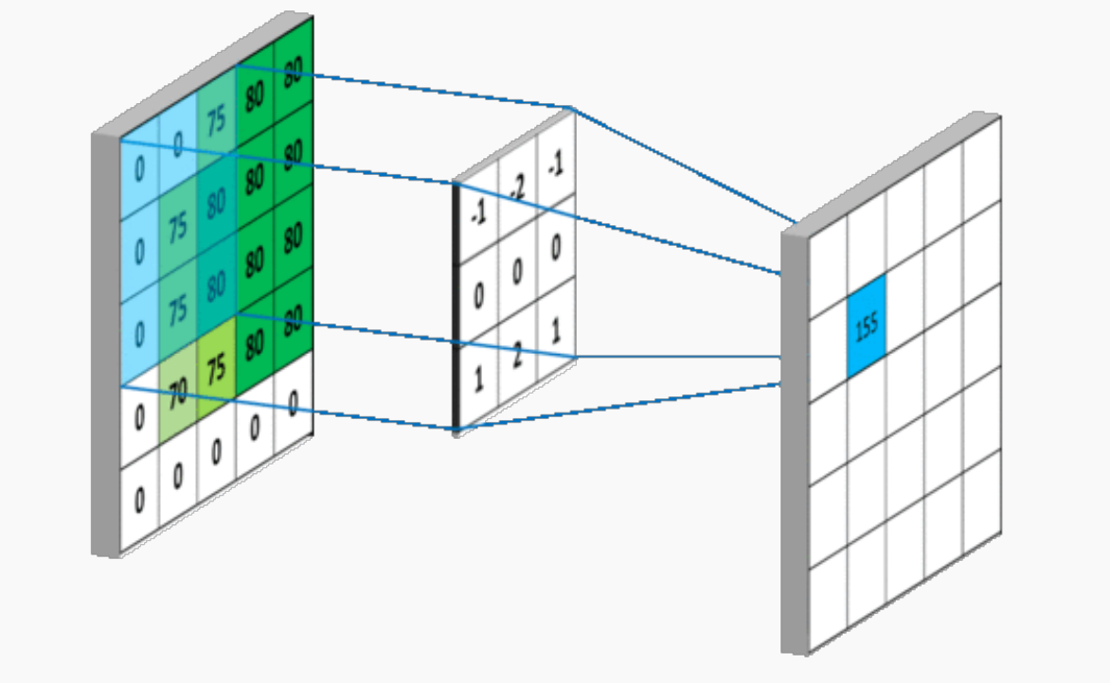
Overview of key machine learning layers
Convolution finds array of features, attention finds key features
Convolutional layers
Attention layers

Slide 17
Data pre-processing pipelines
Top level genome
RNA-seq SRA
Top level genome
ChIP-seq SRA
fastq
fastq
QC
QC
fastQC
fastQC
Trim
Trim
trimmomatic
trimmomatic
Index
Alignment
Index
Alignment
STAR
STAR
bowtie2
bowtie2
Read count
Sort
HTSeq
samtools
RNA-Seq data
Chip-seq data

Slide 18
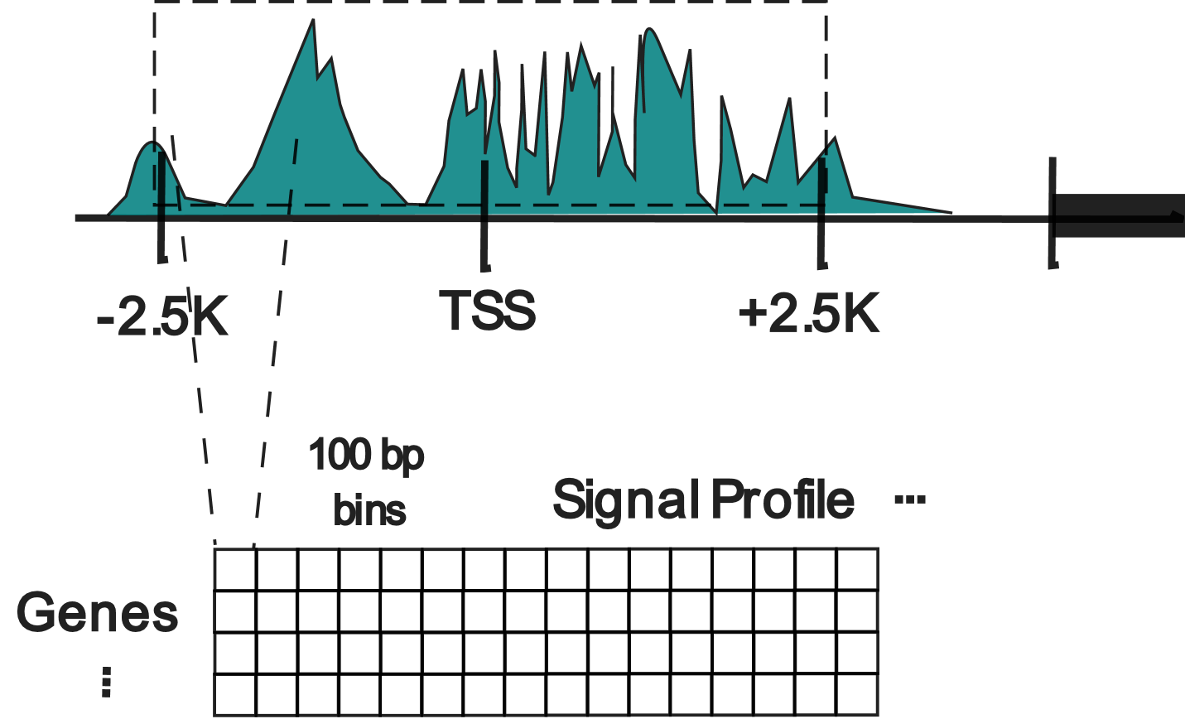
Data preparation
Indexed genome
Chip-seq data
Coverage
bedtools
Define coverage window (+/- TSS)
Expression in window
Shallow Learning: Expression average gene
Deep Learning: Expression signal profiles per gene

Slide 19
Mined epigenetic data
Fgram matchup table
 | Run | genotype | GEO Accession | Antibody
1 | SRR999608 | WT | GSM1226424 | Active Motif 39155 | H3K27me3
4 | SRR999611 | WT | GSM1226427 | abcam ab 9050 | H3K36me3
6 | SRR999613 | WT | GSM1226429 | Millipore 07-030 | H3K4me2
10 | SRR999617 | WT | GSM1226433 | abcam ab 8580 | H3K4me3
N crassa matchup table
 | Run | Assay Type | genotype | chip_antibody
9 | SRR12229305 | ChIP-Seq | WT | H3K27ac
10 | SRR12229306 | ChIP-Seq | WT | H3K4me1
11 | SRR12229307 | ChIP-Seq | WT | H3K4me2
12 | SRR12229308 | ChIP-Seq | WT | H3K4me3
13 | SRR12229309 | ChIP-Seq | WT | H3K36me3
14 | SRR12229310 | ChIP-Seq | WT | H3K9me3
18 | SRR12229314 | ChIP-Seq | WT | H3K27me2/3

Slide 20
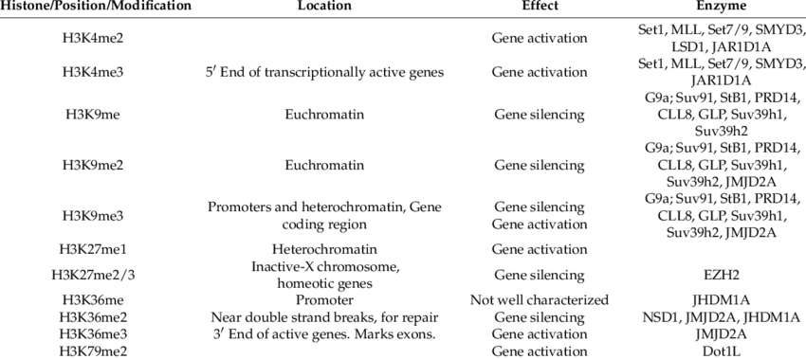
Histone modification functions

Slide 21
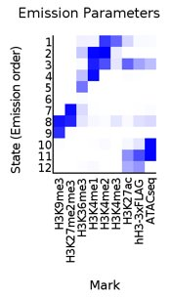
Data viz to Confirm expression patterns
deepTools to create a correlation clustergram
ChromHMM to observe combinatorial correlations
H3K4me1/2 (gene activation)
RNA sequencing (‘outcome’)
H3K4me3 (gene activation)
Gene expression level (counts)
ATAC-seq (gene activation)
H3K27ac (gene activation)
State at the start site of gene
hH3 (light-sensitive intro)
H3K27ac (gene activation)
H3K27me2/3 (gene silencing)
H3K9me3 (gene silencing)

Slide 22
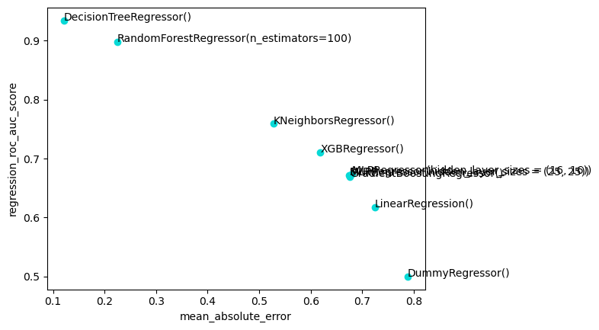
Shallow model results: model battery screening
Tree-based models outperform other shallow learning models on intra-species prediction using N. crassa data.
Decision Tree Regressor
Random Forest Regressor
K-Nearest Neighbors Regressor
XGBoost Regressor
MLP Regressor
Gradient Boosting Regressor
Support Vector Regressor
Linear Regressor
Dummy Regressor

Slide 23
Shallow model results: precision
Leptosphaeria maculans
Neurospora crassa
Fusarium graminearum

