Slide 1
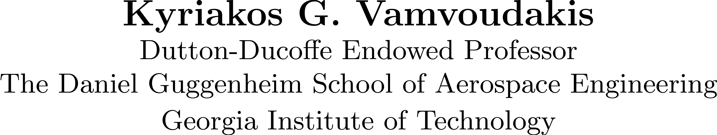

Slide 2

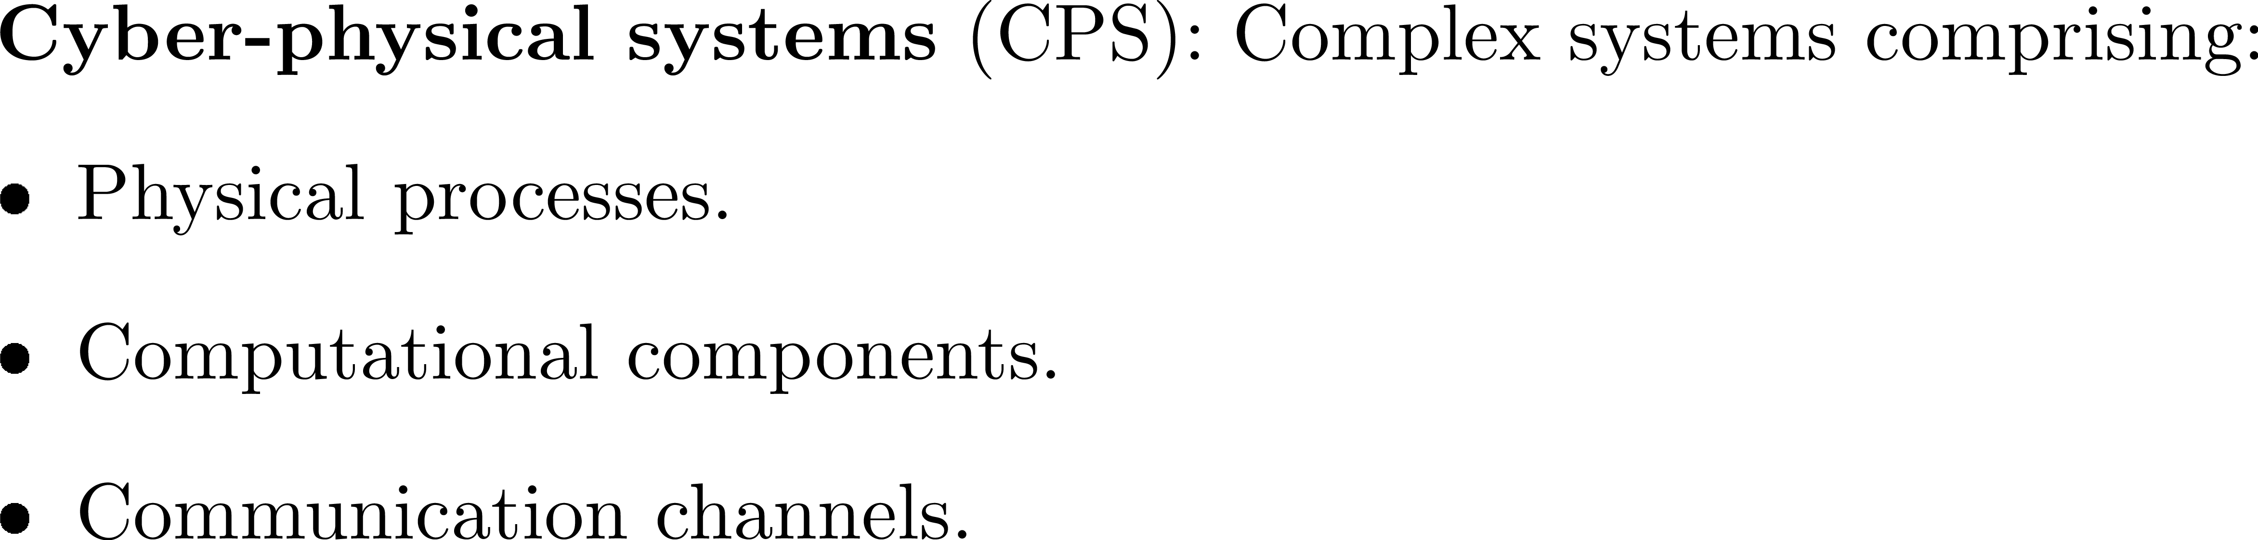

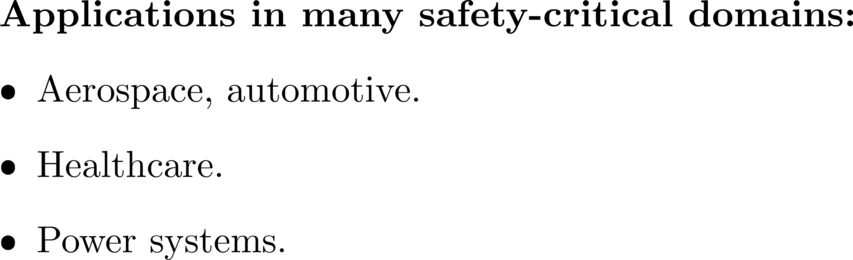
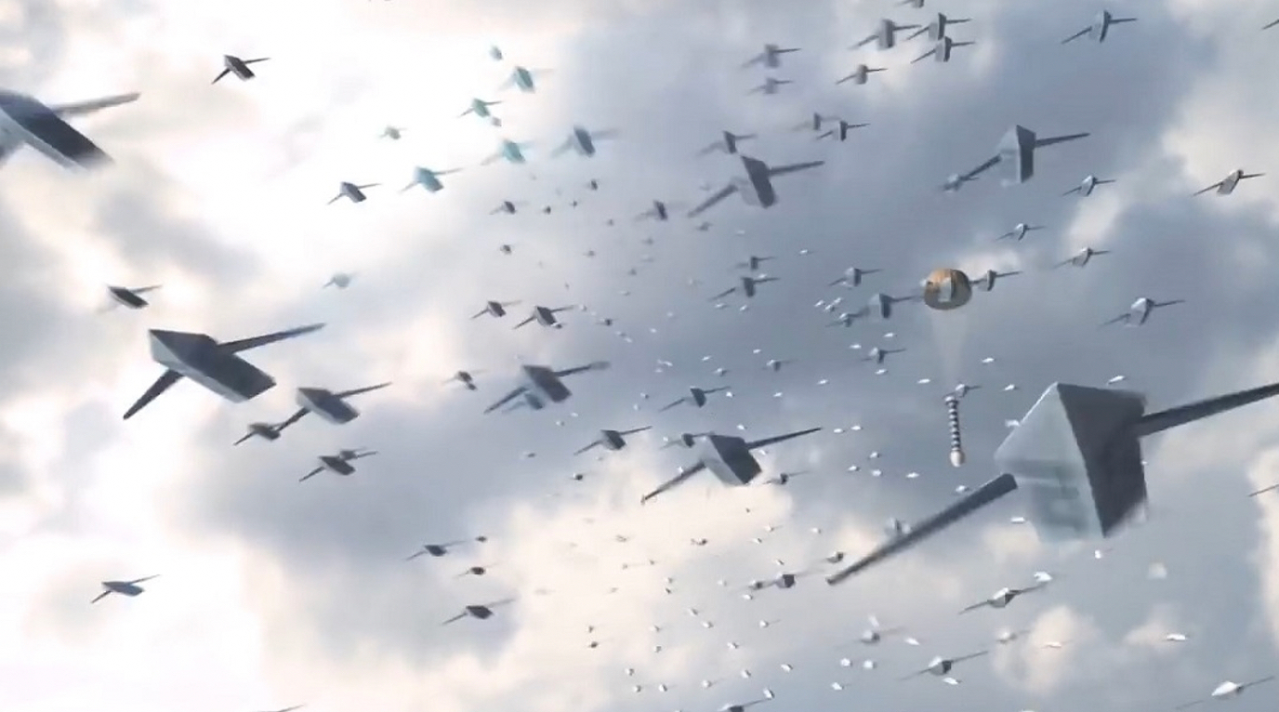


Motivation

Slide 3

Challenges
3
How can we build intelligent and safe digital systems that interact with the physical world?
Perception, control, and coordination: continuous and ubiquitous
  Self-monitoring, real-time neuro symbolic learning and adapting
We need to bridge two worlds
Computing side: Computing abstractions currently focus primarily on functionality, and secondarily on aspects of the physical world (e.g., time, space, energy, temperature, human behavior)
Engineering side: Cautiously over-designed systems preclude flexibility offered by computing’s power, especially the intelligence embodied in software.
Jeannette M. Wing

Slide 4
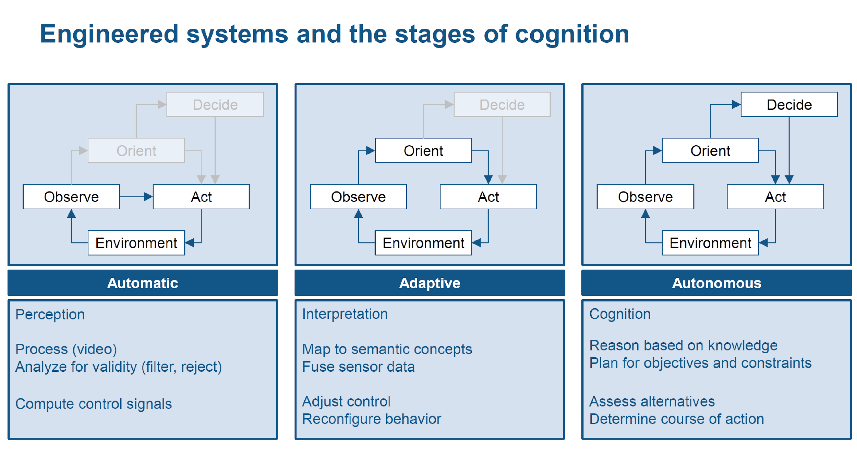
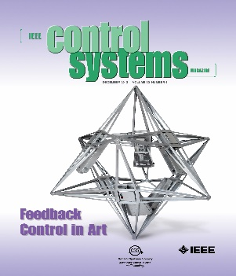

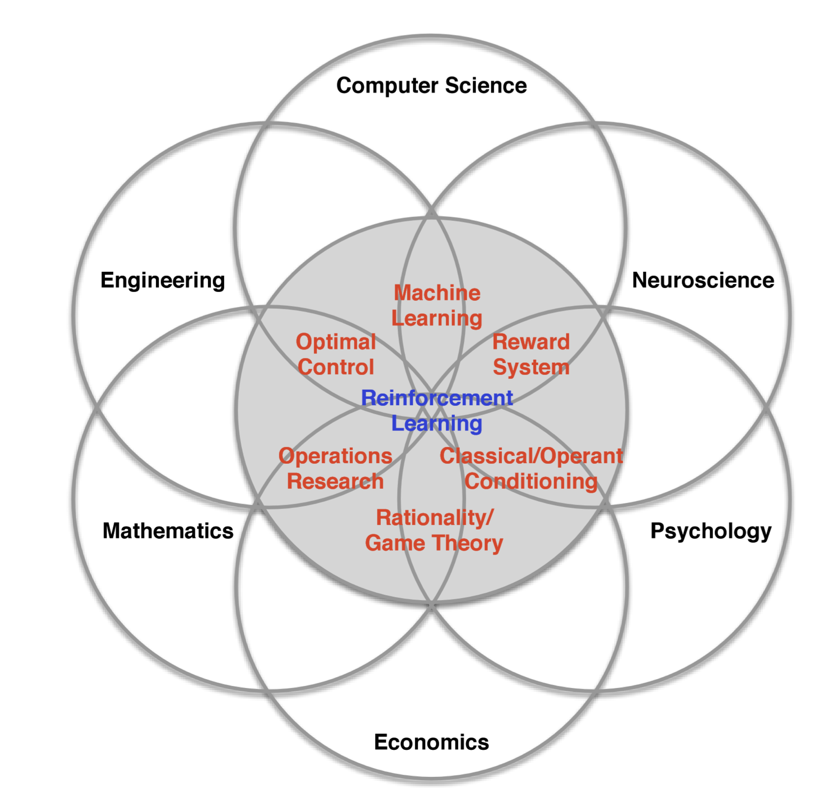
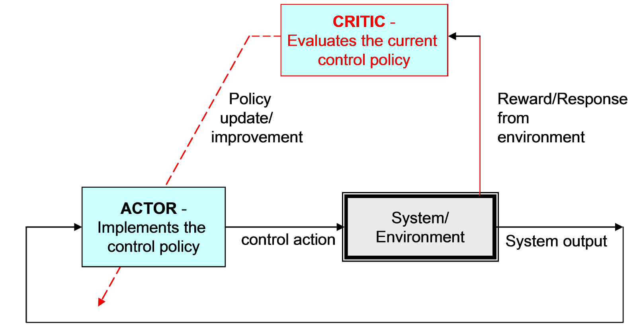
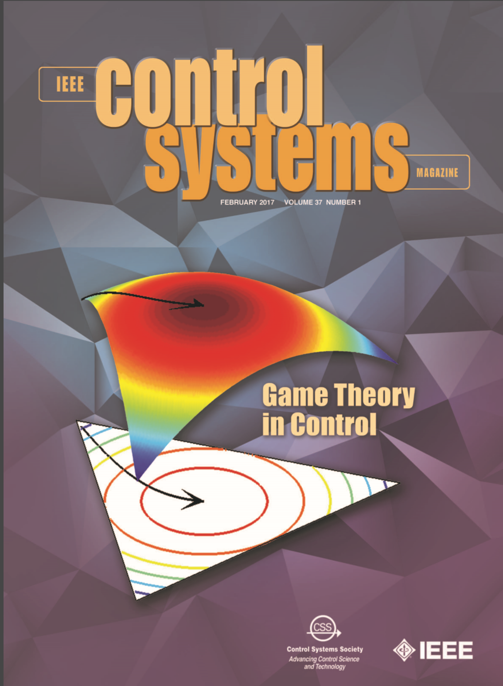
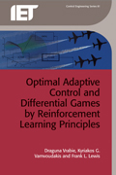
What is learning?
4
Ability to learn a new task, without being specifically programmed for that task (offline optimal control)
David Silver, Google DeepMind
Pieter Mosterman, Mathworks
KGV, et al, “Game Theory-Based Control System Algorithms with Real-Time Reinforcement Learning,” IEEE Control Systems Magazine 2017.
F. L. Lewis, D. Vrabie, KGV, “Reinforcement Learning and Feedback Control: Using Natural Decision Methods to Design Optimal Adaptive Controllers,” IEEE Control Systems Magazine, 2012.

Slide 5
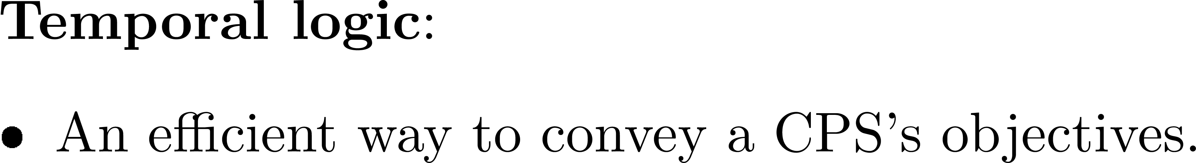
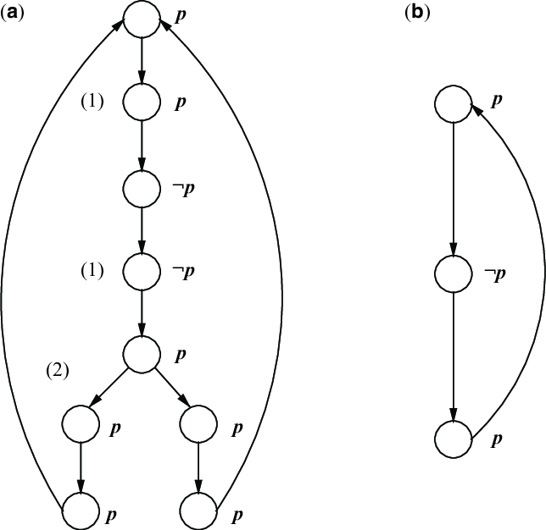
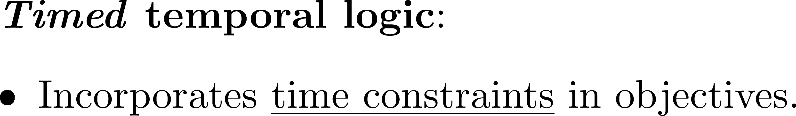
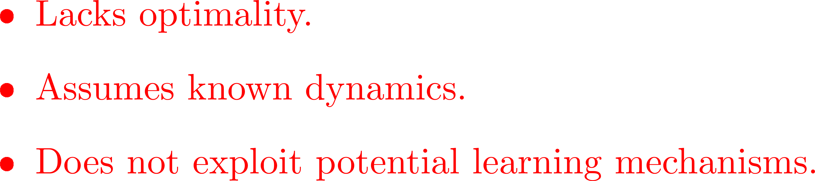
Motivation

Slide 6
Scope

Slide 7


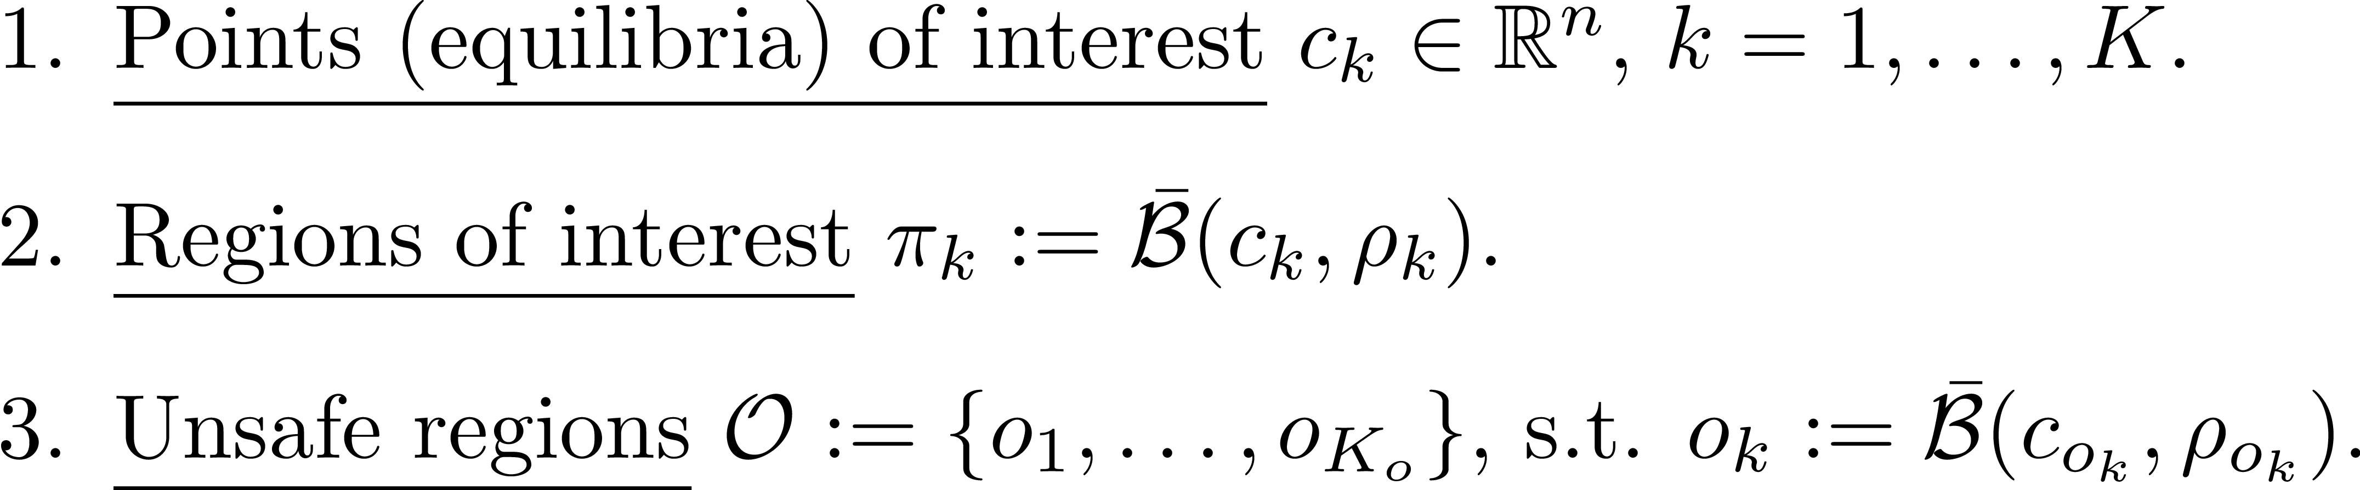

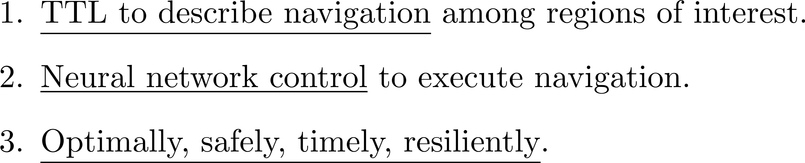
Problem Formulation

Slide 8
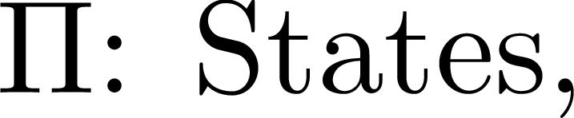
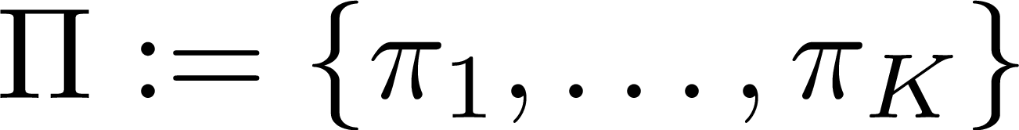
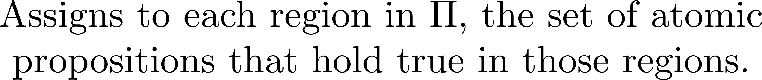

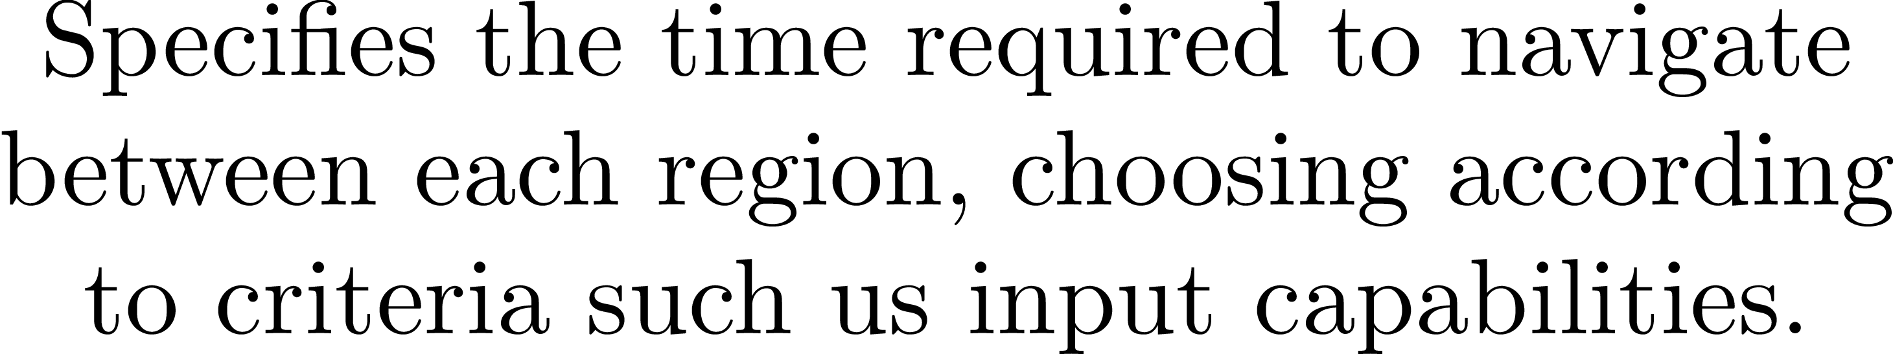

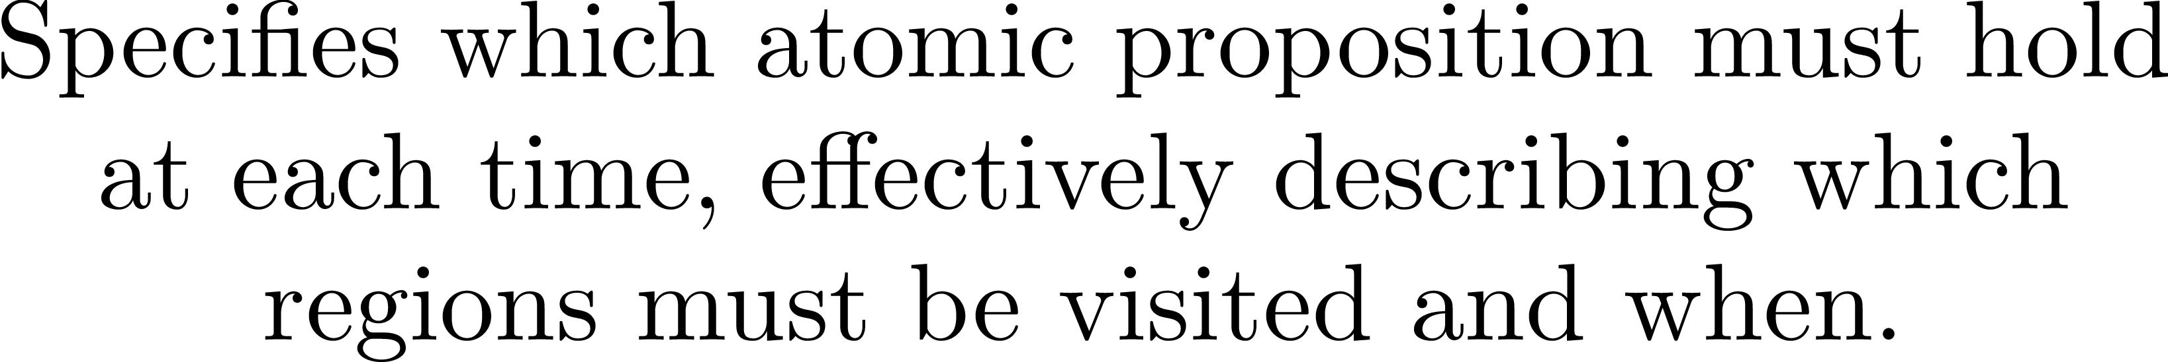
TTL Preliminaries

Slide 9
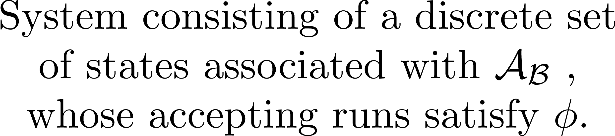
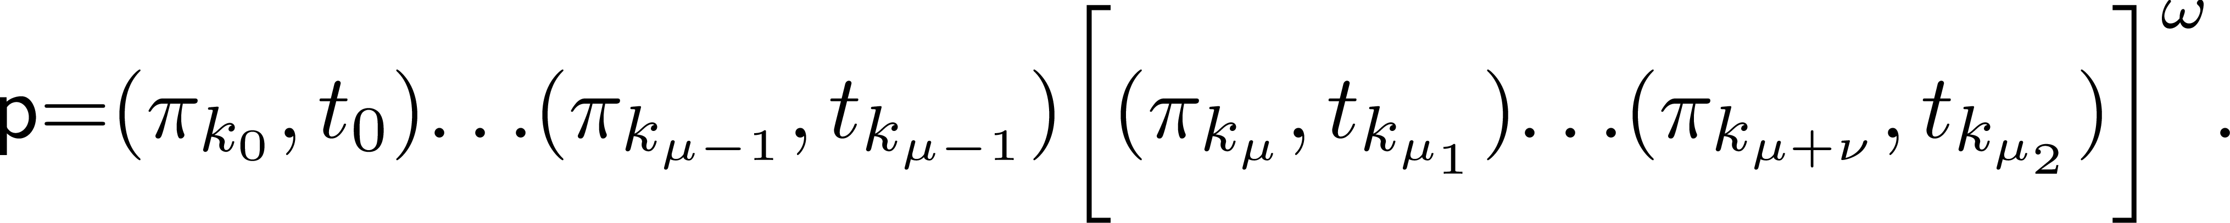
High-level Plan Generation

Slide 10
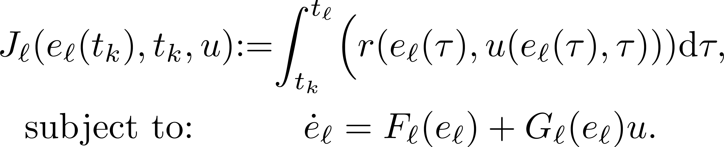
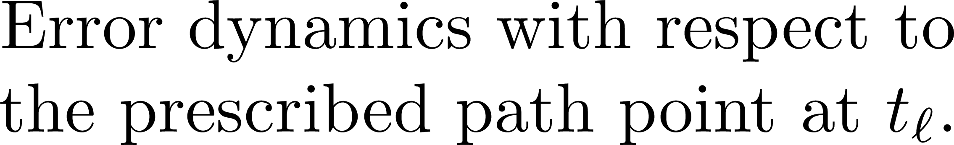
Optimal Control Problem

Slide 11
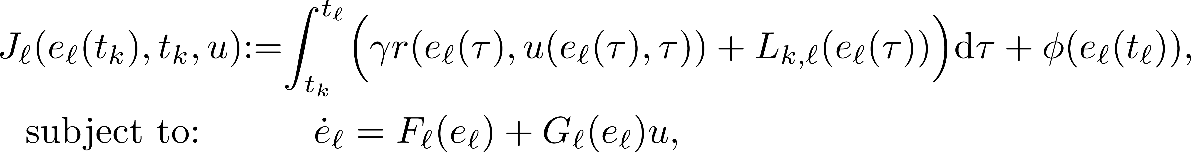
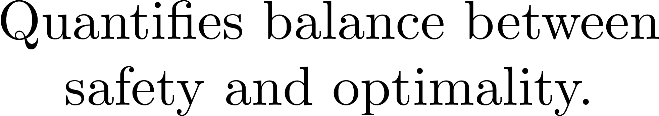
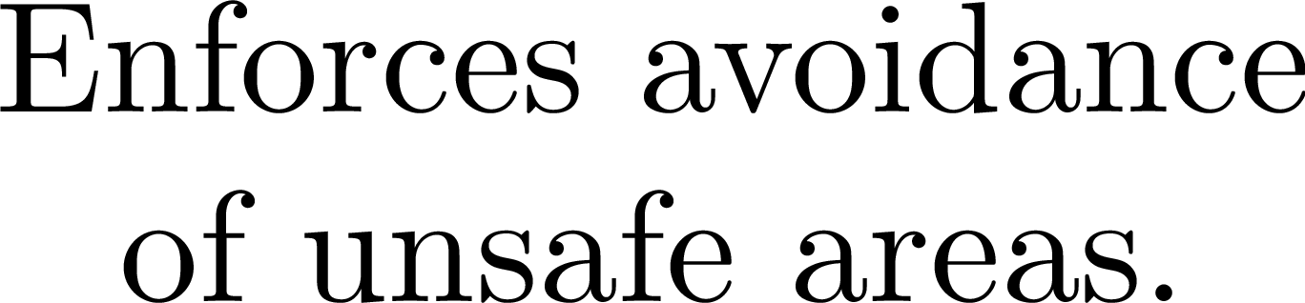
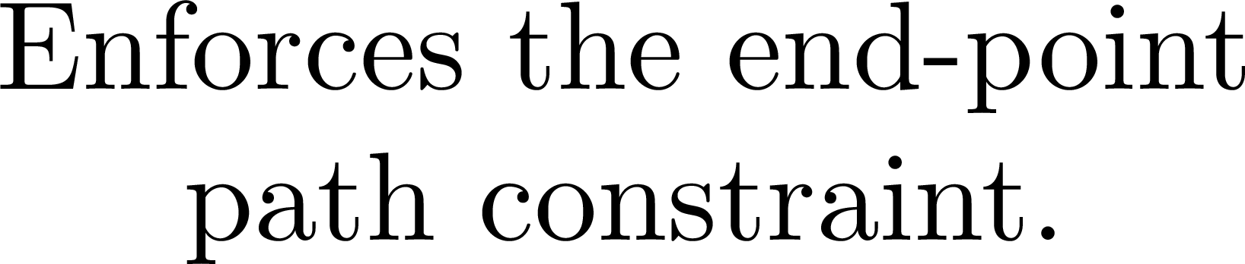

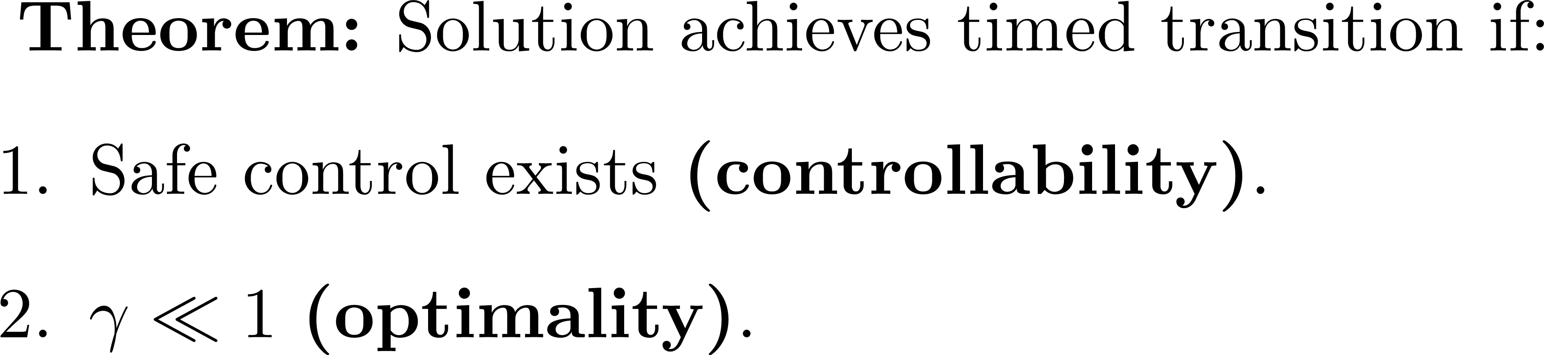
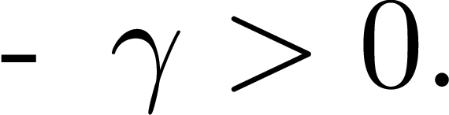
Soft-Constrained Optimal Control Problem

Slide 12
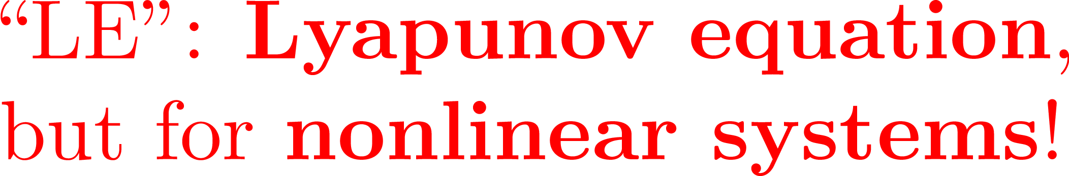
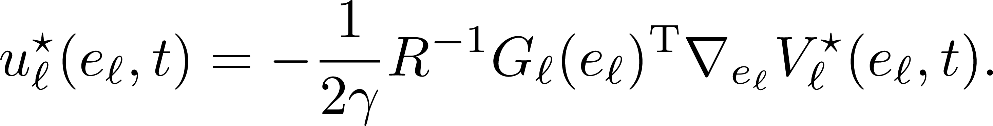
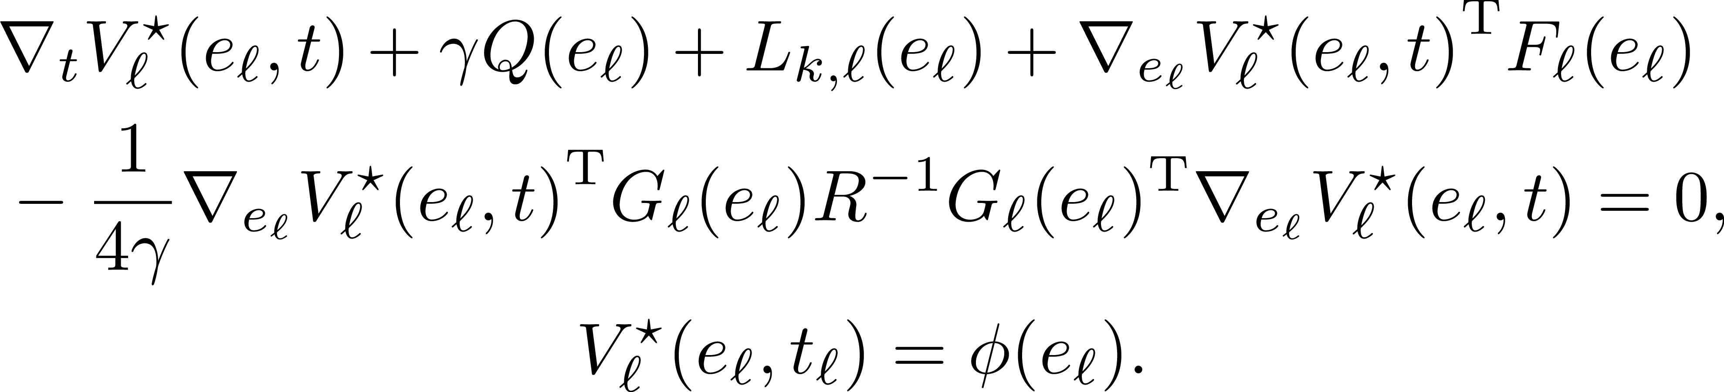

Solution to Optimal Control Problem

Slide 13
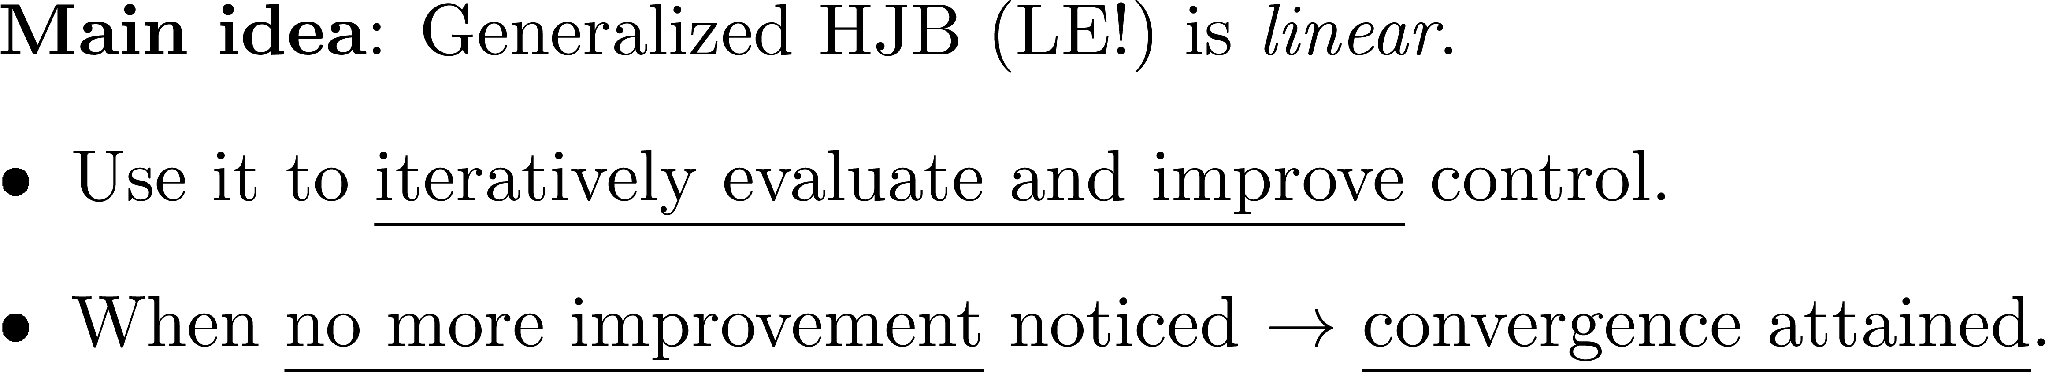
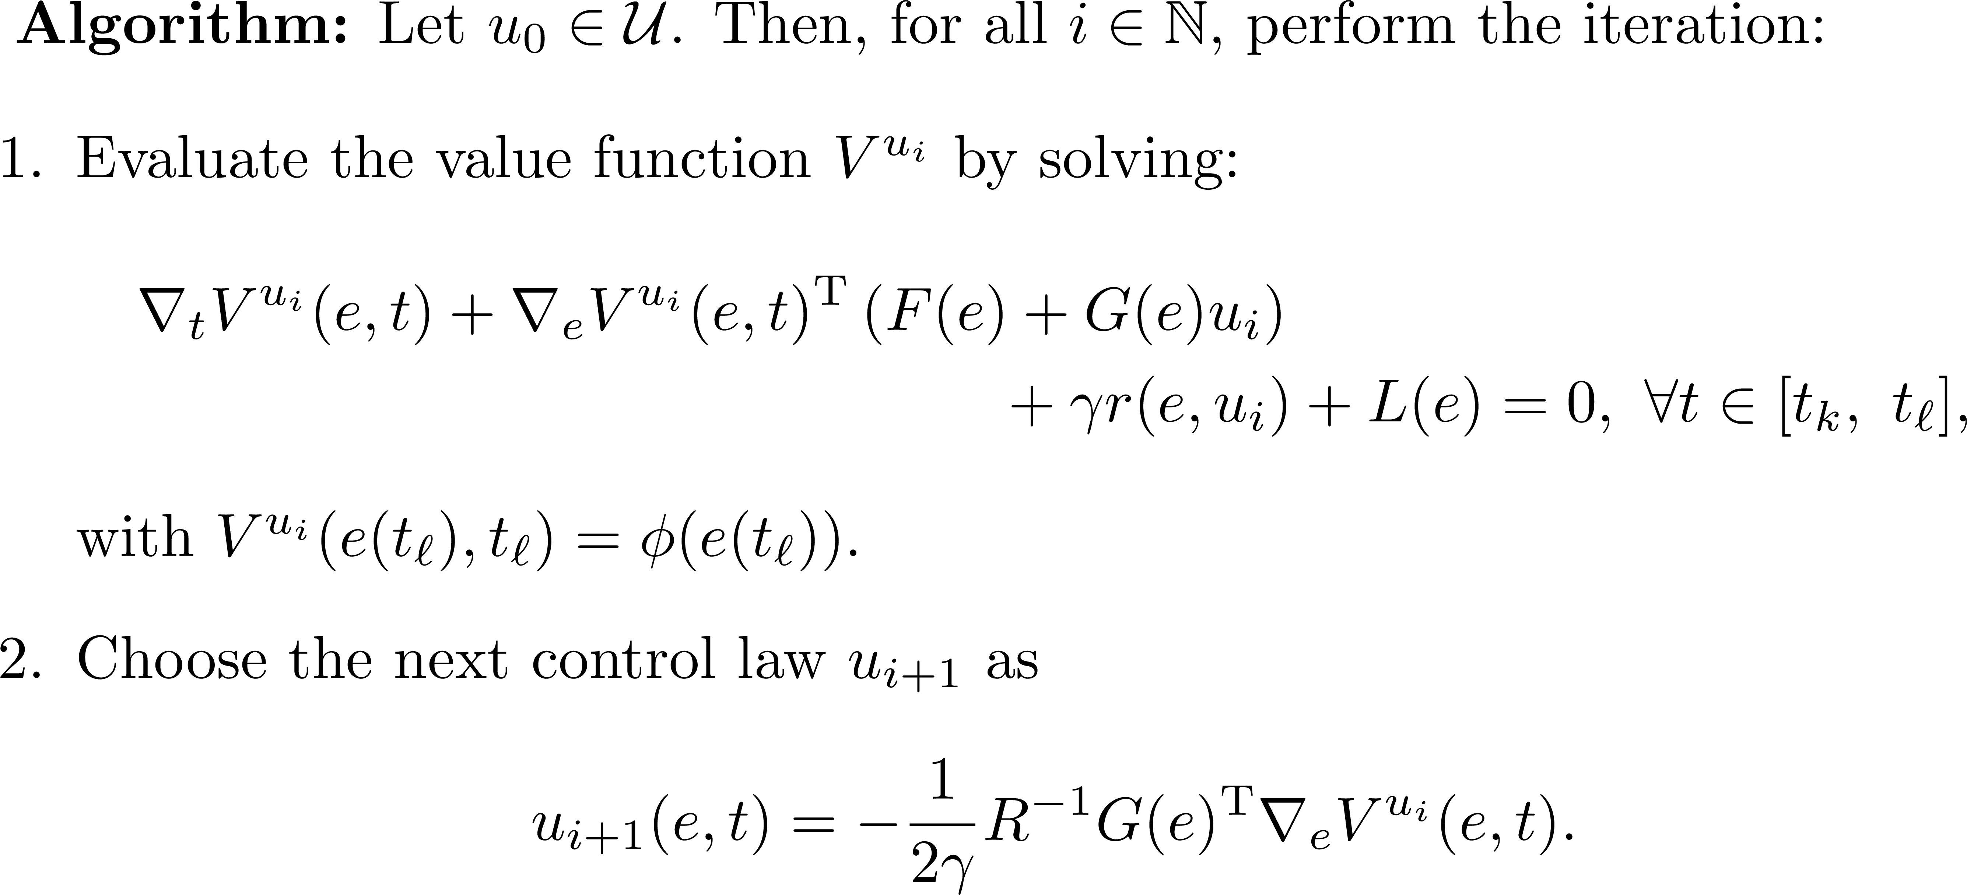
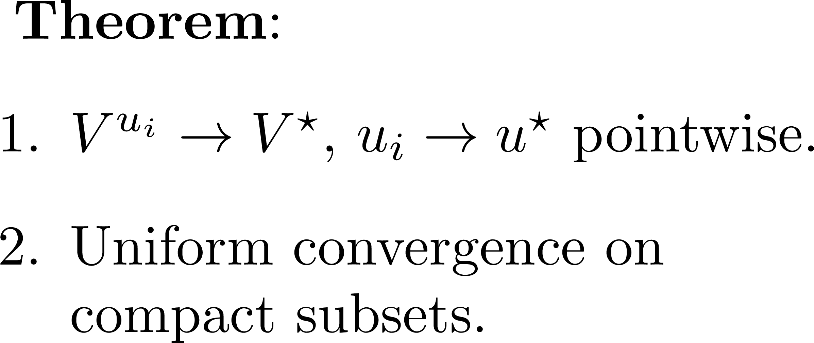
Policy Iteration for Optimal Control

Slide 14


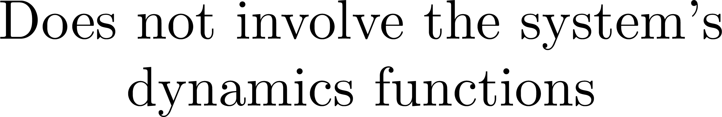

Learning-based Policy Iteration

Slide 15
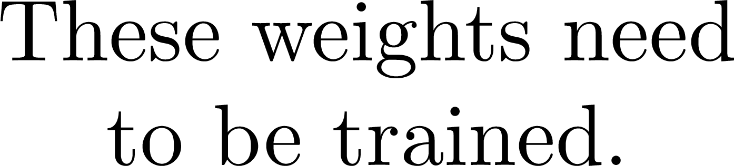
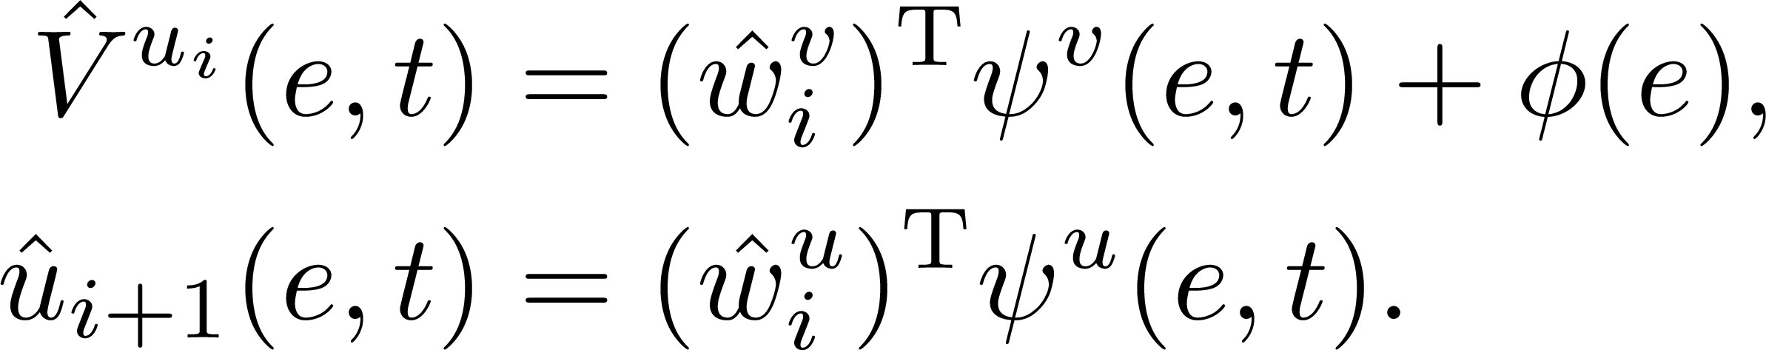
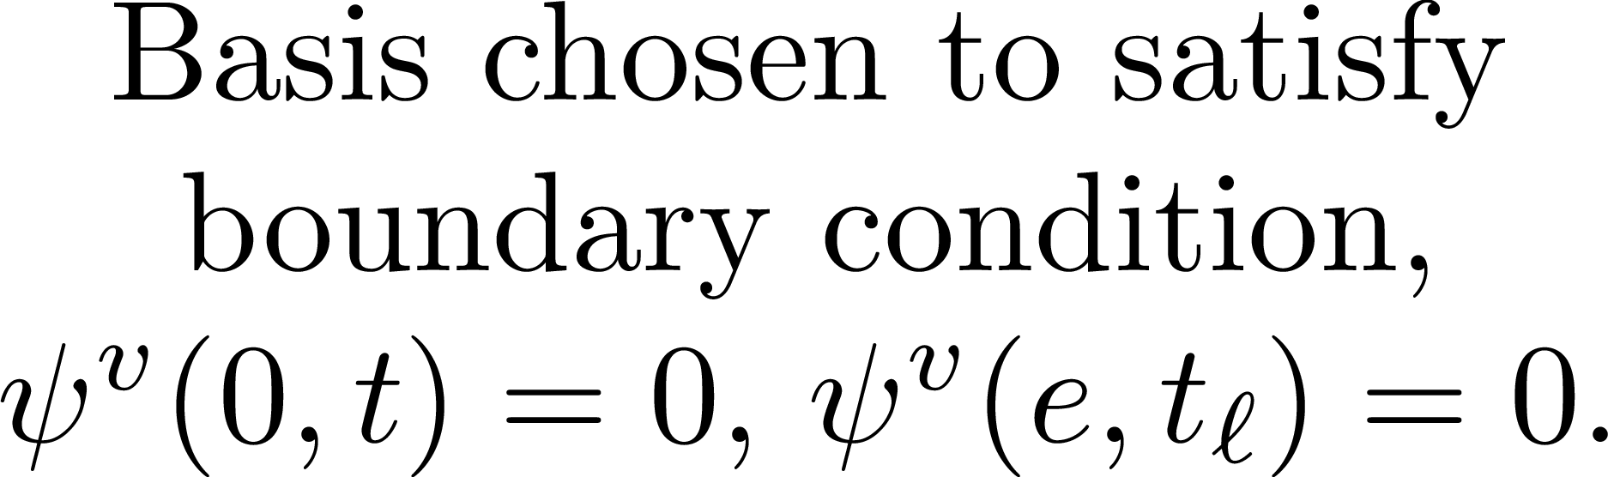
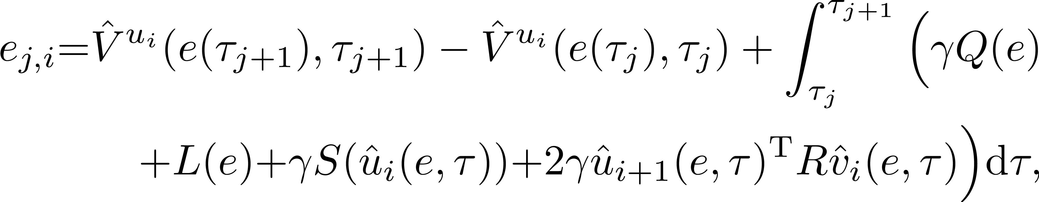
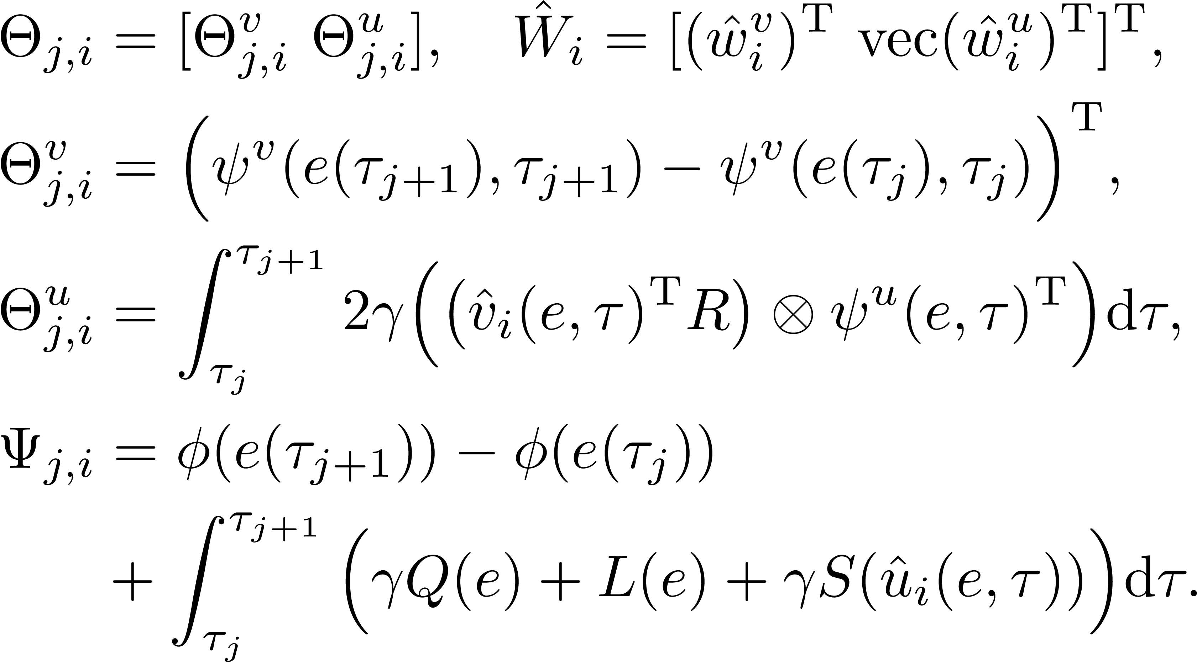
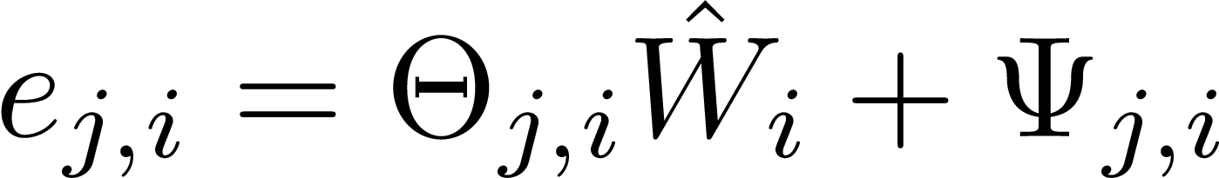


Learning-based Policy Iteration

Slide 16
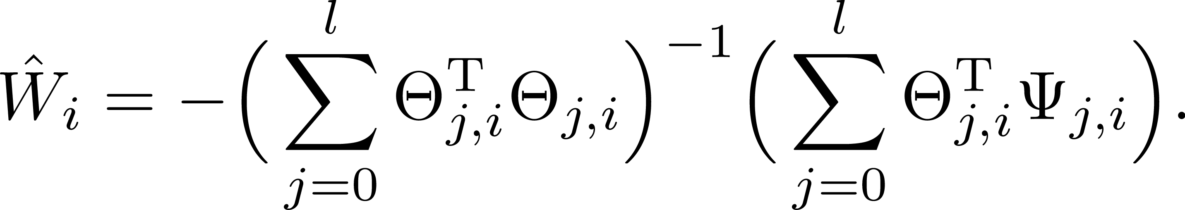
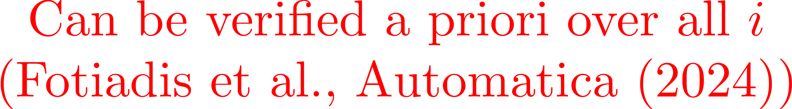
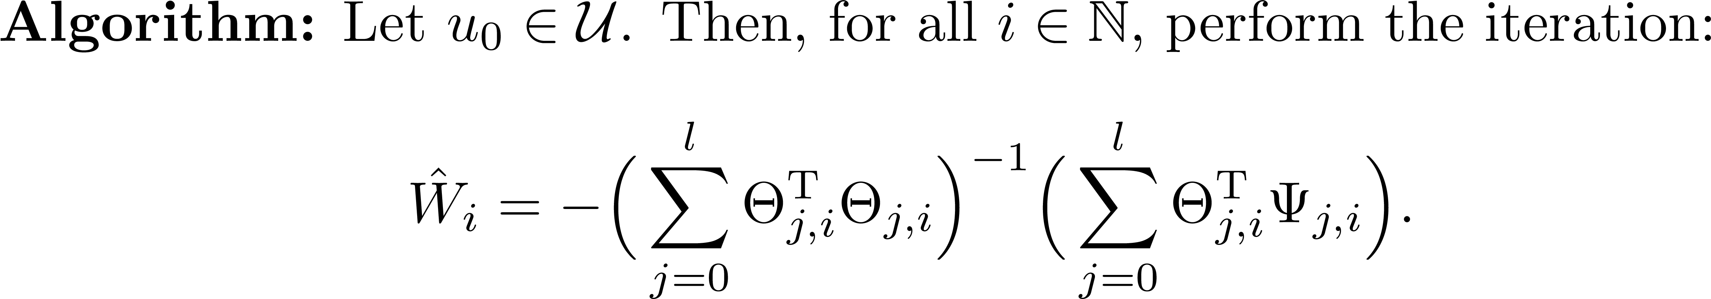

Learning-based Policy Iteration

Slide 17
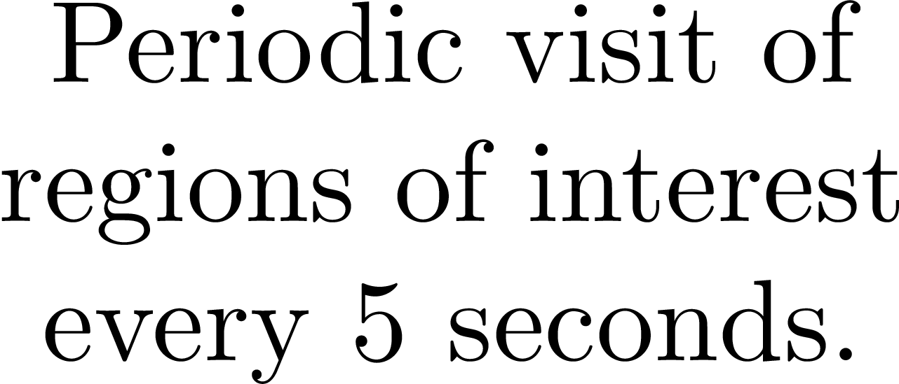
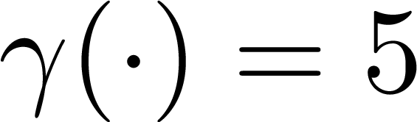
Simulation

Slide 18
Simulation

Slide 19
Simulation

Slide 20
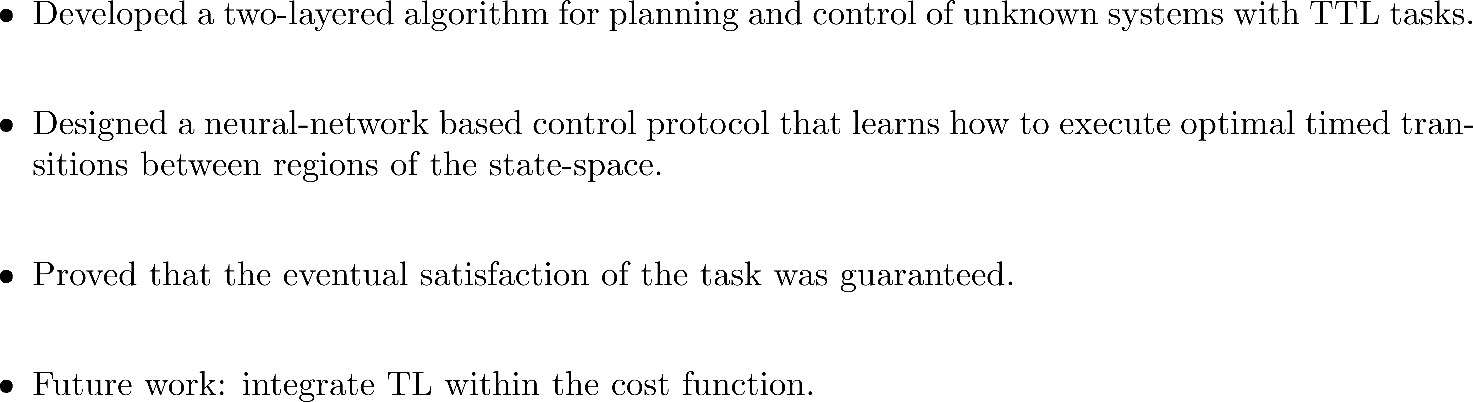
Conclusion and Future Work

Slide 21













Questions?
Questions?
THANK YOU
For papers please see: kyriakos.ae.gatech.edu/
Dr. F. Fotiadis

