Slide 1
AI for Clean Energy Integration
Presenter: Joseph A. Azzolini, PhD
Email: jazzoli@sandia.gov
SAND#1752948

Slide 2
Outline
Introduction / Background
AI for Improving Grid Models
AI for Faster Grid Simulations
AI for Data-Driven Analyses
Notes:
a downtown office building (500 kW) was allowed to install 30 kW of PV

Slide 3
Introduction and Background

Slide 4
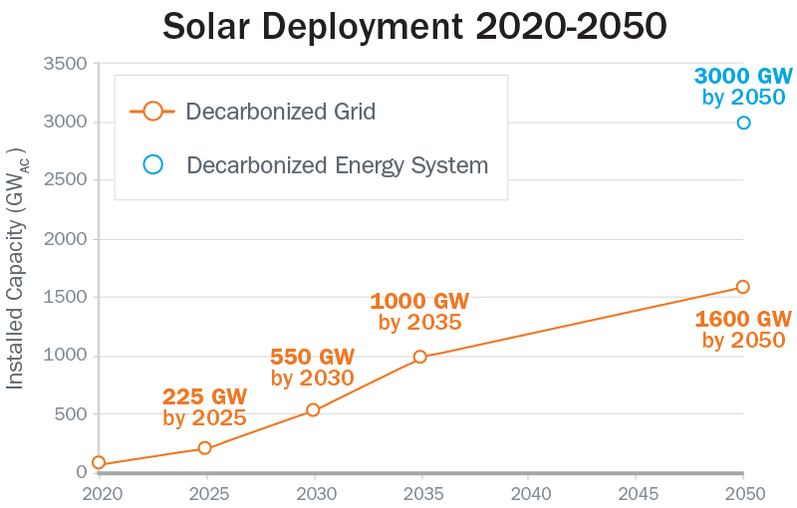
Introduction and Background
US power grid is undergoing a rapid transformation to decarbonize
Solar deployment will need to ramp up to 60 GW per year—4x the current deployment rate—between 2025-2030 to hit US decarbonization goals
Interconnection queues for residential solar photovoltaic (PV) systems are already considered a bottleneck in many areas
New tools are needed to streamline the interconnection process and rapidly evaluate PV impacts on the grid, with or without advanced inverter functions enabled
https://www.energy.gov/eere/solar/solar-futures-study
Notes:
Utilities and grid operators are increasingly leveraging these capabilities for a variety of objectives, such as mitigating voltage issues on distribution feeders [2], preventing excess reverse power flows [3], increasing PV hosting capacity (HC) [4], improving the dispatchability of PV [5], and offsetting the need for upgrading various grid components [6].

Slide 5
Introduction and Background
Conventional model-based approaches may not be sufficient:
  Require highly detailed grid models (created and updated manually)
  LV secondary circuit models are over-simplified or non-existent
  Time-consuming simulation-based evaluations
  Limited capability for evaluating advanced inverter grid support functions
  The distribution system is constantly changing and evolving over time.
Example model-based PV hosting capacity analysis (HCA)

Slide 6
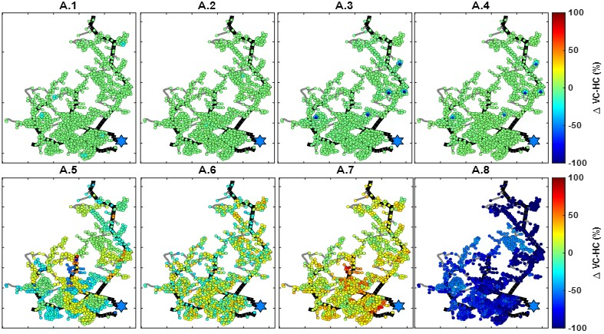
Background and Motivation
Conventional model-based HCA:
HCA accuracy is highly sensitive to modeling errors [1]
Errors can have local or feeder-wide impacts
Worst-case “snapshot” style analyses can significantly underestimate PV hosting capacity
Model Error Scenarios
Impact of poor distribution models on hosting capacity estimates for each residential customer (generally 10-30 kW hosting capacity)
Percent Error in Hosting Capacity
[1] J. Azzolini, S. Talkington, M. J. Reno, S. Grijalva, L. Blakely, and D. Pinney, “Improving Behind-the-Meter PV Impact Studies with Data-Driven Modeling and Analysis”, IEEE Photovoltaic Specialists Conference (PVSC), 2022.

Slide 7
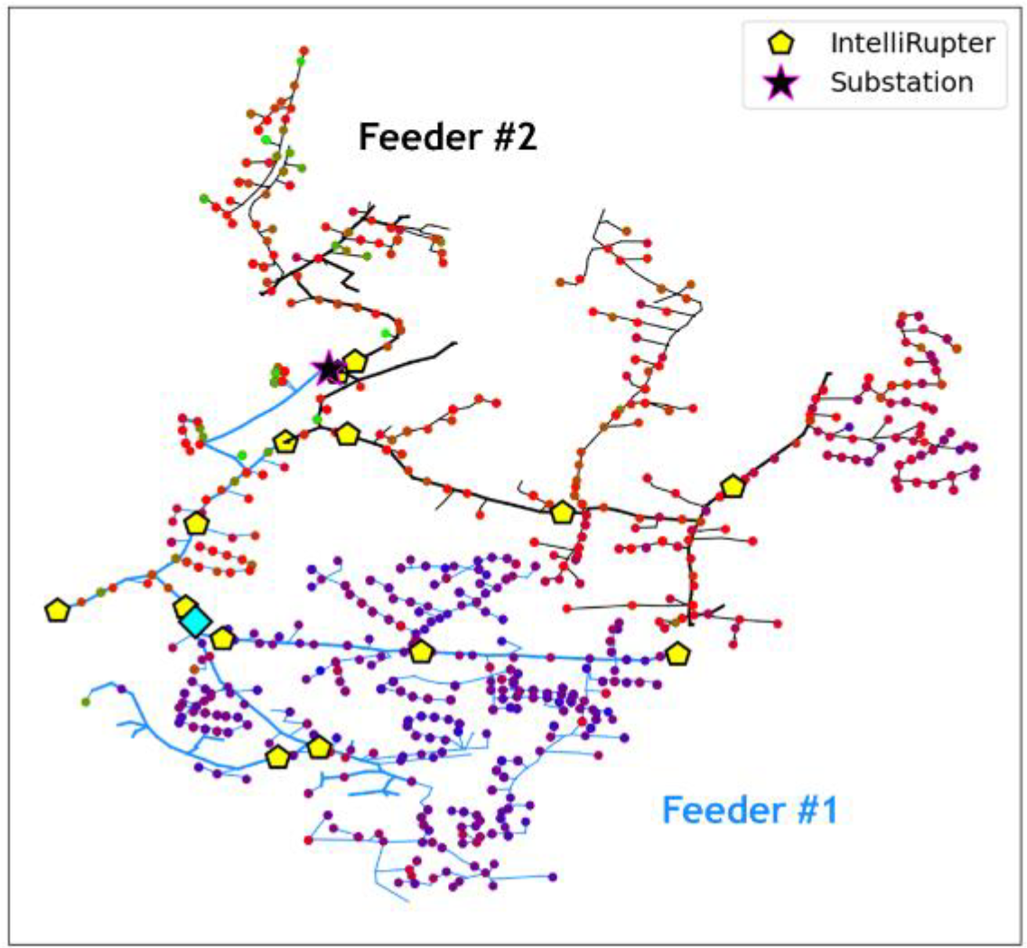
Introduction and Background
Recent additions of Advanced Metering Infrastructure (AMI)—smart meters, phasor measurement units (PMUs), intelligent reclosers, PV, etc.—greatly improved the temporal and spatial resolution of measurement data
Before: low resolution substation measurements
Now: voltage and current sensors throughout the medium voltage (MV) feeders and smart meters at customer premises on the low voltage (LV) system
  Real Power (P)
  Reactive Power (Q)
  Voltage (V)
  Current (I)
  15-min resolution
    common for smart meters and MV measurements

Slide 8
AI for Improving Grid Models

Slide 9
AI for Improving Grid Models

Slide 10

PV System Identification
Motivation: PV systems and their corresponding inverters may vary from the interconnection plan, and utilities and ISOs oftentimes have limited information
Problem: Keeping PV interconnection databases updated is a major challenge. Utilities may not record or may not have full knowledge of PV system parameters, such as PV system size, location, or control parameters
Objective: Use machine learning and Big Data from grid edge measurements to identify various parameters of uncertain PV in distribution grids from net load data
Hypothesis: ML can learn the signatures real and reactive power injections from behind-the-meter PV + Inverter systems to identify their parameters, behavior, and control characteristics.
PV+Inverter Systems
Control Parameters?
Injection State?
Power Factor?

Slide 11
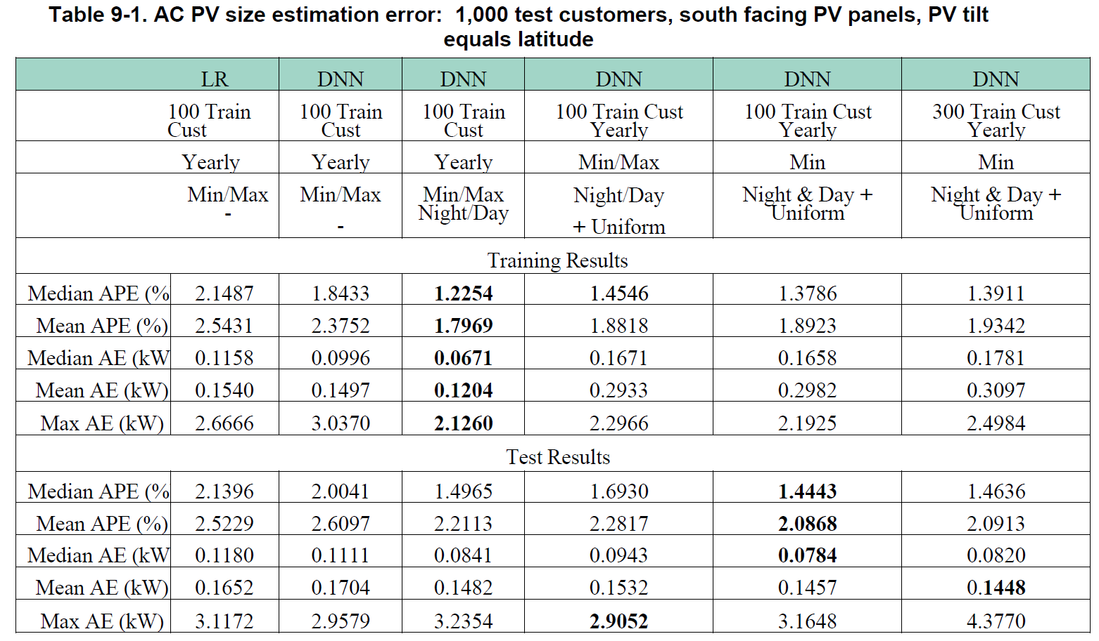
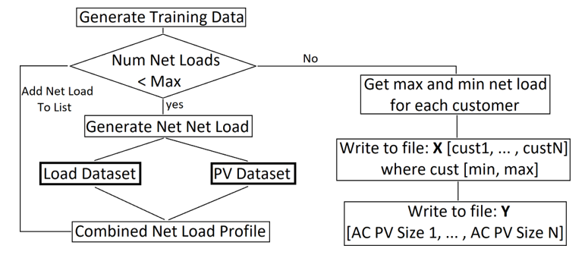
PV System Identification
PV Presence Detection
Classify presence of PV temporal pattern in AMI data-stream (daily profiles fed into CNN w/ binary output)
PV Size Estimation
Use DNN to estimate scaling factor for PV temporal pattern. Infer PV size from the scaling factor.
Data Inputs:
Semi-Synthetic AMI Measurements:
Net Load Active; Reactive Power and Voltage
Learn PV temporal pattern scaling factor as proxy for size
Notes:
After the net load profiles are generated, each customer’s profile is sliced into daily profiles and fed into the convolutional neural network (CNN). The output of the CNN is a binary value showing whether the CNN has detected a PV output pattern in that daily net load profile or not. This is done for all the daily profiles of a customer to obtain daily detected outputs. Once all the days are classified as “with PV” or “without PV,” if the number of days for which outputs are detected as “with PV” is greater than a threshold (e.g., 200 days out of 365 days), we detect that customer as a “with PV” customer and assign a label.
A similar approach was taken in this set of simulations by passing the maximum and minimum net loads per customer to the deep neural network (DNN) as input. The DNN then predicted the size of the installed PV from these inputs. The simulations were conducted using a dataset of 80 training customers, 20 validation customers and 1,000 test customers. The DNN was trained for 400 epochs with early stopping implemented. The input features were the minimum yearly day and night net load values. When evaluated on this new data set, the proposed DNN provides a mean absolute percentage error (MAPE) of 4.578% and mean absolute error (MAE) of 0.246 kW. In contrast, the benchmark LR approach provides a MAPE of 5.312% and MAE of 0.266 kW

Slide 12



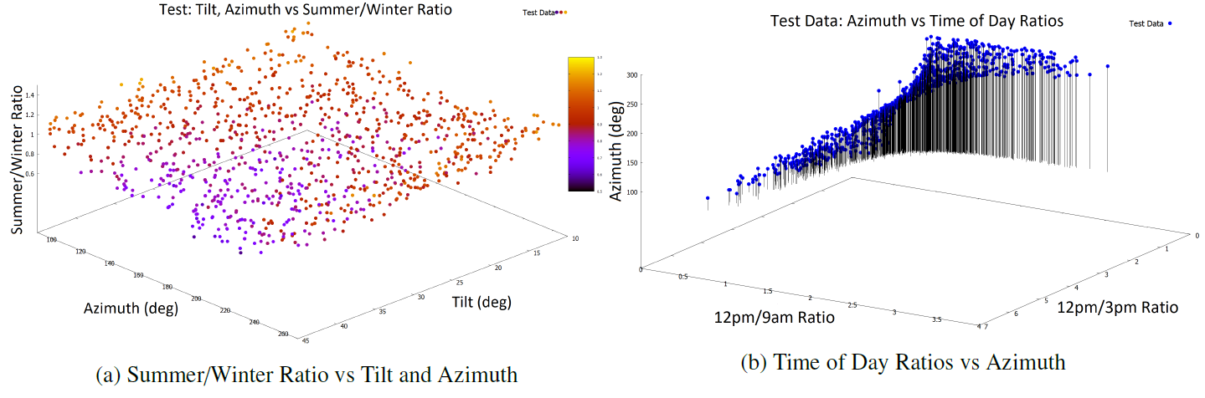
PV System Identification
PV Tilt and Azimuth Estimation
Learn Tilt and Azimuth at timestep via extracted features:
  Historical Summer/Winter net load ratios
  Time of day at timestep
  Input the features into DNN
Notes:
A set of simulations were conducted that calculated the DNN input feature ratios, using net load data of varying resolution: Res = [1, 5, 15, 30, 60] minutes. The simulations investigate how robust is the proposed DNN method for tilt and azimuth estimation to imperfect training data. The DNN was trained with data sets consisting of [0; 10; 20; 30; 40; 50; 90] % mislabeled customers. Each mislabeled customer in this training set has their recorded tilt and azimuth reset to a random tilt and azimuth in the ranges [10; 45] and [90; 270] degrees respectively.
Deep neural networks can accurately estimate the size of installed PV systems with a MAPE of 2.09% using only features extracted from net load data, i.e., the minimum overall net load and the minimum nighttime net load over one year. This is a lower error than the benchmark linear regression approach.
This corresponds to an absolute error of 2.55. and 4.71. respectively.

Slide 13
AI for Faster Grid Simulations

Slide 14
AI for Faster Grid Simulations
Quasi-static time-series (QSTS) is needed to simulate and understand seasonal and high-speed interactions of solar PV variability and the benefits of smart grid controls
QSTS is a type of time-domain power flow analysis
Industry has been slow to adopt QSTS due to its computational processing requirements. High-resolution QSTS simulations can take between 10-120 hours to run.
Objective is to increase the speed of QSTS (solved in less than 5 minutes) to make QSTS the industry standard

Slide 15
ML for QSTS
Goal - Reduce the computational time of QSTS simulations by:
  Identifying the key time periods throughout the year that need to be run with QSTS simulation
  Using that data as input to a Machine Learning algorithm and predicting the number of tap changes for the remainder of the time periods to accurately reproduce the full baseline QSTS analysis
The year is separated in time periods. This could be hours, days, or weeks, two hour periods have been shown to be optimal. QSTS simulations are performed on the sampled time periods.

Slide 16
ML for QSTS
Calculate Features for all periods
Features – Statistics calculated from the raw Load and PV data, used as ML inputs
Evaluation Metric - Voltage Regulator Tap Changes
  With the increasing prevalence of highly variable DER, an increasing number of tap changes can increase O&M costs.
Evaluation Accuracy – Compare predicted number of yearly tap changes to the actual number in a full-length QSTS simulation
10% error threshold deemed acceptable by industry partners
Intelligently sample a percentage of the year & run QSTS
Train machine learning algorithm
Use ML to predict the remainder of the year

Slide 17
Feature Selection for Input Variables
For each time period, a variety of different statistics and potential variables can be calculated.
An important part of machine learning is the feature selection, deciding which variables and data attributes should be used to train the model
Variables should be non-redundant and relevant
Redundant features are removed by examining the correlation coefficient matrix
The relevance of features is determined by doing a stepwise linear regression using forward selection to iteratively add the most significant variables

Slide 18
Intelligent Sample Selection
Intelligent Sampling uses representative samples from input time-series data to perform a QSTS analysis
Stratified sampling ensures that QSTS is run for at least one sample for each type of time period
Decomposes the year into smaller 6-hour time periods, then characterizes them using the solar variability index and mean load values
The underlying assumption is that similar time periods will have closely correlated QSTS results.
After running one period, all other periods are assumed to have the same results, e.g. number of tap changes as shown on the right
So, by only solving the representative samples, the results can be extrapolated for the whole year.

Slide 19
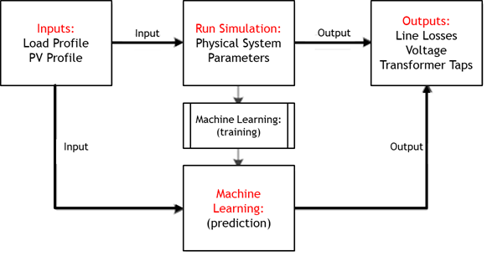
Overview of ML for QSTS
ML, including ensembles of multiple types, have been investigated to utilize the brute-force QSTS to initially train the machine learning, which can then be used to accurately model the distribution system for other times during the year.
  NNs, ensemble NNs, random forest decision trees, boosted decision tree ensembles, etc.
Significantly reduces the amount of the year to be solved (only 20% required) compared to random sampling (>85% of the year) or intelligent sampling (40% of the year) by learning the correlations.
Each period of the QSTS is dependent on the previous periods, so sampling and running specific time periods in the year adds error because each period may not be initialized correctly.

Slide 20
AI for Data-Driven Analyses

Slide 21
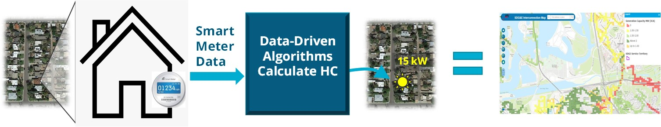
Data-Driven Hosting Capacity Analysis for Clean Energy Sources
Hosting Capacity (HC) is the maximum size of a distributed energy resource (DER), like rooftop solar, that can be installed at various locations on the grid without adverse effects
Smart energy meter data is passed into the tool and data-driven algorithms are applied to calculate HC subject to voltage and thermal constraints
  Any changes to the distribution network are inherently captured in the smart meter data
No simulations are required = much faster than model-based methods
Reduced computational burden means HC maps can be updated more frequently to keep pace with increasing levels of interconnection requests

Slide 22
Model-free Algorithms Overview
Voltage-constrained HC Concept:
Data-driven models learn how changes in power consumption impact the voltage
Use that model to predict the max PV size that customer can install without causing voltage violations
Repeat this prediction for all customer locations on a feeder
Note: this method can be used to predict out for both generation interconnections (solar, wind, etc.) and additional load (electric vehicles, energy storage, etc.)

Slide 23
Model-free Algorithms Overview
Voltage-constrained HC Algorithms Developed:
More data = better accuracy
Regression-based² and PINN-based³ methods have been the focus
Algorithms | Required Inputs | MAE (kW) | Max Error (kW) | % of Locations >1kW Error
1. Constant Sensitivity⁵ | Max V | 1.49 | 20.74 | 50.88%
2. Statistics-based AdaBoost – V⁵ | Min, Max, Std of (V) | 1.25 | 15.57 | 22.50%
3. Statistics-based AdaBoost – PV⁵ | Min, Max, Std of (P, V) | 0.98 | 14.80 | 17.74%
4. Statistics-based AdaBoost – PQV⁵ | Min, Max, Std of (P, Q, V) | 0.95 | 14.35 | 17.83%
5. DNN-based⁴ | Time-series (P, Q, V) | 0.78 | 2.49 | 30.40%
6. Regression-based² | Time-series (P, Q, V) | 0.26 | 2.84 | 3.40%
7. PINN-based³ | Time-series (P, Q, V) | 0.89 | 1.57 | 12.28%
[2] J. A. Azzolini, M. J. Reno, J. Yusuf, S. Talkington, S. Grijalva, “Calculating PV Hosting Capacity in Low-Voltage Secondary Networks using Only Smart Meter Data” in IEEE Innovative Smart Grid Technologies (ISGT-NA), Washington, DC, 2023.
[3] L. Liu, N. Shi, D. Wang, Z. Ma, Z. Wang, M. J. Reno, J. A. Azzolini, “Voltage Calculations in Secondary Distribution Networks via Physics-Inspired Neural Network Using Smart Meter Data,” IEEE Transactions on Smart Grid, 2024.
[4] J. Yusuf, J. A. Azzolini, M. J. Reno, “Predicting Voltage Changes in Low-Voltage Secondary Networks using Deep Neural Networks” in IEEE Power and Energy Conference at Illinois (PECI), Champaign, IL, 2023
[5] J. Yusuf, J. A. Azzolini, M. J. Reno, “PV Hosting Capacity Estimation in Low-Voltage Secondary Networks Using Statistical Properties of AMI Data,” IEEE Innovative Smart Grid Technologies Latin America (ISGT-LA), 2023.

Slide 24
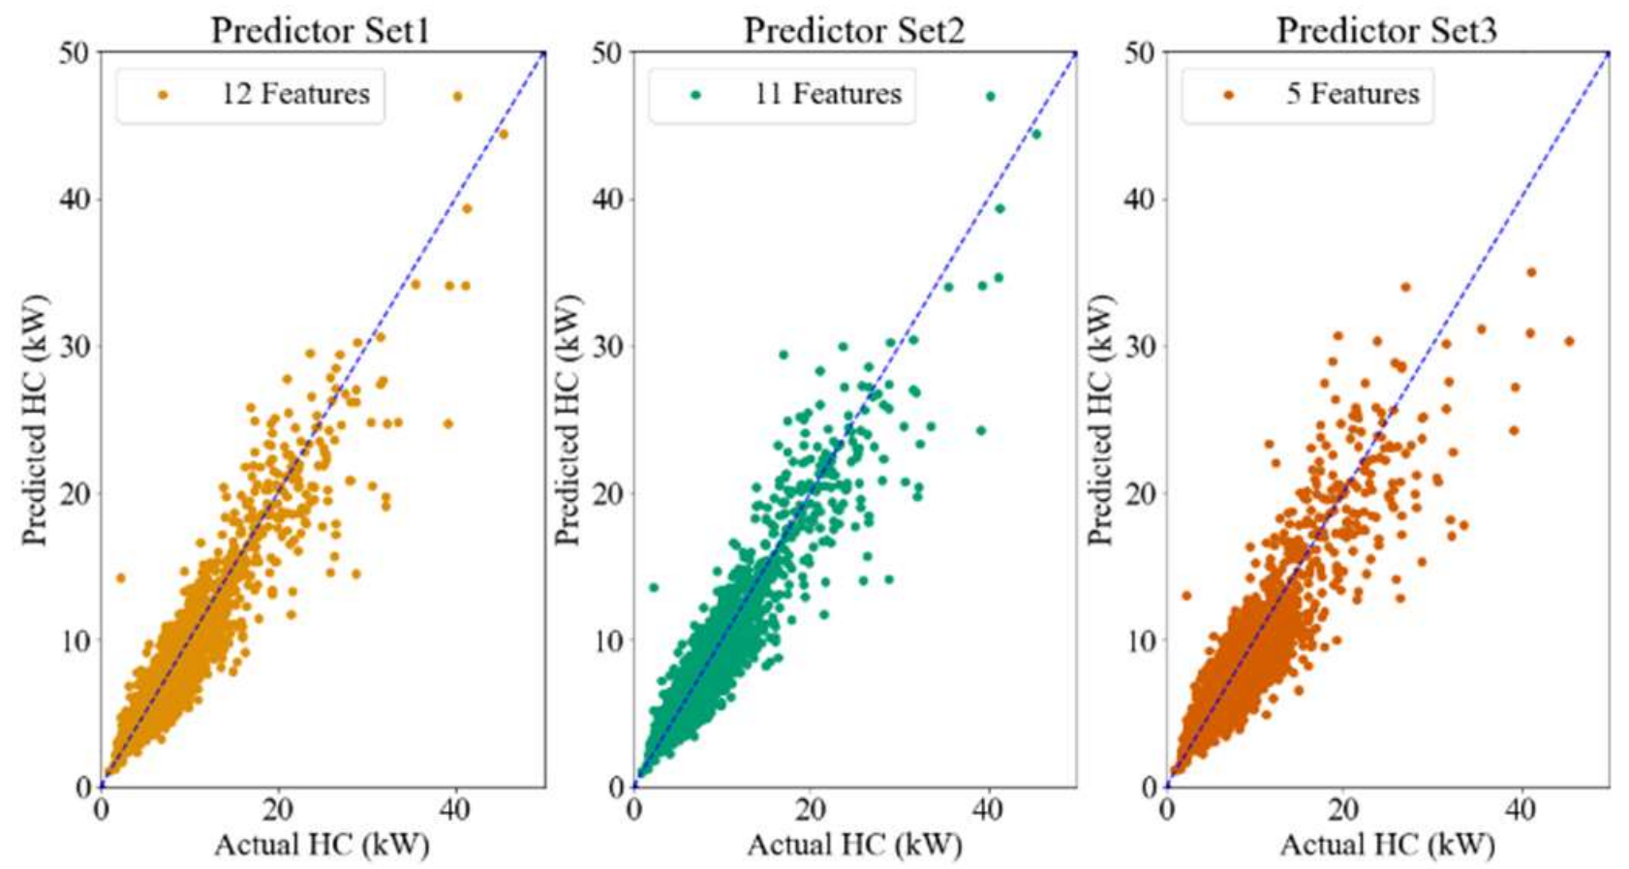
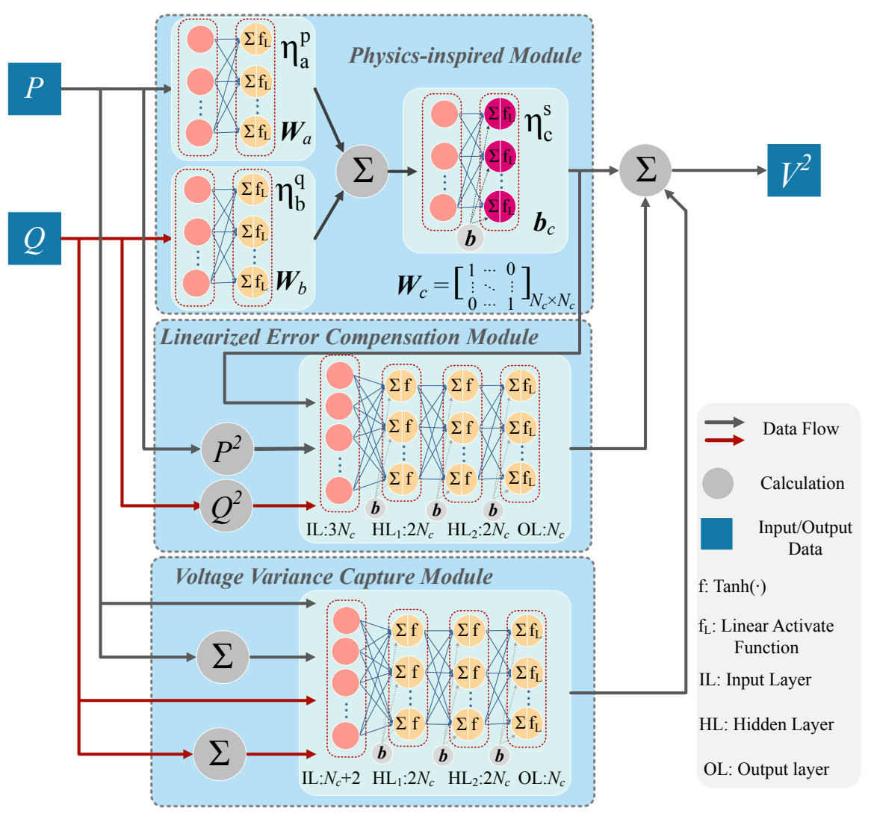
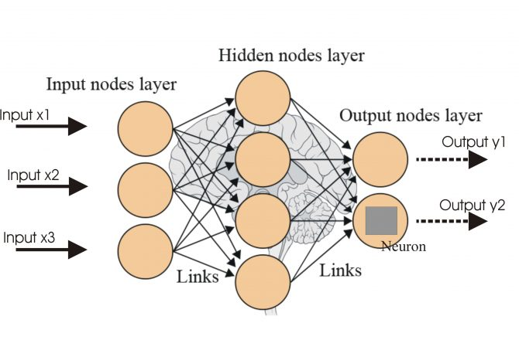
Model-free Algorithms Overview
Voltage-constrained HC Algorithms Developed:
AdaBoost Ensemble-based
Regression-based
PINN-based
21 features are created
Random forest to select key predictors for AdaBoost algorithm
DNN-based
Input data: P, Q of all the customers
Output data: V of customers

Slide 25
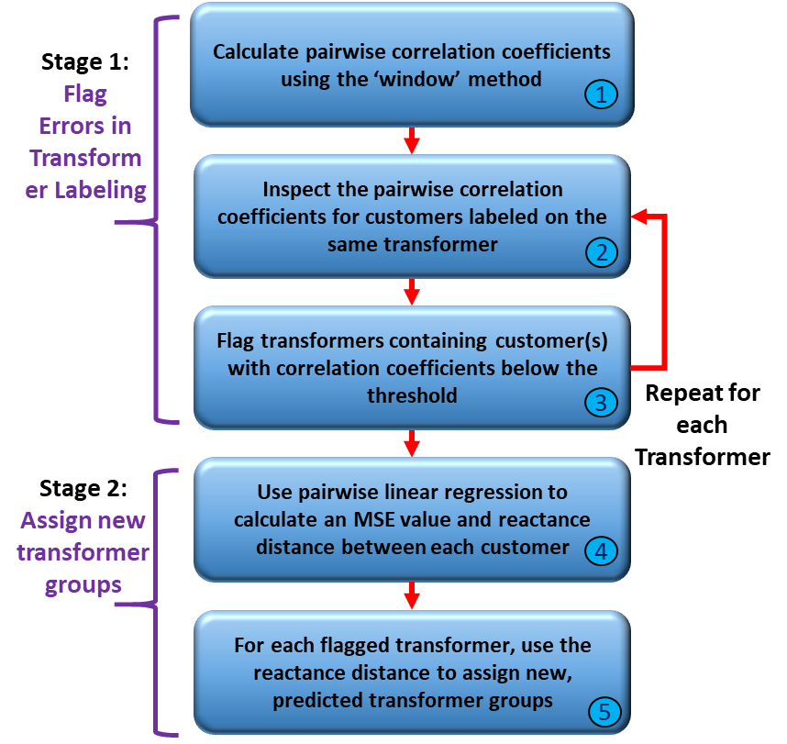

Model-free Algorithms Overview
Thermal-constrained HC Concept:
Identify Transformer-Customer Groupings^{3,7,8}
  i.e., which customers are connected served by the same transformer
Determine the Transformer kVA Ratings⁶
Calculate the Thermal-constrained HC
  i.e., how much PV (or other DER) can be installed without over-loading the transformer
[3] L. Liu, N. Shi, D. Wang, Z. Ma, Z. Wang, M. J. Reno, J. A. Azzolini, “Voltage Calculations in Secondary Distribution Networks via Physics-Inspired Neural Network Using Smart Meter Data,” IEEE Transactions on Smart Grid, 2024.
[6] J. A. Azzolini, M. J. Reno, J. Yusuf, “A Model-free Approach for Estimating Service Transformer Capacity Using Residential Smart Meter Data," IEEE Journal of Photovoltaics, 2023.
[7] L. Blakely and M. J. Reno, “Identification and Correction of Errors in Pairing AMI Meters and Transformers,” IEEE Power and Energy Conference at Illinois (PECI), 2021.
[8] M. Reno et al., "IMoFi - Intelligent Model Fidelity: Physics-Based Data-Driven Grid Modeling to Accelerate Accurate PV Integration Final Report," Sandia National Laboratories, SAND2022-0215, 2022.

Slide 26
Model-free Algorithms Overview
Thermal-constrained HC Algorithms:
Pairwise Estimation of Service Transformer Impedance:
Since the topology is unknown, multiple impedance estimates are generated for the target transformer by iteratively pairing it with nearby transformers (physically close)
 | $$\left(V_{1}−V_{2}\right)=−R_{T1}I_{R1}−X_{T1}I_{X1}+R_{T2}I_{R2}+X_{T2}I_{X2}$$
[6] J. A. Azzolini, M. J. Reno, J. Yusuf, “A Model-free Approach for Estimating Service Transformer Capacity Using Residential Smart Meter Data," IEEE Photovoltaic Specialists Conference (PVSC), 2023.

Slide 27

Model-free Algorithms Overview
Thermal-constrained HC Algorithms:
Determination of Service Transformer Capacity:
The algorithm then uses a weighted voting scheme to combine the multiple estimates into a single kVA prediction, where the best matching R and X values from the lookup table receives a vote:
 | $$Error =\min\left(\left|R_{est}−R_{Lookup}\right|+\left|X_{est}−X_{Lookup}\right|\right)$$
The votes are then weighted according to the RMSE of the linear regression models:
 | $$WF_{t} =\frac{1/(RMSE_{t})}{sum\left(1/RMSE_{T}\right)}$$
Xfmr Type 3 = 79%
Xfmr Type 4 = 14%
Xfmr Type 5 = 7%
Distance from Target (ft) | R_{est} (Ω) | X_{est} (Ω) | Predicted ID (Table I) | WF (8)
375 | 0.0396 | 0.0566 | 3 | 0.107
486 | 0.0561 | 0.0291 | 4 | 0.046
529 | 0.0576 | 0.0300 | 4 | 0.042
540 | 0.0525 | 0.0361 | 3 | 0.050
544 | 0.0525 | 0.0343 | 3 | 0.057
587 | 0.0596 | 0.0227 | 5 | 0.038
[6] J. A. Azzolini, M. J. Reno, J. Yusuf, “A Model-free Approach for Estimating Service Transformer Capacity Using Residential Smart Meter Data," IEEE Photovoltaic Specialists Conference (PVSC), 2023.

Slide 28
Conclusions
Grid sensors are becoming widespread, enabling higher spatial and temporal resolution for grid measurements
We have applied AI/ML techniques on those measurements to
  Identify and correct grid models
  Reduce computational burden of grid simulations
  Perform data-driven analyses
New sensors continue to be installed, with higher resolution and better on-board computing, meaning plenty of opportunities for future applications of AI/ML

Slide 29

Sandia ‘s Electric Grid AI/ML Homepage:
Questions?
Joe Azzolini
jazzoli@sandia.gov

