Slide 1

Behavioral Segmentation and clustering of Geospatial TRAJECTORIES
September 2024
Presented by: Jessica Jones
Team: Andrew Wilson, Renee Gooding, Jon Whetzel, Keith Dalbey, Daniel DeLayo, Nitin Sharan, Laura Appleby
SAND2024-10649C

Slide 2
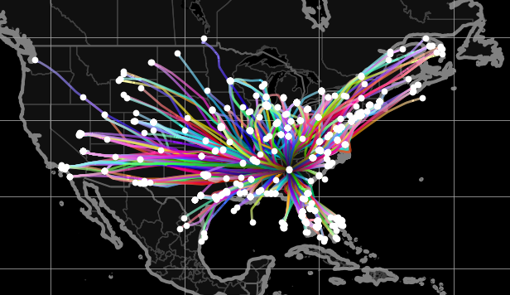
Our Goal
We seek to quickly identify patterns of interest and anomalies present in geospatial trajectory datasets for which manual detection is prohibitively time consuming, or impossible.
Air traffic outgoing from Atlanta International airport in Georgia, US on July 4, 2024.
Data obtained from The OpenSky Network: http://www.opensky-network.org.
Trajectories assembled and rendered with tracktable: https://tracktable.sandia.gov.

Slide 3
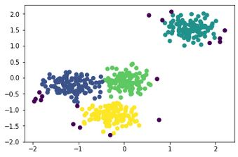
OUR APPROACH
Phase I: Segment Trajectories to
Strings Representing Behaviors
Phase II: Cluster Strings Using DBSCAN
https://iq.opengenus.org/dbscan-clustering-algorithm
ABDD…C
ABBC…D
BBAA…D
…
DABC…C
CBAA…C
ABCD…C
Trajectories as a Sequence of GPS Points
Trajectories as Points in Feature Space

Slide 4
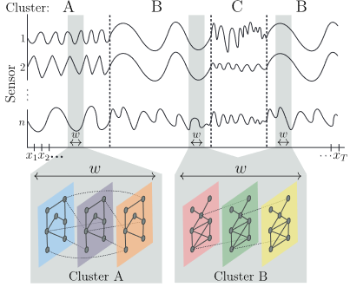
Phase I: Segmentation Using TICC
B
C
B
A
ABCB
Previously, TICC has been successfully applied to…
heart rate monitor data (detected states “running”, “walking”, etc.)
vehicle data (detected “straight”, “turning”, etc. from internal car sensor data)
stock indices (detected repeatable patterns in stock pricing)
[1] Hallac, et al., Toeplitz Inverse Covariance-Based Clustering of Multivariate Time Series Data (2017)

Slide 5
Phase I: Segmentation Using TICC
B
C
B
A
ABCB
Possible sensors timeseries for geospatial data:
velocity
acceleration
heading
“straightness”
distance to a point of interest
curvature
change in centroid
distance from shore
distance from origin
distance from destination
distance from a given border
[1] Hallac, et al., Toeplitz Inverse Covariance-Based Clustering of Multivariate Time Series Data (2017)

Slide 6
PHASE I: SEGMENTATION USING TICC
TICC
How many behaviors?
…
What data to correlate?
…
What window in time?
…
Behavioral Labels for Every (Resampled) Point of Each Trajectory
Flights out of Atlanta for one week in July 2024
Resample trajectories with equal temporal spacing of…
10 seconds

Slide 7
PHASE I: SEGMENTATION USING TICC
TICC
How many behaviors?
10
What data to correlate?
change in heading
change in speed
What window in time?
50 seconds
Behavioral Labels for Every (Resampled) Point of Each Trajectory
Flights out of Atlanta for one week in July 2024
Resample trajectories with equal temporal spacing of…
10 seconds

Slide 8
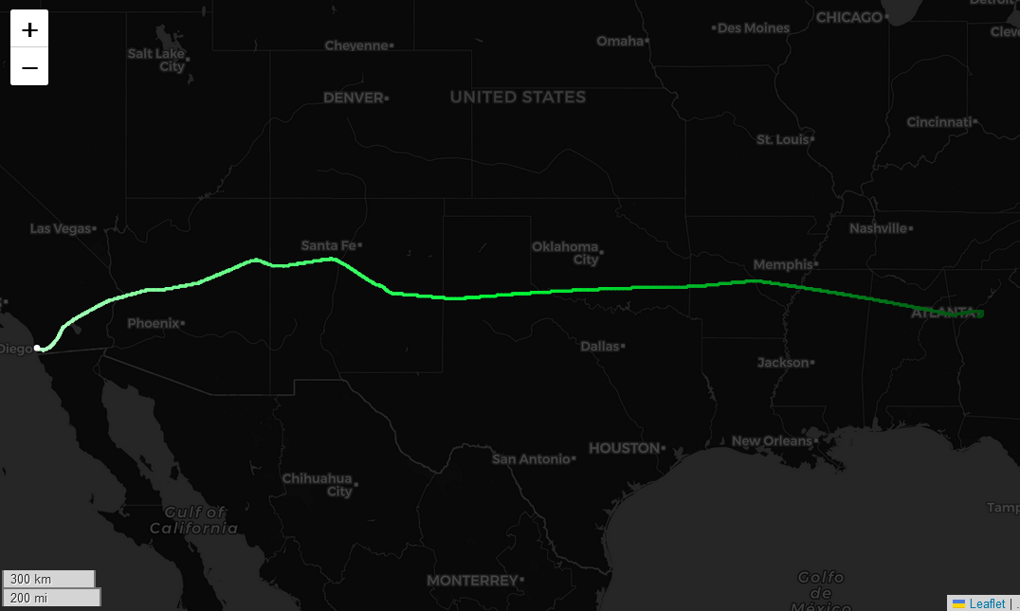
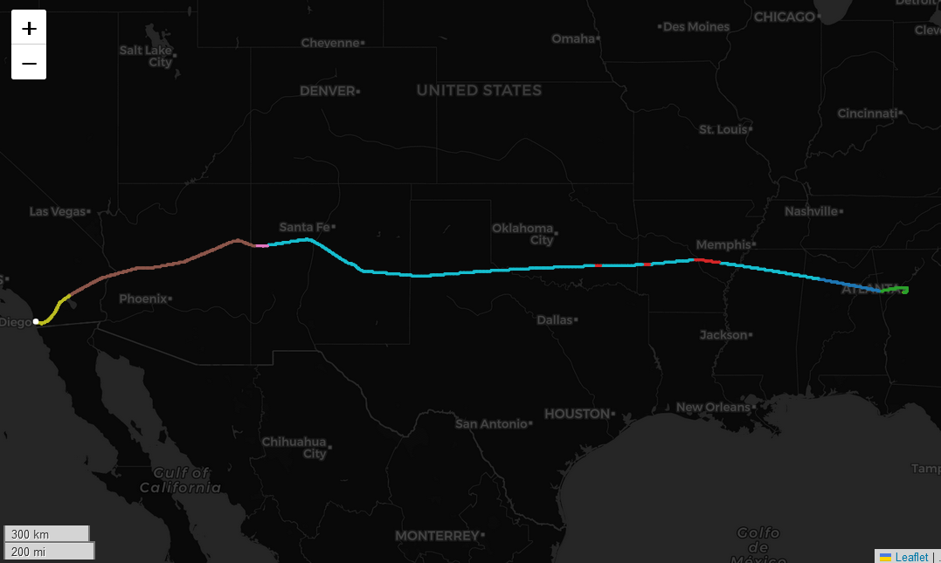
An Example of a Behaviorally segmented trajectory
original trajectory
trajectory with TICC behavioral labels shown as colors

Slide 9
PHASE 2: How Do we find tracks doing the same thing?
DBSCAN
What is your feature vector?
…
What radius in feature space?
…
What minimum cluster size?
…
Flights out of Atlanta for one week in July 2024
with behavioral labels from TICC

Slide 10
PHASE 2: How Do we find tracks doing the same thing?
DBSCAN
What is your feature vector?
…
What radius in feature space?
…
What minimum cluster size?
…
Flights out of Atlanta for one week in July 2024
with behavioral labels from TICC

Slide 11
PHASE 2: How Do we find tracks doing the same thing?
Metric DBSCAN
What is your metric?
edit distance
(w/ log scaling)
What radius in metric space?
…
What minimum cluster size?
…
Flights out of Atlanta for one week in July 2024
with behavioral labels from TICC

Slide 12
PHASE 2: How Do we find tracks doing the same thing?
Metric DBSCAN
What is your metric?
edit distance
(w/ log scaling)
What radius in metric space?
6
What minimum cluster size?
10
Flights out of Atlanta for one week in July 2024
with behavioral labels from TICC

Slide 13
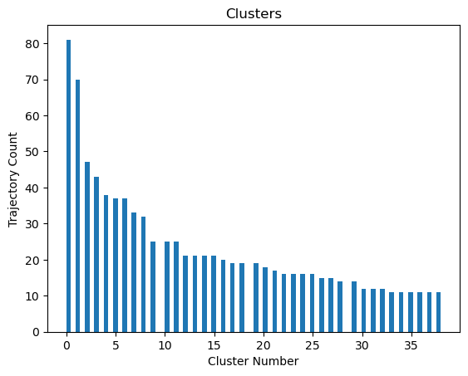
PHASE 2: How Do we find tracks doing the same thing?
Metric DBSCAN
What is your metric?
edit distance w/
log scaling
What radius in feature space?
6
What minimum cluster size?
10
Flights out of Atlanta for one week in July 2024
with behavioral labels from TICC
5264 outliers

Slide 14
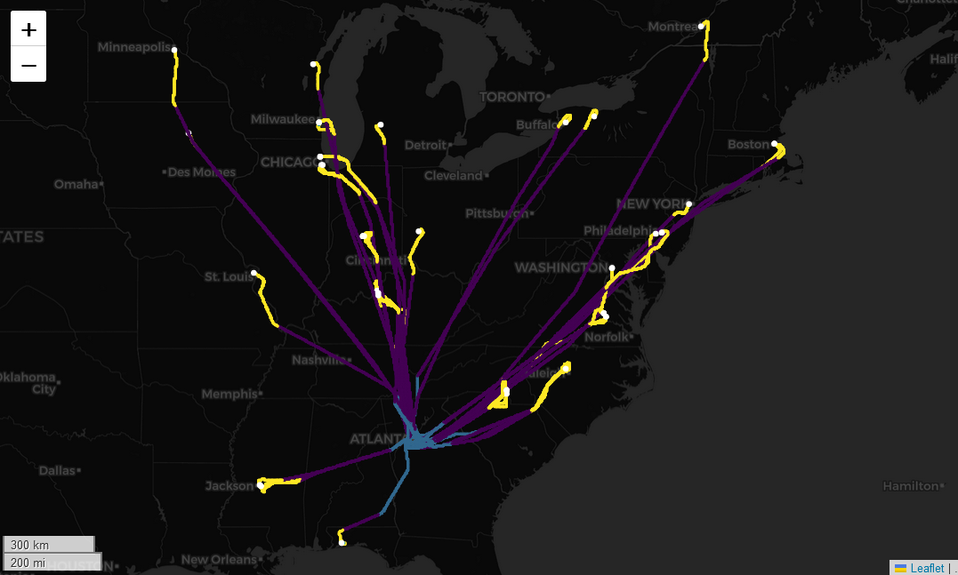
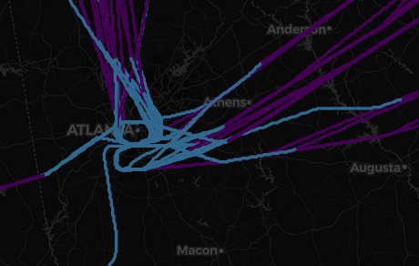
Cluster 0 out of 38: 81 trajectories

Slide 15
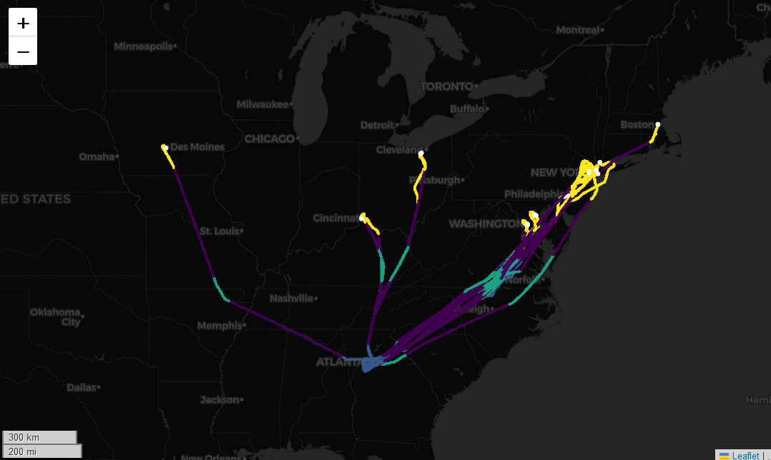
Cluster 3 out of 38: 43 trajectories

Slide 16
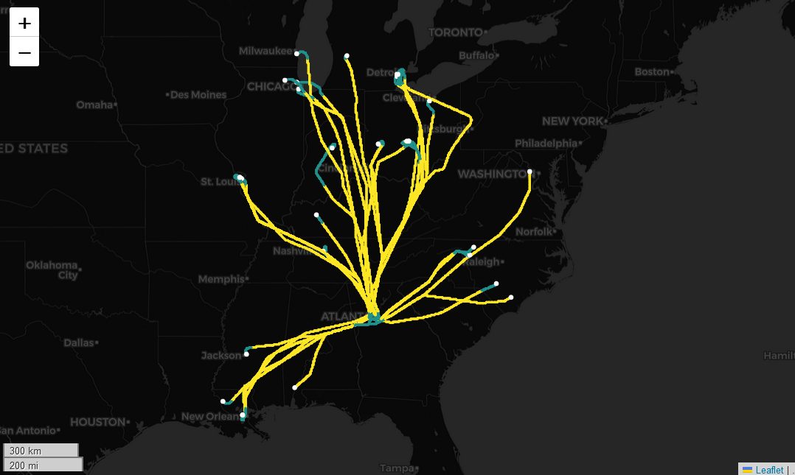
Cluster 6 out of 38: 37 trajectories

Slide 17
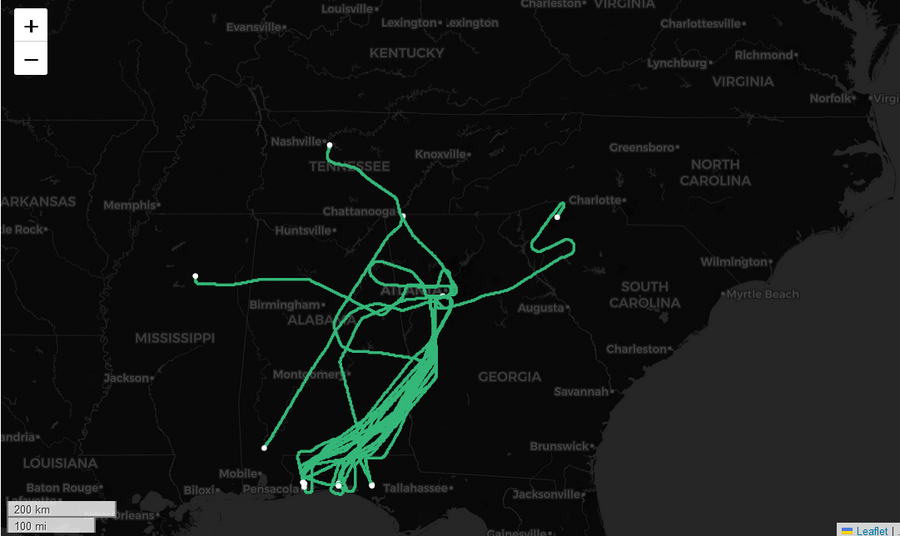
Cluster 11 out of 38: 25 trajectories

Slide 18
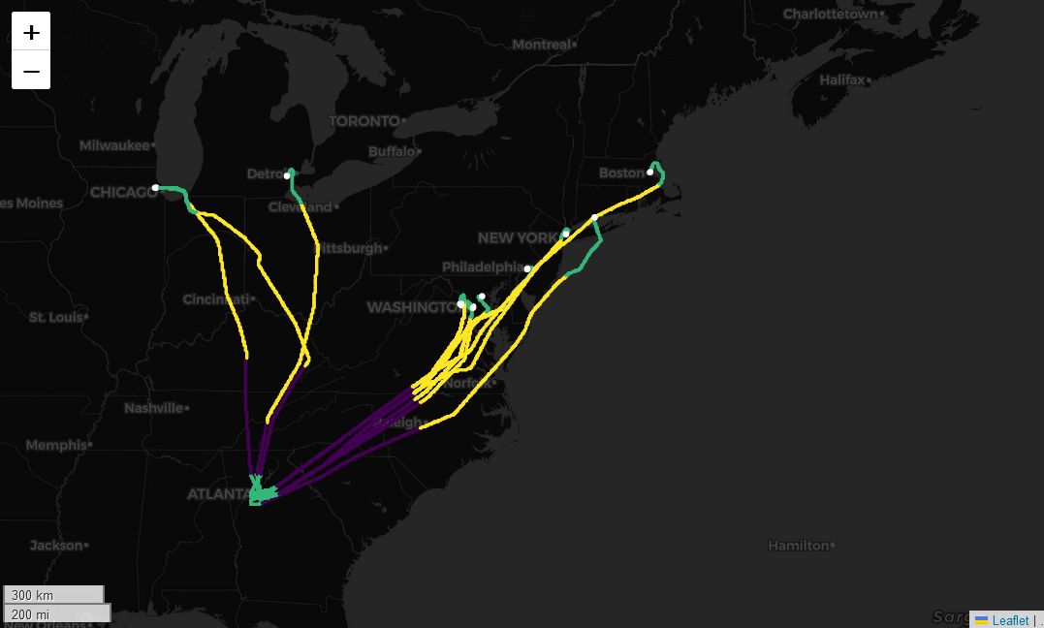
Cluster 26 out of 38: 15 trajectories

Slide 19
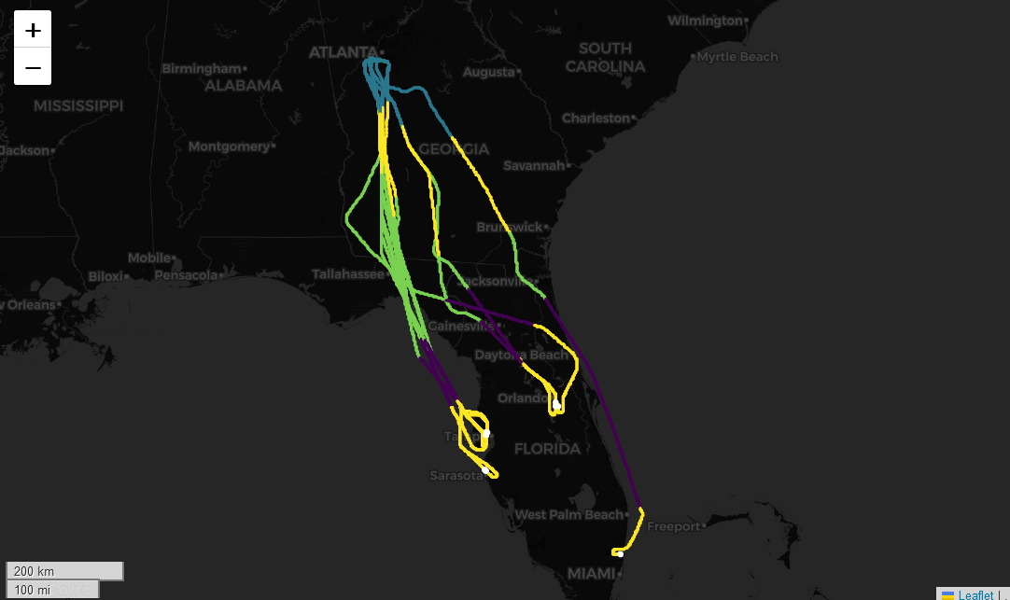
Cluster 26 out of 38: 15 trajectories

Slide 20
PHASE 2: How Do we find tracks doing Unusual THings?
Metric DBSCAN
What is your metric?
edit distance w/
log scaling
What radius in feature space?
100
What minimum cluster size?
10
Flights out of Atlanta for one week in July 2024
with behavioral labels from TICC
1 cluster
3 outliers

Slide 21
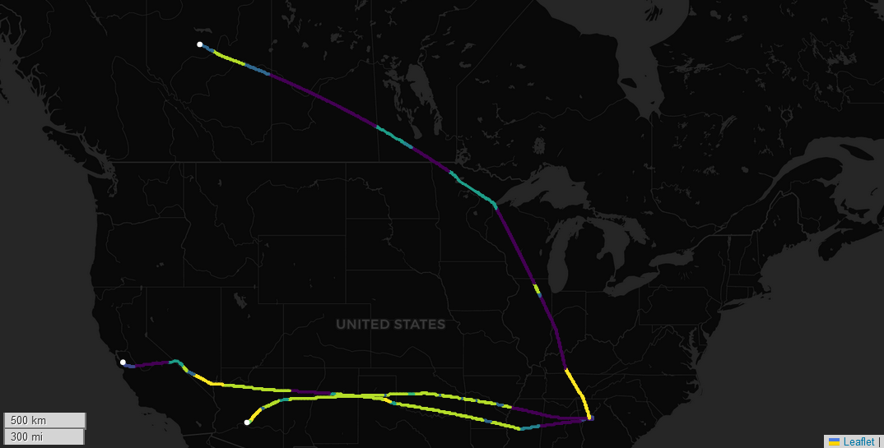
Outliers

Slide 22
DO TRY THIS AT HOME!
Public Python Packages
pip install fast-ticc
pip install metric-dbscan
To be kept updated on when the python package that wraps these up specifically for trajectory analysis becomes available, please email wg-cupcake@sandia.gov.

Slide 23




Sandia National Laboratories is a multimission laboratory managed and operated by National Technology & Engineering Solutions of Sandia, LLC, a wholly owned subsidiary of Honeywell International Inc., for the U.S. Department of Energy’s National Nuclear Security Administration under contract DE-NA0003525.
Bringing up OpenSky: A large-scale ADS-B sensor network for research
Matthias Schäfer, Martin Strohmeier, Vincent Lenders, Ivan Martinovic, Matthias Wilhelm
ACM/IEEE International Conference on Information Processing in Sensor Networks, April 2014
The OpenSky Network, http://www.opensky-network.org
All trajectories were assembled and rendered using the python package tracktable.

