Slide 1
Machine Learning Application for Smart Network Traffic Prediction
Islam Omar * Whit Schonbein * Abdel-hameed badawy
New Mexico State university * sandia national labs

Slide 2
Abstract
Using real-world traffic data collected at Sandia National Labs for several scientific applications, we investigate the features of these datasets and how different preprocessing methods affect the behavior of different machine learning models. Specifically, we evaluate the performance of several machine learning models, including Dynamic Linear Regression (DLR), Support Vector Machine (SVM), Random Forest (RF), and XGBoostRegressor (XGBR), against the AutoRegressive Integrated Moving Average (ARIMA) model.

Slide 3
Data Analysis
Data Analysis:
Discovering the trends in the dataset and how that differs from one run to another and from one application to another.
Having an idea of which types of machine learning models would work better with the nature of our datasets and our goal.

Slide 4
Datasets & Challenges

Slide 5
Considered ML Models
Classic Machine Learning Models:
Dynamic Linear Regression (DLR)
Support Vector Machine Regressor (SVM)
Random Forest Regressor (RFR)
XGBoostRegressor (XGBR)
Time Series Forecasting Model:
Auto Regressive Integrated Moving Average (ARIMA)

Slide 6
Considered Approaches
Approaches
Split By Runs
One Big Dataset
Just One Run
Didn’t work due to technical difficulty
Required high computational power
Just split it into 80:20

Slide 7
Data Preprocessing
Data Preprocessing:
Polynomial Features
Undersampling
Labels Encoding (LabelEncoder())
Normalization (StandardScaler())

Slide 8
ML Models Building Steps
Labels Encoding
Split the dataset into 80:20 training and testing sub-datasets.
Normalization
Training
Testing And models’ Evaluation

Slide 9
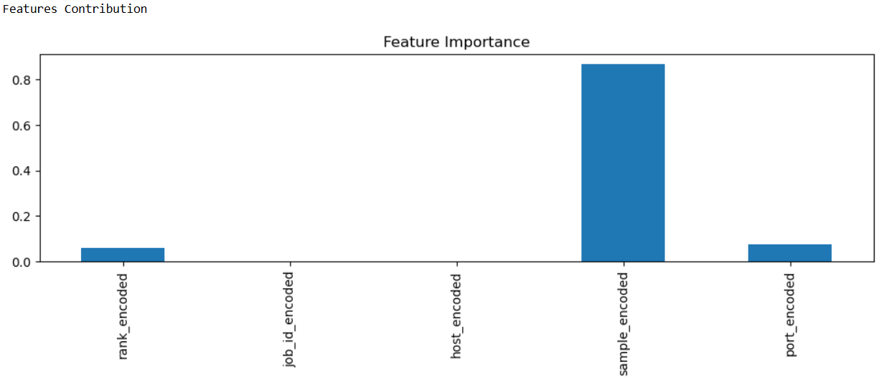
XGBRegressor
RFRegressor

Slide 10
Evaluation Metrics
Mean Absolute Error (MAE)
Mean Square Error (MSE)
R2-Score

Slide 11
Results

Slide 12
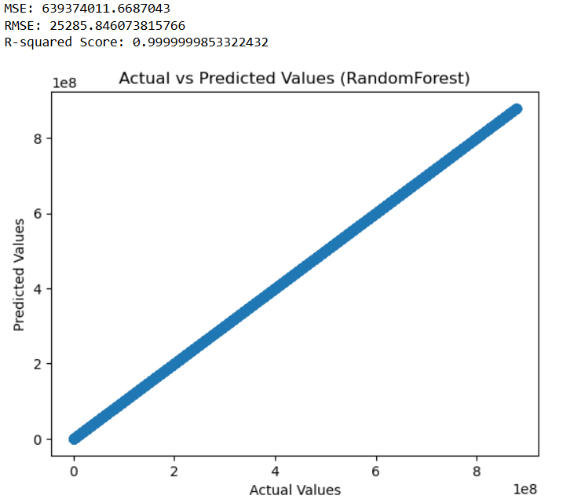
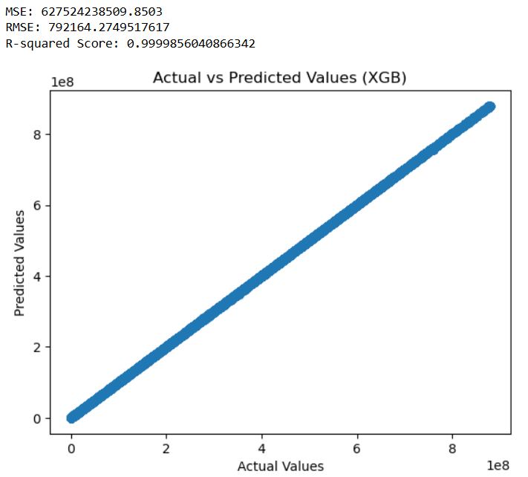
Actual Vs. Pred

Slide 13
XGBR Actual Vs. Predicted

Slide 15
ARIMA

Slide 16
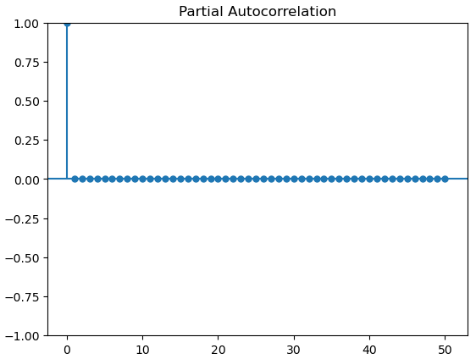

Slide 17
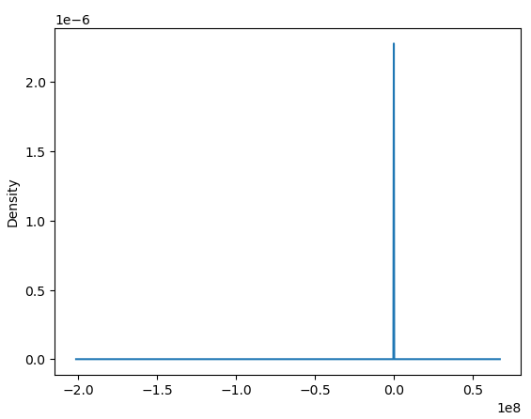

Slide 18
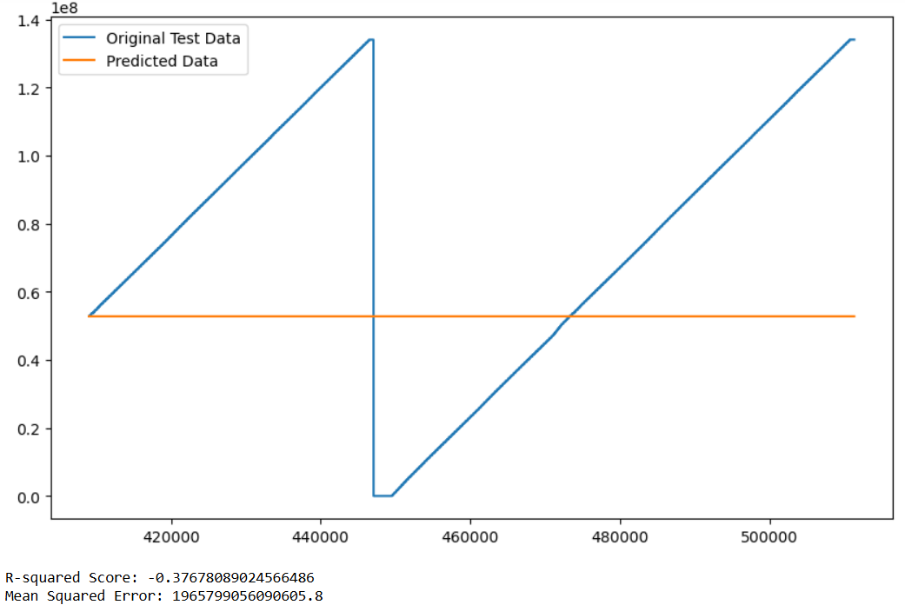
ARIMA Prediction Results Features

Slide 19
Conclusion
XGBR & RFR Gave a similar very high MAE & MSE like the ARIMA, however, they showed we better R2-Score.
XGBR & RFR can converge with a time series datasets even with the least provided features.
In our case, R2-Score showed it is more reliable evaluation metric compared to MAE & MSE and comparison between the actual testing values and their corresponding predicted values came from the XGBR & RFR models.

Slide 20
Questions?

Slide 21
Long Live ML!

