Slide 1
An Artificial Intelligent Bot that Hacks Simulated Cyber-Physical Networks in the Power Grid
SAND2024-10121C
Presenter: George Fragkos
This material is based upon work supported by the U.S. Department of Energy’s Office of Energy Efficiency and Renewable Energy (EERE) under the Solar Energy Technology Office (SETO), Award Number DE-EE00038450.
George Fragkos
Principal Member of Technical Staff @ Sandia National Laboratories
Machine Learning & Deep Learning Conference

Slide 2
Agenda
SAND2024-10121C
Introductory Notes
Network Attack Simulator (NASim) Testbed
Reinforcement Learning-based Hacking
Evaluation
Future work

Slide 3
AI, Critical Infrastructure & Cyber Adversaries
SAND2024-10121C
Opportunities and Challenges
Artificial Intelligence (AI) serves as a common tool across various applications, e.g., cybersecurity
AI will make critical infrastructure (power grid) more secure
It will also create more sophisticated adversary actions and stealthy cyber-attacks
There are cyber-attacks that utilize AI for finding blind spots within a system
AI vs Human Adversaries
There is a need to:
Explore how AI can automate the creation of cyber-attacks
Examine how human-led decision-making for execution of cyber-attacks compares with those driven by AI
This research work examines the development and testing of AI algorithms and techniques for automating various stages of cyber-attacks
Is it better or worse than bruteforce or random attacks?
Image created with the Llama 3 Generative model from Meta AI

Slide 4
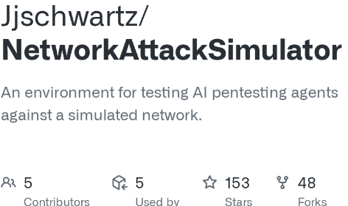
Network Attack Simulator (NASim)
SAND2024-10121C
What is NASim?
It is a lightweight, high-level network attack simulator written in Python
It can be used for rapid testing of autonomous pen-testing agents using Reinforcement Learning (RL) and planning
Implements RL environments, states, actions, partial observability and varied network topologies
The RL environment is modelled after the Open AI gym interface
What kind of networks can we simulate?
It does not represent actual cyber networks
It offers a hypothetical instantiation that includes key components and characteristics of real-world networks
We can create a cyber-physical network with:
Multiple subnets
Multiple hosts
Different OSs, services, and processes
Communications that are governed by specific firewall rules
Open-Source Github repository
[https://github.com/Jjschwartz/NetworkAttackSimulator]

Slide 5
Network Attack Simulator (NASim)
SAND2024-10121C
Network Topology
The network topology can be specified in a .yaml file
The goal is to “hack” predefined “sensitive hosts” that represent solar panels
How?
Starting from the public internet
Perform privilege escalation
Gain root access
What kind of RL agents do we use:
Softmax-based Deep Q Network (DQN)
Deep SARSA Network
The environment can either be fully observable or non-observable
Sensitive hosts/subnet that represent Modbus clients
*More information about NASim tool and scenarios: https://networkattacksimulator.readthedocs.io/en/latest/tutorials/scenarios.html

Slide 6
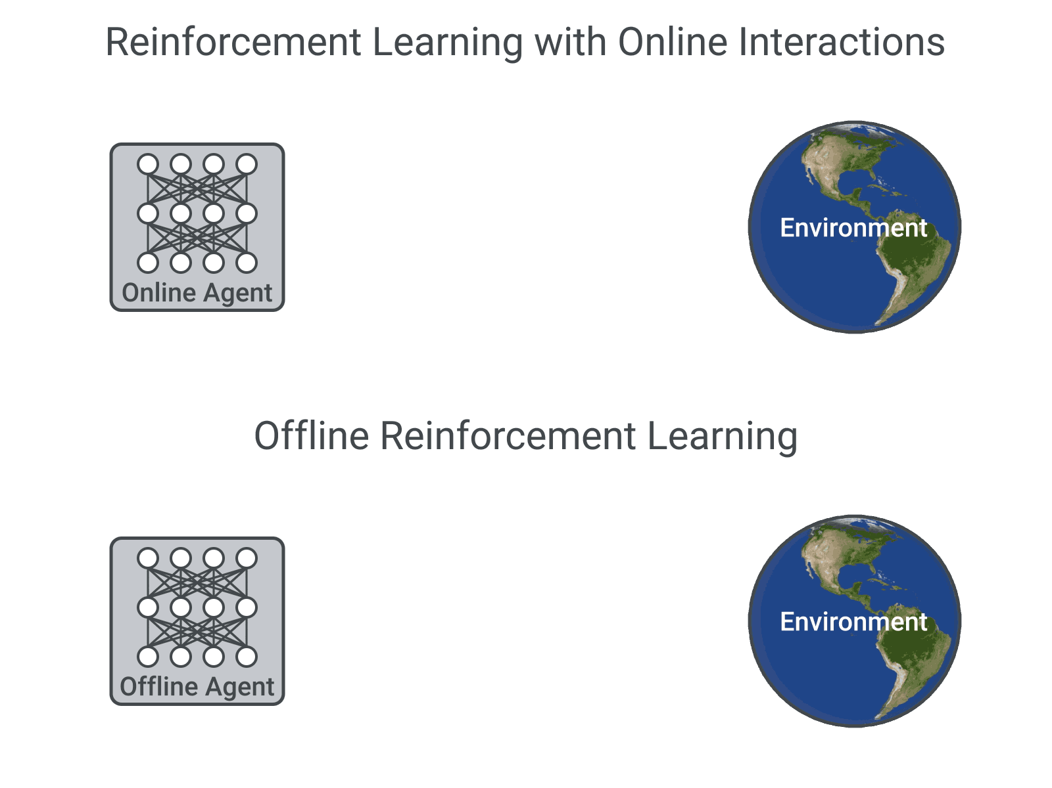
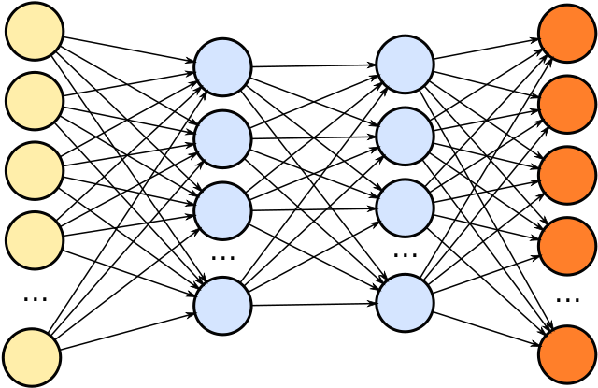
Reinforcement Learning-based Hacking
SAND2024-10121C
Reinforcement Learning (RL) Problem Statement
All sequential decision-making problems can be formulated as an Online RL agent, i.e., decision-maker, who interacts online with a stochastic unknown environment to learn by trial-and-error.
Based on that interaction, i.e., observed experiences, the online RL agent learns to optimally determine its actions/decisions.
Data Structure (Table)
Predicted reward
r(a) + Σγr’(a)
Non-linear Function Approximator

Slide 7
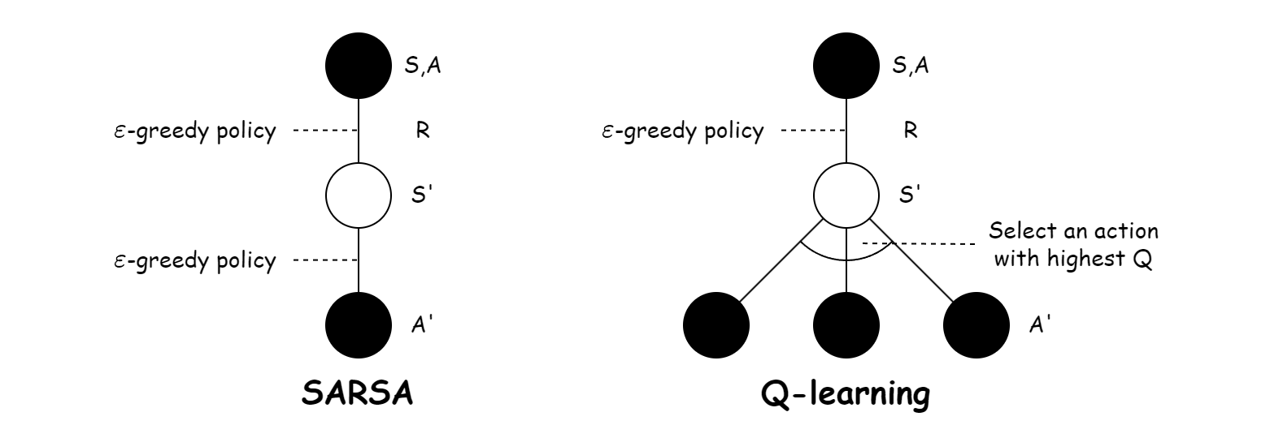
Reinforcement Learning-based Hacking
SAND2024-10121C
Softmax-based DQN
It is a deep neural network that implements Q-learning
It is an off-policy algorithm because when it chooses the new action it selects the one with the highest expected return (Q-value) – ignores current learned policy
Addition: We implemented a softmax-based ε-greedy approach for action selection based on the Q-values for better/more clever exploration
Deep SARSA
It is a deep neural network that implements SARSA
It is an on-policy algorithm because for the next state, we follow the currently learned policy to choose an action
Comparison
DQN is a more aggressive agent that SARSA
When we have a fast-iterating environment: DQN may be a better fit
When mistakes are costly: SARSA may be a better fit

Slide 8
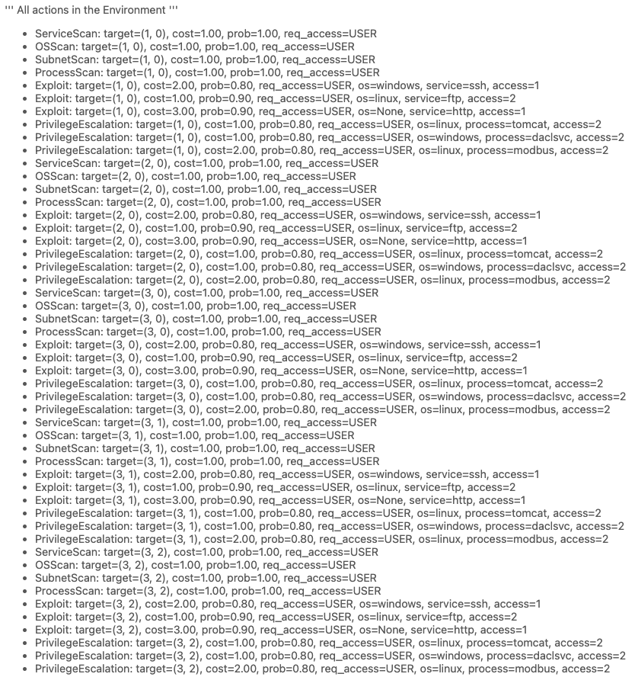
Reinforcement Learning-based Hacking
SAND2024-10121C
RL agents environment
Fully observable: The entire state of the network and the attack is observed after each step (‘easy-mode’)
Non-observable: The agents start with no knowledge of the location and configuration of the hosts
Actions: Subnet Scan, Exploit, OSScan, Service Scan, Process Scan, Privilege Escalation (cost: [-1, -2])
Rewards: Discovery (+20), Service/Process Scan (+50), Privilege Escalation (+100)
Human-based Approaches
Random: A hacker tries random actions to hack the environment
Bruteforce: A hacker tries all the actions sequentially in each state

Slide 9
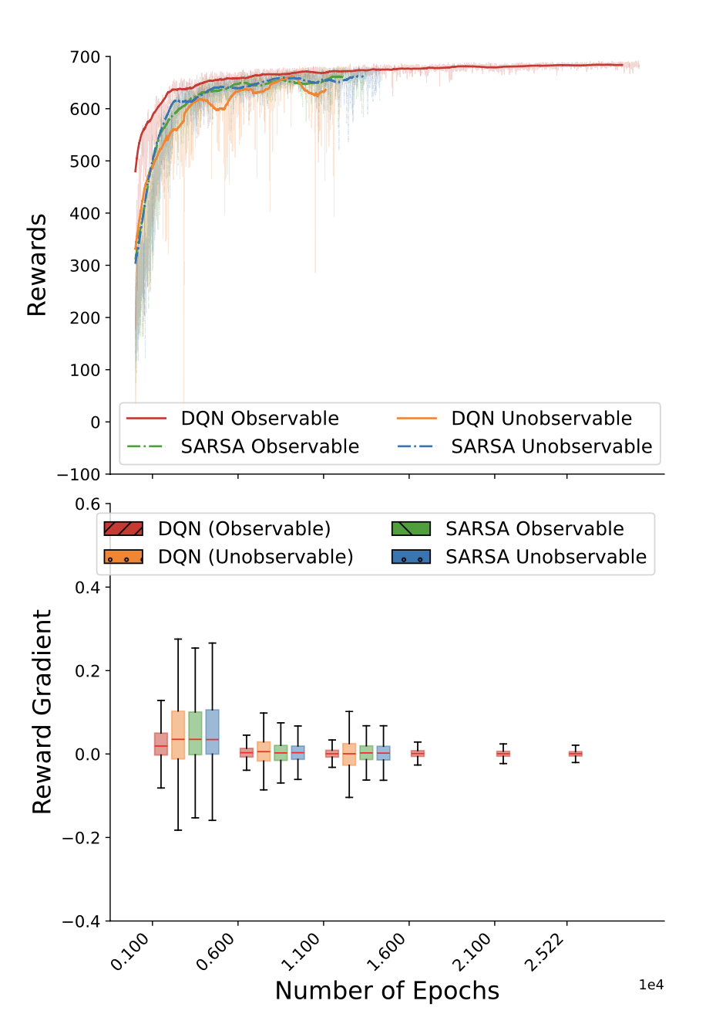
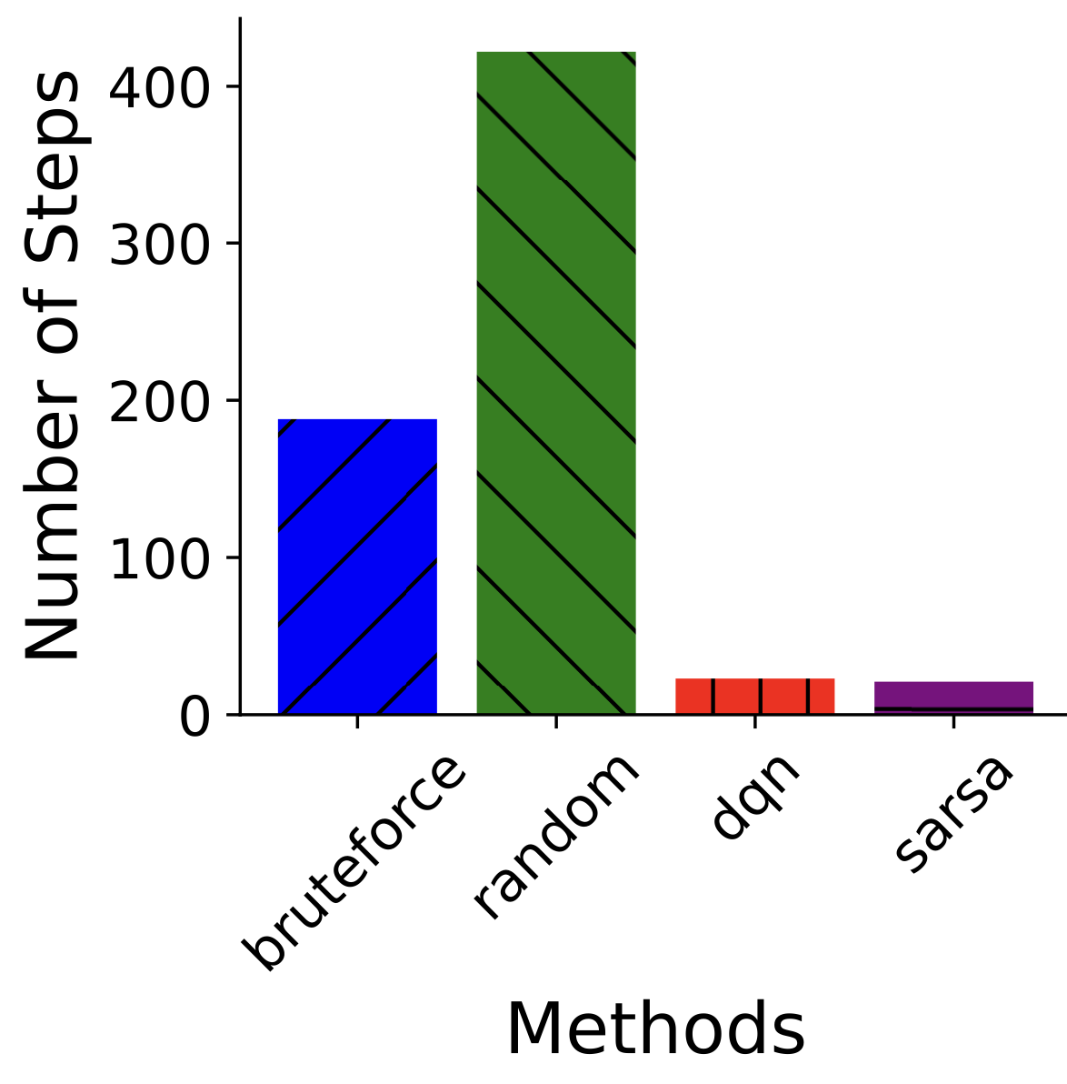
Evaluation
SAND2024-10121C
Training

Slide 10
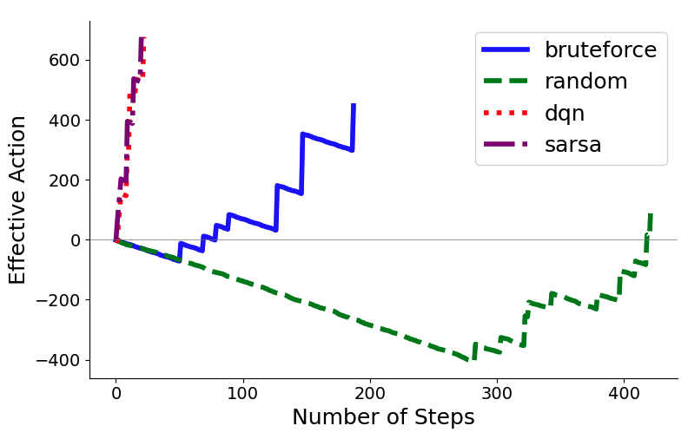
Evaluation
SAND2024-10121C
Online Deployment

Slide 11
Future/Ongoing Research Work
SAND2024-10121C
Team will explore how the already trained agents behave in different topologies
Evaluate agent’s performance in more complex topologies
Open-source our RL implementation for NASim in the respective Github repo

Slide 12
Contact: gfragko@sandia.gov
SAND2024-10121C

