Slide 1
Unsupervised physics-informed disentanglement of multimodal data
Elise Walker
Systems Mission Engineering
Sandia National Laboratories
PIMA Algorithm Collaborators:
Jonas A. Actor (1442), Carianne Martinez (5575), Troy Shilt (1513), Nathaniel Trask (UPenn)
MLDL 2024
Contact: eawalke@sandia.gov
SAND2024-09688C
Notes:
Hello, I’m Elise Walker. I am in department 6324. This work was done jointly with fellow Sandians Jonas Actor, Cari Martinez, and Troy Shilt, as well as Nat Trask who is now at UPenn.
Almost identical to: SAND2024-05789C

Slide 2
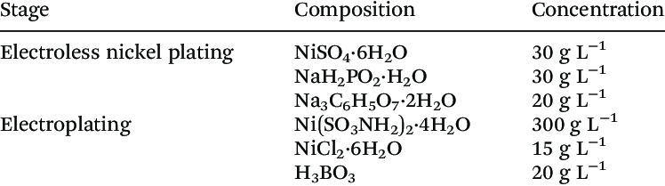
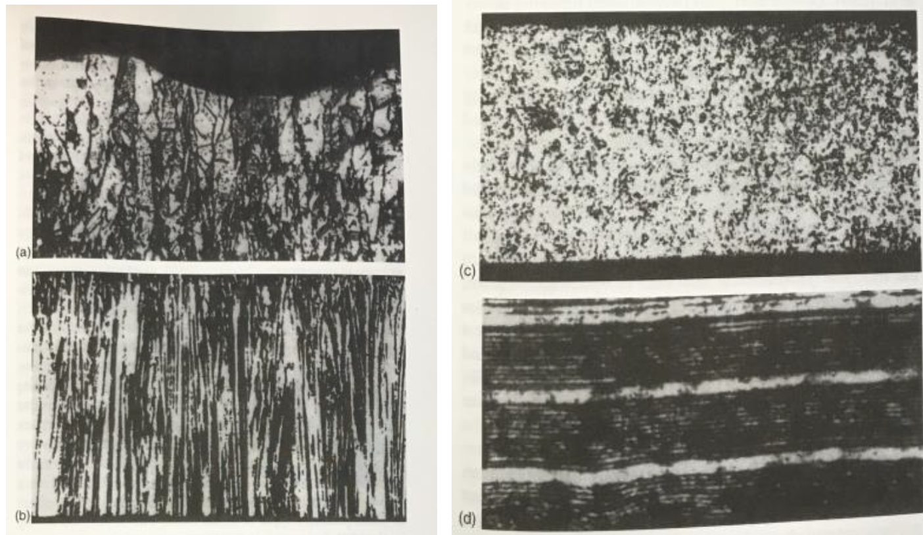
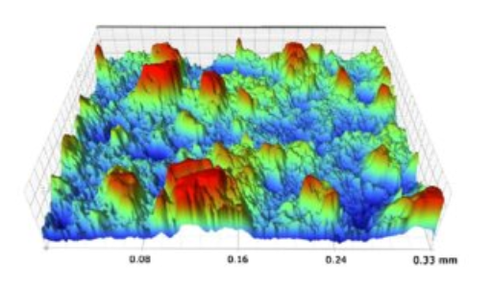
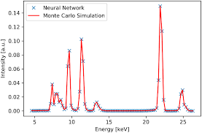
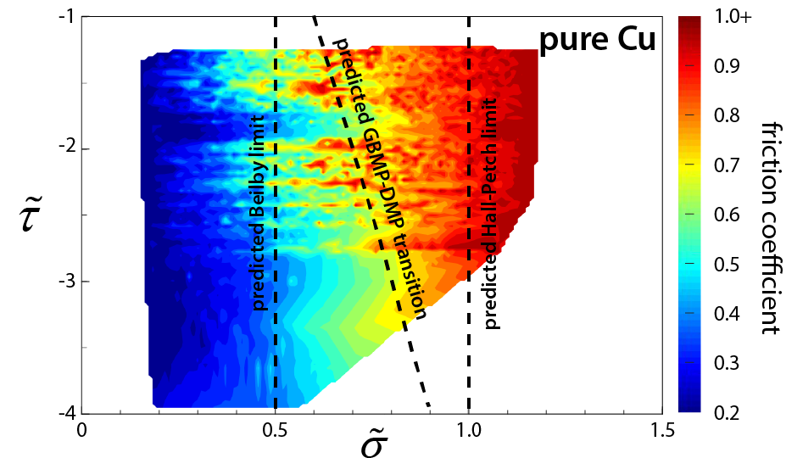
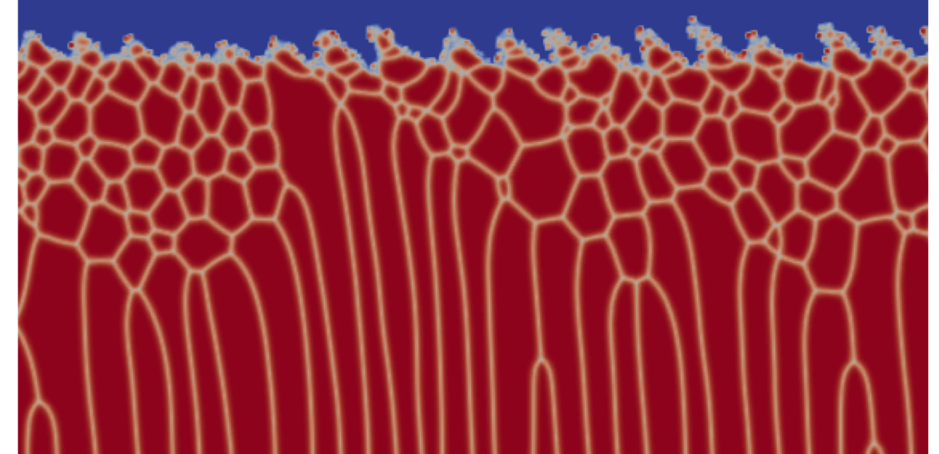
The data avalanche: multimodal data streams
Pre-process In-process Post-process
What features are important?
How are the features related?
Microscopy & Characterization
Time-series data
Precursor characterization
High-fidelity mod/sim
Property/Performance/Aging Measurements
In-situ characterization

Slide 3
Multimodal representation methods needed to comprehend data avalanche
We need a way to:
Pre-process In-process Post-process
Jointly view and comprehend multiple modalities.
Make cross-modal predictions.
Microscopy & Characterization
Have the capacity to detect fingerprints.
Time-series data
Precursor characterization
Incorporate known physics constraints.
Property/Performance/Aging Measurements
Understand dependency structure between features.
High-fidelity mod/sim
In-situ characterization
Notes:
This work was originally motivated by the BeyondFingerprinting Grand Challenge here at Sandia. In this Grand Challenge, material scientists created large materials datasets consisting of multiple data modalities, such as process parameters for generating the materials, data collected while the material is being made, and characterization modalities after the material was synthesized. Thus these modalities have various fidelities and contain different, complementary infromation. A key goal was to find meaningful ways to view all of these disparate modalities simultaneously. Thus we aimed to develop a machine learning algorithm that could help us view all modalities jointly, make cross-modal predictions between the modalities, have the capacity to detect fingerprints or patterns within the data, all while incorporating known physical constrains coming from the materials. We furthermore wanted to be able to understand the dependency structure behind the features we discovered. We tackled the first four goals, which are in orange, by developing our PIMA algorithm.

Slide 4
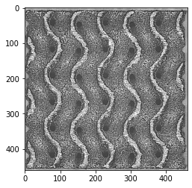
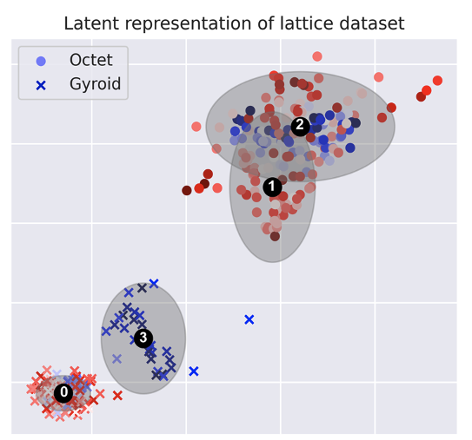
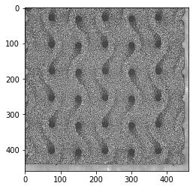
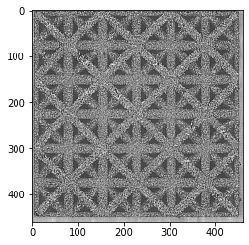

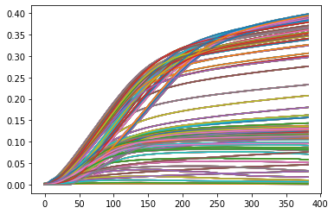
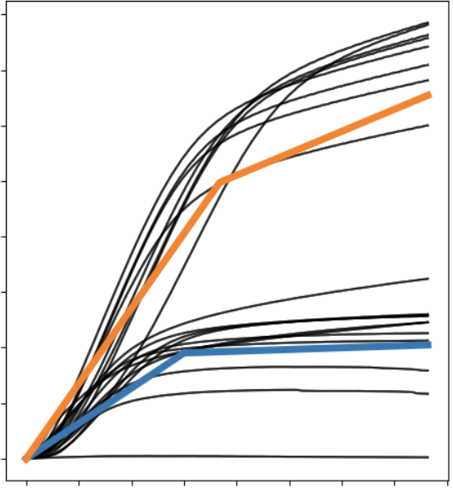
Physics-informed multimodal autoencoders (PIMA) perform multimodal representation learning
Cross-modal predictions
Fingerprints detected by clusters
Encoder
Decoder
N(μ₁,Σ₁)
N(μ,Σ)
z
Encoder
Expert
Physics
Model
N(μ₂,Σ₂)
c
Multimodal Data
Prediction
Multimodal view in latent space
Off-label use: capacity to handle missing modalities
Physics constraints in decoders
E. Walker, N. Trask, C. Martinez, K. Lee, J. Actor, S. Saha, T. Shilt, D. Vizoso, R. Dingreville, B. Boyce, “Unsupervised physics-informed disentanglement of multimodal data”, FoDS April 2024
Notes:
PIMA, which stands for physics-informed multimodal autoencoders, is a variational autoencoder designed to tackle those first four criteria. As a variational autoencoder, the aim of PIMA was to develop a meaningful latent space for understanding our data. In our algorithm, each modality gets its own encoder. Thus each modality of a given material sample is represented as a Gaussian distribution. We combine these modalities through a product of experts, which essentially means we multiply all the individual modality Gaussian distributions together to get one Gaussian distribution per material sample in the latent space. Thus one point here in the latent space represents information from all modalities for a given sample. Our latent space has a Gaussian mixture model prior, which encourages the data to separate into clusters. These clusters then can help us identify patterns, or fingerprints, in the data. After training, we furthermore can perform cross-modal inference by encoding one modality and decoding to a different modality. This operation essentially drops modalities out of the multimodal product, which means that our algorithm also has the capacity to train when some modalities are missing for a subset of samples. Finally, our PIMA algorithm incorporates any known physics through expert decoders. In this example here, we use a piece-wise linear model to capture the shape of the stress-strain curves instead of letting a neural network with hundreds or thousands of parameters try to learn these curves.

Slide 5
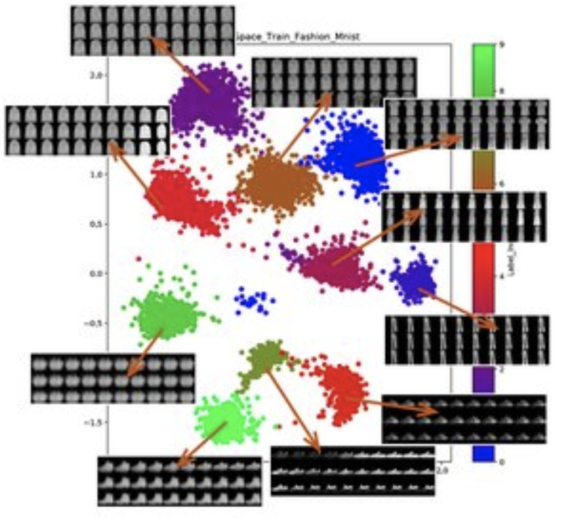
Physics-informed multimodal autoencoder (PIMA):
A variational autoencoder framework with capable of fusing multiple modalities and incorporating physics knowledge.
Patterns are identified in the latent space with a Gaussian mixture prior.
Encoder
Decoder
N(μ₁,Σ₁)
N(μ,Σ)
z
Encoder
Expert
Physics
Model
N(μ₂,Σ₂)
c
Multimodal Data
Prediction
Unimodal embeddings (neural networks)
Product of experts (multimodal embedding)
Sample from multimodal embedding
Decode via a mixture of experts
Update parameters from loss function
Input modalities
E. Walker, N. Trask, C. Martinez, K. Lee, J. Actor, S. Saha, T. Shilt, D. Vizoso, R. Dingreville, B. Boyce, “Unsupervised physics-informed disentanglement of multimodal data”, FoDS April 2024

Slide 6
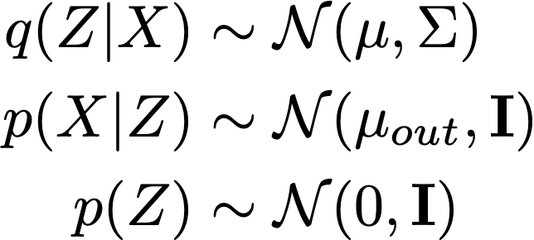
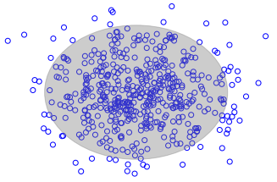

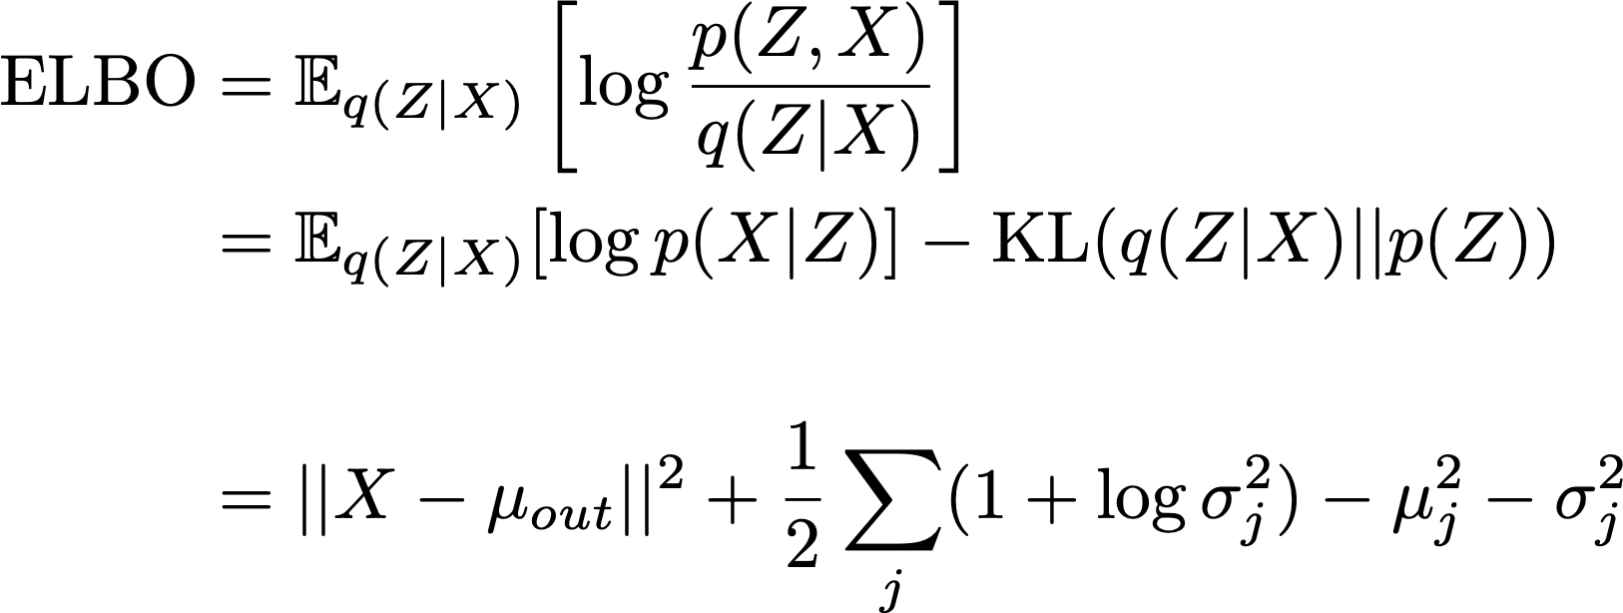
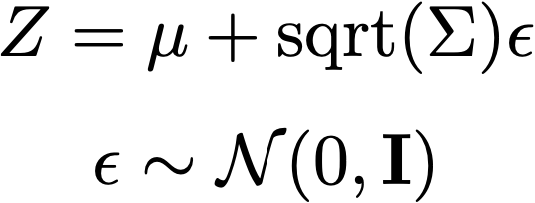

Variational autoencoders (VAEs) provide structured dimension reduction
Variational Autoencoder Model
X
encoder
decoder
encoder
Prior on latent distribution
Variational Autoencoder Training
Z
reconstruction
KL divergence
decoder
Closed form expressions for all terms in ELBO
Obtain regularization of vanilla AE
Idea: map X into balls around Z
Notes:
\text{ELBO} &= \mathbb{E}_{q(Z|X)}\left[ \log \frac{p(Z,X)}{q(Z|X)} \right] \\
&= \mathbb{E}_{q(Z|X)}[\log p(X|Z)] - \text{KL}(q(Z|X) || p(Z)) \\
& \\
&= ||X-\mu_{out}||^2 + \frac{1}{2}\sum_j (1+\log \sigma_j^2) - \mu_j^2 - \sigma_j^2

Slide 7
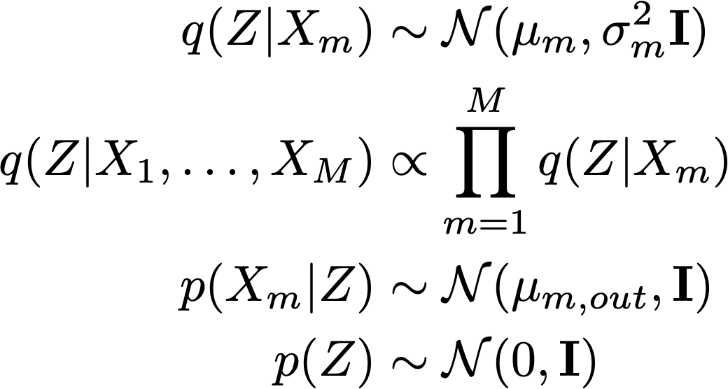




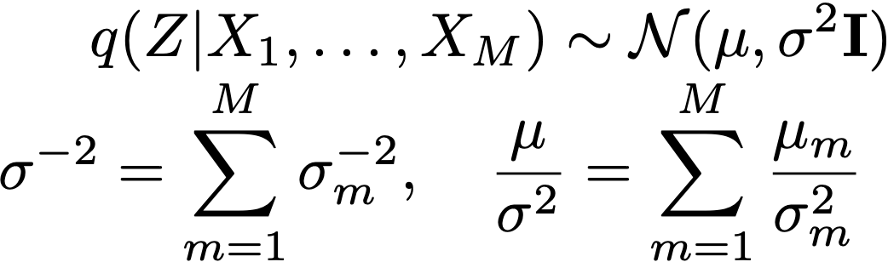
Multimodal variational autoencoders
Multimodal Variational Autoencoder Model
X
X
Unimodal encoders
encoder
encoder
Multimodal embedding
Unimodal decoders
Prior on latent distribution
Product of experts combines unimodal embeddings
Multimodal embedding still a Gaussian
Z
Z
decoder
decoder
Notes:
q(Z|X_m) &\sim \mathcal{N}(\mu_m, \sigma_m^2 \mathbf{I}) \\
q(Z|X_1, \dots, X_M) &\propto \prod_{m=1}^M q(Z|X_m) \\
p(X_m|Z,C) &\sim \mathcal{N}(\mu_{m,out}, \mathbf{I}) \\
p(Z,C) &= p(Z|C)p(C) \\
p(C) &\sim \text{Cat}(N) \\
p(Z|C=c) &\sim \mathcal{N}(\widetilde{\mu}_c, \widetilde{\sigma}^2_c \mathbf{I})

Slide 8
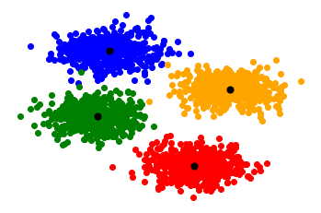
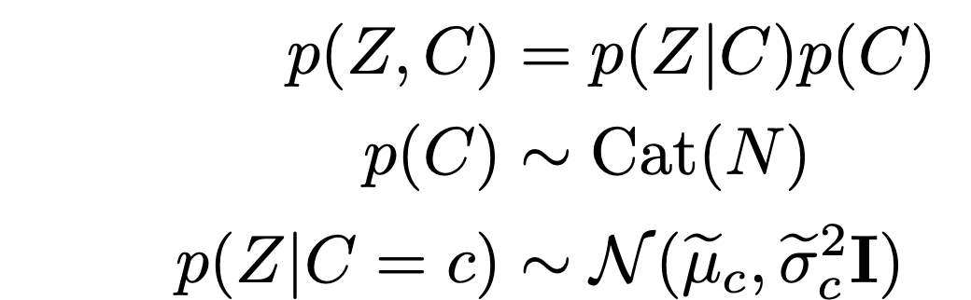
Gaussian mixture prior on latent space
1
2
4
3
Latent space with Gaussian Mixture prior
Notes:
q(Z|X_m) &\sim \mathcal{N}(\mu_m, \sigma_m^2 \mathbf{I}) \\
q(Z|X_1, \dots, X_M) &\propto \prod_{m=1}^M q(Z|X_m) \\
p(X_m|Z,C) &\sim \mathcal{N}(\mu_{m,out}, \mathbf{I}) \\
p(Z,C) &= p(Z|C)p(C) \\
p(C) &\sim \text{Cat}(N) \\
p(Z|C=c) &\sim \mathcal{N}(\widetilde{\mu}_c, \widetilde{\sigma}^2_c \mathbf{I})

Slide 9
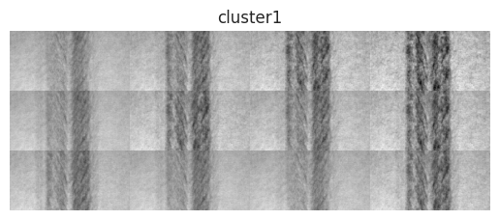
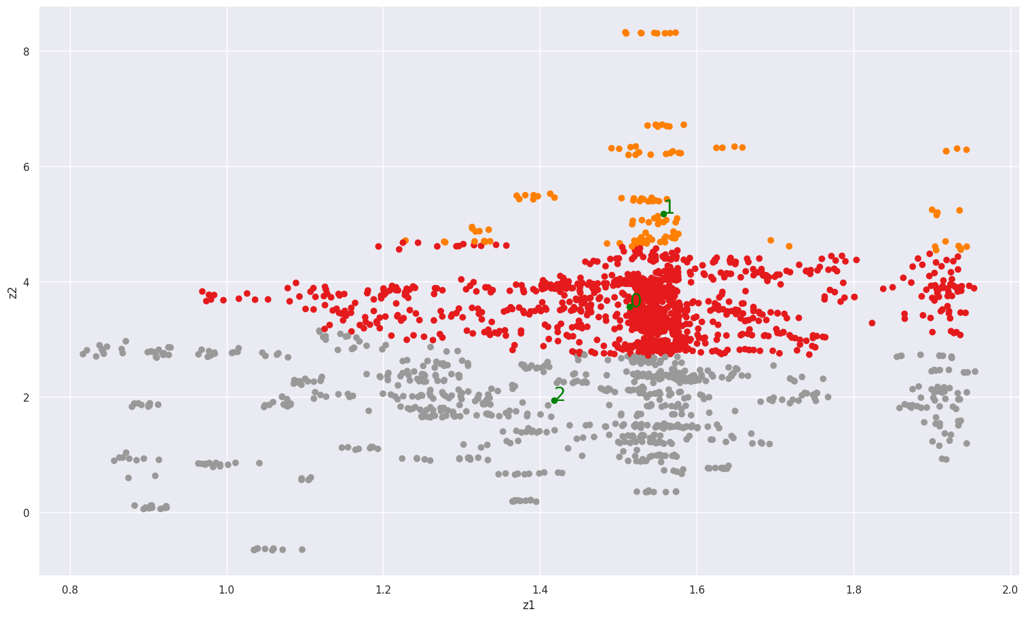

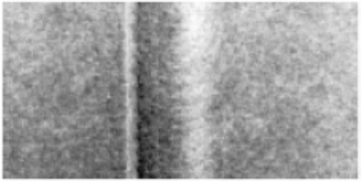
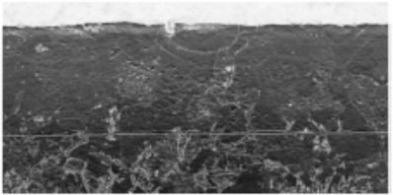
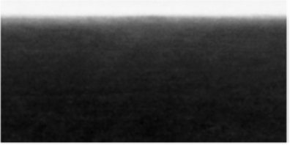
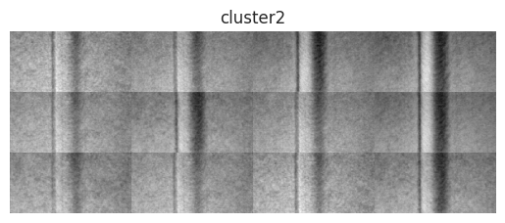
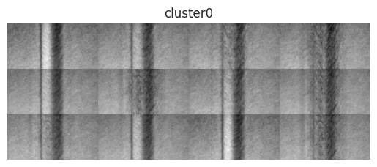
Overview: towards causal multimodal disentanglement
PIMA (physics-informed multimodal autoencoders) disentangles multimodal data
Encoder
Decoder
1
Encoder
Decoder
0
Width
Depth
Peak-to-trough
Encoder
Decoder
Width
Depth
Peak-to-trough
2
Are there any causal relationships between the features and/or clusters?
Can we guide clustering by causality?

Slide 10
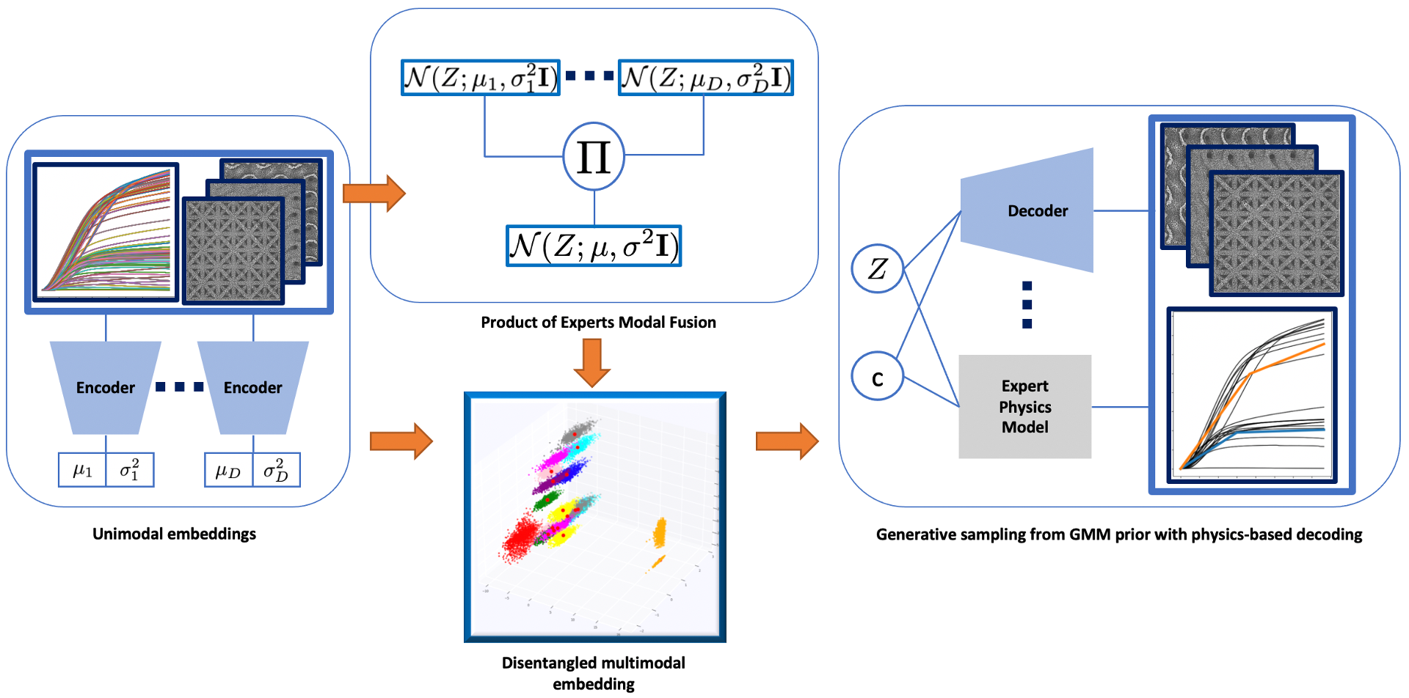
PIMA (Physics-informed multimodal autoencoders)
Input modalities
$$X_{1},…, X_{D}$$
𝑋_1,…, 𝑋_𝐷
Unimodal embeddings into $Z$
Unimodal embeddings into 𝑍
$$q(Z|X_{i})$$
𝑞(𝑍|𝑋_𝑖)
Product of Experts
$$q(Z|X_{1},…, X_{D})$$
𝑞(𝑍|𝑋_1,…, 𝑋_𝐷)
Gaussian Mixture prior
$$p(Z|c)$$
𝑝(𝑍|𝑐)
Physics-informed Mixture of Experts
$$p(X_{i}|Z,c)$$
𝑝(𝑋_𝑖 |𝑍,𝑐)
(Encoding)
(Decoding)

Slide 11
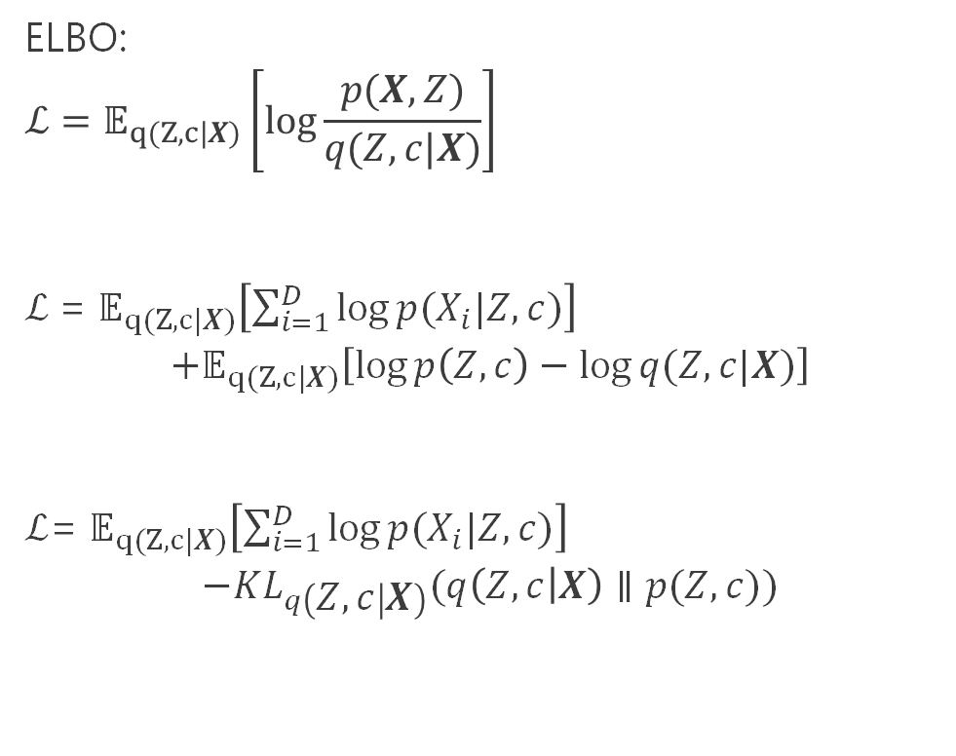
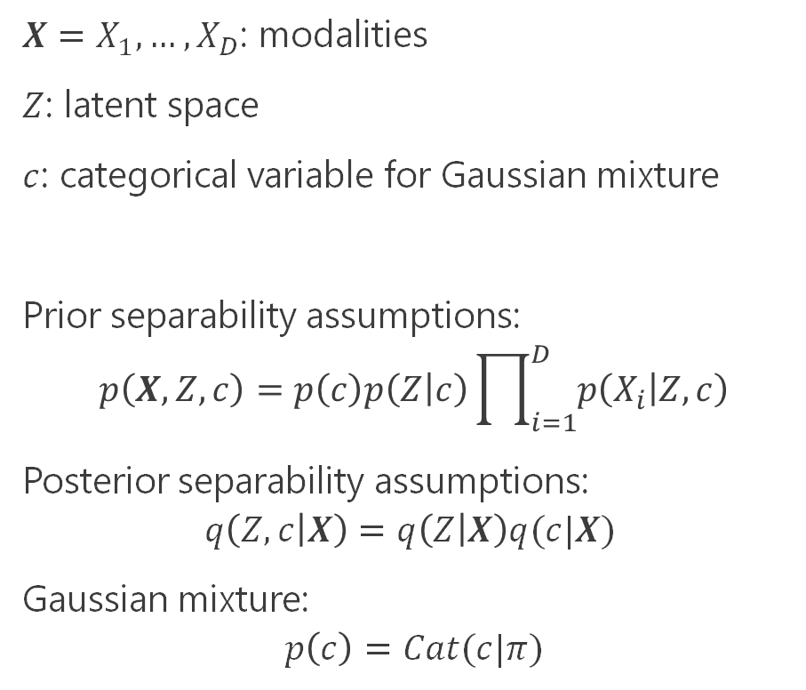
PIMA ELBO
$X=X_{1}, …, X_{D}$: modalities
$Z$: latent space
$c$: categorical variable for Gaussian mixture
Prior separability assumptions:
$$p\left(X,Z,c\right)=p\left(c\right)p\left(Z | c\right)\prod_{i=1}^{D}{p\left(X_{i} | Z,c\right)}$$
Posterior separability assumptions:
$$q\left(Z,c | X\right)=q\left(Z | X\right)q(c|X)$$
Gaussian mixture:
$$p\left(c\right)=Cat(c|π)$$
ELBO:
$$ℒ=𝔼_{q(Z,c|X)}\left[\log{\frac{p(X,Z)}{q(Z,c|X)}}\right]$$
$ℒ$= $𝔼_{q(Z,c|X)}\left[\sum_{i=1}^{D}{\log{p(X_{i}|Z,c)}}\right]$
$$+𝔼_{q(Z,c|X)}\left[\log{p\left(Z,c\right)−\log{q(Z,c|X)}}\right]$$
$ℒ$= $𝔼_{q(Z,c|X)}\left[\sum_{i=1}^{D}{\log{p(X_{i}|Z,c)}}\right]$
$$−KL_{q\left(Z,c | X\right)}(q\left(Z,c | X\right)∥p(Z,c))$$

Slide 12
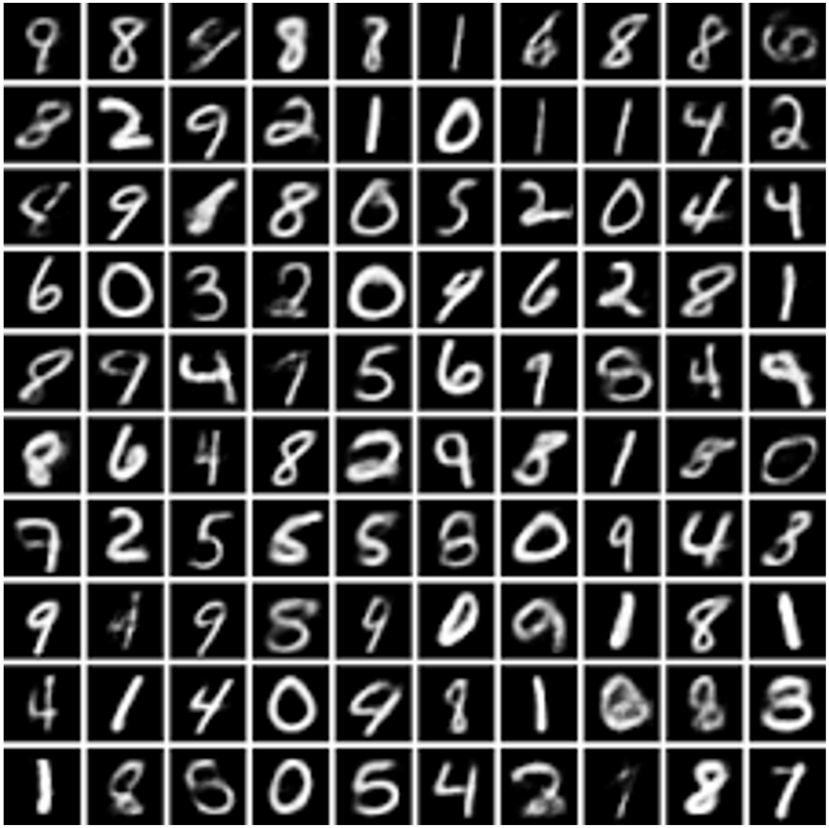
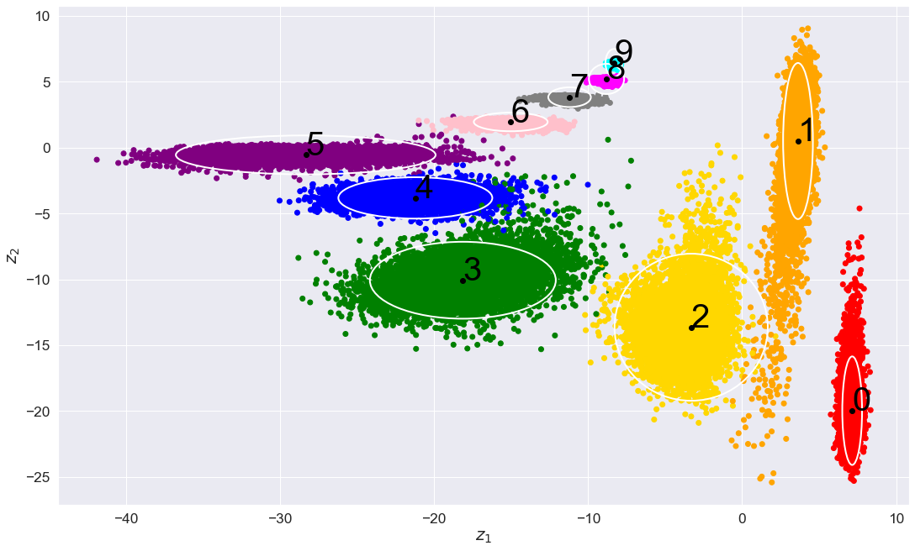
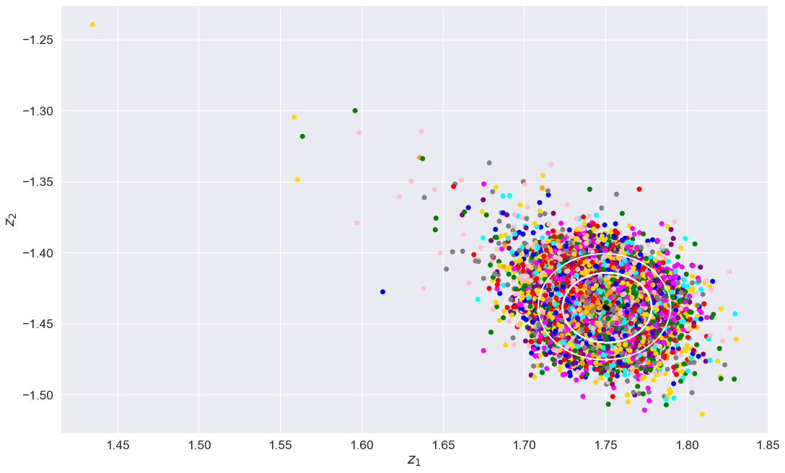
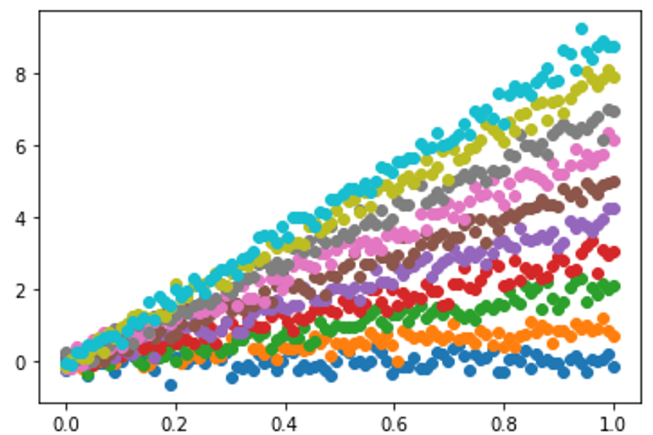
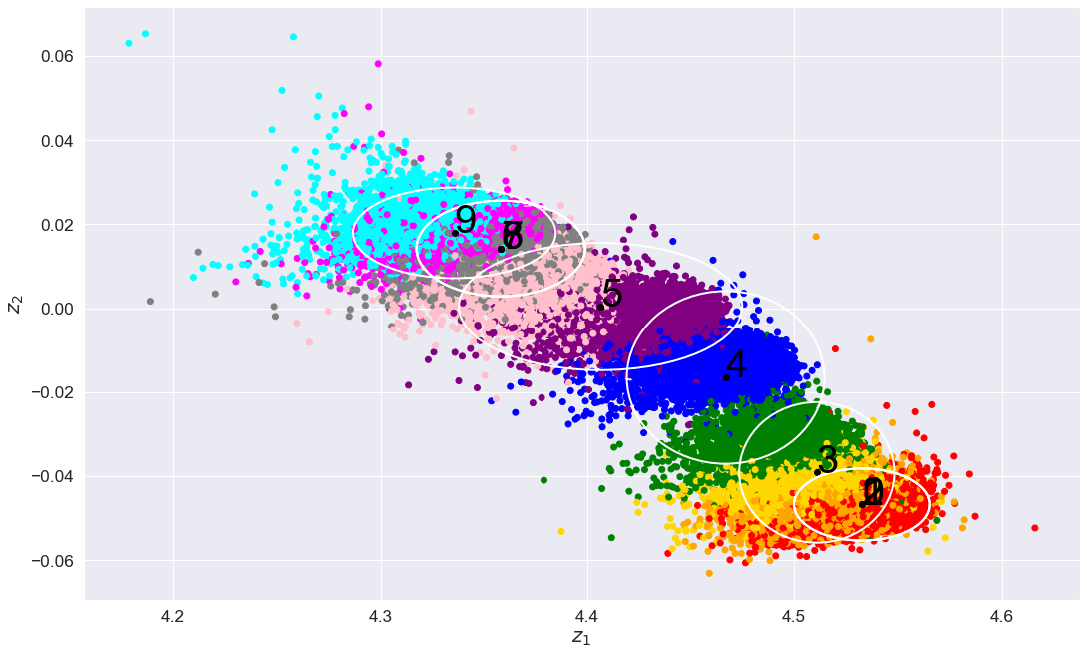
Fusion of modalities improves performance in MNIST
Multimodal latent space
Accuracy: 99.42%
X₁
X₁-only
latent space
Accuracy: 14.84%
X₂
X₂-only
latent space
Accuracy: 53.37%
Notes:
Now we wanted to test the viability of this mutlimodal framework, so we first tested PIMA on a standard ML dataset called MNIST. MNIST consists of images of handwritten digits, along with their true labels. In our experiments, we augmented the images with a synthetic modality X_2, where the label for each image was used as the slope for a line going through the origin. We wanted to see if there was any benefit from using both modalities instead of just one modality. When we fed just the images through PIMA, we saw that the image-only latent space was not interpretable, with digits scattered throughout the latent space. When we used just the X_2 synthetic modality, we started to see organization of the digits in the latent space, but the unsupervised accuracy classifying digits was still fairly low. When we used both modalities in PIMA, which is the top image, we saw 10 separate clusters, one for each digit, and a fairly high unsupervised classification accuracy. Thus we saw that viewing the modalities jointly was greater than the sum of the individual modalities.

Slide 13
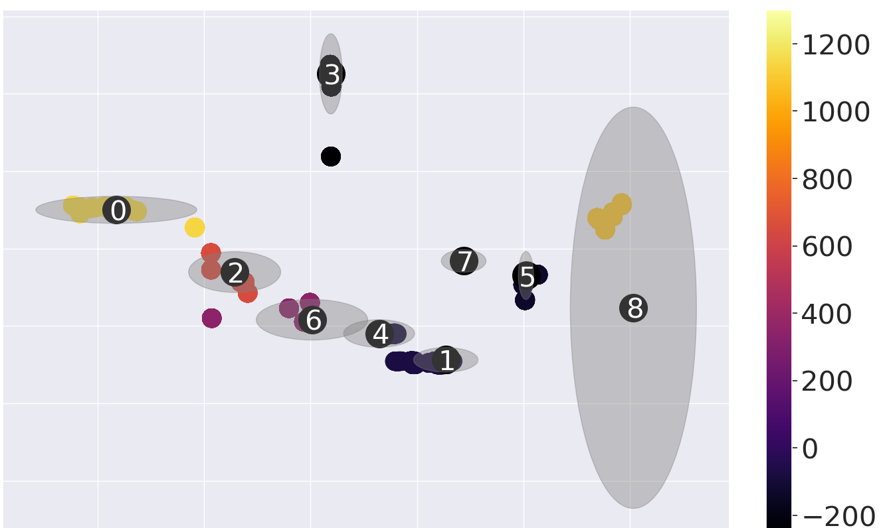
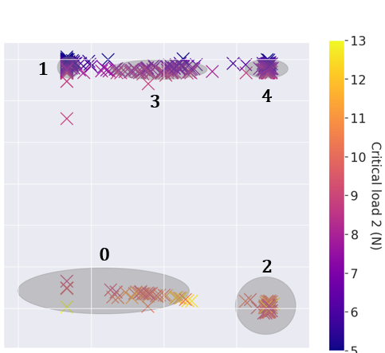
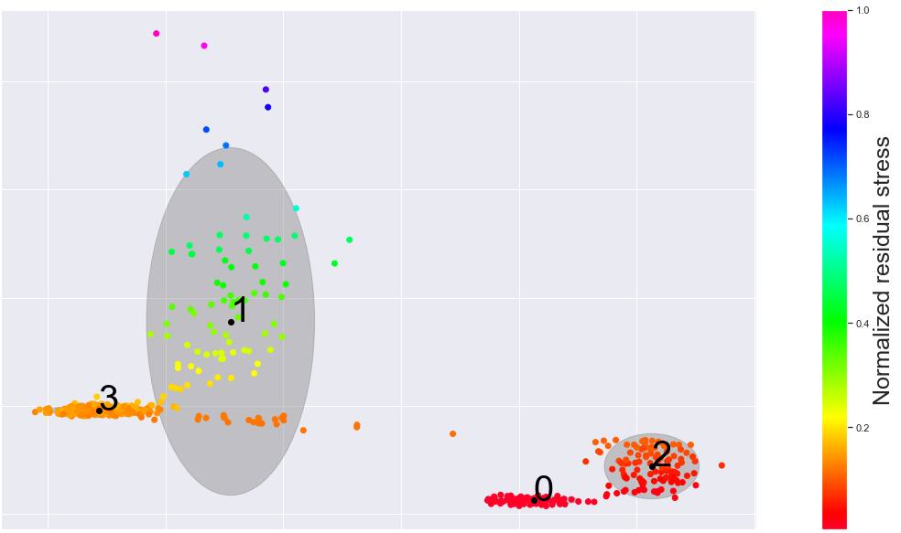
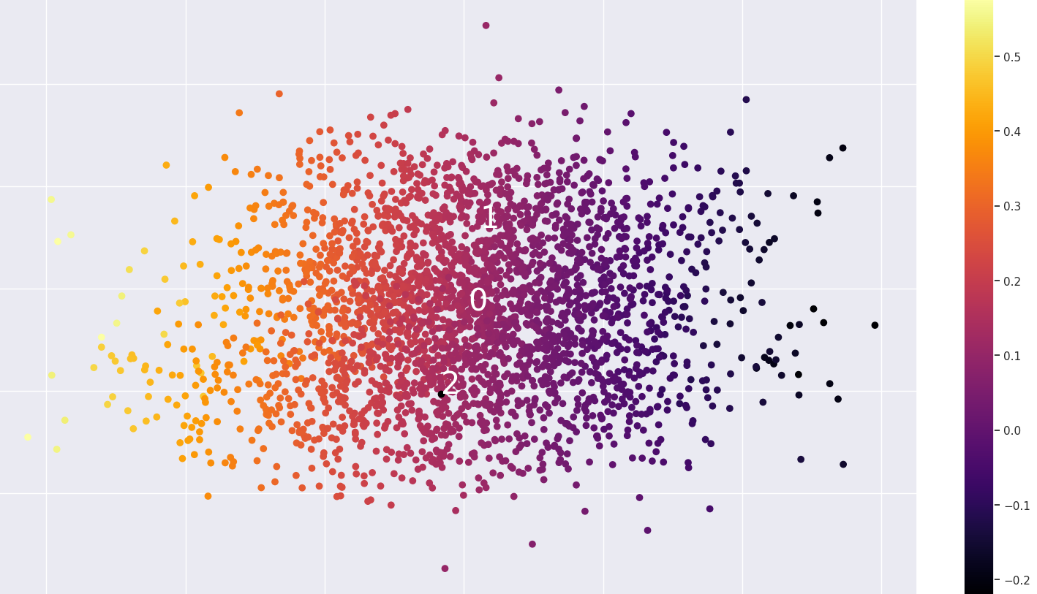
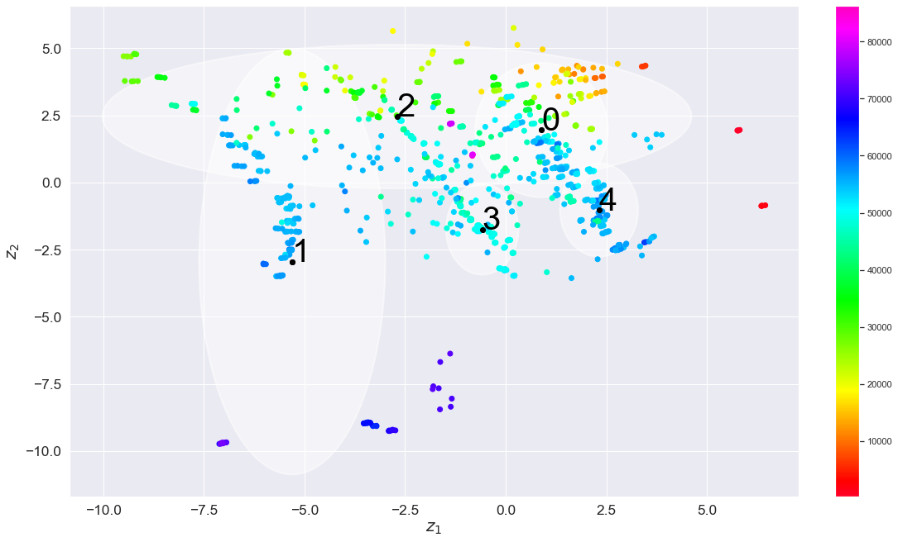
PIMA applications throughout BeyondFingerprinting
Latent representation of PVD molybdenum dataset
Latent representation of adhesion dataset
Clusters are independent. How do we find dependencies among the features?
Residual stress (MPa)
Delamination resistance (LC2)
Latent representation of VDoS dataset
Latent representation of melt pool dataset
Latent representation of voltage & XRF dataset
1
0
Normalized melt pool width
XRF nickel peak height
2
E. Walker, et. al. “Unsupervised physics-informed disentanglement of multimodal data”, Foundations of Data Science, doi:10.3934/fods.2024019
N. Trask, C. Martinez, T. Shilt, E. Walker, K. Lee, A. Garland, D. Adams, J. Curry, M. Dugger, S. Larson, B. Boyce, “Unsupervised physics-informed disentanglement of multimodal materials data”, submitted 2023
Notes:
We then tested PIMA on a variety of materials datasets coming from BeyondFingerprinting, a selection of which are depicted here. However, as with MNIST, we saw that the clusters are independent from each other. We wanted to see if we could find features that depend on each other, and get an idea of what that dependency structure might look like.

Slide 14
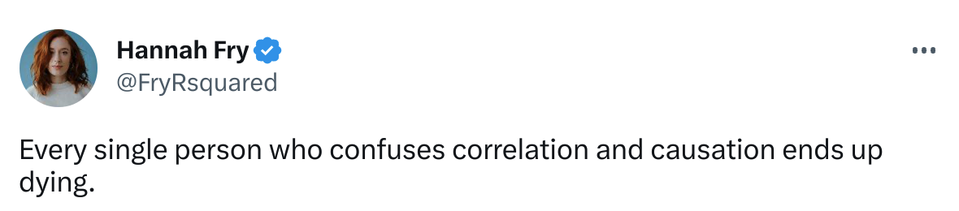
The case for causality

Slide 15
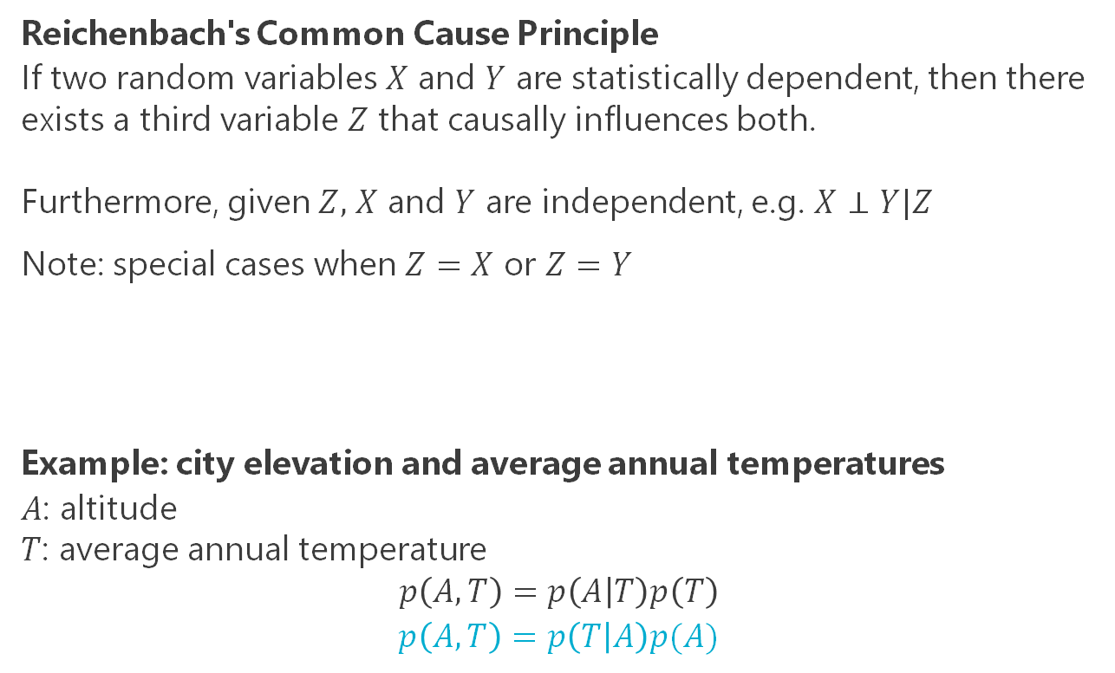
The case for causality
Reichenbach's Common Cause Principle
If two random variables $X$ and $Y$ are statistically dependent, then there exists a third variable $Z$ that causally influences both.
Furthermore, given $Z,$ $X$ and $Y$ are independent, e.g. $X⊥Y|Z$
Note: special cases when $Z=X$ or $Z=Y$
Example: city elevation and average annual temperatures
$A$: altitude
$T$: average annual temperature
$$p\left(A,T\right)=p\left(A | T\right)p\left(T\right)$$
$$p\left(A,T\right)=p\left(T | A\right)p(A)$$
Z
X
Y
A
T
Elements of Causal Inference: Foundations and Learning Algorithms, Peters, Janzing, & Schölkopf (2017)

Slide 16
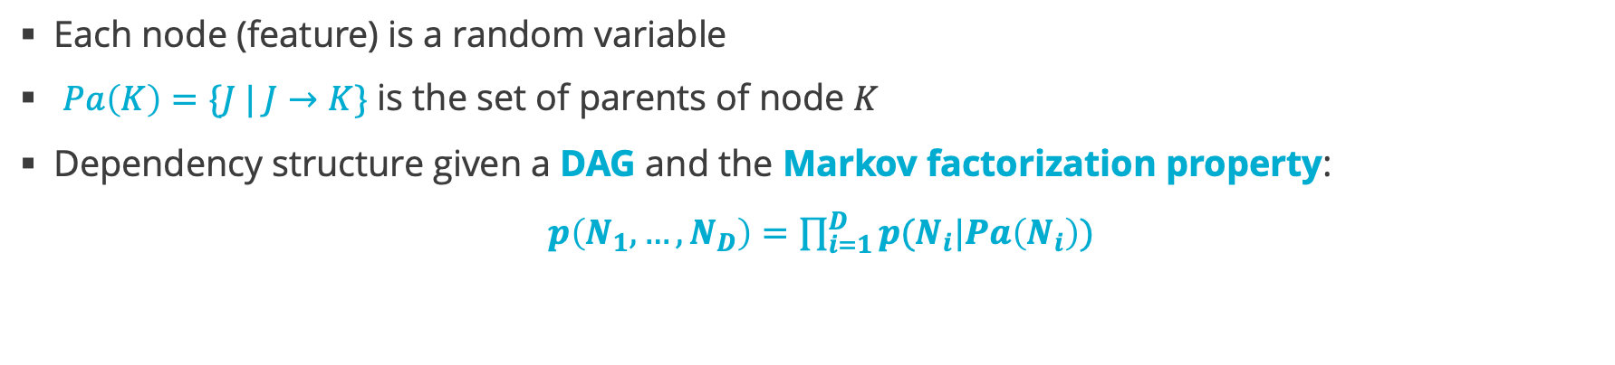
Directed acyclic graphs (DAGs) encode dependencies on nodes
B
N₂
D
N₄
E
N₅
A
N₁
C
N₃
Each node (feature) is a random variable
$Pa\left(K\right)=\{J | J→K\}$ is the set of parents of node $K$
Dependency structure given a DAG and the Markov factorization property:
$p\left(N_{1},…, N_{D}\right)=\prod_{i=1}^{D}{p(N_{i}|Pa\left(N_{i}\right))}$
Notes:
So how are we going to encode dependent relationships of features? Well, one way of encoding dependent relationships is through directed acyclic graphs, known as DAGs. By graph I mean that we have nodes and edges, by directed I mean that the edges are arrows, and by acyclic I mean that if I start at any node and follow the arrows, then I won’t ever end up back at the node that I started with. In our case, we are going to let each node represent a random variable of a feature. Parents of a given feature or node are all the nodes with an arrow directly into the given node. We probabilistically encode the dependency structure suggested by the DAG through the Markov factorization property, which states that the joint probability distribution of the nodes factors according to the DAG. Specifically, this product structure states that any node given its parents is independent of any other node given their parents.

Slide 17
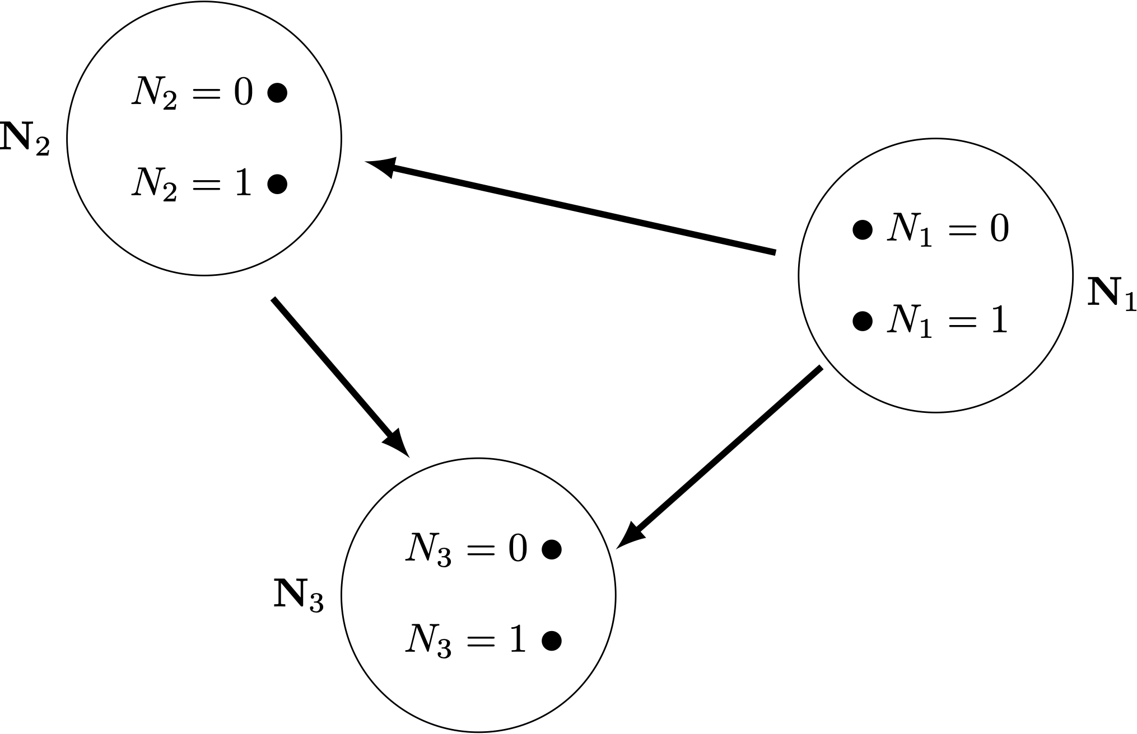
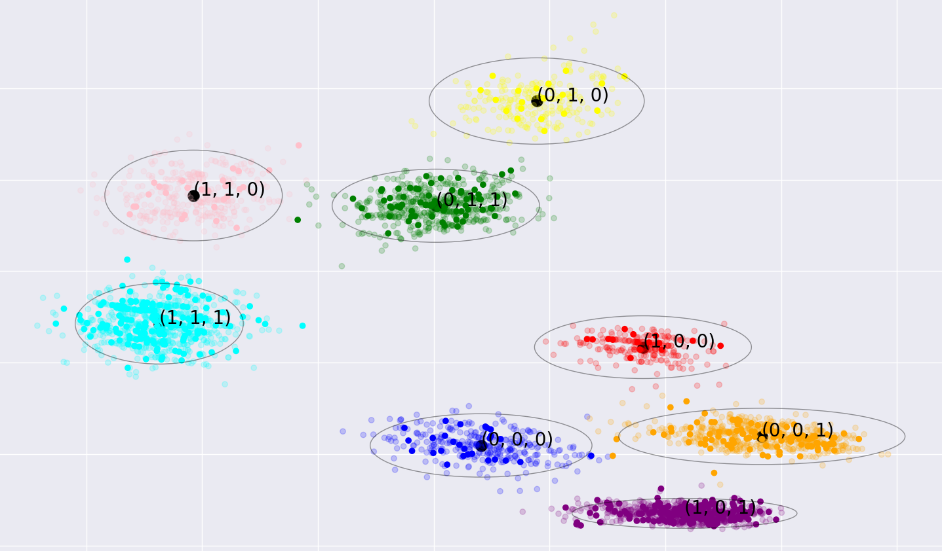
pimaDAG: incorporating dependency structure in PIMA via DAGs
Encoder
Decoder
N(μ₁,Σ₁)
N(μ,Σ)
z
Encoder
Expert
Physics
Model
N(μ₂,Σ₂)
c
Multimodal Data
Variational autoencoder (VAE) with a latent Gaussian mixture prior
Trainable directed acyclic graph (DAG) which defines mixture probabilities
Joint training of VAE and DAG through a single, tractable loss function
Prediction
E. Walker (SNL), J. Actor (SNL), C. Martinez (SNL), N. Trask (UPenn), “Causal disentanglement of multimodal data”, 2023. arXiv:2310.18471v2
Notes:
Thus our goal is to take our PIMA algorithm, and incorporate a trainable DAG so we can learn a latent space of features and a DAG relating those features simultaneously. And we want to do this concurrently through a single, tractable loss function.

Slide 18
Incorporating a DAG into a VAE
A node in a DAG is a categorical variable (represents an attribute)
Each category in a node represents a different attribute realization
Choose the number of nodes in the DAG and the number of categories per node
Example:
Dataset consists of images of red and green circles of different size and center shifts
Might choose a graph with 3 nodes, each with two categories
Color
red
green
Size
Center
large
small
left
right

Slide 19
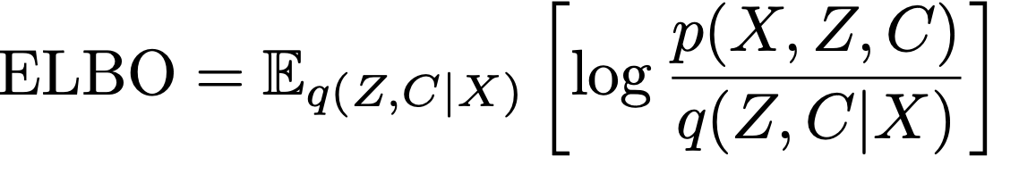
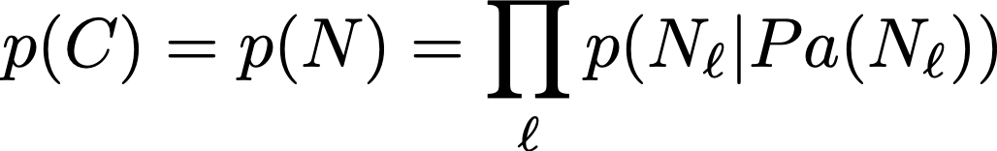
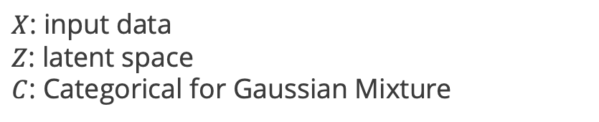

Incorporating DAG structure into VAE ELBO
Each node is a categorical random variable
Latent space clusters identified with realizations of DAG nodes
Probability of each cluster is DAG-dependent, i.e. $p\left(N_{1},…, N_{D}\right)=\prod_{i=1}^{D}{p(N_{i}|Pa\left(N_{i}\right))}$
A₁
A₂
B₁
B₂
A
B
Learned DAG
$X$: input data
$Z$: latent space
$C$: Categorical for Gaussian Mixture
(A₁, B₁)
(A₁, B₂)
(A₂, B₂)
(A₂, B₁)
$$p\left(A_{1},B_{2}\right)=p\left(B=B_{2}\right)p\left(A=A_{1}\right|B=B_{2})$$
Latent space structured by the DAG
Notes:
The way we tie the DAG in to the VAE is through the Gaussian mixture model. Recall that PIMA had clusters in the latent space from the Gaussian mixture model. Every Gaussian mixture model comes with the probability of belonging to a given cluster. We are going to identify that mixture probability with the joint probability distribution on the nodes. I have here a simple example where we have two binary nodes, A and B. This means the joint distribution of A and B has 4 realizations. In this cartoon, we are identifying the probability of belonging to the orange cluster with the probability of node A being equal to A_1, and node B being equal to B_2. Thus we require that the cluster probabilities be equal to the nodal probabilities, which we require to factor via the Markov factorization property. So it’s through this identification between clusters and nodal outcomes that we tie our DAG into our VAE model.

Slide 20
Incorporating a DAG into PIMA ELBO
$X=X_{1}, …, X_{D}$: modalities
$Z$: latent space
$c$: categorical variable for Gaussian mixture
Prior separability assumptions:
$$p\left(X,Z,c\right)=p\left(c\right)p\left(Z | c\right)\prod_{i=1}^{D}{p\left(X_{i} | Z,c\right)}$$
Posterior separability assumptions:
$$q\left(Z,c | X\right)=q\left(Z | X\right)q(c|X)$$
Gaussian mixture:
$$p\left(c\right)=Cat(c|π)$$
ELBO:
$$ℒ=𝔼_{q(Z,c|X)}\left[\log{\frac{p(X,Z)}{q(Z,c|X)}}\right]$$
$ℒ$= $𝔼_{q(Z,c|X)}\left[\sum_{i=1}^{D}{\log{p(X_{i}|Z,c)}}\right]$
$$+𝔼_{q(Z,c|X)}\left[\log{p\left(Z,c\right)−\log{q(Z,c|X)}}\right]$$
$ℒ$= $𝔼_{q(Z,c|X)}\left[\sum_{i=1}^{D}{\log{p(X_{i}|Z,c)}}\right]$
$$−KL_{q\left(Z,c | X\right)}(q\left(Z,c | X\right)∥p(Z,c))$$

Slide 21


Incorporating a DAG into PIMA ELBO
$X=X_{1}, …, X_{D}$: modalities
$Z$: latent space
$N=(N_{1},…, N_{L})$: collection of nodes
Prior separability assumptions:
$$p\left(X,Z,N\right)=p\left(N\right)p\left(Z | N\right)\prod_{i=1}^{D}{p\left(X_{i} | Z,N\right)}$$
Posterior separability assumptions:
$$q\left(Z,N | X\right)=q\left(Z | X\right)q(N|X)$$
Gaussian mixture:
$$p\left(N\right)=\prod_{ℓ=1}^{L}{p(N_{ℓ}|Pa\left(N_{ℓ}\right))}$$
ELBO:
$$ℒ=𝔼_{q(Z,c|X)}\left[\log{\frac{p(X,Z)}{q(Z,N|X)}}\right]$$
$ℒ$= $𝔼_{q(Z,N|X)}\left[\sum_{i=1}^{D}{\log{p(X_{i}|Z,N)}}\right]$
$$+𝔼_{q(Z,c|X)}\left[\log{p\left(Z,N\right)−\log{q(Z,N|X)}}\right]$$
$ℒ$= $𝔼_{q(Z,N|X)}\left[\sum_{i=1}^{D}{\log{p(X_{i}|Z,N)}}\right]$
$$−KL_{q\left(Z,N | X\right)}(q\left(Z,N | X\right)∥p(Z,N))$$

Slide 22
Learning Causal Mechanisms
Need to find a DAG that encodes causal relationships in the latent space
Need to parameterize probability distributions that accommodates changes in causal relationships (i.e.) different DAGs

Slide 23
Smoothly learning a DAG via graph-curl
2
4
5
1
3
Any function on edges of this graph has a graph-curl of 0
2
4
5
1
3
Functions on edges this graph are not inherently graph-curl-free!
Notes:
The next piece we need to tackle is how to smoothly parametrize a DAG so we can learn a DAG concurrently with a VAE. We are going to use concepts from discrete exterior calculus, which generalizes the notions of gradient and curl from vector calculus to graphs. Essentially, functions on edges of a DAG will inherently have a graph-curl of 0, whereas functions on edges of graphs with a cycle will not be graph-curl free. So we will be using this notion of curl-free implies DAGs in our parametrization.

Slide 24








Smoothly learning a DAG
$$N_{i}$$
$$ξ_{i}=0.1$$
$E$: directed adjacency matrix. $E_{ij}=p(N_{i}→N_{j}$)
$B$: is a trainable metric ($B_{ij}$nonnegative scalars)
$𝒢$: is the graph gradient
$ξ$: trainable node scores
$β$: temperature parameter
$$E_{ij}$$
$$Nj$$
$ξ_{j}=0.$5
Theorem: $\lim_{β→0}{E}$ defines a DAG and can recover any DAG.
Proof sketch: $Curl ∘Grad=0$, so $E$ is curl-free and defines a DAG. Graph gradient recovers complete DAGs, and $B$ allows recovery for any sub-DAG.
Notes:
This DAG parametrization starts by assigning a trainable score to each node. These scores induce a partial order on the nodes. When we take the graph gradient, which is the difference of the node scores, we get scores on the edges that define a complete directed acyclic graph. To learn subgraphs of the complete DAG, we weight each edge score by a nonnegative scalar B. In this manner, we can recover edges defining any DAG. We turn these scores into an edge-indicator function by applying tanh and ReLU, and we show as the temperature parameter beta approaches 0, our edge indicator function will approach either 0 or 1 and defines a DAG.

Slide 25


Encoding Causal Distributions
Z
Z
X
Y
X
Y
$$P\left(X,Y,Z\right)=P\left(Z\right)P\left(X | Z\right)P(Y|Z)$$
$P\left(X,Y,Z\right)=P\left(Z\right)P\left(X | Z\right)P(Y|X,Z)$
Need a flexible way of changing parameterization of causal factorization, depending on DAG
Notes:
After smoothly parametrizing our DAG, we also need to smoothly parameterize the joint distribution on our nodes. Since the factorization of this distribution changes as our DAG changes, we need a flexible way of parameterizing this distribution.

Slide 26

Encoding Causal Distributions
Learn probability kernels $W^{X}$, $W^{Y}$, $W^{Z}$ for each feature
  Each kernel is a 3-tensor: one mode per feature
  $W^{X}=P(X|Y,Z)$
  $W^{Y}=P(Y|X,Z)$
  $W^{Z}=P\left(Z | X,Y\right)$
If $X$ is not a parent of $Z:$
  $P\left(Z | X,Y\right)=P(Z|Y)$
  Need parameterization of $P(Z|Y)$ invariant to $X$
  Contract $W^{Z}$ along mode-$X$ against a fixed vector to remove effect of $X$
Notes:
Without going into the details, we essentially assume all other nodes are parents of each node, and then we remove the effect of non-parents by averaging out the non-parents.

Slide 27


Encoding Causal Distributions
Build conditional and joint probabilities as we traverse the DAG. For example:
  Step 1: build $P(Z)$
    Contract $W^{Z}$ along modes $X,Y$ via average
  Step 2: build $P(X|Z)$
    Contract $W^{X}$ along mode Y via average
  Step 2a: build $P\left(X,Z\right)=P\left(X | Z\right) P(Z)$
    Contract $W^{X}$ along mode $Z$ against $P(Z)$
  Step 3: build $P(Y|X,Z)$
    This is already $W^{Y}$!
  Step 3a: build $P\left(X,Y,Z\right)=P\left(Y | X,Z\right) P\left(X,Z\right)$
    Contract $W^{Y}$ along modes $X,Z$ against $P(X,Z)$
Z
X
Y
$P\left(X,Y,Z\right)=P\left(Z\right)P\left(X | Z\right)P(Y|X,Z)$

Slide 28

Training
Alternate between:
Expectation Maximization (EM) on:
  Means of clusters in the latent space GMM
  Variances of clusters in the latent space GMM
Gradient Descent on:
  Encoder and Decoder models
  DAG parameters (gradient scores $ξ$, metric $B$)
  Causal factorization parameters (probability kernels $W^{X}, W^{Y}, W^{Z}$ )

Slide 29









pimaDAG recovers important features in synthetic dataset
Synthetic Circles Dataset
features: color, size, and shift
Results
Analysis
$N_{1}$: Size
$N_{2}$: Color
$N_{3}$: Shift
(0,1,1)
(0,1,0)
(1,1,0)
(1,1,1)
(0,0,0)
(0,0,1)
$$p\left(N\right)=p\left(N_{2}\right)p\left(N_{1} | N_{2}\right)p(N_{3}|N_{1},N_{2})$$
(1,0,0)
green circle
(1,0,1)
red circle
Learned latent space
Learned DAG
Edge weights are $p\left(N_{i}=n \right|N_{j}=m)$
Nearest true data to cluster means
Notes:
We ran our causal algorithm on a synthetic dataset that we created of circle images. We generated the circle images with three different important features: color, size, and shift. Each feature was binary and generated such that, in particular, the shift depended upon the size and color. Our goal was for our algorithm to pick up on both important features and on the circles generative process. We ran our algorithm on the circle images with 3 nodes in the trainable DAG. The latent space is given in the center, and we see that the clusters are organized by the key features. Indeed, if we look at the data in the center of each cluster, we see that clusters with a 0 in the middle correspond to red circles, and green circles have a 1, indicating that the second node in our graph corresponds to color. We also see the top row, which has 0’s for the first label, are respectively larger than the second row, indicating that the first node corresponds to size, and you can similarly see that node 2 corresponds to shift. The DAG we learned, which is given on the bottom right, recovers our generative process by indicating that color and size strongly influence shift.

Slide 30





pimaDAG recovers important features in lattice dataset
Lattice dataset
3D-printed lattices of
two geometries
Results & Analysis
Learned latent space
Lattice Images
Nearest true data to cluster means
Learned DAG
Stress-strain curves
$N_{1}$: Stress-strain curve
$N_{2}$: Lattice geometry
Notes:
We also tested our pimaDAG algorithm on a lattice dataset generated from BeyondFingerprinting. The dataset consists of 3D-printed lattices with two separate geometries. Images and stress-strain curves were collected for each lattice. We ran this dataset through pimaDAG with two binary nodes in our DAG. We can see that the second node of the DAG corresponds to lattice-type, whereas the first node relates to the height of the stress-strain curve. Thus, combined with our learned DAG, we see that pimaDAG algorithm shows that lattice geometry influences the stress-strain curve.

Slide 31
Conclusions & future direction
Summary:
PIMA provides multimodal feature discovery with cross-modal inference capabilities
Capacity to handle missing modalities & physical expert models
pimaDAG simultaneously learns features and DAG
  Novel continuous DAG parametrization
  Dependent feature discovery
  Exploratory causal learning
Future considerations:
Incorporation of interventional data
Continuous nodes/features
Notes:
In summary I have shown you two algorithms – PIMA and pimaDAG. Both algorithms are amenable to multimodal datasets, incorporating known physics, and handling incomplete datasets. Our pimaDAG algorithm implements novel parametrizations of DAGs and Markov probability kernels and gives additional dependency structure information on the discovered features. Future incorporation of interventional data could furthermore give causal representations within multimodal datasets.

Slide 32
Thank you!
Sandia PIMA Team: Carianne Martinez, Troy Shilt, Jonas Actor, Elise Walker
Contact: eawalke@sandia.gov
Available References:
E. Walker, N. Trask, C. Martinez, K. Lee, J. Actor, S. Saha, T. Shilt, D. Vizoso, R. Dingreville, B. Boyce, “Unsupervised physics-informed disentanglement of multimodal data”, FoDS April 2024. https://www.aimsciences.org/article/doi/10.3934/fods.2024019
E. Walker, J. Actor, C. Martinez, N. Trask, “Causal disentanglement of multimodal data”, 2023. arXiv:2310.18471v2
Notes:
Our references for PIMA and pimaDAG are provided here. Please feel free to reach out to any of the Sandia PIMA team if you are interested in the PIMA code or applying PIMA to your data.

