Slide 1
Neural-ODE Surrogates for Fuel Degradation Processes in Nuclear Waste Repository Simulations
Caitlin Curry, Calvin Madsen, Bert Debusschere, and Paul Mariner
Sandia National Laboratories
Sandia ML DL Workshop
Sept. 2024
SAND2024-09887C
Sandia National Laboratories is a multi-mission laboratory managed and operated by National Technology and Engineering Solutions of Sandia LLC, a wholly owned subsidiary of Honeywell International Inc. for the U.S. Department of Energy’s National Nuclear Security Administration under contract DE-NA0003525.

Slide 2
Acknowledgements and Disclaimers
Acknowledgements:
  Funding by the Department of Energy (DOE), Office of Nuclear Energy, Spent Fuel and Waste Science and Technology
Disclaimer:
  This presentation describes objective technical results and analysis. Any subjective views or opinions that might be expressed in the presentation do not necessarily represent the views of the U.S. Department of Energy or the United States Government.

Slide 3
Overview
Computational Modeling of Spent Nuclear Fuel
Training Data
Neural-ODE Surrogates
  Methods
  Logistic Decay Toy Problem
  Application to Spent Nuclear Fuel
Conclusions and Future Work

Slide 4
Computational Modeling of Spent Nuclear Fuel

Slide 5
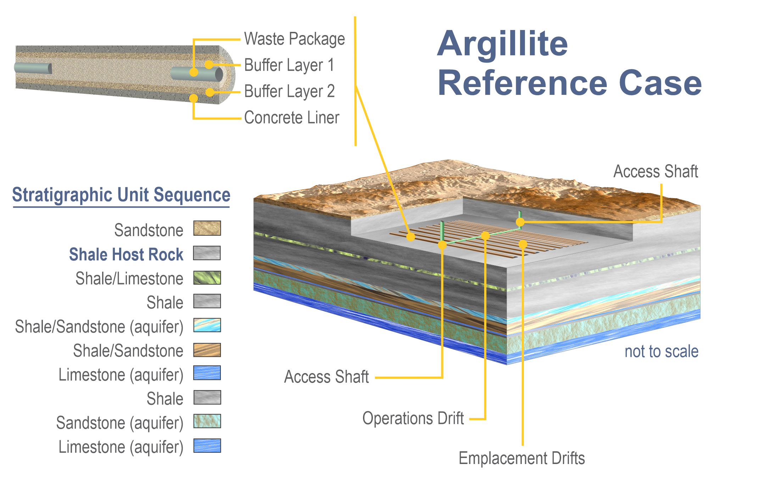
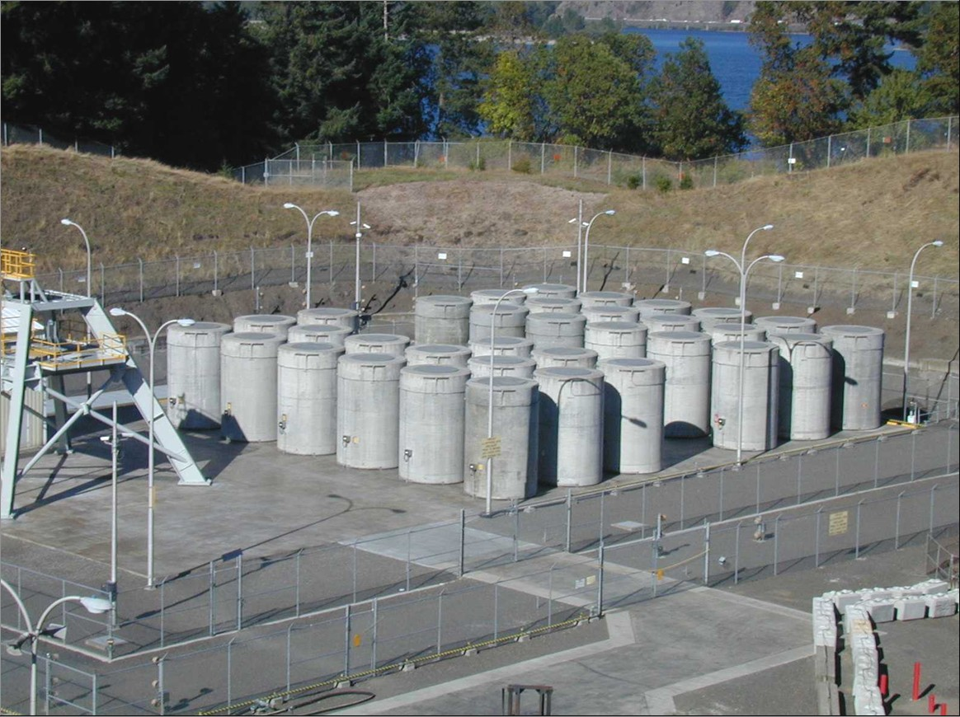
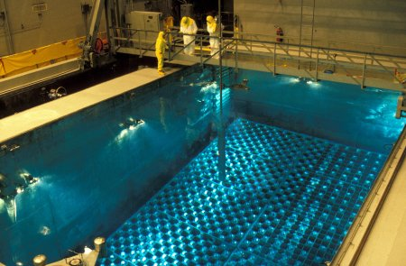
More Spent Nuclear Fuel in Dry Storage
Storage Projections (2 models)
Nuclear Waste Repository
Today
The US inventory of spent nuclear fuel is rapidly increasing
Moving from pool storage to dry storage
Dry
Pool
[1] Adapted from Freeze et al. (2021, Figure 2-3)
Notes:
MTHM: Metric tons of heavy metal (mostly uranium)
CSFP and NGSAM (Next Generation System Analysis Model) are models with sets of assumptions that extrapolate the US CSNF till 2080.

Slide 6
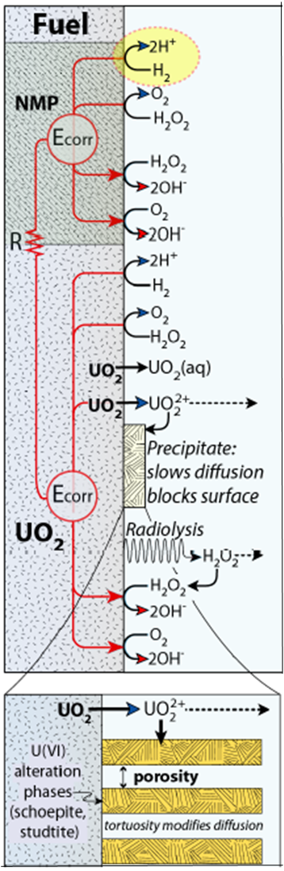
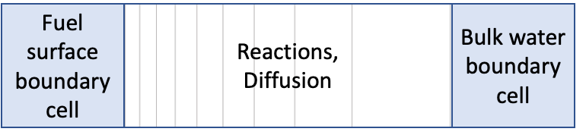
Fuel Matrix Degradation Model (FMDM)
1-dimensional reactive transport model of a waste package
Needed for each breached package in the repository at each time point
Computationally intensive to calculate UO₂ degradation rates
Surrogate models map inputs to outputs with less computational cost
[2] Adapted from Jerden et al. (2015)

Slide 7
Training Data

Slide 8
Sampling Input Parameters
Parameter | Distribution | Min. | Max.
Init. Temp. (K) | Uniform | 300 | 600
Burnup (Gwd/MTU) | Uniform | 40 | 80
Delay Time (years) | Log-uniform | 10² | 10⁴
Env. CO₃^{2‑} (mol/m³) | Log-uniform | 10⁻³ | 2x10⁻²
Env. O₂ (mol/m³) | Log-uniform | 10⁻⁷ | 10⁻⁵
Env. Fe²⁺ (mol/m³) | Log-uniform | 10⁻³ | 10⁻²
Env. H₂ (mol/m³) | Log-uniform | 10⁻⁵ | 2x10⁻²
Process model input parameters sampled from expected ranges in reservoir simulations to generate training data time-trajectories
Ranges that span multiple orders of magnitude sampled with log-uniform distribution
Parameters are externally-imposed

Slide 9
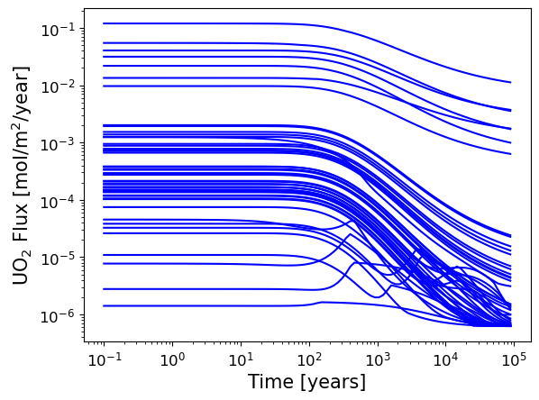
Surrogate Inputs and Outputs
Environmental CO₃^{2‑} and H₂
Temperature
Dose rate (function of time and burnup)
UO₂ Degradation (Surface Flux)

Slide 10
Neural ODEs
Methods

Slide 11
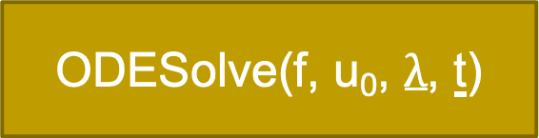
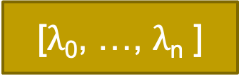
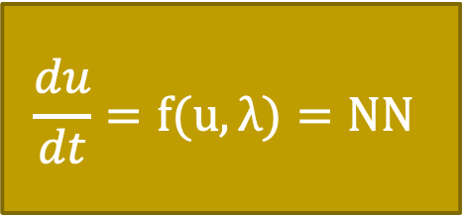
Neural ODEs Background
$$\frac{du}{dt}=f(u, λ)=NN$$
[$λ$₀, …, $λ$_{n} ]
u₀
[t₀, …, t_{n} ]
ODESolve(f, u₀, $λ$, t)
Neural ODEs approximate the derivative of the system state as a Neural Network
Predict with ODE Solver
[u₀, …, u_{n} ]
[3] “Neural Ordinary Differential Equations”, Chen et al.

Slide 12
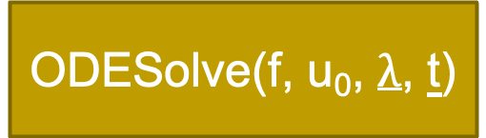
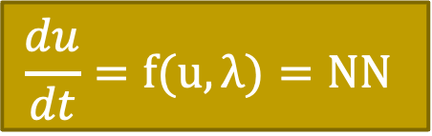
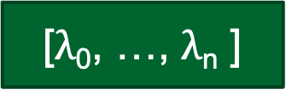
Training Process and Hyperparameters
Select random points from a trajectory to serve as batch initial conditions
Hyperparameters to tune:
  Learning rate
  Number of layers
  Number of neurons per layer
  Number of batches (batch_size)
  Number of time steps to predict/integrate during training (batch_time)
  Amount of training data
  Number of time points to use from training data
  Choice of numerical ODE solver
[$λ$₀, …, $λ$_{n} ]
u₀
[t₀, …, t_{n} ]
ODESolve(f, u₀, $λ$, t)
$$\frac{du}{dt}=f(u, λ)=NN$$
Optimizer
[u₀, …, u_{n} ]
Loss
[u^{true}₀, …, u^{true}_{n} ]

Slide 13
Neural ODEs
Logistic Decay Toy Problem

Slide 14
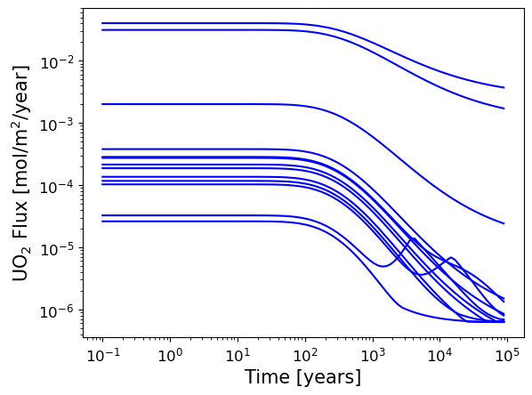
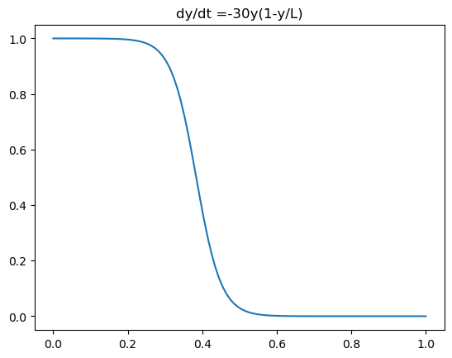
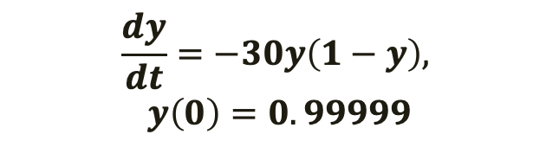
Simplify Problem-Solving with Logistic Decay ODE
Logistic Decay ODE with precise initial conditions mimics plateau-and-decay shape of UO₂ flux trajectories but has known dynamics and no parameter dependence
y (t)
t
$$\frac{dy}{dt}=−30y\left(1−y\right),$$
$$y\left(0\right)=0.99999$$
UO₂ Flux

Slide 15
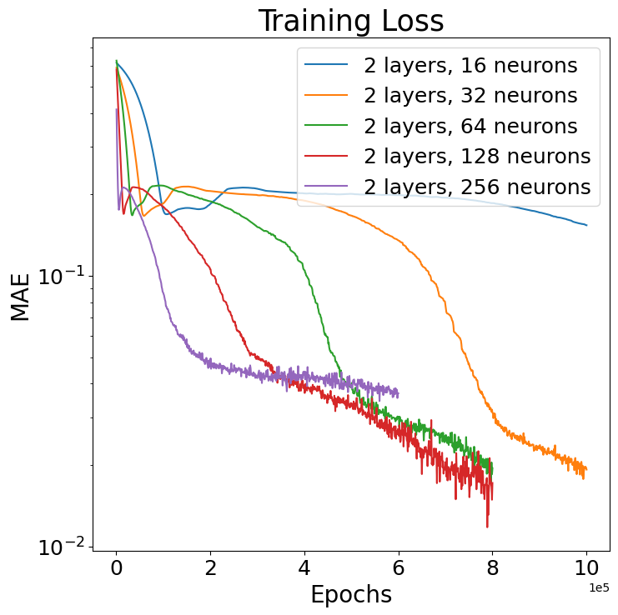
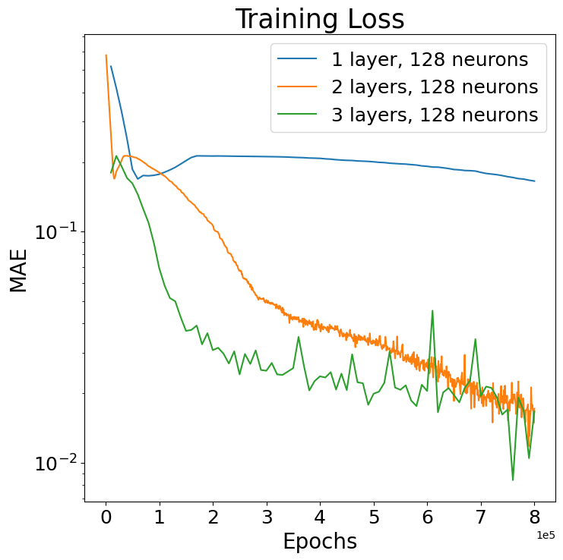
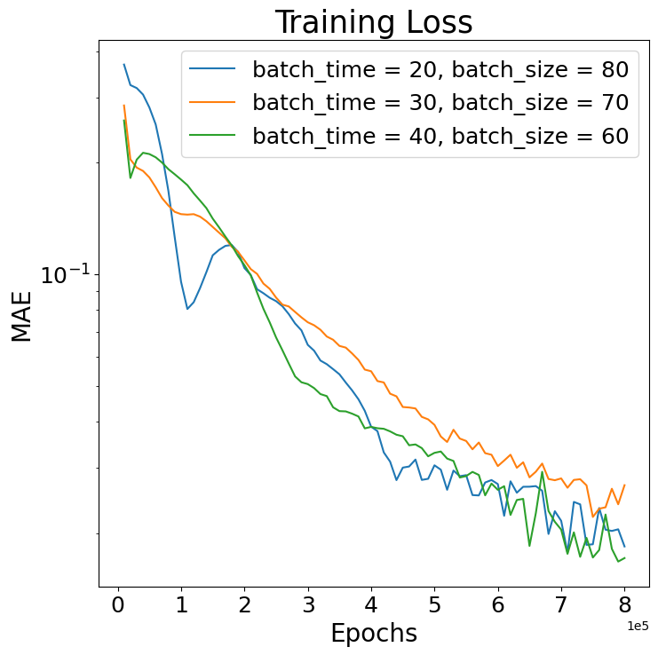
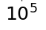
Experiments with Logistic Decay
Dopri5 has best balance of speed and accuracy in torchdiffeq.odeint solvers (with NRMSE = 9.4490e-05 when solving the true RHS of the ODE)
Precision of the problem requires a learning rate of 1e-6
Lowest training loss with 2 layers, 128 neurons, batch_time 20, and batch_size 80
batch_time = 40, batch_size = 60
batch_time = 40, batch_size = 60
2 layers, 128 neurons/layer

Slide 16
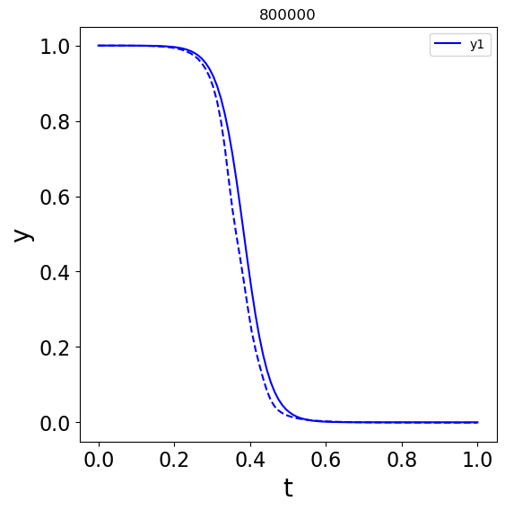
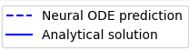
Logistic Decay Results
Neural ODEs have difficulty learning a trajectory with an initial plateau
Very sensitive to initial conditions
For the best set of hyperparameters, training NRMSE = 0.08323 after 1.2M epochs

Slide 17
Neural ODEs
FMD Application

Slide 18
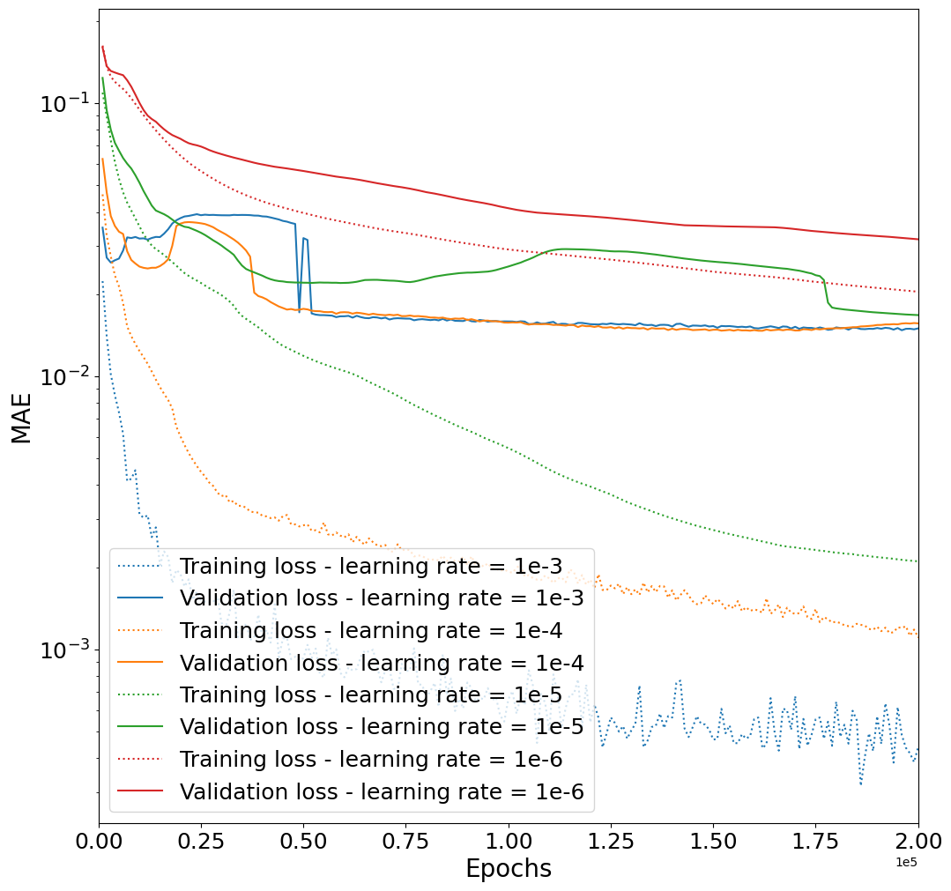
Hyperparameter Tuning: Learning Rate
For preliminary tests, we use
  torchdiffeq.dopri5 solver
  100 trajectories (80 training/ 20 validation)
  100 time steps
  Batch_time = 20
  Batch_size = 80
  2 layers, 128 neurons
A learning rate of 1e-4 is a good balance of speed, accuracy, and stability

Slide 19
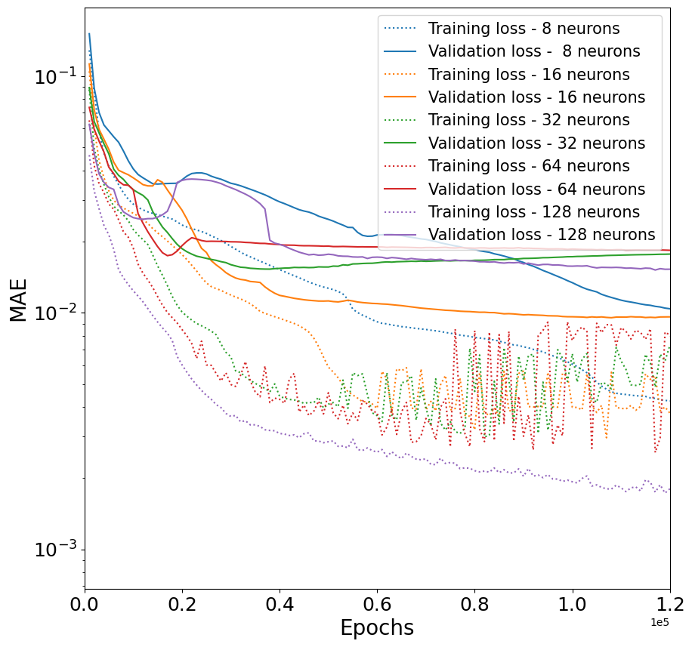
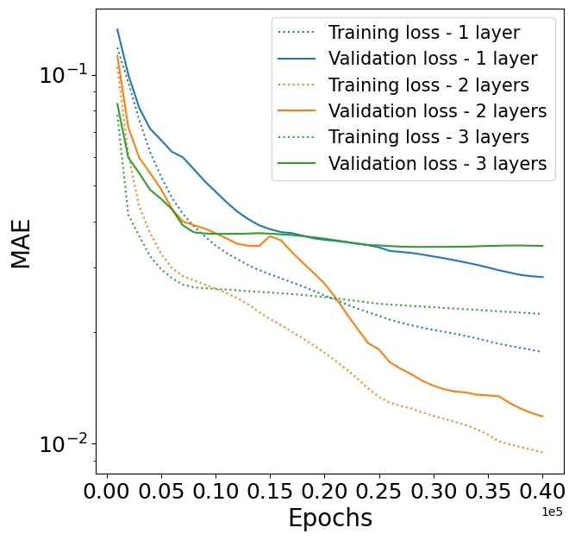
Hyperparameter Tuning: Neurons and Layers
16 neurons
An architecture of 16 neurons and 2 layers has the lowest validation loss
Learning rate = 1e-4

Slide 20
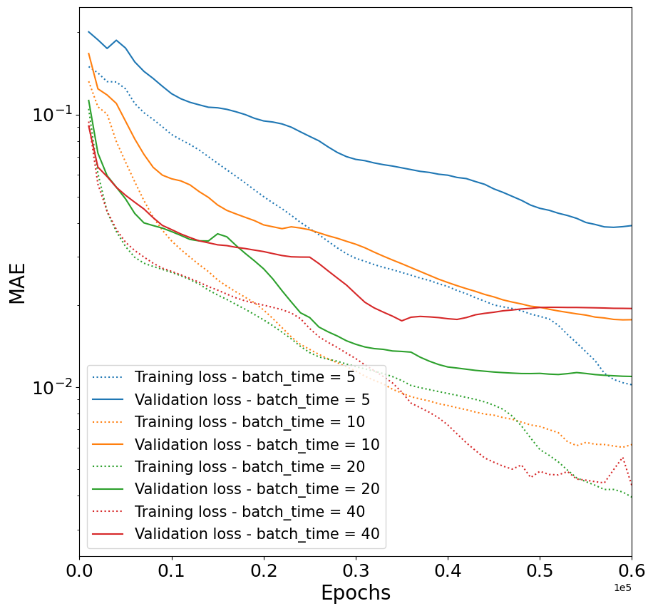
Hyperparameter Tuning: batch_time
Batch_time = 20 yields the lowest validation loss
Note: For each batch_time, batch_size = # time steps – batch_time

Slide 21
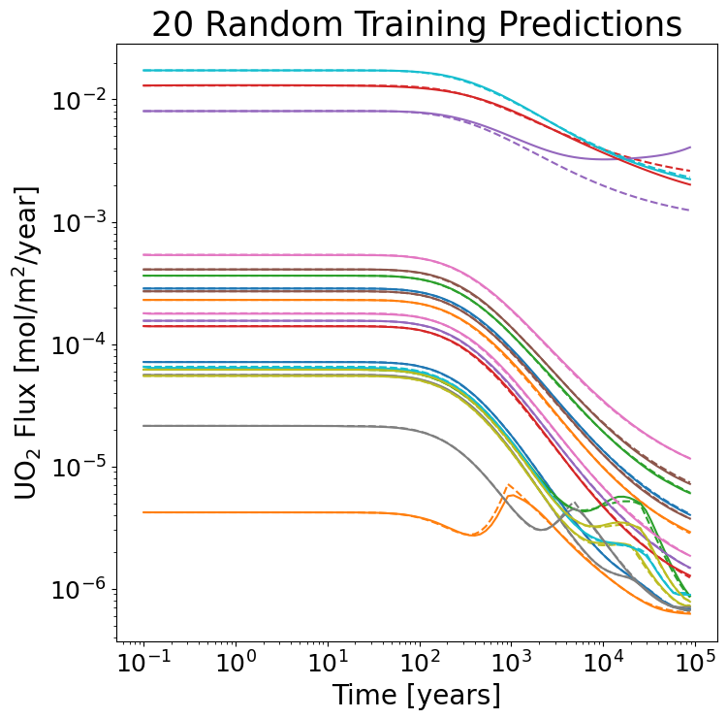
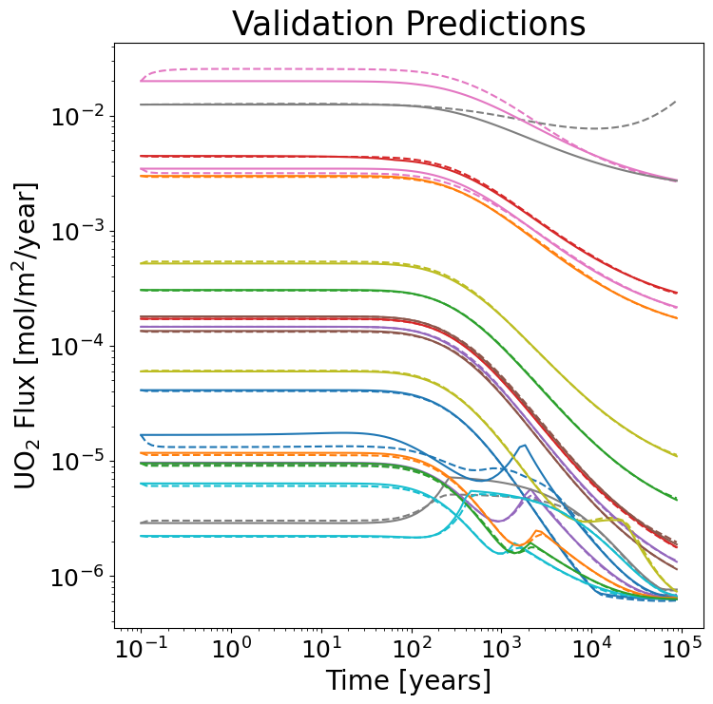
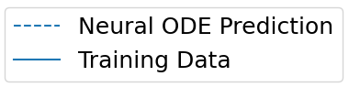
Prediction of FMD Validation Data from Initial Flux
MAE = 0.0072875 NRMSE = 0.066859
MAE = 0.0095912 NRMSE = 0.23046

Slide 22
Conclusions and Future Work

Slide 23
Conclusions and Ongoing Work
Choosing an accurate ODE solver and a large enough batch_time are crucial for learning the timing of the slope transition.
Training requires over 100,000 epochs and may involve local minima in the loss.
Neural ODEs have shown the ability to learn the dynamics of the FMDM data and predict a time trajectory from its initial condition, and therefore, have potential as a surrogate.
Ongoing Work
  Further Hyperparameter tuning of
    Number of trajectories of training data
    Number of time steps in training data
    Choice of numerical solver
  Cross-validation for hyperparameter tuning
  Evaluation on testing data

Slide 24
References
Freeze, G., E.J. Bonano, P. Swift, E. Kalinina, E. Hardin, L. Price, S. Durbin, R. Rechard, and K. Gupta, “Integration of the Back End of the Nuclear Fuel Cycle.” SAND2021-10444. Sandia National Laboratories, Albuquerque, New Mexico (2021)
J. Jerden, K. Frey, and W. Ebert, “A Multiphase Interfacial Model for the Dissolution of Spent Nuclear Fuel,” Journal of Nuclear Materials, 462, 135, https://doi.org/10.1016/j.jnucmat.2015.03.036 (2015)
Chen, Ricky T. Q., Yulia Rubanova, Jesse Bettencourt, and David K. Duvenaud, “Neural Oridinary Differential Equations.” Advances in Neural Information Processing Systems 31 (2018).
J. Harvey et al.: Development of an Efficient Version of the Fuel Matrix Degradation Model, IHLRWM 22 (2022)

Slide 25
Additional Materials

Slide 26
The Fuel Matrix Degradation (FMD) process model computes the degradation rate of spent nuclear fuel
1D reactive-transport model (diffusion only)
Chemical (slow) and oxidative (fast) dissolution of UO₂ matrix
Hydrogen peroxide production via alpha-radiolysis
Precipitation and dissolution of U(VI) (i.e., schoepite) corrosion layer at the fuel surface
Arrhenius temperature dependence
Complexation of uranium with carbonates
Hydrogen as an oxidation sink (focused on fuel interface)
Logarithmic spatial discretization for enhanced accuracy near the solid interfaces
[4] J. Harvey et al. 2022

Slide 27
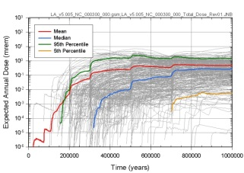
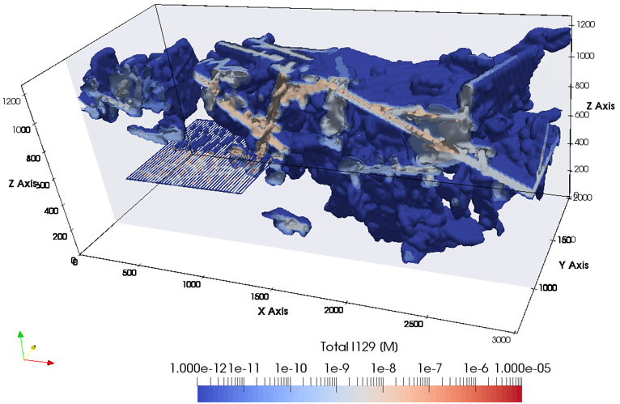







Surrogate FMD models can alleviate cost of UO₂ flux computation in probabilistic repository assessments
Input Parameters
Computational Support
Results
Uncertainty Sampling and Sensitivity Analysis
Processing
Visualization
Parameter database
Fuel Matrix Degradation Model (FMDM)
Offline, MATLAB
Multi-Physics Simulation and Integration
PFLOTRAN
Source Term and Engineered Barrier System Evolution Model
Inventory
Decay, ingrowth
Waste form degradation
Waste package degradation
Radionuclide release
Thermal, mechanical
Gas generation
Flow and Transport Model
Advection, diffusion, dispersion
Discrete fracture networks
Multiphase flow
Sorption, solubility, colloids
Isotope partitioning
Decay, ingrowth
Thermal effects
Chemical reactions
Models
FMDM Surrogates:
PFLOTRAN Coupled
HPC Speed and Scale
Fortran
Biosphere Model
Exposure pathways
Uptake/ transfer
Dose calculations
Notes:
Each repository simulation: > 750 core hours (1.5 hours on 512 cores), and we need 1000s of runs
Surrogate models provide a mapping between the relevant model input parameters and its outputs that are much cheaper to evaluate than the original, full model.

Slide 28
Model inputs that do not impact the fuel degradation rate much can be dropped
Correlation between fuel degradation rate and O₂, Fe²⁺ is very small

Slide 29
Data conditioning improves the quality of the training data
Remove FMD process model runs that are physically unrealistic
  Runs that do not finish
  Runs that stagnate at late time
  Runs with Corrosion Layer Thicknesses that exceed physical domain size
  Runs with UO₂ (aq) over 2 times the solubility concentration
Log-transform data
Scale between -1 and 1
Notes:
LS: explain top two figures: t-SNE (Stochastic Neighbor Embedding) of the inputs corresponding to 1500 points of the training data. t-SNE does a mapping from high D to 2D such that points that close in high D space are also close by in 2D space. And points that are far away in high D space are also far away from each other in 2D space. Left: full FMD process model run trajectories. Right: 1 point randomly chosen from 1500 runs. Without downsampling, the data is too clustered and kNNr struggles to pick points from a range of input conditions.

Slide 30
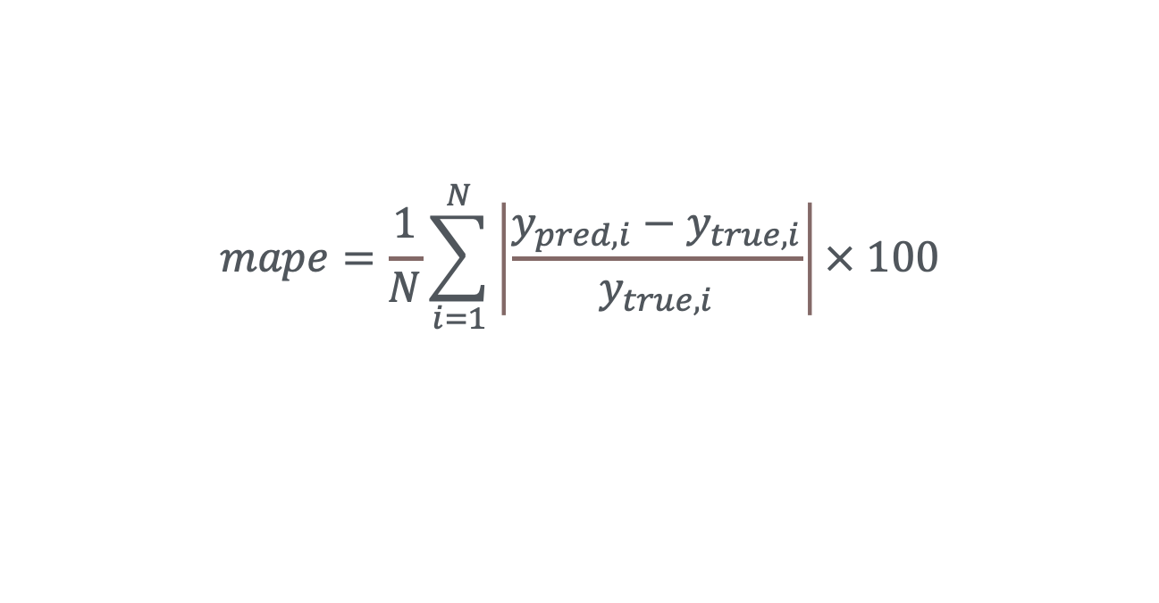
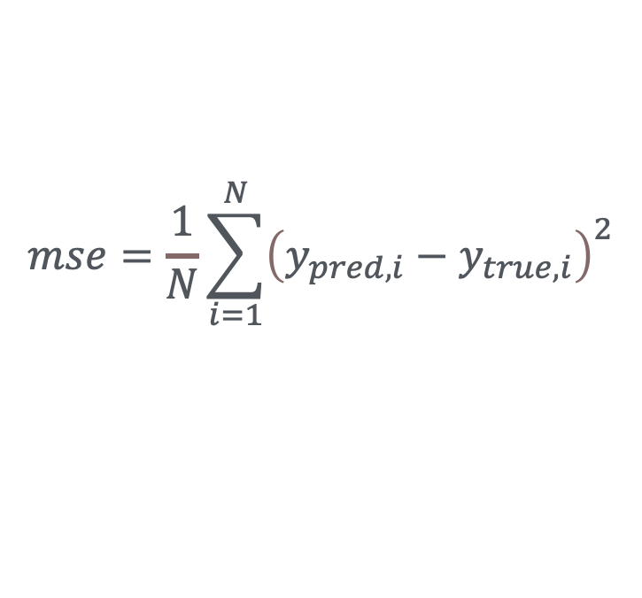
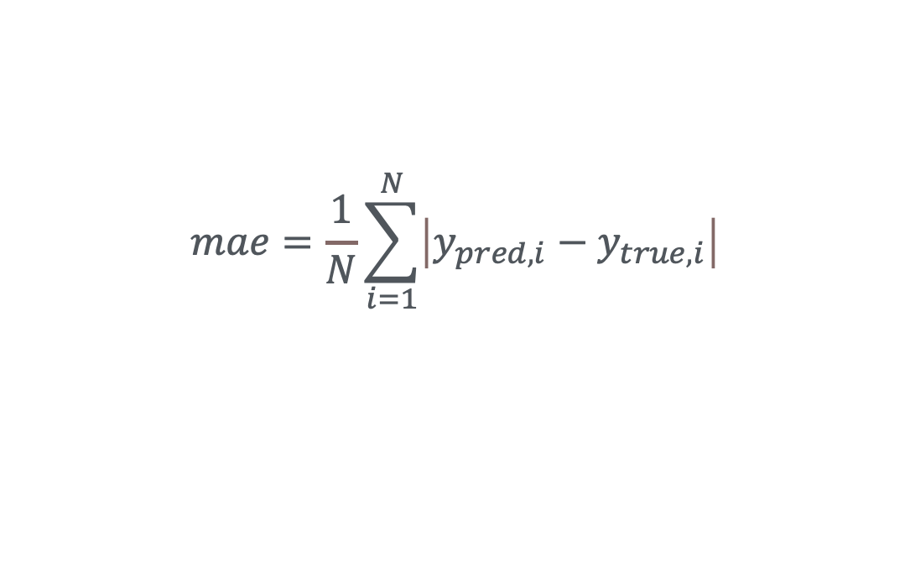
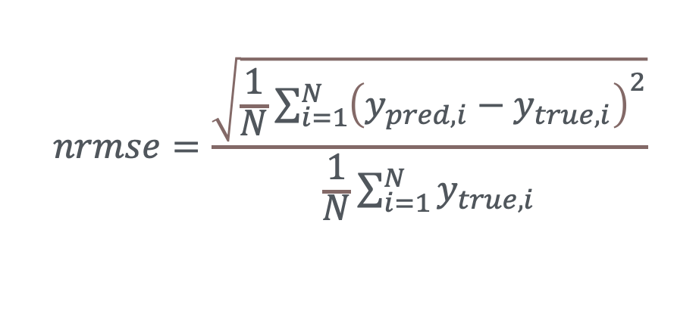
A variety of metrics evaluate different elements of the surrogate model accuracy
(Normalized Root) Mean Squared Error
  Good metric for engineering purposes
Mean Absolute Percentage Error
  Highlights errors in small values
Mean Absolute Error
  Not as sensitive to outliers
$$nrmse=\frac{\sqrt{\frac{1}{N}\sum_{i=1}^{N}{{\left(y_{pred,i}−y_{true,i}\right)}^{2}}}}{\frac{1}{N}\sum_{i=1}^{N}{y_{true,i}}}$$
$$mse=\frac{1}{N}\sum_{i=1}^{N}{{\left(y_{pred,i}−y_{true,i}\right)}^{2}}$$
$$mape=\frac{1}{N}\sum_{i=1}^{N}{\left|\frac{y_{pred,i}−y_{true,i}}{y_{true,i}}\right|}× 100$$
$$mae=\frac{1}{N}\sum_{i=1}^{N}{\left|y_{pred,i}−y_{true,i}\right|}$$
Notes:
Does nrmse assume y is always positive?

