Slide 1








Designing Large Datasets: Data-Scarce and Stable Deep Generative Models for Turning Sparse Experiments into Big Datasets in Materials Science
Andreas E. Robertson
aerober@sandia.gov
Michael Buzzy, Conlain Kelly, Remi Dingreville, Surya Kalidindi
SAND2024-09646C
Sandia National Laboratories is a multimission laboratory managed and operated by National Technology and Engineering Solutions of Sandia LLC, a wholly owned subsidiary of Honeywell International Inc. for the U.S. Department of Energy’s National Nuclear Security Administration under contract DE-NA0003525

Slide 2
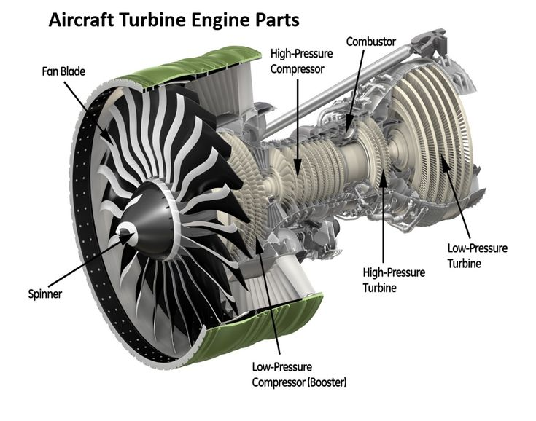
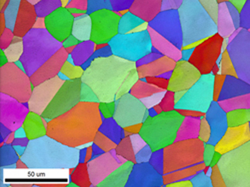
Let us consider the design of a structural material for a turbine…
        We have a set of design requirements: yield behavior, expected fatigue life, stiffness, etc.
Notes:
In Materials Informatics, we aim to advance our capacity to design, discover, and manufacture engineering materials.
As a field, we’ve settled on the PSP paradigm for doing this – which centralizes the importance of microstructure. The properties that define and bound our capacity to do design at the product and component length scale are defined by microstructure.
From this perspective, the study of materials very much becomes a field centralized around this idea representation. Which makes it very compatible with data science.
Over the past four years, I have studied the compatibility: developing latent spaces and representations for materials informatics – challenging because of the low data availability, high dimensionality, and complexity. The technique I have used I refer to as “algorithm hybridization” – basically studying how different paradigms produce their own latent representations and how these tools can be combined together to make up for their weaknesses and highlight their strengths.
I am going to talk about two big ones (statistics and microstructure), then I am going to talk about how we can use these latent representations to solve a application problem (design) and a technical problem (dataset development). Here, we we actual see a third latent space arise – a learned one.

Slide 3
Let us consider the design of a structural material for a turbine…
Which alloying elements?
What grain structure?
How do we manufacture that?
Notes:
In Materials Informatics, we aim to advance our capacity to design, discover, and manufacture engineering materials.
As a field, we’ve settled on the PSP paradigm for doing this – which centralizes the importance of microstructure. The properties that define and bound our capacity to do design at the product and component length scale are defined by microstructure.
From this perspective, the study of materials very much becomes a field centralized around this idea representation. Which makes it very compatible with data science.
Over the past four years, I have studied the compatibility: developing latent spaces and representations for materials informatics – challenging because of the low data availability, high dimensionality, and complexity. The technique I have used I refer to as “algorithm hybridization” – basically studying how different paradigms produce their own latent representations and how these tools can be combined together to make up for their weaknesses and highlight their strengths.
I am going to talk about two big ones (statistics and microstructure), then I am going to talk about how we can use these latent representations to solve a application problem (design) and a technical problem (dataset development). Here, we we actual see a third latent space arise – a learned one.

Slide 4
Answering these requires expensive microstructure data in very high dimensional spaces
Which alloying elements?
What grain structure?
How do we manufacture that?
Notes:
In Materials Informatics, we aim to advance our capacity to design, discover, and manufacture engineering materials.
As a field, we’ve settled on the PSP paradigm for doing this – which centralizes the importance of microstructure. The properties that define and bound our capacity to do design at the product and component length scale are defined by microstructure.
From this perspective, the study of materials very much becomes a field centralized around this idea representation. Which makes it very compatible with data science.
Over the past four years, I have studied the compatibility: developing latent spaces and representations for materials informatics – challenging because of the low data availability, high dimensionality, and complexity. The technique I have used I refer to as “algorithm hybridization” – basically studying how different paradigms produce their own latent representations and how these tools can be combined together to make up for their weaknesses and highlight their strengths.
I am going to talk about two big ones (statistics and microstructure), then I am going to talk about how we can use these latent representations to solve a application problem (design) and a technical problem (dataset development). Here, we we actual see a third latent space arise – a learned one.

Slide 5
What characterizes valuable microstructure datasets?
Value
Volume
Diverse
Reusable

Slide 6


These significant investments are justifiable if they can be reused.
Notes:
In Materials Informatics, we aim to advance our capacity to design, discover, and manufacture engineering materials.
As a field, we’ve settled on the PSP paradigm for doing this – which centralizes the importance of microstructure. The properties that define and bound our capacity to do design at the product and component length scale are defined by microstructure.
From this perspective, the study of materials very much becomes a field centralized around this idea representation. Which makes it very compatible with data science.
Over the past four years, I have studied the compatibility: developing latent spaces and representations for materials informatics – challenging because of the low data availability, high dimensionality, and complexity. The technique I have used I refer to as “algorithm hybridization” – basically studying how different paradigms produce their own latent representations and how these tools can be combined together to make up for their weaknesses and highlight their strengths.
I am going to talk about two big ones (statistics and microstructure), then I am going to talk about how we can use these latent representations to solve a application problem (design) and a technical problem (dataset development). Here, we we actual see a third latent space arise – a learned one.

Slide 7
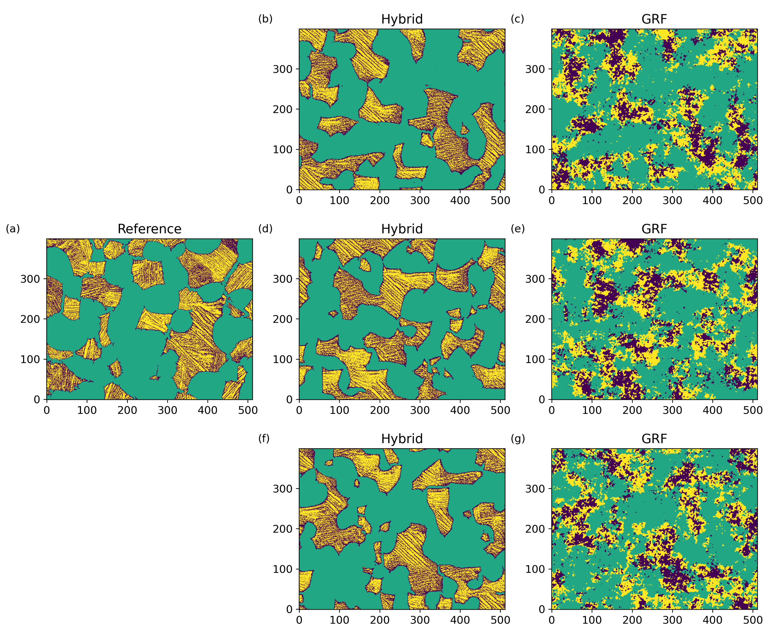

Goal: Generate a statistically diverse microstructure dataset
Challenging to curate:
High dimensionality
Expensive to collect experimentally
Numerical dissimilarity ≠ microstructural dissimilarity
Requires stability (i.e., discovery)
Generated using LGD-Diffusion Models
The microstructure space is not well structured

Slide 8

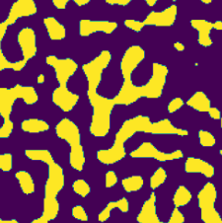
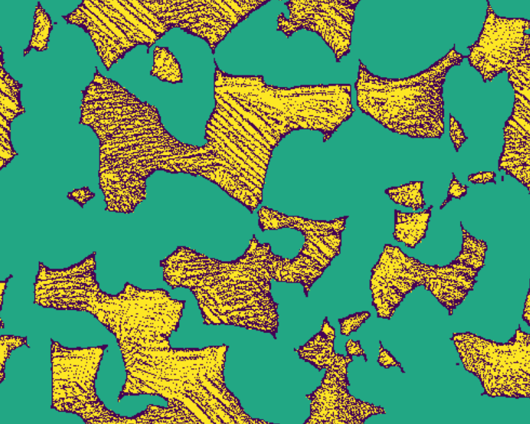
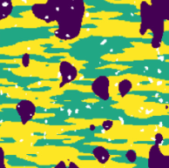
Statistical Latent representations provide the necessary stability and topology.
2-Point Statistics Space
Microstructure Space
Diversity in Statistics signals diversity in Property and Structure

Slide 9
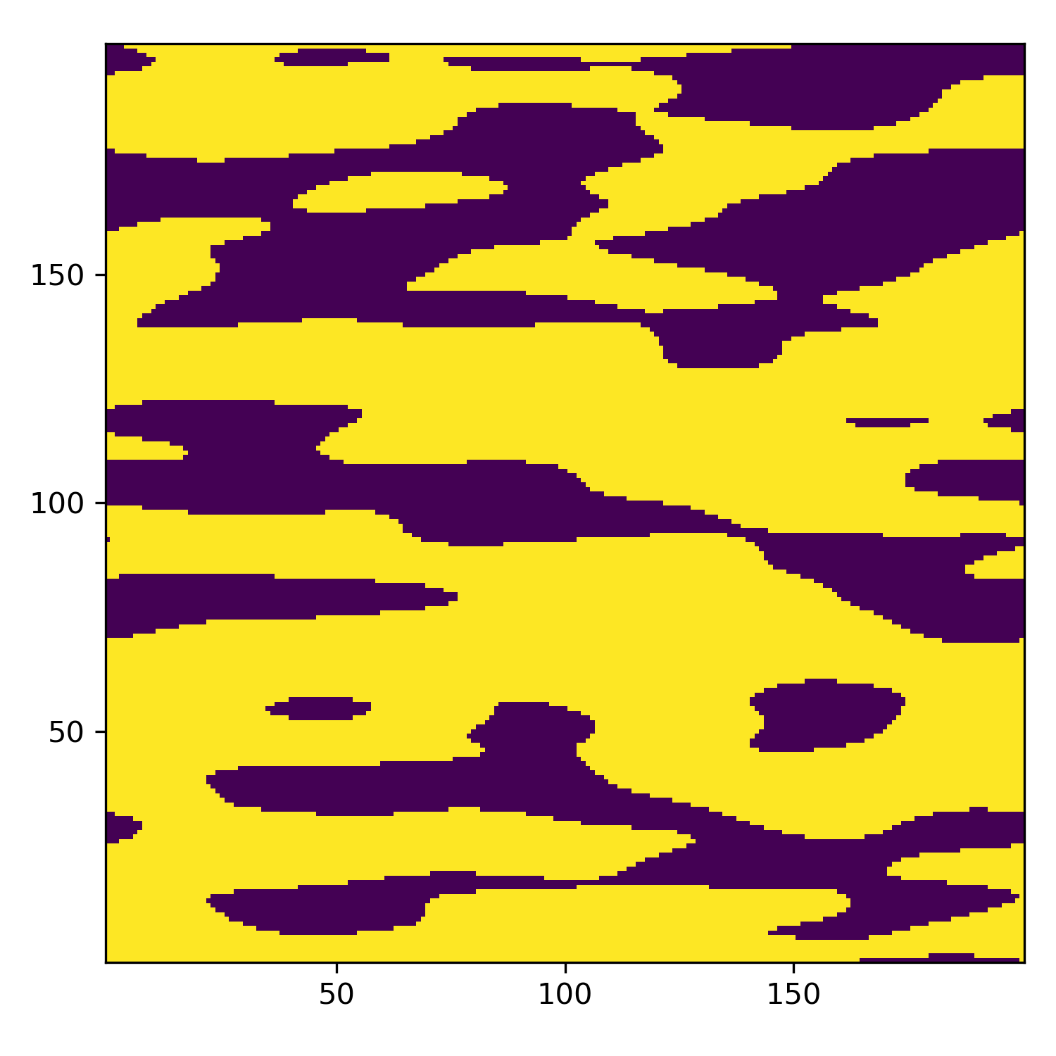
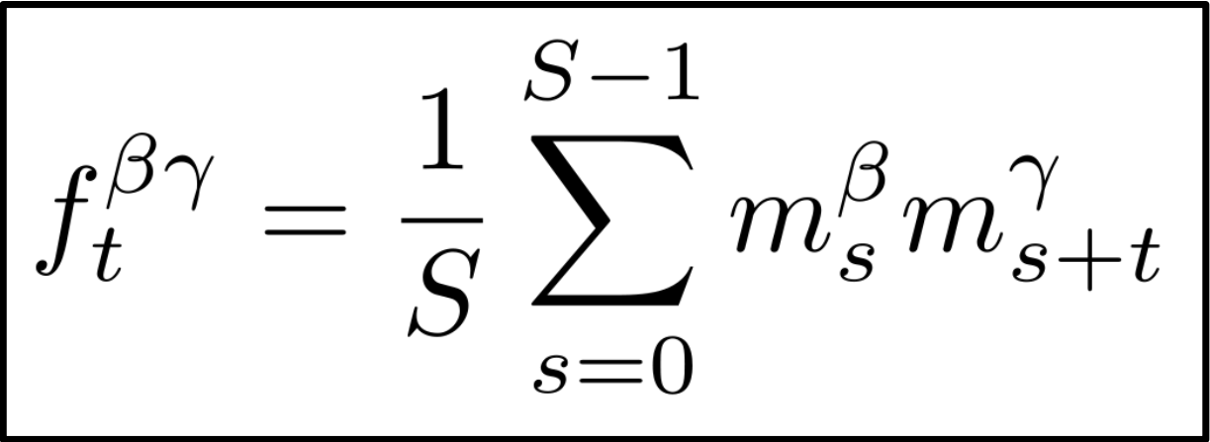
2-Point Spatial Statistics quantify the spatial arrangement of salient microstructure features
2-Phase Microstructure
They are physics-driven descriptors that capture the most important microstructure information with respect to many arbitrary properties

Slide 10
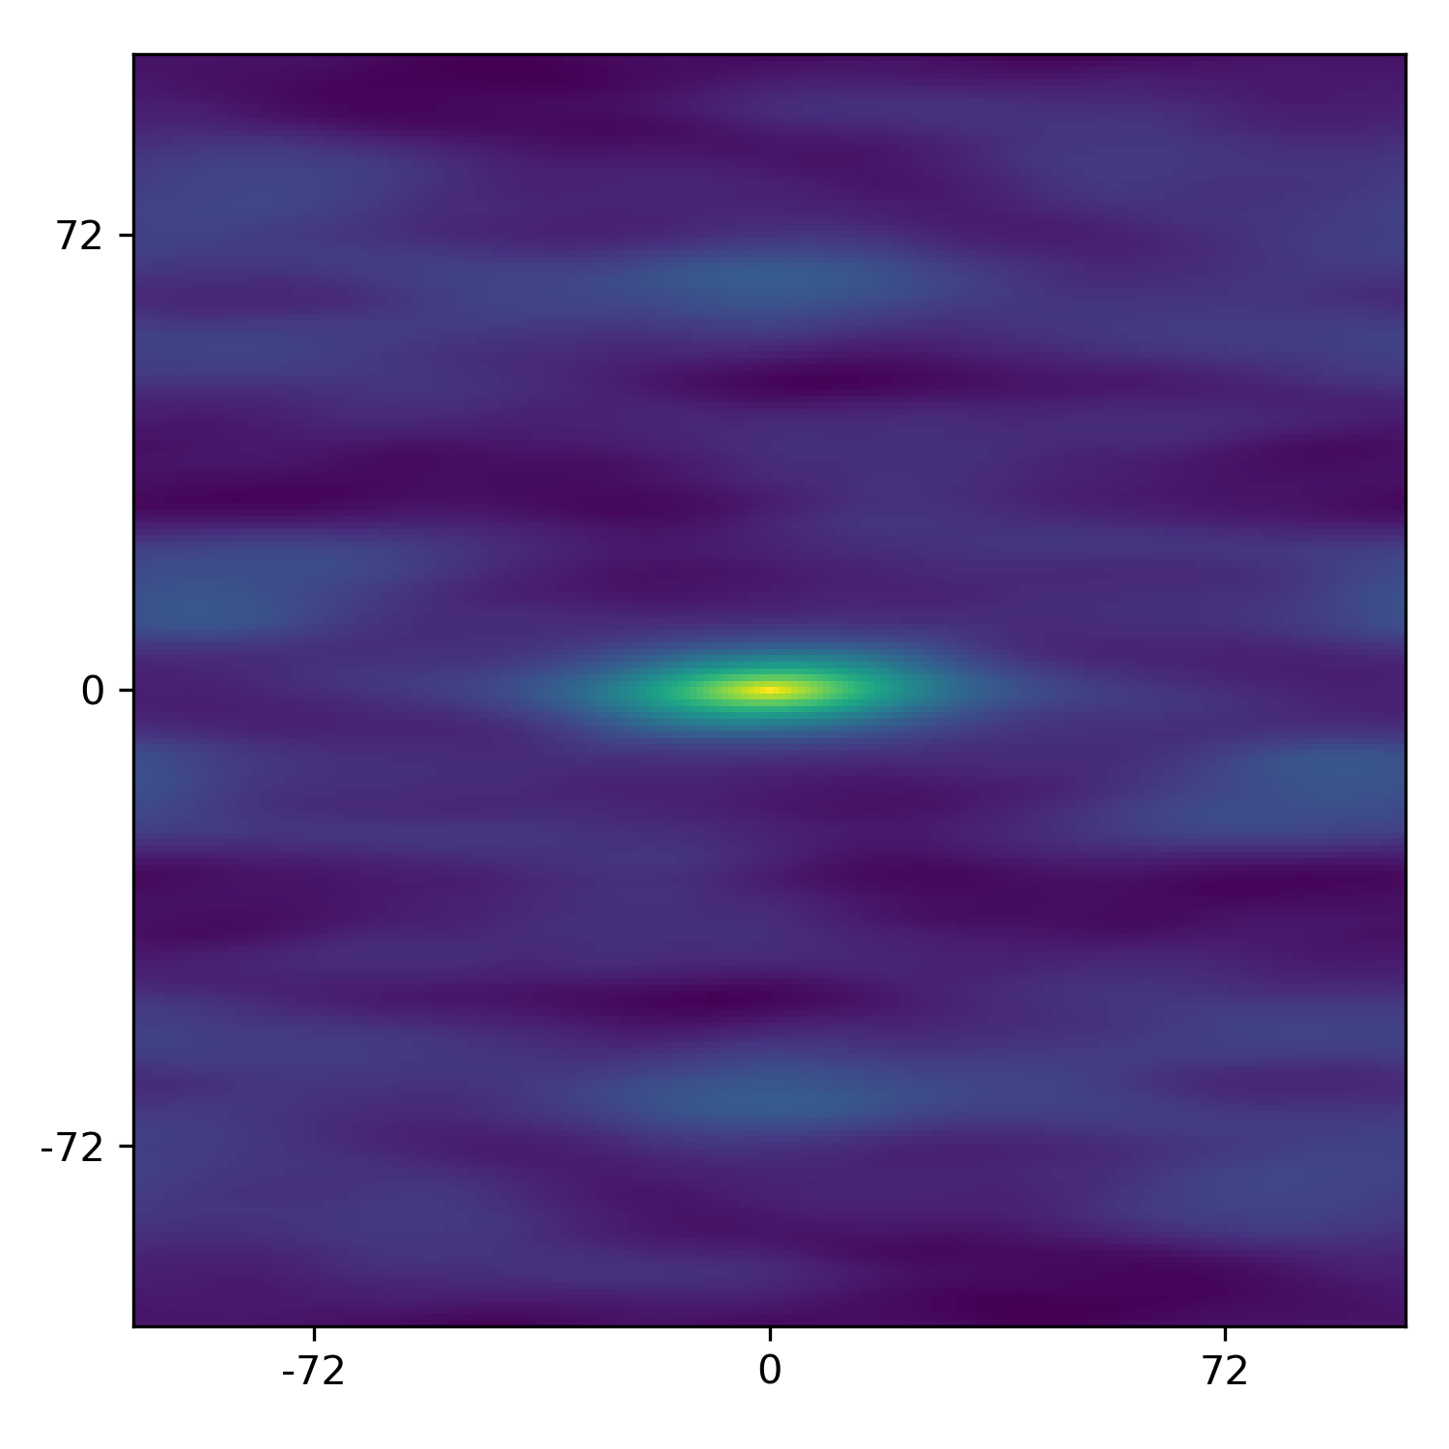
2-Point Spatial Statistics quantify the spatial arrangement of salient microstructure features
2-Phase Microstructure
2-point statistics of Yellow Phase
They are physics-driven descriptors that capture the most important microstructure information with respect to many arbitrary properties

Slide 11
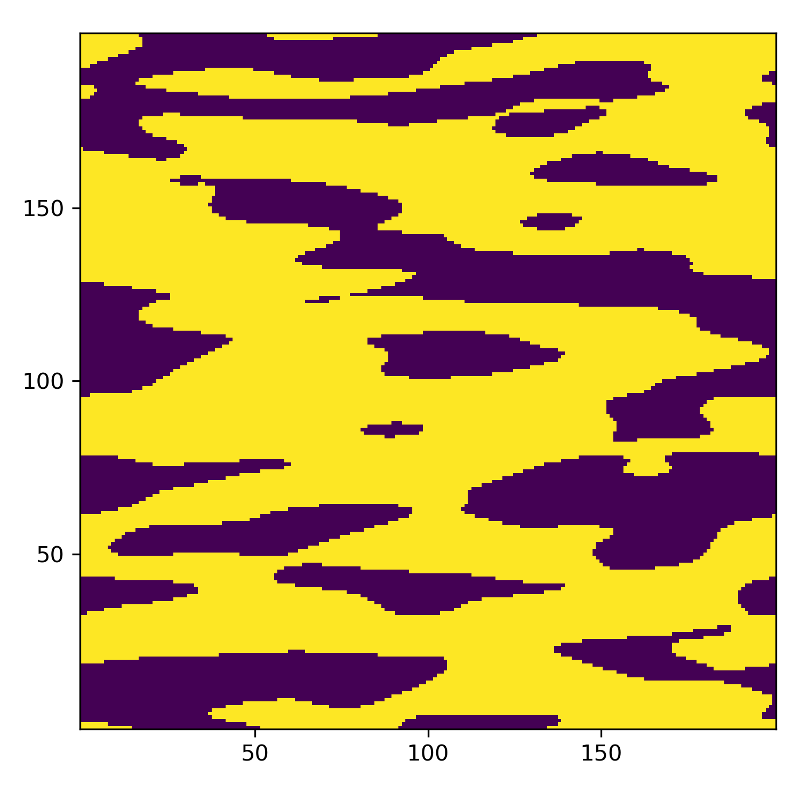
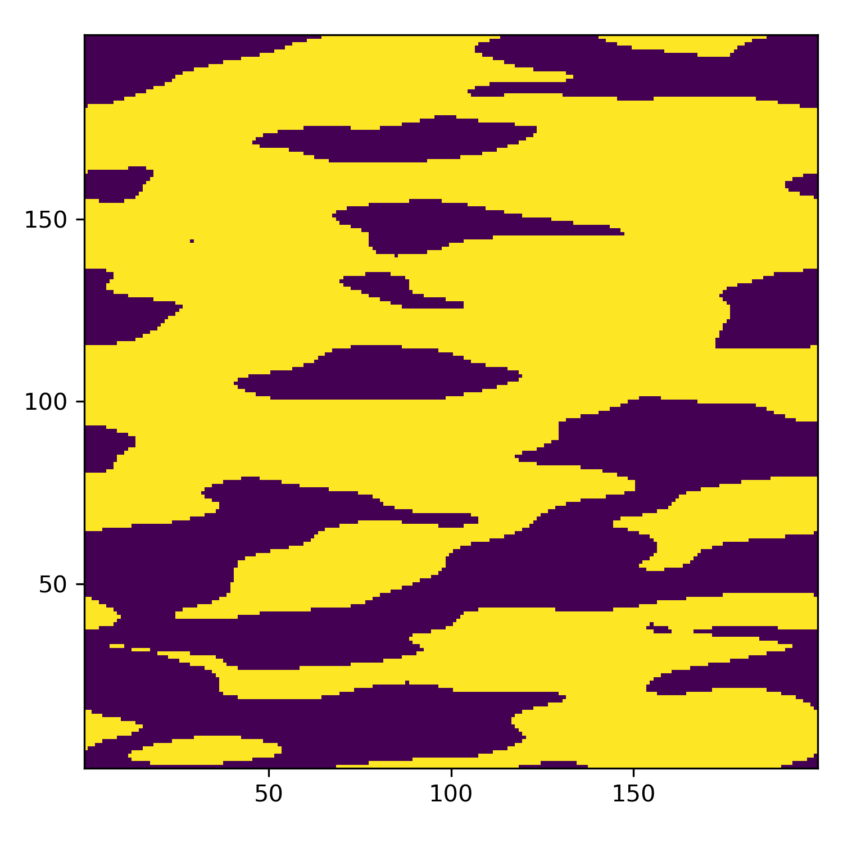
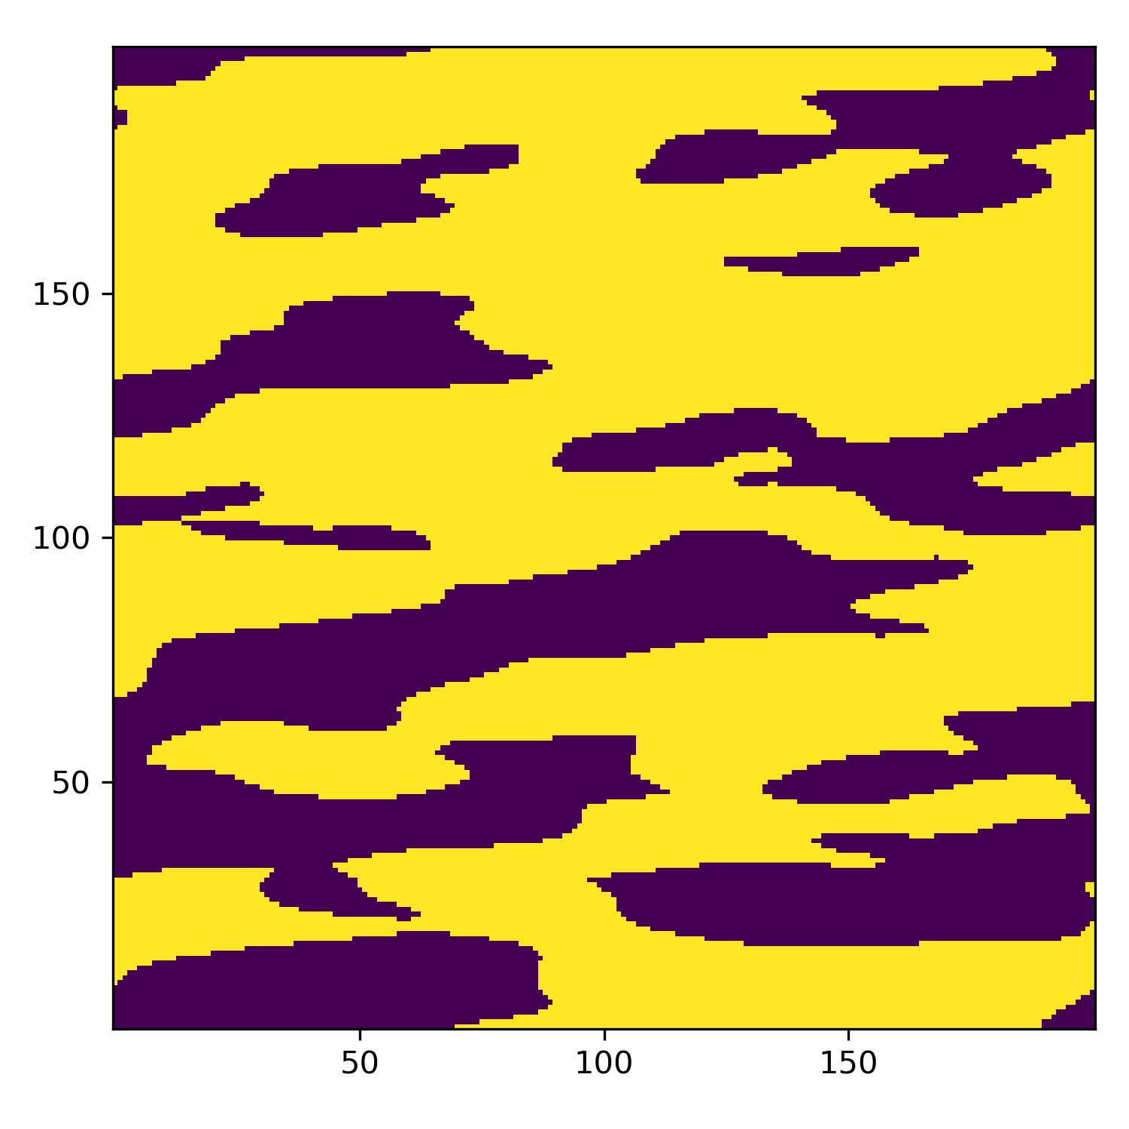
2-Point Spatial Statistics quantify the spatial arrangement of salient microstructure features
2-point statistics of Yellow Phase
They are physics-driven descriptors that capture the most important microstructure information with respect to many arbitrary properties

Slide 12
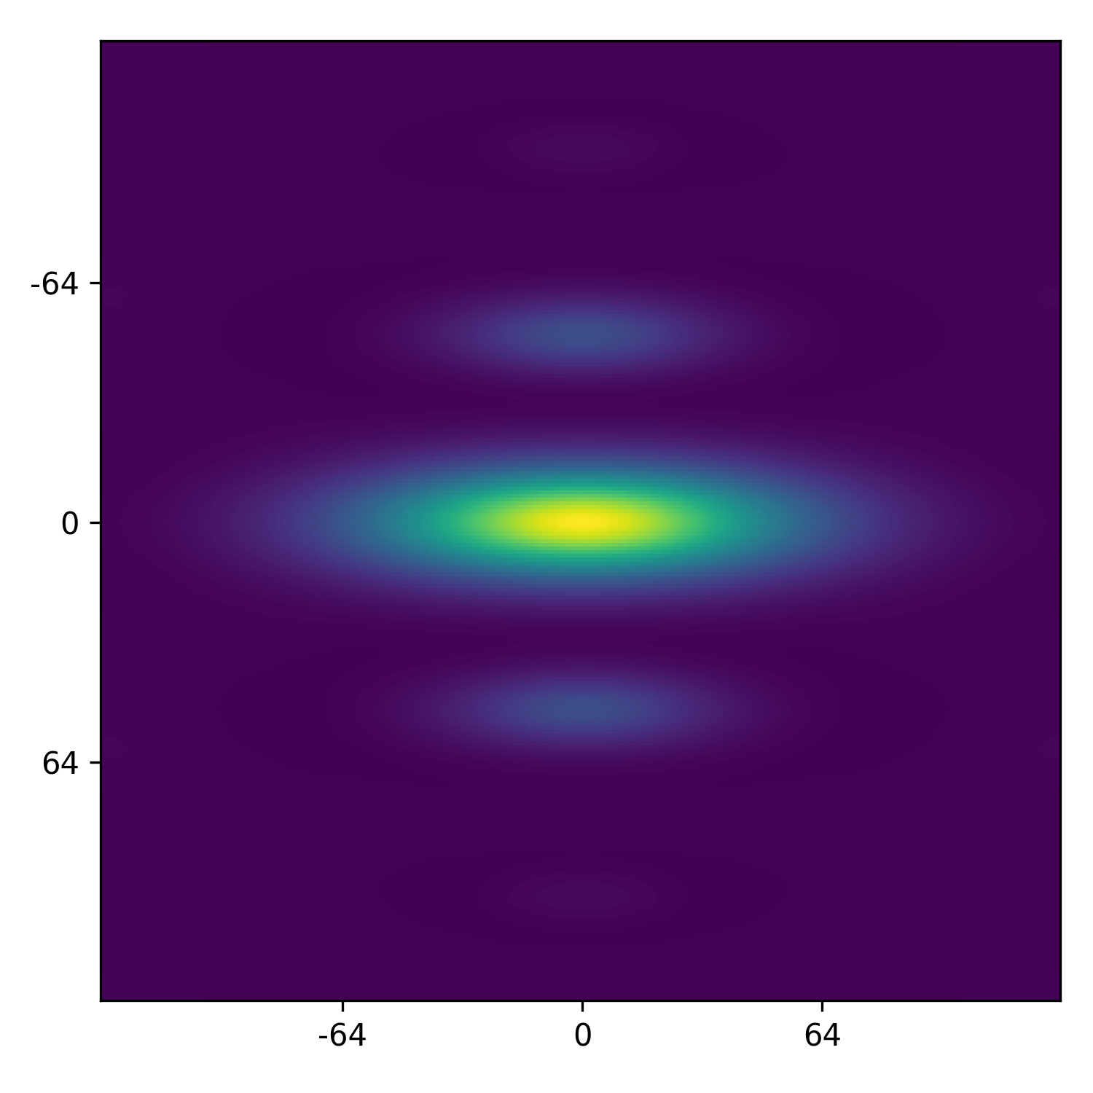
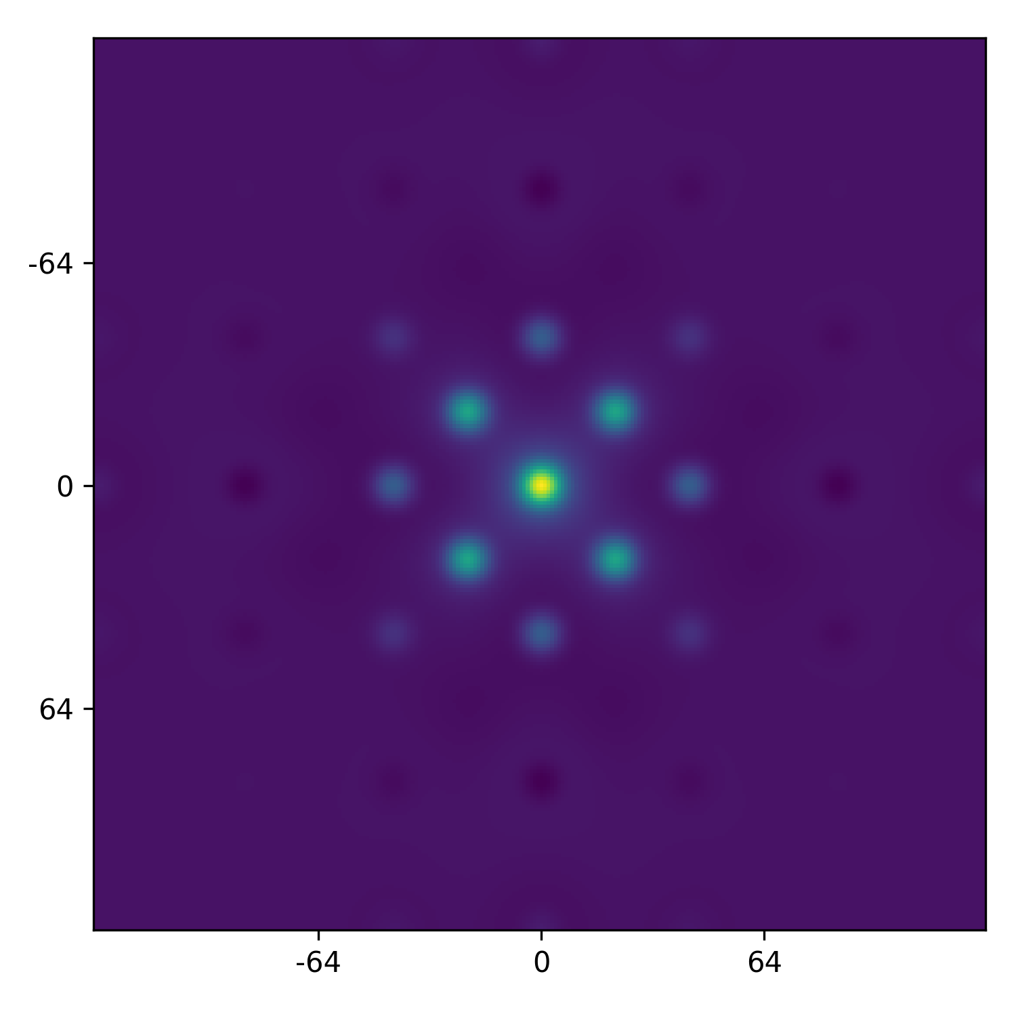
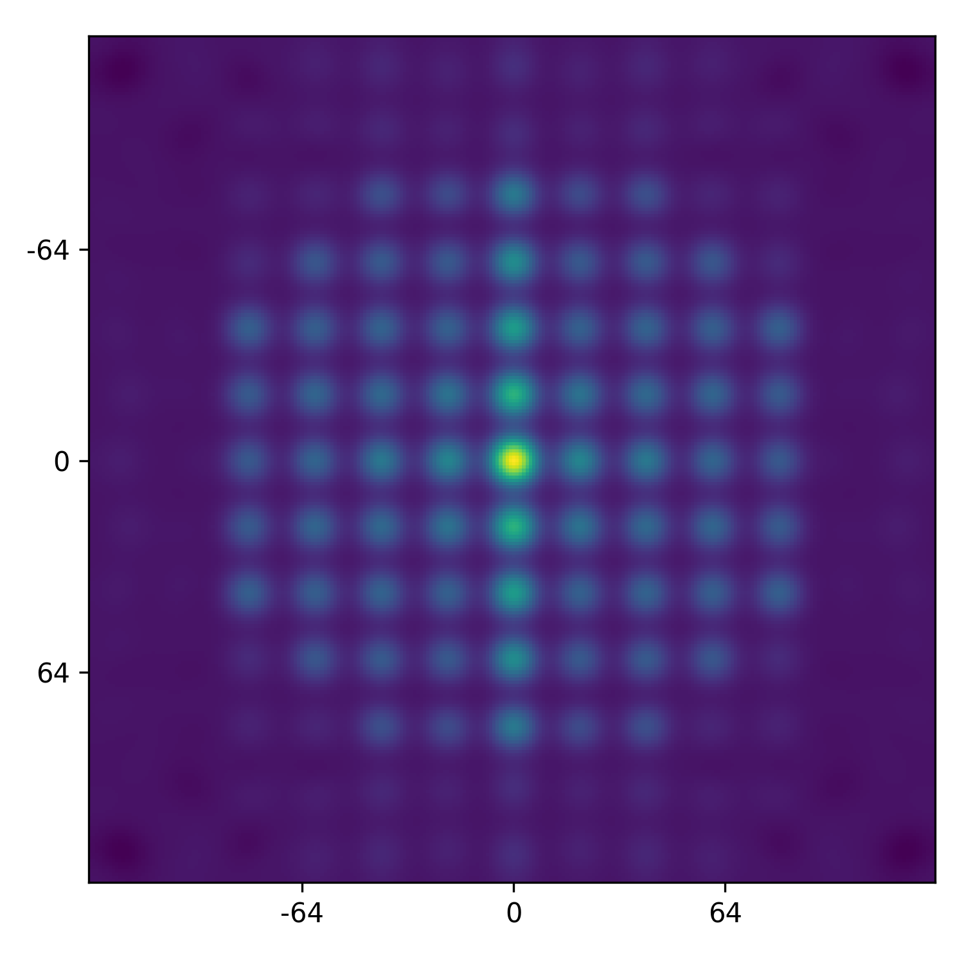
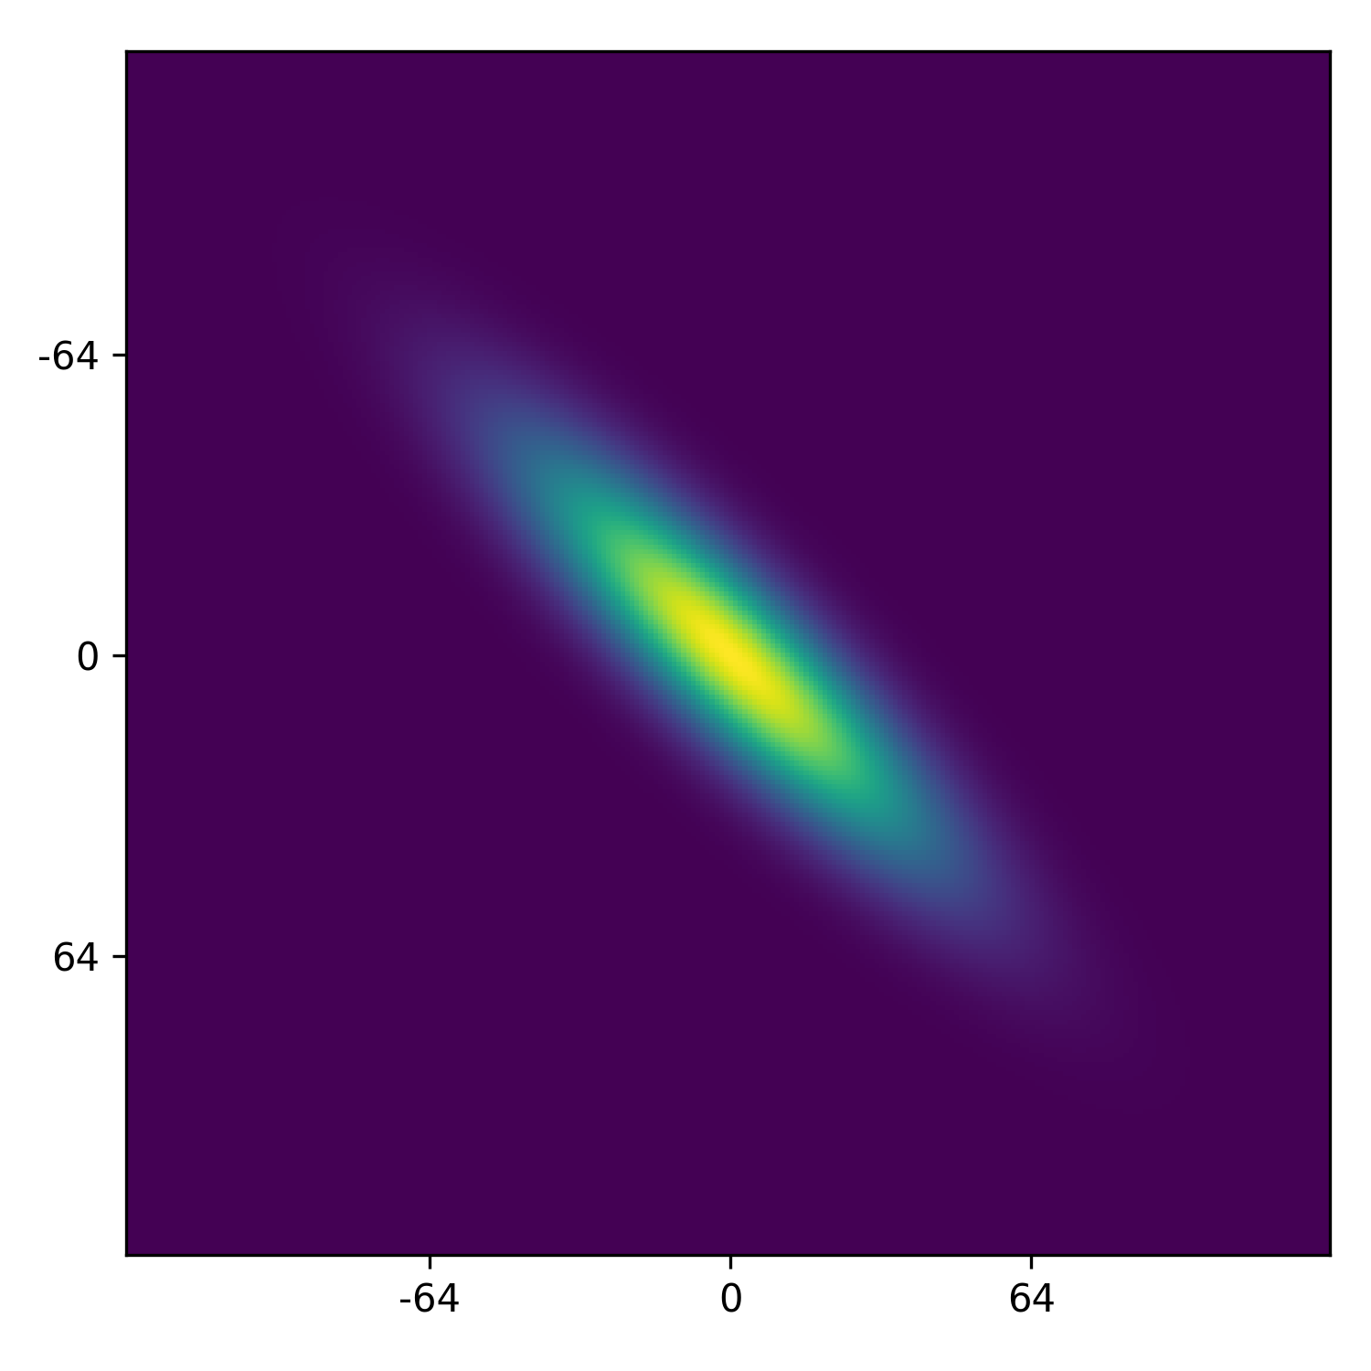
Proposed Solution: Create an intermediate dataset in the space of statistics…
Sample space of 2-Point Statistics
2-Point Statistics Space
Synthesize 2-point statistics
Filtering

Slide 13
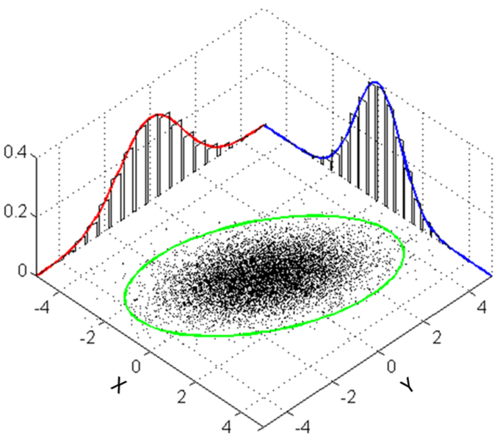
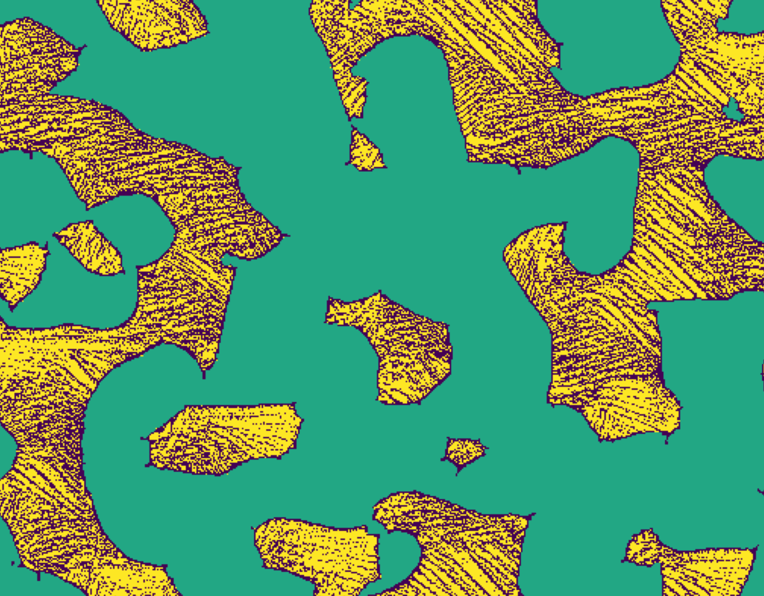
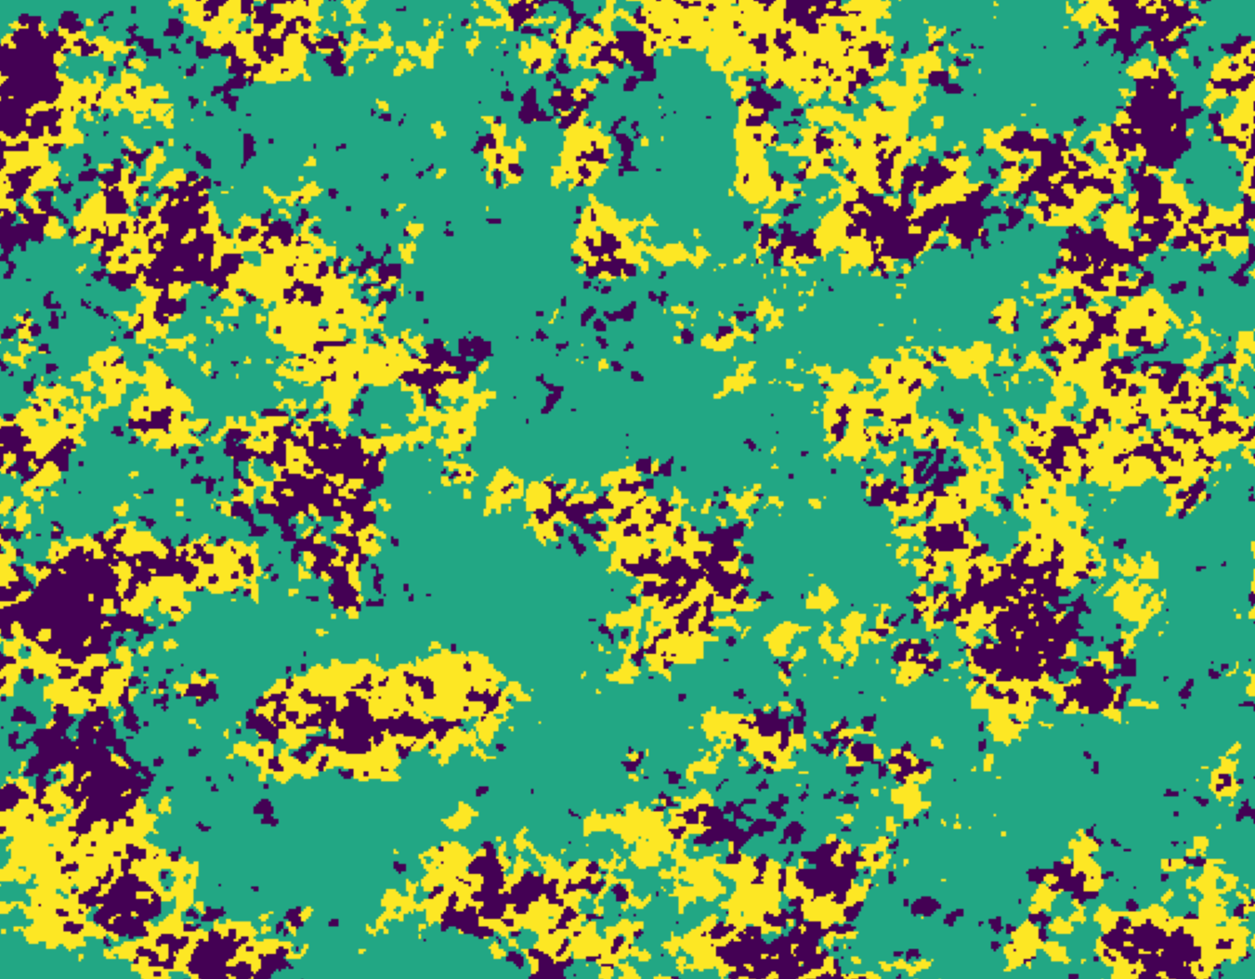
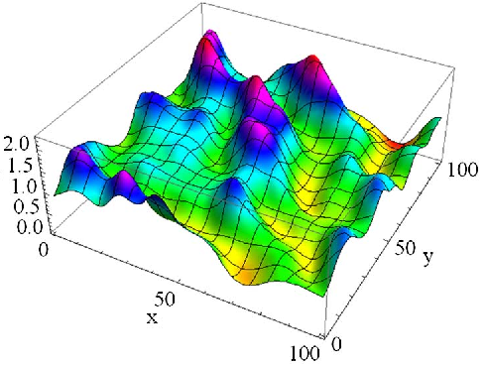
Proposed Solution: … then, generate a microstructure dataset
Sample space of 2-Point Statistics
2-Point Statistics Space
Synthesize 2-point statistics
Filtering
Local-Global Generative models to Synthesize Microstructures from statistics
Global Gaussian Random Field
Local Neighborhood Denoising
i^{th} pixel
j^{th} pixel

Slide 14
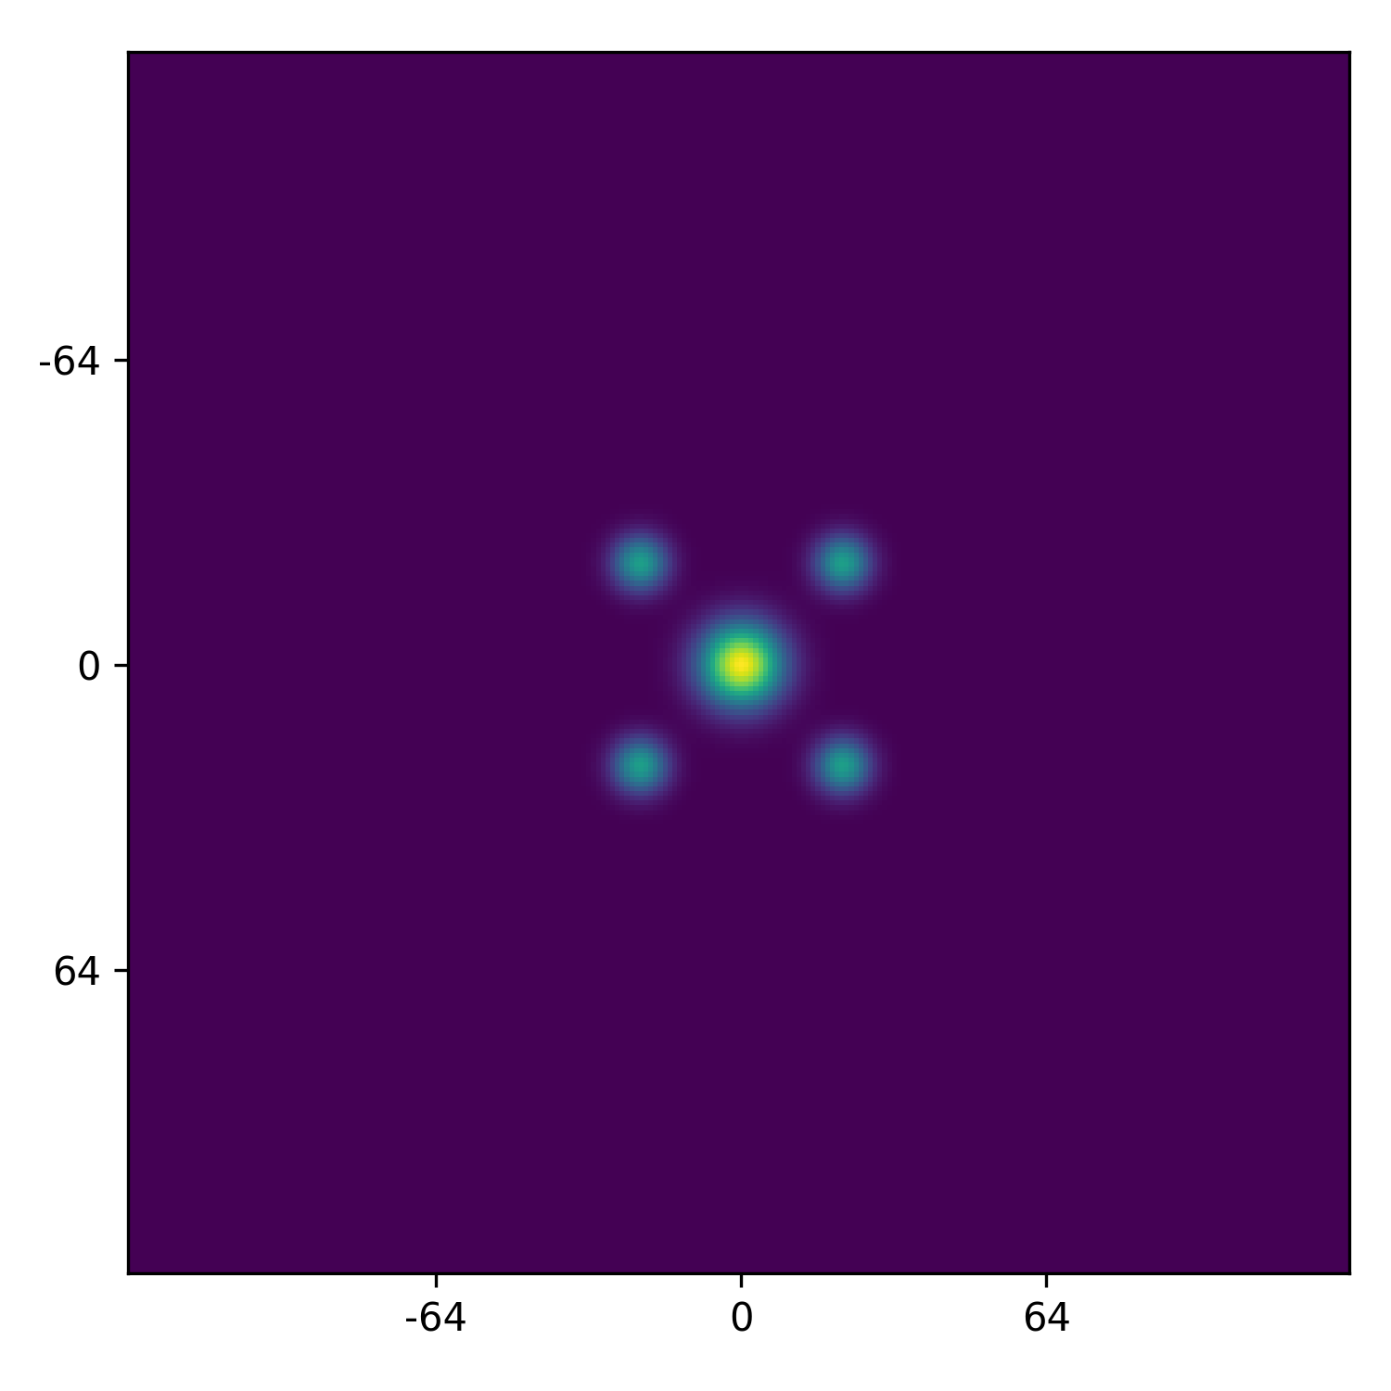
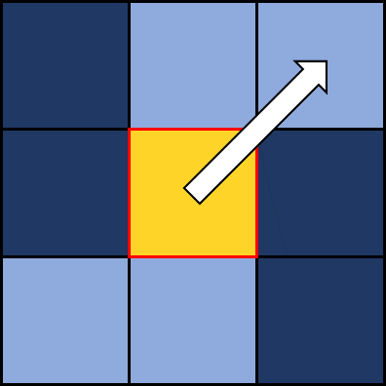

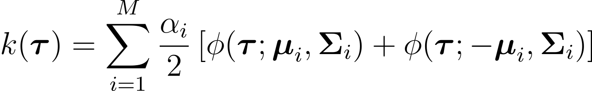
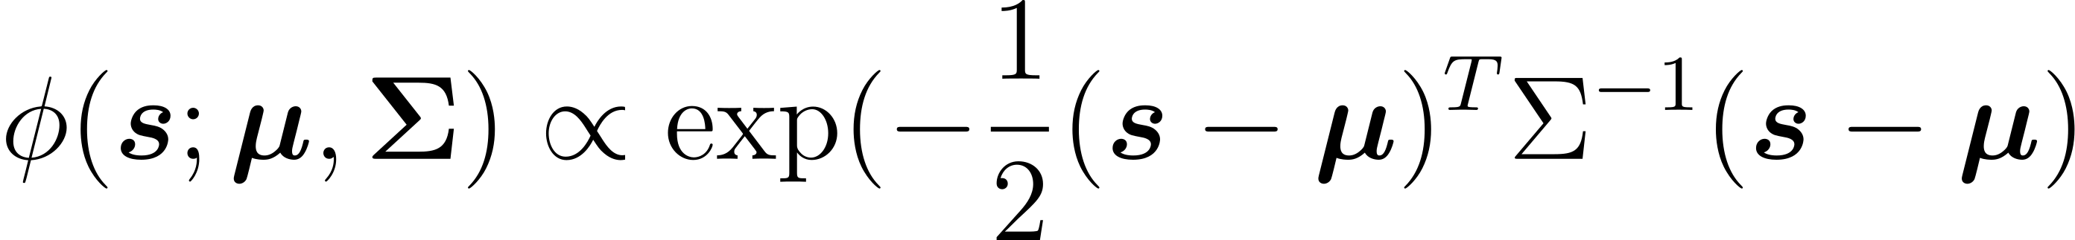

Gaussian Process kernels provide a potential mechanism for ‘dreaming up’ 2-point statistics
Spectral Mixture Kernels

Slide 15
We constructed four parametric strategies for placing the Spectral Mixtures
a
b
ψ
ψ
θ
L
L
Central major axis strength, minor axis strength, angle
Volume fraction
Central major axis strength, minor axis strength, angle
Primary major axis strength, minor axis strength, radial distance
Volume fraction
Central major axis strength, minor axis strength, angle
Primary and Secondary major axis strength, minor axis strength, radial distance
Volume fraction
Major axis strength, minor axis strength
Lattice rotation, lattice spacing, lattice cutoff
Volume fraction
An overwhelming parameter space… N⁹ autocorrelations

Slide 16
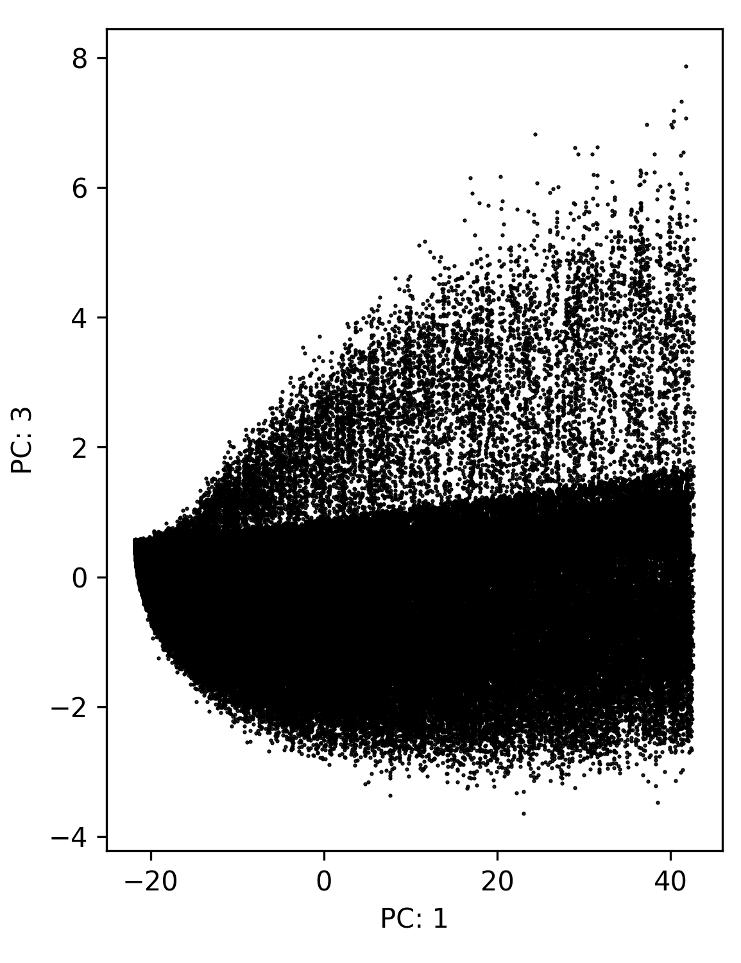
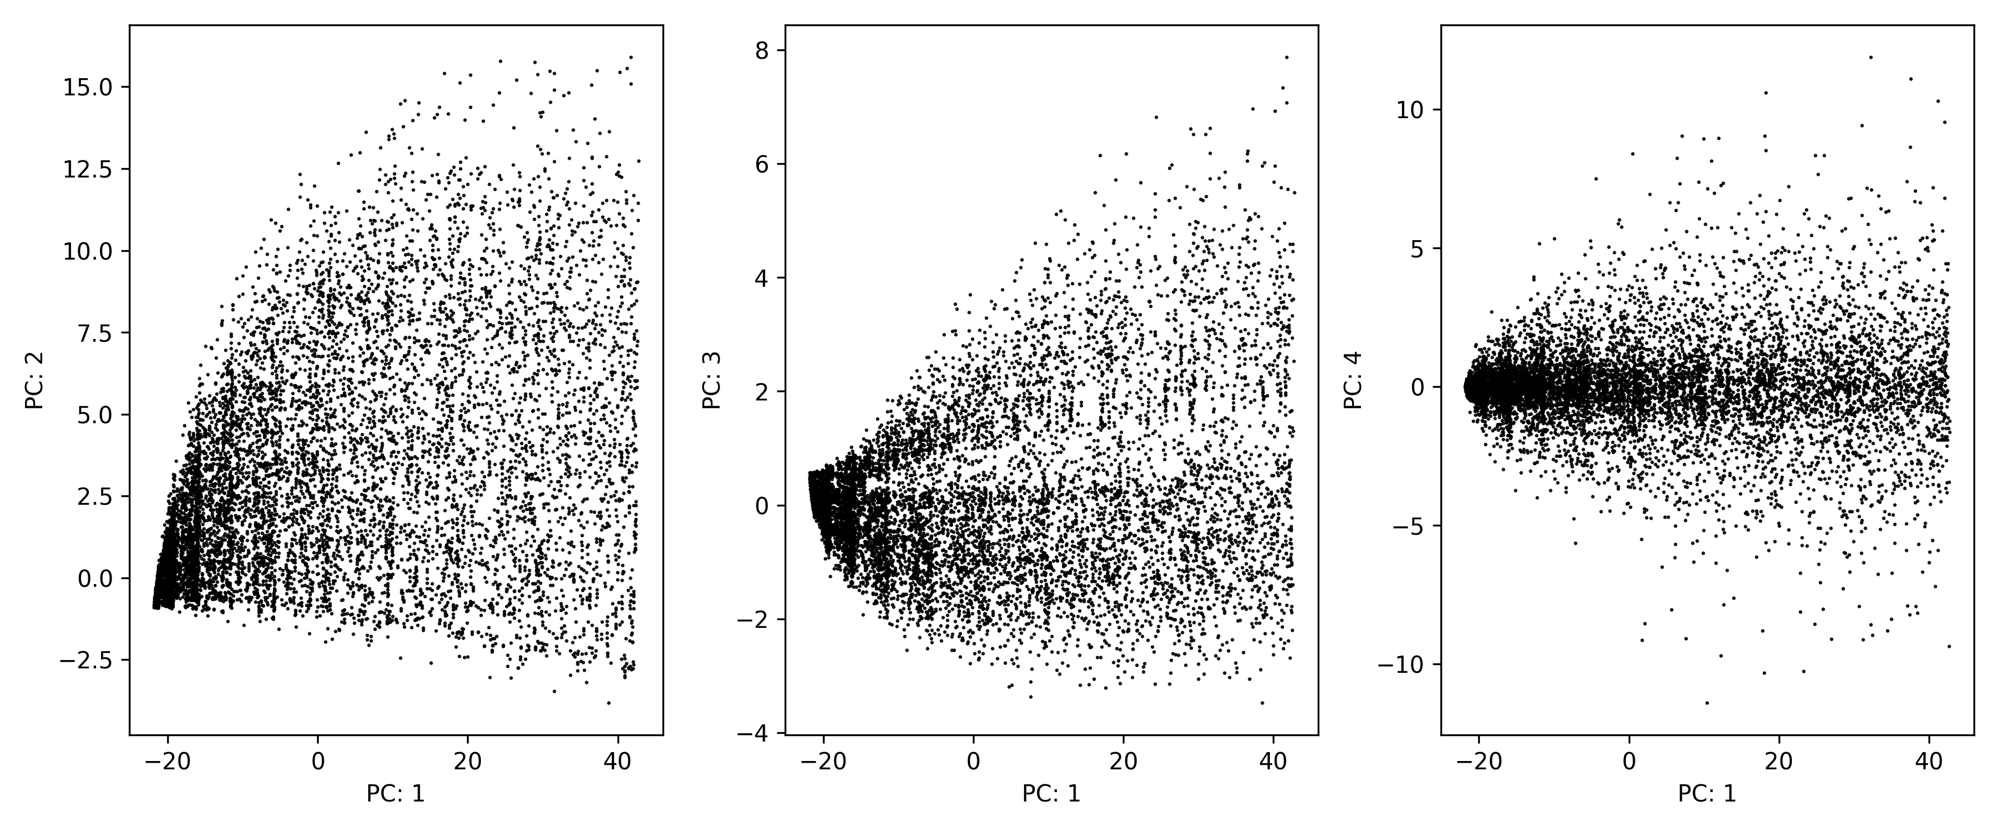
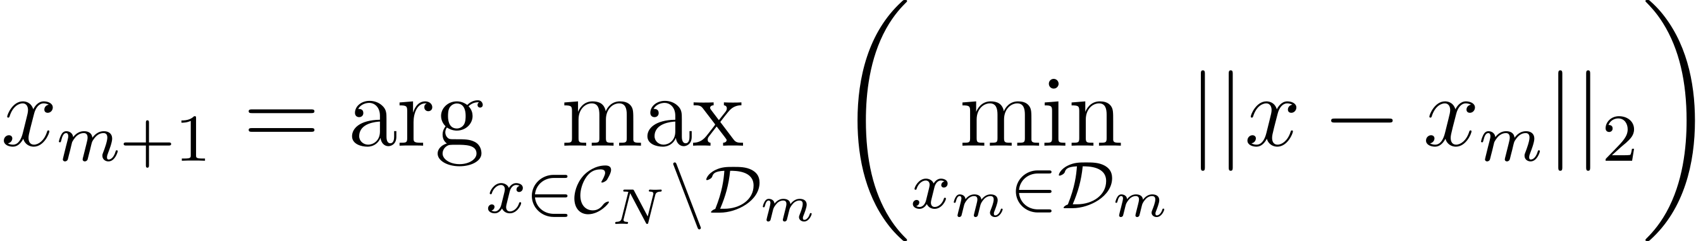
Space-Filling reduces data set size while improving uniformity of coverage.
Subsampled to 10k Autocorrelations

Slide 17
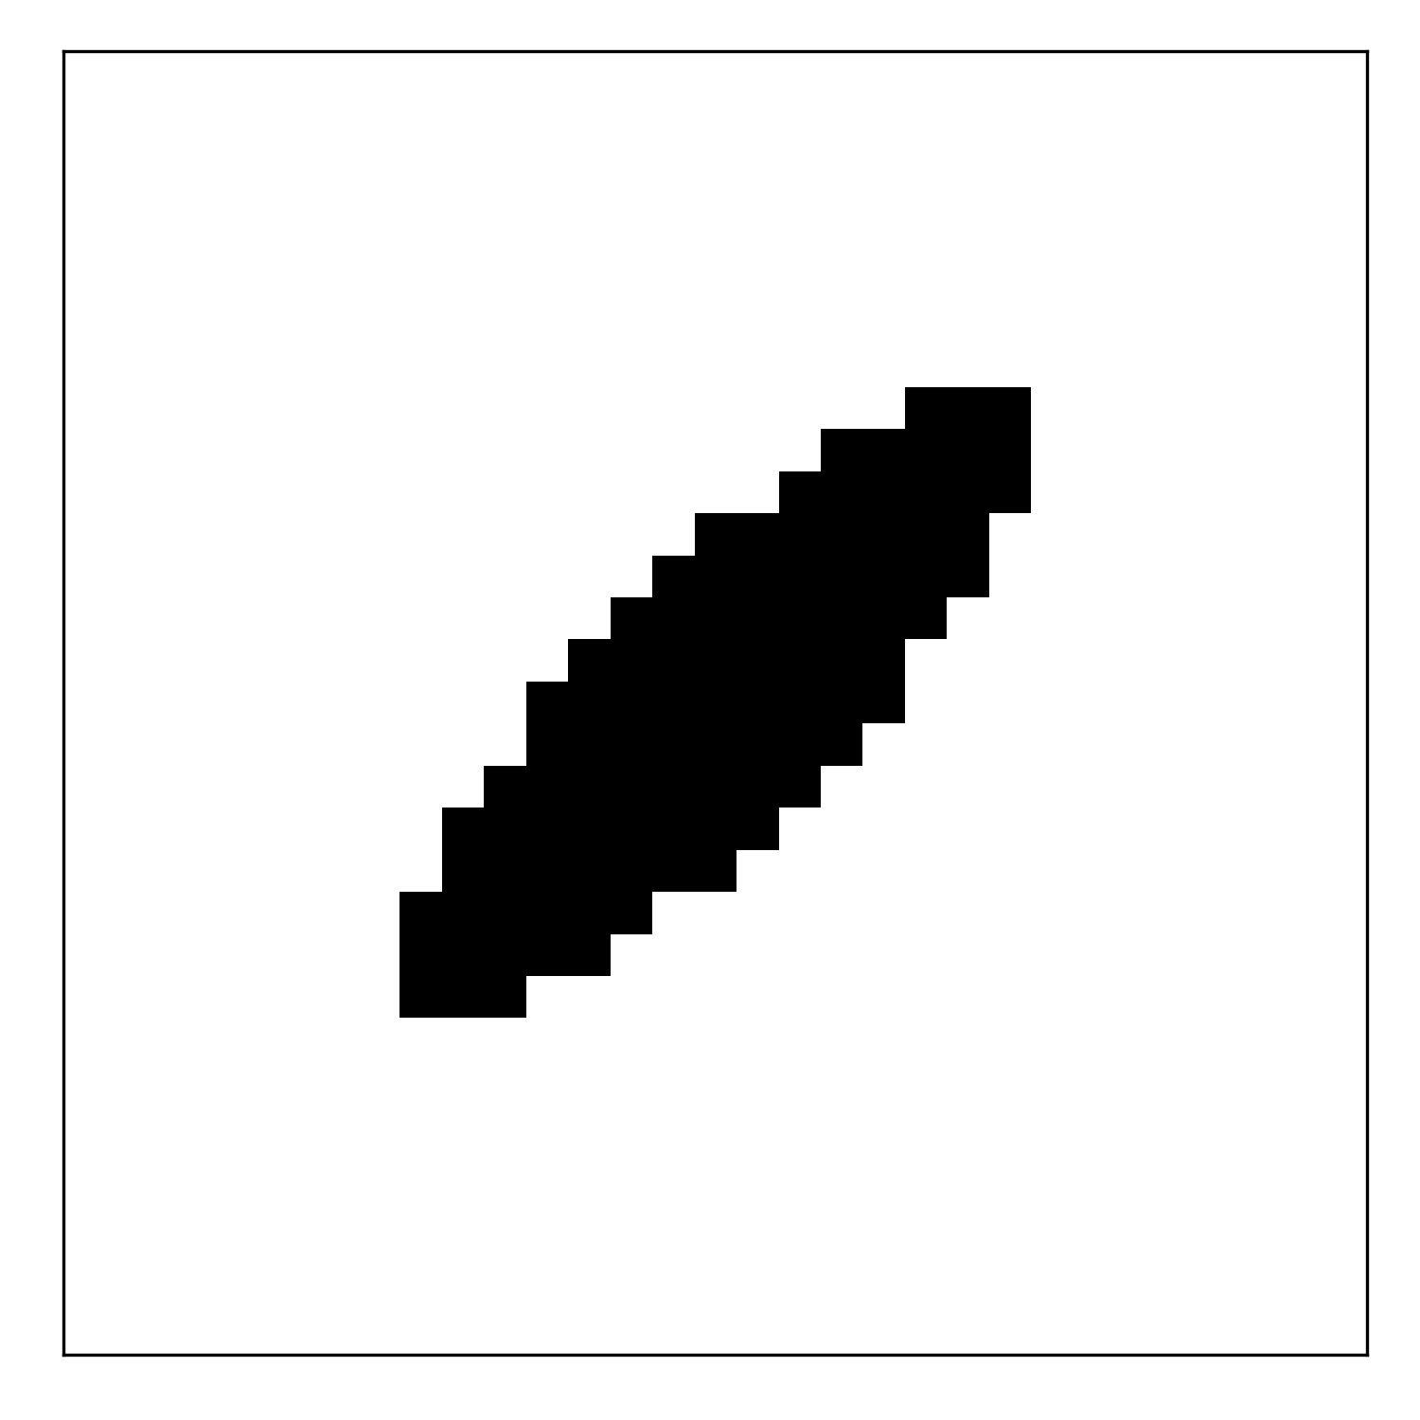
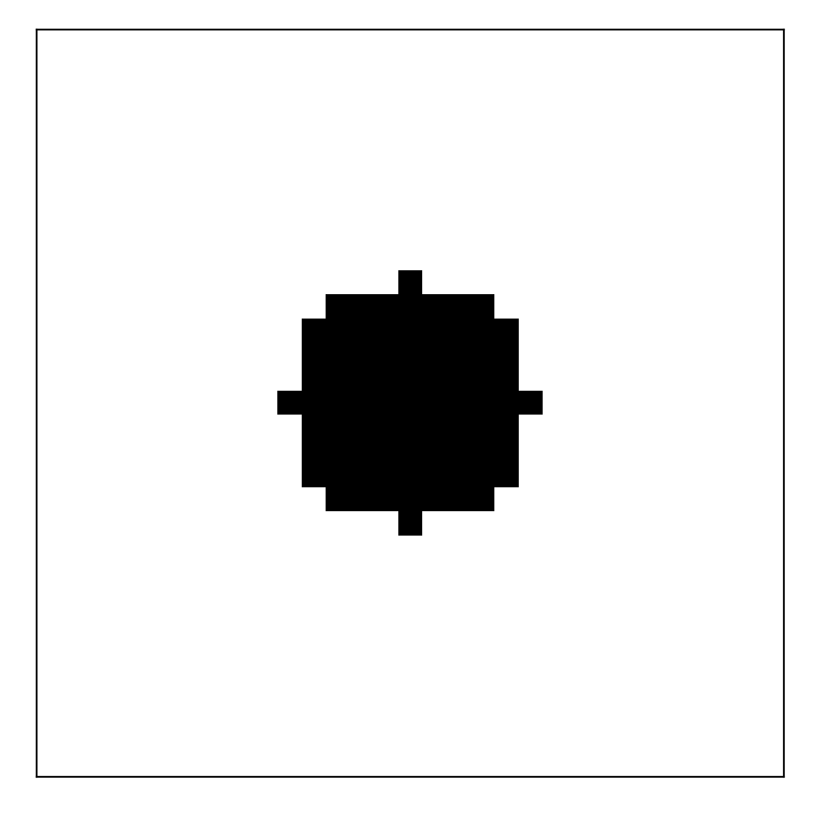
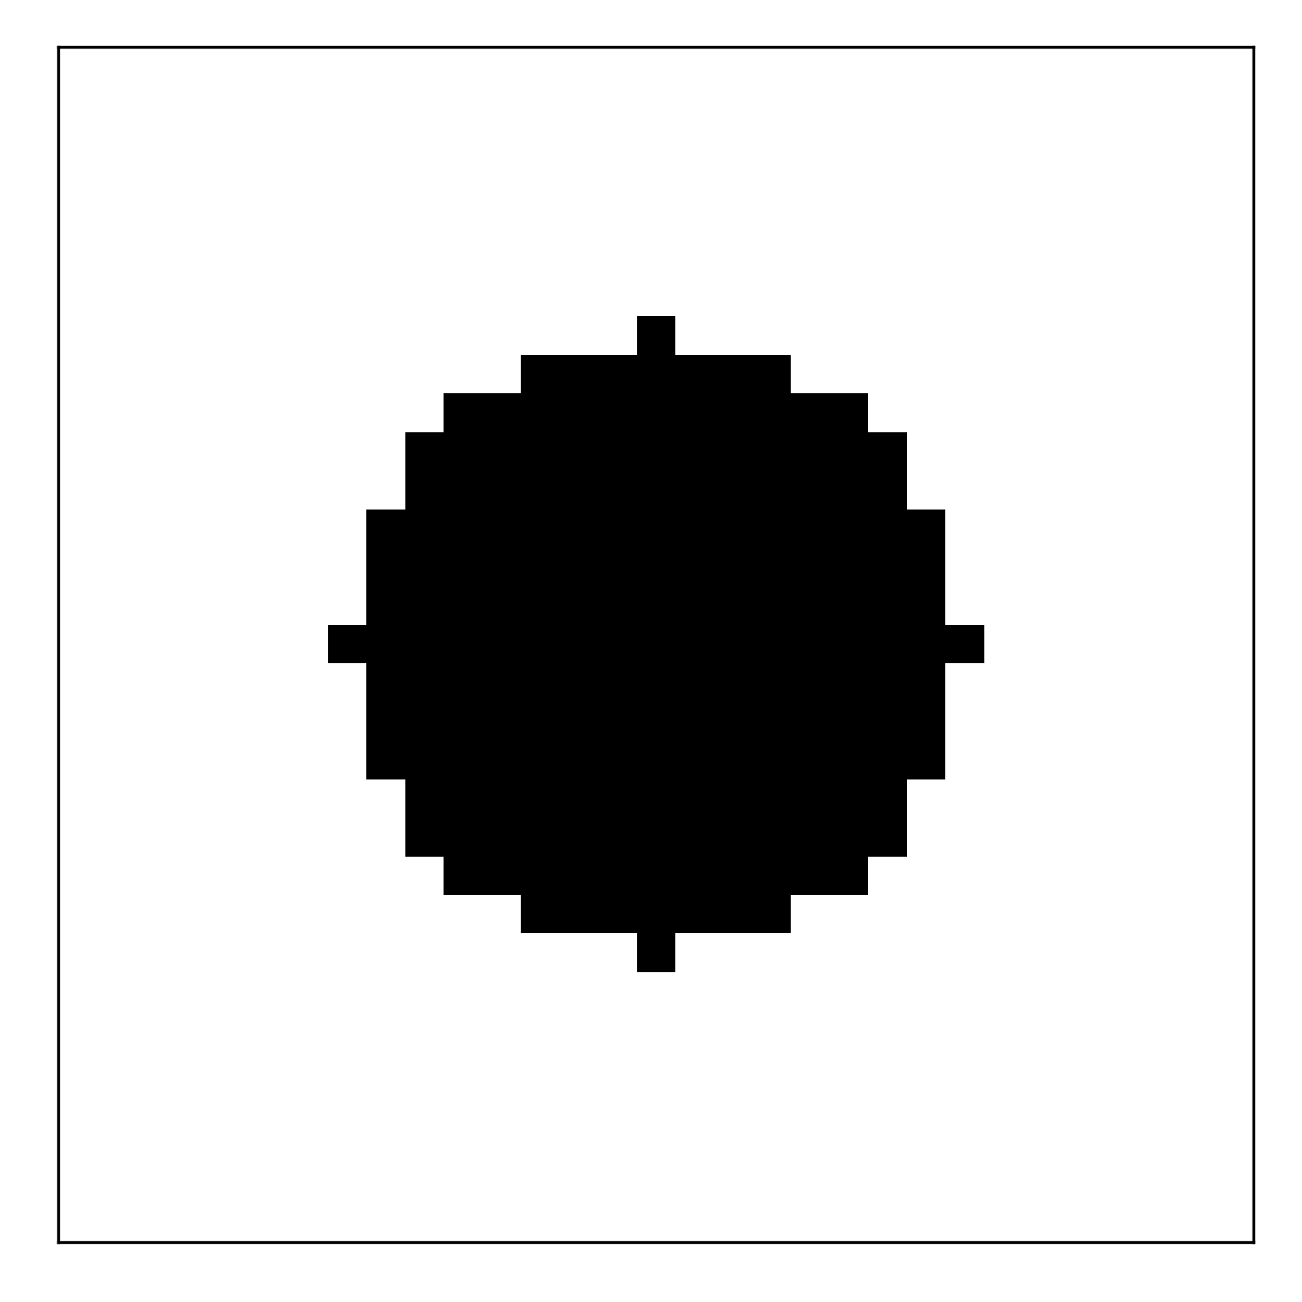
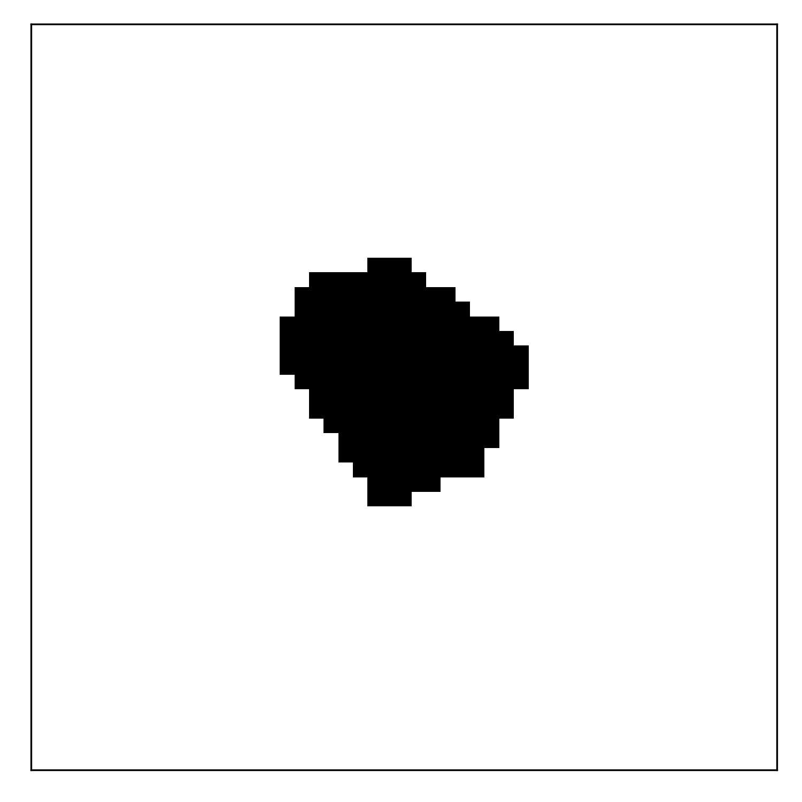
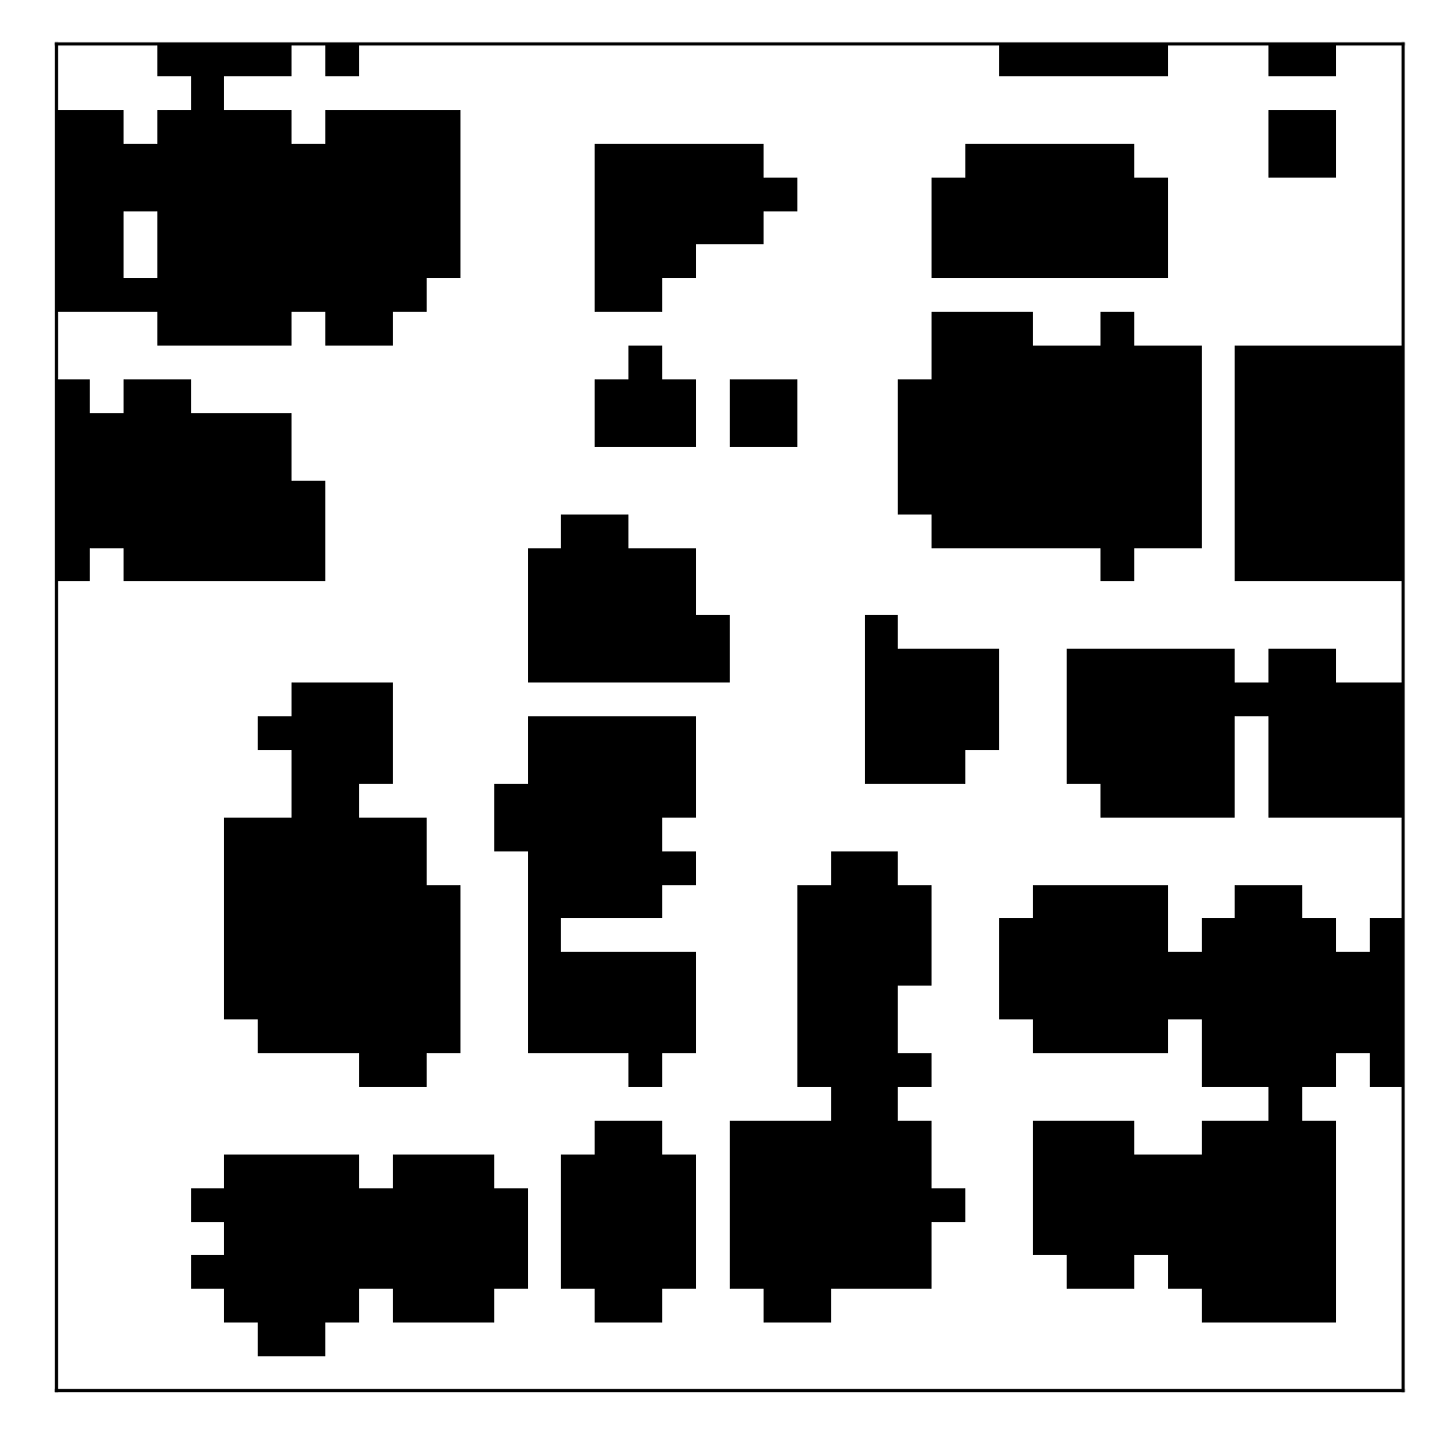
We generate the dataset by combining the identified autocorrelations with neighborhoods
Global Gaussian Random Field
Local Neighborhood Denoising
Synthesize Microstructures
i^{th} pixel
j^{th} pixel

Slide 18
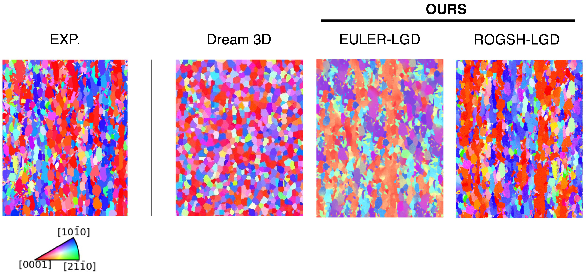
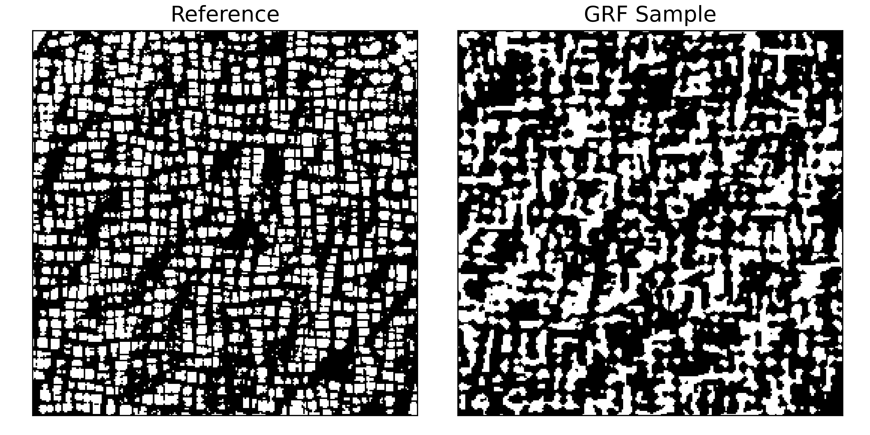
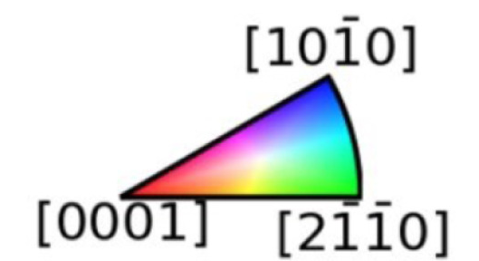
Local-Global Decomposition Models are deep generative models which systematically target physics-driven microstructure statistics
TI64 – EBSD
Nickel Superalloy – Segmented SEM

Slide 19
Long range patterns are governed by 2-point statistics
TI64 – EBSD
Nickel Superalloy – Segmented SEM

Slide 20
Higher order statistics characterize local neighborhoods
TI64 – EBSD
Nickel Superalloy – Segmented SEM

Slide 21
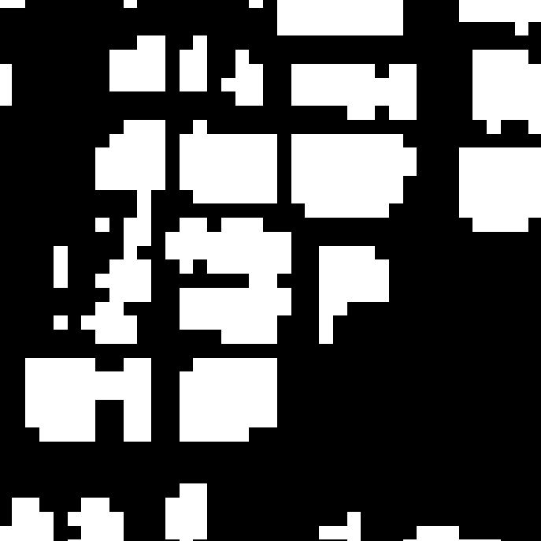
The theoretical LGD model explicitly incorporates both sets of statistics
A global Gaussian Random Field model
A Local Deep Diffusion Model
Trained with just 1 training image
Combined model can extrapolate to out-of-distribution 2-point statistics.
A Generative Framework

Slide 22
We generate the dataset by combining the identified autocorrelations with neighborhoods
Global Gaussian Random Field
Local Neighborhood Denoising
Synthesize Microstructures
i^{th} pixel
j^{th} pixel

Slide 23


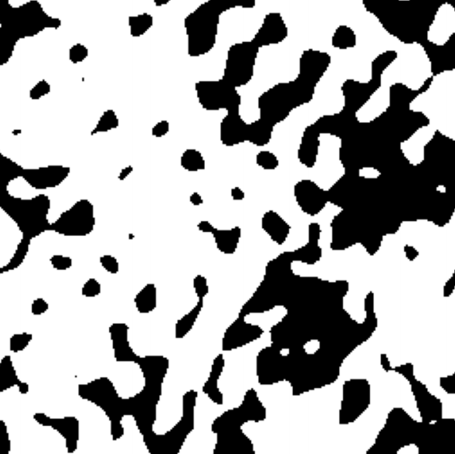

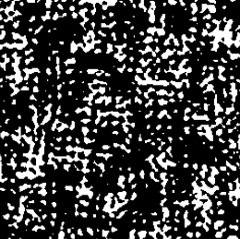
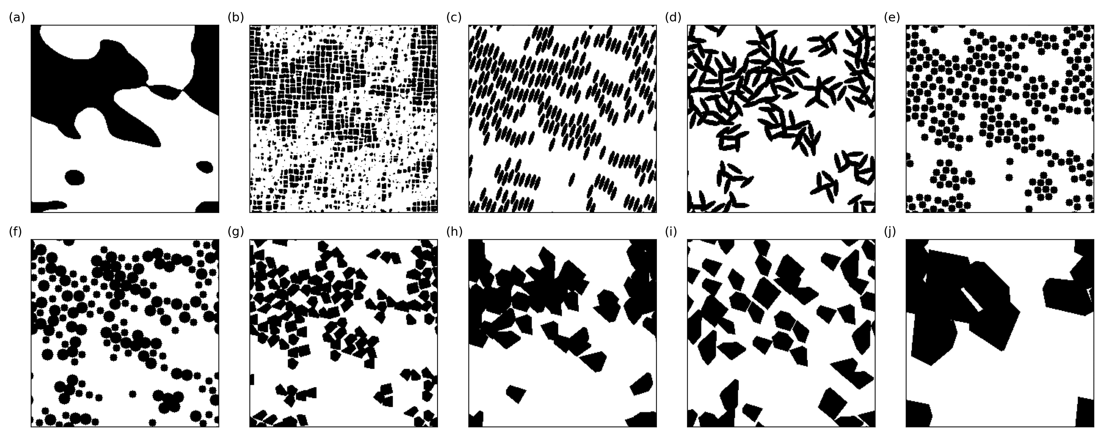

The dataset is generated by via the Local-Global Decomposition Inverse Transformation.
Salient Statistical Diversity: 1- and 2-point statistics
Feature Diversity: Higher order statistics
Generate a diverse dataset by inverting a simpler uniform distribution over microstructure statistics

Slide 24
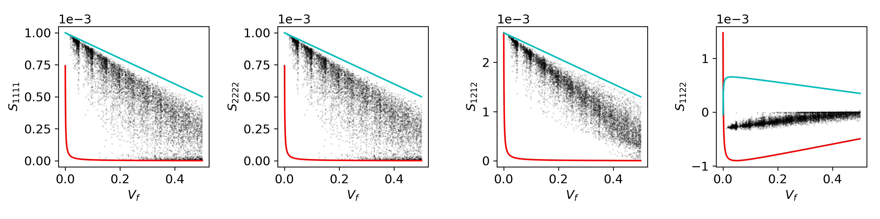
Efficiently covering the microstructure space also…
For GRF, 1000 Contrast Ratio
… yields good coverage of many property spaces.

Slide 25
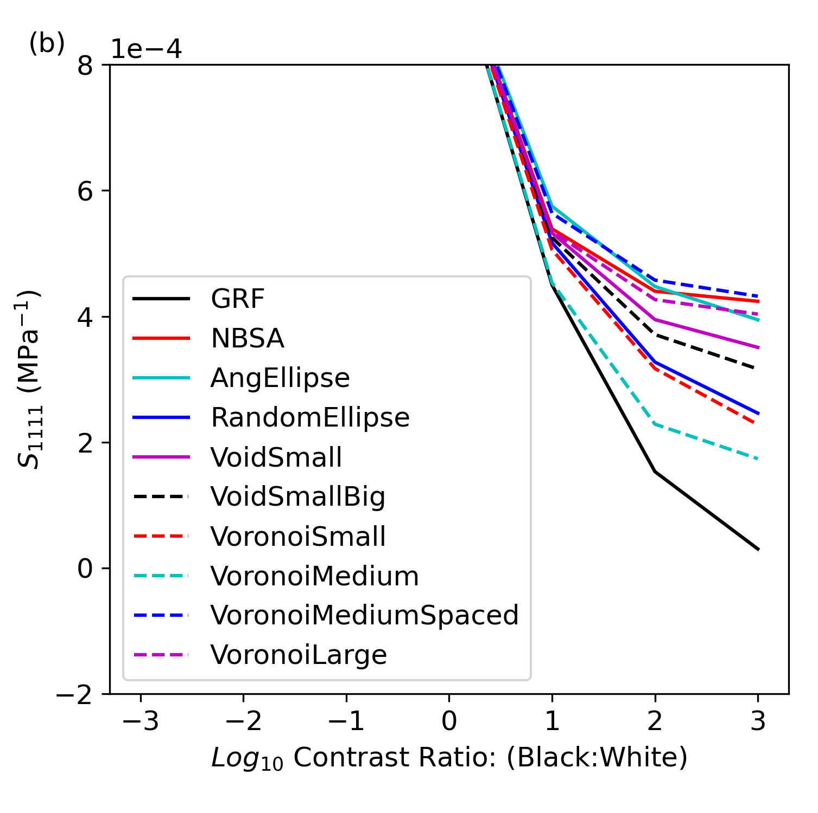
Specific properties can be achieved by modulating 2-point or higher statistics.

Slide 26

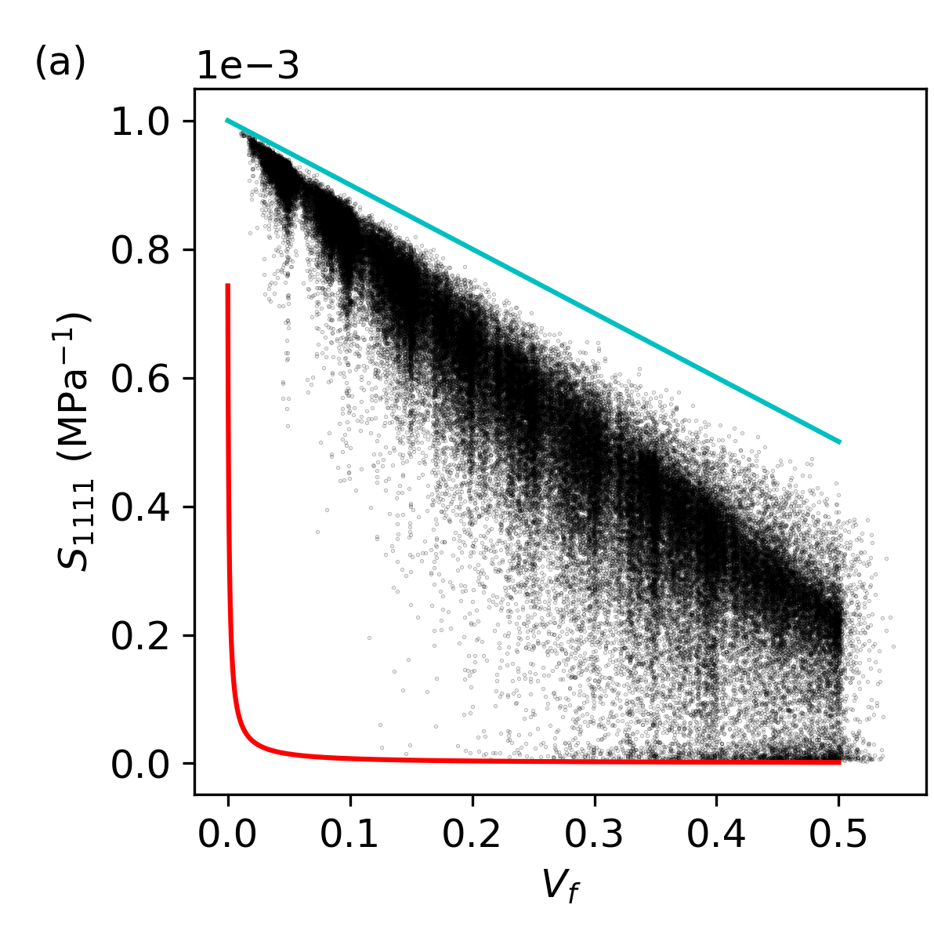


Important Takeaways
MICRO2D is an open-source big microstructure dataset
Statistics guided Microstructure Dataset Construction provides achievable targets to maximize diversity in structure and property
Volume
Value?
Diverse
Reusable

Slide 27
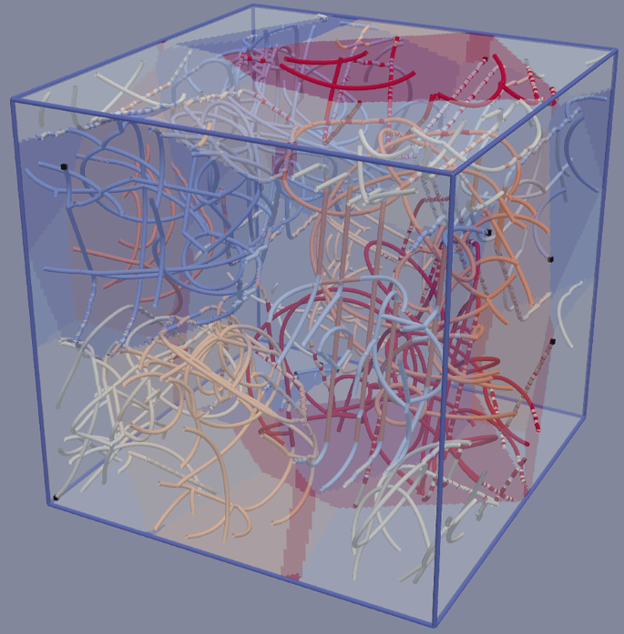
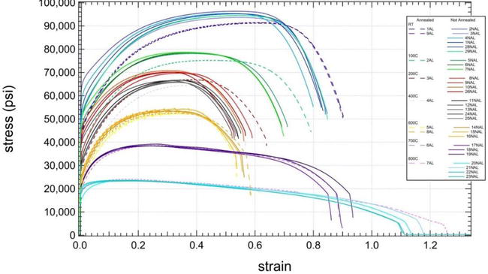



Materials Priors and Multi-modal Modeling
$$P(M, A, S, …)$$
Michael Buzzy

Slide 28
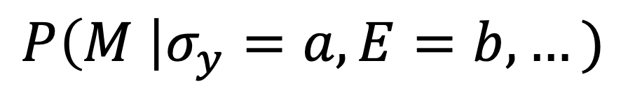
Materials Priors and Multi-modal Modeling
$$P(M, A, S, …)$$
$$P\left(M \right|σ_{y}=a, E=b, …)$$
Microstructure Sensitive Design
Michael Buzzy
Generale, Robertson, ... “Inverse Stochastic Microstructure Design”, 2024.
Generale, ..., Robertson, ... “A Bayesian Approach to Designing Microstructures and Processing Pathways for Tailored Material Properties”, 2024.

Slide 29
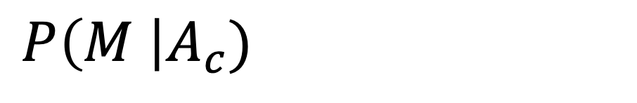
Materials Priors and Multi-modal Modeling
$$P(M, A, S, …)$$
$$P\left(M \right|A_{c})$$
Nondestructive Monitoring
Michael Buzzy
Rossin et al. “Bayesian inference of elastic constants and texture coefficients in additively manufactured cobalt-nickel superalloys using resonant ultrasound spectroscopy”, 2021.

Slide 30
Lets look at LLMs to understand challenges we might face…
Udandarao et al. “No “Zero-shot” Without Exponential Data: Pretraining Concept Frequency Determines Multimodal Model Performance”, 2024.
Generalized, multi-application and multi-modal models exacerbate the need for data.

Slide 31


Questions?
87,379 2D 2-phase Microstructures:
  10 Neighborhood classes
Regression Targets:
Repeated for Low (10x), Medium (100x), and High Contrast (1000x):
  Effective Elastic Coefficients (C₁₁, C₁₂, C₂₂)
  Full-field Elastic Strain
Thermal Conductivities:
  Effective Thermal Conductivities (k₁₁, k₂₂)
Andreas E. Robertson – aerober@sandia.gov
Dr. Surya R. Kalidindi – surya.kalidindi@me.gatech.edu
Adam P. Generale – agenerale3@gatech.edu
Conlain Kelly – ckelly84@gatech.edu
Michael Buzzy – mbuzzy3@gatech.edu
Robertson, A.E., Generale, A.P., Kelly, C., Buzzy, M., and Kalidindi, S.R., MICRO2D: A Large, Statistically Diverse Heterogeneous Microstructure Dataset, IMMI, 2024.

Slide 32
Extra Slides

Slide 33
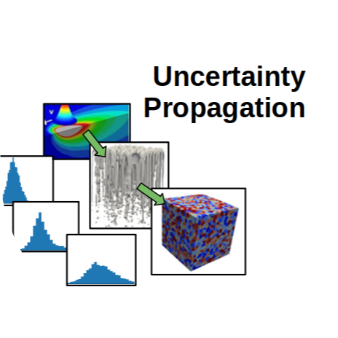
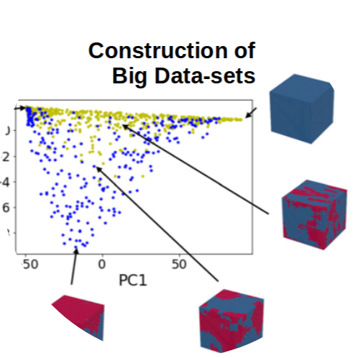
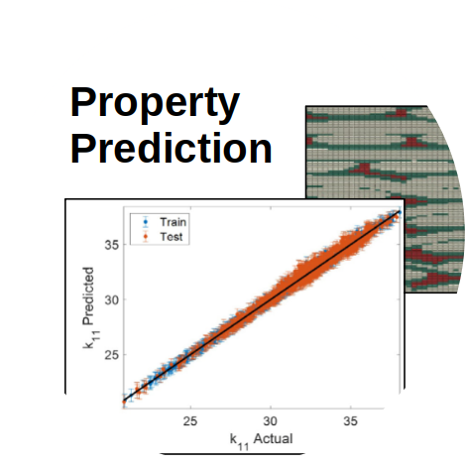
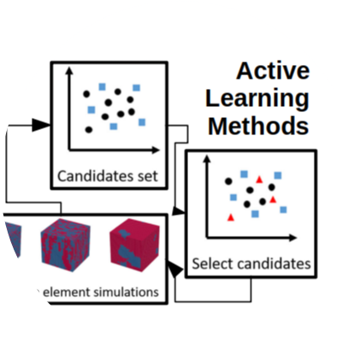
What characterizes valuable microstructure datasets?
Value
Volume
Diverse
Reusable

Slide 34


Synthetic microstructures match salient properties
… even without specifically targeting them in the generative model

Slide 35




Available generation strategies specialize in specific characteristics
(1) “Mechanical MNIST”
(2) Process Driven Curation
t₀
t₁₀
t₁₀₀
Volume
Value
Diverse
Reusable
Volume
Value
Diverse
Reusable
Lejeune. 2020.
Zapiain et al. 2021.

Slide 36

In practice, the statistics and the GRF guides and stabilizes the deep diffusion model

Slide 37


The neighborhood distributions produce diversity in higher order statistics
2-point statistics
3-point statistics

Slide 38


The generated dataset displays greater diversity when compared to other datasets…
… such as the TAMU spinodal dataset.

Slide 39



What’s next? It’s unlikely we have sampled everything useful passively.
Active exploration strategies and application specific targets could provide guidance.

Slide 40

123 PC Vectors are Necessary to capture 99.9% of the Variance
The GRF Class displays the widest diversity

Slide 41

The remaining classes cover subsets of the microstructure space because their…
… neighborhoods are restricted.

