Slide 1
Hardware Trojan Insertion and Detection Using Reinforcement Learning
Amin Sarihi
Ph.D. Candidate at
Klipsch School of ECE, New Mexico State University
Notes:
Good Morning. I would like to thank the committee members for taking the time to review my report and being here to participate in this session.

Slide 2
Outlines
Introduction
Problem Statement
Reinforcement Learning
Hardware Trojan Insertion
Hardware Trojan Detection
Adversarial HT Insertion
Real-world HT Benchmarking
Conclusion
1

Slide 3
Introduction
1

Slide 4
Introduction
Hardware designs had long been deemed secure
Side-channel attacks in late 90’s [1]
Hardware Trojan (HT) coined in 2007 [2]
Malicious hardware modifications
Lead to secret leakage or chip malfunction
Chips are widely used in various civilian and military applications
[1] Paul Kocher, Joshua Jaffe, and Benjamin Jun. Differential power analysis. In Advances in Cryptology—CRYPTO’99: 19th Annual International Cryptology Conference Santa Barbara, California, USA, August 15–19, 1999 Proceedings 19, pages 388–397. Springer, 1999.
[2] Dakshi Agrawal, Selcuk Baktir, Deniz Karakoyunlu, Pankaj Rohatgi, and Berk Sunar. Trojan detection using ic fingerprinting. In 2007 IEEE Symposium on Security and Privacy (SP’07), pages 296–310. IEEE, 2007
Notes:
So, it is very important to have proper security mechanisms to counter the threats on chips.

Slide 5
Introduction
An HT Example
Trigger
Rare
Nets
A
1
A=1
B=1
C=0
B
1
1
D=1
E is flipped!
C
0
1
D
1
Payload
1
1
$$\overline{E}$$
Towards
Output
Circuit Nets
$$E$$
Discovering HTs are not easy!
c7552 has 207 inputs , i.e., 2²⁰⁷ input patterns, larger than the estimated number of atoms in the universe!
Notes:
The Trojan circuits consists of two parts: Trigger and Payload
From attacker’s POV, the HT should not be activated frequently. If activated frequently, the existence of the HT will be given away.

Slide 6
Problem Statement
1

Slide 7
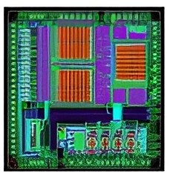
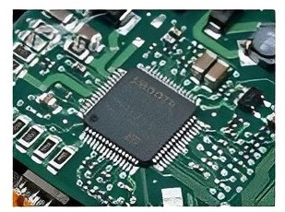
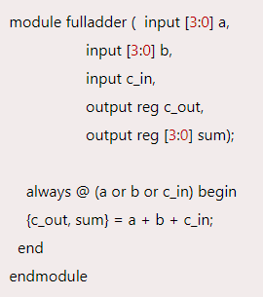
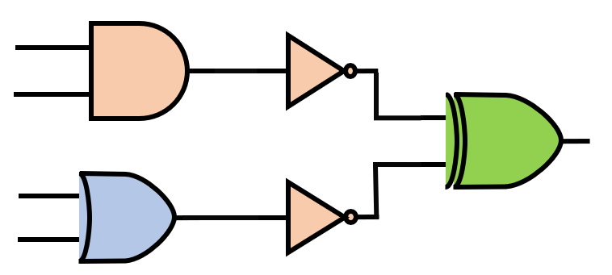
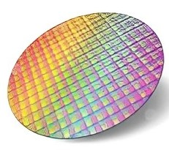
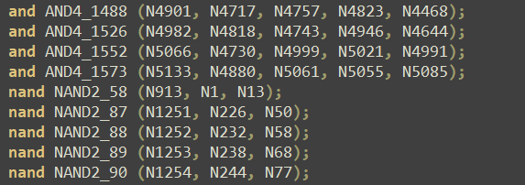
Problem Statement
Silicon Supply Chain Stages
IP Core
EDA Tools
Specification
RTL Design/
Behavioral Level
Netlist / Gate Level
Physical Design Layout
Fabrication
Assembly & Testing
Market
Functionality
Performance Req
Architecture
3PIP
Reverse-engineering

Slide 8
Problem Statement
To study HTs, we need HT Benchmarks. The most referenced HT benchmark is from trust-hub.org:
Limited Dataset on trust-hub.org
The number of HT-infected circuits is very limited
HT insertion is done through a one-dimensional lens
Fine-tuned HT detectors
Lack of circuit variety
Impossible to insert HTs in different circuits
Reinforcement Learning emerges as a viable solution!

Slide 9
Reinforcement Learning
1

Slide 10
Background Theory
Reinforcement Learning
Action a_{t}
B
A
Agent
Environment
State s_{t}
State s_{t+1}
Reward r
Reward r_{t+1}
The agent’s goal is to maximize the sum of collected rewards over all episodes
Notes:
1- Reinforcement Learning is a machine learning strategy for decision-making through trial and error

Slide 11
HT Insertion
1

Slide 12
HT Insertion
Flow of the Insertion Tool
SCOAP (Sandia Controllability/Observability Analysis Program) Measures
Controllability: a measure for the difficulty of setting a particular net in a design to either ’0’ or ’1’.
Observability: a measure for the difficulty of propagating a net value to at least one of the circuit’s primary outputs
Notes:
We must specify the trigger nets or the rare nets.

Slide 13
HT Insertion
HT Insertion with RL
0
Action space
|
|
|
|
|
|
|
|
|
|
|
|
|
|
|
Next Level
Previous Level
Same Level Up
Same Level Down
No Action
Trigger
Nets
Trigger
Logic
0
Payload
Logic
1
S₁
3
4
0
S₄
S₂
2
0
3
S₃
Target net
1
0
…
0
2
State space: logic-levels of the HT connections
$$S_{t}=[2, 1, 3, 4]$$
Action space: Encoding actions 0-4
$$a_{t}=[0,1]$$

Slide 14
HT Insertion
The HT Insertion Algorithm & Rewarding
Insert the HT randomly in the circuit
HT trigger nets start moving (actions are taken)
HT functionality is tested with PODEM
Functional $⇒$ Agent is rewarded + based on the number of rare triggers
Not functional or no rare triggers$⇒$ Agent is rewarded -1
Agent resets when terminal state is reached

Slide 15
HT Detection
1

Slide 16
HT Detection
Flow of the Detection Tool
Generate test vectors that activate rare nets many times!
The detection agent’s goal is to activate as many rare nets as it can
Static Sim: Derive the HTS values for each net
Dynamic Sim: Record Switching activities with 100k random test vectors
Notes:
In summary, the goal of the HT detector is to generate test vectors that activate the identified rare nets as much as possible.

Slide 17
HT Detection
Action Space
Old Test Vector
Action
New Test Vector
$$a_{t}=[a_{1},a_{2},…,a_{n−1},a_{n}]$$
$$\left[\begin{matrix}1 \\ 0 \\ 1 \\ 0 \\ 0\end{matrix}\right]$$
$$\left[\begin{matrix}0 \\ 0 \\ 1 \\ 1 \\ 1\end{matrix}\right]$$
$$\left[\begin{matrix}1 \\ 0 \\ 0 \\ 1 \\ 1\end{matrix}\right]$$
$n=$number of circuit inputs
⊕
$$⇒$$
Binary actions:
0. Leave it unchanged 1. Flip the bit
State Space
Rare Nets Status
New State
State Space
$$\left[\begin{matrix}s_{1} \\ s_{2} \\ s_{3} \\ s_{4} \\ s_{5}\end{matrix}\right]$$
$$\left[\begin{matrix}Active \\ Inactive \\ Active \\ Inactive \\ Inactive\end{matrix}\right]$$
$$\left[\begin{matrix}1 \\ 0 \\ 1 \\ 0 \\ 0\end{matrix}\right]$$
Action
$$⇒$$
$$⇒$$
$$s_{t}=[s_{1},s_{2},…,s_{m−1},s_{m}]$$
$m=$number of rare nets

Slide 18
HT Detection
Detection Rewarding Function D1
Test vectors are generated (actions are taken)
Count the number of activated rare nets
Keep a copy of the previous state
Net-wise comparison of the new and previous states
The most + reward $⇒$ an inactive net becomes active
The most - reward $⇒$ an active net becomes inactive

Slide 19
HT Detection
Detection Rewarding Function D2
Target nets are based on switching activities
Rare nets’ switching vector is passed to the algorithm
Test patterns are generated (actions are taken)
Rewards are proportionate to the inverse of switching activities
The more the rare nets are activated $⇒$ The higher the reward

Slide 20
HT Detection
Detection Rewarding Function D3
Target nets are based on controllability
Nets’ controllability vector is passed to the algorithm
Test patterns are generated (actions are taken)
Rewards are proportionate to the controllability amounts
The more the rare nets are activated $⇒$ The higher the reward

Slide 21
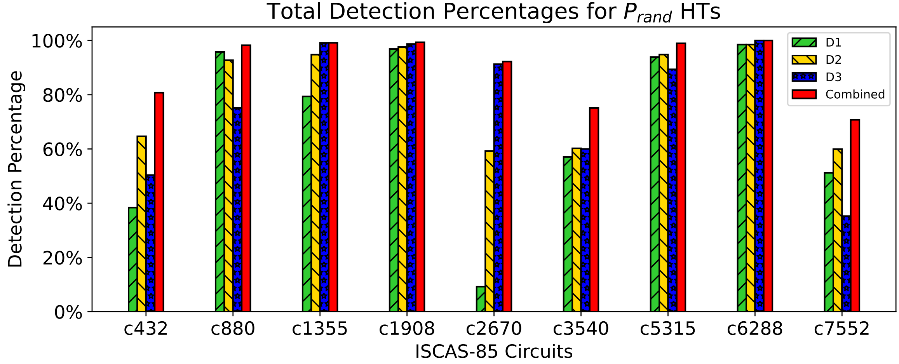
Results and Analysis
HT Detection Figures for D1, D2, D3 Detectors [1]
Payload is placed Randomly
The combined detector includes D1, D2, and D3
[1] Sarihi, A., Patooghy, A., Jamieson, P. and Badawy, A.H.A., 2024. Trojan playground: a reinforcement learning framework for hardware Trojan insertion and detection. The Journal of Supercomputing, pp.1-35.

Slide 22
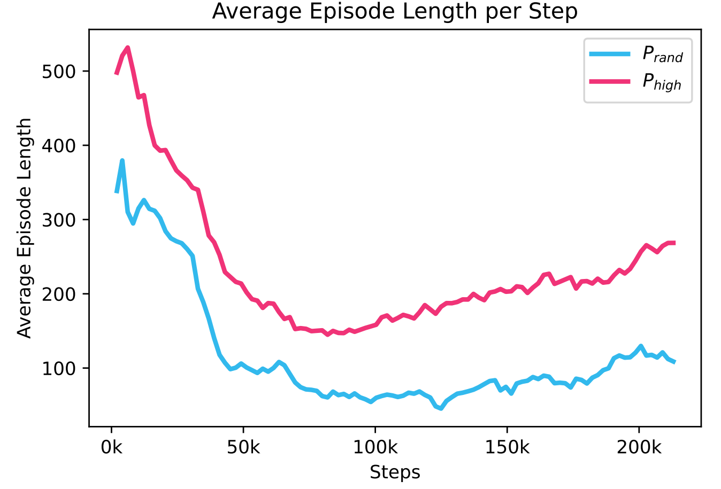
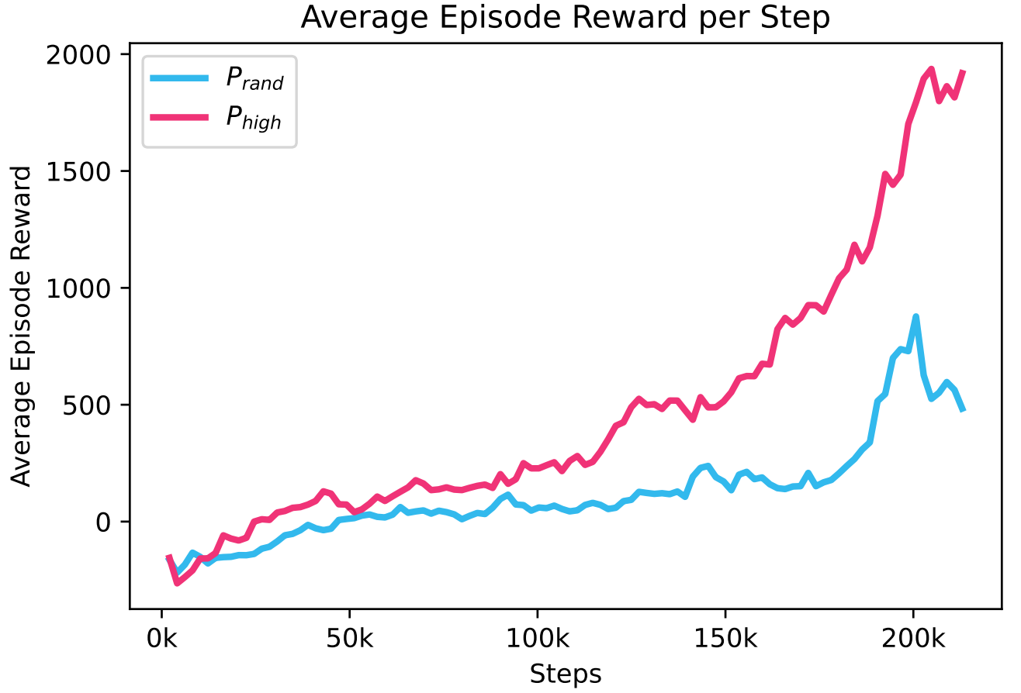
Results and Analysis
RL Agents Performance
The insertion agent in c5315 [1]
The insertion agent in c5315 [1]
[1] Sarihi, A., Patooghy, A., Jamieson, P. and Badawy, A.H.A., 2024. Trojan playground: a reinforcement learning framework for hardware Trojan insertion and detection. The Journal of Supercomputing, pp.1-35.
Notes:
In the insertion phase, the agent tends to finish the episodes in the beginning to avoid further losses
After several thousand timesteps, it learns how to accumulate positive rewards and increase the episode length
In the detection phase, the agent collects positive rewards along the way; however, it hits diminishing returns
The trade-off between training time and detection accuracy must be considered

Slide 23
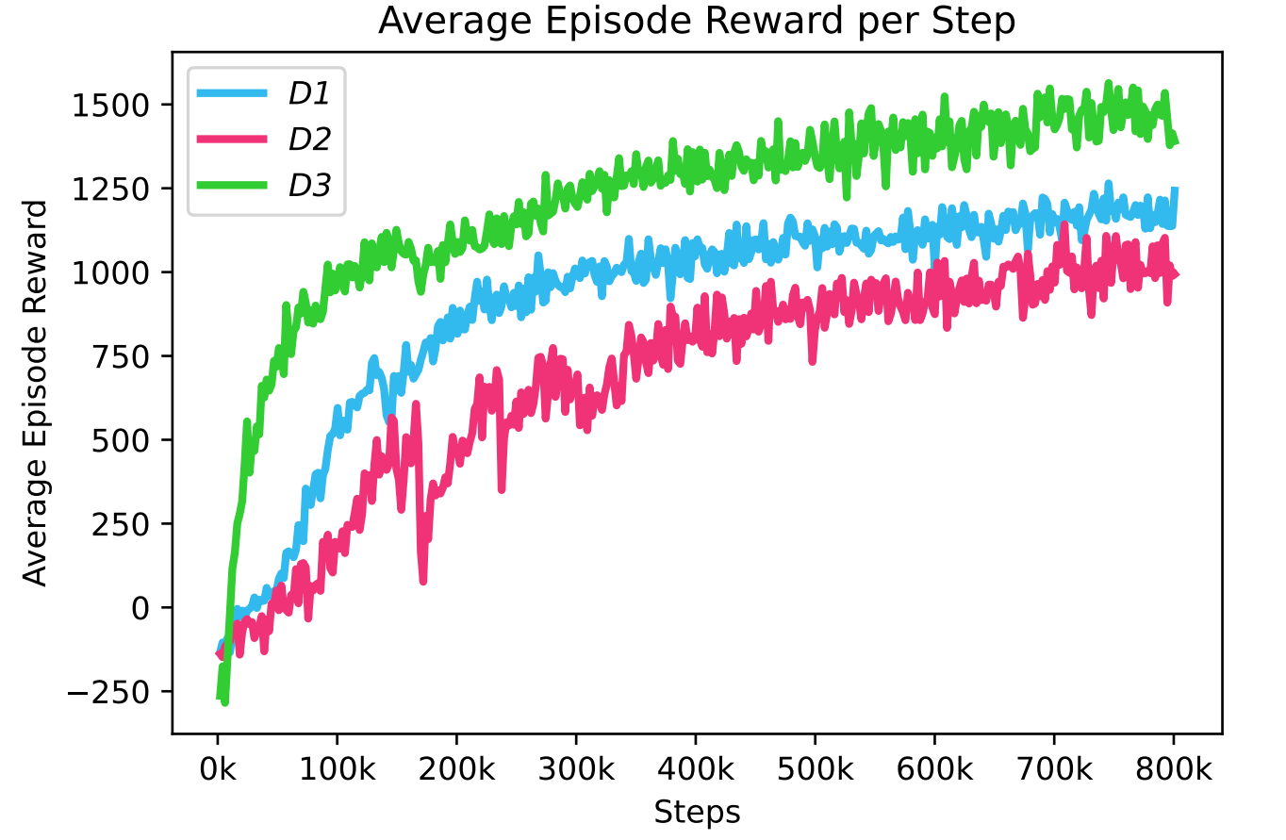
Results and Analysis
RL Agents Performance (Contd.)
The detection agent in c5315
[1] Sarihi, A., Patooghy, A., Jamieson, P. and Badawy, A.H.A., 2024. Trojan playground: a reinforcement learning framework for hardware Trojan insertion and detection. The Journal of Supercomputing, pp.1-35.
Notes:
In the detection phase, the agent collects positive rewards along the way; however, it hits diminishing returns
The trade-off between training time and detection accuracy must be considered

Slide 24
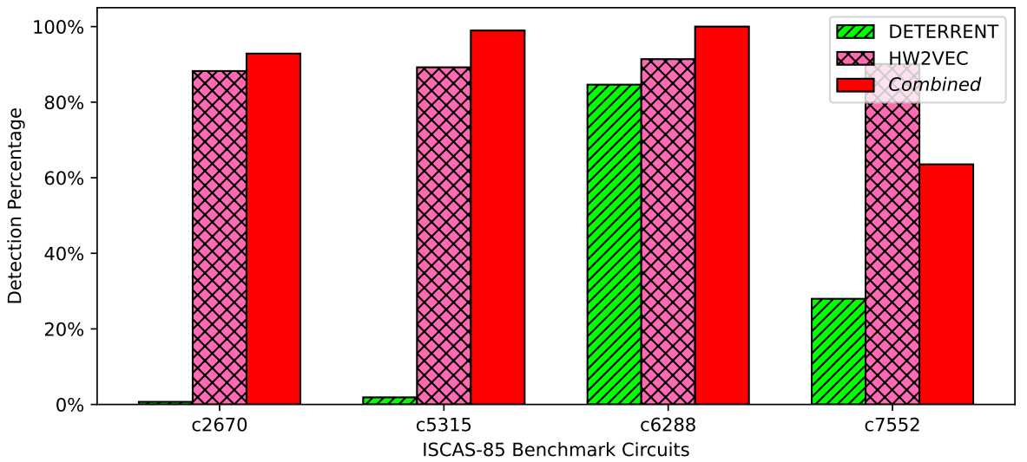
Results and Analysis
Our Detection Accuracy vs. Two state-of-the-art Detectors [1]
[1] Sarihi, A., Patooghy, A., Jamieson, P. and Badawy, A.H.A., 2024. Trojan playground: a reinforcement learning framework for hardware Trojan insertion and detection. The Journal of Supercomputing, pp.1-35.
24
Notes:
Combined vs DETERRENT
Combined outperforms DETERRENT in all 4 circuits.
The detection gap is significant in c2670 and c5315
Our tool insertion criteria is not fully captured in DETERRENT’s detection capabilities
________________________________________________________________________________________________________________________________________
Combined vs HW2VEC
Scenario I:
Train data: TJ_RTL, Test data: Our inserted HTs + two versions of ISCAS-85 HT-free benchmarks
HW2VEC shows a detection rate of 87% across all 4 circuits with 0 FPs
Scenario II:
Train: TJ_RTL + EPFL [1], Test: Similar to the previous scenario
HW2VEC detection rate drops to 48% with 0 FPs
ML HT detectors are very sensitive to the train data
More HT benchmarks are needed for better training
Combined still performs better than DETERRENT in 3 cases

Slide 25
Adversarial HT Insertion
1

Slide 26
Detection-Insertion Loop
Hide Trojans
Create a loop that combines an HT inserting agent with an HT detector
The goal is to create HT instances that outsmart the current detectors
Agent
Detect Trojans
Adversarial HT Insertion Flow

Slide 27
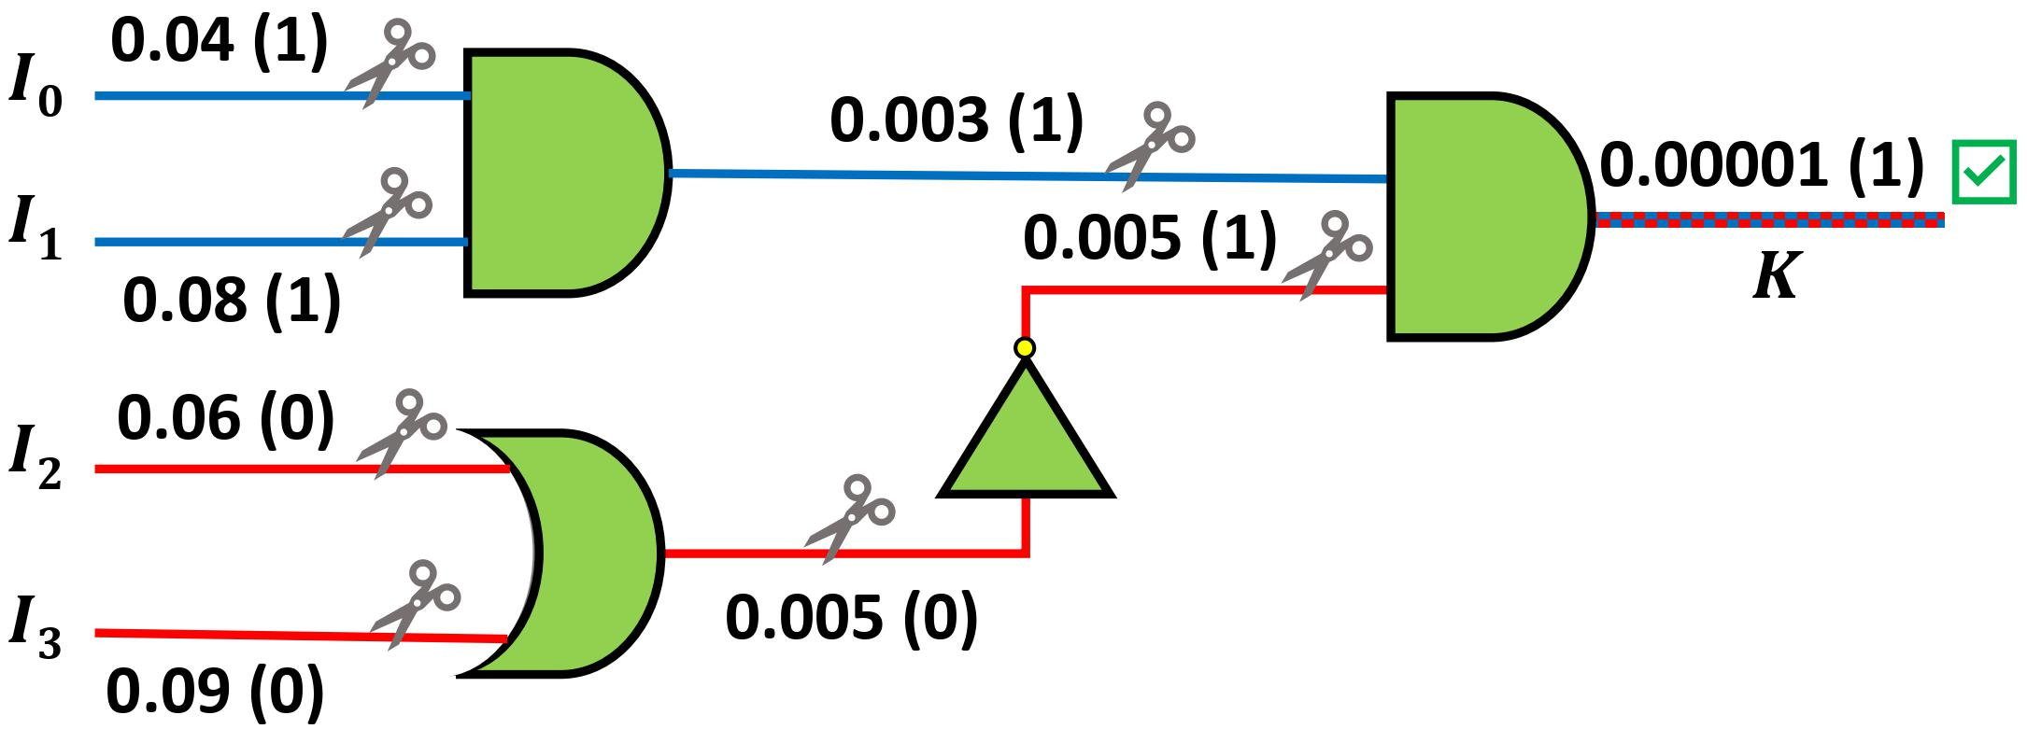
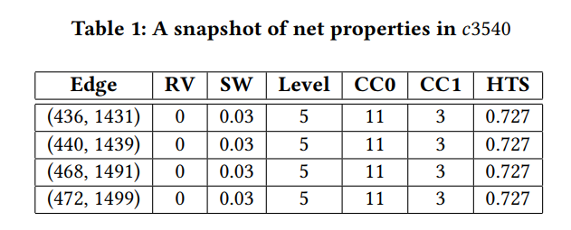
Functional and Structural Pruning
Structural Pruning
Functional Pruning
After both pruning methods take place, we select 20 random trigger nets to build HT instances.

Slide 28
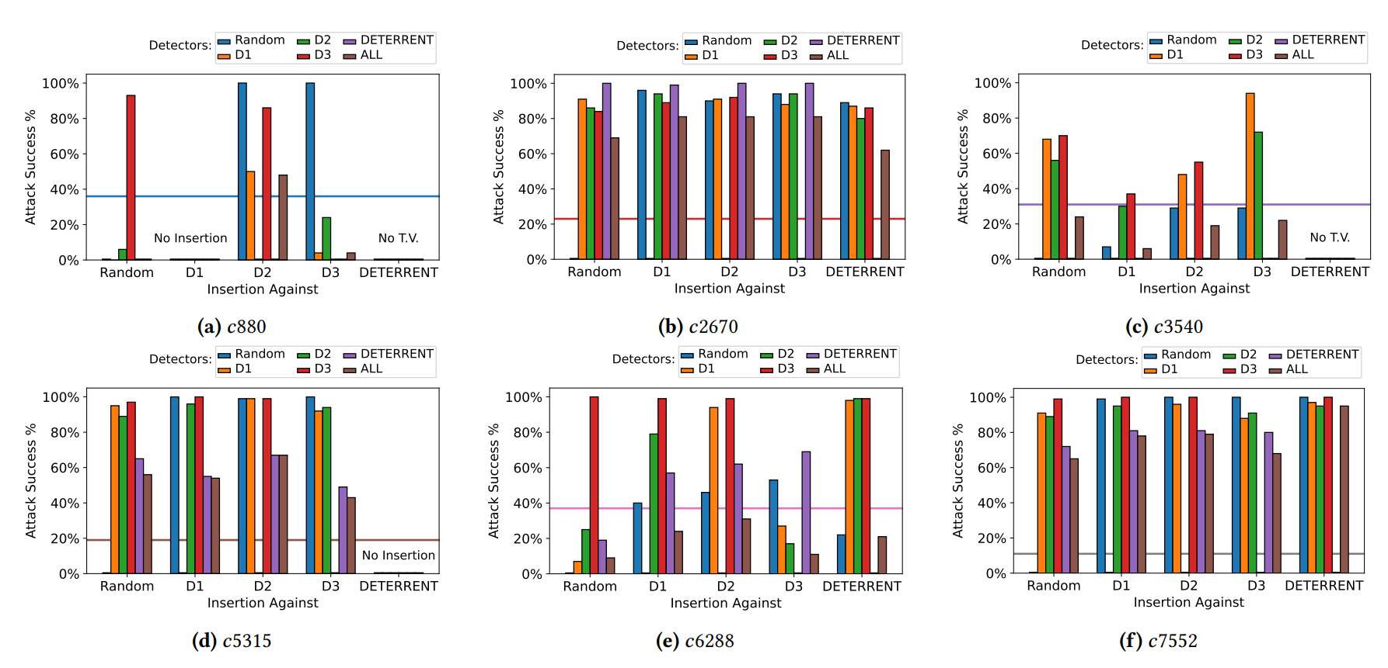
Attack Success Rates
[2] Sarihi, A., Jamieson, P., Patooghy, A., and Badawy, A. A., 2024, September. TrojanForge: Generating Adversarial Hardware Trojan Examples Using Reinforcement Learning, In Proceedings of the 2024 ACM/IEEE Workshop on Machine Learning for CAD.

Slide 29
Real-world HT Benchmarking
1

Slide 30
Real-world Benchmarking
Comparison of a) current HT detection approaches with static HT benchmarks that only contain HT-infected circuits vs. b) our proposed HT detection flow, including restructured benchmarks with and without HTs
Most HT detectors are trained on trust-hub.org benchmark suffering many issues:
Only three out of 83 studied HT circuits are usable in real-world scenarios
The major issues were pre-synthesis and post-synthesis discrepancies, unsatisfiable trigger conditions, and incorrect original designs [3].
Krieg, C., 2023, October. Reflections on trusting TrustHUB. In 2023 IEEE/ACM International Conference on Computer Aided Design (ICCAD) (pp. 1-9). IEEE.
30

Slide 31
Graph Structural Analysis
For more circuit variety, we can use ABC, an open-source logic optimization tool to transform each circuit graph to its equivalent AND-inverter-graph (AIG) circuit representation
One of the recent HT detection ideas: HW2VEC HT detector:
Uses GNNs (Graph Neural Networks) for HT detection
Extracts graph representations from hardware designs
HW2VEC provides 200 data points for each circuit
Question: Does graph restructuring techniques change the circuit representation?
31

Slide 32
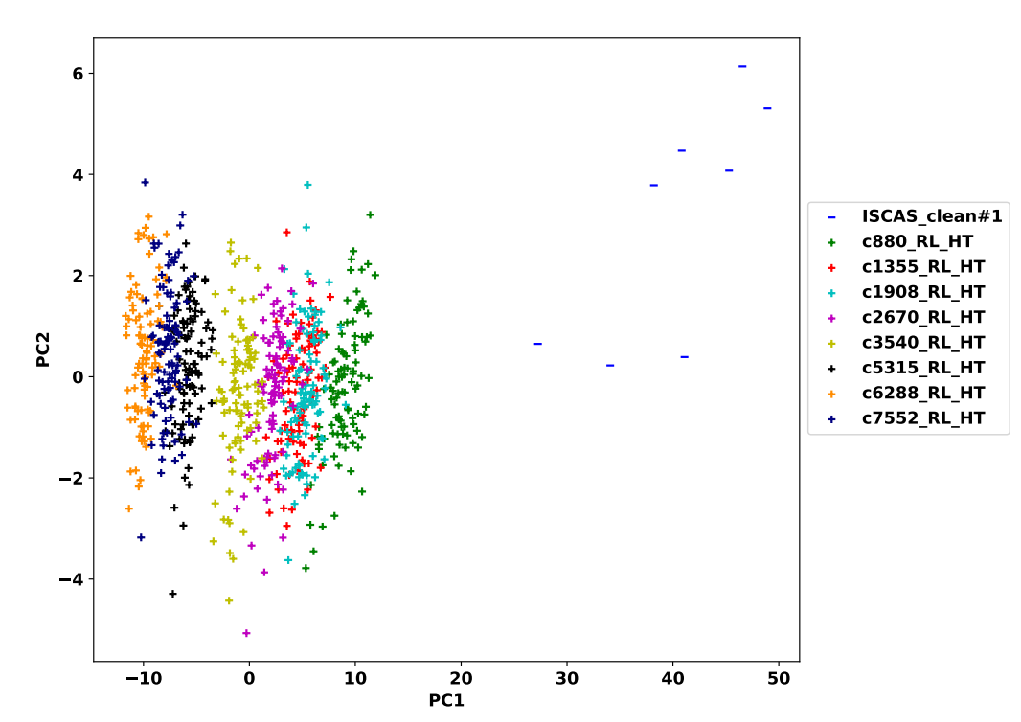
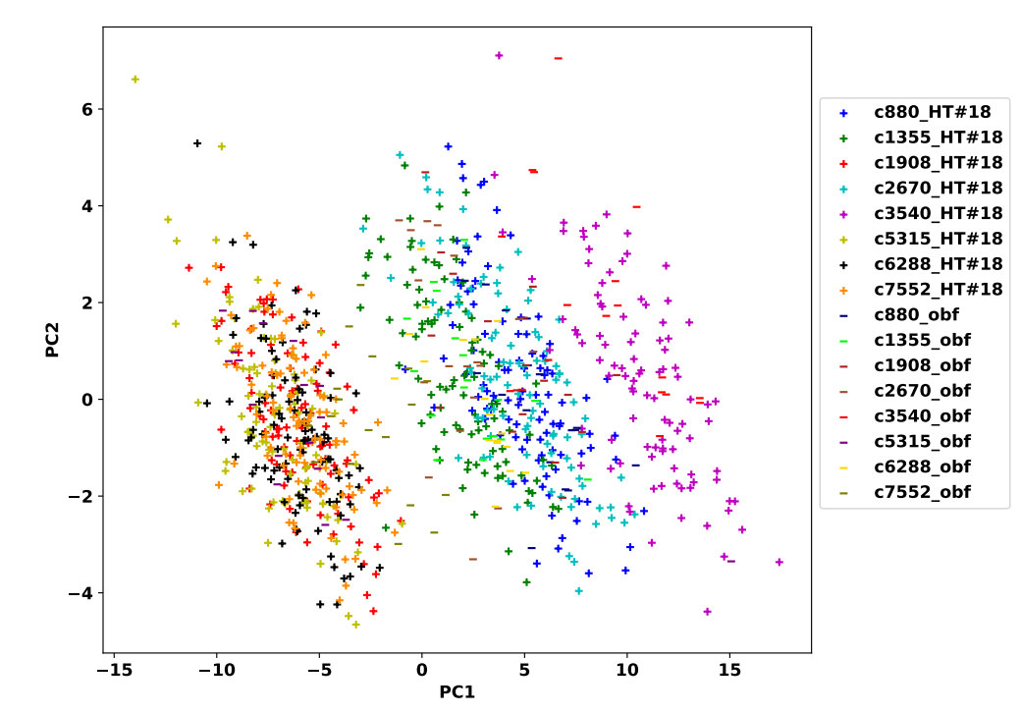
PCA Analysis Findings
Before graph restructuring
After graph restructuring (AIG)
PCA analysis of hidden HTs vs. clean functionally transformed ISCAS-85 circuits
HT-free and HT-infected circuits have very similar distributions after functional restructuring!
32

Slide 33
Impact of training dataset on HT Detection
HT detection accuracy of 18 functionally equivalent transformation methods trained with a) S1 and b) S2 for ISCAS-85 benchmarks.
The HT detection accuracy spans between 0%
and 80% for S1
The HT detection accuracy spans between 0%
and 20% for S2
S_{1:} 26 HT-infected and 11 HT-free instances. S_{2:} 26 HT-infected and 27 HT-free instances.
The training data heavily impacts the HT detection accuracy!
33

Slide 34
Conclusion & Future Work
1

Slide 35
Conclusion & Future Work
Conclusion:
Introduced automated multi-criteria HT insertion and detection
Demonstrated the vulnerabilities of HT detectors by generating adversarial HT instances in a GAN-like loop
Introduced a new HT benchmarking approach to mimic HT detection in a real-world scenario
Future directions:
Add support for sequential circuits
Experiment with circuit restructuring techniques in a GAN-like loop
1

Slide 36
Thank You!
1

