Slide 1
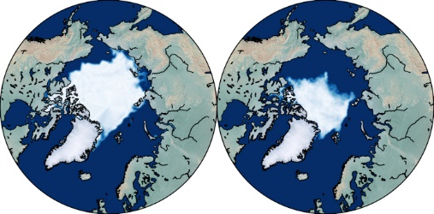
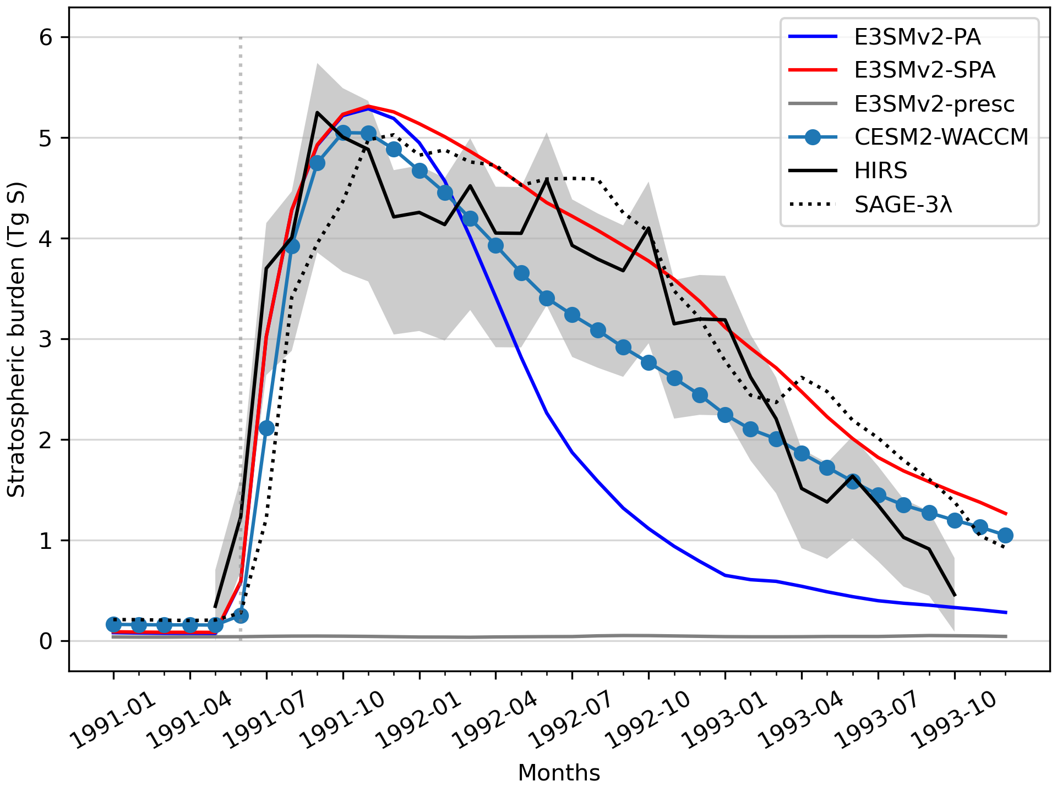
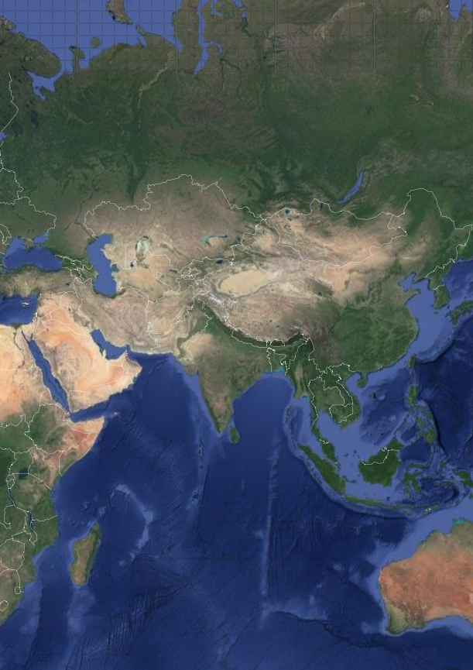
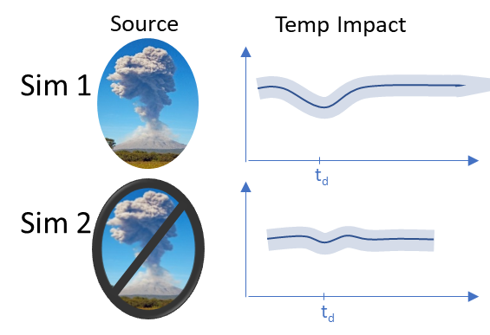
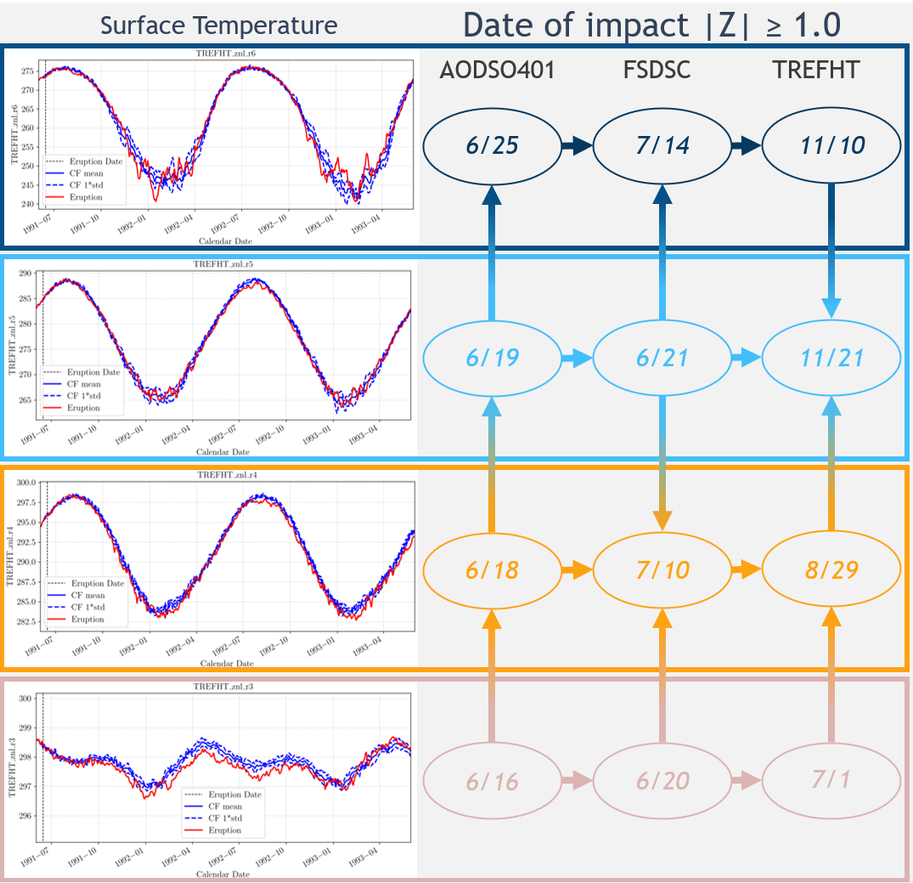
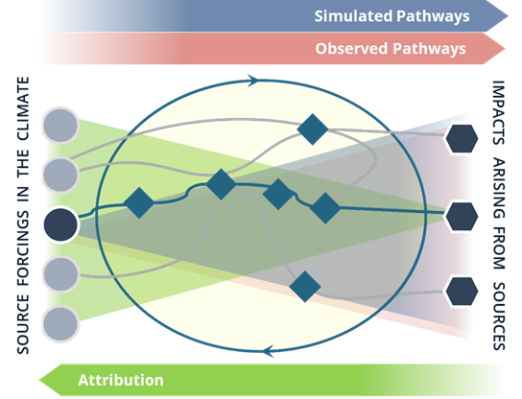
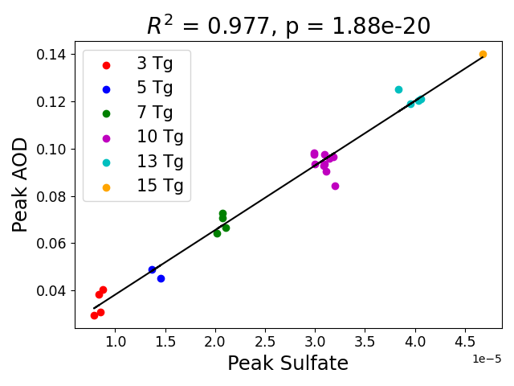
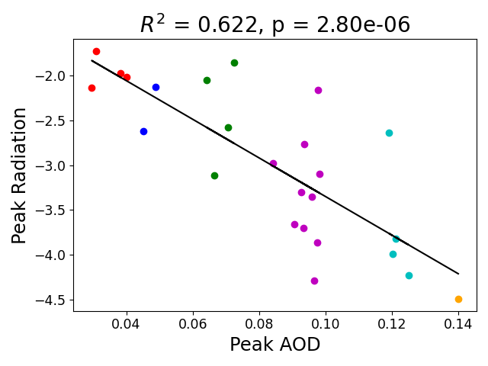
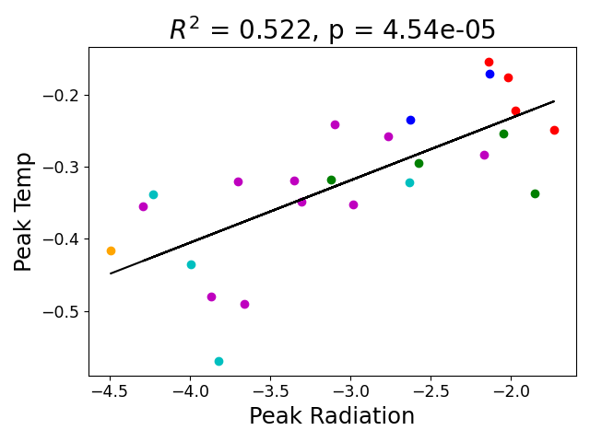
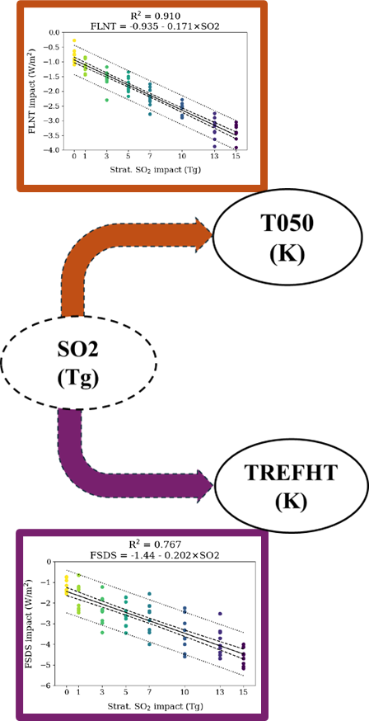
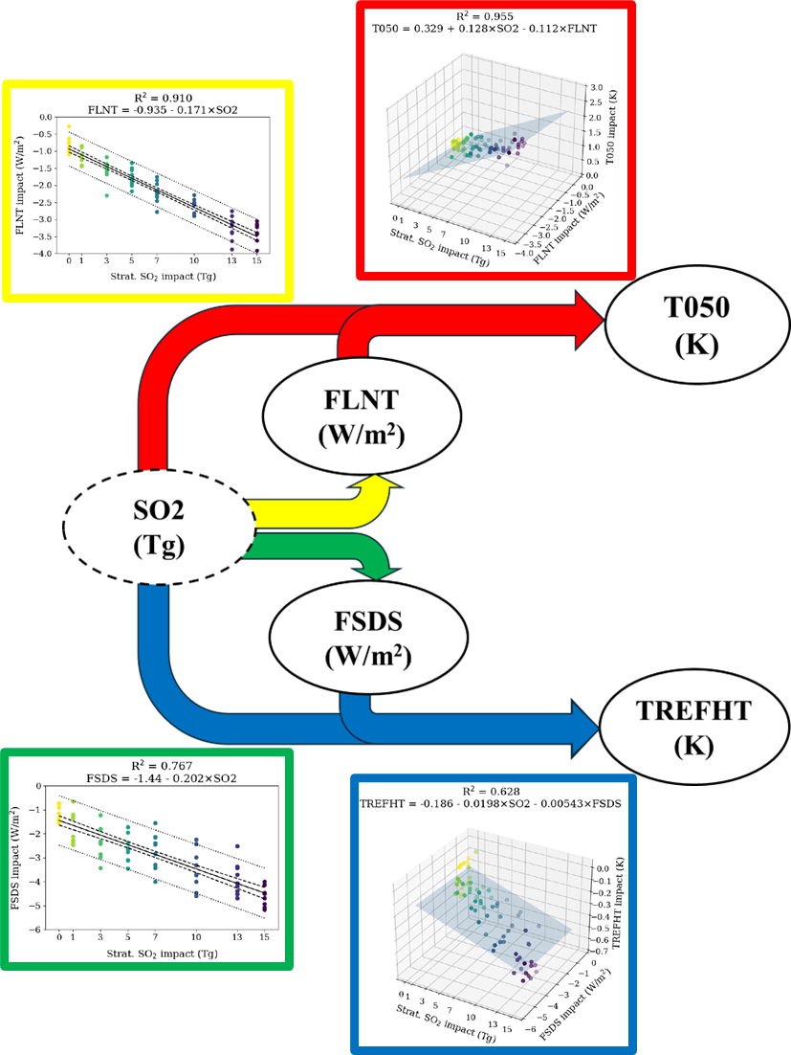
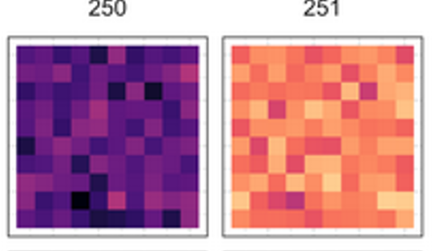
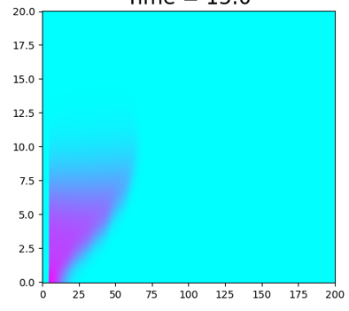
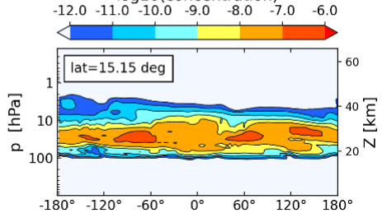
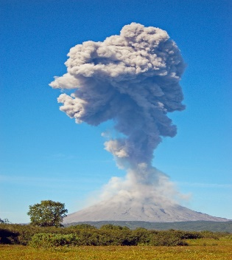
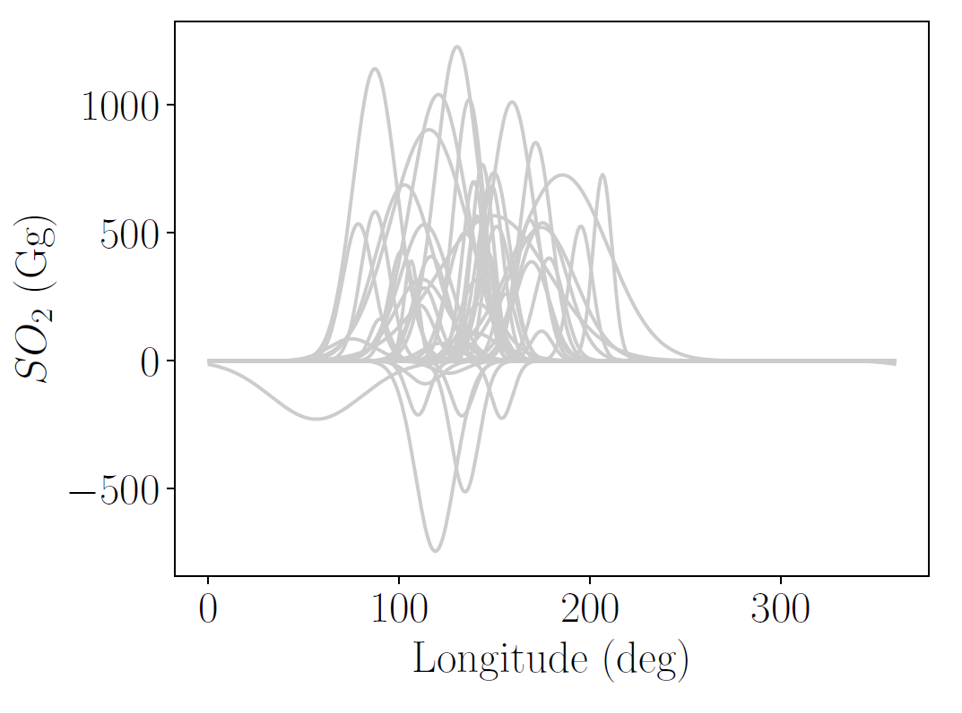
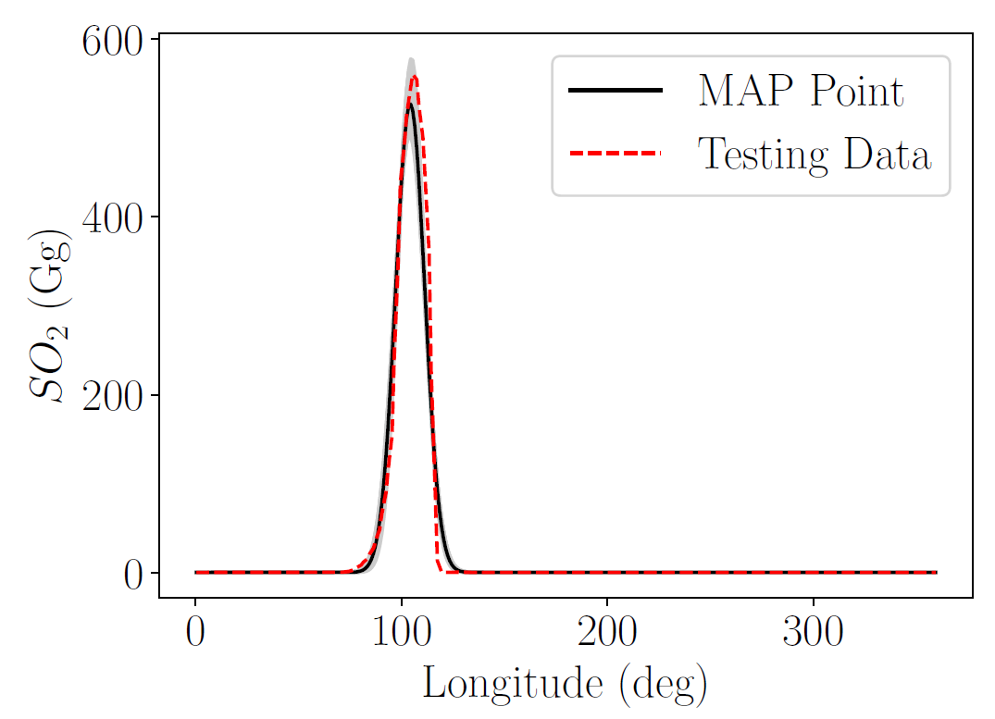
CLDERA – CLimate impact: Determining Etiology thRough pAthways Leadership Team: Diana Bull, Kara Peterson, Irina Tezaur, Lyndsay Shand, Laura Swiler
sandia.gov/cldera
OBJECTIVE
Sandia is advancing attribution science in the climate through quantitative approaches that capture the pathway from source to societally-relevant impacts.
Developed stratospheric expertise and aerosol modeling capabilities in E3SM
There is a great divide between current attribution science and what is needed for decision-makers.
Developed stratospheric prognostic aerosol
Only 5 GeoMIP6 models capable
Enhanced tracers – tagging & new diagnostics
Massive simulation campaign
400⁺ TB of data encompassing source magnitude varying ensembles
Innovative initial condition constrained, paired counter-factual ensembles
Uncovered biases in E3SM stratosphere
Overall overturning circulation slow, QBO fast
Validated stratospheric aerosol performance in E3SMv2-SPA against observations (Brown et al. 2024)
Will a shift in mid-latitude climate be attributable to the disappearance of Arctic Sea Ice?
Will a shift in Indian monsoon be attributable to the development of Sky River?
Before CLDERA
E3SM has strong dry bias in stratosphere (Jablonowski)
Complex coupling between Earth system processes obscures relationships between sources and downstream impacts.
Posit and fingerprint to establish impact’s relationship to source
Created original methods to detect and model pathways from source to impact
The technical challenge is to draw quantitative relationships in a multi-step attribution framework.
Developed and implemented 8 novel methods to understand pathways
Advanced machine learning and statistical approaches that all consider multiple variables
Exploratory and confirmatory approaches
E3SM in situ approach
Extended detection methods for spatio-temporally evolving changes
Surface Temp
After CLDERA
Polar [65N→90N]
Aerosol
Rad
Temp
Modified from: http://www.thesourgrapevine.com/2019/11/the-ball-of-string-theory-for-learning.html
APPROACH
Model impact’s relationship to source through multiple steps over space and time
Temperate [35N→65N]
Employ well-observed and researched localized source forcing for method development
Stratospheric injection of sulfur dioxide in the 1991 eruption of Mt. Pinatubo in the Philippines
Develop quantitative approaches capable of representing multi-variate pathways (e.g., spatio-temporally evolving relationships) between source and impact
Understand climate system
Detect changes
Represent relationships
Model the time evolution of relationships
Use approaches to develop attribution techniques
Ensure robust quantitative approaches through tiered verification
Subtropical [23.5N→35N]
Poleward via Brewer–Dobson Circulation
Data Source
E3SM
MERRA2
Explainable Echo State Networks to identify how input variables are used in predictions (Goode et al. 2024., McClernon et al. 2024., Ries et al.
Tropical [23.5S→23.5N]
With Eruption
Without Eruption
Commandeer profiling techniques with CLDERA-Tools for in situ tracking of space-time statistics with graph-based pathway depiction (Steyer, et al. 2024, Watkins, et al.)
Modeling pathways with Explainable Echo State Networks to determine how input variables are used in predictions (Goode et al. 2024., McClernon et al. 2024., Ries et al.
Evolved climate attribution through novel methods, cases, and approaches
Methods to determine forcing magnitude given an impact
Novel employment of pattern-scaling to identify relationships that are robust to variability in the system
Epidemiological dose-response
Constraining natural variability to sharpen impacts
Similar to analogues / storyline approaches
ENSO3.4 and QBO initialized to historical values
References
Developing methods using increasingly complex datasets
Meredith G. L. Brown, Matt Peterson, Irina Tezaur, Kara Peterson, and Diana Bull. “Random Forest Regression Feature Importance for Climate Impact Pathway Detection.” Submitted to Journal of Computational and Applied Mathematics, September 2024.
Hart, Joseph and Gulian, Mamikon and Manickam, Indu, and Swiler, Laura P. "Solving high-dimensional inverse problems with auxiliary uncertainty via operator learning with limited data," Journal of Machine Learning for Modeling and Computing, Volume 4, Issue 2, 2023, pp. 105-133. DOI: 10.1615/JMachLearnModelComput.2023048105 arXiv: https://arxiv.org/abs/2303.11379
Joseph P. Hollowed, Christiane Jablonowski, Hunter Y. Brown, Benjamin R. Hillman, Diana L. Bull, and Joseph L. Hart. “HSW-V v1.0: localized injections of interactive volcanic aerosols and their climate impacts in a simple general circulation model.” Geoscientific Model Development, 17, 5913–5938, https://doi.org/10.5194/gmd-17-5913-2024, 2024.
Brown, H. Y., Wagman, B., Bull, D., Peterson, K., Hillman, B., Liu, X., Ke, Z., and Lin, L. “Validating a microphysical prognostic stratospheric aerosol implementation in E3SMv2 using observations after the Mount Pinatubo eruption.” Geoscientific Model Development, 17, 5087–5121, https://doi.org/10.5194/gmd-17-5087-2024, 2024.
Jablonowski, C., Hollowed, J., Nguyen, L., Hillman, B., Ehrmann, T., Wagman, B. “Stratospheric Characteristics in E3SMv2.” To be submitted by December 2024.
K. Goode, D. Ries, and K. McClernon, “Characterizing climate pathways using feature importance on echo state networks”, Stat. Anal. Data Min.: ASA Data Sci. J. 17 (2024), e11706. https://doi.org/10.1002/sam.11706.
McClernon, Kellie. Goode, Katherine. Ries, Daniel. “A comparison of model validation approaches for echo state networks using climate model replicates”. Spatial Statistics. 2024. https://doi.org/10.1016/j.spasta.2024.100813
Daniel Ries, Katherine Goode, Kellie McClernon, and Ben Hillman. “Using feature importance as exploratory data analysis tool on earth system models.” Submitted to GMD Special Issue: Theoretical and computational aspects of ensemble design, implementation, and interpretation in climate science, July 2024. The review preprint is available at: https://gmd.copernicus.org/preprints/gmd-2024-133/
Andrew Steyer, Luca Bertagna, Graham Harper, JerryWatkins, Irina Tezaur, and Diana Bull. “In-situ data extraction for pathway analysis in an idealized atmosphere configuration of E3SM.” Submitted to Computing in Science & Engineering, August 2024.
Jerry Watkins, Luca Bertagna, Graham Harper, Andrew Steyer, Irina Tezaur, and Diana Bull. “Entropy-based feature selection for capturing impacts in Earth system models with extreme forcing.” Submitted to Journal of Computational and Applied Mathematics, September 2024.
Joseph Hart, Indu Manickam, Mamikon Gulian, Laura Swiler, Diana Bull, Thomas Ehrmann, Hunter Brown, Benj Wagman, and Jerry Watkins. Stratospheric aerosol source inversion: Noise, variability, and uncertainty quantification, submitted to Journal of Machine Learning for Modeling and Computing. This manuscript is available on arXiv, https://doi.org/ 10.48550/arXiv.2409.06846.
Christopher R. Wentland, Michael Weylandt, Laura P. Swiler, Thomas S. Ehrmann, Diana Bull. “Conditional multi-step attribution for climate forcings.” Submitted to Journal of Climate, Aug. 2024. This manuscript is available on arXiv: https://doi.org/10. 48550/arXiv.2409.01396.
Operator Neural Network prediction across winds
Test data
Day 1
Day 5
Day 9
Correct source forcing obtained from inverse optimization in the face of both wind variability and background aerosol signals using operator learning representations simulation output (Hart)
prior
posterior
43.5%
76.9%
Synthetic Relationships (M. Brown)
Wind Driven Gaussian Plume (Hart et al., 2023)
Idealized atm. + embedded pathways (Hollowed et al., 2024)
Mt. Pinatubo in fully coupled climate model (H. Brown et al., 2024)
prior
Best Bayesian Estimate
posterior
Successful demonstration of inverse optimization using deep learning representations of fully-coupled E3SM simulation output (Wentland)
SAND2024-

