Slide 1
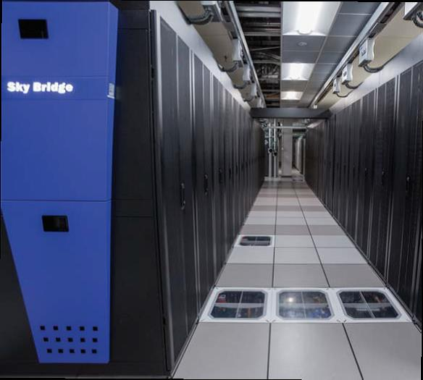
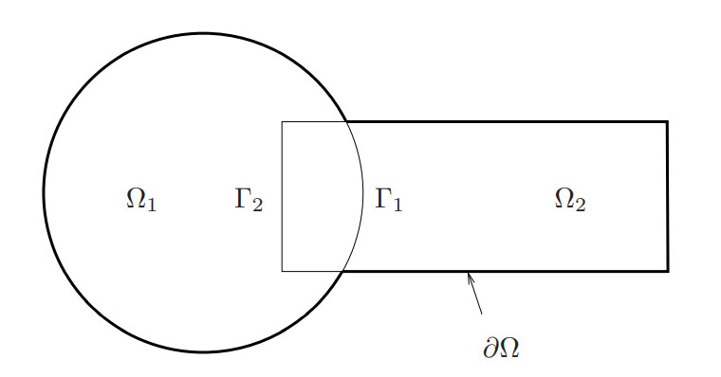
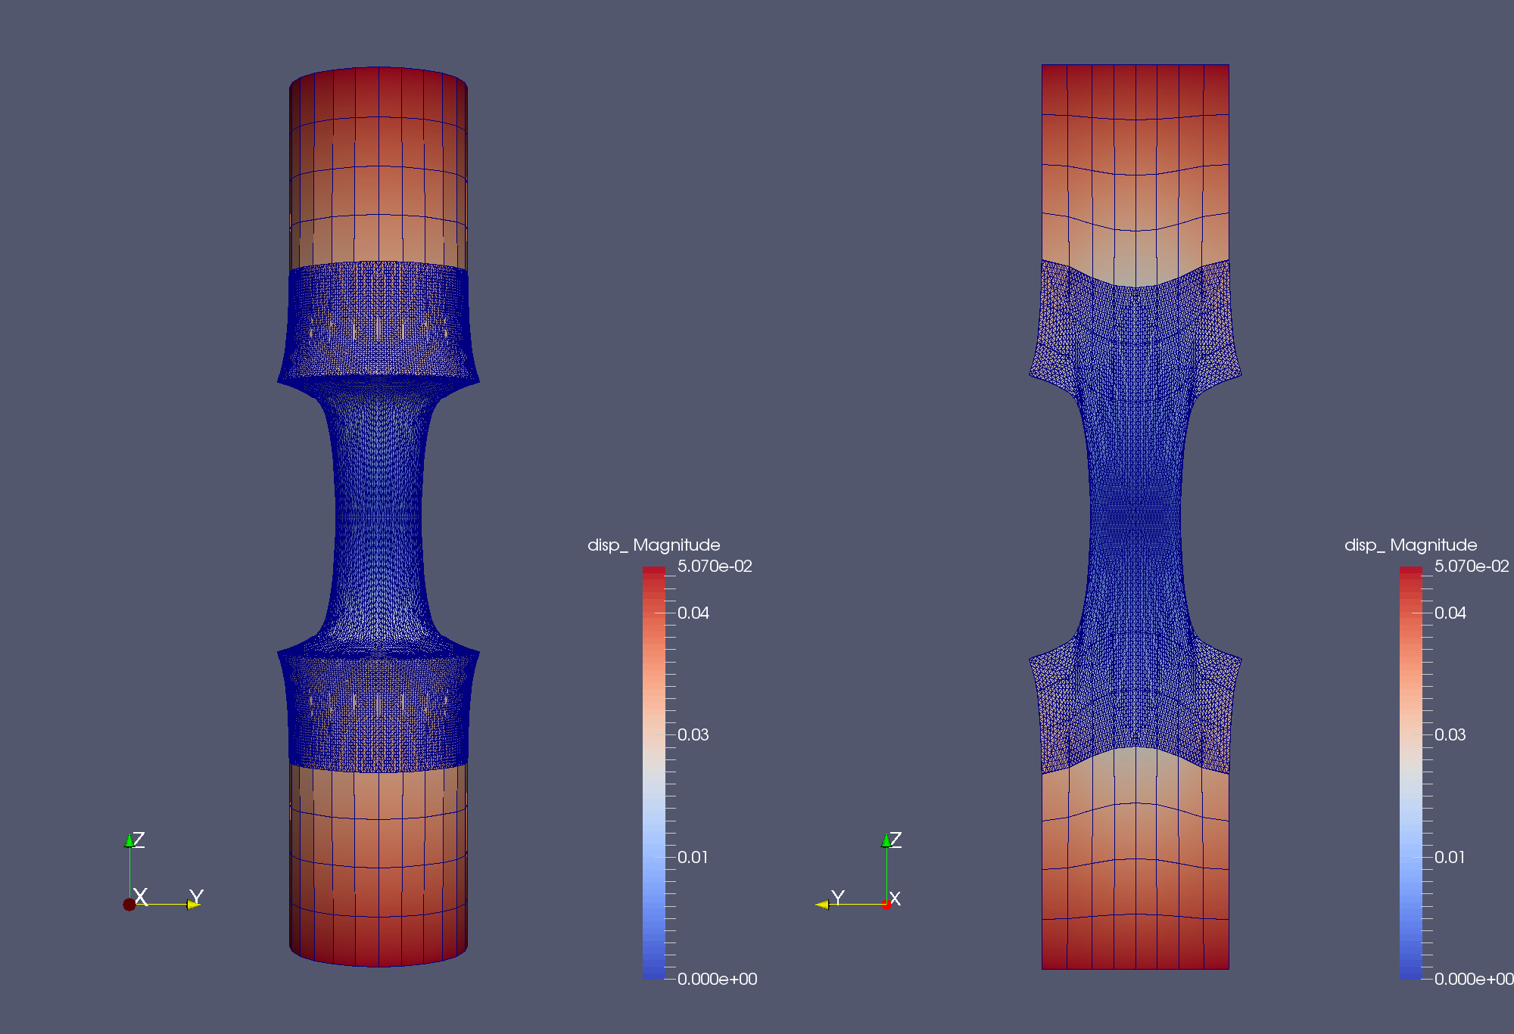
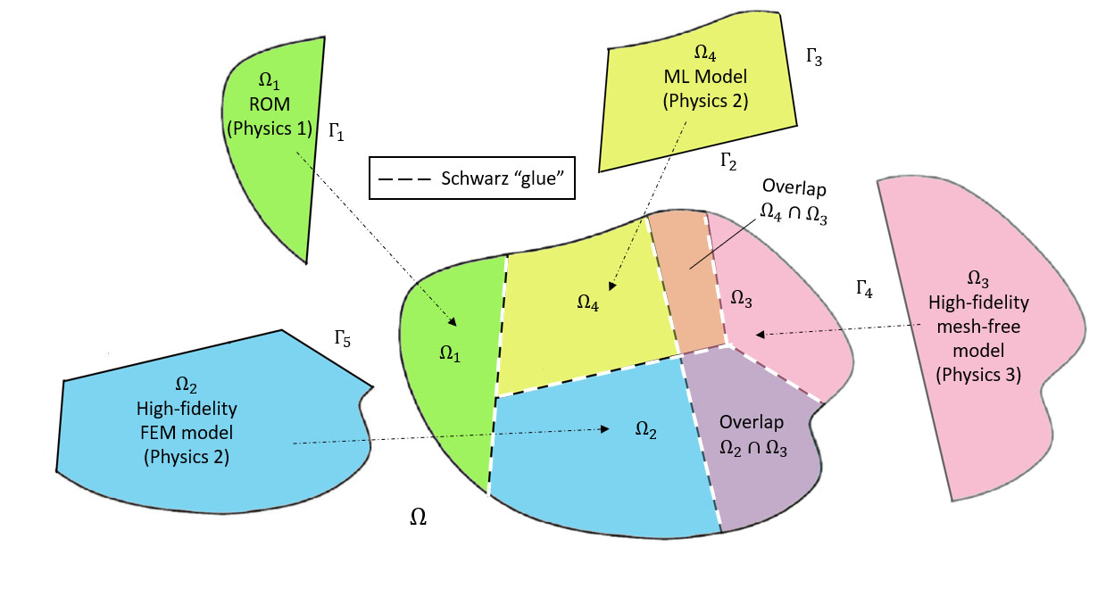
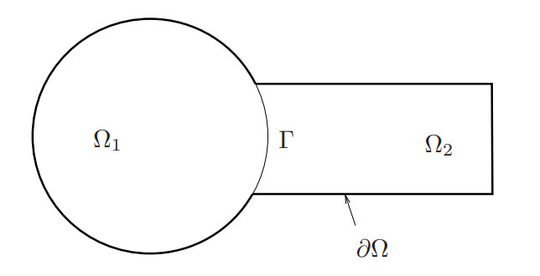
Flexible domain decomposition-based couplings of conventional and data-driven models via the Schwarz alternating method
Irina Tezaur¹, Chris Wentland¹, Francesco Rizzi², Joshua Barnett³, Alejandro Mota¹
¹Sandia National Laboratories, ²NexGen Analytics, ³Cadence Design Systems
2nd AMS-UMI International Joint Meeting
Palermo, Italy. July 23-26, 2024
SAND2024-08453C

Slide 2
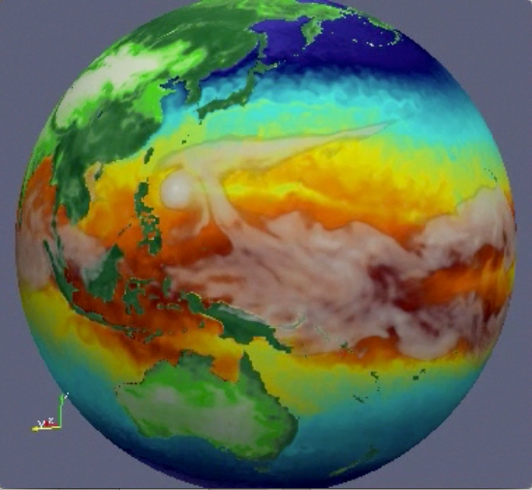

Motivation: multi-scale & multi-physics coupling
Atmos.
(EAM)
Ocean
(MPAS-O)
☺
There exist established rigorous mathematical theories for coupling multi-scale and multi-physics components based on traditional discretization methods (“Full Order Models” or FOMs).
Sea Ice
(MPAS-SI)
Land
(ELM)
Land Ice
(MALI)
N₁
N₂
N₁
N₂
M₁
M₂
M₃
M₄
N₄
N₃
N₄
N₃
N₅
N₅
Complex System Model
Traditional Methods
Coupled Numerical Model
PDEs, ODEs
Nonlocal integral
Classical DFT
Atomistic, …
Mesh-based (FE, FV, FD)
Meshless (SPH, MLS)
Implicit, explicit
Eulerian, Lagrangian…
Monolithic (Lagrange multipliers)
Partitioned (loose) coupling
Iterative (Schwarz, optimization)
Notes:
The past decades have seen a tremendous amount of investment in the development of simulation frameworks for coupled multi-scale and multi-physics problems. These frameworks rely on established mathematical theories to couple physics components discretized using so-called traditional discretization methods such as finite elements, finite volumes and finite differences. A prime example is the DOE’s global climate model, the Energy Exascale Earth System Model (E3SM), which couples 5 physics components (atmosphere, ocean, sea ice, land ice and land). Each component is developed separately according to the relevant physics, dynamics and numerical methods, and the components are coupled in a way that ensures stability, accuracy and conservation.

Slide 3
Motivation: multi-scale & multi-physics coupling
Atmos.
(EAM)
Ocean
(MPAS-O)
☺
There exist established rigorous mathematical theories for coupling multi-scale and multi-physics components based on traditional discretization methods (“Full Order Models” or FOMs).
Sea Ice
(MPAS-SI)
Land
(ELM)
Land Ice
(MALI)
N₁
N₂
N₁
N₂
N₁
PINN=N₂
M₁
M₂
M₃
M₄
N₄
N₃
N₄
ROM=N₄
N₃
N₅
DMD=N₃
N₅
UDE=N₅
Complex System Model
Traditional Methods
Coupled Numerical Model
Traditional + Data-Driven Methods
PDEs, ODEs
Nonlocal integral
Classical DFT
Atomistic, …
Mesh-based (FE, FV, FD)
Meshless (SPH, MLS)
Implicit, explicit
Eulerian, Lagrangian, …
Monolithic (Lagrange multipliers)
Partitioned (loose) coupling
Iterative (Schwarz, optimization)
PINNs
Neural ODEs
Projection-based ROMs, …
Unfortunately, existing algorithmic and software infrastructures are ill-equipped to handle plug-and-play integration of non-traditional, data-driven models!
☹

Slide 4

Flexible Heterogeneous Numerical Methods (fHNM) Project
Principal research objective:
Discover mathematical principles guiding the assembly of standard and data-driven numerical models in stable, accurate and physically consistent ways.
Principal research goals:
“Mix-and-match” standard and data-driven models from three-classes
  Class A: projection-based reduced order models (ROMs)
  Class B: machine-learned models, i.e., Physics-Informed Neural Networks (PINNs)
  Class C: flow map approximation models, i.e., dynamic model decomposition (DMD) models
This talk.
Ensure well-posedness & physical consistency of resulting heterogeneous models.
Solve such heterogeneous models efficiently.
Three coupling methods:
Alternating Schwarz-based coupling
Optimization-based coupling
Coupling via generalized mortar methods
This talk.

Slide 5
Outline
The Schwarz Alternating Method for Domain Decomposition-Based Coupling
Extension to FOM*-ROM# and ROM-ROM Coupling
Numerical Examples
  2D Burgers Equation
  2D Shallow Water Equations
  Teaser: 2D Euler Equations Riemann Problem
Summary & Future Work
*Full-Order Model. #Reduced Order Model.

Slide 6
Outline
The Schwarz Alternating Method for Domain Decomposition-Based Coupling
Extension to FOM*-ROM# and ROM-ROM Coupling
Numerical Examples
  2D Burgers Equation
  2D Shallow Water Equations
  Teaser: 2D Euler Equations Riemann Problem
Summary & Future Work
*Full-Order Model. #Reduced Order Model.

Slide 7
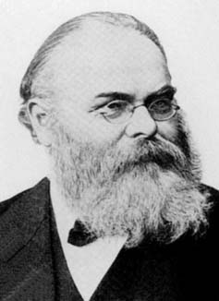
Schwarz Alternating Method for Domain Decomposition
Proposed in 1870 by H. Schwarz for solving Laplace PDE on irregular domains.
Crux of Method: if the solution is known in regularly shaped domains, use those as pieces to iteratively build a solution for the more complex domain.
H. Schwarz (1843–1921)
Basic Schwarz Algorithm
overlapping
Initialize:
Solve PDE by any method on $Ω_{1}$ w/ initial guess for transmission BCs on $Γ_{1}$.
Iterate until convergence:
Solve PDE by any method on $Ω_{2}$ w/ transmission BCs on $Γ_{2}$ based on values just obtained for $Ω_{1}$.
Solve PDE by any method on $Ω_{1}$ w/ transmission BCs on $Γ_{1}$ based on values just obtained for $Ω_{2}$.
non-overlapping
Schwarz alternating method most commonly used as a preconditioner for Krylov iterative methods to solve linear algebraic equations.
Idea behind this work: using the Schwarz alternating method as a discretization method for solving multi-scale or multi-physics partial differential equations (PDEs).
²Lions, 1990. ³Zanolli et al., 1987.

Slide 8
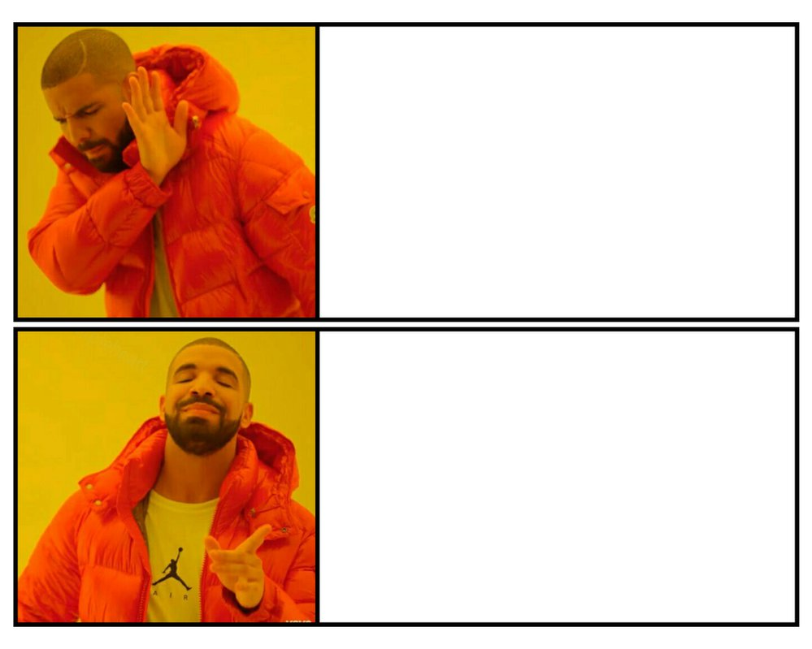
How We Use the Schwarz Alternating Method
8
AS A PRECONDITIONER FOR THE LINEARIZED SYSTEM
AS A SOLVER FOR THE COUPLED
FULLY NONLINEAR PROBLEM

Slide 9



Spatial Coupling via (Multiplicative) Alternating Schwarz
Overlapping Domain Decomposition
$$\left\{\begin{aligned} N(u)=f\text{,} \text{in} Ω \\ u=g\text{,} \text{on} ∂Ω \end{aligned}\right.$$
$$\left\{\begin{aligned}N\left(u_{1}^{(n+1)}\right)=f \text{, }\text{in} Ω_{1} \\ u_{1}^{(n+1)}=g\text{, }\text{o}\text{n} ∂Ω_{1}\backslash Γ_{1} \\ u_{1}^{(n+1)}=u_{2}^{(n)} \text{on} Γ_{1}\end{aligned}\right.$$
Model PDE:
Dirichlet-Dirichlet transmission BCs [Schwarz 1870; Lions 1988; Mota et al. 2017; Mota et al. 2022]
$$\left\{\begin{aligned}N\left(u_{2}^{(n+1)}\right)=f \text{, }\text{in} Ω_{2} \\ u_{2}^{(n+1)}=g\text{, }\text{o}\text{n} ∂Ω_{2}\backslash Γ_{2} \\ u_{2}^{(n+1)}=u_{1}^{(n+1)} \text{on} Γ_{2}\end{aligned}\right.$$
Non-overlapping Domain Decomposition
$$\left\{\begin{aligned}N\left(u_{1}^{(n+1)}\right)=f\text{, } \text{in} Ω_{1} \\ u_{1}^{(n+1)}=g\text{, } \text{on} ∂Ω_{1}\backslash Γ \\ u_{1}^{(n+1)}=λ_{n+1}, \text{on} Γ\end{aligned}\right.$$
Relevant for multi-material and multi-physics coupling
Alternating Dirichlet-Neumann transmission BCs [Zanolli et al. 1987]
Robin-Robin transmission BCs also lead to convergence [Lions 1990]
$θ∈\left[0,1\right]:$relaxation parameter (can help convergence)
$$\left\{\begin{aligned}N\left(u_{2}^{(n+1)}\right)=f \text{, } \text{in} Ω_{2} \\ u_{2}^{(n+1)}=g\text{, } \text{on} ∂Ω_{2}\backslash Γ \\ {∇u}_{2}^{(n+1)}∙n={∇u}_{1}^{(n+1)}∙n\text{, }\text{on} Γ\end{aligned}\right.$$
$$λ_{n+1}=θφ_{2}^{(n)}+\left(1−θ\right)λ_{n}, on Γ, for n≥1$$

Slide 10
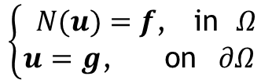
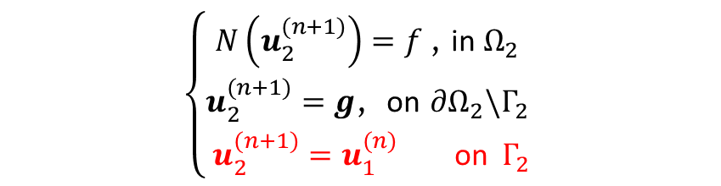

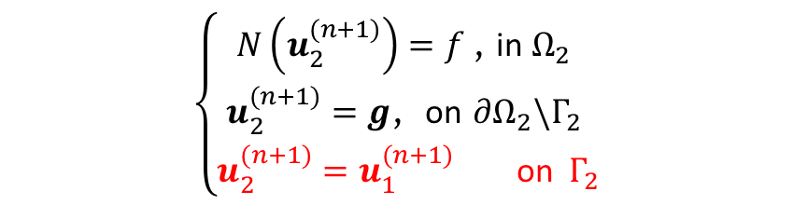

Additional Parallelism via Additive Schwarz
Model PDE:
Multiplicative Overlapping Schwarz
Additive Overlapping Schwarz
$$\left\{\begin{aligned} N(u)=f\text{,} \text{in} Ω \\ u=g\text{,} \text{on} ∂Ω \end{aligned}\right.$$
$$\left\{\begin{aligned}N\left(u_{1}^{(n+1)}\right)=f \text{, }\text{in} Ω_{1} \\ u_{1}^{(n+1)}=g\text{, }\text{o}\text{n} ∂Ω_{1}\backslash Γ_{1} \\ u_{1}^{(n+1)}=u_{2}^{(n)} \text{on} Γ_{1}\end{aligned}\right.$$
$$\left\{\begin{aligned}N\left(u_{1}^{(n+1)}\right)=f \text{, }\text{in} Ω_{1} \\ u_{1}^{(n+1)}=g\text{, }\text{o}\text{n} ∂Ω_{1}\backslash Γ_{1} \\ u_{1}^{(n+1)}=u_{2}^{(n)} \text{on} Γ_{1}\end{aligned}\right.$$
$$\left\{\begin{aligned}N\left(u_{2}^{(n+1)}\right)=f \text{, }\text{in} Ω_{2} \\ u_{2}^{(n+1)}=g\text{, }\text{o}\text{n} ∂Ω_{2}\backslash Γ_{2} \\ u_{2}^{(n+1)}=u_{1}^{(n+1)} \text{on} Γ_{2}\end{aligned}\right.$$
$$\left\{\begin{aligned}N\left(u_{2}^{(n+1)}\right)=f \text{, }\text{in} Ω_{2} \\ u_{2}^{(n+1)}=g\text{, }\text{o}\text{n} ∂Ω_{2}\backslash Γ_{2} \\ u_{2}^{(n+1)}=u_{1}^{(n)} \text{on} Γ_{2}\end{aligned}\right.$$
Multiplicative Schwarz: solves subdomain problems sequentially (in serial)
Additive Schwarz: advance subdomains in parallel, communicate boundary condition data later
  Typically requires a few more Schwarz iterations, but does not degrade accuracy
  Parallelism helps balance additional cost due to Schwarz iterations
  Applicable to both overlapping and non-overlapping Schwarz

Slide 11
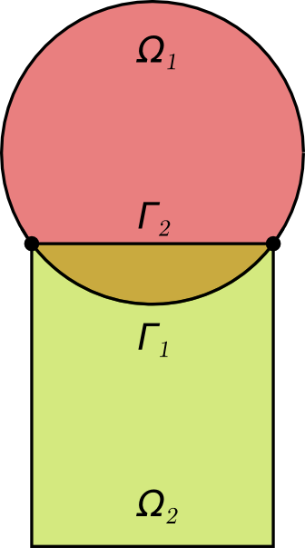
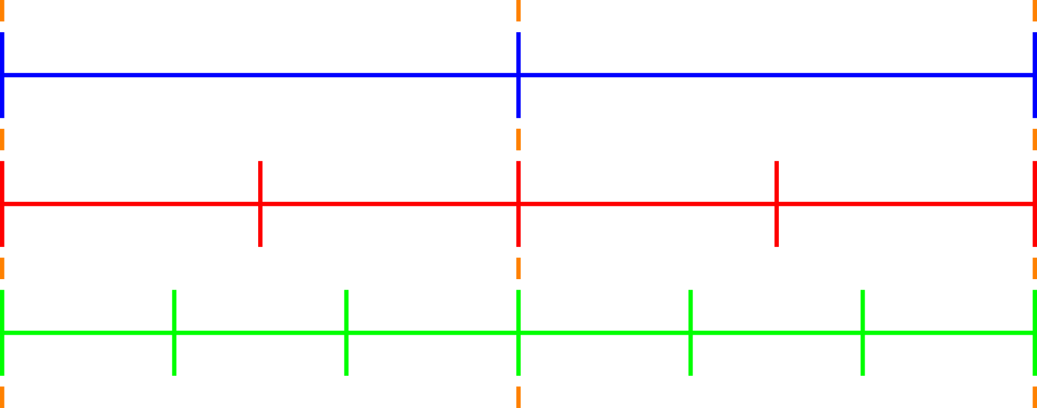
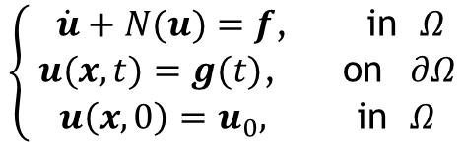
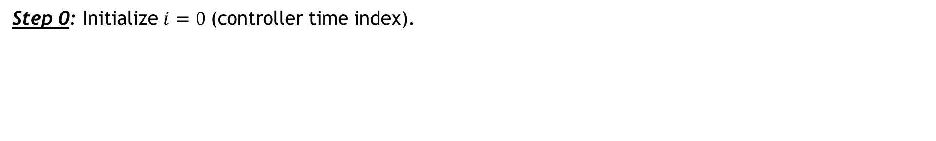


Time-Advancement Within the Schwarz Framework
$$T_{0}$$
$$T_{1}$$
Controller time stepper
Time integrator for Ω₁
Time integrator for Ω₂
Step 0: Initialize $i=0 \text{(}\text{controller} \text{time} \text{index}\text{).}$
$$\left\{ \begin{aligned} \dot{u}+N(u)=f\text{,} \text{in} Ω \\ u(x,t)=g(t)\text{,} \text{on} ∂Ω \\ u\left(x,0\right)=u_{0}, \text{in} Ω\end{aligned}\right.$$
Model PDE:
Notes:
TODO? Change equations?

Slide 12
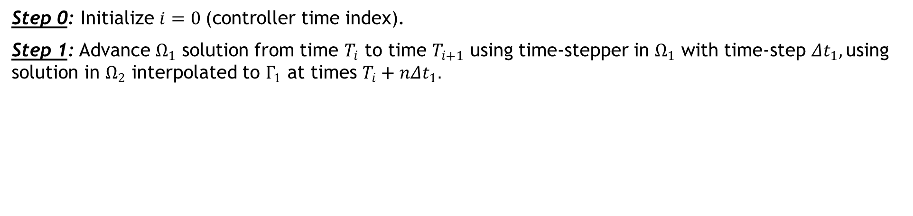

Time-Advancement Within the Schwarz Framework
$$T_{0}$$
$$T_{1}$$
Controller time stepper
Time integrator for Ω₁
Time integrator for Ω₂
Integrate using ${Δt}_{1}$
Step 0: Initialize $i=0 \text{(}\text{controller} \text{time} \text{index}\text{).}$
Step 1: Advance $Ω_{1}$ solution from time $T_{i}$ to time $T_{i+1}$ using time-stepper in $Ω_{1}$ with time-step ${Δt}_{1},$using solution in $Ω_{2}$ interpolated to $Γ_{1}$ at times $T_{i}+n{Δt}_{1}.$
$$\left\{ \begin{aligned} \dot{u}+N(u)=f\text{,} \text{in} Ω \\ u(x,t)=g(t)\text{,} \text{on} ∂Ω \\ u\left(x,0\right)=u_{0}, \text{in} Ω\end{aligned}\right.$$
Model PDE:

Slide 13
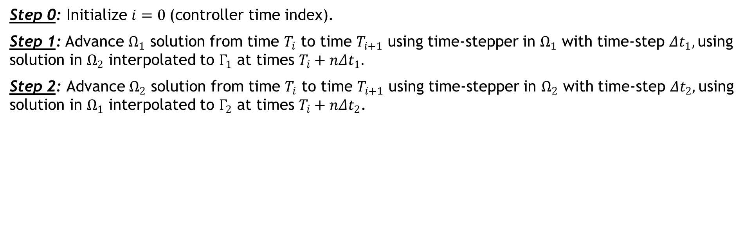


Time-Advancement Within the Schwarz Framework
$$T_{0}$$
$$T_{1}$$
Controller time stepper
Time integrator for Ω₁
Time integrator for Ω₂
Interpolate from $Ω_{1}$ to $Γ_{2}$
Integrate using ${Δt}_{2}$
Step 0: Initialize $i=0 \text{(}\text{controller} \text{time} \text{index}\text{).}$
Step 1: Advance $Ω_{1}$ solution from time $T_{i}$ to time $T_{i+1}$ using time-stepper in $Ω_{1}$ with time-step ${Δt}_{1},$using solution in $Ω_{2}$ interpolated to $Γ_{1}$ at times $T_{i}+n{Δt}_{1}.$
Step 2: Advance $Ω_{2}$ solution from time $T_{i}$ to time $T_{i+1}$ using time-stepper in $Ω_{2}$ with time-step ${Δt}_{2},$using solution in $Ω_{1}$ interpolated to $Γ_{2}$ at times $T_{i}+n{Δt}_{2}$.
$$\left\{ \begin{aligned} \dot{u}+N(u)=f\text{,} \text{in} Ω \\ u(x,t)=g(t)\text{,} \text{on} ∂Ω \\ u\left(x,0\right)=u_{0}, \text{in} Ω\end{aligned}\right.$$
Model PDE:

Slide 14
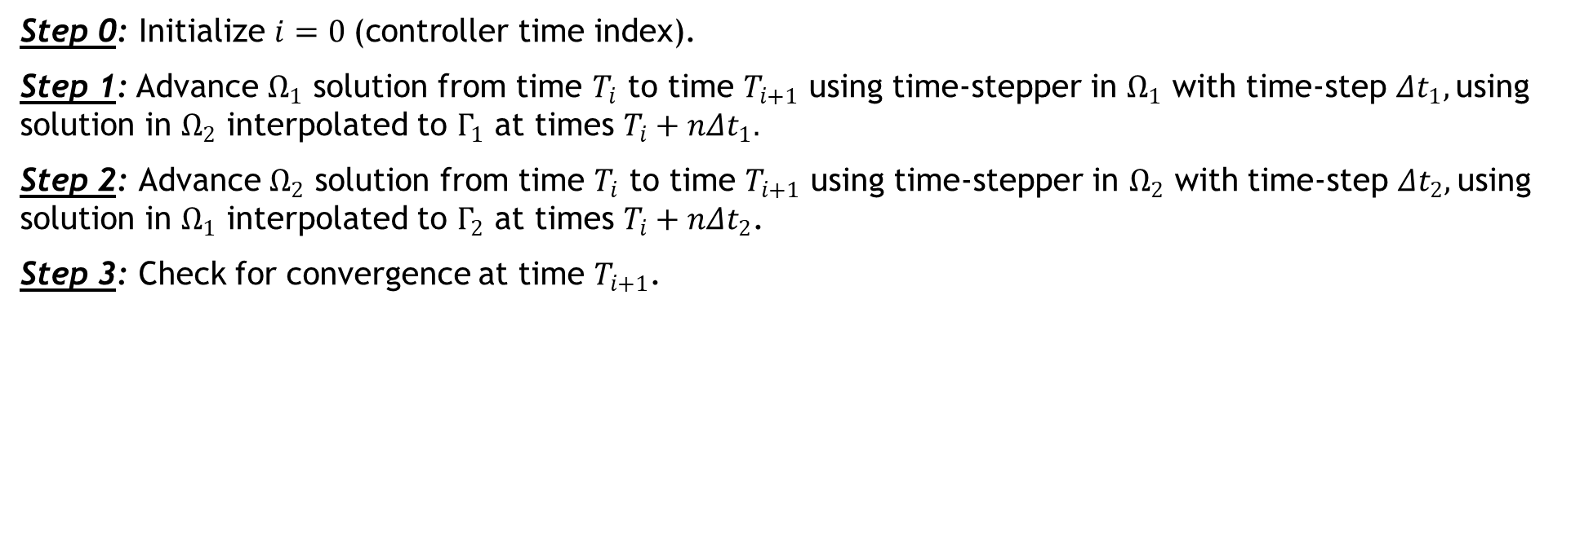
Time-Advancement Within the Schwarz Framework
$$T_{0}$$
$$T_{1}$$
Controller time stepper
Time integrator for Ω₁
Time integrator for Ω₂
Step 0: Initialize $i=0 \text{(}\text{controller} \text{time} \text{index}\text{).}$
Step 1: Advance $Ω_{1}$ solution from time $T_{i}$ to time $T_{i+1}$ using time-stepper in $Ω_{1}$ with time-step ${Δt}_{1},$using solution in $Ω_{2}$ interpolated to $Γ_{1}$ at times $T_{i}+n{Δt}_{1}.$
Step 2: Advance $Ω_{2}$ solution from time $T_{i}$ to time $T_{i+1}$ using time-stepper in $Ω_{2}$ with time-step ${Δt}_{2},$using solution in $Ω_{1}$ interpolated to $Γ_{2}$ at times $T_{i}+n{Δt}_{2}$.
Step 3: Check for convergence at time $T_{i+1}$.
$$\left\{ \begin{aligned} \dot{u}+N(u)=f\text{,} \text{in} Ω \\ u(x,t)=g(t)\text{,} \text{on} ∂Ω \\ u\left(x,0\right)=u_{0}, \text{in} Ω\end{aligned}\right.$$
Model PDE:

Slide 15
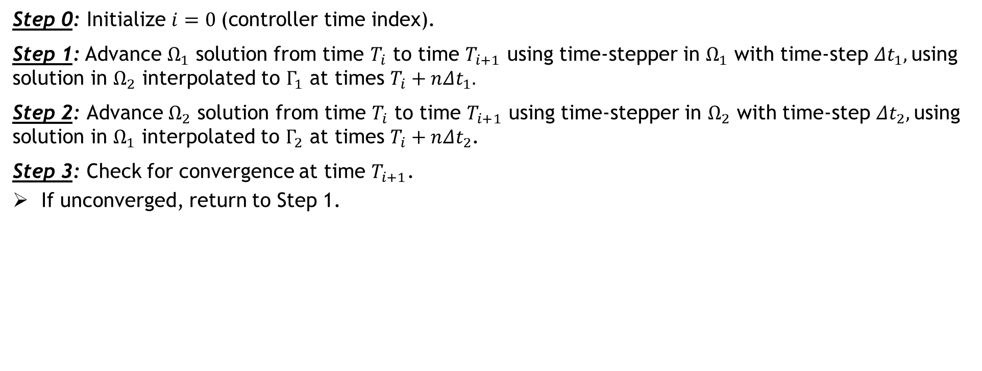

Time-Advancement Within the Schwarz Framework
$$T_{0}$$
$$T_{1}$$
Controller time stepper
Time integrator for Ω₁
Time integrator for Ω₂
Integrate using ${Δt}_{1}$
Interpolate from $Ω_{2}$ to $Γ_{1}$
Step 0: Initialize $i=0 \text{(}\text{controller} \text{time} \text{index}\text{).}$
Step 1: Advance $Ω_{1}$ solution from time $T_{i}$ to time $T_{i+1}$ using time-stepper in $Ω_{1}$ with time-step ${Δt}_{1},$using solution in $Ω_{2}$ interpolated to $Γ_{1}$ at times $T_{i}+n{Δt}_{1}.$
Step 2: Advance $Ω_{2}$ solution from time $T_{i}$ to time $T_{i+1}$ using time-stepper in $Ω_{2}$ with time-step ${Δt}_{2},$using solution in $Ω_{1}$ interpolated to $Γ_{2}$ at times $T_{i}+n{Δt}_{2}$.
Step 3: Check for convergence at time $T_{i+1}$.
If unconverged, return to Step 1.
$$\left\{ \begin{aligned} \dot{u}+N(u)=f\text{,} \text{in} Ω \\ u(x,t)=g(t)\text{,} \text{on} ∂Ω \\ u\left(x,0\right)=u_{0}, \text{in} Ω\end{aligned}\right.$$
Model PDE:

Slide 16

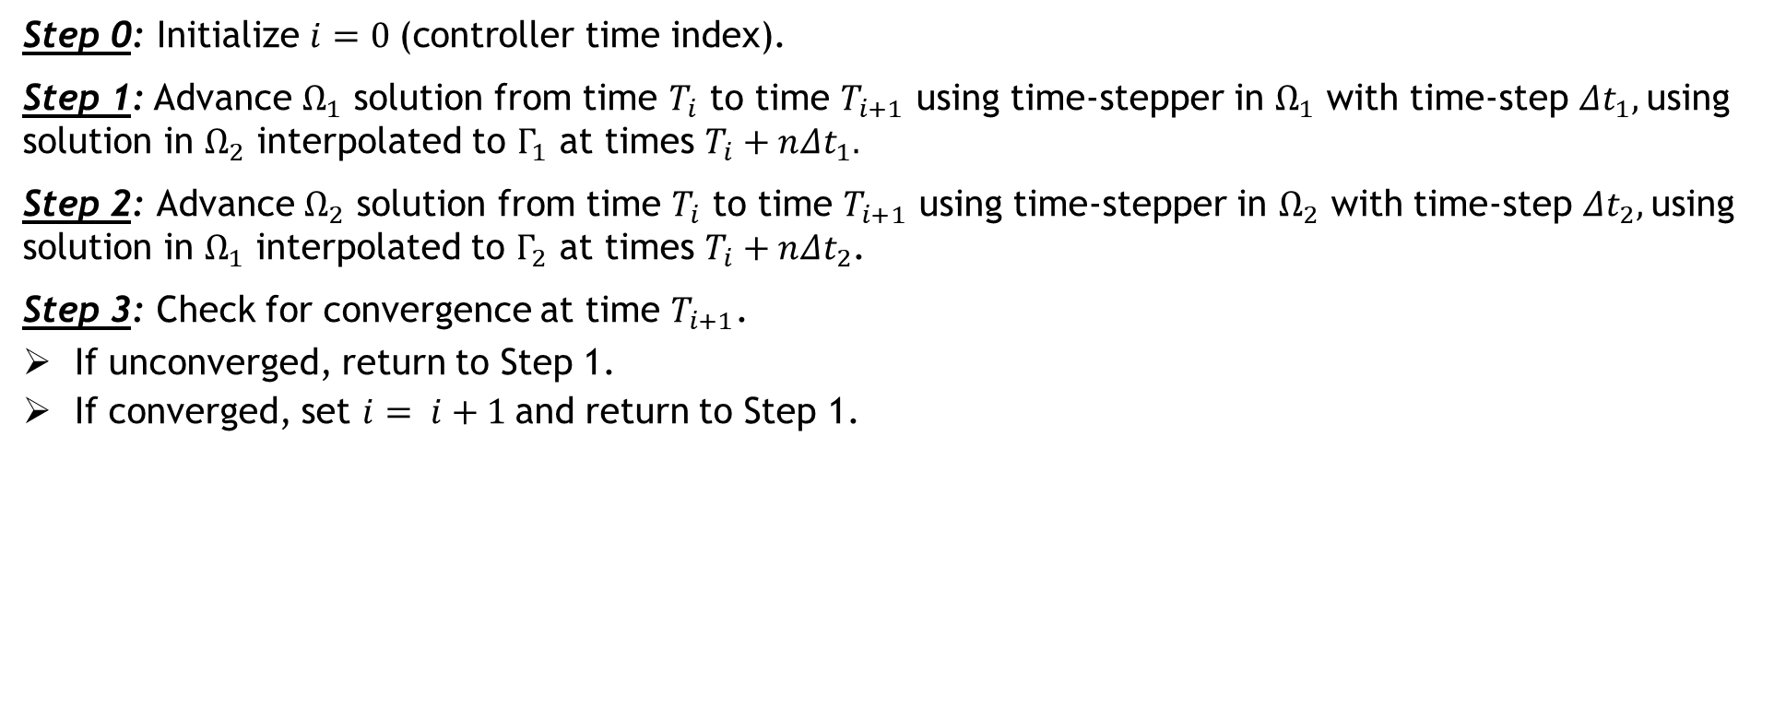

Time-Advancement Within the Schwarz Framework
$$T_{0}$$
$$T_{1}$$
$$T_{2}$$
Controller time stepper
Time integrator for Ω₁
Time integrator for Ω₂
Integrate using ${Δt}_{1}$
Interpolate from $Ω_{2}$ to $Γ_{1}$
Can use different integrators with different time steps within each domain!
Step 0: Initialize $i=0 \text{(}\text{controller} \text{time} \text{index}\text{).}$
Step 1: Advance $Ω_{1}$ solution from time $T_{i}$ to time $T_{i+1}$ using time-stepper in $Ω_{1}$ with time-step ${Δt}_{1},$using solution in $Ω_{2}$ interpolated to $Γ_{1}$ at times $T_{i}+n{Δt}_{1}.$
Step 2: Advance $Ω_{2}$ solution from time $T_{i}$ to time $T_{i+1}$ using time-stepper in $Ω_{2}$ with time-step ${Δt}_{2},$using solution in $Ω_{1}$ interpolated to $Γ_{2}$ at times $T_{i}+n{Δt}_{2}$.
Step 3: Check for convergence at time $T_{i+1}$.
If unconverged, return to Step 1.
If converged, set $i= i+1$and return to Step 1.
$$\left\{ \begin{aligned} \dot{u}+N(u)=f\text{,} \text{in} Ω \\ u(x,t)=g(t)\text{,} \text{on} ∂Ω \\ u\left(x,0\right)=u_{0}, \text{in} Ω\end{aligned}\right.$$
Model PDE:

Slide 17
Time-Advancement Within the Schwarz Framework
$$T_{0}$$
$$T_{1}$$
$$T_{2}$$
Controller time stepper
Time integrator for Ω₁
Time integrator for Ω₂
Integrate using ${Δt}_{1}$
Interpolate from $Ω_{2}$ to $Γ_{1}$
Time-stepping procedure is equivalent to doing Schwarz on space-time domain [Mota et al. 2022].
Step 0: Initialize $i=0 \text{(}\text{controller} \text{time} \text{index}\text{).}$
Step 1: Advance $Ω_{1}$ solution from time $T_{i}$ to time $T_{i+1}$ using time-stepper in $Ω_{1}$ with time-step ${Δt}_{1},$using solution in $Ω_{2}$ interpolated to $Γ_{1}$ at times $T_{i}+n{Δt}_{1}.$
Step 2: Advance $Ω_{2}$ solution from time $T_{i}$ to time $T_{i+1}$ using time-stepper in $Ω_{2}$ with time-step ${Δt}_{2},$using solution in $Ω_{1}$ interpolated to $Γ_{2}$ at times $T_{i}+n{Δt}_{2}$.
Step 3: Check for convergence at time $T_{i+1}$.
If unconverged, return to Step 1.
If converged, set $i= i+1$and return to Step 1.
$$\left\{ \begin{aligned} \dot{u}+N(u)=f\text{,} \text{in} Ω \\ u(x,t)=g(t)\text{,} \text{on} ∂Ω \\ u\left(x,0\right)=u_{0}, \text{in} Ω\end{aligned}\right.$$
Model PDE:

Slide 18


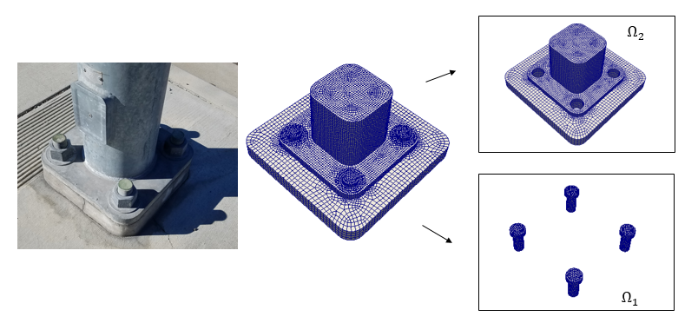


Schwarz for Multiscale FOM-FOM Coupling in Solid Mechanics$1$
Model Solid Mechanics PDEs:
Coupling is concurrent (two-way).
Ease of implementation into existing massively-parallel HPC codes.
Scalable, fast, robust (we target real engineering problems, e.g., analyses involving failure of bolted components!).
Coupling does not introduce nonphysical artifacts.
Theoretical convergence properties/guarantees$1$.
Quasistatic:
Dynamic:
“Plug-and-play” framework:
  Ability to couple regions with different non-conformal meshes, different element types and different levels of refinement to simplify task of meshing complex geometries.
  Ability to use different solvers/time-integrators in different regions.
²
¹ Mota et al. 2017; Mota et al. 2022. ² https://github.com/sandialabs/LCM.

Slide 19
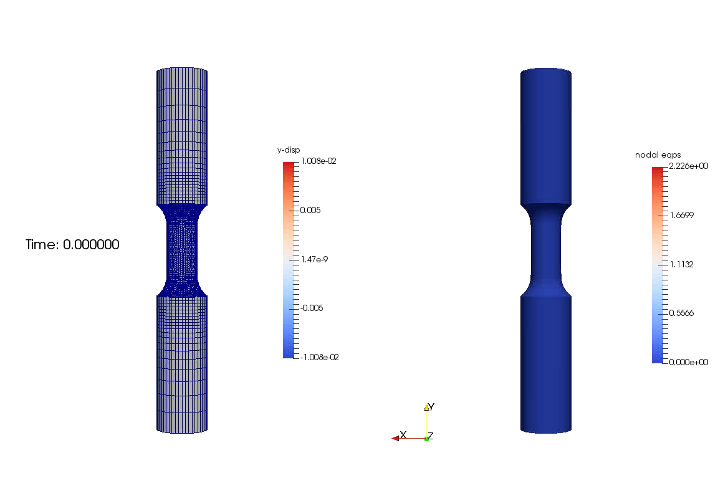
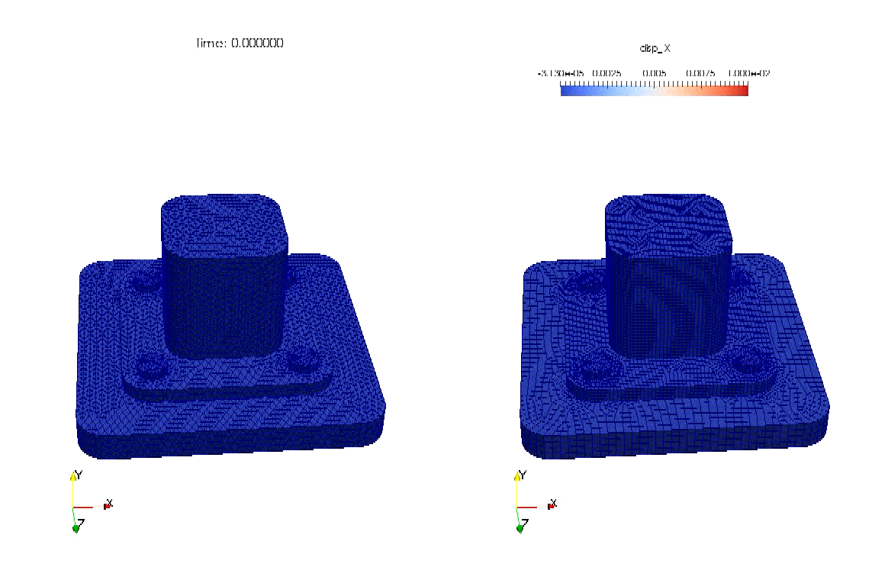
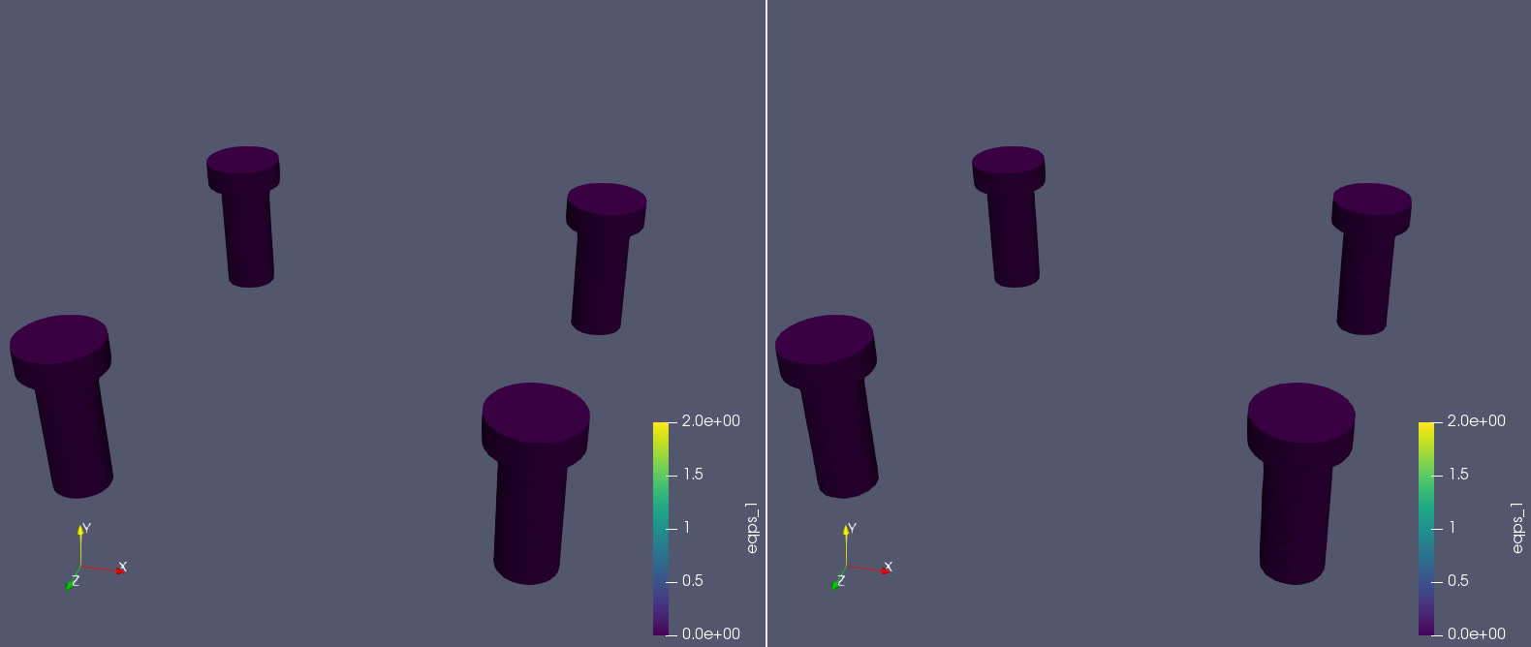
Schwarz for Multiscale FOM-FOM Coupling in Solid Mechanics$1$
Single $Ω$
Schwarz
y-displacement
EQPS
Figure above: tension specimen simulation coupling composite TET10 elements with HEX elements in Sierra/SM.
Figures right: bolted joint simulation coupling composite TET10 elements with HEX elements in Sierra/SM.
Single $Ω$
Schwarz
¹ Mota et al. 2017; Mota et al. 2022.

Slide 20
Outline
The Schwarz Alternating Method for Domain Decomposition-Based Coupling
Extension to FOM*-ROM# and ROM-ROM Coupling
Numerical Examples
  2D Burgers Equation
  2D Shallow Water Equations
  Teaser: 2D Euler Equations Riemann Problem
Summary & Future Work
*Full-Order Model. #Reduced Order Model.

Slide 21
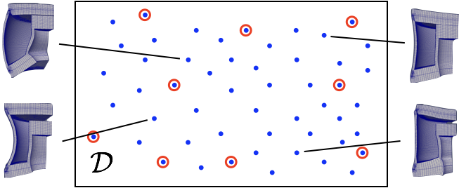



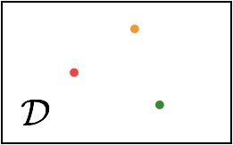


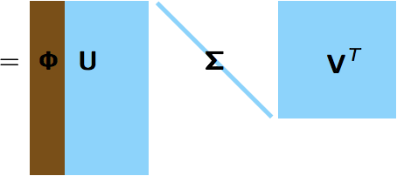


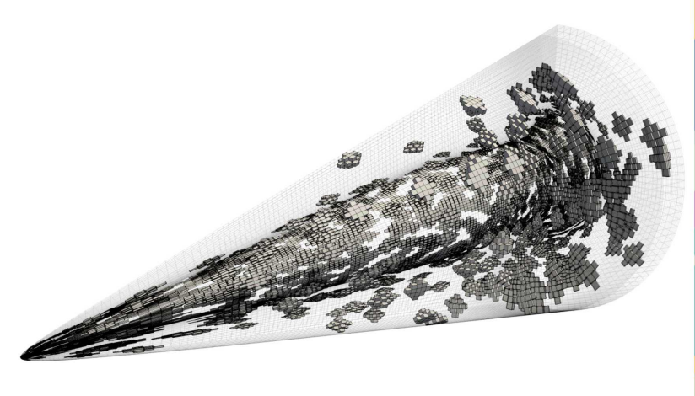
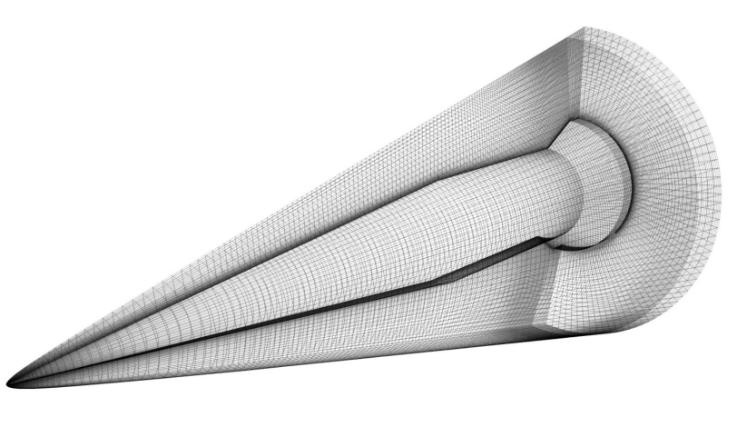




Projection-Based Model Order Reduction via the POD/LSPG* Method
21
Full Order Model (FOM): $\frac{du}{dt}=f(u;t,μ)$
* Least-Squares Petrov-Galerkin
1. Acquisition
3. Projection-Based Reduction
Number of time steps
Choose ODE temporal discretization
$$\frac{du}{dt}=f(u;t,μ)$$
Number of State Variables
$$r^{n}\left(u^{n};μ\right)=0, n=1,…,T$$
$$u\left(t\right)≈\tilde{u}\left(t\right)=Φ\hat{u}(t)$$
Solve ODE at different design points
Save solution data
Reduce the number of unknowns
2. Learning
Proper Orthogonal Decomposition (POD):
Minimize residual
$$A r^{n}( Φ \hat{v}; μ)$$
Hyper-reduction/sample mesh
ROM = projection-based Reduced Order Model HROM = Hyper-reduced ROM

Slide 22
Schwarz Extensions to FOM-ROM and ROM-ROM Couplings
22
Choice of domain decomposition
Overlapping vs. non-overlapping domain decomposition?
  Non-overlapping more flexible but typically requires more Schwarz iterations
FOM vs. ROM subdomain assignment?
  Do not assign ROM to subdomains where they have no hope of approximating solution
Snapshot collection and reduced basis construction
Are subdomains simulated independently in each subdomains or together?
Enforcement of boundary conditions (BCs) in ROM at Schwarz boundaries
Strong vs. weak BC enforcement?
  Strong BC enforcement difficult for some models (e.g., cell-centered finite volume, PINNs)
Optimizing parameters in Schwarz BCs for non-overlapping Schwarz?
Choice of hyper-reduction
What hyper-reduction method to use?
  Application may require particular method (e.g., ECSW for solid mechanics problems)
How to sample Schwarz boundaries in applying hyper-reduction?
  Need to have enough sample mesh points at Schwarz boundaries to apply Schwarz

Slide 23
Outline
The Schwarz Alternating Method for Domain Decomposition-Based Coupling
Extension to FOM*-ROM# and ROM-ROM Coupling
Numerical Examples
  2D Burgers Equation
  2D Shallow Water Equations
  Teaser: 2D Euler Equations Riemann Problem
Summary & Future Work
*Full-Order Model. #Reduced Order Model.

Slide 24
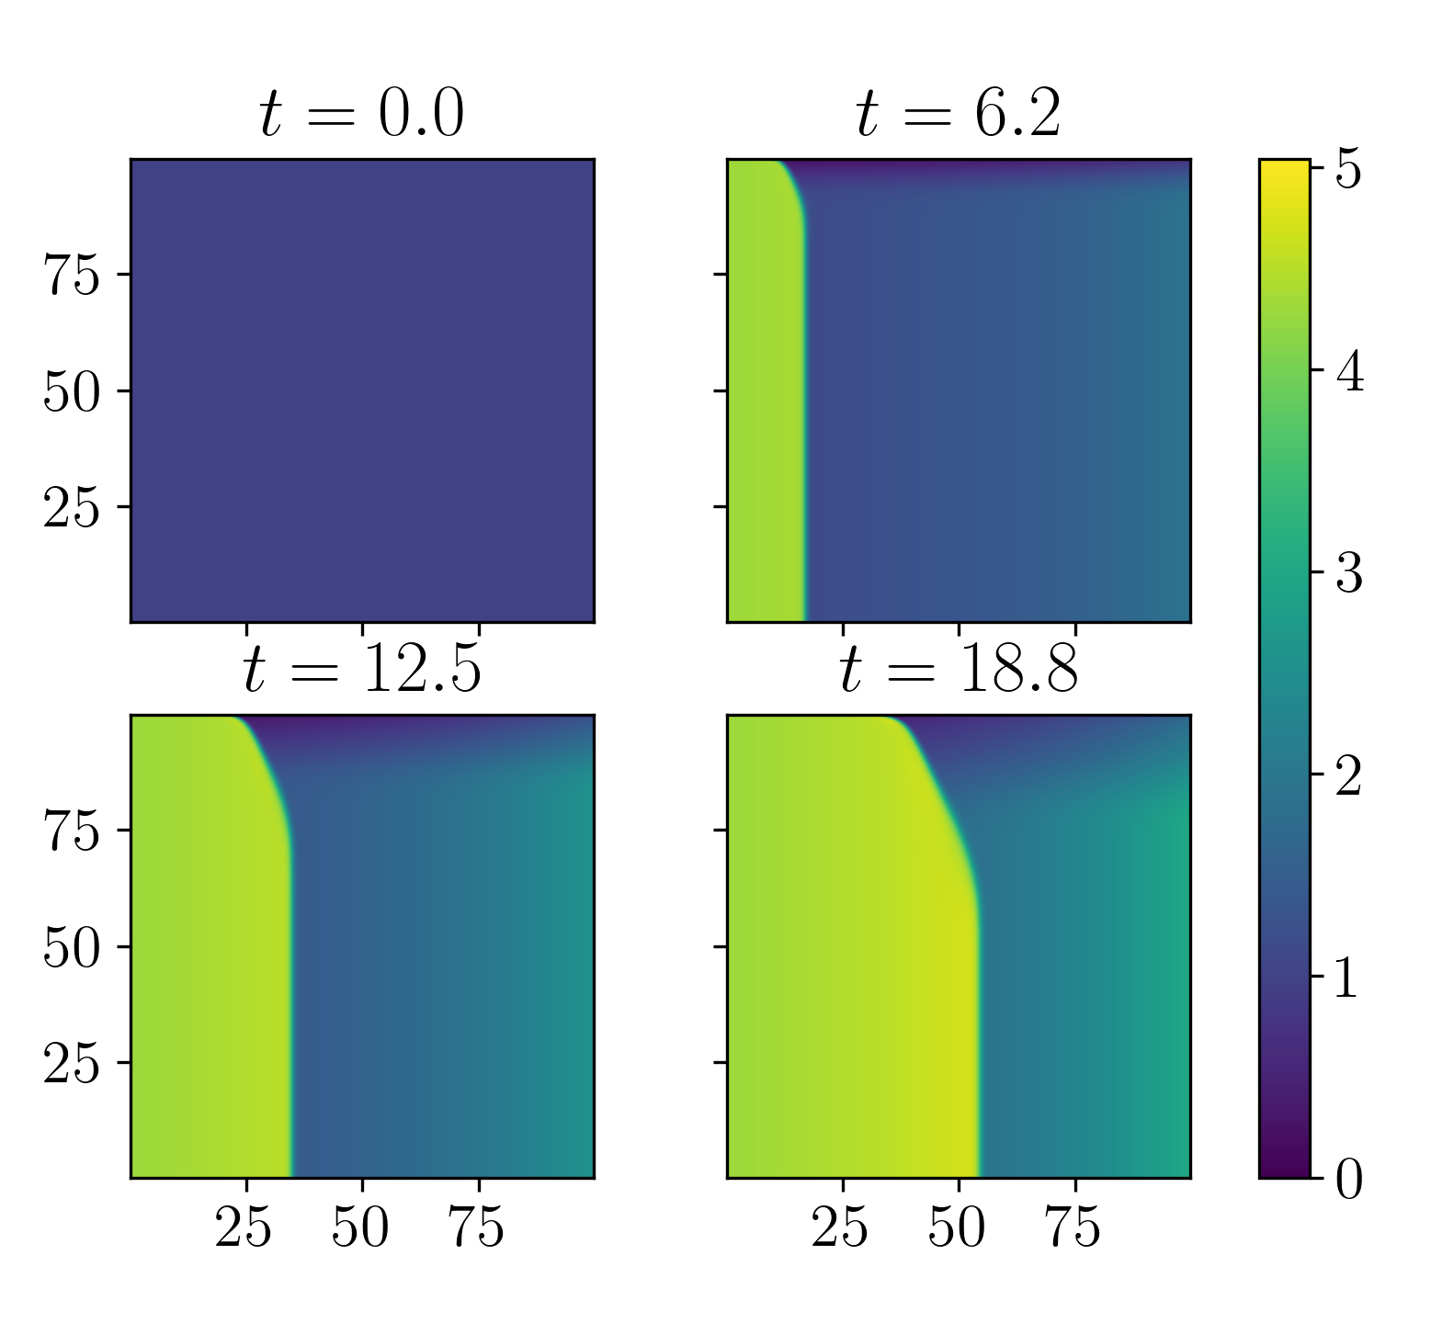
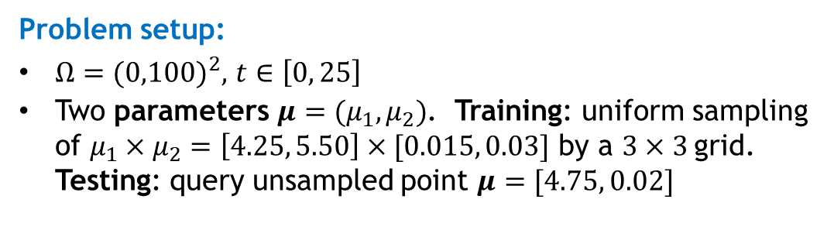
2D Inviscid Burgers Equation
Popular analog for fluid problems where shocks are possible, and particularly difficult for conventional projection-based ROMs
$$\frac{∂u}{∂t}+\frac{1}{2}\left(\frac{∂(u^{2})}{∂x}+\frac{∂(uv)}{∂y}\right)=0.02\exp\left(μ_{2}x\right)$$
$$\frac{∂v}{∂t}+\frac{1}{2}\left(\frac{∂(vu)}{∂x}+\frac{∂(v^{2})}{∂y}\right)=0$$
$$u\left(0,y,t;μ\right)=μ_{1}$$
$$u\left(x,y,0\right)=v\left(x,y,0\right)=1$$
0
$$x$$
100
0
$$Ω_{1}$$
$$y$$
100
Problem setup:
$Ω={(0,100)}^{2},$ $t∈\left[0, 25\right]$
Two parameters $μ=(μ_{1},μ_{2})$. Training: uniform sampling of $μ_{1}×μ_{2}=\left[4.25, 5.50\right]×[0.015, 0.03]$ by a $3×3$grid. Testing: query unsampled point $μ=[4.75, 0.02]$
FOM discretization:
Spatial discretization given by a Godunov-type scheme with $N = 250$elements in each dimension
Implicit trapezoidal method with fixed $∆t = 0.05$
Figure above: solution of $u$ component at various times
Notes:
TODO: say something about how BCs implemented?

Slide 25
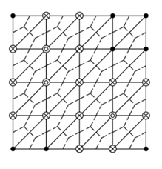
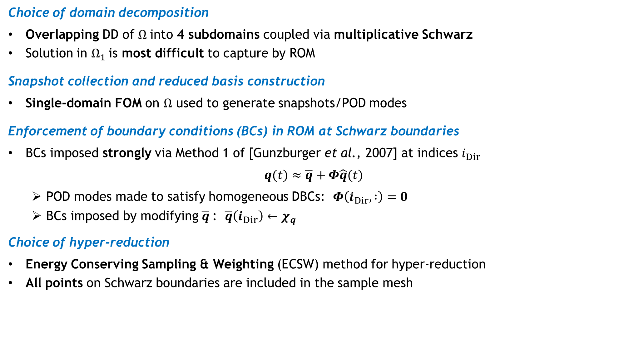
Schwarz Coupling Details
25
Choice of domain decomposition
Overlapping DD of $Ω$into 4 subdomains coupled via multiplicative Schwarz
Solution in $Ω_{1}$is most difficult to capture by ROM
Snapshot collection and reduced basis construction
Single-domain FOM on $Ω$ used to generate snapshots/POD modes
Enforcement of boundary conditions (BCs) in ROM at Schwarz boundaries
BCs imposed strongly via Method 1 of [Gunzburger et al., 2007] at indices $i_{Dir}$
$$q(t)≈\overline{q}+Φ\hat{q}(t)$$
  POD modes made to satisfy homogeneous DBCs: $Φ\left(i_{Dir}, :\right)=0$
  BCs imposed by modifying $\overline{q}$: $\overline{q}\left(i_{Dir}\right)←χ_{q}$
Choice of hyper-reduction
Energy Conserving Sampling & Weighting (ECSW) method for hyper-reduction
All points on Schwarz boundaries are included in the sample mesh
0
$$x$$
100
0
$$Ω_{1}$$
$$Ω_{2}$$
$$y$$
$$Ω_{4}$$
$$Ω_{3}$$
100
Figure above: 4 subdomain overlapping DD
Figure above: ECSW augmented reduced mesh
Notes:
TODO: say how possible to do strong BC impl in FV method.
TODO: double check about all points on Schwarz boundaries being included in sample mesh with Joshua/Chris.

Slide 26
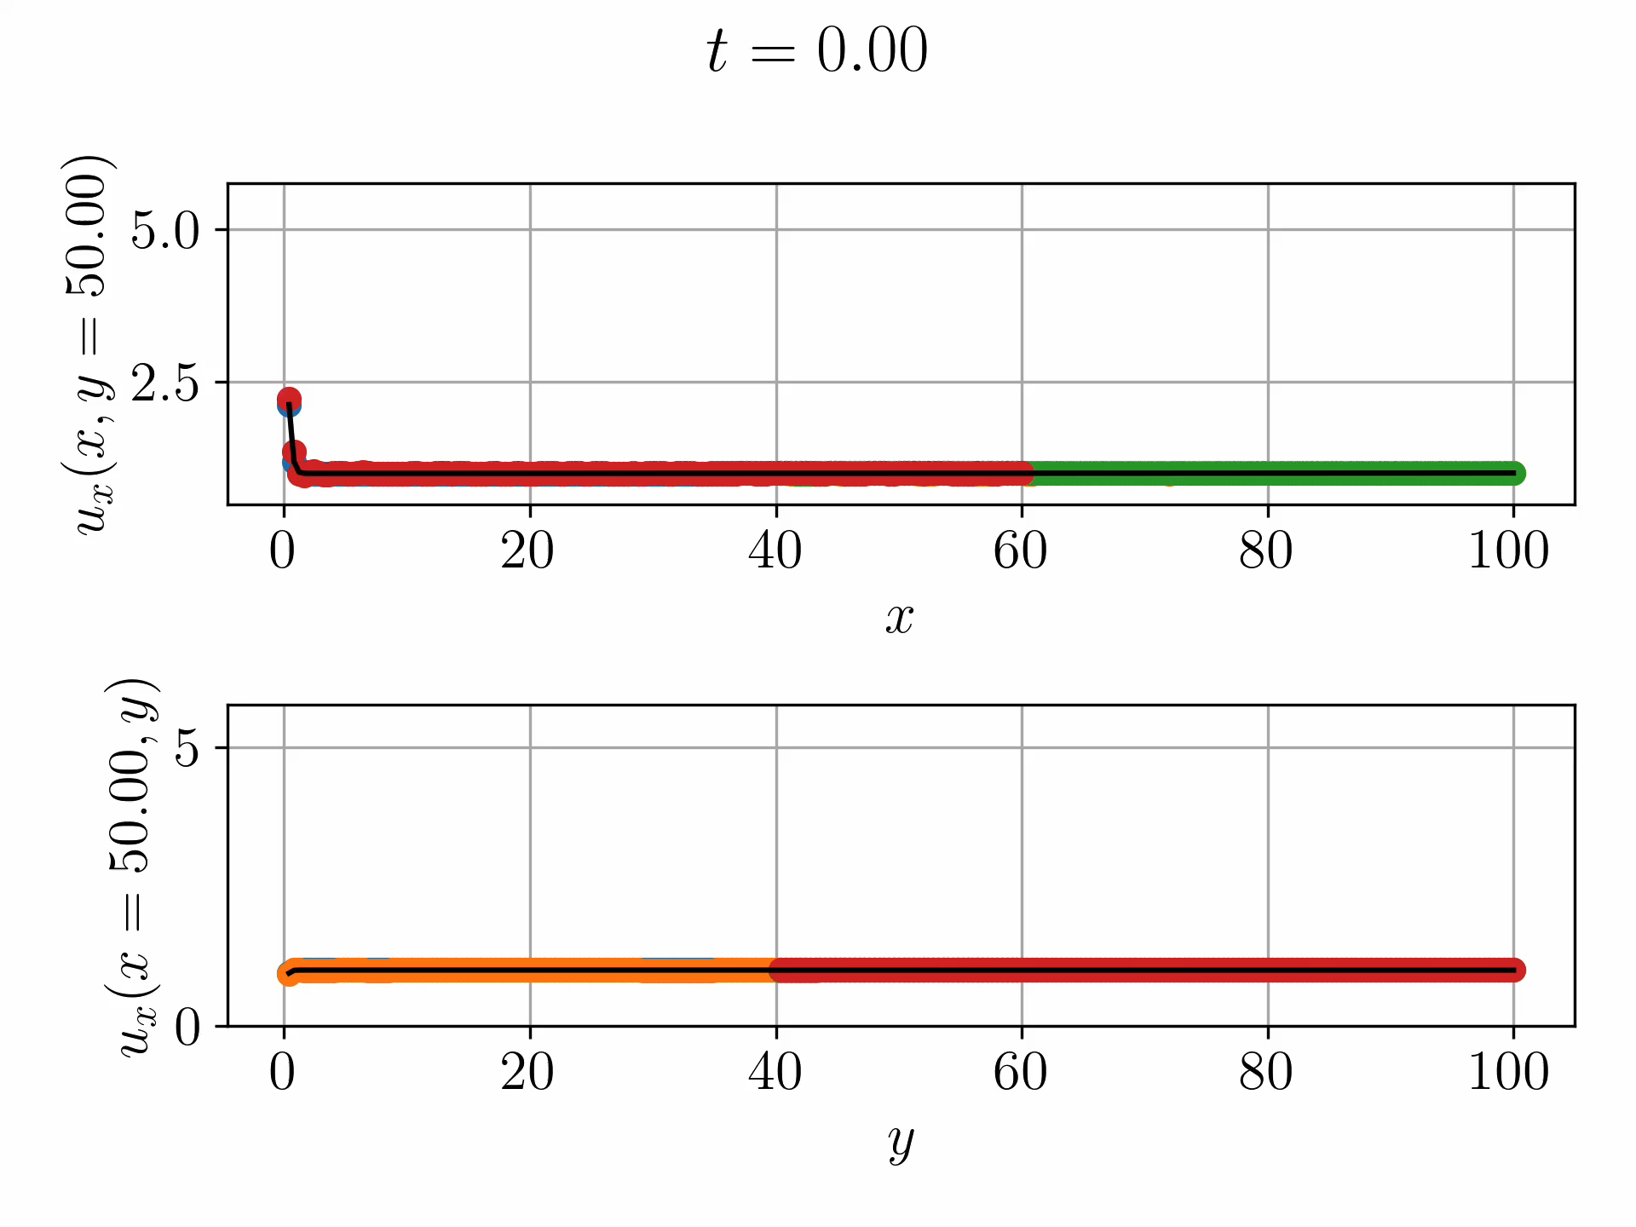
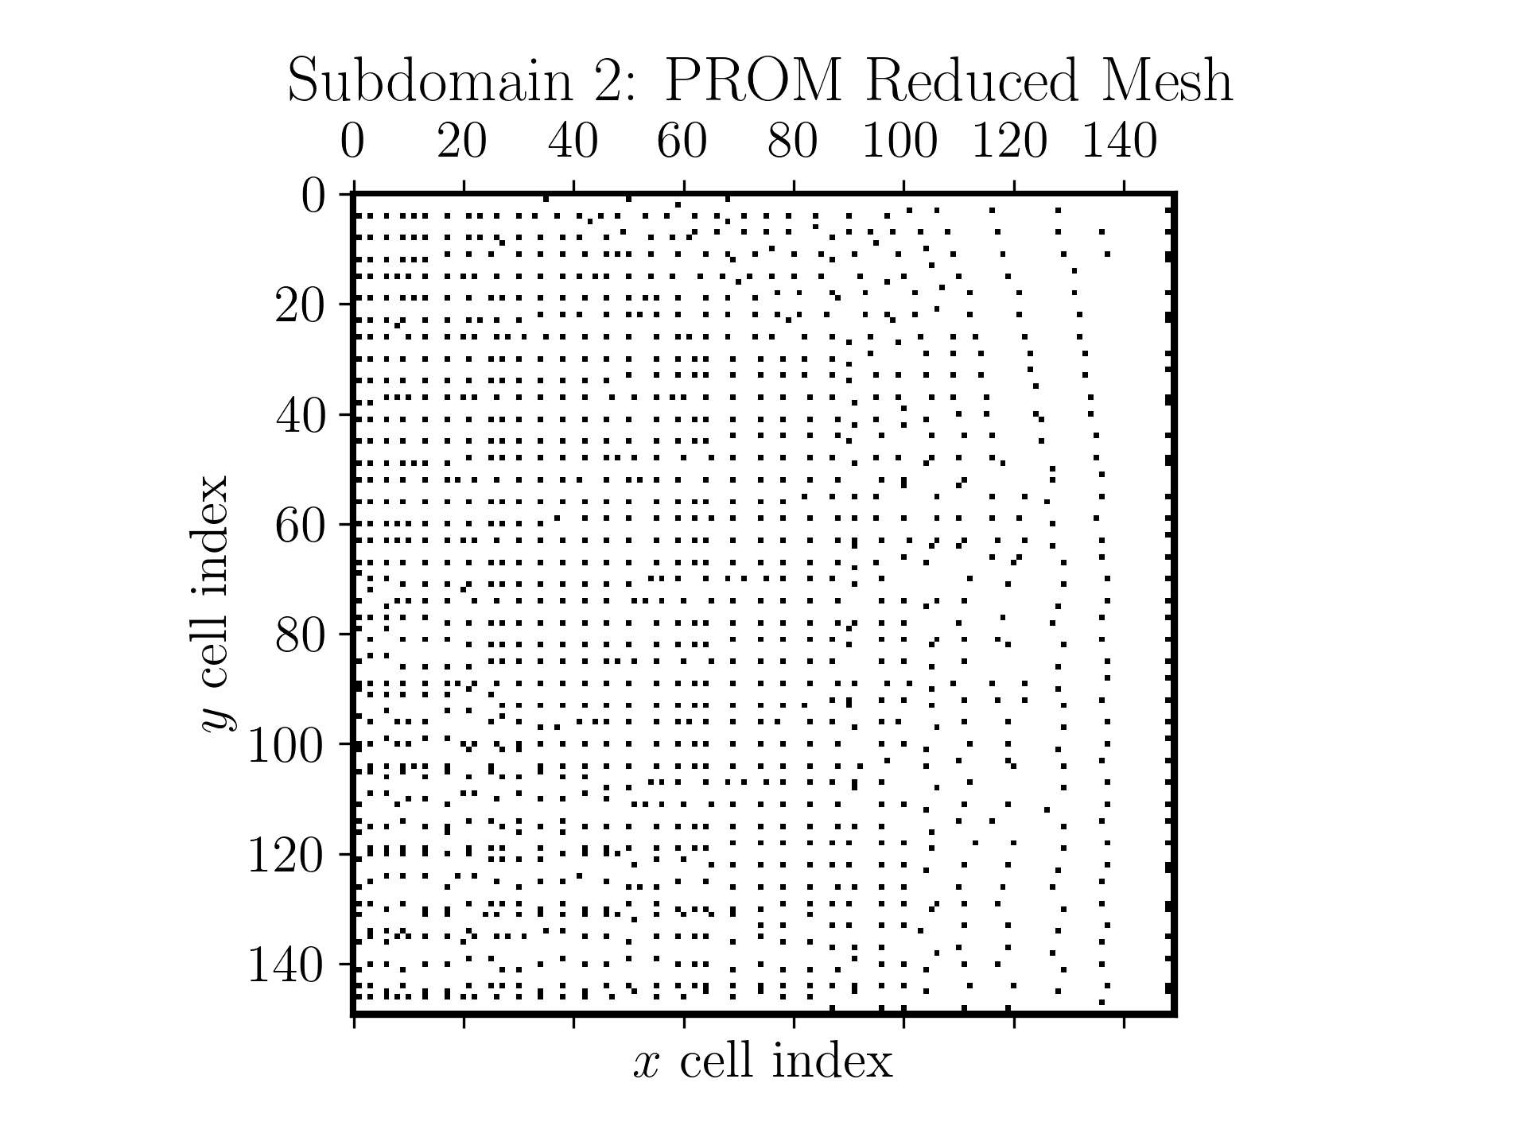
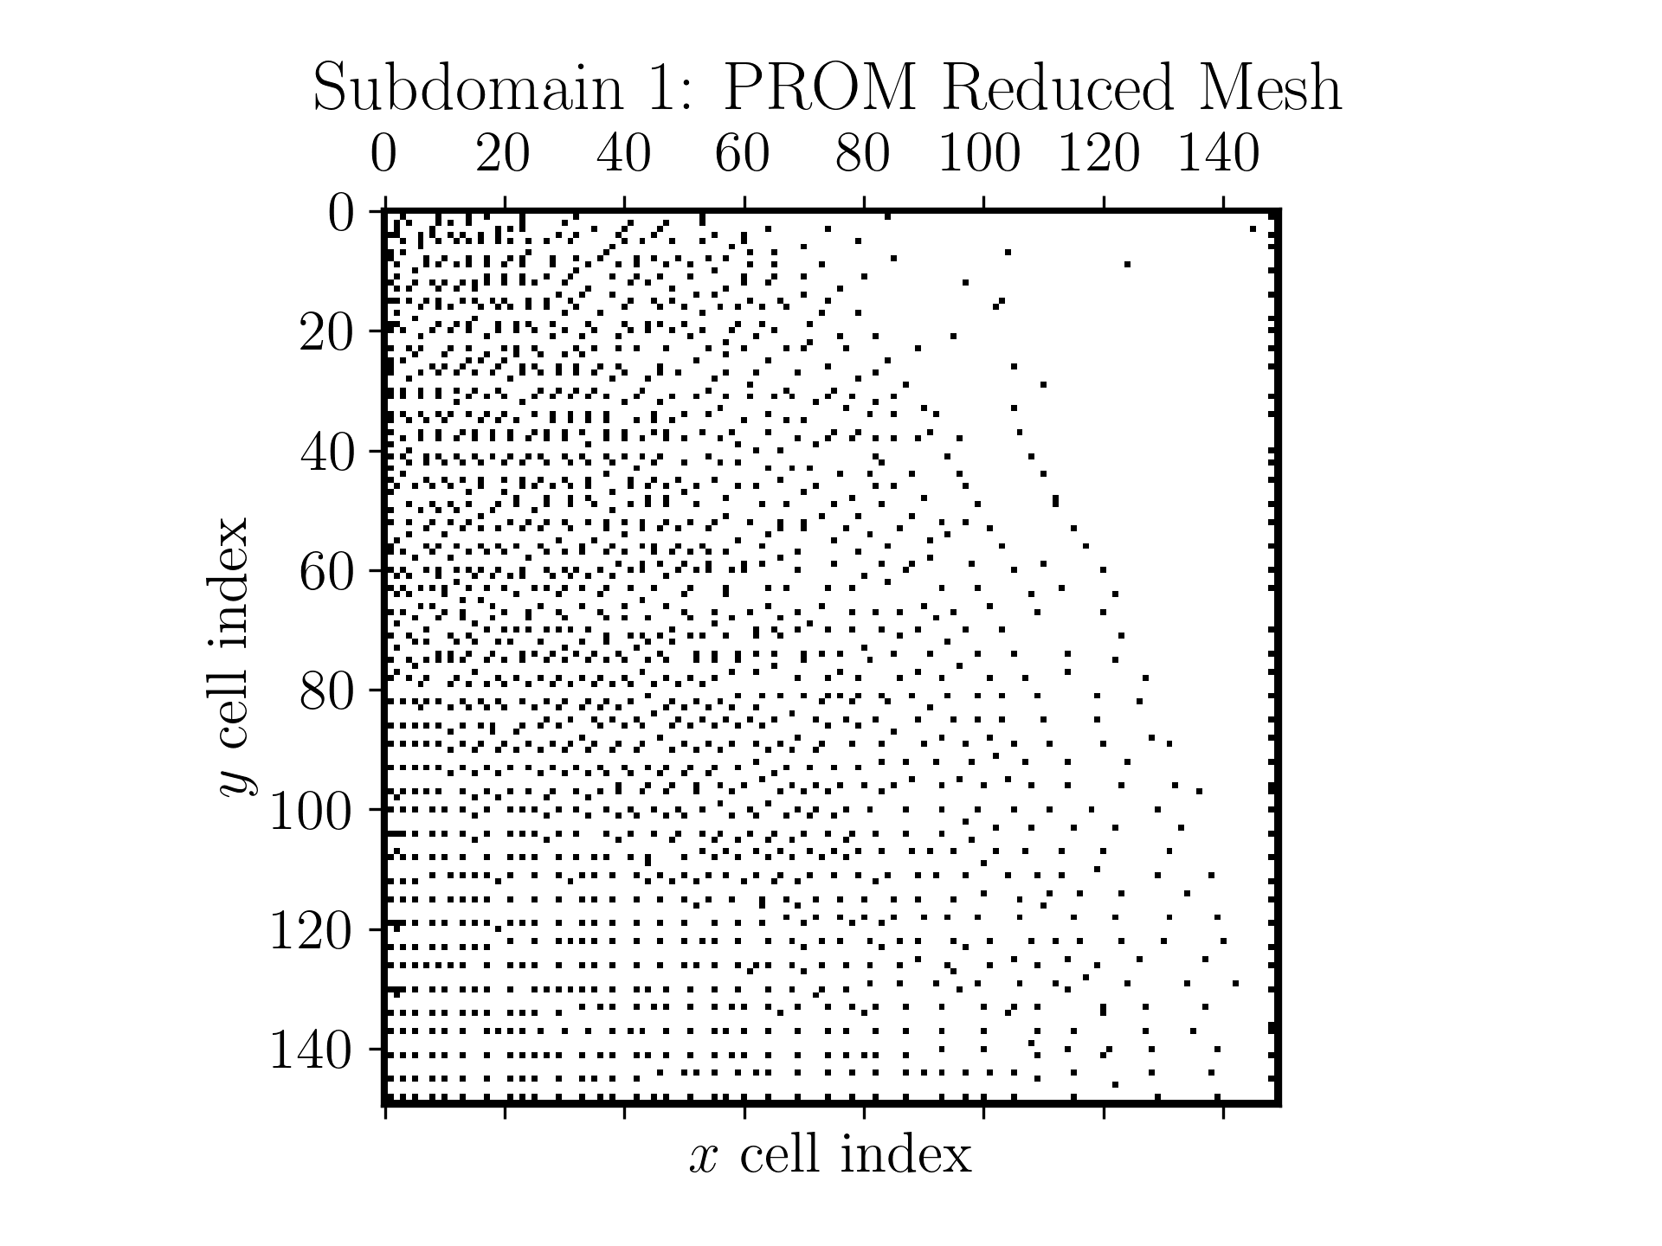
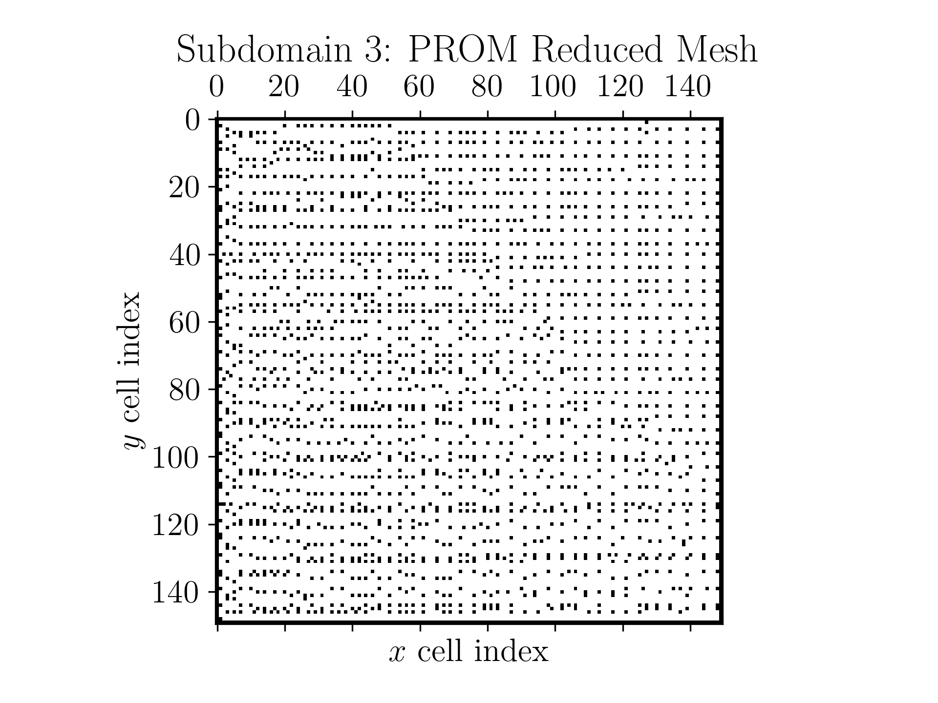
FOM-HROM-HROM-HROM Coupling
Subdomains | 99% SV Energy
 | $$M$$ | MSE (%) | CPU time (s)
$$Ω_{1}$$ | $$−$$ | 0.0 | 95
$$Ω_{2}$$ | 120 | 0.26 | 26
$$Ω_{3}$$ | 60 | 0.43 | 17
$$Ω_{4}$$ | 66 | 0.34 | 21
Total |  |  | 159
$$Ω_{1}$$
$$Ω_{2}$$
$$Ω_{3}$$
$$Ω_{4}$$
1 SD
FOM in $Ω_{1}$ as this is “hardest” subdomain for ROM
HROMs in $Ω_{2}$, $Ω_{3}$, $Ω_{4}$ capture 99% snapshot energy
Method converges in 3 Schwarz iterations per controller time-step
Errors O(0.1%) with 0 error in $Ω_{1}$
2.26$×$ speedup achieved over all-FOM coupling
0
$$x$$
100
0
$$Ω_{1}$$
$$Ω_{2}$$
$$y$$
$$Ω_{4}$$
$$Ω_{3}$$
100
Further speedups possible via code optimizations, additive Schwarz and reduction of # sample mesh points.
Notes:
360: all-FOM case
Not possible for subdomain 2->4 to pollute 1 b/c of direction of propagation

Slide 27
Outline
The Schwarz Alternating Method for Domain Decomposition-Based Coupling
Extension to FOM*-ROM# and ROM-ROM Coupling
Numerical Examples
  2D Burgers Equation
  2D Shallow Water Equations
  Teaser: 2D Euler Equations Riemann Problem
Summary & Future Work
*Full-Order Model. #Reduced Order Model.

Slide 28
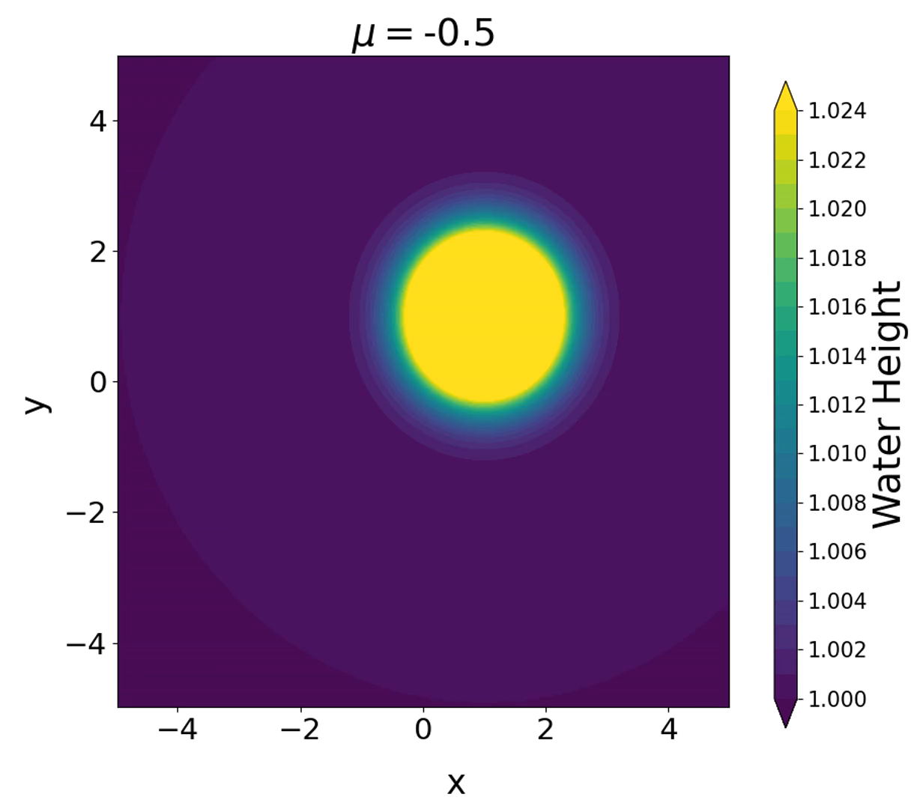


2D Shallow Water Equations (SWE)
Hyperbolic PDEs modeling wave propagation below a pressure surface in a fluid (e.g., atmosphere, ocean).
$$\frac{∂h}{∂t}+\frac{∂(hu)}{∂x}+\frac{∂(hv)}{∂y}=0$$
$$\frac{∂(hu)}{∂t}+\frac{∂}{∂x}\left(hu^{2}+\frac{1}{2}gh^{2}\right)+\frac{∂}{∂y}\left(huv\right)=−μv$$
$$\frac{∂(hv)}{∂t}+\frac{∂}{∂x}\left(huv\right)+\frac{∂}{∂y}\left(hv^{2}+\frac{1}{2}gh^{2}\right)=μu$$
Problem setup:
$Ω={(−5,5)}^{2},$ $t∈\left[0, 10\right]$, Gaussian initial condition
Coriolis parameter$μ∈\left\{−4,−3,−2,−1,0\right\}$ for training, and $μ∈\left\{−3.5,−2.5,−1.5,−0.5\right\}$for testing
Figure above: FOM solutions to SWE for $μ=−0.5$ (left) and $μ=−3.5$ (right).
FOM discretization:
Spatial discretization given by a first-order cell-centered finite volume discretization with $N =300$elements in each dimension
Implicit first order temporal discretization: backward Euler with fixed $∆t = 0.01$
Implemented in Pressio-demoapps (https://github.com/Pressio/pressio-demoapps)
Notes:
TODO: ask Chris re: temporal discretization

Slide 29
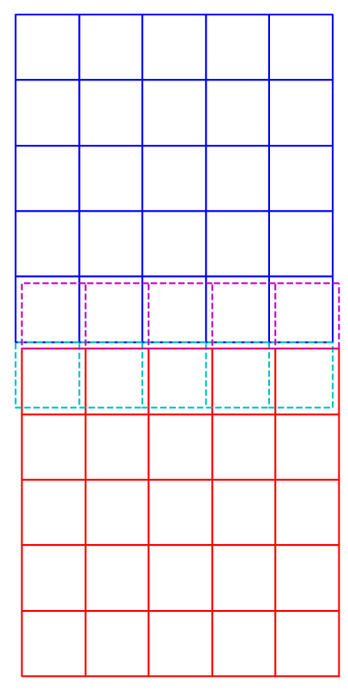
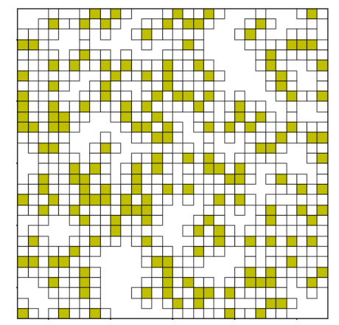
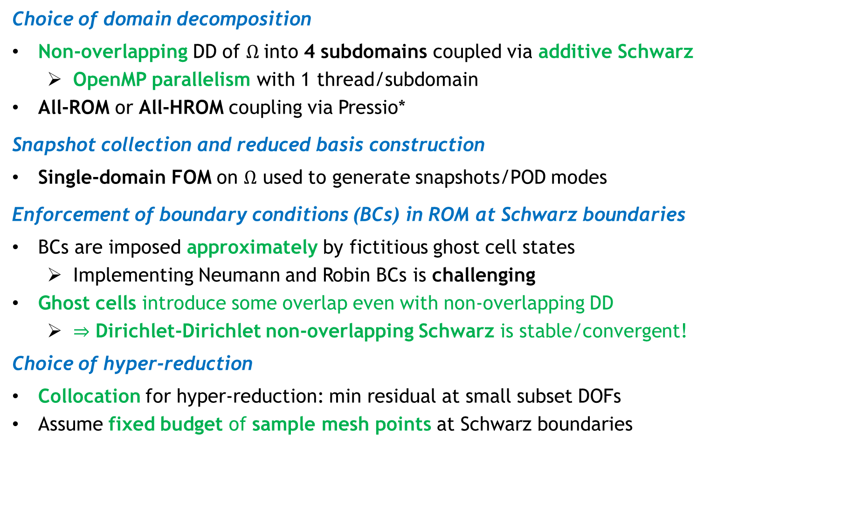
Schwarz Coupling Details
29
Green: different from Burgers’ problem
Choice of domain decomposition
Non-overlapping DD of $Ω$into 4 subdomains coupled via additive Schwarz
  OpenMP parallelism with 1 thread/subdomain
All-ROM or All-HROM coupling via Pressio*
Snapshot collection and reduced basis construction
Single-domain FOM on $Ω$ used to generate snapshots/POD modes
Enforcement of boundary conditions (BCs) in ROM at Schwarz boundaries
BCs are imposed approximately by fictitious ghost cell states
  Implementing Neumann and Robin BCs is challenging
Ghost cells introduce some overlap even with non-overlapping DD
  $⇒$ Dirichlet-Dirichlet non-overlapping Schwarz is stable/convergent!
Choice of hyper-reduction
Collocation for hyper-reduction: min residual at small subset DOFs
Assume fixed budget of sample mesh points at Schwarz boundaries
Figure right: non-overlapping DD w/ ghost cells creating overlap
Ghost cells
Figure above: sample mesh (yellow) and stencil (white) cells
*https://github.com/Pressio/pressio-demoapps
Notes:
TODO: ask Chris what hyper-reduction is used now.

Slide 30
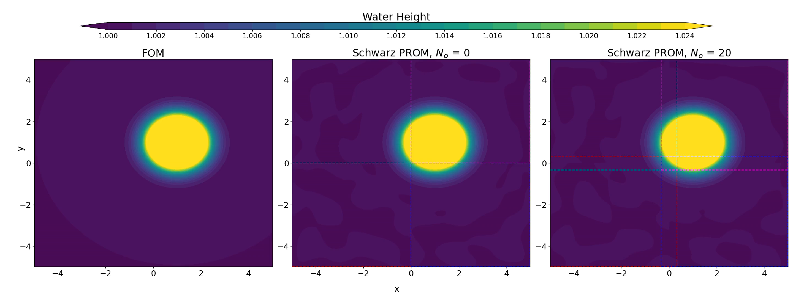
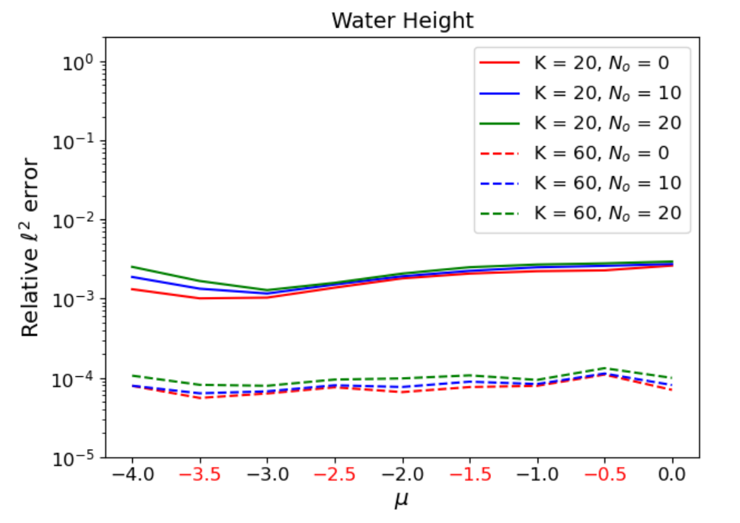
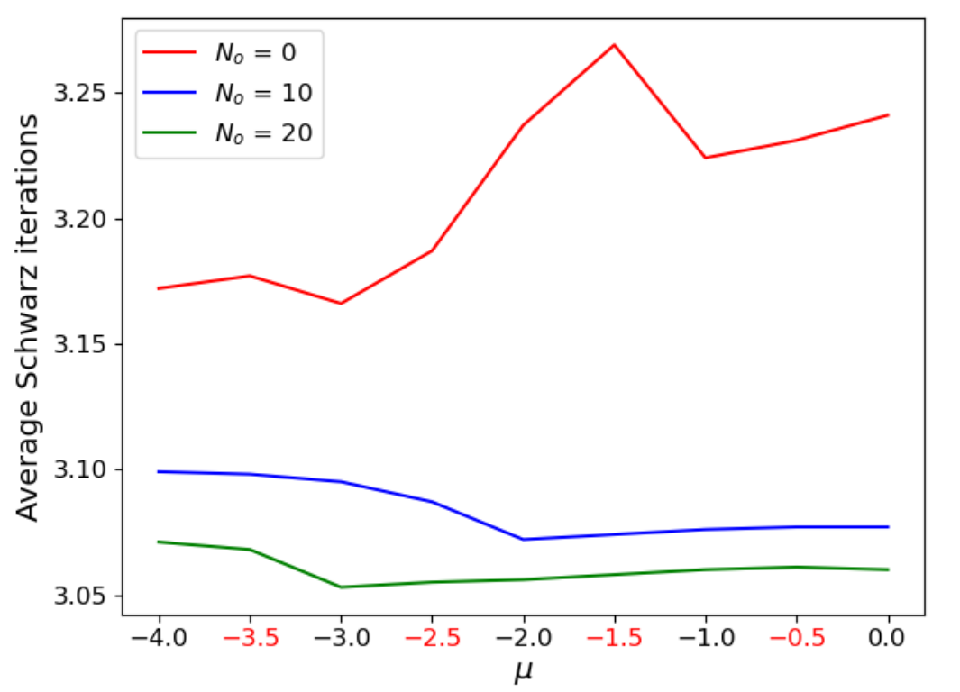
Schwarz All-ROM Domain Overlap Study
30
Study of Schwarz convergence for all-ROM coupling as a function of $N_{o}$ := cell width of overlap region (not including ghost cells).
Dirichlet-Dirichlet coupling with no-overlap ${(N}_{o}=0)$ performs well with no convergence issues (movie, left) and errors comparable to Dirichlet-Dirichlet coupling with overlap (figure below, left)
Movie above: FOM (left), 4 subdomain ROM coupled via non-overlapping Schwarz (middle), and 4 subdomain ROM coupled via overlapping Schwarz (right) for predictive SWE problem with $μ=−0.5$. All ROMs have $K=80$POD modes.
Schwarz iterations decrease (very roughly) with $N_{o}^{0.25}$ (figure, right) whereas evaluating $r(q)$ scales with $N_{o}^{2}$
  $⇒$ there is no reason not to do non-overlapping coupling for this problem
Figures above: relative error and average # Schwarz iterations as a function of $μ$ and $N_{o}.$ Black $μ$: training, red $μ$: testing.
Notes:
Q: Is it true that 80 POD modes/subdomain? Had K = 80 in Chris’s slides.

Slide 31
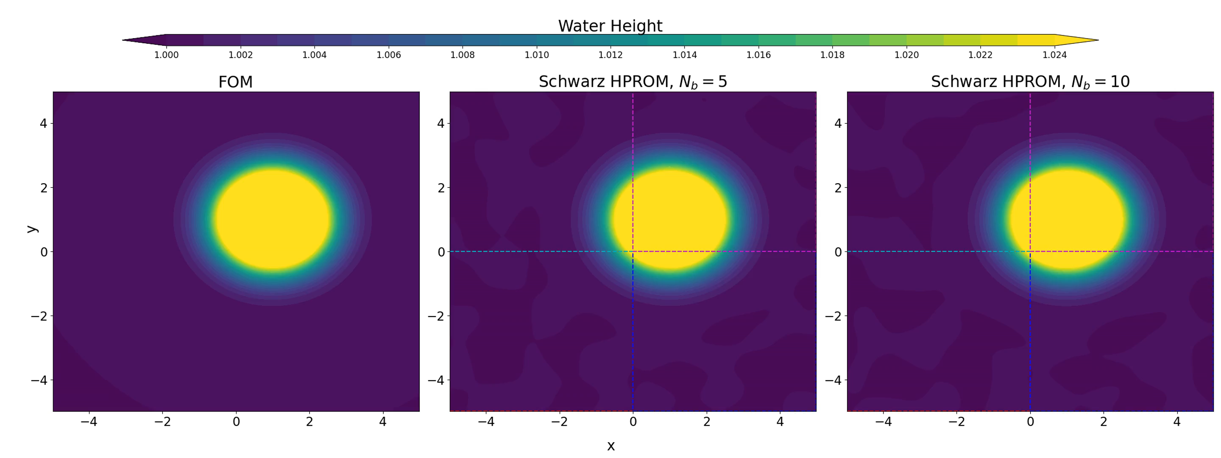
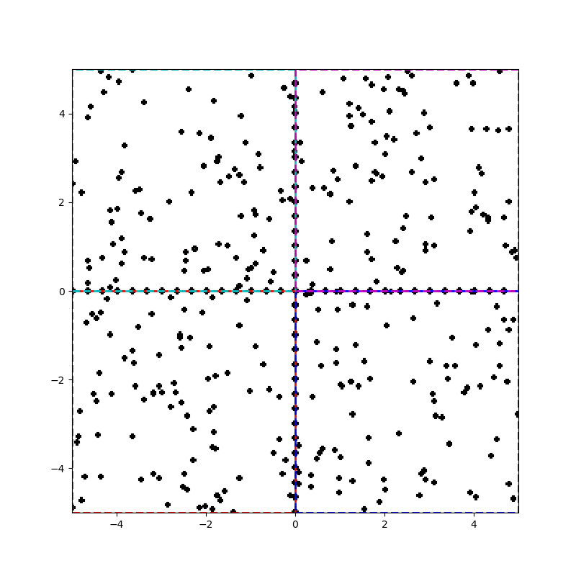
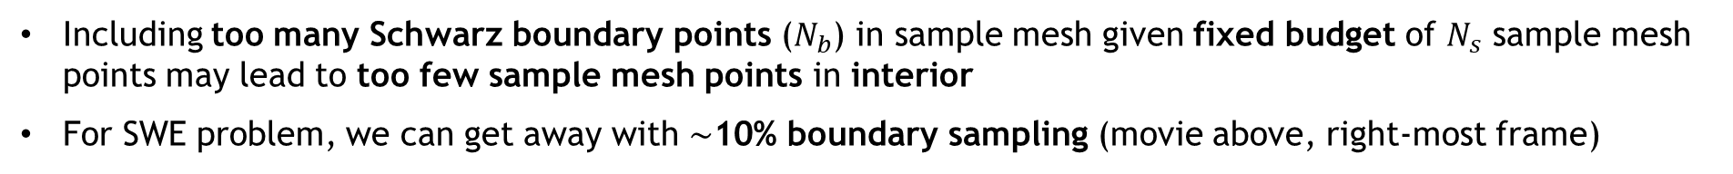

Schwarz Boundary Sampling for All-HROM Coupling
31
Key question: how many Schwarz boundary points need to be included in sample mesh when performing HROM coupling?
Naïve/sparsely-sampled Schwarz boundary results in failure to transmit coupling information during Schwarz
Movie above: FOM (left), all HROM with $N_{b}=5\%$ (middle) and all HROM with $N_{b}=10\%$ (left). ROMs have $K=100$modes and $N_{s}=0.5\%N$ sample mesh points.
Figure above: example sample mesh with sampling rate $N_{b}=10\%$
Including too many Schwarz boundary points ($N_{b}$) in sample mesh given fixed budget of $N_{s}$ sample mesh points may lead to too few sample mesh points in interior
For SWE problem, we can get away with $\sim$10% boundary sampling (movie above, right-most frame)
Notes:
To clarify the sampling rate Nb, the value of Nb = 0 just means that there is no deliberate sampling at the interface; there is still roughly N * X% points sampled at the interface given a random sampling scheme. Nb is a fixed rate of sampling at the interface, regardless of the overall sampling rate. Nb = 10 means every tenth cell at the interface is sampled, or 10% of all interface cells (Nb = 5 is 20% of all interface cells, etc). The use of an integer for Nb was just stylistic, since N and Ns are also integers.
hris.

Slide 32
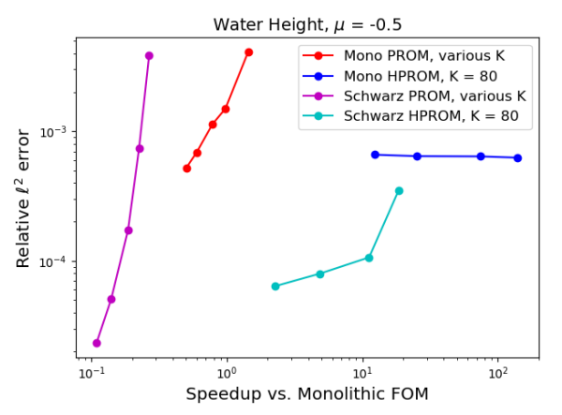
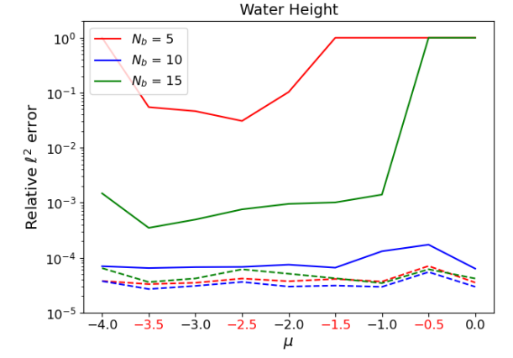
Coupled HROM Performance
32
Solid: ${ N}_{s}=0.5\%N$
Dashed: $N_{s}=1\%N$
For a fixed ROM dimension, Schwarz delivers lower error and comparable cost!
There are noticeable cost savings relative to monolithic FOM!
Accuracy similar for predictive $μ$ (red) and non-predictive $μ$ (black) cases.
Notes:
To clarify the sampling rate Nb, the value of Nb = 0 just means that there is no deliberate sampling at the interface; there is still roughly N * X% points sampled at the interface given a random sampling scheme. Nb is a fixed rate of sampling at the interface, regardless of the overall sampling rate. Nb = 10 means every tenth cell at the interface is sampled, or 10% of all interface cells (Nb = 5 is 20% of all interface cells, etc). The use of an integer for Nb was just stylistic, since N and Ns are also integers.
hris.

Slide 33
Outline
The Schwarz Alternating Method for Domain Decomposition-Based Coupling
Extension to FOM*-ROM# and ROM-ROM Coupling
Numerical Examples
  2D Burgers Equation
  2D Shallow Water Equations
  Teaser: 2D Euler Equations Riemann Problem
Summary & Future Work
*Full-Order Model. #Reduced Order Model.

Slide 34
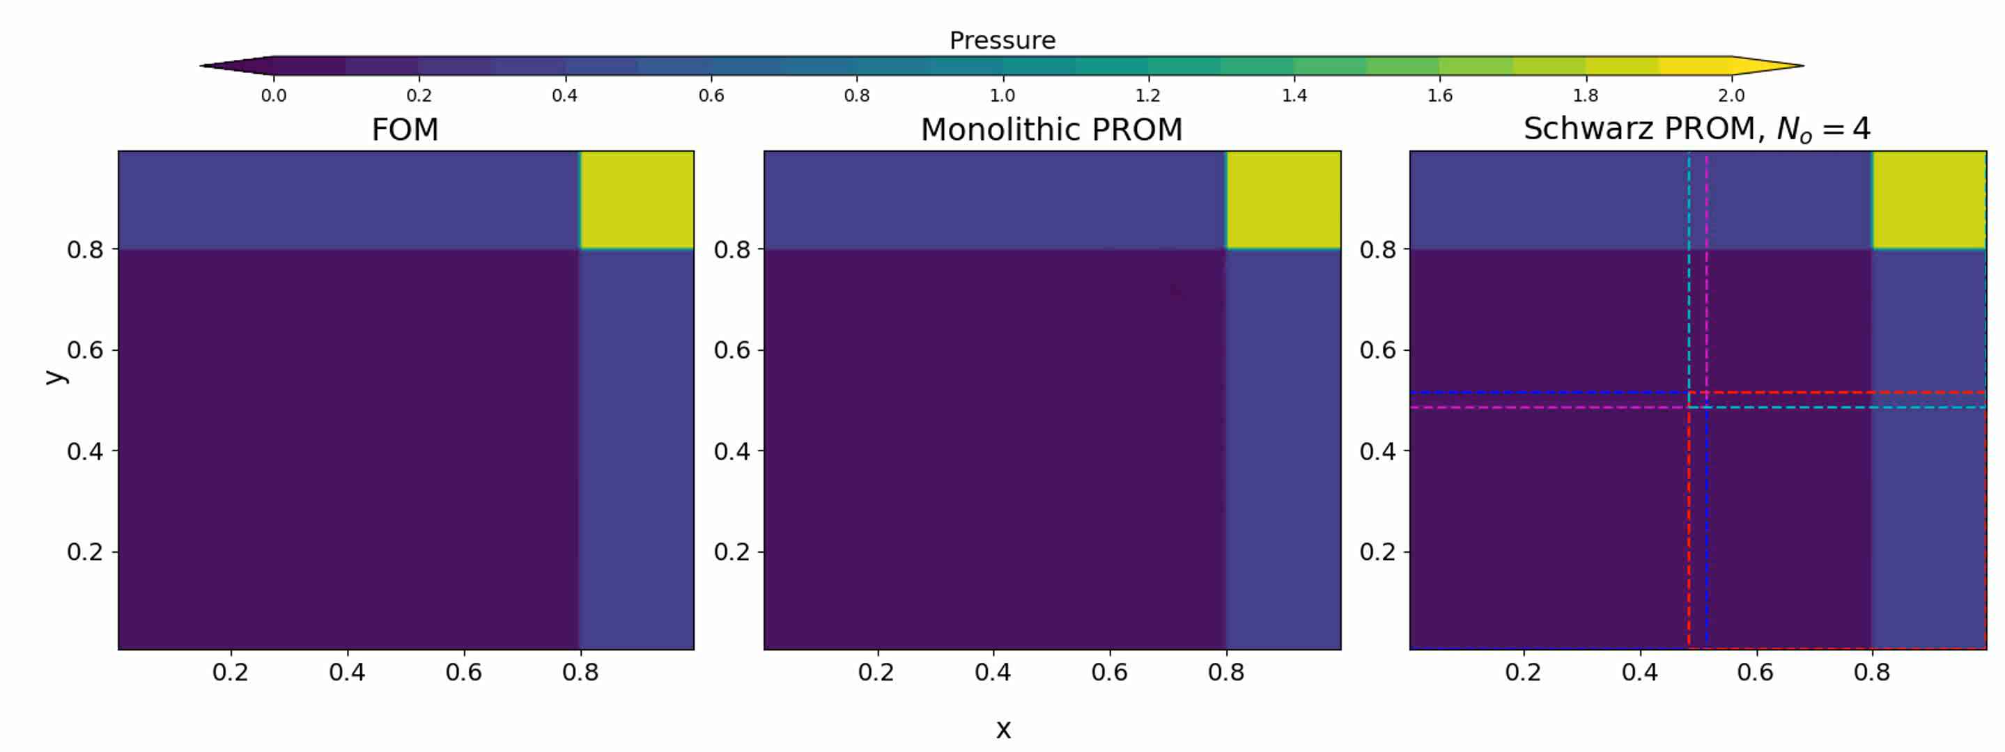
Teaser: 2D Euler Equations Riemann Problem
$\frac{∂}{∂t}\left(\begin{matrix}ρ \\ ρu \\ \begin{aligned}ρv \\ ρE\end{aligned}\end{matrix}\right)+\frac{∂}{∂x}\left(\begin{matrix}ρu \\ ρu^{2}+p \\ \begin{aligned}ρuv \\ \left(E+p\right)u\end{aligned}\end{matrix}\right)$+ $\frac{∂}{∂y}\left(\begin{matrix}ρv \\ ρuv \\ \begin{aligned}ρv^{2}+p \\ \left(E+p\right)v\end{aligned}\end{matrix}\right)=0$
$$p=(γ−1)\left(ρE−\frac{1}{2}ρ(u^{2}+v^{2})\right)$$
Problem setup:
$Ω={(0,1)}^{2},$ $t∈\left[0, 0.8\right]$, homogeneous Neumann BCs
Fix $ρ_{1}=1.5$, $u_{1}=v_{1}=0$, $p_{3}=0.029$
Vary $p_{1}$; IC from compatibility conditions*
  Training: $p_{1}∈\left[1.0, 1.25,1.5,1.75,2.0\right]$
  Testing: $p_{1}∈\left[1.125, 1.375,1.625,1.875\right]$
Preliminary results:
Schwarz can stabilize unstable monolithic ROM for fixed dimension $K$ (above)
Since shock traverses all parts of domain, achieving speedups with Schwarz is more difficult
FOM discretization:
Spatial discretization given by a first-order cell-centered finite volume discretization with $N = 300$or $N =N =100$elements in each dimension
Implicit first order temporal discretization: backward Euler with fixed $∆t = 0.005$
Implemented in Pressio-demoapps (https://github.com/Pressio/pressio-demoapps)
*Schulz-Rinne, 1993.
Notes:
TODO: ask Chris re: spatial discretization.

Slide 35
Outline
The Schwarz Alternating Method for Domain Decomposition-Based Coupling
Extension to FOM*-ROM# and ROM-ROM Coupling
Numerical Examples
  2D Burgers Equation
  2D Shallow Water Equations
  Teaser: 2D Euler Equations Riemann Problem
Summary & Future Work
*Full-Order Model. #Reduced Order Model.

Slide 36



Summary and Future Work
36
Summary:
Schwarz has been demonstrated for coupling of FOMs and (H)ROMs
Computational gains can be achieved by coupling HROMs and using the additive Schwarz variant
Ongoing & future work:
Extension to other applications (fasteners, laser welds)
Rigorous analysis of why Dirichlet-Dirichlet BC “work” when employing non-overlapping Schwarz with discretizations that employ ghost cells
Learning of “optimal” transmission conditions to ensure structure preservation
Extension of Schwarz to enabling coupling of non-intrusive ROMs (e.g., DMD, OpInf, Neural Networks)
Development of automated criteria to determine appropriate use of less refined or reduced-order models without sacrificing accuracy, enabling real-time transitions between different model fidelities
$→$New project: AHeaD LDRD
* https://pressio.github.io

Slide 37








Team & Acknowledgments
37
Irina Tezaur
Chris Wentland
Francesco Rizzi
Joshua Barnett
Alejandro Mota
Will Snyder
Former Intern from Virginia Tech [Schwarz + PINNs]
Ian Moore
Intern from Virginia Tech
[Schwarz + OpInf]
Notes:
TODO: add Ian.

Slide 38
References
[1] A. Mota, I. Tezaur, C. Alleman. “The Schwarz Alternating Method in Solid Mechanics", Comput. Meth. Appl. Mech. Engng. 319 (2017), 19-51.
[2] A. Mota, I. Tezaur, G. Phlipot. “The Schwarz Alternating Method for Dynamic Solid Mechanics”, Comput. Meth. Appl. Mech. Engng. 121 (21) (2022) 5036-5071.
[3] J. Barnett, I. Tezaur, A. Mota. “The Schwarz alternating method for the seamless coupling of nonlinear reduced order models and full order models”, ArXiv pre-print, 2022. https://arxiv.org/abs/2210.12551
[4] W. Snyder, I. Tezaur, C. Wentland. “Domain decomposition-based coupling of physics-informed neural networks via the Schwarz alternating method”, ArXiv pre-print, 2023. https://arxiv.org/abs/2311.00224
[5] A. Mota, D. Koliesnikova, I. Tezaur. “A Fundamentally New Coupled Approach to Contact Mechanics via the Dirichlet-Neumann Schwarz Alternating Method”, ArXiv pre-print, 2023. https://arxiv.org/abs/2311.05643
Email: ikalash@sandia.gov
URL: www.sandia.gov/~ikalash

Slide 39
Start of Backup Slides

Slide 40


All-ROM Coupling
95% Singular Value (SV) Energy Retention
99% Singular Value (SV) Energy Retention
$$Ω_{1}$$
$$Ω_{2}$$
$$Ω_{3}$$
$$Ω_{4}$$
1 SD
Method converges in only 3 Schwarz iterations per controller time-step
Errors O(1%) or less
1.47$×$ speedup over all-FOM coupling for 95% SV energy retention case
Subdomains | 95% SV Energy |  |  | 99% SV Energy
 | $$M$$ | MSE (%) | CPU time (s) | $$M$$ | MSE (%) | CPU time (s)
$$Ω_{1}$$ | 57 | 1.1 | 85 | 146 | 0.18 | 295
$$Ω_{2}$$ | 44 | 1.2 | 56 | 120 | 0.18 | 216
$$Ω_{3}$$ | 24 | 1.4 | 43 | 60 | 0.16 | 89
$$Ω_{4}$$ | 32 | 1.9 | 61 | 66 | 0.25 | 100
Total |  |  | 245 |  |  | 700
0
$$x$$
100
0
$$Ω_{1}$$
$$Ω_{2}$$
$$y$$
$$Ω_{4}$$
$$Ω_{3}$$
100
Notes:
Q for Joshua:
- What are dx and dt in each subdomain? Are they the same or diff?
What is going on with last frame in movie??
Solutions look discontinuous at certain times…
Subdomain 1: 75.38 s 0.94 s
Subdomain 2: 61.52 s 0.91 s
Subdomain 3: 61.54 s 0.91 s
Subdomain 4: 77.02 s 0.93 s

Slide 41
Summary
The Schwarz alternating method has been developed for concurrent multi-scale coupling of conventional and data-driven models.
☺
Coupling is concurrent (two-way).
Ease of implementation into existing massively-parallel HPC codes.
“Plug-and-play” framework: simplifies task of meshing complex geometries!
  Ability to couple regions with different non-conformal meshes, different element types and different levels of refinement.
  Ability to use different solvers (including ROM/FOM) and time-integrators in different regions.
Scalable, fast, robust on real engineering problems
Coupling does not introduce nonphysical artifacts.
Theoretical convergence properties/guarantees.
☺
☺
☺
☺
☺
☺
☺

Slide 42
























Bonus: PINN-PINN and PINN-FOM coupling
42
Will Snyder
Summer Intern
Virginia Tech
Neural Network
$$a_{1}^{(1)}$$
$$a_{1}^{(L)}$$
$$a_{2}^{(1)}$$
$$a_{2}^{(L)}$$
$$α$$
PDE loss $ℒ_{r}(θ)$
Minimize
$$⋮$$
$$⋮$$
$$β$$
$$x$$
$$\hat{u}(x)$$
BC loss $ℒ_{b}(θ)$
Loss $ℒ(θ$)
$θ^{∗}=$ $\underset{θ}{argmin}{ℒ\left(θ\right)}$
$$⋮$$
$$⋮$$
Input
Output
Data loss $ℒ_{d}(θ)$
$$⋮$$
$$⋮$$
$$γ$$
Loss
$$a_{N}^{(1)}$$
$$a_{N}^{(L)}$$
$$⋮$$
$$ℒ\left(θ\right)={α_{r}ℒ}_{r}\left(θ\right)+{α_{b}ℒ}_{b}\left(θ\right)+{α_{d}ℒ}_{d}(θ)$$
Hidden Layers
Focus thus far
Scenario 1: use Schwarz to train subdomain PINNs (offline)
Goal: investigate the use of the Schwarz alternating method as a means to couple Physics-Informed Neural Networks (PINNs)
Scenario 2: use Schwarz to couple pre-trained subdomain PINNs/NNs (online)
Related work: Li et al., 2019, Li et al., 2020, Wang et al., 2022.

Slide 43









Bonus: PINN-PINN coupling
43
$$Ω_{2}$$
1D steady advection-diffusion equation on $Ω=\left[0,1\right]:$
$$0$$
$$γ_{2}$$
$$γ_{1}$$
$$1$$
$u_{x}−νu_{xx}=1,$ $u(0)=u(1)=0$
PINNs are notoriously difficult to train for higher Peclet numbers!
$$Ω_{1}$$
Overlapping DD: $Ω=Ω_{1}∪Ω_{2}$ with boundary $∂Ω=\{0,1\}$
Can Schwarz help?
$$ℒ_{r,i }\left(θ\right)=MSE\left(−ν{∇_{x}^{2}NN}_{Ω_{i}}(x,θ)+{∇_{x}NN}_{Ω_{i}}(x,θ)−1\right)$$
$$ℒ_{b,i}\left(θ\right)=MSE\left({NN}_{Ω_{i}}(∂Ω,θ)\right)+MSE\left({NN}_{Ω_{i}}\left(γ_{i},θ\right)−{NN}_{Ω_{j}}(γ_{i},θ)\right)$$
Schwarz PINN training algorithm:
Loop over subdomains $Ω_{i}$ until convergence of Schwarz method
  Train PINN in $Ω_{i}$with loss ${ℒ_{i}\left(θ\right)=αℒ}_{r,i}\left(θ\right)+{βℒ}_{b,i}\left(θ\right)+{γℒ}_{d,i}(θ)$
  Communicate Dirichlet data between neighboring subdomains
  Update boundary data on $γ_{i}$ from neighboring subdomains
  If strong enforcement of Dirichlet BC (SDBC), set ${\hat{u}}_{Ω_{i}}\left(x,θ\right)=$ ${NN}_{Ω_{i}}\left(x,θ\right)$
  If weak enforcement of Dirichlet BC (WDBC), set $β=0 \text{and}{ \hat{u}}_{Ω_{i}}\left(x,θ\right)=v\left(x\right){NN}_{Ω_{i}}\left(x,θ\right)+ψ\left(x\right){\hat{u}}_{Ω_{j}}\left(γ_{j},θ\right)$ where $v(x)$ is chosen s.t. $v(0)=v(γ_{i})=v(1)=0$and $ψ\left(x\right)$ is chosen s.t. $v\left(γ_{i}\right)=1$

Slide 44





Bonus: PINN-PINN coupling
WDBC
SDBC on $∂Ω$
How Dirichlet boundary conditions are handled has a large impact on PINN convergence
Convergence not improved in general with increasing overlap
Increasing # subdomains in general will increase CPU time
SDBC on $γ_{i}$

Slide 45


Bonus: PINN-PINN coupling
Using SDBCs and data loss helps with PINN/NN convergence and accuracy

Slide 46

Bonus: PINN-FOM coupling
PINN subdomain
FOM subdomain
PINN-FOM coupling gives rapid PINN convergence for arbitrarily high Peclet numbers
PINN-FOM couplings works with both WDBC and SDBC configurations
Notes:
PINN-FOM coupling works for both the WDBC and SDBC configurations.

Slide 47





Theoretical Foundation
Using the Schwarz alternating as a discretization method for PDEs is natural idea with a sound theoretical foundation.
S.L. Sobolev (1936): posed Schwarz method for linear elasticity in variational form and proved method’s convergence by proposing a convergent sequence of energy functionals.
S.G. Mikhlin (1951): proved convergence of Schwarz method for general linear elliptic PDEs.
P.-L. Lions (1988): studied convergence of Schwarz for nonlinear monotone elliptic problems using max principle.
A. Mota, I. Tezaur, C. Alleman (2017): proved convergence of the alternating Schwarz method for finite deformation quasi-static nonlinear PDEs (with energy functional $Φ[φ]$) with a geometric convergence rate.
S.L. Sobolev (1908 – 1989)
S.G. Mikhlin
(1908 – 1990)
P.- L. Lions (1956-)
$$Φ\left[φ\right]= \int_{B}{A\left(F,Z\right) dV−}\int_{B}{B∙φ dV}$$
$$∇∙P+B=0$$
A. Mota, I. Tezaur, C. Alleman
Notes:
A(F,Z) = Helmholtz free-energy density, Z = collection of internal variables, F = grad(phi) = deformation gradient, B = body force, T = traction on boundary
P = \partial A/\partial F = first Piola-Kirchoff stress
2nd equation is Euler-Lagrange equation

Slide 48

Convergence Proof*
*A. Mota, I. Tezaur, C. Alleman. "The Schwarz Alternating Method in Solid Mechanics", CMAME 319 (2017), 19-51.
Notes:
The proof effectively constructs a sequence of solutions phi^n and demonstrates that this sequence converges to the unique minimizer of the energy functional \Phi defining the single-domain problem, and combines concepts used in the analysis of Sobolev, Lions, and others, in studying the convergence of the Schwarz method.

Slide 49



Schwarz Alternating Method for Dynamic Multiscale Coupling: Theory
Like for quasistatics, dynamic alternating Schwarz method converges provided each single-domain problem is well-posed and overlap region is non-empty, under some conditions on $Δt$.
Well-posedness for the dynamic problem requires that action functional $S\left[φ\right]≔\int_{I}{\int_{Ω}{L}\left(φ,\dot{φ}\right)dVdt}$ be strictly convex or strictly concave, where $L\left(φ,\dot{φ}\right)≔$ $T\left(\dot{φ}\right)+V\left(φ\right)$is the Lagrangian.
  This is studied by looking at its second variation $δ^{2}S\text{[}φ_{h}\text{]}$
We can show assuming a Newmark time-integration scheme that for the fully-discrete problem:
$$δ^{2}S\text{[}φ_{h}\text{]=}x^{T}\left[\frac{γ^{2}}{{(βΔt)}^{2}}M−K\right]x$$
$δ^{2}S\text{[}φ_{h}\text{]}$ can always be made positive by choosing a sufficiently small $Δt$
Numerical experiments reveal that $Δt$ requirements for stability/accuracy typically lead to automatic satisfaction of this bound.
*A. Mota, I. Tezaur, G. Phlipot. "The Schwarz alternating method for dynamic solid mechanics", IJNME, 2022.

Slide 50


Energy-Conserving Sampling and Weighting (ECSW)
Project-then-approximate paradigm (as opposed to approximate-then-project)
$$r_{k}\left(q_{k},t\right)=W^{T}r\left(\tilde{u}, t\right) \\ =\sum_{e∈ℰ}{W^{T}L_{e}^{T}r_{e}(L_{e^{+}}\tilde{u},t)}$$
$L_{e}∈{\left\{0,1\right\}}^{d_{e}×N}$ where $d_{e}$ is the number of degrees of freedom associated with each mesh element (this is in the context of meshes used in first-order hyperbolic problems where there are $N_{e}$ mesh elements)
$L_{e^{+}}∈{\left\{0,1\right\}}^{d_{e}×N}$ selects degrees of freedom necessary for flux reconstruction
Equality can be relaxed

Slide 51

ECSW: Generating the Reduced Mesh and Weights
Using a subset of the same snapshots $u_{i}, i∈1,…, n_{h}$ used to generate the state basis $V$, we can train the reduced mesh
Snapshots are first projected onto their associated basis and then reconstructed
$$c_{se}=W^{T}L_{e}^{T}r_{e}\left(L_{e^{+}}\left(u_{ref}+V V^{T}\left(u_{s}−u_{ref}\right)\right),t\right)∈ℝ^{n} \\ d_{s} =r_{k}\left(\tilde{u}, t\right)∈ℝ^{n}, s=1, …,n_{h}$$
We can then form the system
$$C=\left(\begin{matrix}c_{11} & … & c_{1N_{e}} \\ ⋮ & ⋱ & ⋮ \\ c_{n_{h}1} & … & c_{n_{h}N_{e}}\end{matrix}\right), d=\left(\begin{matrix}d_{1} \\ ⋮ \\ d_{n_{h}}\end{matrix}\right)$$
Where $Cξ=d, ξ∈ℝ^{N_{e}}$, $ξ=1$ must be the solution
Further relax the equality to yield non-negative least-squares problem:
$ξ={arg min}_{x∈ℝ^{n}}{||Cx−d||}_{2}$ subject to $x≥0$
Solve the above optimization problem using a non-negative least squares solver with an early termination condition to promote sparsity of the vector $ξ$

